Slide 1
Optimistic
Responsibility
Proactive
Commitment
Cherish
Be Proactive and optimistic in facing the COVID-19 epidemic
(Primary)
Perseverance
Care for Others
Gratitude
Respect for Others
Notes:
Taking into consideration of school context and needs of students, schools may adjust the content of this PPT in fostering students’ positive values and attitudes effectively and promoting healthy lifestyle.

Slide 2
Background
What is COVID-19？
COVID-19 refers to the cluster of viral pneumonia cases occurring in Wuhan, Hubei Province, since December 2019. According to investigation by the Mainland health authorities, a novel coronavirus is found to be the causative agent.
According to information provided by the Mainland health authorities, symptoms of the cases include fever, malaise, dry cough and shortness of breath. Some cases were in serious condition.
The main mode of transmission is through respiratory droplets, the virus can also be transmitted through contact. Most estimates of the incubation period range from 1 to 14 days.
Notes:
Source：https://www.coronavirus.gov.hk/eng/index.html

Slide 3
Prevention of COVID-19
There is no vaccine for this infectious disease at the moment.
To prevent pneumonia and respiratory tract infection, the public should maintain good personal hygiene at all times and keep both hands clean.
After returning to Hong Kong from travelling, if you have a fever or other symptoms, wear a surgical mask, consult a doctor promptly and reveal the recent travel history.
Pay attention to the latest news about COVID-19 released from the Centre for Health Protection.
COVID-19 Thematic Website: https://www.coronavirus.gov.hk/eng/index.html

Slide 4
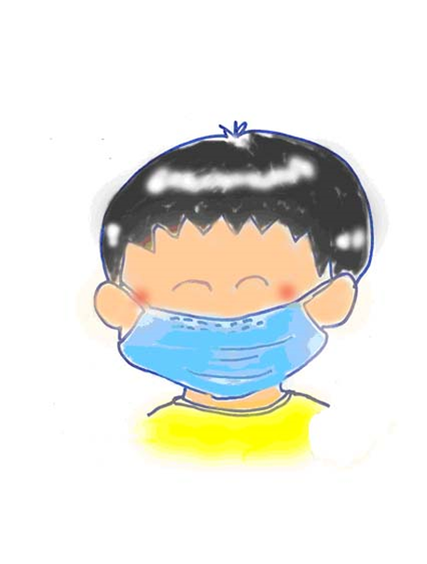
Personal Level
Family Level
School Level
Community Level
What can I do ?

Slide 5
Personal Level
X
(Self-discipline) Adopt healthy habits, including maintain personal hygiene, living routine and stay positive.
(Proactive) Exercise regularly, develop healthy living and eating habits, stay healthy.
(Rational) Be vigilant in verifying information from different media and will not believe in hearsay blindly.
Self-discipline
Proactive
Perseverance
Optimistic

Slide 6
Personal Level。。。I Can Do It !
X
Avoid Crowds Wear a surgical mask when taking public transport or staying in crowded places. It is important to wear a mask properly.
Always keep hands clean especially before touching one's mouth, nose or eyes; after touching public installations such as handrails or door knobs, wash hands with liquid soap and water, and rub for at least 20 seconds.
Cover your mouth and nose with tissue paper when sneezing or coughing. Dispose of soiled tissues into a lidded rubbish bin, then wash hands thoroughly.
After using the toilet, put the toilet lid down before flushing to avoid spreading germs.

Slide 8
Personal Level
Family Level
School Level
Community Level
What can I do ?

Slide 9
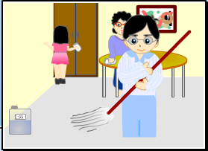
Family Level
(Care for Others) Remind family members to adopt healthy living habits.
(Commitment) Take the initiative to understand and care for the health of family members (grandparents, parents, brothers and sisters) and stay positive.
(Responsibility) Take an active part in keeping the household clean.
X
Care for Others
Proactive
Responsibility

Slide 10
Family Level。。。I Can Do It !
X
Take an active part in helping with the housework to keep home clean and tidy.
When having respiratory symptoms, wear a surgical mask, refrain from close contacts with family members and seek medical advice promptly.
Remind family members to maintain drainage pipes properly and regularly (about once a week) pour about half a liter of water into each drain outlet (U-traps) to ensure environmental hygiene.

Slide 11
Personal Level
Family Level
School Level
Community Level
What can I do ?

Slide 12
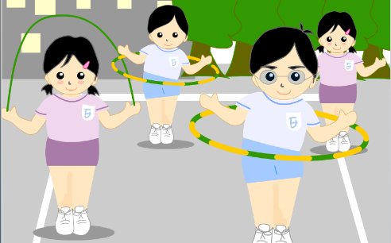
School Level。。。I Can Do It !
(Proactive) Learn actively in different modes of learning during the class suspension period.
(Self-discipline) Stay vigilant and keep the school environment clean.
(Care for Others) Take the initiative to express your gratitude to those who have helped us (teachers, janitors, school staff, school bus drivers, etc.).
X
Gratitude
Proactive
Cherish

Slide 13
Personal Level
Family Level
School Level
Community Level
What can I do ?

Slide 14
Community Level。。。I Can Do It !
(Responsibility) Reflect on own behaviour, be responsible for keeping the community clean.
(Care for Others) Take the initiative to show your care and support for the disadvantaged/ needy in the society.
(Rational) Be rational, do not believe/ forward messages with unverified information.
X

Slide 16
My Pledge to Act

Slide 17
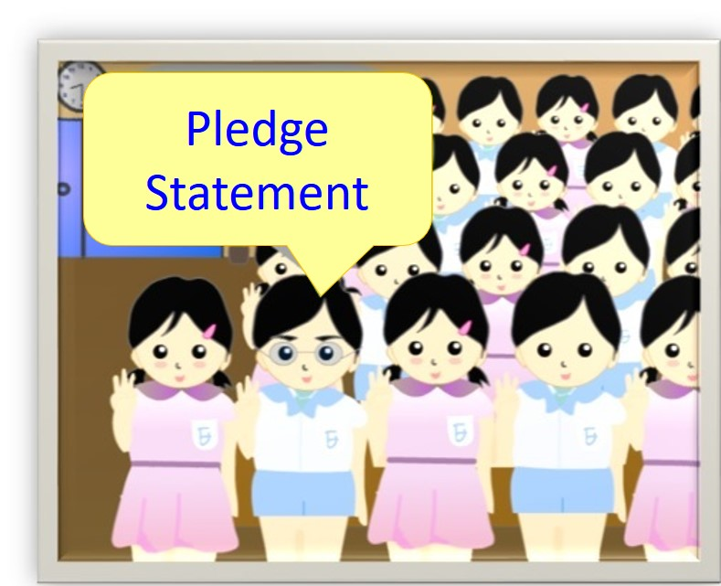
“ I pledge, from now on, to maintain personal, environmental and food hygiene, adopt prevention measures properly in order to fight the virus.”
Notes:
Suggested Pledge Statement

Slide 18
Matching Game

Slide 19
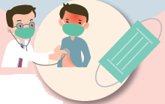
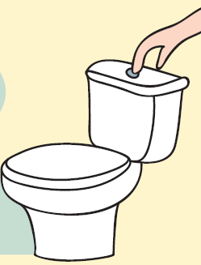
Protecting Ourselves
. . . .
. . . .
When having a fever or respiratory symptoms, wear a surgical mask and seek medical advice promptly
Put the toilet lid down before flushing
Keep both hands clean frequently
Cover your mouth and nose when sneezing or coughing

Slide 20
The End

