Slide 1
General Studies for Primary Schools Learning Strand – Health and Living
General Studies for Primary Schools
Additional Resources
Health and Living Series
Primary One to Three
(Teachers’ Copy)

Slide 2
General Studies for Primary Schools Learning elements related to Health and Living
Importance of food, physical exercises, rest to health, e.g. balanced diet, regular exercise, proper postures, eye protection
Basic personal and environmental hygiene, e.g. wash hands properly, do not litter
Washing hands properly and safe disposal of a used mask

Slide 3
Learning and Teaching Resources CD for Primary General Studies “Our Wonderful Body” (Includes learning activities of “communicable diseases”)
Theme | Learning Activities
Structure of our body | Sensory organs (Key Stage 1) Main parts and functions of digestive system (Key Stage 1) Bones and muscles (Key Stage 1) Our respiratory system (Key Stage 1) Importance of circulatory system (Key Stage 1) Functions of nervous system (Key Stage 2)
Healthy living | 1. Healthy eating (Key Stage 1) 2. Common diseases (Key Stages 1 and 2)
Website:
https://www.edb.gov.hk/attachment/en/curriculum-development/kla/general-studies-for-primary/learning-and-teaching_resource_cd_st/Healthy_life_en_2.zip

Slide 4
Suggested Learning Activity
Watch ETV:
「打敗病菌大王」, understand the existence of bacteria in the environment and ways to prevent diseases

Slide 5
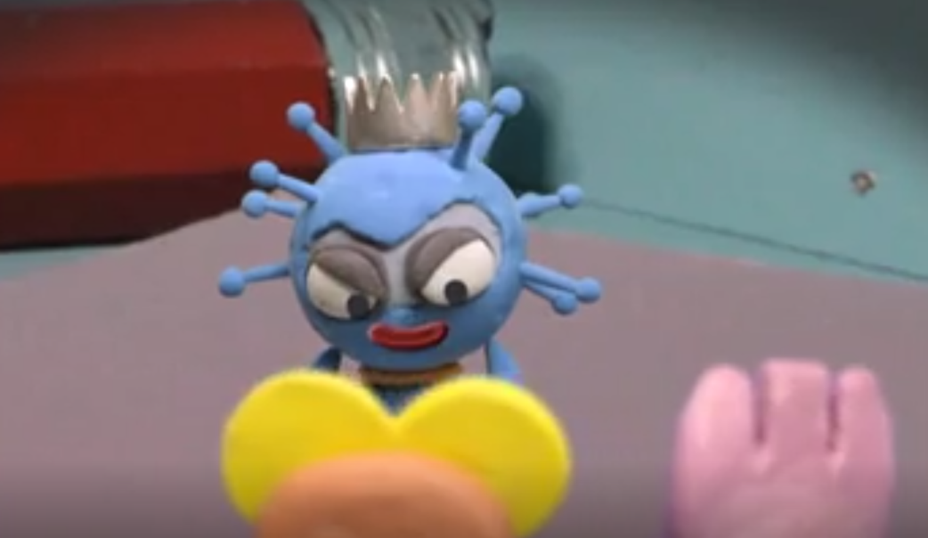
ETV, EDB 打敗病菌大王
Key Stages 1 and 2
https://www.hkedcity.net/etv/resource/4718096912
This programme aims at promoting healthy living, explaining the existence of bacteria in the living environment and introducing ways to prevent diseases.

Slide 6
Hand hygiene ── a simple yet effective way to prevent diseases
Why perform hand hygiene?
When to perform hand hygiene?
Who should perform hand hygiene?

Slide 7
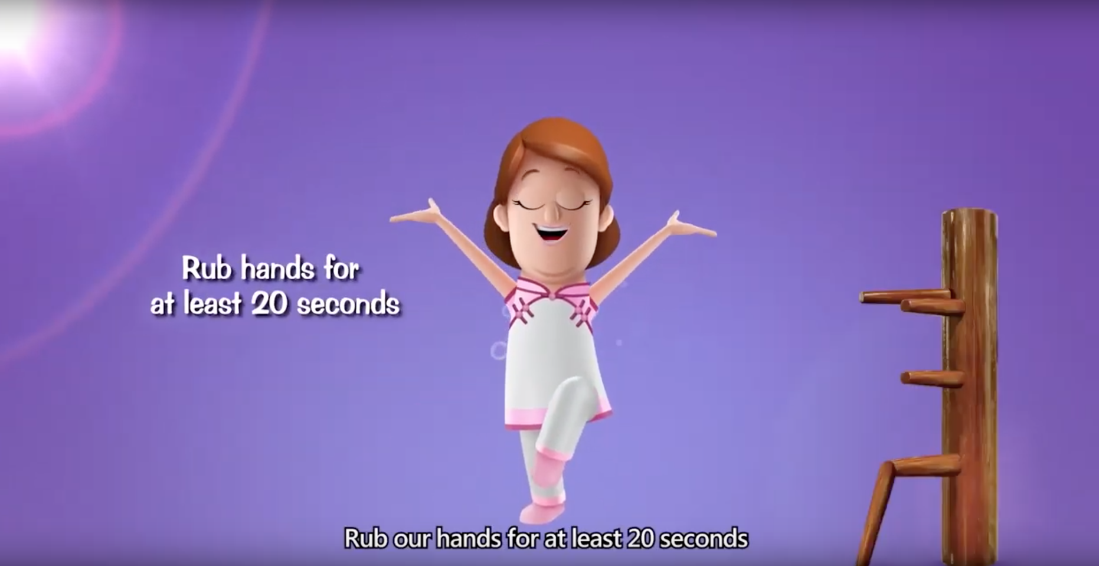
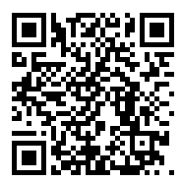
CHP, Department of Health “How to clean our hands properly” (video)
Website:
https://www.youtube.com/watch?v=sKFUOlyTJVg&feature=youtube

Slide 9
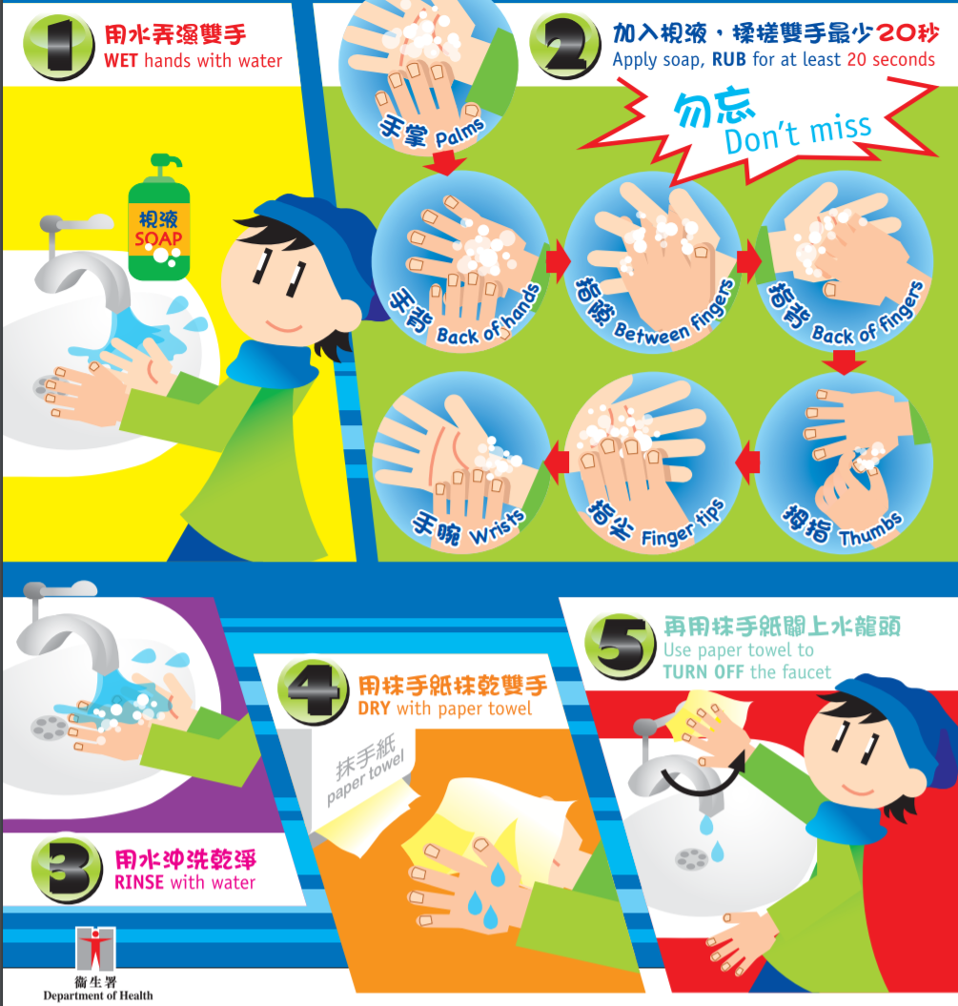
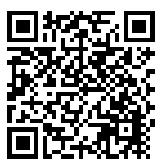
CHP, Department of Health 5 Steps for Proper Hand Washing (Poster)
Website:
https://www.chp.gov.hk/files/pdf/5_steps_for_proper_hand_washing.pdf

Slide 10
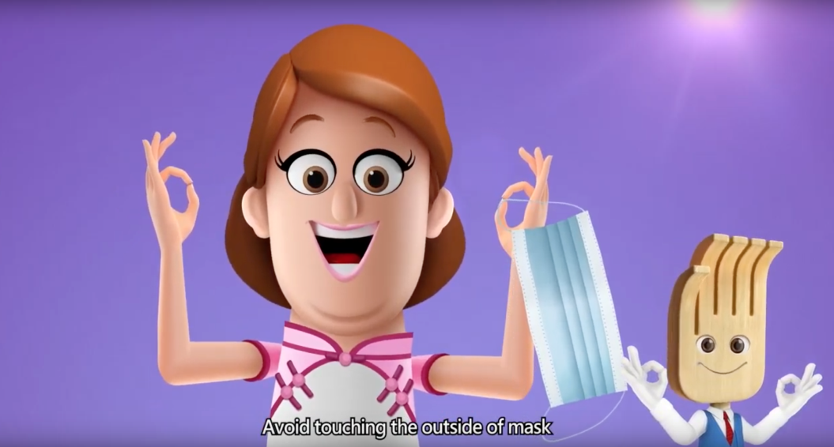
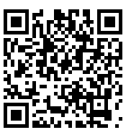
CHP, Department of Health How to take off a surgical mask properly (Video) and safe disposal of a surgical mask
Website:
https://www.youtube.com/watch?v=D9M57hycc7A&feature=youtube

Slide 11
Suggested Learning Activity
With reference to the webpage of COVID-19, CHP, Department of Health, learn the health guides about the prevention of COVID-19 and the process of the virus transmission

Slide 12
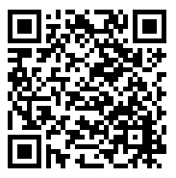
Introduction of the webpage of COVID-19, CHP, Department of Health
https://www.chp.gov.hk/en/healthtopics/content/24/102466.html

Slide 13
Suggested Learning Activity
Show your care to your relatives/ friends/ elderly
Give a call with your family members to show your care to relatives/ friends/ elderly, and share with them the measures that you have learned, e.g. how to clean hands and wear a mask properly to prevent the virus transmission.
Make greeting cards
Design greeting cards (take photos of the cards) to encourage healthcare professionals, cleaners or epidemic precaution personnel who you know and appreciate their contribution. Then ask your parents to send the cards to them through social platforms or media.

Slide 14
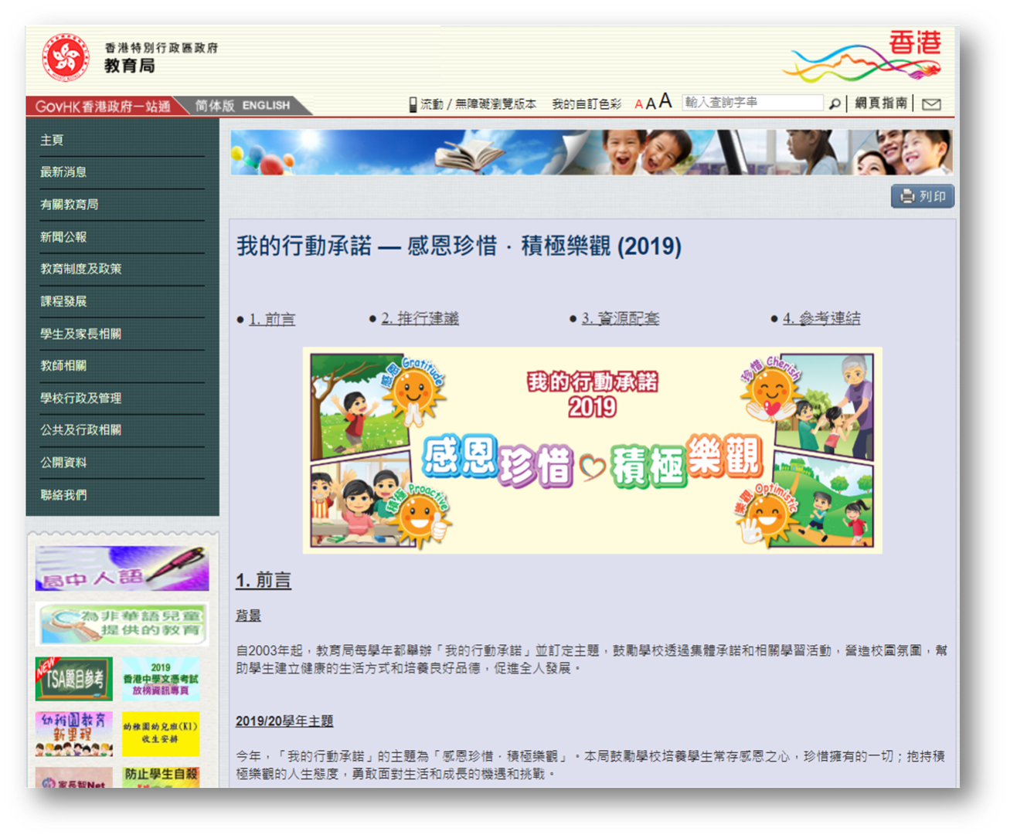
Resources on web
Instant messaging stickers can be added to the greeting cards and downloaded from the EDB website

Slide 15
To fight the virus positively
To keep good personal hygiene to protect yourself and others

Slide 16
To show your care
To thank and appreciate the effort of healthcare professionals and other epidemic precaution personnel

Slide 18
Worksheets (Teachers’ version)
How much do you know about COVID-19?
Super “Hand Washers”
Smartest Virus Fighter (Board game)

Slide 19
Wish You Good Health!

