Slide 1
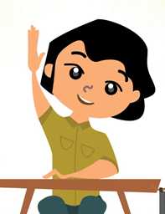
Liberal Studies X Information Literacy For students Coronavirus Disease 2019 (COVID-19) “Be an information master!”

Slide 2
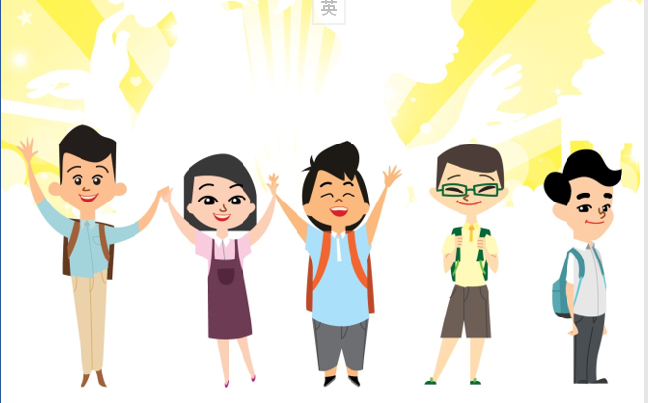
Preamble don’t panic during the epidemic…
As a student, you may / may not have actually experienced the time of SARS outbreak. The anxiety in the society and even panic caused by the emergence of “COVID-19” in 2019 is due to people’s inability to fully grasp the transmission, prevention and treatment methods of the epidemic. Therefore the related non-evidence based information is spreading at an alarming rate …
However, in times of crisis, we should embrace the scientific spirit of respect for evidence, use critical thinking skills, and find out the truth from multiple perspectives. We must think critically, share reliable and accurate information with others, and maintain personal and environmental hygiene. Together, we fight the virus!

Slide 3
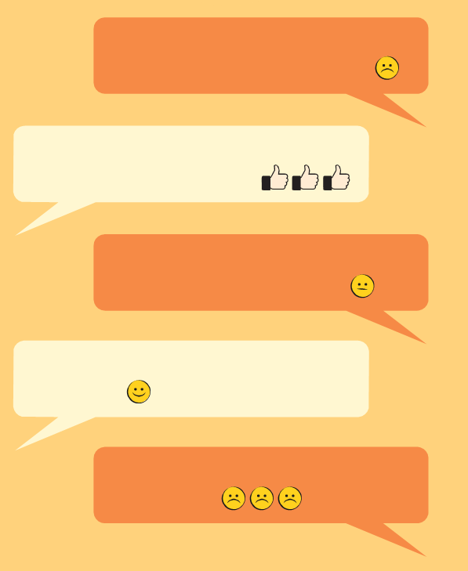
Have you/ your friends ever had the above conversation?
(Please broadcast!) The security guard at XX Plaza urged everyone not to go there because many employees took sick leave due to a high fever.
Thanks for sharing! I also received that recording!
The epidemic is serious now, and it is better to believe it! Go to buy daily necessities. I heard that the imports from the Mainland are about to be suspended!
Thanks! I'll go with my mom to buy daily necessities now!
Ugh! Anyway, just buy as many as you can!
(simulated conversation)

Slide 4
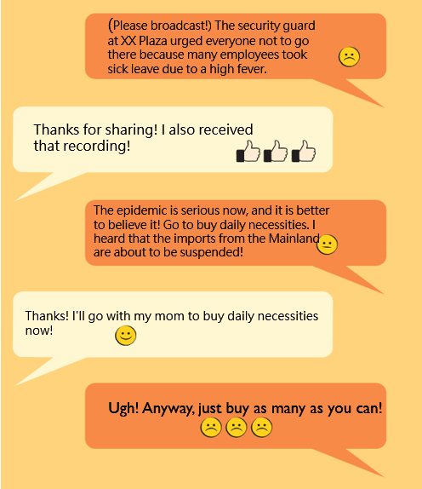
Based on the above conversation, what do you think is worth noting?
(1) The source of the information is not clear, yet asking people to broadcast. For example, it can only point out that it is from “the security guard at XX Plaza", but does not provide any web link to allow others to verify the source of the message.
(2) Believe without checking the validity of the message received.
(3) A misconception. An attitude of “it is better to believe it” will not help you to find out the truth.
(simulated conversation)

Slide 5
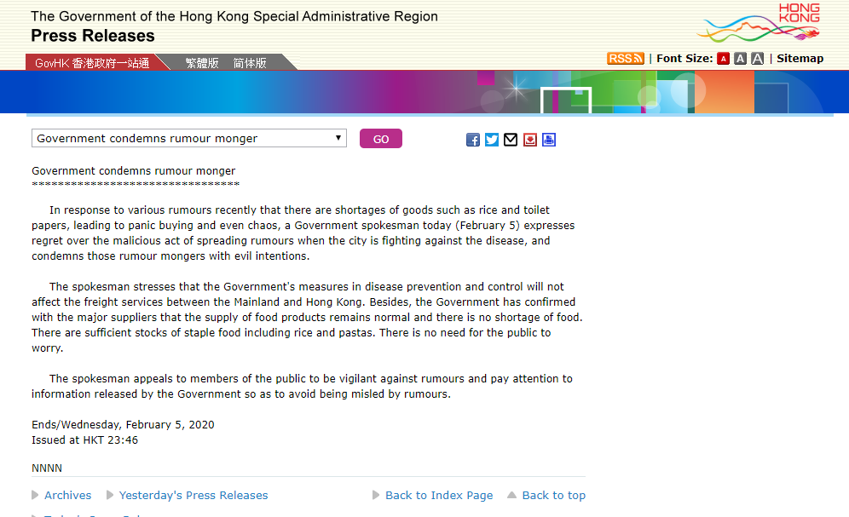
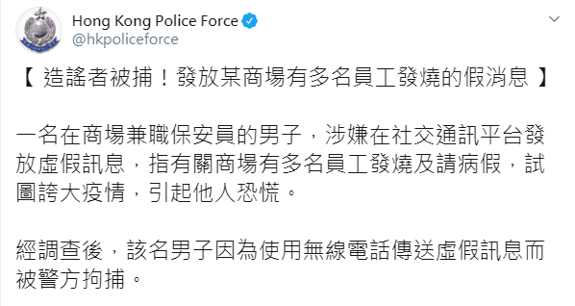
The Truth is . . .
Government releases a press release "Government condemns rumour monger" on February 5, 2020
People involved were arrested for using radiotelephone to transmit false information
Relevant News/Information﹕
"Government condemns rumour monger" on February 5, 2020。 Retrieved from:
https://www.info.gov.hk/gia/general/202002/05/P2020020500797.htm
“Rumour monger arrested! Fake news on multiple employees having a fever in a mall” on February 4, 2020。 Retrieved from:
https://twitter.com/hkpoliceforce/status/1224631797134188544

Slide 6
How can I analyze the authenticity of the information?
When you receive any information, you should carefully consider the following questions:
Who created the message?
Who forwarded the message to me?
What should I do after receiving the message?
What are the contents of the message, and how can I verify them?
What will happen if I forward the unverified messages?

Slide 7
Q1: Who create the message?
During a severe epidemic, it is difficult to find the author of the message, but if it is not from credible agencies or Government official information, we should always stay alert.
Further reflection:
Why did they create these messages?
Who are they? What are their backgrounds?
If the messages are widely believed, what benefits / harms will these messages bring and what impacts will they have on the society?

Slide 8
Q2: Who forwarded the message to me?
The person who forwarded the message may be your family, friends, or even seniors. They may forward the message out of love and care, but this does not mean that the message forwarded must be correct.
Instead, we must verify the content of the message and inform the sender to correct the message in a timely manner. To be a responsible person, we should not forward any doubtful and incorrect message.
Further reflection :
Why did they forward these messages?
Have they verified the authenticity of the message before forwarding it to me?
If I do not agree with what they forwarded to me, how should I inform them to correct the message?

Slide 9
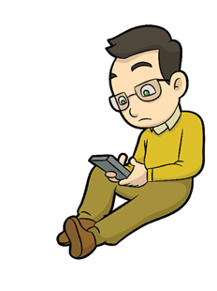
Q3: What should I do after receiving the message?
When we receive any forwarded message, we should first “stop and think”, instead of rushing to forward the messages received. We should find out the key points of the message, analyse and verify it detailedly, and point out any unreasonable and illogical contents, respect for evidence and think critically.

Slide 10
Q4: What are the contents of the message, and how can I verify them?
Carefully analyse the contents of the message and try to identify any parts unreasonable.
Verify the message by finding out authoritative, credible, and reliable websites, such as the Information Services Department, Centre for Health Protection of the Department of Health, and cite them:
GovHK
http://www.gov.hk/en/residents/
Centre for Health Protection of the Department of Health https://www.chp.gov.hk/en/index.html
Census and Statistics Department http://www.censtatd.gov.hk/home/index_tc.jsp

Slide 11
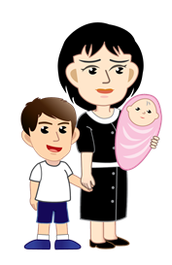
Q5: What will happens if I forward unverified messages?
We are responsible for our own words. If the unverified message is forwarded, the negative consequences may not appear immediately, but with the impact of conformity, some people will eventually hoard the goods, resulting in insufficient supply, and those who are really in need may not be able to obtain the resources in time.

Slide 12
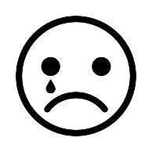
What should you do if you receive this message again? [Think of your own answer]
(Please broadcast!) The security guard at XX Plaza urged everyone not to go there because many employees took sick leave due to a high fever.
Friend A
(What should I reply？)
Me
The epidemic is serious now, and I’d better believe it!
(What should I reply？)
Friend A
Me

Slide 13
What should you do if you receive this message again? [Suggested answer]
(Please broadcast!) The security guard at XX Plaza urged everyone not to go there because many employees took sick leave due to a high fever.
Thank you! Where did the information come from? Is it reliable? If it spreads without confirmation, it may cause social panic!
Friend A
Me
The epidemic is serious now, and I’d better believe it!
Just because the epidemic is serious, we need to face it and discuss it rationally. Take care of yourself!
Friend A
Me
You too！Take care, my friend!
Friend A
Me

Slide 14
Conclusion﹕ Together! We fight the virus
The epidemic is severe, what students can do is ﹕
Refuse to be the creator and disseminator of unconfirmed information, analyse the authenticity of information rationally, adopt a “stop and think” approach, avoid increasing the burden on other sectors caused by panic created;
Avoid believing and reacting to unverified information such as hoarding daily necessities, masks, etc. so that patients and healthcare staff who are really in need are able to purchase such materials;
Based on evidence and information obtained from reliable websites, share proven, useful and correct information with family and friends around you;
Hold a positive and optimistic attitude to prevent and fight the epidemic, pay attention to personal and environmental hygiene, take more exercise, and make good use of your time at home to equip yourself;
Love your neighbour as yourself, help each other, care more about the people around you, and encourage each other during times of adversity!

