Slide 1
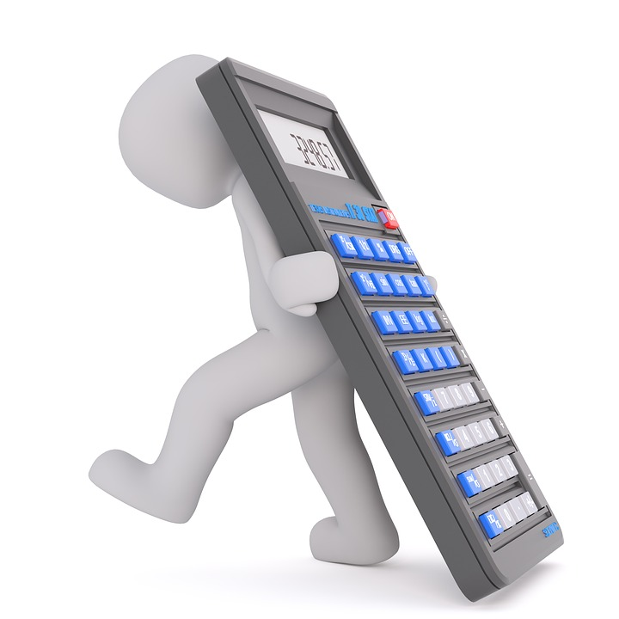
Dilution of household bleach : Applying ratios and proportions to solve real-life problems
Mathematics Education Section
Curriculum Development Institute
Education Bureau

Slide 2
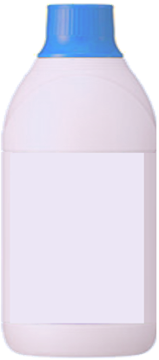
Background: Infectious diseases caused by viruses, such as influenza, avian influenza, SARS, and the recent Coronavirus Diseases 2019, not only endanger personal health, but also pose a great threat to public health. To prevent infectious diseases and fight against the epidemic, it is important for citizens to keep homes clean and maintain personal hygiene together. The use of diluted bleach for household cleaning and disinfection is one of the common methods.
In the following, we will introduce the application of the concepts of ratios and proportions in the preparation of diluted bleach, and the relevant basic knowledge about bleach.
漂白水
主要成分:
次氯酸鈉
Bleach
Active ingredient:
Sodium hypochlorite

Slide 3
Bleach is a strong and effective disinfectant. Its active ingredient, sodium hypochlorite, denatures protein in micro-organisms and is therefore effective in killing bacteria, fungus and viruses.
Why can bleach disinfect and sterilise?
What ingredients does bleach contain?
漂白水
主要成分:
次氯酸鈉
Bleach
Active ingredient:
Sodium hypochlorite
Source：
Centre for Health Protection “The Use of Bleach” https://www.chp.gov.hk/files/pdf/the_use_of_bleach.pdf

Slide 4
When using bleach, it is often diluted to a concentration of “1:99” or “1:49” .
What are “1:99” and “1:49” ?
Both are the dilution ratios of bleach:
“1:99” : mixing 1 part of bleach with 99 parts of water
“1:49” : mixing 1 part of bleach with 49 parts of water
Practice:
Calculate the amount of bleach and water (in mL) in 500 mL of “1:99” diluted bleach and 500 mL of “1:4” diluted bleach.
Explore the method of making 1 L of “1:99” diluted bleach by water and 200 mL of “1:4” diluted bleach.
漂白水
主要成分:
次氯酸鈉
Bleach
Active ingredient:
Sodium hypochlorite

Slide 5
Practice:
Calculate the amount of bleach and water (in mL) in 500 mL of “1:99” diluted bleach and 500 mL of “1:4” diluted bleach.
Solution:
In 500 mL of “1:99” diluted bleach,
Amount of bleach = (500 × $\frac{1}{1+99}$ ) mL = 5 mL
Amount of water = (500 $×\frac{99}{1+99}$ ) mL = 495 mL
In 500 mL of “1:4” diluted bleach,
Amount of bleach = (500 × $\frac{1}{1+4}$ ) mL = 100 mL
Amount of water = (500 × $\frac{4}{1+4}$ ) mL = 400 mL
漂白水
主要成分:
次氯酸鈉
Bleach
Active ingredient:
Sodium hypochlorite

Slide 6
Practice:
Explore the method of making 1 L of “1:99” diluted bleach by water and 200 mL of “1: 4” diluted bleach.
Solution:
1 L of “1:99” diluted bleach has 10 mL of bleach and 990 mL of water. In 200 mL of “1: 4” diluted bleach, amount of bleach = $\left(200×\frac{1}{1+4} \right)\text{mL}=40 \text{mL}$, which is 4 times the amount needed. Therefore, in $\frac{200}{4}$ mL = 50 mL “1:4” diluted bleach, there is 10 mL of bleach. Hence, adding 950 mL of water will get 1 L of “1:99” diluted bleach. (Other methods can also be used)
漂白水
主要成分:
次氯酸鈉
Bleach
Active ingredient:
Sodium hypochlorite

Slide 7
When using bleach, it is often diluted to a concentration of “1:99” or “1:49” .
What are “1:99” and “1:49” ?
Both are the dilution ratios of bleach:
“1:99” : mixing 1 part of bleach with 99 parts of water
“1:49” : mixing 1 part of bleach with 49 parts of water
Point to note:
The dilution ratio of bleach is actually determined based on a 5.25% concentration of sodium hypochlorite in bleach. Therefore, the dilution ratio of bleach has to be adjusted if the concentration of sodium hypochlorite of the bleach is not 5.25%.
漂白水
主要成分:
次氯酸鈉
Bleach
Active ingredient:
Sodium hypochlorite

Slide 8
Using bleach of different concentrations
The dilution of bleach using the ratios “1:99” and “1:49” is based on the assumption that the sodium hypochlorite concentration of the bleach is 5.25%. However, the sodium hypochlorite concentration of the bleach sold in the market is often not 5.25%. In such cases, the amount of bleach and water used for the dilution should be adjusted accordingly.
Example 1:
If the sodium hypochlorite concentration of the bleach is 2.625%, calculate the amount of bleach and water required to prepare 1 L of “1:99” diluted bleach.
5.25%
10mL
Solution:
When the sodium hypochlorite concentration of the bleach is 5.25%, the required amount of bleach is 10 mL. As $\frac{5.25}{2.625}$ = 2, that is, 10 mL bleach of standard concentration contains twice as much active ingredients as 10 mL of the bleach being used. Therefore, it is necessary to use 2 times the amount of bleach, i.e. 20 mL, to produce the same amount of active ingredients as in the bleach of standard concentration. Hence, the amount of water = (1000−20) mL = 980 mL.
2.625%
10mL
×2

Slide 9
Consider the multiplier of the amount of bleach M = $\frac{5.25}{x}$ , then the amount of bleach required＝VM mL
Using bleach of different concentrations
How to adjust the amount of bleach required according to the concentration of sodium hypochlorite?
In general, let the amount of bleach need when bleach with a sodium hypochlorite concentration of 5.25% is used be V mL, and the sodium hypochlorite concentration of the bleach being used be x%.
Example 2:
How much bleach (in mL) is required to make 1 L of “1:99” diluted bleach with bleach having sodium hypochlorite concentration of 2.5%?
Solution:
When using bleach with sodium hypochlorite concentration of 5.25% , the amount of bleach required = (1000 × $\frac{1}{1+99}$) mL = 10 mL.
If bleach with sodium hypochlorite concentration of 2.5% is used, the multiplier of the amount of bleach M = $\frac{5.25}{2.5}$ = 2.1, the amount of bleach required = (10 × 2$.1)$ mL = 21 mL.

Slide 10
Using bleach of different concentrations
Example 3:
How much bleach is required to make 600 mL of “1:49” diluted bleach with bleach having sodium hypochlorite concentration of 6.4%?
Solution:
When using bleach with sodium hypochlorite concentration of 5.25%, the amount of bleach required = (600 × $\frac{1}{1+49}$ ) mL = 12 mL.
If bleach with sodium hypochlorite concentration of 6.4% is used, the multiplier of the amount of bleach M = $\frac{5.25}{6.4}$ = 0.82,
the amount of bleach required = (12 × 0.82 ) mL = 9.84 mL.
The calculations introduced by the Centre for Health Protection:
(https://www.chp.gov.hk/files/pdf/the_use_of_bleach.pdf)

Slide 11
Using bleach of different concentrations
Practice:
Try to collect the ingredient labels of different brands of bleach, find out their sodium hypochlorite concentration, and calculate the amount of bleach and water required to prepare 1 L of “1:99” diluted bleach. （Give the answers correct to the nearest mL if necessary.)
Bleach brand | Standard | Example 1 | （Reference） A | （Reference） B
sodium hypochlorite concentration (%) | 5.25 | 2.625 | 3.5 | 6.4
the amount of bleach （mL） | 10 | 20 | 15 | 8
the amount of water （mL） | 990 | 980 | 985 | 992
漂白水
主要成分:
次氯酸鈉
Bleach
Active ingredient:
Sodium hypochlorite

Slide 12
The use of diluted bleach prepared with household bleach containing 5.25% sodium hypochlorite is as follows:
Why is it necessary to use bleach with different dilution ratios?
“1:99” diluted household bleach is used for general household cleaning and disinfection;
“1:49” diluted household bleach is used for surfaces or articles contaminated with vomitus, excreta and secretions;
“1:4” diluted household bleach is used for surfaces or articles contaminated with blood spillage.
Source：
Centre for Health Protection “The Use of Bleach” https://www.chp.gov.hk/files/pdf/the_use_of_bleach.pdf

Slide 13
Reference:
Consumer Council「漂白水必讀 10 招」(Chinese version only)
https://www.consumer.org.hk/ws_chi/news/specials/2020/bleach-usage.html
Centre for Health Protection “The Use of Bleach”
https://www.chp.gov.hk/files/pdf/the_use_of_bleach_chi.pdf

