Slide 1
Workshop on “Application of the Assessment Program for Affective and Social Outcomes (2nd Version)” (Primary Schools)
Assessment Research Centre
The Hong Kong Institute of Education

Slide 2
Unit One
In this unit, participants will learn the following:
The background, structure and guiding principles of APASO
The core functions of the E-platform for School Development and Accountability (ESDA)
The guidelines for selecting and using scales and subscales

Slide 3
Unit Two
In this unit, participants will learn the following:
How to publish APASO-II user-defined and pre-defined surveys using “online” and “offline” modes in ESDA
How to complete APASO-II surveys in “online mode”
How to check the status of implementation of a survey
How to import survey data offline

Slide 4
Unit Three
In this unit, participants will learn the following:
How to review different data reports
How to interpret the data from different reports
Summarize the learning issues and share the experience

Slide 5
Background
To provide support to schools for self-evaluation, EDB launched the Assessment Program for Affective and Social Outcomes (APASO) in 2003
Work was conducted from 2008 to 2010 to review, validate and revise APASO. New scales were added and the norms of all scales were updated
The final product becomes the 2nd version of Assessment Program for Affective and Social Outcomes (APASO-II)

Slide 6
Purposes
It supports schools to obtain objective student performance data in comparison to related indicators for self-evaluation. This instrument is intended to measure a group of students or the whole school student body rather than individuals
Schools can gain an in-depth understanding of students' performance and development in the affective and social domains. This facilitates the evaluation of the impact of support services and activities on the students and then the formulation of an action plan for improvement
Parents can also get information on students' performance in these domains through such channels as parent meetings and school reports

Slide 7
Scales and Subscales
Scale Name | Subscale Name
Self
 | General School
 | Mathematics
Self-Concept | Parent Relationships
 | Peer Relation
 | Physical Appearance
 | Reading
Self-others
 | Care for Others
Interpersonal Relationships | Inappropriate Assertiveness *
 | Respect for Others
Self-school
 | Achievement
 | Experience
 | General Satisfaction
Attitudes to School (Quality of School Life) | Negative Affect *
 | Opportunity
 | Social Integration
 | Teacher-Student Relationship

Slide 8
Scales and Subscales
Scale Name | Subscale Name
Self-school
 | Affiliation
 | Competition
 | Effort
 | Praise
Motivation | Social Concern
 | Social Power
 | Task
 | Token
 | Failure Ability Attribution *
 | Failure Effort Attribution *
Causal Attribution | Failure Strategy Attribution *
 | Success Ability Attribution
 | Success Effort Attribution
 | Success Strategy Attribution
 | Creative Thinking
Learning Competency | Critical Thinking
 | Problem Solving

Slide 9
Scales and Subscales
Scale Name | Subscale Name
Self-school
 | Academic Affect
 | Academic Initiation
 | Academic Monitoring
 | Academic Self Concept
 | Change to Improve
 | Costs of Help Seeking *
Independent Learning Capacity | Education Aims
 | Goal Setting
 | Inquisitiveness
 | Strategic Help Seeking
 | Study Environment Control
 | Study Plan
 | Value of School Work

Slide 10
Scales and Subscales
Scale Name | Subscale Name
Self-society
 | Code of Conduct
 | Commitment
 | Attitudes toward the Nation
Values | Perseverance
 | Sense of Responsibility
 | Social Harmony
 | Well-behaved

Slide 11
Purposes of Taking APASO II:
What is the purpose of conducting an APASO-II survey?
What sort of data are collected from APASO-II?
Is it to understand certain affective and social behavior of students?
Or do you want to understand the impact of a certain intervention or a program?

Slide 12
Administration Guidelines
It is not advisable to use the same tool too often. The recommended interval between two surveys is at least six months. Preferably an academic year should elapse before the administration of the same tool again
Schools are advised to identify a set of APASO-II scales to suit its own needs
The majority of primary (P3 or above) students can complete 80 to 100 items from APASO-II scales in around 30 to 40 minutes
Schools have to limit the number of scales to be administered at any one time in order not to overload their students

Slide 13
Administration Guidelines
Schools may administer the APASO-II scales on a class or group basis during class time. Schools should not arrange for a large number of students to complete APASO-II questionnaires in one place simultaneously
Students should be separated sufficiently in their seating to allow privacy and confidentiality of their responses to questions. This is vital as these are self-reporting surveys
There is no time limit on taking any of the tools

Slide 14
Administration Guidelines
The teacher administering an APASO-II survey must state briefly the purpose and method of responding. They should emphasize that the questionnaires will be anonymous and the information collected be kept strictly confidential and there will be four levels of responses
Evaluative wording such as right/wrong, high/low, strong/weak should be avoided
The instruction should not take too long

Slide 15
Administration Guidelines
When students are responding to questionnaires, teachers should not assume a monitoring role, or check the students' responses, as this may discourage students to give their true responses
For students with difficulty in reading, teachers may read out aloud the instructions for completing the questionnaires and also each item as the students progress through them. Problems related to reading ability may be minimized as students can hear the items as they read them

Slide 16
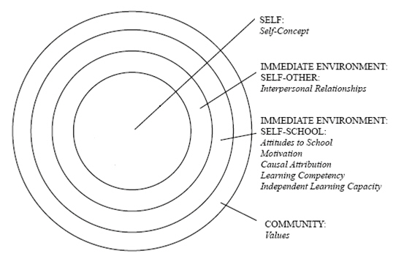
Scales Selection
Schools may select APASO-II scales and subscales according to their own concern. The scales available for use from APASO-II are organized on the basis of Bronfenbrenner’s (1995) model

Slide 17
Scales Selection
Scale / Subscale | School Concern
 | Learning Strategies | Quality of School Life | Learning Motivation | Social Relationship | Moral Conduct | Emotion | Self-Efficacy | Values
Self-Concept
General School |  |  |  |  |  |  | 
Mathematics |  |  |  |  |  |  | 
Parent Relationships |  |  |  |  |  |  | 
Peer Relation |  |  |  |  |  |  | 
Physical Appearance |  |  |  |  |  |  | 
Reading |  |  |  |  |  |  | 
Interpersonal Relationships
Care for Others |  |  |  |  | 
Inappropriate Assertiveness * |  |  |  |  | 
Respect for Others |  |  |  |  |  |  |  | 

Slide 18
Scales Selection
Scale / Subscale | School Concern
 | Learning Strategies | Quality of School Life | Learning Motivation | Social Relationship | Moral Conduct | Emotion | Self-Efficacy | Values
Attitudes to School
Achievement |  |  |  |  |  |  | 
Experience |  | 
General Satisfaction |  |  |  |  |  | 
Negative Affect * |  |  |  |  |  | 
Opportunity |  |  |  |  |  |  |  | 
Social Integration |  |  |  | 
Teacher-Student Relationship |  |  |  | 
Motivation
Affiliation |  |  |  |  |  |  |  | 
Competition |  |  |  |  |  |  |  | 
Effort |  |  |  |  |  |  |  | 
Praise |  |  |  |  |  |  |  | 
Social Concern |  |  |  |  |  |  |  | 
Social Power |  |  |  |  |  |  |  | 
Task |  |  |  |  |  |  |  | 
Token |  |  |  |  |  |  |  | 

Slide 19
Scales Selection
Scale / Subscale | School Concern
 | Learning Strategies | Quality of School Life | Learning Motivation | Social Relationship | Moral Conduct | Emotion | Self-Efficacy | Values
Causal Attribution
Failure Ability Attribution * |  |  | 
Failure Effort Attribution * |  |  | 
Failure Strategy Attribution * |  |  | 
Success Ability Attribution |  |  | 
Success Effort Attribution |  |  | 
Success Strategy Attribution |  |  | 
Learning Competency
Creative Thinking |  |  |  |  |  |  | 
Critical Thinking |  |  |  |  |  |  | 
Problem Solving |  |  |  |  |  |  | 

Slide 20
Scales Selection
Scale / Subscale | School Concern
 | Learning Strategies | Quality of School Life | Learning Motivation | Social Relationship | Moral Conduct | Emotion | Self-Efficacy | Values
Independent Learning Capacity
Academic Affect |  |  | 
Academic Initiation |  |  | 
Academic Monitoring |  |  | 
Academic Self-Concept |  |  |  |  |  |  | 
Change to Improve |  |  | 
Costs of Help Seeking * |  |  |  |  |  |  | 
Education Aims |  |  |  |  |  |  |  | 
Goal Setting |  |  | 
Inquisitiveness |  |  | 
Strategic Help Seeking |  |  | 
Study Environment Control |  |  | 
Study Plan |  |  | 
Value of School Work |  |  |  |  |  |  |  | 

Slide 21
Scales Selection
Scale / Subscale | School Concern
 | Learning Strategies | Quality of School Life | Learning Motivation | Social Relationship | Moral Conduct | Emotion | Self-Efficacy | Values
Values
Code of Conduct |  |  |  |  |  |  |  | 
Commitment |  |  |  |  |  |  |  | 
Attitudes toward the Nation |  |  |  |  |  |  |  | 
Perseverance |  |  |  |  |  |  |  | 
Sense of Responsibility |  |  |  |  |  |  |  | 
Social Harmony |  |  |  |  |  |  |  | 
Well-behaved |  |  |  |  |  |  |  | 

Slide 22
The Design of APASO-II Survey
Schools can administer APASO-II scales/subscales at different times of the school year to achieve different purposes, e.g. to assess the effectiveness of an intervention program or to monitor the development of their students across years
Schools can also rotate the administration of scales across cohorts of students based on their developmental characteristics

Slide 23
Pre-test/post-test Design
Some schools may be interested to know whether their intervention program is effective. To achieve this purpose, schools can adopt the pre-test/post-test design
For example, a school is planning to launch a courtesy campaign to improve students’ moral conduct. Before the campaign, students need to complete a set of scales/subscales (which correspond to school’s concern related to moral conduct); and after the campaign, students need to complete the same set of scales/subscales again. Post-test scores can then be compared with pre-test scores to examine whether there is improvement in students’ moral conduct

Slide 24
Longitudinal Design
Some schools may be interested to track students’ development across years. To achieve this purpose, schools can adopt the longitudinal design. Every year students complete the same set of scales/subscales that correspond to schools’ key areas of developmental concern
For example, if a school’s concern is on students’ social relationships, then students need to complete annually a set of relevant scales like social integration, teacher-student relationship, interpersonal relationships, affiliation, social concern, parent relationships, peer relation and/or social harmony

Slide 25
Developmentally Sensitive Strategy
Schools may rotate the administration of scales across cohorts of students based on their developmental characteristics. This means schools may administer different scales for different grade levels of students

Slide 26
Group Discussion
Let us suppose that your school is planning to implement an annual self-assessment programme regarding “Student Attitude and Behavior”. It will primarily focus on student attitude toward school, student interpersonal relationships and their values. Please respond to the following questions:
1. Among the scales and subscales, which would you select for your programme? Why so?
2. How would you make appropriate arrangement for your students to respond to the survey? For example, in terms of venue, time allocation and required manpower.
3. Based on the data analysis, what would you do as follow-up action if your student performance on a certain measurement is not satisfactory?

Slide 27
Reports in APASO-II
Mean plot
Box Plot
Item Bar Chart
Cross-year Comparison Plot (only available for “School Attitude” scale)

Slide 28
Mean Plot
The following graph gives means and confidence intervals on a particular scale
The dots indicate the Hong Kong norm whereas the small cross with upper and lower bounds gives the means and confidence intervals for a particular school

Slide 29
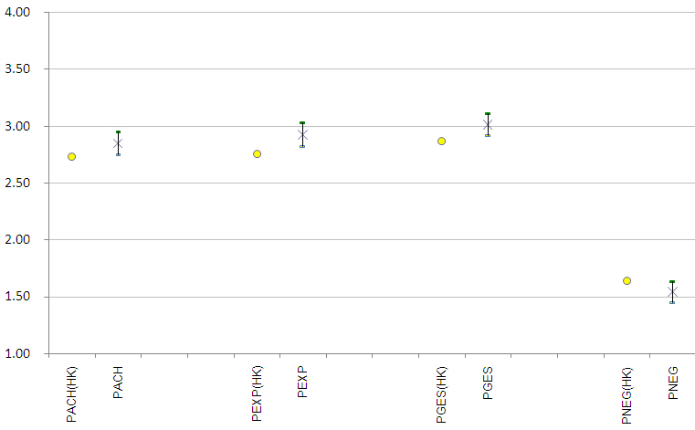

Slide 31
Raw Score and Rasch Score
The advantage of using raw scores is that interpretation can be anchored upon the original response scale (Strongly Disagree coded as 1, Disagree coded as 2, Agree coded as 3, Strongly Agree coded as 4). If the scale mean is above 2.5, there is reason to believe that the students on average have positive attitudes. However, how they really measure will have to depend on whether the mean for this group of students is above or below the norm (in raw scores). In other words, analysis using raw scores gives substantive meaning anchored on the items and the response scale.
The disadvantage of using raw scores is that the scale is not linear. The distance between a pair of adjacent categories, say 1 (Strongly Disagree) and 2 (Disagree), is not the same as that between another pair of adjacent categories, say 2 (Disagree) and 3 (Agree), making interpretation of the meaning of distance on the scale difficult. Non-linearity is particularly prominent at the two ends of the scale.

Slide 32
Raw Score
Rasch Score
3.9
3.9
3.8
2.6
3.8
2.5
2.6
2.5

Slide 33
Box Plot
Compared to Mean Plot, Box Plot better reflects the distribution of data sample. This is because Mean Plot only reflects the centre trend of whole sample whereas Box Plot Chart typically describes 50% of the sample spread plus and minus over the point of median. This helps to further the understanding of the sample.

Slide 34
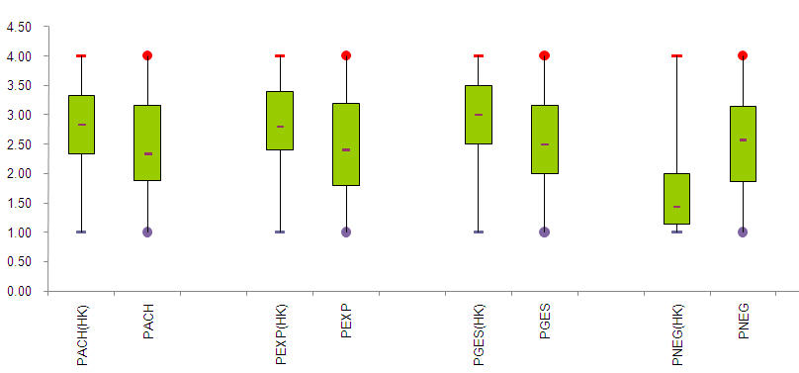

Slide 35
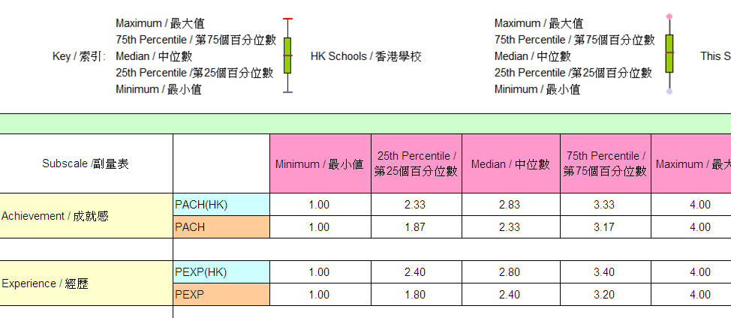

Slide 36
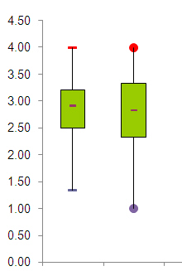

Slide 37
Item Bar Chart
A school needs to determine if scale- or item-level results are required. Scale-level results (e.g. Attitudes to School) give a broad overview of a selected domain (e.g. students’ attitudes toward their school as reflected in their quality of school life) and its subscales (e.g. Teacher-Student Relations). Scale-level results are useful for school policy decisions concerning the affective and social outcomes of students.
On day-to-day operations, teachers might want to refer to Item-level (e.g. “My teacher takes an interest in helping me with my work”) results (Note: only available for raw scores), which give detailed information for each question item. Furthermore, percentages have little meaning if the number is less than 100 students. Item bar charts provide an easy visual aid for schools to detect differences between this school and schools in item-level.

Slide 38
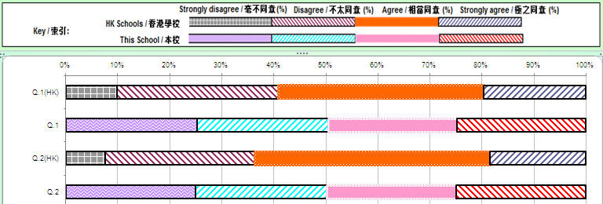

Slide 39
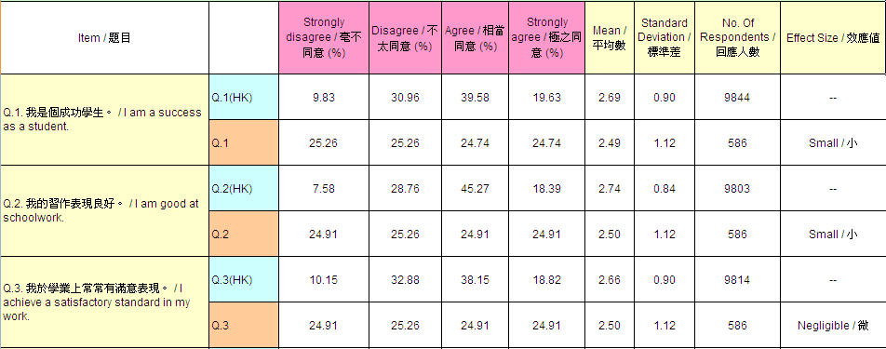

Slide 40
Cross-year Comparison Plot
At the current stage, Cross-year Comparison Plot is only applicable to the scale for “Attitude to School”. ESDA will soon add this format for other scales as well. At maximum, it allows comparisons across three years. This format allows the display of performances by the whole student body per selected scales across the past three years, thus revealing the progress or lack thereof per school

Slide 41
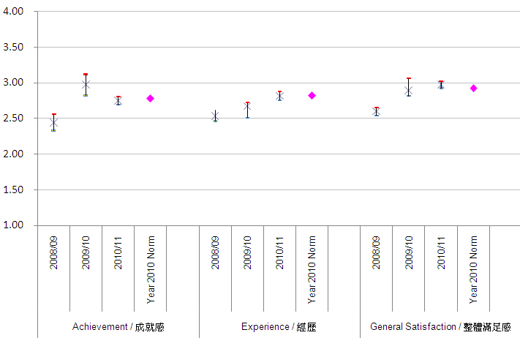

Slide 42
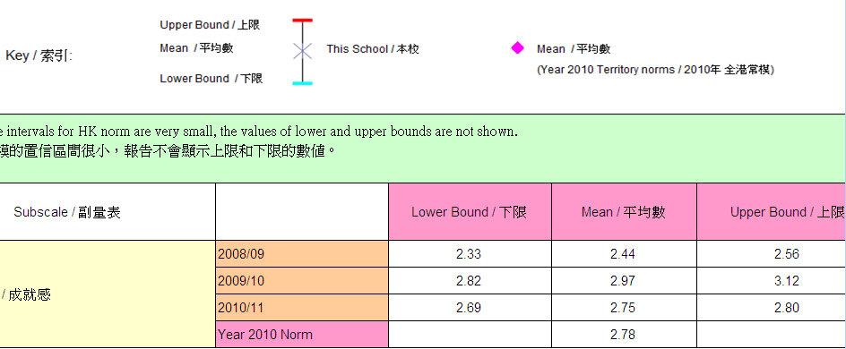

Slide 43
Question and Answer

Slide 44
Thank you!

