Slide 1


Slide 2
Learning Objectives
To understand that gender stereotype limits one’s individual development and choices and may bring about harm to others.
To appreciate the uniqueness of oneself; to understand gender equality and that everybody, regardless of gender, is precious, independent and should be respected.

Slide 3
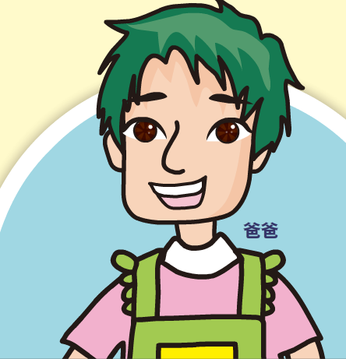
Discussion Question 1:
Elaine’s dad stays at home to do the housework while her mom goes to work. Do you think this arrangement is appropriate? Why?

Slide 4

“Stay-at-home dad” and
“working mom” ?
“Men are breadwinners and women are housewives” was a very typical belief, but not necessarily a must.
Earning money to support the family and doing housework are just different duties. They are suitable for both sexes.
Duties and roles should be arranged according to family needs.

Slide 5
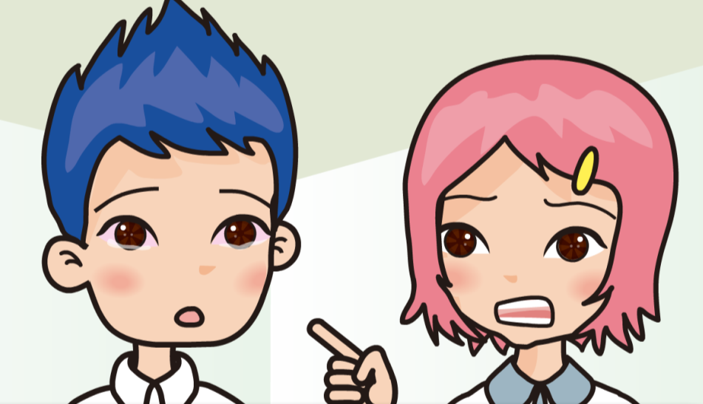
Discussion Question 2:
If social standards are imposed on the behaviour and life of men and women, what will the problems be?

Slide 6

The disadvantages of gender stereotype
Our choices and the development of individual potential will be limited
Making casual criticism of people about their gender could be hurtful.

Slide 7
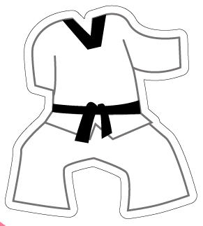
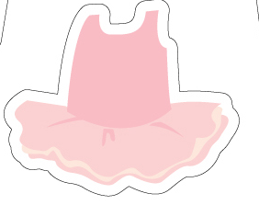
Discussion Question 1:
If you were Elaine, would you choose dancing or Taekwondo? Why?

Slide 8
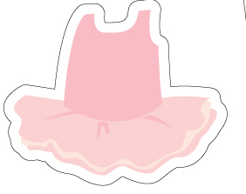
Interests are gender-free
Both boys and girls should not limit their interests because of their gender. One’s preference or talent matters.

Slide 9
Discussion Question 2:
If your classmates laugh at you because you choose a hobby that is said to be “not suitable” to your gender, what would you do?

Slide 10
You are who you are!
We should not be affected by the opinions of other classmates and we should stick to our interests.
Express our preference and ask for their respect for our choice.
If we feel emotionally disturbed, promptly seek help from trustworthy adults.

Slide 11
Conclusions
Everyone possesses different qualities. Girls can be brave and boys can have an eye for detail. We all, regardless of gender, should try to develop good qualities.
We should know how to respect the choices of others and not to tease them about their choices. We should love ourselves, accept our strengths and weaknesses, explore and further develop our potential and good qualities.

Slide 12
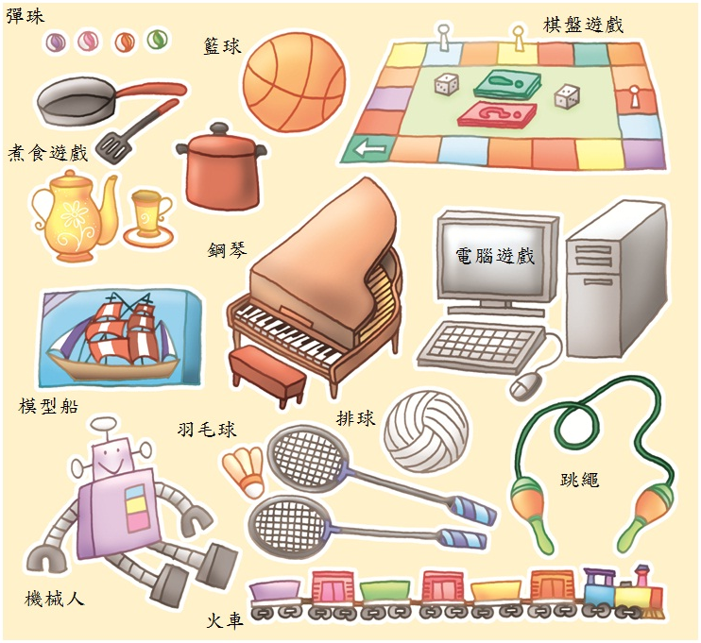
Activity 2: “Play Toys with Fun”
Please circle THREE toys that you like most.

Slide 13
The End

