Slide 1


Slide 2
Learning Objectives
To develop healthy values towards sexuality and learn to respond to sexuality-related social phenomena.
Have self-respect and respect for others as the principle; understand the consequences or impacts of public display of affection to others.

Slide 3
Activity ：
“The Degree of Intimacy”
How would you assign the degree of intimacy to the following behaviour?
What is your acceptance level?

Slide 4
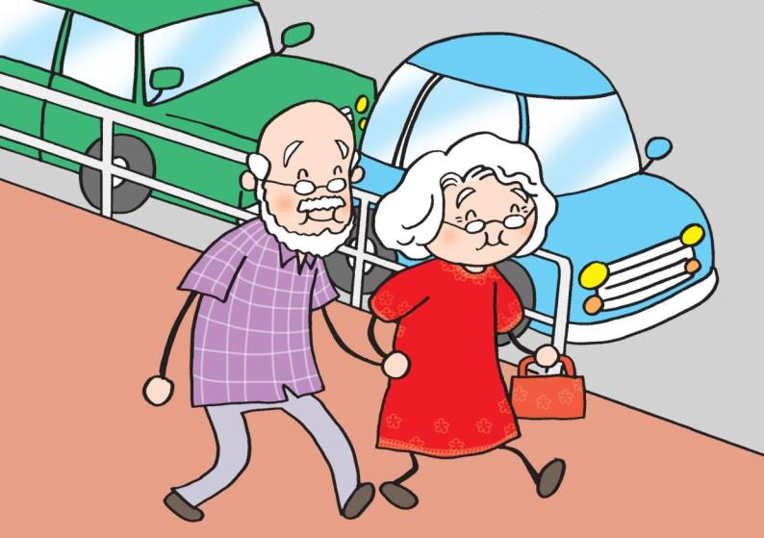
An old couple walking hand in hand in the street

Slide 5
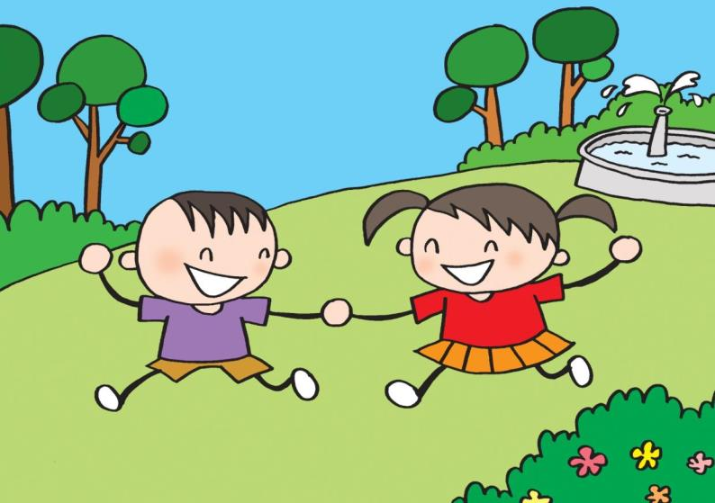
Two kids holding hands in the park

Slide 6
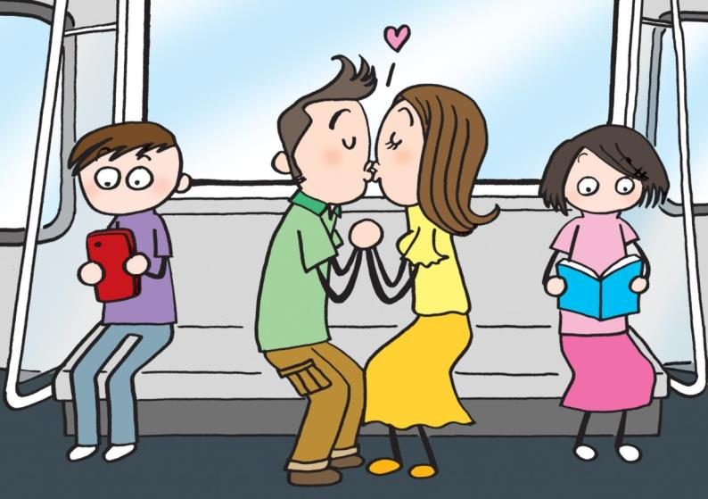
A pair of adult couple kissing in the compartment

Slide 7
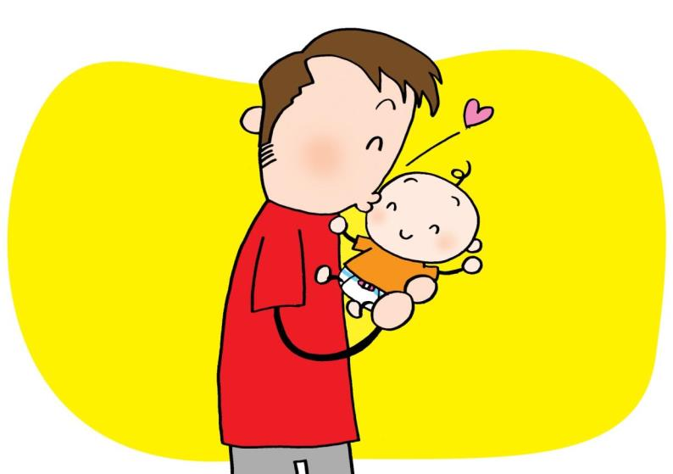
A father kissing his baby

Slide 8
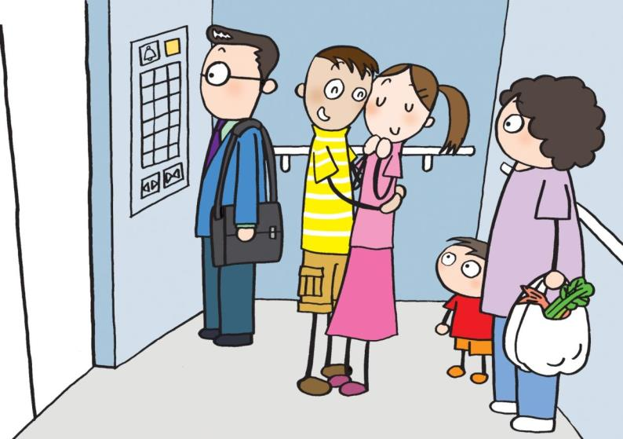
Two local teenagers hugging each other in the lift

Slide 9
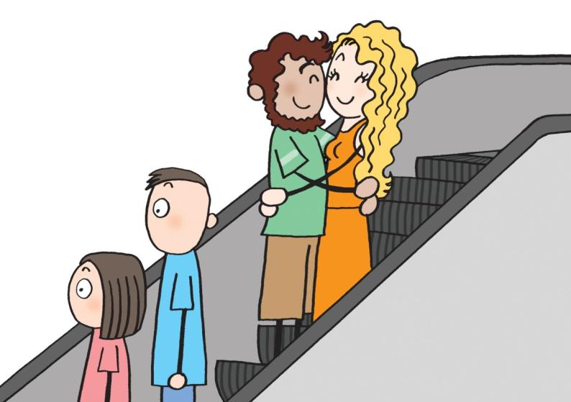
Two foreigners hugging each other on the escalator

Slide 10
Discussion Questions:
In the above scenarios, does your acceptance level vary towards different people conducting the same act? Why?
What factors would influence your acceptance level towards the behaviour?

Slide 11
The levels of acceptance towards intimate behaviour
When judging , we would consider many kinds of factors such as the degree of intimacy and the environment.
Generally, people have a higher level of acceptance towards milder behaviour (such as holding hands)
Factors affecting the acceptance level include the age of the witness and the people involved, their relationship, race, culture, the environment, etc.

Slide 12
The levels of acceptance towards intimate behaviour
Intimate behaviour in a narrow space or a public area with designated purposes/businesses (such as lift, campus) would have greater impacts on others. The acceptance level might be lower if the behaviour is beyond people’s expectations.
People’s feelings and levels of acceptance towards intimate behaviour differ.

Slide 13
It is our responsibility to be careful and respectful to our words and deeds in public.
We should also take care of others’ feelings and avoid causing embarrassment to show self-respect and respect for others apart from enjoying individual freedom.

Slide 14
Activity: “If I were…”

Slide 15
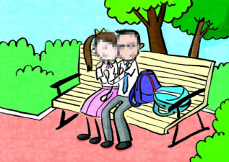
Affectionate young couple in the park becomes an internet controversy: “Identity disclosed!” Complained by the couple
News
Recently, a video of a young student couple who were in school uniform and caressing each other in the park has been widely shared after being uploaded to the Internet two days ago. It has become a controversy with disclosure of the couple’s photos. While some people criticize the younger generation for their open attitude towards sex and inappropriate behaviour, others regard it as an invasion of the couple’s privacy so the identity of the person who recorded the video should also be disclosed. The couple’s information including their names, school names, social media accounts and even the districts where they live were revealed. The couple have deleted their social media accounts because of these disturbances and the girl also suffers from emotional distress and has taken sick leave from school.

Slide 16
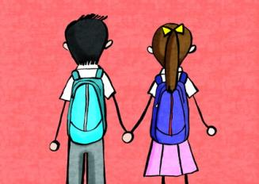
Group A: The young student couple
How would you feel if you were the young couple? Would you insist on having those intimate behaviour if you had a second chance? Why?

Slide 17
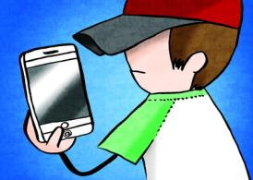
Group B: The person recording or uploading the video without the consent of the people involved
What do you think about recording or uploading the video without consent? Does the result meet your expectation? Would you insist on recording or uploading the photo/video without consent if you had a second chance? Why?

Slide 18
Points to note for the young couple:
Being too intimate in public places, ignoring social morality and causing embarrassment to others
Behave recklessly without taking the consequences into account
Neglect the impacts of their behaviour on their image as a student wearing school uniform
Face a lot of criticism and social pressure

Slide 19
Points to note for the person who recorded or uploaded the video without the consent of the people involved:
Informing the responsible staff or leave the place if you encounter any unacceptable intimate behaviour
Taking photographs or recording videos without consent and uploading related videos/photos to the Internet is an invasion of others’ privacy
Uploading the record of others’ intimate behaviour to the internet or public forum may contravene the "Control of Obscene and Indecent Articles Ordinance"
Causing disturbances to others simply because of fun

Slide 20
“Control of Obscene and Indecent Articles Ordinance”
Class I (neither obscene nor indecent)
※Could be published to anyone
Class II (indecent)
※should be published in accordance with conditions
Class III (obscene)
※should not be published to anyone
Notes:
要了解自己的這種感覺

Slide 21
“Control of Obscene and Indecent Articles Ordinance”
Any person who publishes, possesses or imports Class III article, including publishing it to the internet and public forum, will commit an offence and is liable to a fine of $1,000,000 and to imprisonment for 3 years.
Any person who publishes any indecent article to a juvenile will commit an offence and is liable to a fine of $400,000 and to imprisonment for 12 months on his first conviction, and to a fine of $800,000 and to imprisonment for 12 months on a second or subsequent conviction.
(Reference: Webpage of Bilingual Laws Information System, Department of Justice http://www.legislation.gov.hk/index.htm )

Slide 22
Conclusions
There are different intimate boundaries and different levels of acceptance towards intimate behaviour for different people.
Couples should avoid the intimate behaviour in public places. It is not only to avoid causing uneasy feelings and embarrassment to others, but also to show self-respect and respect for your lover as well as other people.
We should maintain a rational and respectful attitude if we encounter intimate behaviour in public places, rather than respond by causing a disturbance.

Slide 23
The End

