Slide 1
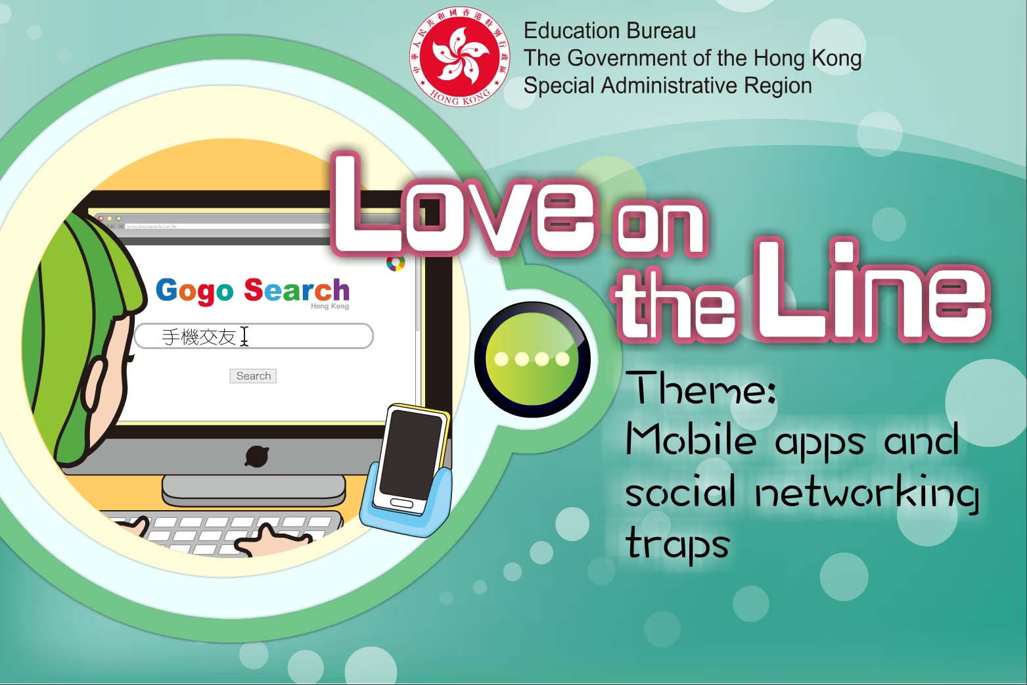

Slide 2
Learning Objectives
Recognise the shortcomings of social networking via mobile apps and hold a cautious attitude towards online social activities.
Equip the skills of protecting their own privacy and reject suspicious invitation.
Beware of the risks behind social networking via mobile apps and learn to deal with suspicious app users, so as to avoid falling into sexual traps.

Slide 3
“The Pros and Cons of Social Networking via Mobile Apps”

Slide 4
“The Pros and Cons of Social Networking via Mobile Apps”
Pro: Users who are not articulate or confident enough can also express themselves well in mobile apps
Con: Users will be at a loss when facing other people if they are immersed in the self-isolated world of mobile apps, without any real life experience of social networking

Slide 5
“The Pros and Cons of Social Networking via Mobile Apps”
Pro: Friends can be made any time with your mobile phone on hand
Con: Mobile social app addicts may pay no attention to other aspects of their life, losing more than they gain from those apps

Slide 6
“The Pros and Cons of Social Networking via Mobile Apps”
Pro: Help is always available with mobile apps by sharing views and experience readily
Con: Users may trust other app users and disclose their own personal information, resulting in financial loss or identity being stolen by lawbreakers

Slide 7
“The Pros and Cons of Social Networking via Mobile Apps”
Pro: More choices of friends are available in mobile apps, which makes it easier to look for dating partners
Con: Name, gender and photos can be fake, think twice before taking the ‘love relationship’ seriously

Slide 8
“The Pros and Cons of Social Networking via Mobile Apps”
Pro: Meet friends, and even lovers with common interests and sincerity
Con: Sweet talk and delightful dates may turn into sexual assaults

Slide 9
“The Pros and Cons of Social Networking via Mobile Apps”
Pro: Meet foreigners online and foster the language and cultural exchange
Con: Being lured into naked chat, naked photo-taking or video recording which may be the trap of blackmailers.

Slide 10
Safer channels for social networking
participate in various social activities, like volunteering, exchange programmes, interest classes, etc
➔ explore his/her own strengths and potential
  accept and actively improve his/her weaknesses, as well as enhance his/her confidence
by getting along with different people
➔ improve communication skills and develop
healthy interpersonal relationship

Slide 11
Safety note of using mobile social apps
Avoid disclosing personal information through the app or to others.
Avoid uploading personal photos, or sharing them with others through the app.
Do not turn on the ‘location identification’ function in the setting of the phone.
Consider the consequences; avoid meeting strangers.
If suspicious messages are received, cease the contact at once and tell people you trust.
If possible, only chat with the acquaintances you know in real life.

Slide 12
When meeting someone who we know only through mobile social apps, we should:
Know more about his/her character and background
Be polite
Stay vigilant
Try to stay in appropriate public places you are familiar with
Set the time limit for the date
Tell people you trust about the date in advance

Slide 13
When meeting someone who we know only through mobile social apps, NEVER…
Consume any food or drinks provided by others
Let others plan the whole schedule of the date
Go on the date alone
Let others pay for the whole date
Get on the car of strangers

Slide 14
If suspicious of being deceived…
Keep as much related information as possible such as conversations and messages as evidence.
Report to the police immediately.
Share with trusted and reliable relatives and friends and look for emotional assistance and support.
Seek professional help from social workers if necessary.

Slide 15
Conclusions
There are advantages of making friends via mobile apps in some aspects, yet users must stay vigilant if they do not want to be victims.
Be prudent and rational when making friends via mobile apps. Do not be easily convinced by others and promise a date. Do not assume that you are capable of identifying imposters, for most imposters would have well thought-out plots and fabricated identities, making them difficult to be uncovered.
There are many reliable and healthy ways of social networking in real life.

Slide 16
The End

