Slide 1
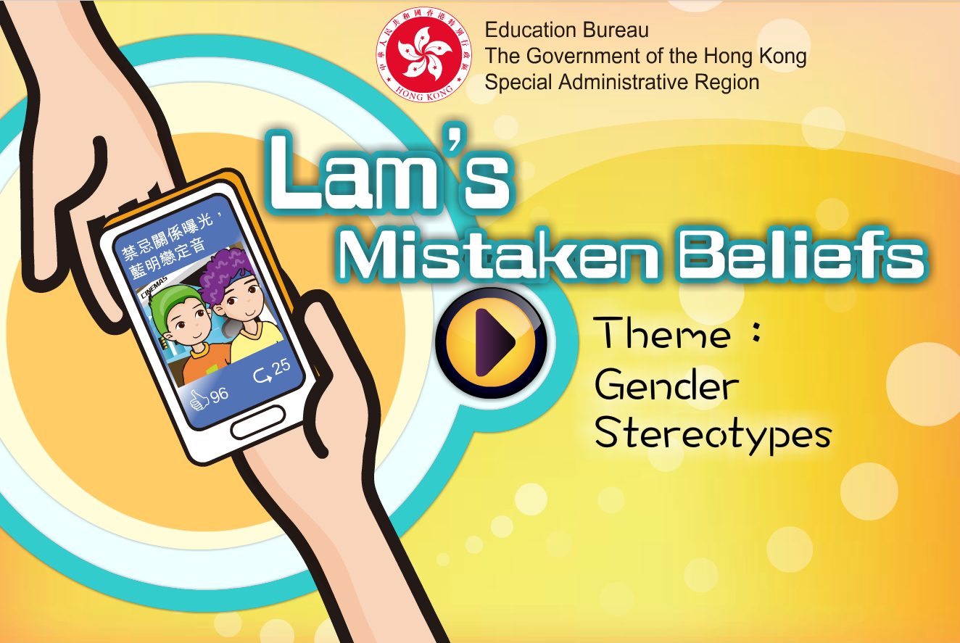

Slide 2
Learning Objectives
Understand what gender stereotyping and the myths are
Understand that gender stereotypes may limit the way people think and behave
Learn to respect individual differences, including personality, to build up equal and respectful relationships with others, regardless of gender and not to judge other people on gender alone.

Slide 3
What kind of gender ideologies does this pictures represent？

Slide 4
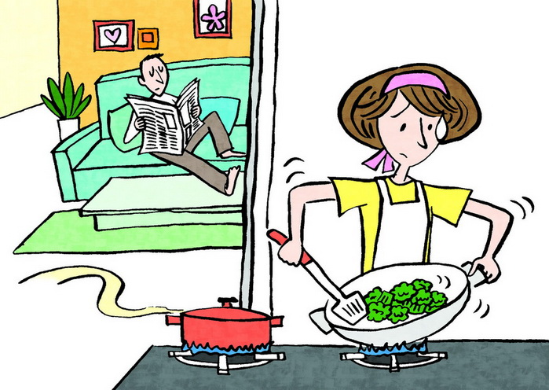

Slide 5
Activity: His or Hers?

Slide 6
Activity: His or Hers?
Discuss the followings:
i. To individual members of the group, does he/she accept the gender/scenario combination? Why?
ii. Is the gender/scenario combination generally accepted in our society?
iii. Will the acceptance level significantly change if the gender in the combination changes?
iv. Does the reason to accept or reject reflect the kinds of expectation and stereotypes towards males and females in our society?

Slide 7
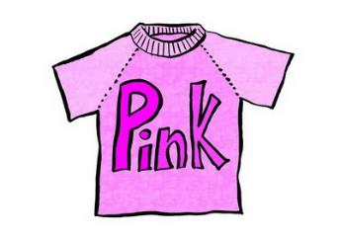
Wear Pink

Slide 8
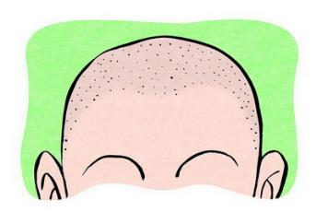
Going Bald

Slide 9
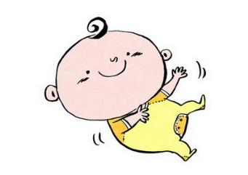
Be a Homemaker and
Take Care of children

Slide 10
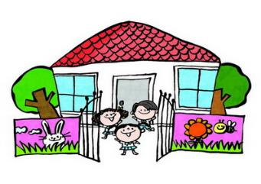
Teach at a Kindergarten

Slide 11
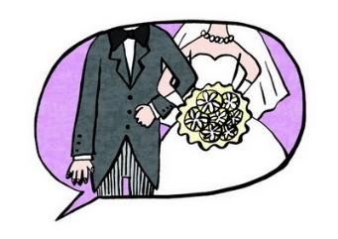
Propose Marriage

Slide 12
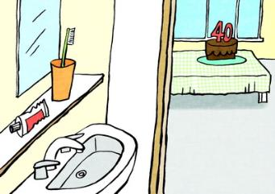
Staying Single at the age of 40

Slide 13

Give Flowers on a Date

Slide 14
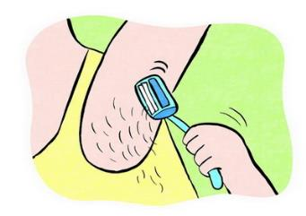
Shave One’s Underarms

Slide 15
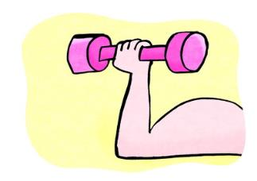
Bodybuilding(Being muscular)

Slide 16
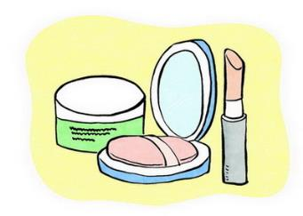
Wear Makeup

Slide 17

Work at Construction Sites

Slide 18
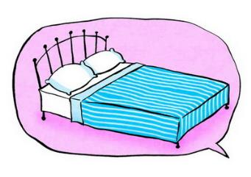
Initiate Sex

Slide 19
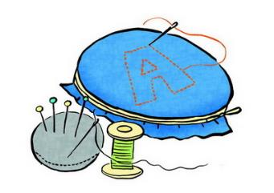
Do Embroidery

Slide 20
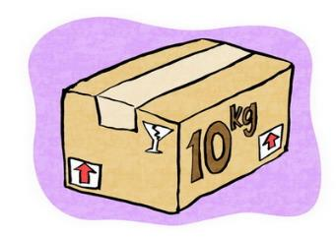
Move Heavy Objects

Slide 21
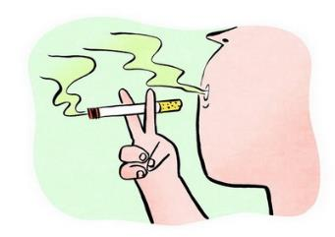
Smoke

Slide 22
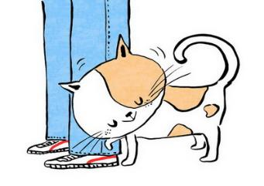
Being Affectionate

Slide 23
Conclusions
Gender stereotyping serves certain functions. For example, it may be a reference framework and one may learn how to be socially accepted by following those commonly accepted or stereotyped models.
However, if one understands gender in a narrow and rigid way, regardless of individual uniqueness or social changes, inequity, limitation or even discrimination may result.
Students are encouraged to reflect on their personal beliefs on gender. If there is less gender stereotyping and more autonomous options, people can develop their talent and capacity fully without being limited by gender inequality.

Slide 24
The End

