Slide 1
Hard Rock
Popular Music Teaching Resources Package
By TaiShun TSE

Slide 2
Performing activities
In the End
Divide the class into two groups, with the given scores on next two slides,
  Practice and sing the bassline.
  Practice and play the drum pattern (only kick and snare)
Observe how bass and drums works as a section.
(Score on next slide) ➔

Slide 3
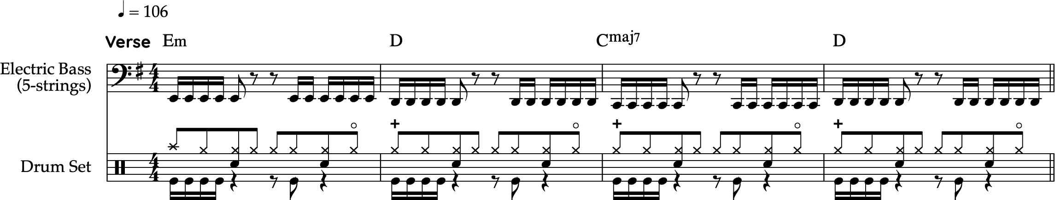
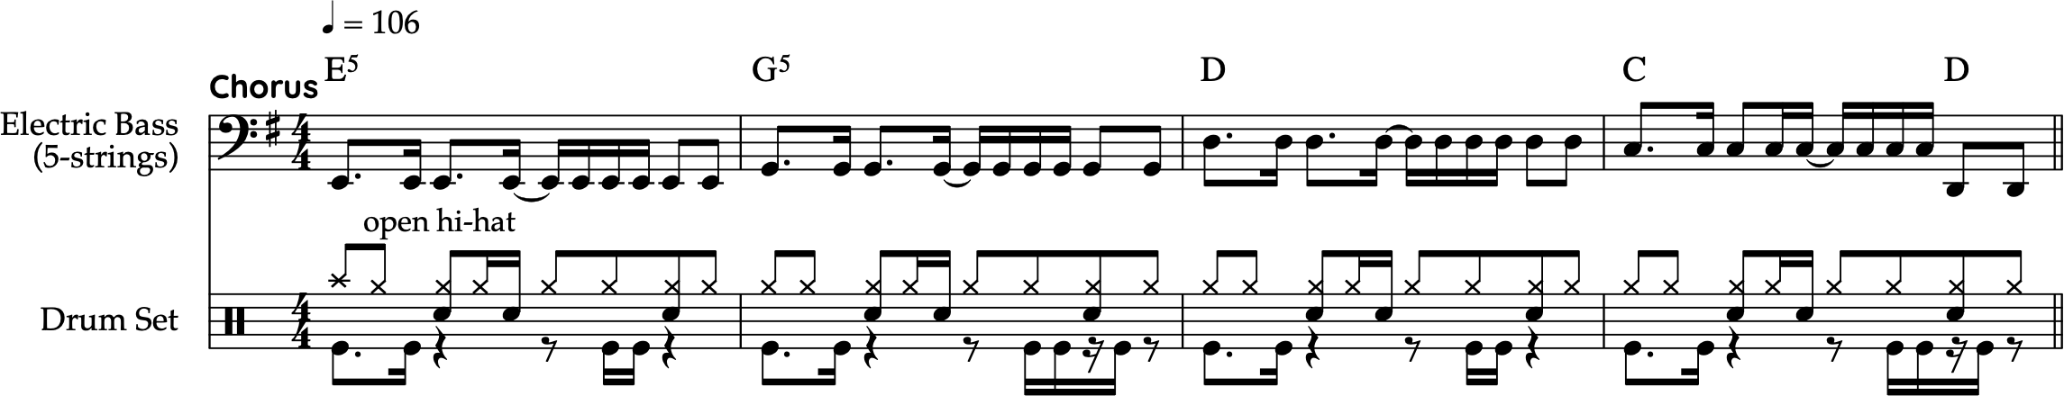
Performing activities
In the End

Slide 4
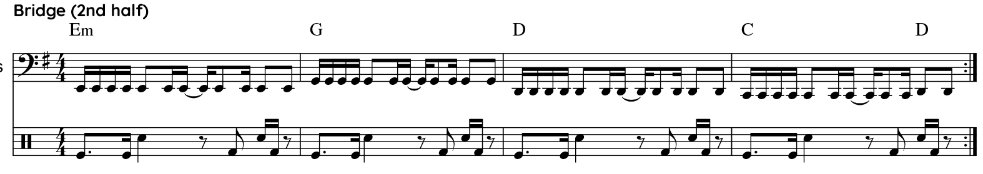
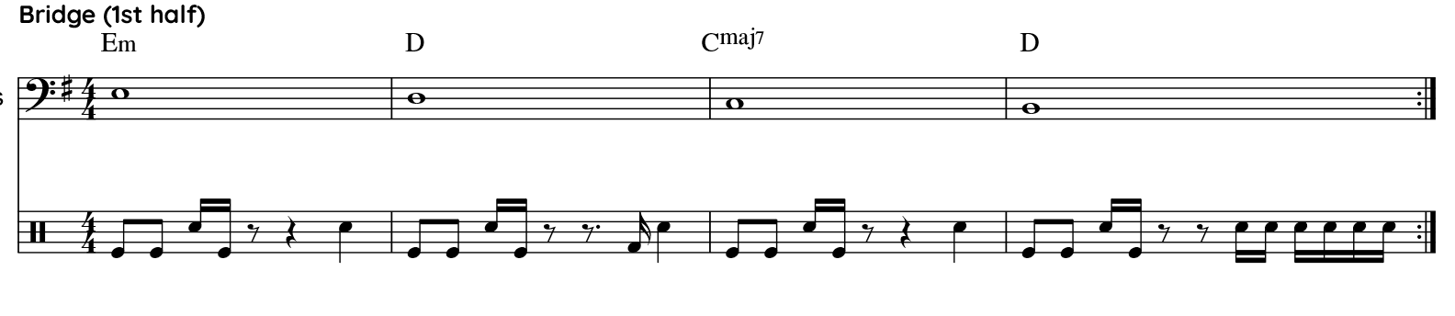
Performing activities
In the End

Slide 5
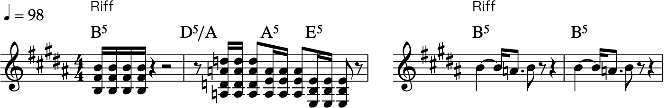
Performing activities
Rock or Bust
Play the guitar riffs
Play the drum pattern (without hi-hat)
How do they contribute the atmosphere of the song?

Slide 6
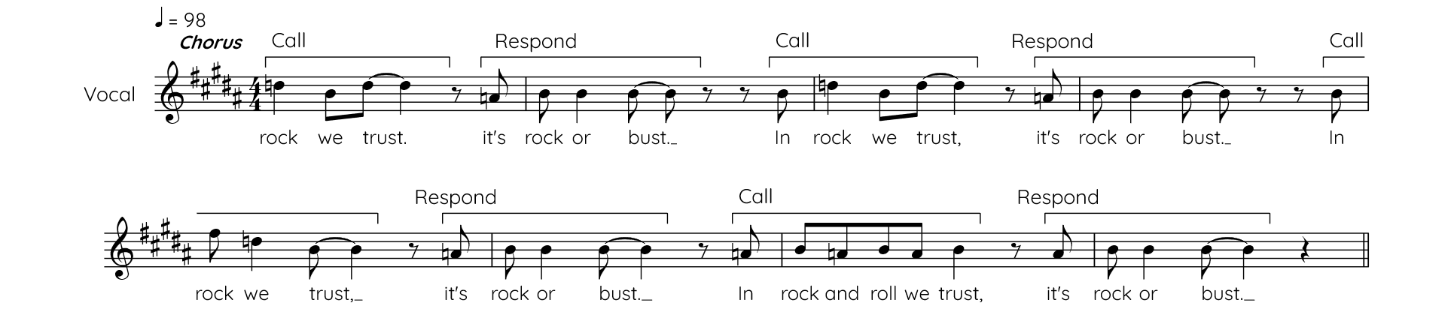
Performing activities
Rock or Bust
Perform the chorus - Call and Response.
The lead vocalist experiment with the 'Call' by using ad-libs and melodic variations to build tension.
The response group remains consistent for the lead to play against.

Slide 7
Listening activities
Rock or Bust
Listen to the Intro:
How does Intro show the characteristics of hard rock?
  Ans: Use of power chords, clear guitar riffs, straight drum pattern (almost without variation)

Slide 8
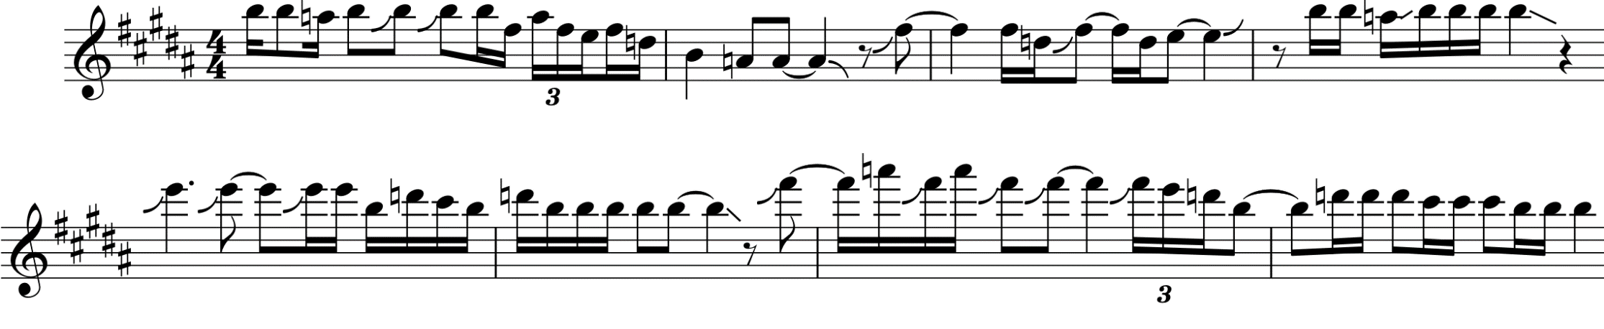
Listening activities
Rock or Bust
What techniques does the guitar use during the solo to stand out from the other parts? What makes the solo distinctive within the song?
  Ans: Pitch bends, blue notes, and a high register for a prominent sound

Slide 9
Listening activities
Rock or Bust
There are two sets of riff in Intro. Listen and write down their rhythm.

Slide 10
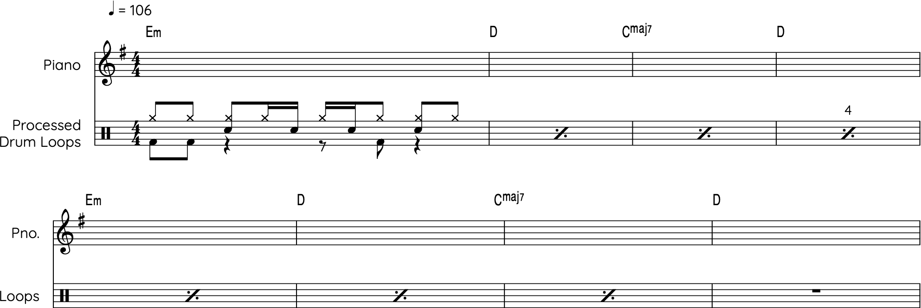
Listening activities
In the End
Listen to the opening melodic riff and transcribe it on the score below.

Slide 11
Listening activities
In the End
The song blends hip-hop and hard rock styles
Identify the structure and the dominant style of each section.
Sections | Intro | Verse 1 |  |  | Verse 2 | Pre Chorus | Chorus |  | Chorus
Main style | -- | Hip-hop |  | Hard Rock |  |  |  | Hip-hop |  | --

Slide 12
Listening activities
In the End
Focus on the guitar part. Analyse the performance and production techniques used in shaping the tone colour of this song.
  Ans: Layering through overdubbing guitar tracks; each layer uses different distortion settings.

Slide 13
Listening activities
New Born
Name two musical characteristics heard in the excerpt of Newborn, which show hard rock stylistic features.
  Ans: Heavily distorted guitar; powerful drums, particularly the snare; vocals reaching into a high register.
When does the guitar riff first appear?
  Ans: After the first pre-chorus
What is the relationship between bass guitar and electric guitar?
  Ans: Doubling in octave

Slide 14
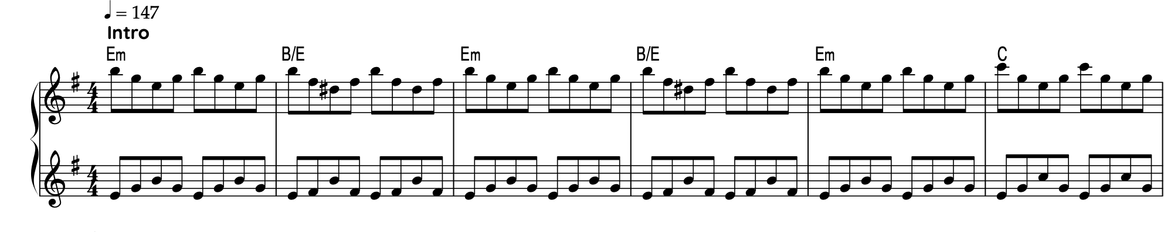
Listening activities
New Born
What kind of piano technique is used?
  Ans: Broken chords
How do the piano and bass work together in the beginning, before the guitar joins?
  Ans: Both instruments play broken chords. The bass doubles the left hand of the piano, which moves in contrary motion with the right hand.

Slide 15

Creating activities
Rock or Bust
Create another guitar riff that fits into the existing harmony
Pick a drum pattern that provided on next slide
Hints: simple rhythm, repetitive

Slide 16

Creating activities
Rock or Bust
Select the excerpt that best matches the hard rock style.
Justify your choice and explain why the other does not.
Drum 1
Drum 2
Drum 3
Drum 4

Slide 17
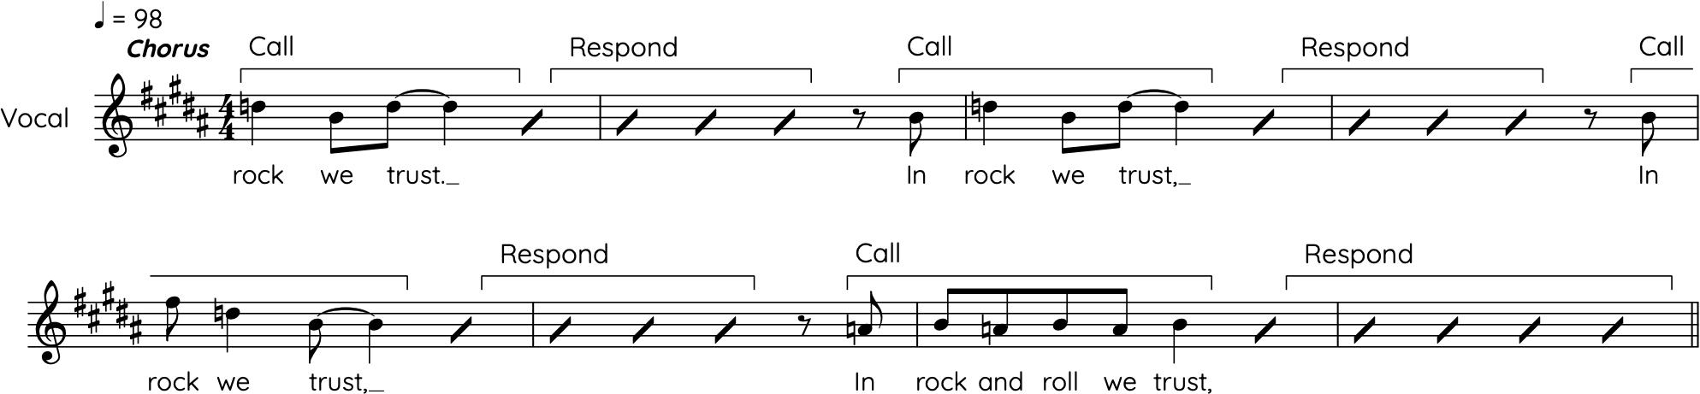
Creating activities
Rock or Bust
Create the response part. Include lyrics, melody.
Hint: it should be short and easy to remember. For example: “In the holy-mountain!”

Slide 18
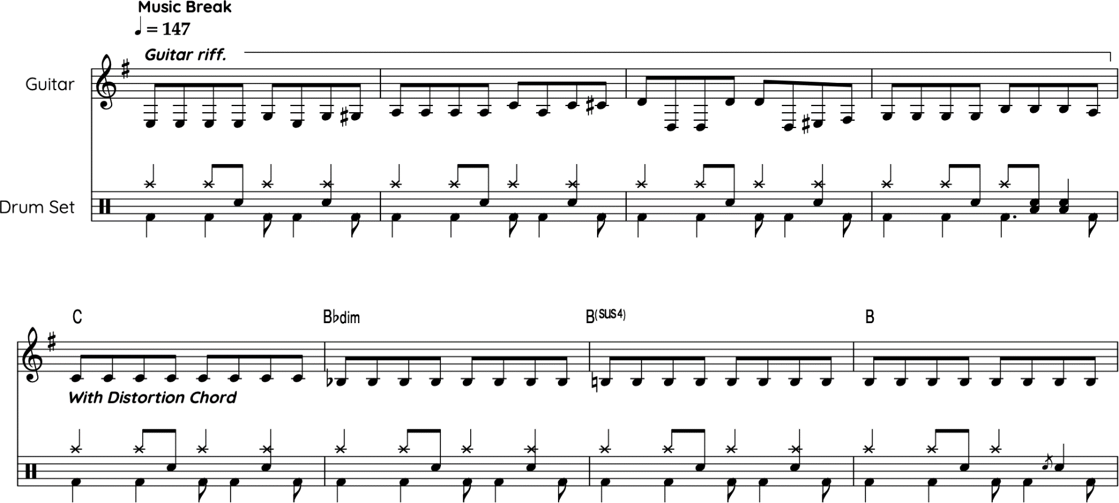
Creating activities
New Born
Revise the original guitar riff, compose an alternative 8-bar music break using the [Major/Minor/blues] scale. First note of each bar is given, or you can compose on your own.
Original
Your version ➔

Slide 19
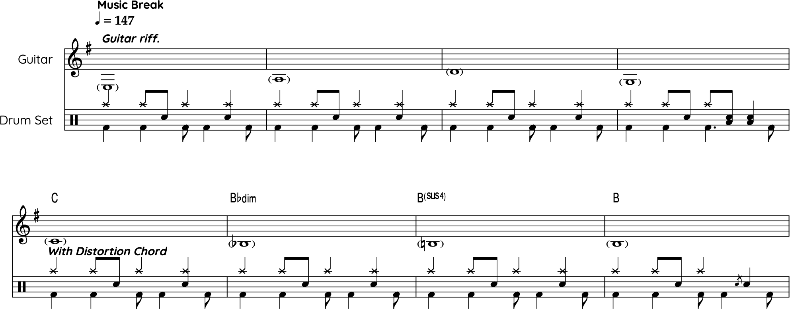
Creating activities
New Born
Hints: (i) connect the notes using a chromatic approach.
(ii) use broken chord patterns
  (iii) use single note with repetitive pattern.
Your version

Slide 20
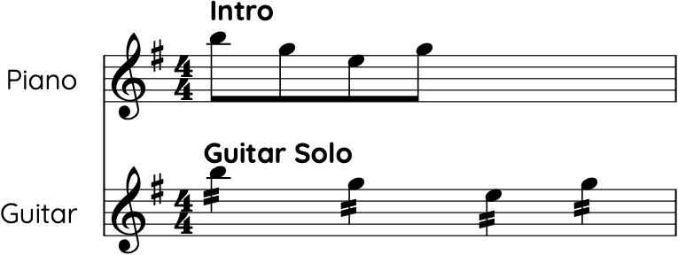
Creating activities
New Born
Explain the relationship between the following musical motif (piano) and the guitar solo.

Slide 21
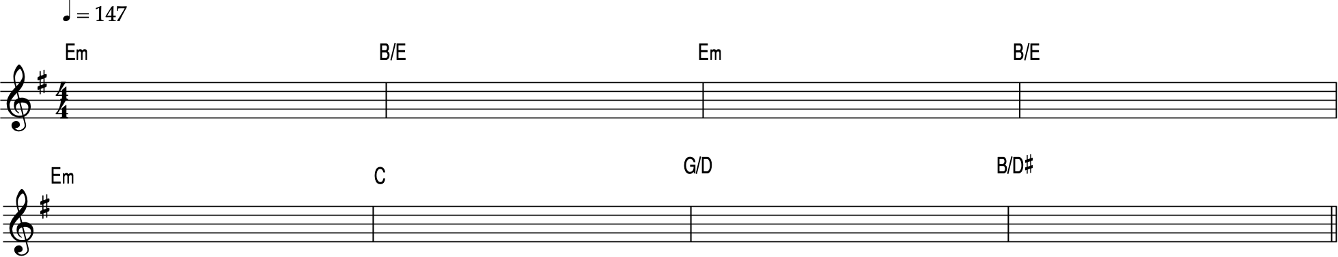
Creating activities
New Born
Compose an alternative musical motif based on the same harmony (intro).
Then, fragment and develop these musical elements.
Share your thoughts on how you would use the materials, consider:
  Which specific instrument it is intended for (e.g. guitar, bass, piano, keyboard) and,
  Which section of the song (e.g. intro, verse, pre-chorus, instrumental break).

Slide 22
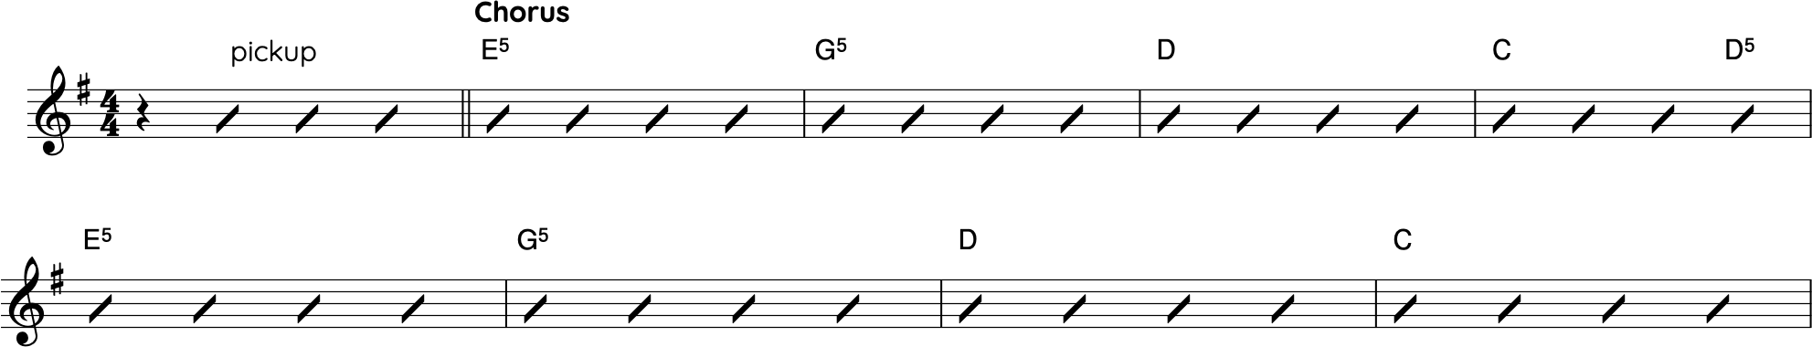
Creating activities
In the End
Based on the given harmonic progression and rap verse,
  Add a respond to the rap (verse)
  Create a new chorus (melody)
Hint: use the higher register to create a contrast with verse. You can start with either a pickup or straight to chorus

