Slide 1
Pop Ballad
Popular Music Teaching Resource Package
By TaiShun TSE

Slide 2
Singing
Always Remember Us This Way
《K歌之王》
What Was I Made For

Slide 3
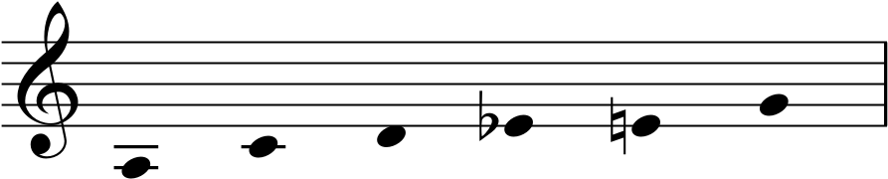
Singing activities
Always Remember Us This Way
Practise and sing the C blues scales, locate the blue note
Feel the blues: sing the ad-lib with and without the blue note.
Does the presence or absence of a blue note make it ‘wrong‘？ or is it simply a matter of stylistic issue?

Slide 4
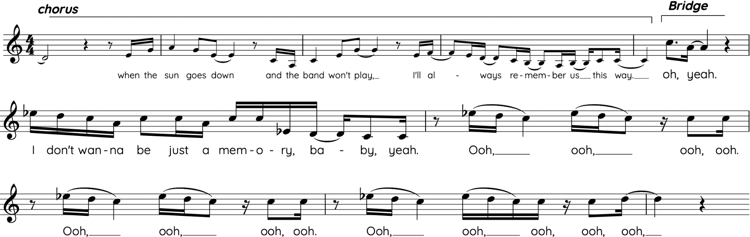

Always Remember Us This Way
⬅ With blue note
Without blue note ➔

Slide 5
Singing activities
Always Remember Us This Way
Bassline comparison
  Sing the bass line of Verse 1, Verse 2, and Chorus (score provided)
  Observe the bass pattern change between Verse 1 and Verse 2
  Observe how the bass line of Verse 2 works with drums
  Compare the bass and drum pattern between verse and chorus

Slide 6
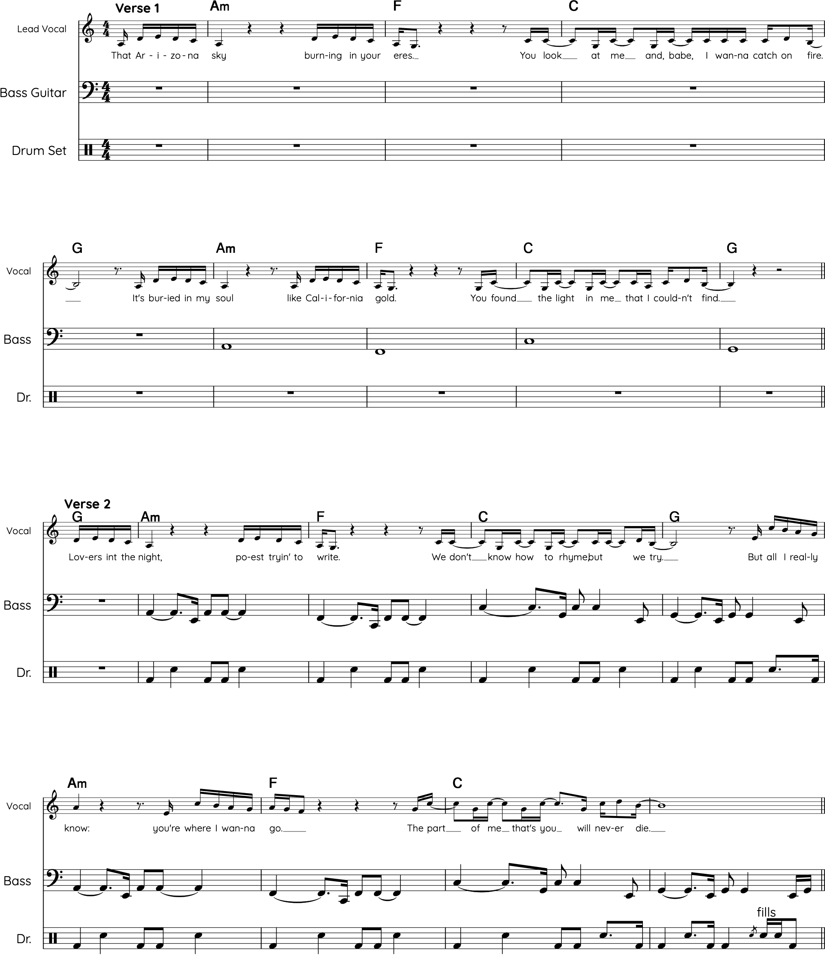
Always Remember Us This Way

Slide 7
Always Remember Us This Way

Slide 8
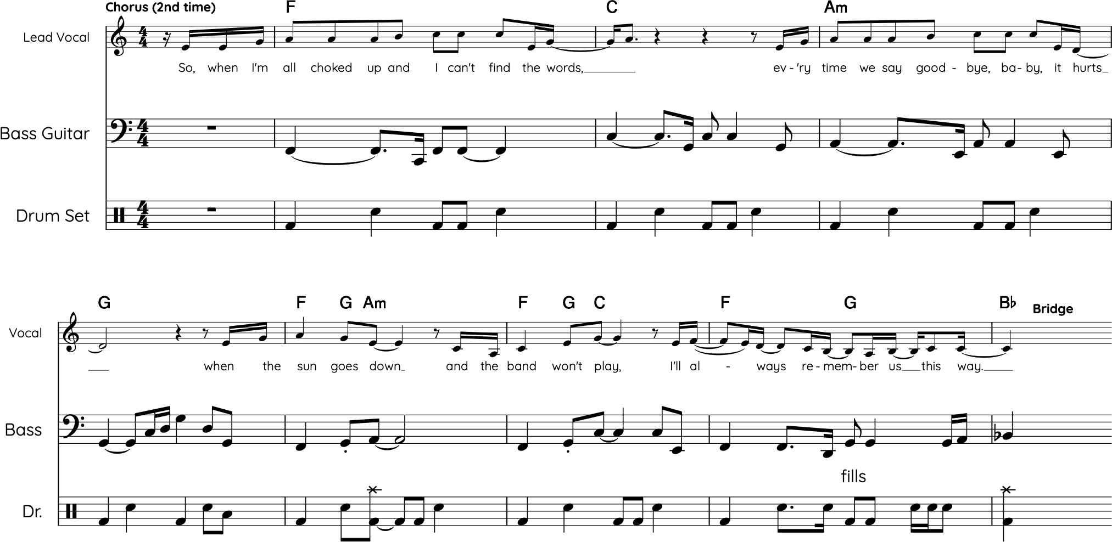
Always Remember Us This Way

Slide 9
Singing activities
Always Remember Us This Way
Always Remember Us This Way
Sing the three choruses, each with a different cadence at the end.
How do they contribute to the atmosphere of the song?

Slide 10
Singing activities
《K歌之王》
Sing the descending bass line with the chord progression.
To get the sense of linear motion and emotional weight to the chord progression.

Slide 11
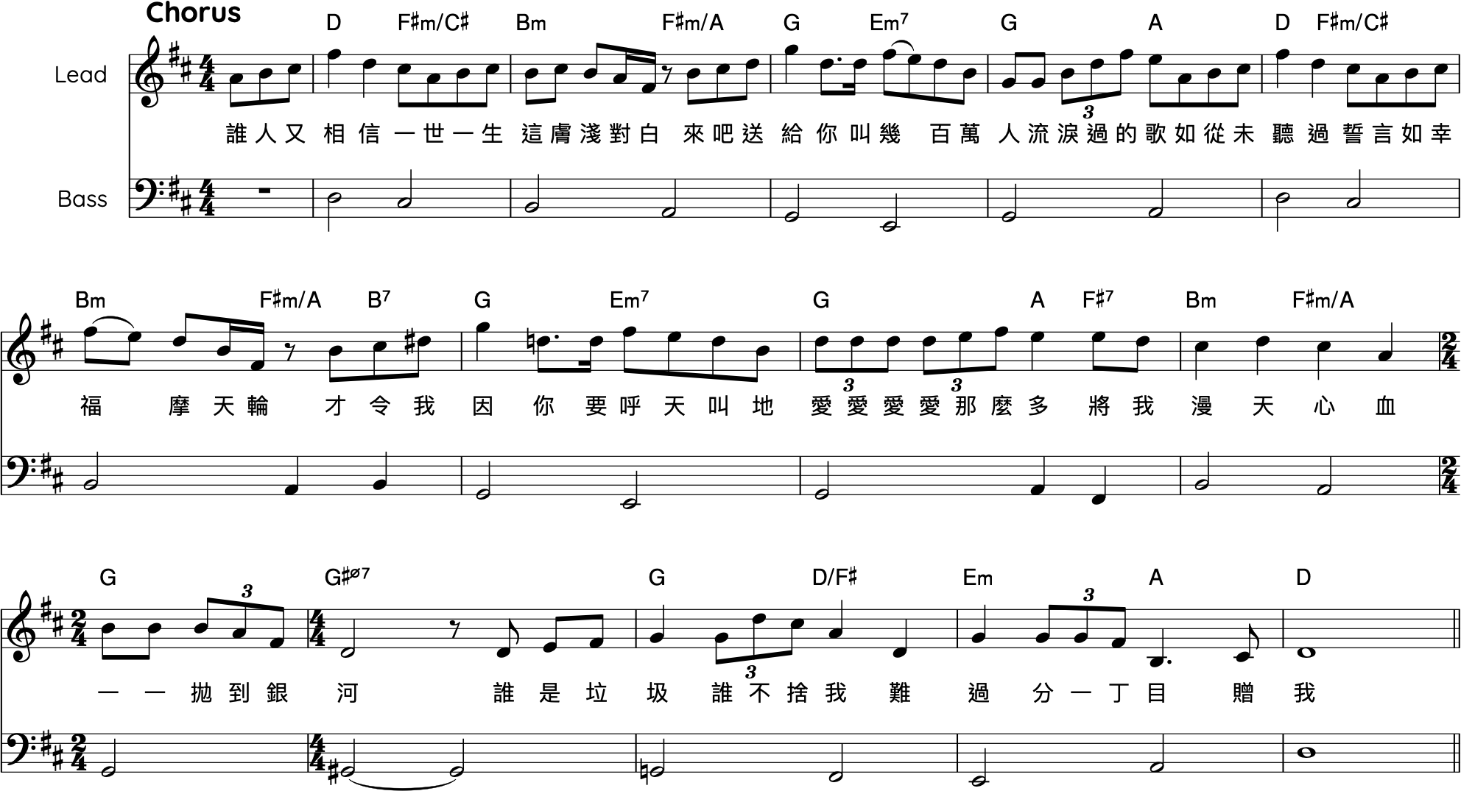
《K歌之王》

Slide 12
Singing activities
《K歌之王》
A descending bass line moves stepwise in a downward direction. This technique can also be applied to inner voices to create harmonic movement
Sing the harmony and bass lines using the vowel sounds "Ooh" or "Ahh
Observe how stepwise movement contributes to the creation of harmony
Identify the chord tone — specifically the third — which determines the quality of the chord

Slide 13
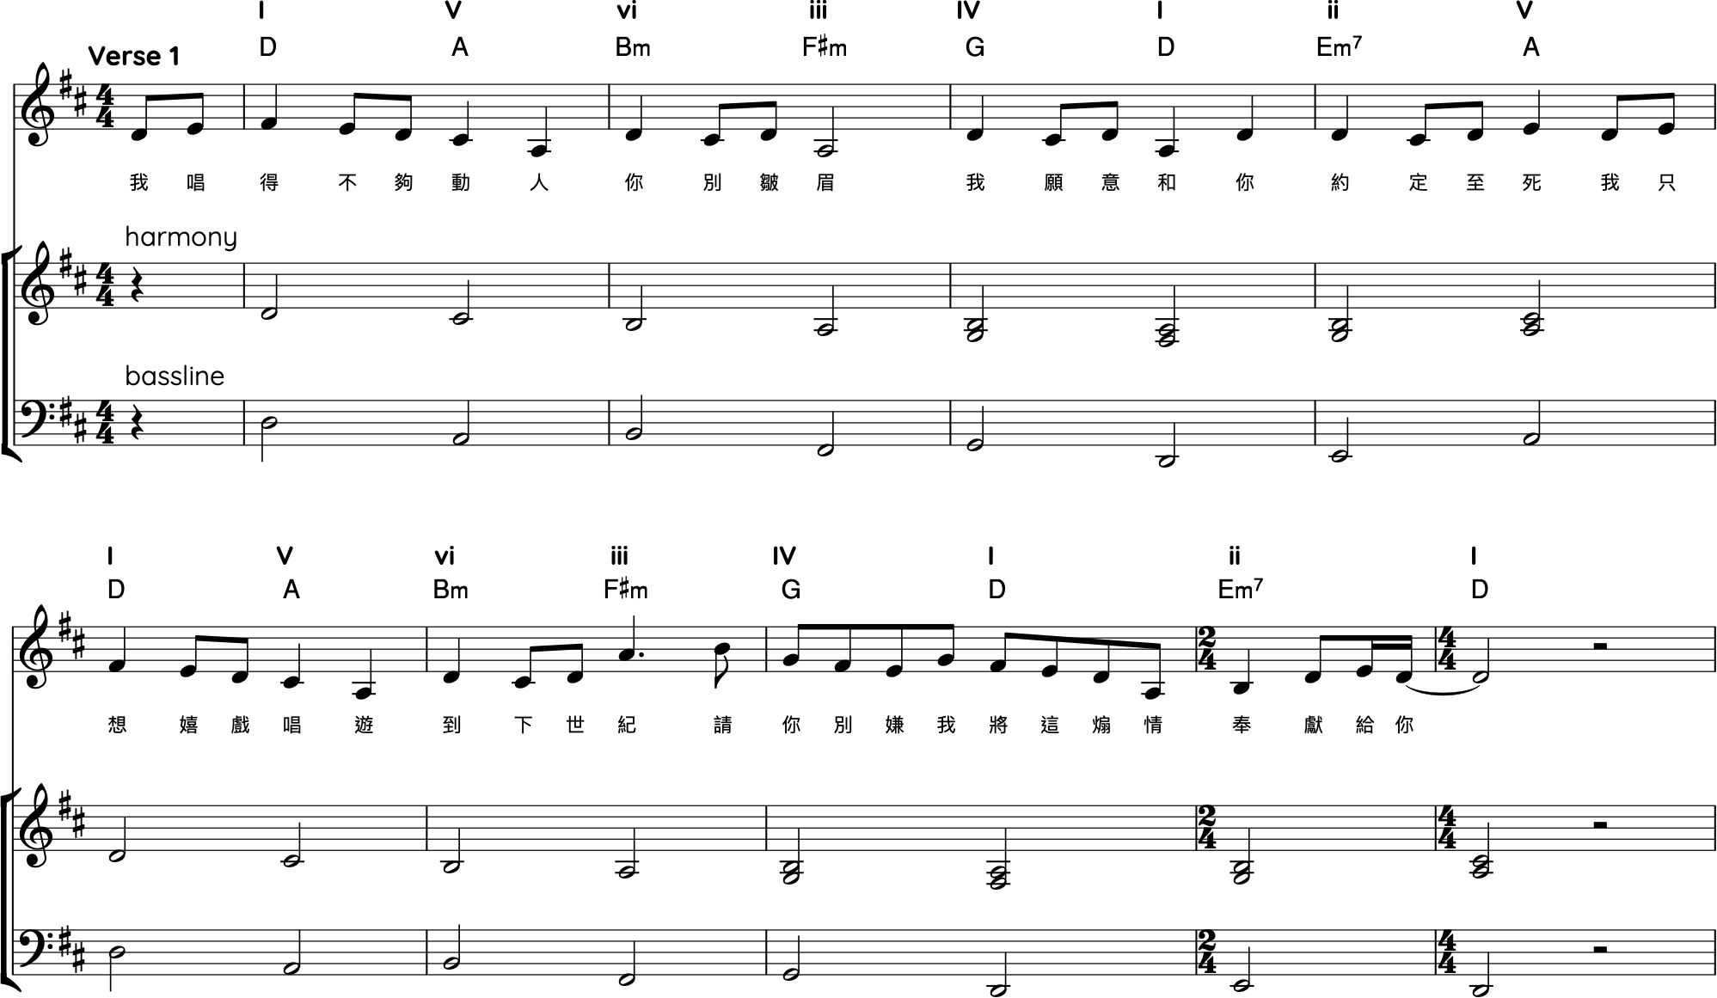
《K歌之王》
Descending (inner voice)
Descending (inner voice)

Slide 14
《K歌之王》
Chord notes

Slide 15
Singing activities
《K歌之王》
Sing through the first and second chorus, paying particular attention to the two-measure extension in the second chorus. Perform with accurate dynamics and expression markings.
Discuss how text, rhythm, dynamics, and articulation interact with and inform one another

Slide 16
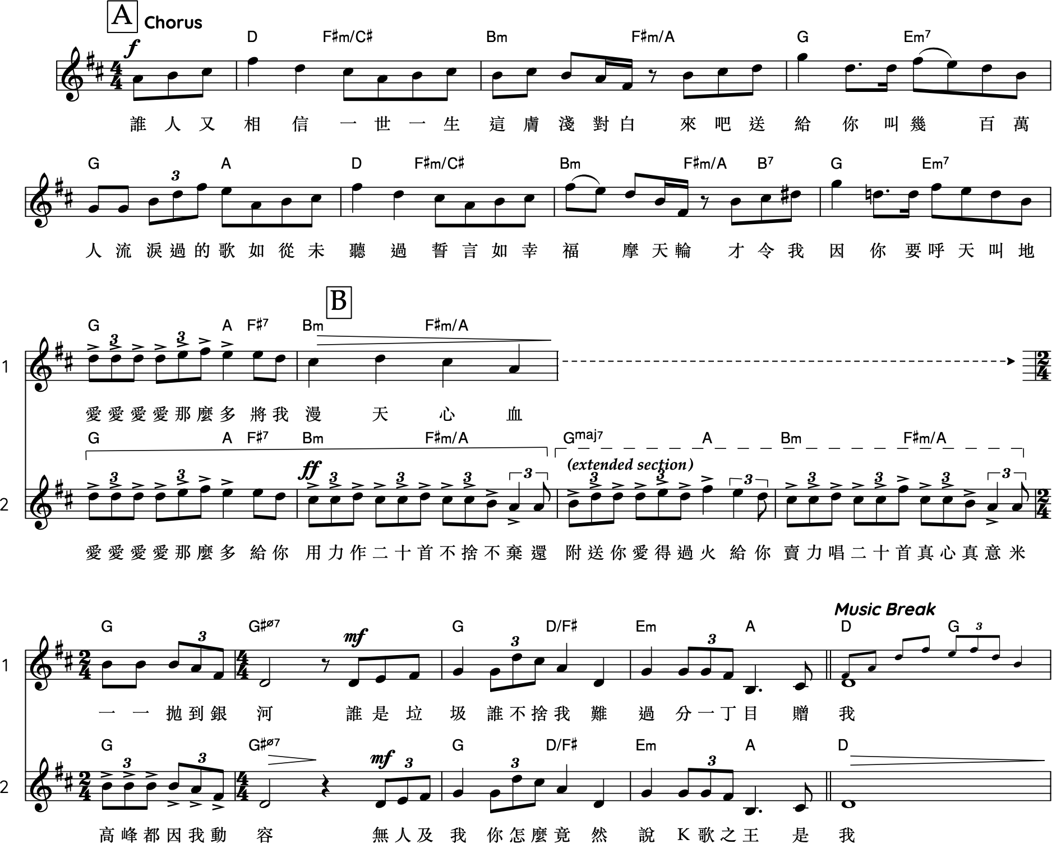
《K歌之王》

Slide 17
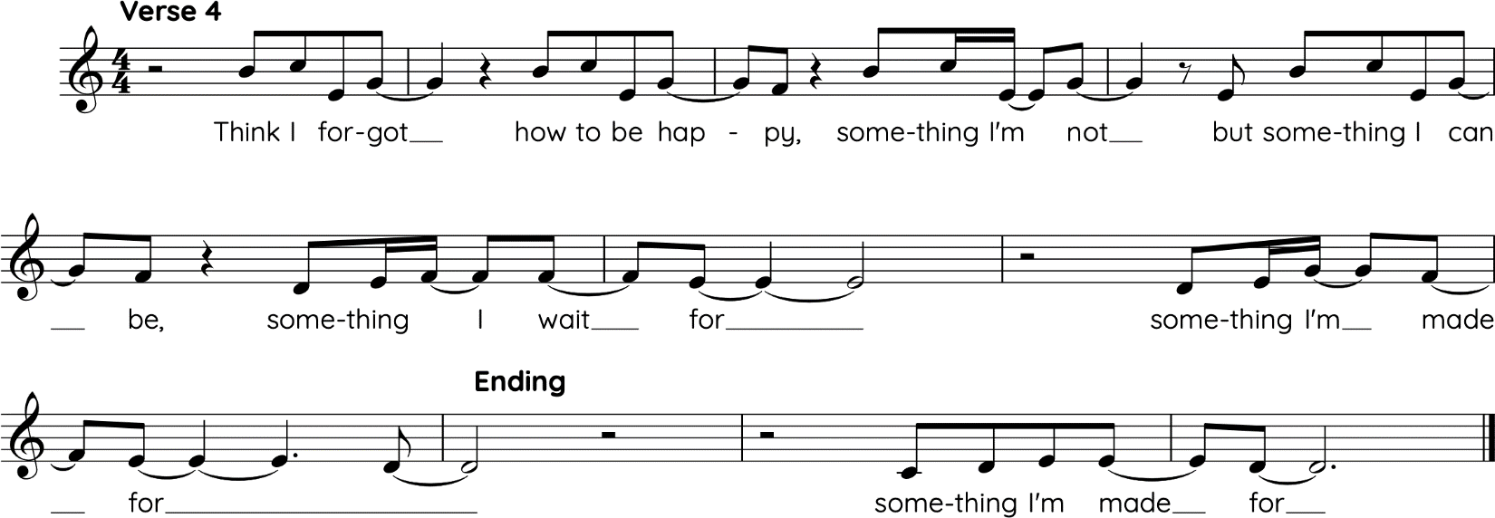
Singing activities
What Was I Made For
Sing the last phrase of melody.
Describe how the ending fits with the text in terms of musical treatments.
Discuss why the text change from “What Was I Made For” to “Something I Made For”.

Slide 18
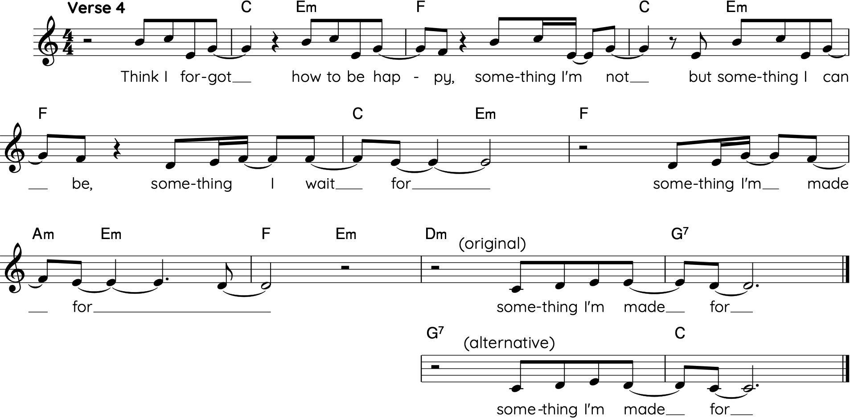
Compare the following two versions: the original and the alternative (arranged)
Discuss how the changes affect the music. Does the altered version change the meaning of the piece?

Slide 19
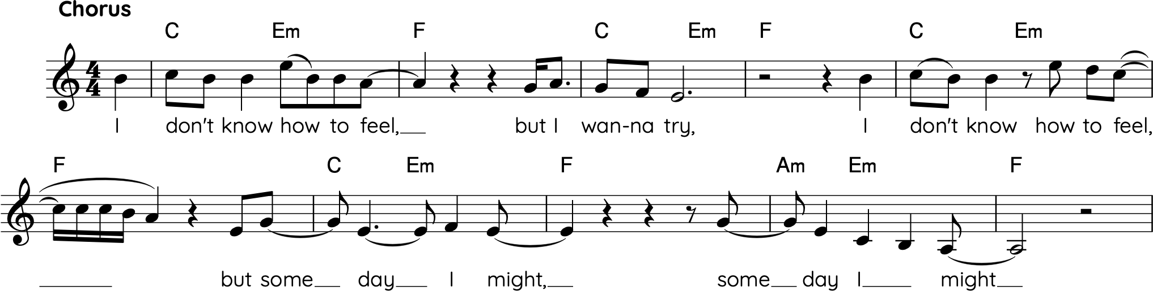
Singing activities
What Was I Made For
Sing the chorus by imitating the singer‘s vocal technique. Share your experience on how to use and control your voice as a musical instrument.

Slide 20
Listening
Always Remember Us This Way
《K歌之王》
What Was I Made For

Slide 21
Listening activities
Always Remember Us This Way / What was I Made For / 《K歌之王》
Lady Gaga and Billie Eilish are both singer-songwriters who feature the piano prominently in their works. Compare how the piano is used in their songs with that in 《K歌之王》. In what ways does the role of the piano differ?
  Suggestions:
    Is it more ornamental (fills, runs)?
    Is it more rhythmic vs harmonic?
    Is it less prominent or more textural?

Slide 22
Listening activities
《K歌之王》
Listen to the bass line of the pre-chorus, how does the bass line assist in building up tension of the pre-chorus?
  Suggestion: Consider whether this is the only section in which the bass line descends chromatically.
Using AI track separation, listen to the bass line and vocal parts only.

Slide 23
Listening activities
《K歌之王》
Explain, in terms of the musical features, how the two-measure extension from the second chorus builds the climax.
  Suggestion: What is being repeated and reused?
Using AI track separation, listen to different parts.

Slide 24
Listening activities
What Was I Made For
Describe the relationship between the text and melody in the chorus, with reference to melodic writing and vocal techniques.
  Suggestion: Notice how the melody resembles an internal dialogue. The opening phrase begins in a higher register, while the responding phrase moves to a lower register.

Slide 25
Listening activities
What Was I Made For
Describe the piano accompaniment.
Besides piano, what other instruments are used in the track? Describe how they are used.

Slide 26
Creating
Always Remember Us This Way
《K歌之王》
What Was I Made For

Slide 27
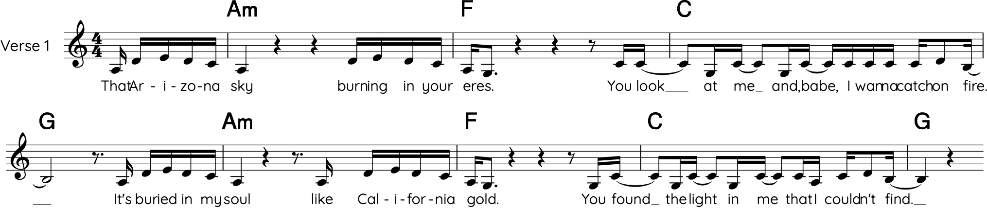
Creating activities
Always Remember Us This Way
Besides piano as the main accompaniment instrument, what other instruments or layers could be added to enhance the arrangement?

Slide 28
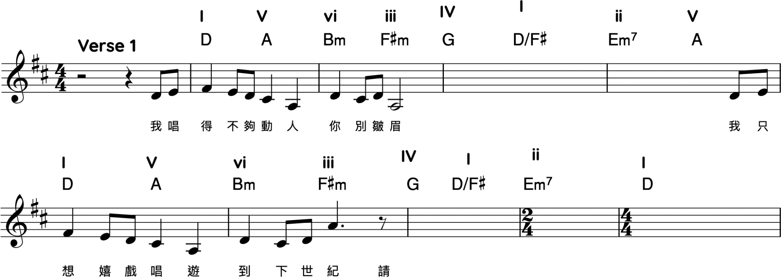
Creating activities
《K歌之王》
Alternative melody:
  Option 1. Based on the same harmony in Verse 1, create a new melody
  Option 2. Based on the same harmony in Verse 1, fill in the missing parts

Slide 29
Creating activities
《K歌之王》
Adopting well-known music phrases to replace the intro or outro.
  It can be of any genre of music, as long as there is a reason behind your choice.

