Slide 1

Learning and Teaching Resources on English Language (P4 - 6)
Developed by English Language Education Section
Curriculum Development Institute
Education Bureau

Slide 2
An Overview of the Learning Task
Content Objectives
  To understand different ways to prevent the spread of COVID-19
  To learn how to wash hands and wear a mask properly
  To learn how to write a thank-you card to doctors and nurses
  To develop positive values and attitudes related to “appreciation” and “care for others”
Language Focuses
  To develop reading and listening skills with the support of images and pictures
  To understand the features of a thank-you card

Slide 3
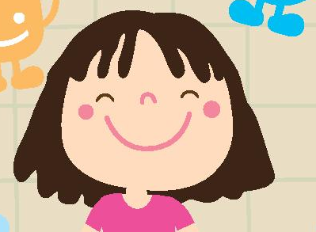
Situation
A virus is a germ that causes disease and makes people ill. A new virus, which causes the disease “COVID-19”, is now affecting Hong Kong badly. To help fight this virus, Ms Susan Kwok, your English teacher, would like you and your classmates to be “Health Ambassadors”. She has prepared the following activities for you:
- Read a poster and learn about how to keep viruses away
- Complete a matching and sequencing activity to find out how to wash
hands properly
Watch a video and complete a diagram to list the main points about how to wear a mask properly
Write a thank-you card to doctors and nurses in Hong Kong
Ms Susan Kwok, your English teacher

Slide 4
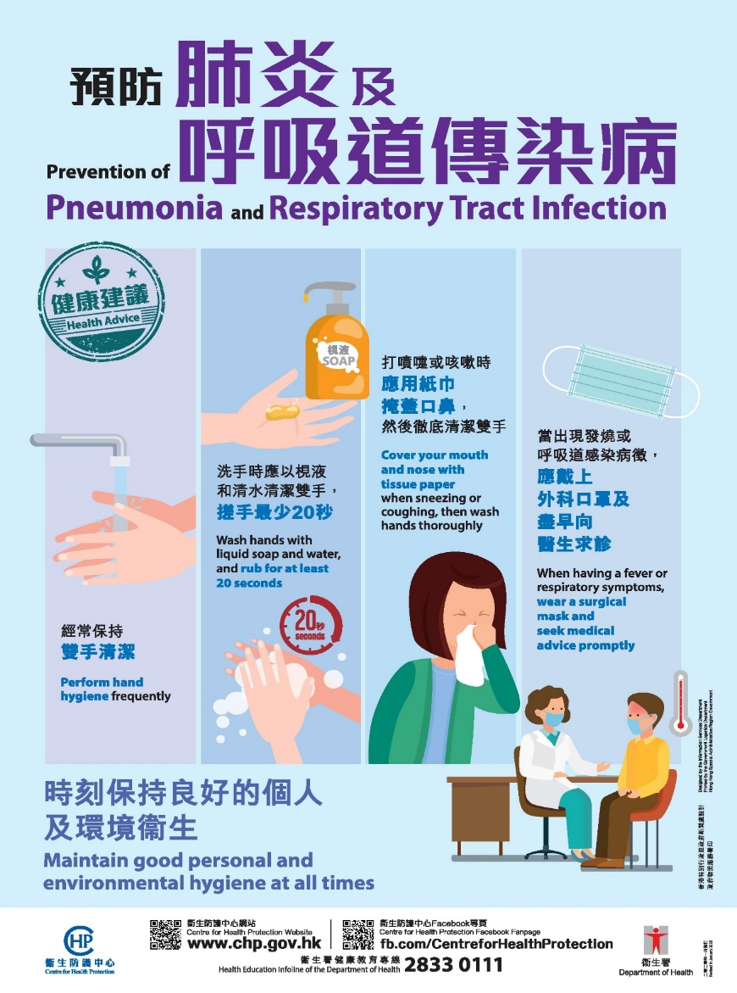

Learning about how to keep viruses away
The Centre for Health Protection has designed the following poster on how to keep viruses away and avoid getting sick. Study the poster and answer Questions 1-7.
Let’s get started!
https://www.chp.gov.hk/files/pdf/pneumonia_health_advice.pdf

Slide 5




Learning about how to keep viruses away
Study the following parts of the poster and answer Questions 1-7.
Q1: Which of the following means “perform hand hygiene” in the first picture?
Use your hands to clean your whole body
Keep your hands clean to prevent disease
Touch your hands
Q2: What should we use to clean our hands with? ____________________
Q3: How long should we rub our hands?
Picture 1
Picture 2
Picture 3
Picture 4
Let’s move on to the next slide!

Slide 6




Q4: Look at Picture 3 and fill in the blanks below.
When we sneeze or ____________, we
should ___________________________.
(b) After that, we should _________________
________________.
Q5: The advice in this box is missing. Look at the
picture. Write a sentence to suggest what
people should do if they do not feel well,
using information from Picture 4.
_____________________________
_____________________________.
Q6: Adverbs are used to describe how we do
something. Find three adverbs in the poster
and complete the table below.
Adverbs | Meaning
(i) | (ii) often
(iii) thoroughly | (iv)
(v) | (vi) quickly
Picture 1
Picture 2
Picture 3
Picture 4

Slide 7






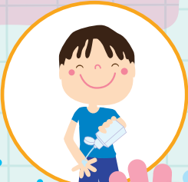
Q7 Can you think of some other health tips for yourselves, your schoolmates, teachers and family to keep viruses away?

Slide 8
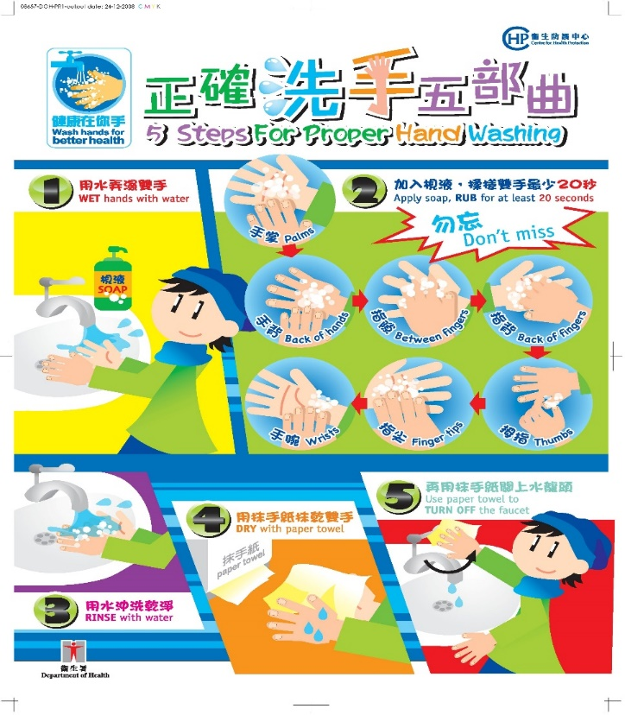
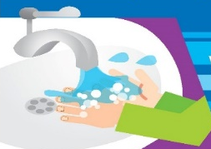

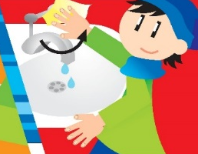


Why are some of the words in the yellow boxes written in CAPITAL LETTERS?
How to wash hands properly
The five pictures show us the steps for proper hand washing.
Put them in the correct order.
Match the pictures with the descriptions in the yellow boxes.
After matching the pictures and putting them in order, write the five steps.
● | ● | ● | ● | ●
● | ● | ● | ● | ●
RINSE with water
DRY with paper towel
Use paper towel to TURN OFF the faucet (and TOUCH the door knob in public washrooms)
Apply soap, RUB for at least 20 seconds
WET hands with water

Slide 9

How to wear a mask properly
How to wear a surgical mask properly?
Watch the video “How to wear a surgical mask properly” (Short version)
(https://www.youtube.com/watch?v=6nmeMq1F50M&feature=youtu.be)
2. Complete the diagram below to list the main points of the video.
1. Where should the metallic strip be placed?
___________
2. Which side of the masks should face outwards?
______________
3. Where should we place the elastic bands of the masks?
__________________
4. “The mask should cover our face as tightly as possible.” Is this correct? Explain your answer.
5. Which parts of our face should the mask fully cover?
a.________, b._________,
c._________
6. What is the last step of wearing a mask in the video?
_____________________
_____________________.

Slide 10
Writing a thank-you card to doctors and nurses
Ms Kwok has shown you a thank-you card she wrote to the Hospital Authority to thank the doctors and nurses for doing their best to help the patients.
You find it very meaningful and you want to write one too.
Dear Doctors and Nurses of Hong Kong,
It has been a tough time for Hong Kong as we are facing the threat of COVID-19. Thank you so much for taking care of the patients and giving them the medical care they need. Your hard work and support have made the patients feel that they are not alone – that’s so important!
I think all of you are heroes! Please have enough rest and stay healthy!
With heartfelt thanks,
Susan Kwok
1. Start your note with a greeting.
2. State what you are thanking them for.
4. Close the card. Expressions which you may use, e.g. “Warm regards”, “Best wishes.”
3. Briefly describe your feelings. You may send them regards here too.
5. Write your name.

Slide 11
Now, write your thank-you card.
Dear Doctors and Nurses of Hong Kong,
_____________________________________________________________
_____________________________________________________________
___________________________________________________________
______________________________________________________
_______________________________________________
______________________________________
______________,

Slide 12
Acknowledgements
Information and images/pictures in this set of slides are taken from the following resources from the Centre for Health Protection:
1. Poster on “Five steps for proper hand washing”
https://www.chp.gov.hk/en/resources/e_health_topics/pdfwav_2886.html
2. Poster on “Prevention of pneumonia and respiratory tract infection””
https://www.chp.gov.hk/files/pdf/pneumonia_respiratory_health_advice_en.pdf
3. Pamphlet on "Hand hygiene"
https://www.chp.gov.hk/files/her/hand_hygiene_pamphlet.pdf
4. Poster on “When to wash our hands”
https://www.chp.gov.hk/en/resources/e_health_topics/pdfwav_2885.html?page=1
5. Video on “How to wear a face mask properly?”
https://www.youtube.com/watch?v=6nmeMq1F50M&feature=youtu.be
More resources are available on the website of the Centre for Health Protection.

Slide 13
Learning about how to keep viruses away (Answers)
Study the following parts of the poster and answer Questions 1-7.
Q1: Which of the following means “perform hand hygiene?” in the first picture?
Use your hands to clean your whole body
Keep your hands clean to prevent disease
Touch your hands
Q2: What should we use to clean our hands with?
Liquid soap and water.
Q3: How long should we rub our hands?
At least 20 seconds.
Picture 1
Picture 2
Picture 3
Picture 4

Slide 14
Learning about how to keep viruses away (Answers)
Q4: Look at Picture 3 and fill in the blanks below.
(a) When we sneeze or cough, we should cover our mouth and nose with tissue paper.
(b) After that, we should wash our hands.
Q5: The advice in this box is missing. Look at the picture. Write a sentence to suggest what people should do if they do not feel well, using information from Picture 4.
We should wear a mask and seek medical advice promptly.
Q6: Adverbs are used to describe how we do something. Find the three adverbs in the poster and complete the table below.
Adverbs | Meaning
(i) frequently | (ii) often
(iii) thoroughly | (iv) completely
(v) promptly | (vi) quickly
Picture 1
Picture 2
Picture 3
Picture 4

Slide 15
(Answers)
Q7 Can you think of other health tips for yourselves, your schoolmates, teachers and family to keep viruses away?
(Any reasonable answers)
Use alcohol-based hand-rubs to clean our hands.
Wash our hands before touching our eyes, nose and mouth.
Cover the toilet seat before flushing.
Wear a surgical mask when we are playing games with friends.
Keep our belongings, e.g. books, stationery and toys clean
…

Slide 16


Why are some of the words in the yellow boxes written in CAPITAL LETTERS?
They are important words.
How to wash hands properly
(Answers)
The five pictures show us the steps for proper hand washing.
Put them in the correct order.
Match the pictures with the descriptions in the yellow boxes.
After matching the pictures and putting them in order, write the five steps.
● | ● | ● | ● | ●
● | ● | ● | ● | ●
RINSE with water
DRY with paper towel
Use paper towel to TURN OFF the faucet (and TOUCH the door knob in public washrooms)
Apply soap, RUB for at least 20 seconds
WET hands with water
Step 1
WET hands with water
Step 2
Apply soap, RUB for at least 20 seconds
Step 3
RINSE with water
Step 4
DRY with paper towel
Step 5
Use paper towel to TURN OFF the faucet (and TOUCH the door knob in public washrooms)

Slide 17
How to wear a mask properly
(Answers)
1. Watch the video “How to wear a surgical mask properly?” (Short version).
(https://www.youtube.com/watch?v=6nmeMq1F50M&feature=youtu.be)
2. Complete the diagram below to list the main points of the video.
How to wear a surgical mask properly?
1. Where should the metallic strip be placed?
Uppermost
2. Which side of the masks should face outwards?
The coloured side
3. Where should we place the elastic bands of the masks?
The elastic bands should be placed around both ears.
4. “The mask should cover our face as tightly as possible.” Is this correct? Explain your answer.
No, it is not. The mask should fit comfortably over our face.
5. Which parts of our face should the mask fully cover?
Mouth, nose and chin
6. What is the last step of wearing a mask in the video?
Mould the metallic strip over the nose bridge.

Slide 18
Writing a thank-you card to doctors and nurses
Ms Kwok has shown you a thank-you card she wrote to the Hospital Authority to thank the doctors and nurses for doing their best to help the patients.
You find it very meaningful and you want to write one too.
Dear Doctors and Nurses of Hong Kong,
It has been a tough time for Hong Kong as we are facing the threat of COVID-19. Thank you so much for taking care of the patients and giving them the support they need. Your care and hard work have made the patients feel that they are not alone – that’s so important!
I think all of you are heroes! Please have enough rest and stay healthy!
With heartfelt thanks,
Susan Kwok
1. Start your note with a greeting.
2. State what you are thanking them for.
4. Close the card. Expressions which you may use, e.g. “Warm regards”, “Best wishes.”
3. Briefly describe your feelings. You may send them regards here too.
5. Write your name.

Slide 19
Write your thank-you card here.
Dear Doctors and Nurses of Hong Kong,
_____________________________________________________________
_____________________________________________________________
___________________________________________________________
______________________________________________________
_______________________________________________
______________________________________
______________,

