Slide 1



Learning and Teaching Resources on English Language
Combatting Misinformation of COVID-19
Developed by English Language Education Section
Curriculum Development Institute
Education Bureau

Slide 2
An Overview of the Learning Task
Learning objectives:
Content
  To develop students’ information literacy skills and guide them to think critically and evaluate the information on the Internet
  To create a visual text to raise awareness of misinformation related to COVID-19
Language
  To understand the features of visual texts
  To use modals (e.g. “can”, “should”, “will”) to make suggestions, express ability, prohibition and future possibility
  To use imperatives to give instructions and express prohibition

Slide 3
How much do you know about the coronavirus disease (COVID-19)?
Let’s take an online quiz on the website of UNICEF: https://www.unicef.org/coronavirus/fact-or-fiction-how-much-do-you-actually-know-about-coronavirus-covid-19
What is your score?
Have you ever been misled by fake news about COVID-19?

Slide 4

A) What do you know about misinformation of COVID-19? Put your answers in the left column of the K-W-L chart on the worksheet.
Part 1 Brainstorming
What do you Know? | What do you Want to Know? | What have you Learnt?

Slide 5
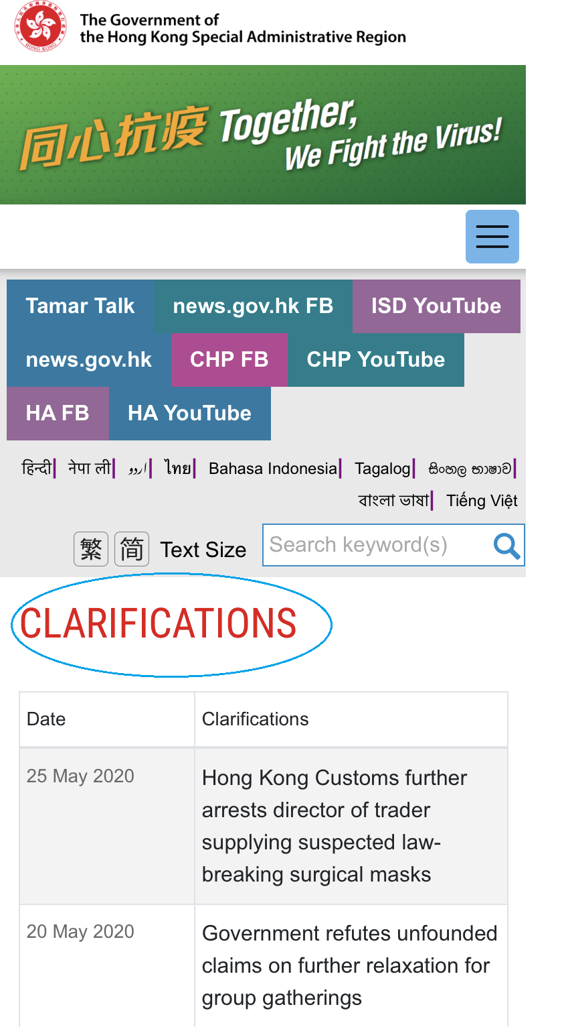
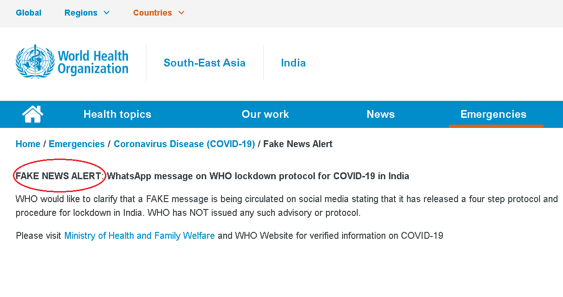
B) Why are these web pages created?
https://www.who.int/india/emergencies/coronavirus-disease-(covid-19)/fake-news-alert
https://www.coronavirus.gov.hk/eng/clarifications.html
( Answers)

Slide 6
Why are these web pages created?
Suggested Answers
These web pages are created because fake news has spread and if it is not clarified, people may be misled and the consequences can be serious or even fatal.

Slide 7

How does fake news spread?
What are the consequences of the spread of fake news?
Part 2
Watch the video clip of Verified on the website of the United Nations: https://news.un.org/en/story/2020/05/1064622.
A) Answer the following questions with the information from
the video clip and your own knowledge.
1. How does fake news spread?
2. Why is the impact of the spread of fake news deadly?
B) What is the key message of this video clip?
From UN launches new initiative to fight COVID-19 misinformation through ‘digital first responders’, by WFP/Sonia Assoue, ©2020 United Nations. Reprinted with the permission of the United Nations.
https://news.un.org/en/story/2020/05/1064622. Date downloaded: 19 June, 2020
( Answers)

Slide 8
A) How does fake news spread?
What are the consequences of the spread of fake news?
Suggested Answers
1. How does fake news spread?
It spreads online (e.g. social media) and through daily communication (e.g. instant messaging, face-to-face interaction).
2. Why is the impact of the spread of fake news deadly?
The spread of fake news is deadly because
i) people may be misled into making wrong decisions which can be life-threatening, such as taking unproven drugs;
ii) fake news spreads at an exponential rate and it is difficult to stop the spread; and
iii) fake news is usually spread among close friends and relatives who are well-trusted and people may not be skeptical about the information being shared.
B)
Fake news, rumours and misinformation spread even faster than the virus.
The impact is deadly.

Slide 9
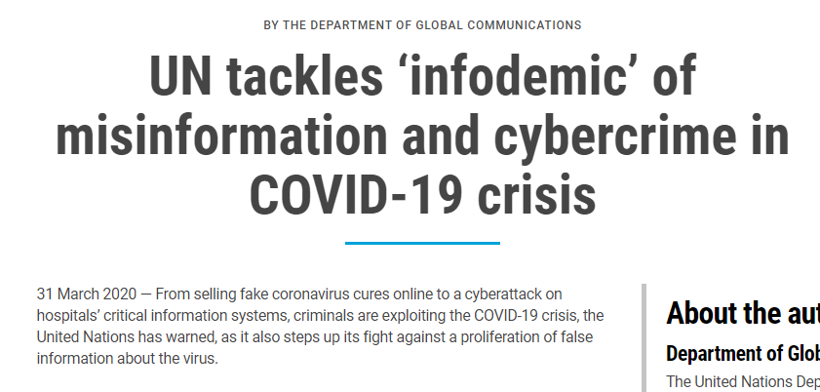
Spread of fake news
C) Scan the following title on the website of the United Nations and identify the word used to describe the spread of misinformation of COVID-19: https://www.un.org/en/un-coronavirus-communications-team/un-tackling-%E2%80%98infodemic%E2%80%99-misinformation-and-cybercrime-covid-19
Which word is used to describe the spread of misinformation of COVID-19?
How is this word formed? How does the formation of the word illustrate the spread of misinformation of COVID-19?
From UN tackles ‘infodemic’ of misinformation and cybercrime in COVID-19 crisis, by the Department of Global Communications, ©2020 United Nations. Reprinted with the permission of the United Nations.
https://www.un.org/en/un-coronavirus-communications-team/un-tackling-%E2%80%98infodemic%E2%80%99-misinformation-and-cybercrime-covid-19. Date downloaded: 19 June, 2020
( Answers)

Slide 10
Spread of fake news
Suggested Answers
The word “infodemic” is used to describe the spread of misinformation of COVID-19.
“Infodemic” is a blended word formed by combining “information” and “pandemic”. COVID-19 is a pandemic, which means a disease that spreads over a whole country or the whole world. The blended word illustrates how misinformation spreads like a pandemic and affects many people in the world.

Slide 11
What do you want to know about misinformation of COVID-19? Put your answers in the middle column of the K-W-L chart on the worksheet.
What do you Know? | What do you Want to Know? | What have you Learnt?

Slide 12


How to differentiate facts from misinformation?
Part 3
Let’s brainstorm some ideas.

Slide 13
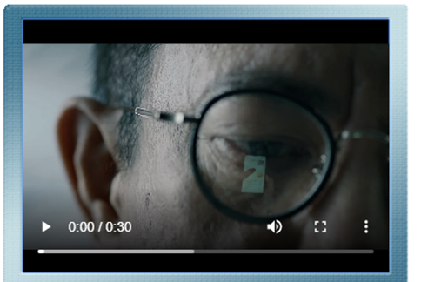
How to differentiate facts from misinformation?
Watch the video clip “Check the facts to keep fake news in check”: https://www.isd.gov.hk/eng/tvapi/19_ms285.html
What are the ways to help us differentiate facts from misinformation?
( Answers)

Slide 14
How to differentiate facts from misinformation?
Suggested Answers
Do you believe everything you read online?
Are you sure it's true?
Does the number of followers guarantee credibility?
On the Internet, anyone can share anything.
What we read might not be true.
So, we need to look more from different angles.
Check facts before jumping to conclusions,
and try not to let emotions sway your judgment.
If fake news goes viral,
it can have severe repercussions.
Check facts to keep fake news in check
Be critical.
Examine the authority of the source. Is it evidence-based? What is the track record of the source?
Are there other sources which show the same information?
Stay calm.
Check facts from the official/reliable websites.
Check whether the images have been edited (e.g. look for similar images and the websites that contain these images).
Do not share information before
we make sure it is accurate!

Slide 15
How to differentiate facts from misinformation?
Six ways to evaluate information: ESCAPE
“E.S.C.A.P.E. Junk News” poster by NewseumEd
https://newseumed.org/sites/default/files/2020-03/Evaluating%20COVID-19%20News.pdf

Slide 16
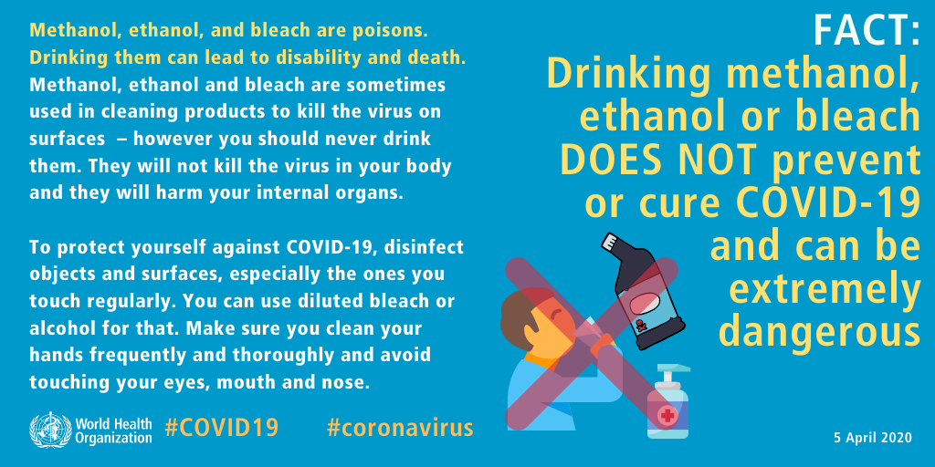
Features of visual texts
Study the features of the following visual texts and complete the table on the worksheet.
Part 4
Visual text 1
Drinking methanol, ethanol or bleach DOES NOT prevent or cure COVID-19 and can be extremely dangerous. Geneva, Switzerland: World Health Organization; 2020. Licence: CC BY-NC-SA 3.0 IGO.
https://www.who.int/emergencies/diseases/novel-coronavirus-2019/advice-for-public/myth-busters

Slide 17
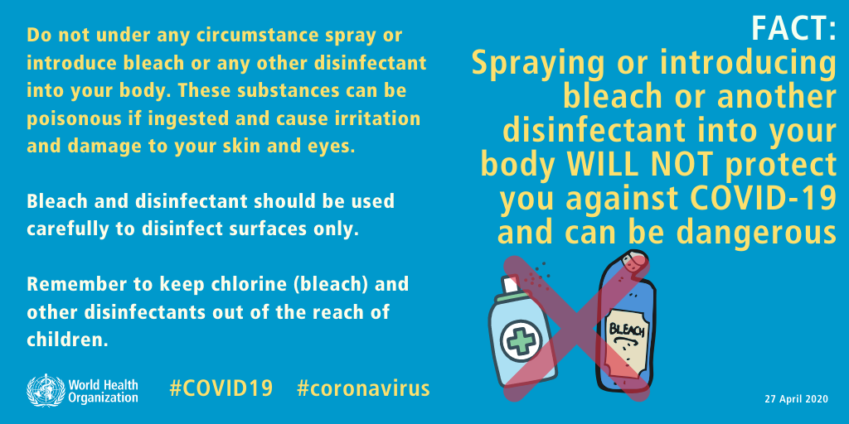
Visual text 2
Spraying or introducing bleach or another disinfectant into your body WILL NOT protect you against COVID-19 and can be dangerous. Geneva, Switzerland: World Health Organization; 2020. Licence: CC BY-NC-SA 3.0 IGO.
https://www.who.int/emergencies/diseases/novel-coronavirus-2019/advice-for-public/myth-busters

Slide 18
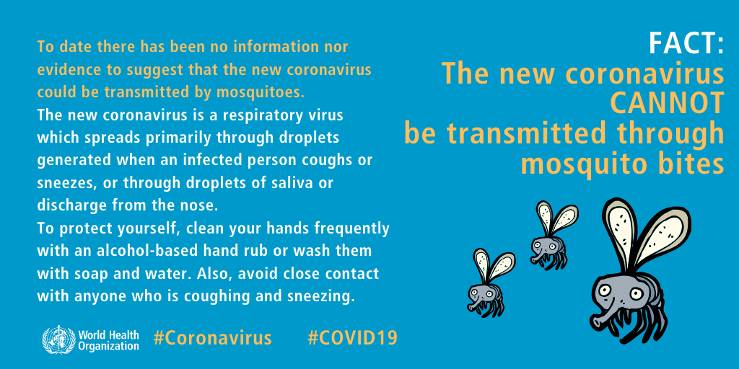
Visual text 3
The new coronavirus CANNOT be transmitted through mosquito bites. Geneva, Switzerland: World Health Organization; 2020. Licence: CC BY-NC-SA 3.0 IGO.
https://www.who.int/emergencies/diseases/novel-coronavirus-2019/advice-for-public/myth-busters

Slide 19
Features of visual texts
 |  | Features (What?) | Purpose (Why?)
1. | Language (e.g. fonts, use of language)
2. | Images (e.g. use of colours, pictures)
3. | Messages (e.g. what the writers want to tell the reader)
( Answers)

Slide 20
Features of visual texts
Suggested Answers
 |  | Features (What?) | Purpose (Why?)
1. | Language (e.g. fonts, use of language) | Use bigger font size and capital letters Use modals Use imperatives Use of hashtags | To draw readers’ attention To make suggestions, and express ability, prohibition and future possibility To give instructions and express prohibition
2. | Images (e.g. use of colours, pictures) | Use different colours and bright colours (yellow) Use pictures | To draw readers’ attention and emphasise key messages To help readers understand the content and grasp the key messages
3. | Messages (e.g. what the writers want to tell the reader) | Clarification of misinformation of COVID-19 Advice about how to keep clean and stay healthy | To warn the readers against believing the misinformation To provide readers with safe suggestions to prevent infection of COVID-19

Slide 21
Creating a visual text (Junior Secondary)
Part 5
You are Chris Wong. Your classmate sent you the following message.
Apply the six ways to evaluate information: ESCAPE to evaluate the reliability of the above message.
!!BREAKING: 5G mobile networks
spread COVID-19!!

Slide 22
Creating a visual text (Junior Secondary)
You find that “5G mobile networks spread COVID-19” is misinformation after checking the facts and decide to create a visual text to debunk the myth. The school will upload the visual text to the school’s website and post it on campus.
The visual text should include the following:
facts related to “5G mobile networks spread COVID-19”;
use of different colours and fonts to help convey the key message;
modals and imperatives; and
image(s)/drawing(s) to illustrate the key message.

Slide 23
Creating two visual texts (Senior Secondary)
Part 5
You are Chris Wong, the Chairperson of the Student Union. The teacher advisor has asked you to research into misinformation about COVID-19. You have to do the following:
identify two pieces of misinformation about COVID-19 by applying the ESCAPE model to evaluate the reliability of the information; and
use appropriate language and features of visual texts in your work
The school will upload the visual texts to the school’s website.

Slide 24
Post-writing self-reflection
Put a ✓ for the item(s) that you can do.
 |  | Yes (✓) | No(✓)
1. | I can search for different types of information from a range of sources.
2. | I can extract and organise information from multiple sources.
3. | I can verify and evaluate the accuracy and reliability of information.
4. | I can integrate, synthesise, summarise, compare and contrast the extracted information.
5. | I can create and present information in different forms, including texts, images, etc.
6. | I can use modals (e.g. “can”, “should”, “will”) to make suggestions, and express ability, prohibition and future possibility.
7. | I can use imperatives to give instructions and express prohibition.

Slide 25
What have you learnt about misinformation of COVID-19? Please put your answers in the right column of the K-W-L chart on the worksheet.
What do you Know? | What do you Want to Know? | What have you Learnt?

Slide 26
Let’s be an effective
and ethical user of
information and IT!

