Slide 1
Collaborative Research & Development
(“Seed”) Project for 2012/2013
Effective Use of Learning and Teaching Resources to Cater for Learner Diversity in the Learning of English at Primary Level
English Language Education Section
Curriculum Development Institute
Education Bureau
Notes:
Thank you for joining the year end sharing today.
Introducing myself and my partner, Grace Wong

Slide 2
Rundown of Today’s Programme
2:00 – 2:10 PM | Registration
2:10 – 2:30 PM | Introduction to the Seed Project – objectives and strategies used
2:30 – 3:30 PM | Sharing on the 1st tryout experience
3:30 – 3:45 PM | Break
3:45 – 4:30 PM | Sharing on the 2nd and 3rd tryout experience
4:30 – 5:00 PM | Way forward Q & A

Slide 3
Objectives of the project (I)
Adopting the framework of differentiated instructions in planning the curriculum and designing learning tasks for KS2 students
Incorporating effective learning and teaching strategies to cater for students’ diverse learning needs and styles
Integrating textbook materials with e-learning and authentic resources to enrich the school-based English Language curriculum
Using effective strategies to provide appropriate scaffolding and challenges to students of different interests and abilities in learning English
Notes:
We all agree that the issue of learner diversity has been a great concern in many schools. The objectives of the seed project is
Develop a curriculum framework by making reference to the framework of differentiated instructions
Explore and incorporate effective Learning and teaching strategies to cater for diverse learning needs and style and to provide appropriate scaffolding and challenges to students
Integrate textbook learning materials with e-learning and authentic resources

Slide 4
Objectives of the project (II)
Developing strategies in giving constructive feedback and designing self-assessment tools
Promoting a collaborative culture and enhancing professional development through co-planning, sharing of tryout experiences and peer lesson observations
Raising students’ motivation and confidence in reading and writing a variety of text types
Enhancing students’ creativity and critical thinking skills through integrated learning tasks
Developing students’ information and reference skills for learning English
Notes:
To promote assessment for learning, we spent time on designing self-assessment tools to help students reflect on their learning and give constructive and quality feedback to help students identify their strengths and weakenesses.
It is hope that a collaborative learning culture can be developed
As for students performance, it is important to raise students’ motivation and confident, enhance their creativity and critical thinking and also the language development strategies.

Slide 5
The framework in planning the curriculum and designing learning tasks
Differentiated Instructions
Content
Process
Product
Use of different texts at a reading level appropriate for each student All students are working towards the same standards and objectives | Differentiating instructions based on students’ learning styles Providing scaffolding for the average and less able students Giving more flexibility and challenges for the more able students | The student product which demonstrates the mastery of the content: tests, evaluations, projects, reports or other activities, e.g. writing, presentation, role-play

Slide 6
Catering for students’ diverse learning needs and styles
Visual
Learn best by seeing
Kinesthetic
Learn best by doing
Auditory
Learn best by hearing

Slide 7
Integrating e-learning resources into the unit plan
Catering for learners’ interest
Motivating resources
Giving immediate feedback
Facilitating understanding
Catering for ability
Promoting learner autonomy

Slide 8
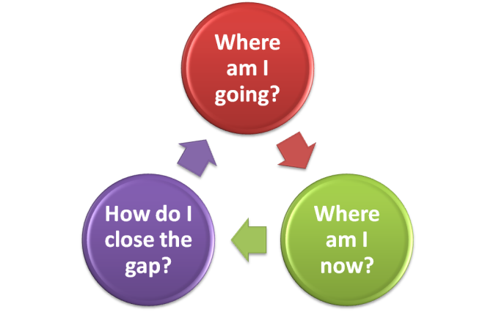
Promoting Assessment for / as learning to help students reflect on their learning
Assessment for Learning
Assessment as Learning
Why assessing?
For teacher’s reference
Identifying learners’ strengths and weaknesses in order to enhance learning and teaching
For students’ reflection
Providing opportunities for students to reflect on their learning e.g. 3-2-1 Summariser, self/peer assessment
Whom to inform?
Mainly learners and teachers
Mainly learners
What to focus?
Providing quality feedback for learners, which entails timely support and enrichment, and helping teachers review the learning objectives, lesson plans and teaching strategies
Developing students’ metacognitive strategies
Providing opportunities for students to take charge of their own learning

Slide 9
Introducing metacognitive strategies to
help students learn effectively
Metacognitive Knowledge
Metacognitive Regulation/ Control Strategies
Memorisation strategies e.g. note-taking, highlighting keywords, paraphrasing, diagramming, sequencing, summarising, using your senses
Elaboration strategies e.g. relating to prior knowledge, integration of knowledge, visualising, making inference, self-questioning, identifying patterns in text types, using reference tools, working with others
Reading tactics e.g. skimming, re-reading, using contextual clues for guessing unknown words
Planning: setting goals and activating relevant background knowledge
Regulation: monitoring and self-testing, e.g. checking the progress, seeking opportunities for practice, arranging conditions that help you learn
Evaluation: assessing how well students have accomplished the task, assessing how well they have used the learning strategies

Slide 10
Timeline and Workflow of the tryouts
1st Tryout
19 Nov
2nd Tryout
25 Feb
3rd Tryout
13 Jun
Sept, 2012
Aug, 2013
E-teaching tryout:
Tryout period: 26/10
To prepare both teachers and students for the use of IT in learning and teaching.
Planning:
1. To identify the learning target
2. To select / design core and extended teaching content
3. To design an overall plan
Evaluation:
Post tryout interview / questionnaires with teachers and students
Implementation:
Questionnaires:
Completed on 5/10
To find out the students’:
1. learning styles
2. e-learning experience
3. learning strategies

Slide 11
Themes and Tasks of the Tryouts
1st Tryout
19 Nov
2nd Tryout
25 Feb
3rd Tryout
13 Jun
Sept, 2012
Aug, 2013
Theme
Language focus
Tasks
A surprise party | Travel advice | Helping others
- Present perfect tense - asking and answering questions | - ‘If’ conditional sentence - giving advice | - Past continuous tense - ‘when’ and ‘while’
Writing about a surprise party | Blog writing | Presentation, Storytelling

Slide 12
1st Tryout: A Surprise Party
Differentiated Instructions
Content
Process
Product
Unit plan
Learning and Teaching Strategies
Teaching the structure of different text types explicitly
Catering for different learning styles
Appropriate scaffolding and greater flexibility for students
Assessment for/as learning
Open-ended
writing task
Learning and Teaching Materials

Slide 13
Unit Plan
Adaptations
adapt course book materials
integrate selected learning and teaching resources
Problems identified in the main writing task:
Not related to the context of the other activities
Not meaningful task
Not authentic
Too mechanical
Adaptations
Keep the theme of the unit, i.e. a surprise party
Create a new writing task

Slide 14
Unit Plan
(Coherence making throughout the learning activities)
A starting point
Choice of materials:
Context: A birthday party for a pet
Motivating
Appropriate level of difficulty
Recycling of the language forms and functions
Choice of materials:
Context: A birthday party for Dad
Having an element of surprise
Motivating
Appropriate level of difficulty
Suitable language forms and functions

Slide 15
Integrating e-learning resources into the unit plan
Self-directed learning
- e-dictionary
- Practices
- Games
Teaching
- e-book
- Websites
(e.g. WLTS, PEERS, One-stop portal)
- Movie clip

Slide 16
Integrating e-learning resources into the unit plan
Learning and teaching (Inside the classroom)
E-book (L3)
forms and functions
main idea
Scrambled sentence (L1)
forms and functions
Surprise (L3)
forms and functions
main idea
Facilitating understanding
Promoting learner autonomy
Motivating resources
Catering for learners’ interest
Giving immediate feedback
Notes:
Let me show you some interesting resources we used and developed.
We designed a sentence making game and a video clip and we make use of the ebook which provided by the developer.
Now, I am going to show you a video on the use of e-resources to teach sentence making.
You can easily find the difference of sentence making game and a task sheet.
You can see it is a motivating resource for the students, they response immediately after receiving the immediate feedback.
Also, they have the autonomy on choosing the level of difficulties.
The students in the video can check answer by themselves and learn from mistakes they made.
This is a movie clip designed by myself using an online program called ‘Zimmerick’ which is very user friendly.
The good point of using movie clip is that I can incorporate the story elements in it.
For a good story, which should implement the problem and solution.
We used different activities to let the students remember the story structure which they can use again in their writing.

Slide 17
Integrating e-learning resources into the unit plan
Self-directed learning activities (Outside the classroom)
Scrambled sentence (L1)
forms and functions
Grammar practice (L2, 4, 5, 7, 8)
forms and functions
Typing practice (L4)
typing conventions
E-dictionary (L5)
spelling
pronunciation
Catering for ability
Motivating resources
Giving immediate feedback
Promoting learner autonomy
Notes:
As I have mentioned, we also used some e-learning tools to facilitate students learning outside classroom
The rationale is that
1.We show them the e-resources, how it works, in the lessons.
2. Teachers monitor the progress to check whether the students did or not.
I guess the online grammar practice is nothing new to you all.
You may wonder why we integrated the typing practice into our plan.
After the e-teaching tryout lesson, we found that the students have a great difficulty on typing.
Therefore, we took this opportunity to teach students on the format of English typing, like the punctuation in a dialogue and the use of spacing.
Since the students learnt the present perfect tense for the very first time.
They had to learn the spelling and the pronunciation of the past participle.
There are many online dictionaries available on the internet.
We actually visited different websites and finally we chose the most suitable one for our students.
For more able students, they were not very interested as they knew the spelling and the pronunciation of words on their own.
For less able and average students, they found it useful and worked on it patiently.
So we found meaningful to look for some useful tools for our students.

Slide 18
Learning and Teaching Strategy:
1. Teaching the structure of different text types explicitly
Longman Express 5A Unit 5
Notes:
18

Slide 19
1st tryout: A surprise party
Reading ⇨ Writing
Direct explanation
Group writing
Modelling
Independent writing
Students worked independently
Guiding students on working in groups
Demonstrating how to write a story using the creative story map
Explaining the storyline
to students
Notes:
This is how we pave the way from reading to the final writing task.
Before students wrote a surprise party, teachers explained the storyline to students.
Teachers then demonstrated how to write a story using the creative story map.
Before students wrote a surprise party, teachers revisited the passages students had previously read.
Teachers guided students to find out the elements of a story line. I would further explain this later.
Then, students work in groups under teachers ‘guidance. Teachers reinforced the teaching of the present perfect tense, past tense and writing dialogues.
Lastly, the students worked independently.

Slide 20
Learning and Teaching Strategy:
2. Catering for different learning styles
Visual
Using graphic organiser
Using pictures / visual aids
Watching video clip
Kinaesthetic
Group Activity
Auditory
Group Discussion
Presentation
Notes:
Another learning and teaching strategy is catering for different learning styles.
We all understand the ways to cater for visual and auditory learners.
This time, our focus is on kinaesthetic learners.
We designed games such as matching/card games to motivate kinesthetic learners

Slide 21
Enhancing students’ participation through
kinesthetic learning activities
Whole class activity:
Matching game
Individual work:
Graphic organiser
Group work: Pelmanism game
Making use of graphic organisers
Vocabulary learning
Understanding the setting of a story

Slide 22
Open-ended Task: Creative story writing about a special party

Slide 23
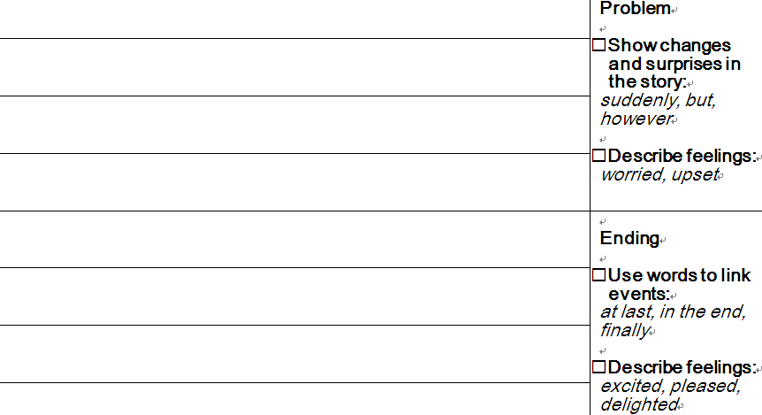
Learning and Teaching Strategy:
3. Appropriate scaffolding and greater flexibility for students
Support to students:
For more able students
Greater learner autonomy
For less able students
Break into steps
Provide prompts
Provide scaffolding
Product
All students achieved the learning objectives / targets
The products varied in breath and depth

Slide 24
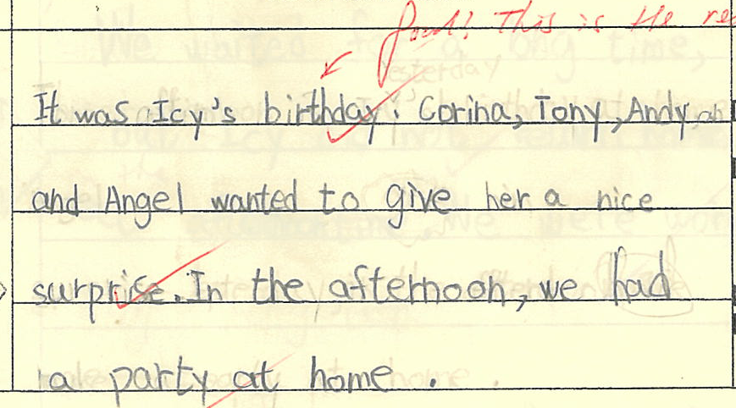
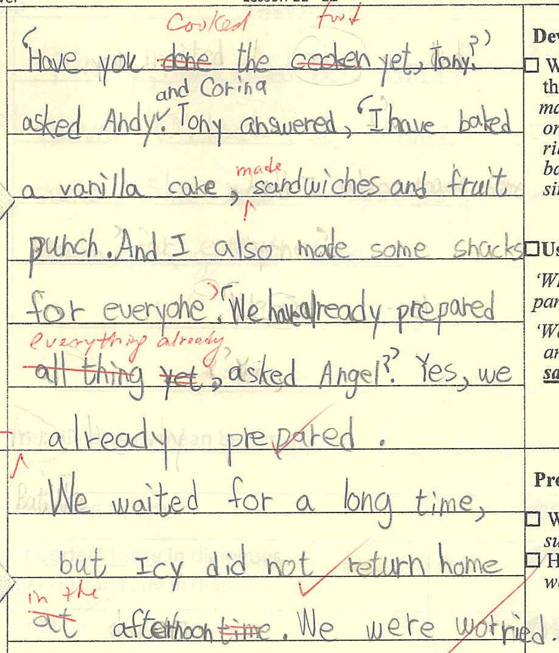
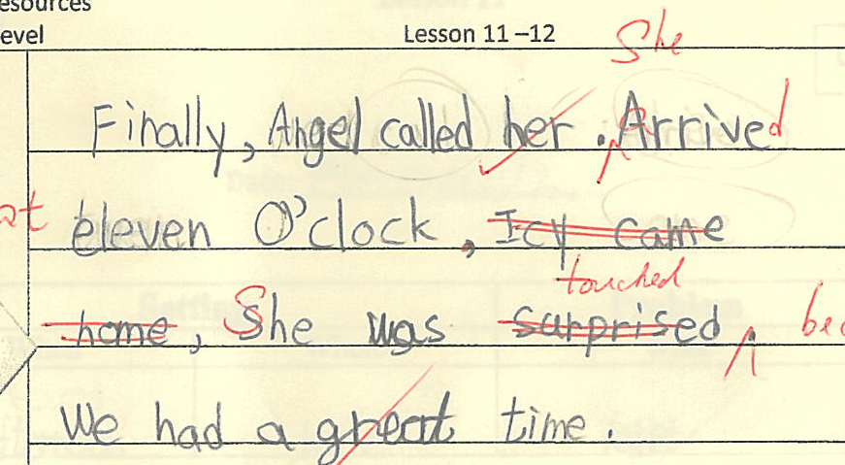
An example of students’ work from 5C
It was Icy’s birthday, Corina, Tony, Andy and Angel wanted to give her a nice surprise. In the afternoon, we had a party at home.
‘Have you cooked the food yet, Tony?’ asked Andy and Corina. Tony answered, ‘I have baked a vanilla cake, made sandwiches and fruit punch. And I also made some snacks for everyone.’ ‘Has everything already been prepared?’ asked Angel. ‘Yes, we have already prepared everything.’
We waited for a long time, but Icy did not return home in the afternoon. We were worried. Finally, Angel called her. When she arrived at eleven o’clock, she was touched because she had a surprise party. They had a great time.
Students are able to…
write with an appropriate story structure that comprises setting, characters, problems, events and solution
use dialogues in writing
use the present perfect tense appropriately
use reporting words
use words to link the events
use adjectives to describe feelings
show changes and surprises in the story

Slide 25
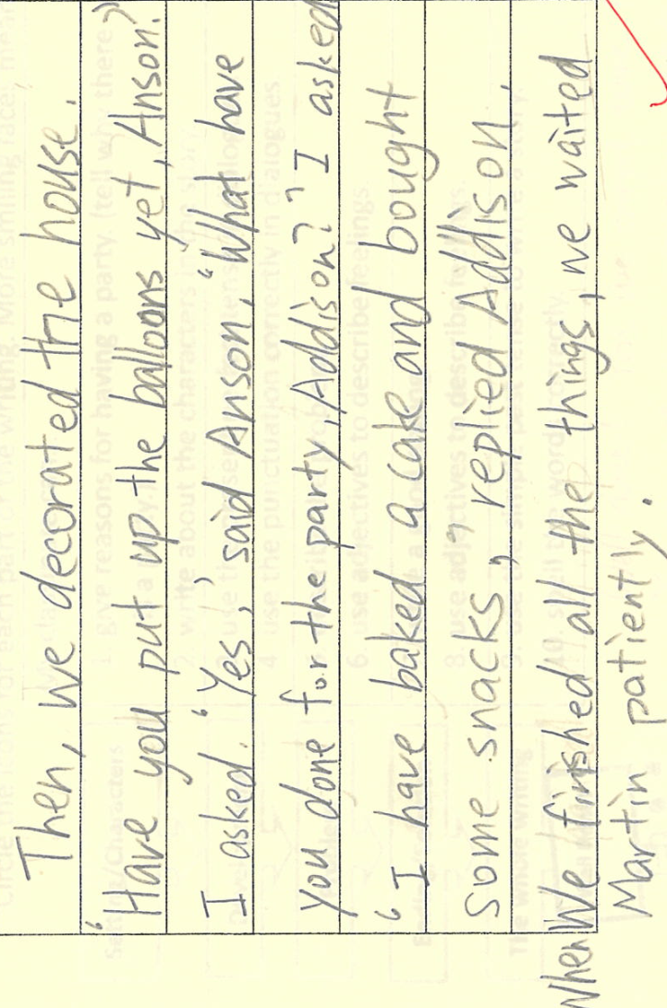
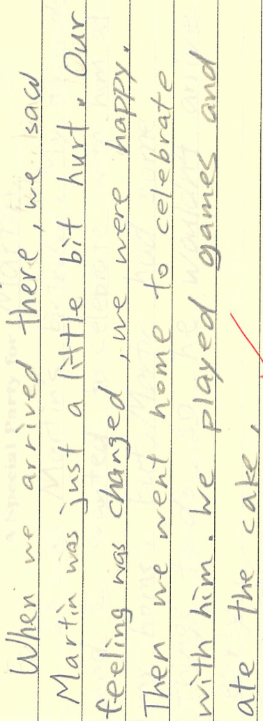
An example of students’ work from 5A
It was Martin’s birthday. My friends and I wanted to celebrate with him at my home. But Martin had something to do, so he wouldn’t arrive early.
Then, we decorated the house. ‘ Have you put up the balloons yet, Anson?’ I asked. ‘Yes,’ said Anson. ‘What have you done for the party, Addison?’ I asked. ‘I have baked a cake and bought some snacks,’ replied Addison. We finished all the things and waited for Martin patiently.
Suddenly, my phone rang. We went to the hospital quickly because Martin was in the hospital. He had a car accident. We were sad and worried about the party.
When we arrived there, we saw Martin was a just a little bit hurt. Our feelings changed, we were happy. Then, we went home to celebrate with him. We played games and ate the cake.
Students are able to…
present main and supporting ideas and wherever appropriate
Elaborate own ideas with more detailed descriptions
write with creative ideas
use cohesive devices
use different language patterns

Slide 26
Learning and Teaching Strategy:
4. Assessment for/as learning
Formative assessment (after lesson 5)
Group work:
Giving feedback / Peer assessment
(Lesson 10)
Role of teacher: | Role of students:
- Effective use of assessment data to evaluate students’ learning | - Making reflection on their own learning, especially the target language structure
Give one suggestion:

Slide 27
Learning and Teaching Strategy:
4. Assessment for/as learning
Individual work:
Giving feedback / Peer assessment (Lesson 12)
Role of teacher: | Role of students:
Identifying students’ strengths and weaknesses Providing constructive feedback | Making reflection on their own learning, especially the writing skills Making improvement based on feedback from teachers and peers
Notes:
The peer assessment can also develop students’ writing skills.
Teachers were no longer only focus on the grammar accuracy.
Teachers gave constructive feedback on the context, ideas, and story development.
Students can make improvement based on the feedback from teachers and peers.

Slide 28
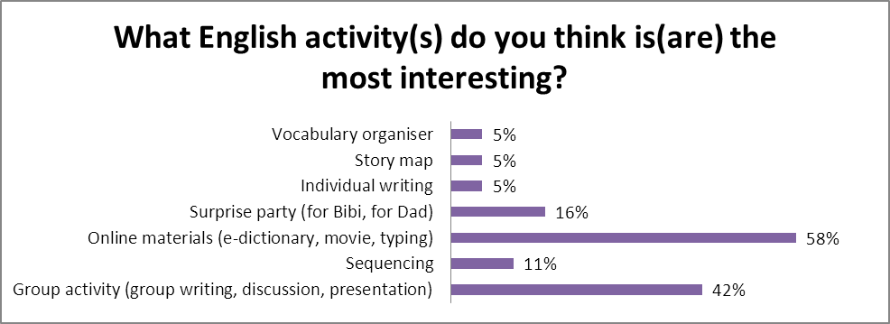
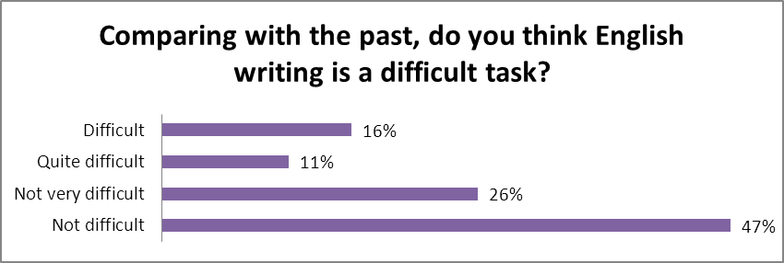
Students’ Feedback

Slide 29
Teachers’ Feedback
Unit Plan | Learning and Teaching Effectiveness
the lessons are coherent with a progressive development of language and writing skills | the writing task can develop the students’ creativity through the story reading and group discussion, students can generate more ideas and have more confidence to finish their individual writing
Learning and Teaching Materials | Areas for improvement
it is worthwhile to use e-learning materials as students are more motivated | the vocabulary building needs to be further developed and consolidated peer assessment is worth doing, it was quite demanding for students to proof-read the whole authentic text

Slide 30
2nd Tryout: Travel Advice
Differentiated Instructions
Content
Process
Product
Unit plan
Learning and Teaching Strategies
Teaching the structure of different text types explicitly
Catering for different learning styles
Appropriate scaffolding and greater flexibility for students
Assessment for/as learning
Open-ended
writing task
Learning and Teaching Materials
Notes:
In February, we had our second round of tryout.
The topic we chose is travel advice from Longman Express Book 5B
As mentioned, we adopted the differentiated instructions framework into our currculum planning.
I will only focus on a few significant areas in the 2nd tryout, like unit plan and open ended task design.

Slide 31
Unit Plan
Problems identified
Reading text: unfamiliar context (a story about alien’s travel experience to the earth)
Main writing task is too easy for Primary 5 students
Adaptations
Reading text: Replaced by a poster on Taiwan Cycling tour
Integrate selected learning and teaching resources with the textbook materials
Main task: Blog writing

Slide 32
Learning and Teaching Strategy:
1. Teaching the structure of different text types explicitly
Theme: Travel advice
Introducing the text type features of a poster
Providing steps for students to read a poster, e.g. looking at the pictures and captions and reading the title to understand the gist, reading the, headings, and sub headings to find out the relevant information
Helping students to analyse the text type features of a blog writing

Slide 33
Unit Plan
2nd tryout: Travel advice
Reading ⇨ Writing
Input
Group writing
Modelling
Independent writing
Students worked independently
Guiding students to generate ideas and work in groups
Introducing the text type features of a blog
Using jigsaw reading to help students understand the cycling tour

Slide 34
Jigsaw Reading
Varying the content to be covered:
The reading passages were simplified by reducing the complexity and adding more contextual clues to them.
Jigsaw reading:
promoting peer learning.
Providing more input for students to complete the final task

Slide 35
Learning and Strategy:
2. Catering for different learning styles
Students are practicing the target language forms through playing the board games. Students work cooperatively and attentively. This activity traces them to the final task.
Designing open-ended task using the RAFT model
Role | A member of the cycling tour
Audience | Parents or friends of the participants
Format | A blog
Topic | More able broke … missed … lost … bad weather… | Average lost… broke… | Remedial bad weather …

Slide 36
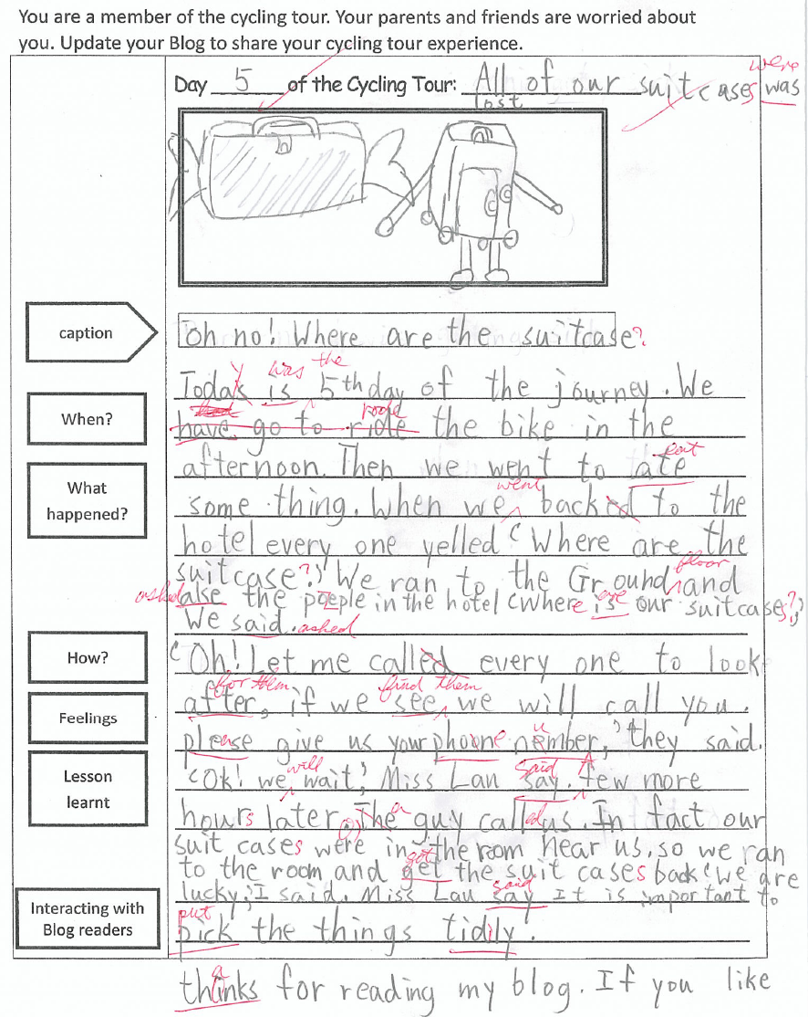
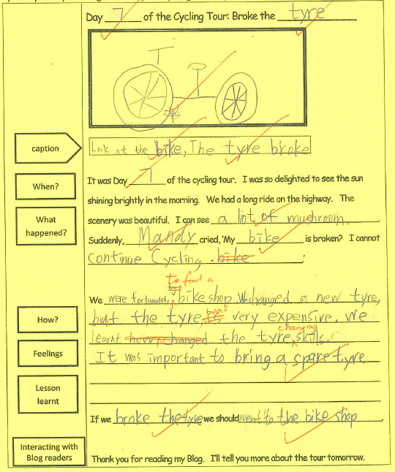
Open-ended Task
For less able students
Day 5 of the Cycling Tour: All our suitcases were lost
Oh no! Where are the suitcases?
Today was the 5th day of the journey. We rode the bike in the afternoon. Then we went to had eat something. When we went back to the hotel, everyone yelled, ‘Where are the suitcases?’ We ran to the ground floor and asked the people in the hotel, ‘Where are out suitcases, ‘ we asked.
‘Oh! Let me call everyone to look for them, if we find them, we will call you. Please give us your phone number,’ they said. ‘Ok! We will wait,’ Miss Lau said. A few more hours later, a guy called us. In fact our suitcases were in the room near us, so we ran to the room and got them back. We were lucky,’ I said. Miss Lau said it was important to put the things tidily.
Thanks for reading my blog. If you like, you can leave me comments.
Provide prompts
More support
Fewer variety of topics
For more able students
Greater learner autonomy
Less support
More variety of topics
Group Work
Individual Work
Look at the bike, The tyre broke
It was Day 7 of the cycling tour. I was so delighted to see the sun shining brightly in the morning. We had a long ride on the highway. The scenery was beautiful. I can see a lot of mushrooms. Suddenly, Mandy cried, ‘My bike is broken! I cannot continue cycling.’
We were fortunately to find a bike shop. We changed a new tyre but it was very expensive. We learnt the tyre changing skills. it was important to bring a spare tyre.
If we broke the tyre we should went to the bike shop.
Thank you for reading my Blog. I’ll tell you more about the tour tomorrow.

Slide 37
Extension activity: e-learning at Easter holiday
1. Assigning holiday homework through the blog
Online reading and
summarising the story
Providing a platform for teachers and students to communicate in English outside the classroom.
Providing an opportunity to read in an authentic situation and share their own experiences / feelings.
2. Sharing daily life experiences
3. Publishing students’ good work
A platform for sharing the class work and celebrating success.

Slide 38
Students’ Feedback
It is helpful to learn the features of different text types
The online resources and the blog are interesting and useful

Slide 39
Teachers’ Feedback
Learning and teaching effectiveness: Students have a steady improvement in writing
Peer assessment: Students are more familiar with the peer assessment which helps students evaluate their own learning
Suggestions:
1. Designing interesting speaking tasks
2. Introducing speaking strategies to improve students presentation skills

Slide 40
3rd Tryout: Helping Others
Differentiated Instructions
Content
Process
Product
Unit plan
Learning and Teaching Strategies
Teaching the structure of different text types explicitly
Catering for different learning styles
Appropriate scaffolding and greater flexibility for students
Assessment for/as learning
Presentation
Role play / Storytelling
Learning and Teaching Materials

Slide 41
Unit Plan
3rd tryout: Helping others
Listening ⇨ Speaking
Lead in
Guided Practice
Modelling
Group work
Students worked collaboratively to tell a story
Guiding students to use notes taken to retell the story
Making use of mind map to generate ideas,
Demonstrating and explaining what note-taking is
Using connectors to organise a story
Introducing the use of online resources to help students generate ideas in a speaking task

Slide 42
Impact on students
Learning attitude
more motivated to learn English because of the interesting topics and resources, as well as the meaningful tasks
Learning outcome
using the target language forms and functions in writing and speaking tasks
Language development strategies
making use of graphic organisers in vocabulary learning and writing
more positive attitudes towards English writing and speaking activities
using the story map that comprises the 5 elements to write and present a story
making use of framework/structures to generate and organise ideas
making use of e-learning resources both inside and outside the classroom
Having greater awareness of using different learning strategies, e.g. note-taking, high-lighting keywords

Slide 43
Impact on teachers
Unit Plan
Making a clear connection between pre-tasks and the main task
L&T resources
Integrating different resources into the lessons
L&T effectiveness
Assessment for learning
Designing task specific assessment rubrics
Introducing learning strategies explicitly to students
Making use of the e-resources and tools in the L&T process
Reinforcing peer assessment through modelling and constructive feedback
Stretching the ability of the more able students
Helping the less able students achieve the learning objectives

Slide 44
Way forward
Teachers
Forming teacher network to facilitate professional development
Sharing teaching resources among schools of similar needs
Students
Helping students to reflect on their learning through self/peer assessment
Helping students to develop metacognitive learning strategies
Curriculum
Further enhancing the materials development at KS2
Exploring strategies to cater for learner diversity at KS1

Slide 45
Networking activities in Year 2013-14
Mar 2014
Networking activity 2: Professional sharing on school-based materials developed by Network schools
Dec 2013
Networking activity 1: Professional sharing on tryout materials
Oct 2013
Workshop on Using Differentiated Instruction to Cater for Learner Diversity in the English Classroom

