Slide 1



Learning and Teaching Materials on
“SOW Inspiring”
Book Gifting Competition
Secondary Level

Slide 2
01
What is “SOW Inspiring” Book Gifting Competition?
CONTENTS
02
Why gift books to someone dear to you?
03
Who to gift your book to and how can it resonate with and inspire him/her?
04
How to generate ideas for the book-gifting message?
05
How to polish your language to enhance your message?
06
What to pay attention to when creating the 2D artwork?

Slide 3
01
What is “SOW Inspiring” Book Gifting Competition?
In the “SOW Inspiring” Book Gifting Competition organised under the campaign on “Promoting Positive Values and Attitudes through English Sayings of Wisdom 2024/25” (SOW Campaign 2024/25), students are to present a book of their choice as a gift to someone dear to them by writing a message with a saying of wisdom (SOW) taken from the book and creating a piece of two-dimensional (2D) artwork to enhance conveyance of meaning and visual representation of the message.

Slide 4



01
What is “SOW Inspiring” Book Gifting Competition?
Each entry should include:
A saying of wisdom (SOW) taken from the book that echoes the overarching theme and/or the four sub-themes
The reason(s) why the book is chosen for the recipient(s), how the book has inspired you and how it will resonate with and inspire him/her/them
A photo or a piece of two-dimensional (2D) artwork that represents and enhances the message

Slide 5
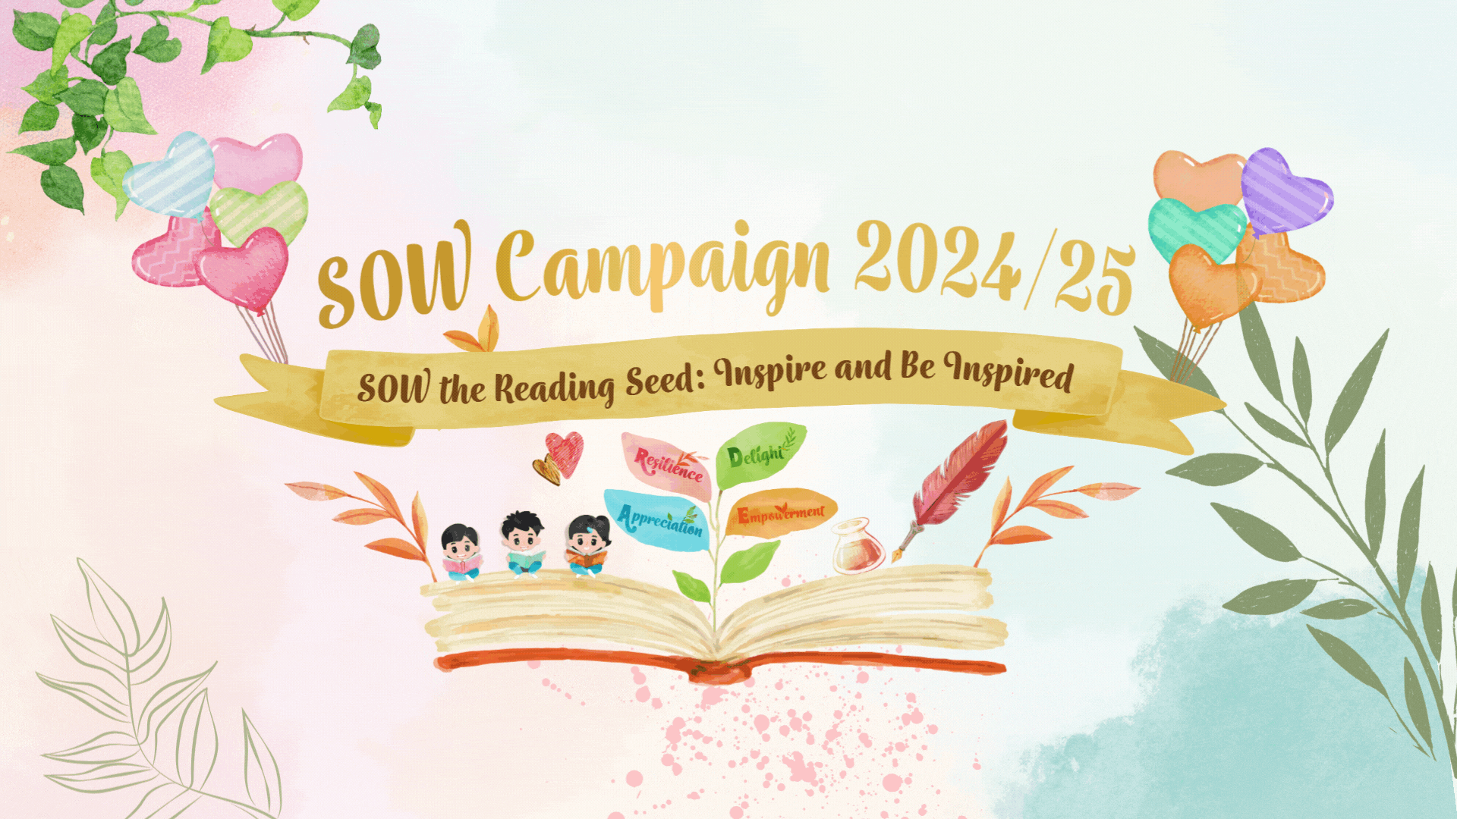
Overarching Theme and Sub-themes
Overarching
theme
“What
Makes us
Different
？”
Sub-themes
Resilience
Empowerment
Appreciation
Delight

Slide 6

Book-gifting Message to Someone Dear to You
Word limit
Junior Secondary Division (Secondary 1 – 3):
180-250 words
Senior Secondary Division (Secondary 4 – 6):
230-300 words

Slide 7
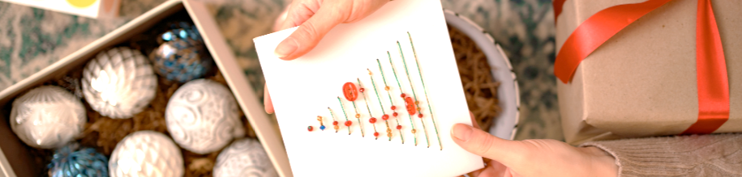
2D Artwork that Represents and Enhances the Message
A4 size (max)
hand-drawn / digitalised
(e.g. photos, computer graphics)
No copyrighted or patented materials should be included

Slide 8



02
Why gift books to someone dear to you?
Personal Connection
Intellectual Stimulation
Emotional Impact
WHAT MAKES US DIFFERENT ?
We have may PowerPoint templates that has been specifically designed to help anyone that is stepping into the world of PowerPoint for the very first time.
Books can serve as a window into interests, passions and experiences. You can create a deeper connection and a shared experience with your loved ones through a book you handpick for them.
Books are a gateway that leads us to new knowledge and new perspectives. Gifting a book can inspire the personal growth and development of your loved ones.
Books are like trusted companions that can offer congratulations and celebration for achievements (e.g. graduation, retirement, success) and provide comfort and encouragement during difficult times (e.g. bereavement, life transition, addiction, illness).

Slide 9
03
Who to gift your book to and how can it inspire him/her?
Identify someone dear to your heart
Identify a book you have read
Who do you know is experiencing
a change/difficulties/
achievements in his/her life right now?
Which book echoes the overarching theme and/or sub-themes and could possibly resonate with and inspire him/her?

Slide 10
Identify someone dear to your heart
Examples
Recipient(s) | Situation facing him/her/them
My father | He has been practising for marathon and wants to break through a running plateau.
My uncle and aunt | They will soon kick off their retirement by travelling by themselves for the first time.
A newly-arrived Non-Chinese speaking (NCS) student | She has just arrived in Hong Kong and joined your school in this school year. She wants to know more about Hong Kong and Chinese culture.
My best friend | He struggles with studies and some academic subjects are a challenge for him. He sees himself as a slow learner and lacks confidence.
My class teacher | She has been teaching my class for three years and is about to see us graduate.
My sister | She has been selected for an international exchange programme and will take part in the Youth Leadership Summit to meet young leaders from different countries.
My cousin | He is suffering from Internet addiction and feels frustrated because he does not know how to unplug from social media and online gaming.

Slide 11

Identify a book you have read
After identifying the recipient(s), think of a book that can inspire him/her/them and a SOW taken from the book that can leave a lasting impact on him/her/them while echoing the overarching theme and/or sub-themes.
Example 1
Recipient | A book that can inspire him/her/them | A SOW from the book that can leave a lasting impact on him/her/them | Overarching theme and/or sub-theme
My father, who has been practising for marathon and wants to break through a running plateau | What I Talk About When I Talk About Running - Haruki Murakami | “In long-distance running the only opponent you have to beat is yourself, the way you used to be.” | Resilience

Slide 12

Identify a book you have read
After identifying the recipient(s), think of a book that can inspire him/her/them and a SOW taken from the book that can leave a lasting impact on him/her/them while echoing the overarching theme and/or sub-themes.
Example 2
Recipients | A book that can inspire him/her/them | A SOW from the book that can leave a lasting impact on him/her/them | Overarching theme and/or sub-theme
My uncle and aunt, who will soon kick off their retirement by travelling the world by themselves for the first time | Around the World in Eighty Days - Jules Verne | “I see that it is by no means useless to travel, if a man wants to see something new.” | Delight

Slide 13

Identify a book you have read
After identifying the recipient(s), think of a book that can inspire him/her/them and a SOW taken from the book that can leave a lasting impact on him/her/them while echoing the overarching theme and/or sub-themes.
Example 3
Recipient | A book that can inspire him/her/them | A SOW from the book that can leave a lasting impact on him/her/them | Overarching theme and/or sub-theme
My sister, who has been selected for an international exchange programme and will take part in the Youth Leadership Summit to meet young leaders from different countries | How to Win Friends and Influence People - Dale Carnegie | "All men have fears, but the brave put down their fears and go forward.” | Empowerment

Slide 14

04
How to generate ideas for the book-gifting message?
After identifying the recipient(s), the book and a SOW from the book, you may follow these steps to generate ideas and express your love, care and support.
1
Expressing your feelings about what the recipient(s) is/are experiencing
2
Explaining how the book may resonate with and inspire the recipient(s)
3
Offering encouragement and well-wishes for the recipient(s)
  What has happened to the recipient(s)?
  How do you feel?
  What is the book about and what impact would it have on the recipient(s)?
  Which SOW from the book would leave a lasting impact on the recipient(s)?
  What words of encouragement do you have for the recipient(s)?
  What wishes do/does the recipient(s) need most at this moment?

Slide 15
Sample 1
Dad,
I know the last few months of training for your first marathon have been a rollercoaster ride. The long runs, the early mornings, the sweats and pains – it's not been easy. I know there have been moments of frustration especially when you've hit that stubborn running plateau and wondered if you could really push through. But through it all, I've been in awe of your unwavering dedication and determination. You haven't let anything stand in your way, and the resilience you display inspires me every single day.
It reminds me of a line Haruki Murakami wrote in his book What I Talk About When I Talk About Running: "In long-distance running the only opponent you have to beat is yourself, the way you used to be." Those words really resonate with me, and I think they may resonate with you too. As an avid runner himself, Murakami understands the journey you're on - the battle to surpass your own previous limitations and unlock your full potential.
I hope that in these pages, you'll find solace, wisdom, and a kindred spirit who understands the profound physical and mental challenges of distance running. Murakami's reflections on how running has shaped his life might just provide the breakthrough you've been seeking. Let his insights empower you to keep showing up, keep pushing forward, and keep believing in yourself, no matter how difficult the path ahead may seem.
Dad, you've come so far already. You've embraced the challenges, and shown incredible strength and perseverance. I have no doubt that with your unwavering heart and iron will, you will cross that finish line stronger than ever before. Dad, I wish you the most fulfilling and transformative run of your life. Mom and I will be there cheering you on every step of the way.
With endless pride and love,
Peter
Expressing your feelings about what the recipient(s) is/are experiencing
Explaining how the book may resonate with and inspire the recipient(s)
Offering encouragement and well-wishes for the recipient(s)

Slide 16
Sample 2
Dear Uncle Ben and Aunt May,
As you two embark on the grand adventure of retirement, I can't help but feel a profound sense of excitement and admiration. After years of dedicated service in the family business, you've more than earned this opportunity to explore the world unencumbered. The thought of you setting off on new journeys, immersing yourselves in diverse cultures, and creating memories that last a lifetime fills me with pure delight.
This is why I've chosen to gift you the classic Jules Verne novel, Around The World In Eighty Days. This book is a timeless celebration of the joy of exploration, of discovering the unfamiliar, and of letting serendipity guide your path. The protagonist's famous words, "I see that it is by no means useless to travel, if a man wants to see something new," capture the very essence of what lies ahead for you. As you lose yourselves in Phileas Fogg's whirlwind race against the clock, I hope you'll be inspired to do the same – to throw caution to the wind, to savour every new sight, and to relish every new rhythm of life. But remember to take your time and don’t do it fast and furious like Phileas.
May this book be the spark that ignites your wanderlust and emboldens you to embrace every adventure that comes your way. I wish you both the most wonderful retirement filled with infinite delights, unforgettable moments, and the freedom to follow your hearts wherever they may lead. Bon voyage, and don't forget to send postcards!
All my love,
Peter
Expressing your feelings about what the recipient(s) is/are experiencing
Explaining how the book may resonate with and inspire the recipient(s)
Offering encouragement and well-wishes for the recipient(s)

Slide 17
04
How to generate ideas for the book-gifting message?
Sample 1
I know the last few months of training for your first marathon have been a rollercoaster ride. The long runs, the early mornings, the sweats and pains – it's not been easy. I know there have been moments of frustration especially when you've hit that stubborn running plateau and wondered if you could really push through. But through it all, I've been in awe of your unwavering dedication and determination. You haven't let anything stand in your way, and the resilience you display inspires me every single day.
1
  Expressing your feelings about what the recipient(s) is/are experiencing
  What has happened to the recipient(s)?
  How do you feel?
Sample 2
As you two embark on the grand adventure of retirement, I can't help but feel a profound sense of excitement and admiration. After years of dedicated service in the family business, you've more than earned this opportunity to explore the world unencumbered. The thought of you setting off on new journeys, immersing yourselves in diverse cultures, and creating memories that last a lifetime fills me with pure delight.

Slide 18
04
How to generate ideas for the book-gifting message?
Sample 1
Sample 2
It reminds me of a line Haruki Murakami wrote in his book What I Talk About When I Talk About Running: "In long-distance running the only opponent you have to beat is yourself, the way you used to be." Those words really resonate with me, and I think they may resonate with you too. As an avid runner himself, Murakami understands the journey you're on - the battle to surpass your own previous limitations and unlock your full potential.
I hope that in these pages, you'll find solace, wisdom, and a kindred spirit who understands the profound physical and mental challenges of distance running. Murakami's reflections on how running has shaped his life might just provide the breakthrough you've been seeking. Let his insights empower you to keep showing up, keep pushing forward, and keep believing in yourself, no matter how difficult the path ahead may seem.
This is why I've chosen to gift you the classic Jules Verne novel, Around The World In Eighty Days. This book is a timeless celebration of the joy of exploration, of discovering the unfamiliar, and of letting serendipity guide your path. The protagonist's famous words, "I see that it is by no means useless to travel, if a man wants to see something new," capture the very essence of what lies ahead for you. As you lose yourselves in Phileas Fogg's whirlwind race against the clock, I hope you'll be inspired to do the same - to throw caution to the wind, to savour every new sight, and to relish every new rhythm of life. But remember to take your time and don’t do it fast and furious like Phileas.
2
  Explaining how the book may resonate with and inspire the recipient(s)
  What is the book about and what impact it may have on the recipient(s)?
  Which SOW from the book would leave a lasting impact on the recipient(s)?

Slide 19
04
How to generate ideas for the book-gifting message?
Sample 1
Dad, you've come so far already. You've embraced the challenges, and shown incredible strength and perseverance. I have no doubt that with your unwavering heart and iron will, you will cross that finish line stronger than ever before. Dad, I wish you the most fulfilling and transformative run of your life. Mom and I will be there cheering you on every step of the way.
3
Offering encouragement and well-wishes for the recipient(s)
  What words of encouragement do you have for the recipient(s)?
  What wishes do/does the recipient(s) need most at the moment?
Sample 2
May this book be the spark that ignites your wanderlust and emboldens you to embrace every adventure that comes your way. I wish you both the most wonderful retirement filled with infinite delights, unforgettable moments, and the freedom to follow your hearts wherever they may lead. Bon voyage, and don't forget to send postcards!

Slide 20
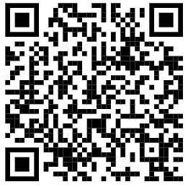
05
How to polish your language to enhance your message?
Creative use of English
enhances the emotional appeal of your message and helps highlight the key features of your book to create an impact. Let's sprinkle a dash of creativity and spice up your writing with the use of literary devices.
Similes & Metaphors
Parallelism &
Repetition
For more tips on the use of literary devices, please watch the following video:
https://emm.edcity.hk/media/1_w6oicivb
Rhyming words
Alliteration

Slide 21


comparing one thing to another explicitly using “like” or “as”
  Effects
Similes
visualising abstract ideas
creating more vivid descriptions
Recipient: | A newly-arrived NCS student who wants to know more about Hong Kong and Chinese culture
Book: | All About China: Stories, Songs, Crafts and Games for Kids by Allison Branscombe
Example: | The book is like a time machine that takes you to travel across different time periods from ancient to modern times to explore the history, customs and rich cultural traditions of China, allowing you to immerse yourself in the wonders of Chinese culture.
Recipient: | My cousin, who suffers from Internet addiction
Book: | Atomic Habits by James Clear
Example: | You may feel that the cyberspace is as irresistible and bottomless as a black hole, constantly pulling you in with alluring distractions and content, but this book assures us that quitting any bad habits, including Internet addiction, is not as difficult as you think. All you need is to follow the steps in the book to develop practical strategies to form good habits and break bad ones.

Slide 22
equating two things based on common/ shared features, using “to be” or direct substitution
  Effects
Metaphors
visualising abstract ideas
creating more vivid descriptions
Recipient: | My class teacher, who has been teaching my class for three years and is about to see us graduate
Book: | Lessons Learned and Cherished: The Teacher Who Changed My Life by Deborah Roberts
Example: | May I present this book to you as a heartfelt tribute and token of thanks, hoping that it will serve as a lasting reminder of the seeds of wisdom you have sowed in our minds. Your class is the fertile ground from which our minds have blossomed and your words of encouragement are the nurturing rain that nourishes our hearts and helps us grow.
Recipient: | My best friend, who struggles with studies and lacks confidence
Book: | Fish in a Tree by Lynda Mullaly Hunt
Example: | I hope the book can awaken the genie within you, empowering you to discover your unique talents, unlock your hidden potential and embrace your boundless possibilities.

Slide 23
parallelism – repeated use of phrasal units and sentence patterns
repetition – repeated use of the same words
often used with the rule of three for emphasis
  Effects
Parallelism & Repetition
enhancing rhythm
creating a sense of pattern and cohesion
adding emphasis to reinforce the message
Recipient: | My sister, who has been selected for an international exchange programme and will take part in the Youth Leadership Summit to meet young leaders from different countries
Book: | How to Win Friends and Influence People by Dale Carnegie
Example: | This timeless guide can enlighten you on how to make new friends, how to increase your influence, and how to create deeper connections, which can surely transform your relationships, your career and your life.
Recipient: | My best friend, who struggles with studies and lacks confidence
Book: | Fish in a Tree by Lynda Mullaly Hunt
Example: | I hope the book can awaken the genie within you, empowering you to discover your unique talents, unlock your hidden potential and embrace your boundless possibilities.

Slide 24
repeated use of initial consonant sounds in nearby words
  Effects
enhancing rhythm
creating more catchy and memorable lines and phrases
Alliteration
Recipient: | A newly-arrived NCS student who wants to know more about Hong Kong and Chinese culture
Book: | All About China: Stories, Songs, Crafts and Games for Kids by Allison Branscombe
Example: | The book opens the door to a cultural cornucopia and a world of wonders
Recipient: | My father, who has been practising for marathon and wants to break through a running plateau
Book: | What I Talk About When I Talk About Running by Haruki Murakami
Example: | I hope Murakami’s captivating chronicle of his running experience can kindle your lifelong love for running and support you on your winding wellness journey.

Slide 25
using words with similar ending sounds
  Effects
Rhyming words
enhancing rhythm and musicality
making the lines more refined and poetic
Recipients: | My uncle and aunt, who will soon kick off their retirement by travelling around the world by themselves
Book: | Around the World in Eighty Days by Jules Vern
Example: | After retirement, you’ll see even more, as the world is yours to explore. May Vern’s classic guides you to roam, and brings unexpected prizes home.
Recipient: | My class teacher, who has been teaching my class for three years and is about to see us graduate
Book: | Lessons Learned and Cherished: The Teacher Who Changed My Life by Deborah Roberts
Example: | As I flip through the book pages, I recall your guidance at different learning stages. Your teaching is a gift I will always treasure. Your inspiration and influence are beyond measure.

Slide 26

05
How to polish your language to enhance your message?
A personal and affectionate tone
helps build connection and evoke emotional resonance with the recipient(s). Let's pour some potions of endearment into your message to make it feel warmer and sweeter.
Here is the fizzing formula of the magic potion for a personal and affectionate tone.
Emotive punctuation
Anecdotes
Inclusive and positive language

Slide 27
05
How to polish your language to enhance your message?
Hey Battle Buddy,
I hope you’re doing well! I’ve been thinking about you a lot lately, and I wanted to reach out because I care about you and your well-being. I know how easy it is to get caught up on the Internet (especially those online role-playing games you never won without teaming up with me!!) — it can really take away the things that truly matter.
Remember all those fun times we had playing outside, food-crawling, and just being silly together? I miss those moments A LOT!! I believe we can create even more amazing memories if we step back from our screens a bit.
Emotive punctuation
Emotive punctuation | Effect
Parenthesis ( ) | To add a side comment or a personal note
Dash – | To create a pause and emphasise a thought
CAPITALISATION | To convey strong feelings

Slide 28
05
How to polish your language to enhance your message?
Hey Battle Buddy,
I hope you’re doing well! I’ve been thinking about you a lot lately, and I wanted to reach out because I care about you and your well-being. I know how easy it is to get caught up on the Internet (especially those online role-playing games you never won without teaming up with me!!)—it can really take away the things that truly matter.
Remember all those fun times we had playing outside, food-crawling, and just being silly together? I miss those moments A LOT!! I believe we can create even more amazing memories if we step back from our screens a bit.
Anecdotes
e.g. funny incidents, inside jokes, shared memories …

Slide 29
05
How to polish your language to enhance your message?
How about we plan some time to hang out, just the two of us? We could go for a hike, watch a movie, or even just grab some snacks and talk about everything and anything. I think it could be a great way to reconnect and enjoy life outside the digital world.
Also, I wanted to recommend a fantastic book called Atomic Habits by James Clear. It offers some great insights on building good habits and breaking free from the ones that hold us back. I think it could really help you as you try to find a better balance with tech.
You’re such a wonderful person, and I know you have so much to offer beyond the screen. Let’s inspire each other to live fully in the moment! What do you think? I’m excited to hear your ideas!
Take care,
Billy
Inclusive and
positive language
i.e. words that show togetherness

Slide 30
05
How to polish your language to enhance your message?
How about we plan some time to hang out, just the two of us? We could go for a hike, watch a movie, or even just grab some snacks and talk about everything and anything. I think it could be a great way to reconnect and enjoy life outside the digital world.
Also, I wanted to recommend a fantastic book called Atomic Habits by James Clear. It offers some great insights on building good habits and breaking free from the ones that hold us back. I think it could really help you as you try to find a better balance with tech.
You’re such a wonderful person, and I know you have so much to offer beyond the screen. Let’s inspire each other to live fully in the moment! What do you think? I’m excited to hear your ideas!
Take care,
Billy
Inclusive and
positive language
i.e. words that show encouragement, acknowledgement and hope

Slide 31
06
What to pay attention to when designing a 2D artwork
The 2D artwork should reflect:
Personalisation
Incorporate a personal message, a shared moment, or a symbolic object or a special reference that makes the artwork feel personal and tailored for the recipient(s).
Thematic alignment
Ensure that the design aligns with the message and the theme of the book you are gifting.
Aesthetics
Consider the personal style and preferences of the recipient(s) when selecting the colours, fonts and overall visual style.

Slide 32

06
What to pay attention to when designing a 2D artwork
The maximum size of the 2D artwork is A4 and only still images are allowed.
Three-dimensional (3D) graphics or animations are not accepted. The visual representations can be:
hand-drawn (in any form, such as poster colour, water colour, crayon, oil pastel and ink);
digitalised (photos or still images of computer graphics); or
a collage or mosaic with an assemblage of various art forms.

Slide 33
06
What to pay attention to when designing a 2D artwork
The artwork must be original. No copyrighted or patented materials are allowed.
While participants are strictly prohibited from using AI tools in writing the book-gifting message, they are allowed to use AI tools in the creation and/or editing of the artwork.

Slide 34

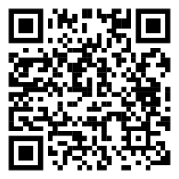
Reminders
Deadline for submission | 6:00 p.m., 31 March 2025 (Monday)
Requirements | Each entry should include: a book-gifting message with a SOW taken from the book that leaves a lasting impact on the recipient(s) and echoes the overarching theme and/or four sub-themes; and a piece of 2D artwork that represents and enhances the message to be delivered to the recipient(s).
For more information about the Competition, please refer to the competition webpage: https://www.edb.gov.hk/BookGifting

Slide 35
A checklist for your submission
Content
Opening: Express your feelings about what the recipient(s) is/are experiencing
  situation facing the recipient(s)
  your feelings
Body: Explain how the book will resonate with and inspire the recipient(s)
  introduction about the book and its inspiration to the recipient(s)
  a SOW from the book that would leave a lasting impact on the recipient(s)
Ending: Offer encouragement and well-wishes for the recipient(s)
  words of encouragement for the recipient(s)
  well-wishes for the recipient(s)
Language
Write with a personal and affectionate tone to build connection and evoke emotional resonance with the recipient(s)
  emotive punctuation
  anecdotes
  inclusive and positive language
Include the creative use of English to enhance the emotional appeal of the message:
  similes and metaphors
  parallelism and repetition
  alliteration
  rhyming words
Visual aids
Include a piece of 2D artwork that reflects:
  personalisation
  thematic alignment
  aesthetics

