Slide 1






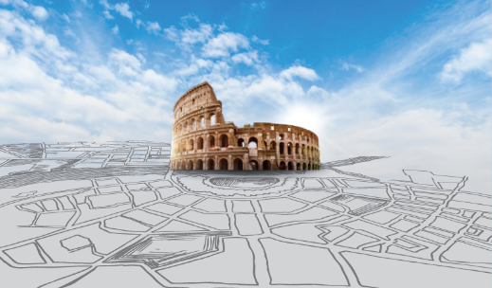




Picture card 1
Picture card 6
SOW 1
SOW 6
Count your blessing.
Every cloud has a silver lining.
Picture card 2
Picture card 7
SOW 2
A friend in need is a friend indeed.
All roads lead to Rome.
SOW 7
Match and Win
How to play:
Pick a picture card and one SOW card.
If the two cards match, keep them.
If the two card don’t match, flip them back.
Picture card 3
Picture card 8
SOW 3
SOW 8
Gratitude turns what we have into enough.
Prevention is better than cure.
Picture card 4
Picture card 9
SOW 4
SOW 9
The early bird catches the worm.
There is light at the end of the tunnel.
Picture card 5
Picture card 10
SOW 5
SOW 10
The grass is always greener on the other side of the fence.
Home is where the heart is.

