Slide 1

English Sayings of Wisdom (SOW)
Set A
English Language Education Section
Curriculum Development Institute
Education Bureau

Slide 2
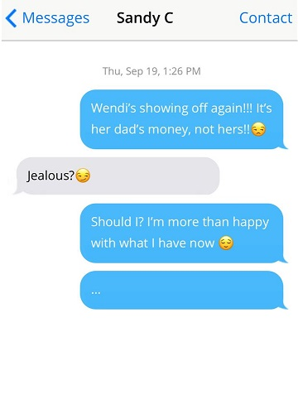



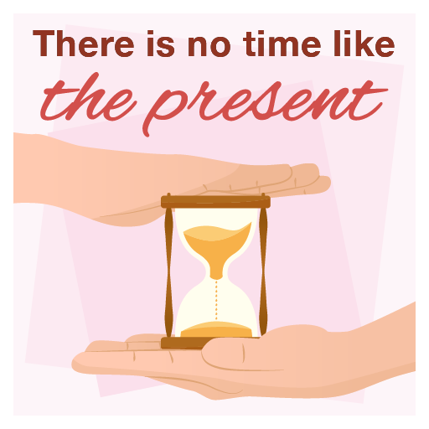

1 out of 20
Show Hints
Hide Hints
1
Being content with what we have will make us emotionally wealthy.
1
2
2
Every difficult or sad situation has a more hopeful side.
3
Time is precious and should not be wasted. The best time to take action is now.
3
4
4
Laughing (a positive outlook) can beat negative emotions during hard times.

Slide 3
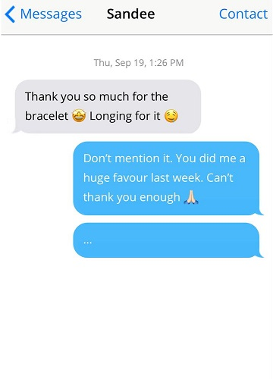



2 out of 20
Show Hints
Hide Hints
1
Being content with what we have will make us emotionally wealthy.
1
2
2
Every difficult or sad situation has a more hopeful side.
3
If someone does you a favour, take the chance to return it.
3
4
4
There are different ways to achieve the same goal.

Slide 4




3 out of 20
Show Hints
Hide Hints
1
It is better to stop something bad from happening than to deal with it after it has happened.
1
2
2
Make good use of an opportunity or a favourable condition while it lasts.
3
Take a chance when it comes because it may not come again after we miss it.
3
4
4
It is important to be thankful for what we have, instead of running after what we don’t.

Slide 5
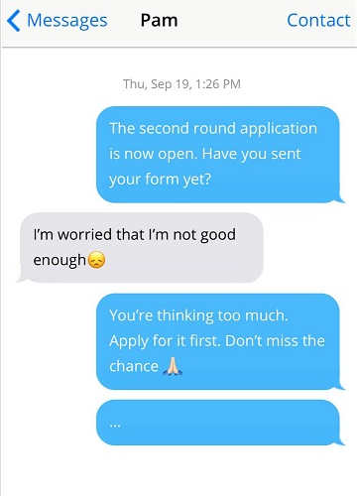


4 out of 20
Show Hints
Hide Hints
1
Home is the place that offers you most emotional comfort, no matter where you are.
1
2
2
Take a chance when it comes because it may not come again after we miss it.
3
Laughing (a positive outlook) can beat negative emotions during hard times.
3
4
4
Being thankful is the quality of a fine and admirable person.

Slide 6
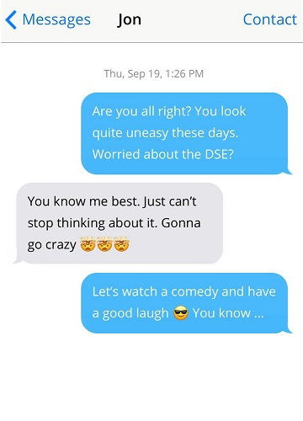

5 out of 20
Show Hints
Hide Hints
1
Success can only be achieved through hard work.
1
2
2
Time is precious and should not be wasted. The best time to take action is now.
3
Laughing (a positive outlook) can beat negative emotions during hard times.
3
4
4
A true friend helps you when you are in trouble or difficulty.

Slide 7
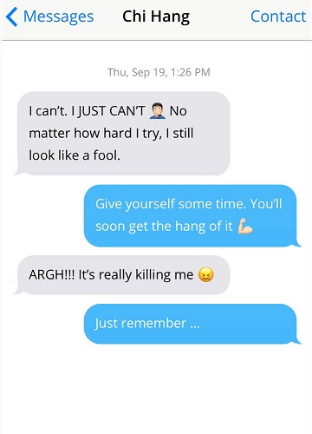

6 out of 20
Show Hints
Hide Hints
1
It takes time and efforts to achieve something great.
1
2
2
There are different ways to achieve the same goal.
3
Home is the place that offers you most emotional comfort, no matter where you are.
3
4
4
If someone does you a favour, take the chance to return it.

Slide 8
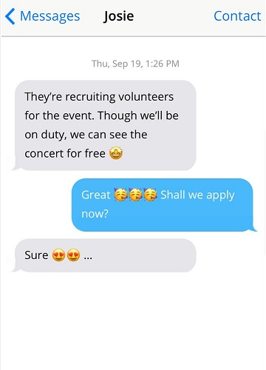

7 out of 20
Show Hints
Hide Hints
1
An unpleasant situation or difficult task will come to an end one day.
1
2
2
Time is precious and should not be wasted. The best time to take action is now.
3
A true friend helps you when you are in trouble or difficulty.
3
4
4
Every difficult or sad situation has a more hopeful side.

Slide 9

8 out of 20
Show Hints
Hide Hints
1
Being content with what we have will make us emotionally wealthy.
1
2
2
Be the first to do something to gain the advantage over others.
3
It is important to be thankful for what we have, instead of running after what we don’t.
3
4
4
There are different ways to achieve the same goal.

Slide 10
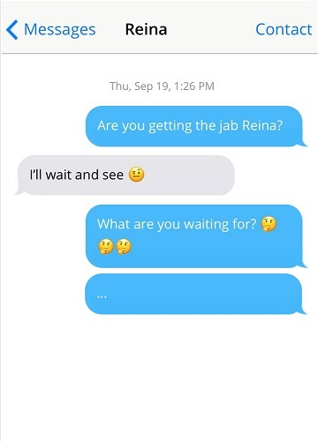


9 out of 20
Show Hints
Hide Hints
1
It is better to stop something bad from happening than to deal with it after it has happened.
1
2
2
Life is precious and should be lived to the fullest.
3
With strong determination, one can find a way to achieve one’s goal against all obstacles.
3
4
4
Laughing (a positive outlook) can beat negative emotions during hard times.

Slide 11
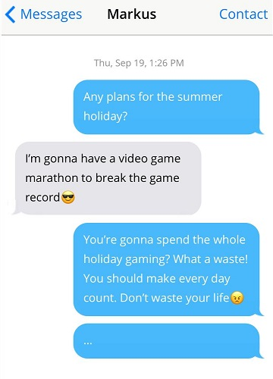
10 out of 20
Show Hints
Hide Hints
1
There are different ways to achieve the same goal.
1
2
2
Life is precious and should be lived to the fullest.
3
Make good use of an opportunity or a favourable condition while it lasts.
3
4
4
Be the first to do something to gain the advantage over others.

Slide 12
End of Set A

