Slide 1

English Sayings of Wisdom (SOW)
Set B
English Language Education Section
Curriculum Development Institute
Education Bureau

Slide 2
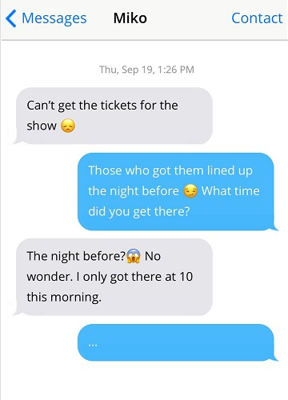



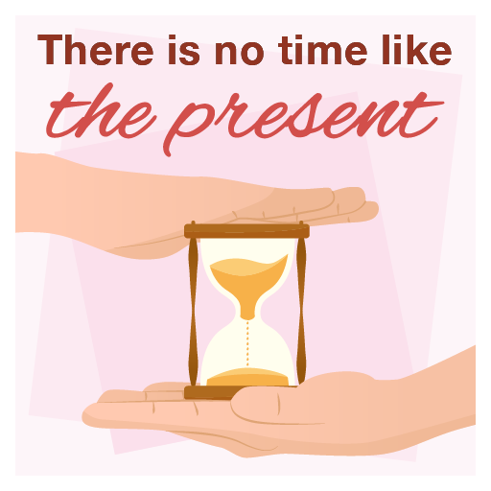

11 out of 20
Show Hints
Hide Hints
1
It is better to stop something bad from happening than to deal with it after it has happened.
1
2
2
An unpleasant situation or difficult task will come to an end one day.
3
Time is precious and should not be wasted. The best time to take action is now.
3
4
4
Be the first to do something to gain the advantage over others.

Slide 3
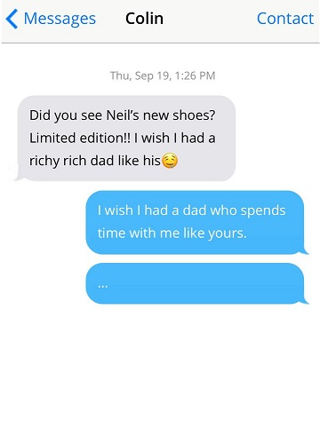



12 out of 20
Show Hints
Hide Hints
1
A true friend helps you when you are in trouble or difficulty.
1
2
2
Appreciate and be thankful for what we have.
3
Home is the place that offers you most emotional comfort, no matter where you are.
3
4
4
Time is precious and should not be wasted. The best time to take action is now.

Slide 4
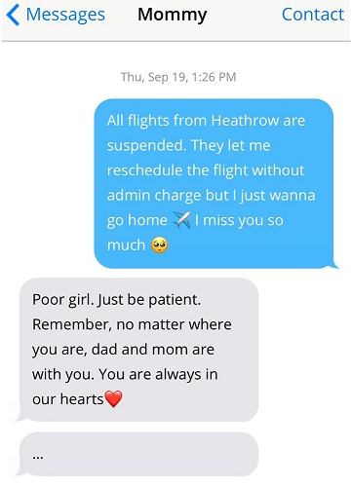



13 out of 20
Show Hints
Hide Hints
1
Home is the place that offers you most emotional comfort, no matter where you are.
1
2
2
Make good use of an opportunity or a favourable condition while it lasts.
3
Being thankful is the quality of a fine and admirable person.
3
4
4
Being content with what we have will make us emotionally wealthy.

Slide 5
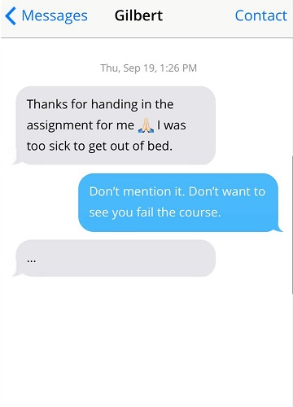

14 out of 20
Show Hints
Hide Hints
1
Make good use of an opportunity or a favourable condition while it lasts.
1
2
2
Be the first to do something to gain the advantage over others.
3
A true friend helps you when you are in trouble or difficulty.
3
4
4
Laughing (a positive outlook) can beat negative emotions during hard times.

Slide 6
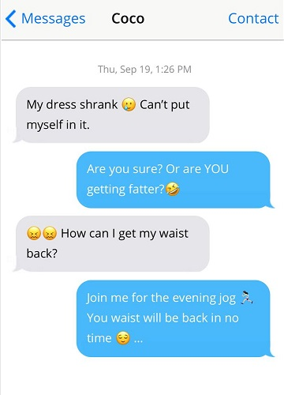


15 out of 20
Show Hints
Hide Hints
1
Success can only be achieved through hard work.
1
2
2
Time is precious and should not be wasted. The best time to take action is now.
3
Every difficult or sad situation has a more hopeful side.
3
4
4
A true friend helps you when you are in trouble or difficulty.

Slide 7
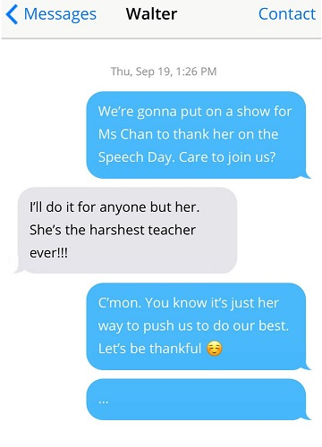

16 out of 20
Show Hints
Hide Hints
1
It takes time and efforts to achieve something great.
1
2
2
Being thankful is the quality of a fine and admirable person.
3
Home is the place that offers you most emotional comfort, no matter where you are.
3
4
4
Appreciate and be thankful for what we have.

Slide 8
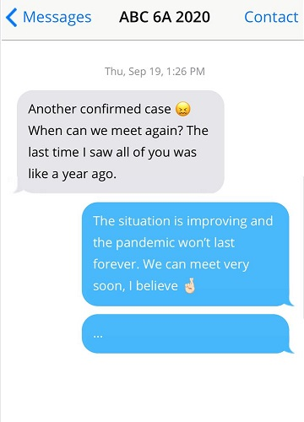
17 out of 20
Show Hints
Hide Hints
1
An unpleasant situation or difficult task will come to an end one day.
1
2
2
Make good use of an opportunity or a favourable condition while it lasts.
3
It is better to stop something bad from happening than to deal with it after it has happened.
3
4
4
Time is precious and should not be wasted. The best time to take action is now.

Slide 9
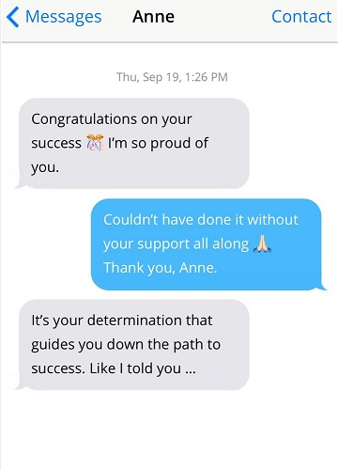
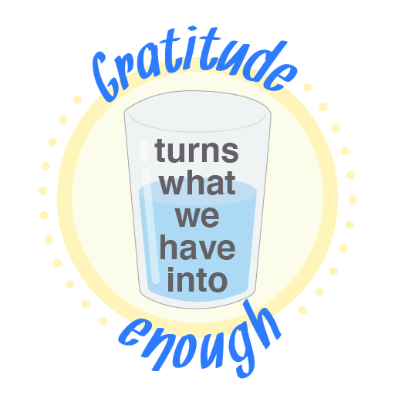

18 out of 20
Show Hints
Hide Hints
1
Being content with what we have will make us emotionally wealthy.
1
2
2
Be the first to do something to gain the advantage over others.
3
It is important to be thankful for what we have, instead of running after what we don’t.
3
4
4
With strong determination, one can find a way to achieve one’s goal against all obstacles.

Slide 10
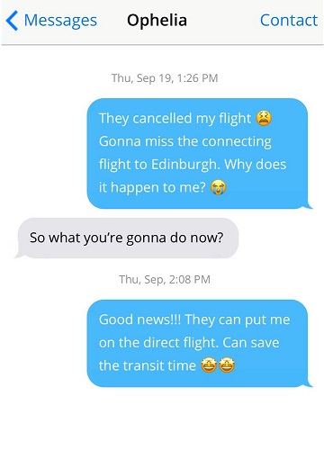

19 out of 20
Show Hints
Hide Hints
1
It is better to stop something bad from happening than to deal with it after it has happened.
1
2
2
Life is precious and should be lived to the fullest.
3
Every difficult or sad situation has a more hopeful side.
3
4
4
Laughing (a positive outlook) can beat negative emotions during hard times.

Slide 11
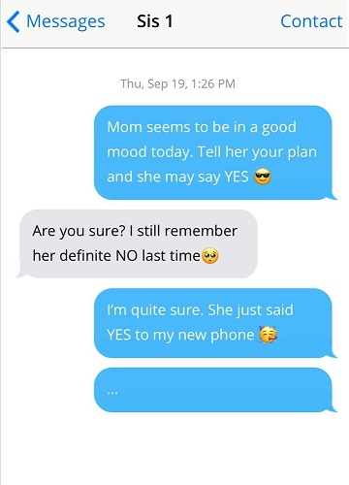


20 out of 20
Show Hints
Hide Hints
1
There are different ways to achieve the same goal.
1
2
2
A true friend helps you when you are in trouble or difficulty.
3
Make good use of an opportunity or a favourable condition while it lasts.
3
4
4
If someone does you a favour, take the chance to return it.

Slide 12
End of Set B

