Slide 1
Learning and Teaching Resources on Law-abidingness
Developed by English Language Education Section
Curriculum Development Institute
Education Bureau
2023

Slide 2
Activity Description
Learning Objectives: | Through watching a video, reading texts and group discussion, students: reflect on the importance of protecting intellectual property rights understand the need to respect copyright and abide by the relevant law
 | learn vocabulary related to intellectual property rights explore techniques used to appeal to the audience in promotional texts
Values and attitudes covered: | Respect for Others, Responsibility, Integrity, Law-abidingness
圖片來源: https://www.freepik.com
Notes:
Source of picture: https://www.freepik.com/free-vector/realistic-green-and-black-chalkboard-with-wooden-frame-and-chalk_12721078.htm

Slide 3
How much do you know about copyright?
What do you Know? | What do you Want to Know? | What have you Learnt?
Notes:
This part mainly serves to elicit response and previous knowledge on intellectual property rights.

Slide 4
Video Watching
Support Creativity Respect Copyright
Source of the video:
https://www.ipd.gov.hk/chi/promotion_edu/pevideos.htm
https://www.youtube.com/watch?v=-pSqKtZUWls
Image:Freepik.com
Notes:
Source of picture: https://www.freepik.com/free-vector/digital-device-mockup_4122511.htm

Slide 5
Discussion
The following three questions are asked in the video:
When you appreciate their creativity, have you ever shown respect to them?
When you applaud their work,
do you want their hard work to be rewarded?
When you’re enjoying their works, have you ever thought about the creators’ efforts?
 | Discussion Questions
1 | Why does the speaker ask these three questions in the video?
2 | What public speaking technique is used in the above? What effect is created?
3 | What are your answers to the three questions? Share your views and the reasons with your classmates.
Notes:
The questions are asked to draw students’ attention to the speech techniques used to arouse interest on the topic in the video as well as to encourage their reflection on the issue of copyrights.
Some suggested answers to the questions:
1. to catch the viewers’ attention, to provoke feelings and stimulate thoughts and interests on the topic
2. techniques used: rhetorical questions (e.g. “When you’re enjoying their works, have you ever thought about the creators’ efforts?” OR
the magic three / parallel structure (e.g. asking three rhetorical questions in a row to create a pattern)
effects created: to engage the viewers / to emphasise the idea and add force / to create a pattern and rhythm
3. free answers (mainly to encourage student reflection on the issue)

Slide 6
If you were an artist, how would you feel when your work is copied by others?
Reflection
Image:Freepik.com
Notes:
The question is mainly asked to encourage students to put themselves into artists’ and creators’ shoes and show empathy.
Sources of pictures:
https://www.freepik.com/search?dates=any&format=search&from_query=talend&page=1&query=talent&sort=popular
https://www.freepik.com/free-vector/intellectual-property-flat-icons-set_3887122.htm#page=1&query=intellectual&position=4

Slide 7
Jigsaw Reading
Students work in groups of four.
Each student is assigned a reading text (i.e. Texts A / B / C / D).
Each student reads his/her assigned text and presents the key ideas to the other three students to share knowledge of copyrights.
Notes:
The purpose of the jigsaw reading activity is to provide an opportunity for students to acquire and share knowledge of copyrights.
The reading activity also allows students to learn vocabulary related to intellectual property rights.
Teachers can assign reading texts to students based on their needs and ability levels.

Slide 8
Text A
What is copyright?
Copyright is the right given to the owner of an original work. This right can subsist in literary works such as books and computer software, musical works such as musical compositions, dramatic works such as plays, artistic works such as drawings, paintings and sculptures, sound recordings, films, broadcasts, cable programmes and the typographical arrangement of published editions of literary, dramatic or musical works, as well as performers’ performances. Copyright works available on the Internet environment are also protected.
In fact, the subsistence of copyright does not require the work to have an aesthetic value nor to be very creative. It exists even in an item as simple as a photograph taken by an ordinary person in daily life.
Copyright is an automatic right. It arises when a work is created. Unlike other intellectual property rights such as patents, trademarks and industrial designs, it is not necessary to register in the Hong Kong SAR to get protection under the law of the Hong Kong SAR.
Adapted from: https://www.ipd.gov.hk/eng/pub_press/publications/hk.htm
Notes:
The purpose of the jigsaw reading is to provide an opportunity for students to enhance understanding and share
The text provides a general definition and description of copyright.

Slide 9
Text B
Why is copyright protection important?
Copyright protects creativity. The efforts of writers, artists, designers, software programmers and other talents need to and should be protected so as to create an environment where creativity can flourish and hard work can be rewarded. In return, the public benefits from the creations.
Hong Kong is a creative place. Our film production, television production, sound recording production, publications, fashion, jewellery and graphical design are known world-wide and enjoy a ready market overseas. Hong Kong is also an international trading centre. We need to provide the necessary protection of intellectual property rights, including copyright, to our investors to assure them of a free and fair environment to do business.
Adapted from: https://www.ipd.gov.hk/eng/pub_press/publications/hk.htm
Notes:
The text shows the importance of copyright protection and explains why we should respect intellectual property rights.

Slide 10
Text C
What is Copyright Law?
Copyright law tries to maintain a balance between the rights of copyright owners for adequate payment for the use of their works, and the rights of society as a whole to have access to ideas and information. It is often said that copyright does not protect ideas, but only the expression or product of ideas. For example, you will probably infringe the copyright in a recipe book if you photocopy it without authorization, but if you use the recipe to make a meal, copyright in the book is not infringed.
The Copyright Ordinance currently in force in the Hong Kong SAR has come into effect since 27 June 1997. The Ordinance is reviewed and revised from time to time to provide comprehensive protection for recognised categories of literary, dramatic, musical and artistic works, as well as for films, television broadcasts and works made available to the public on the Internet. Furthermore, performers of live performances and persons having exclusive recording contracts with performers are also entitled to protection.
A copyright owner can take civil legal action against any person who infringes the copyright. The Customs and Excise Department is responsible for enforcing criminal aspects of copyright infringement. It has the power to confiscate infringing copies.
Adapted from: https://www.ipd.gov.hk/eng/pub_press/publications/hk.htm
Notes:
This part explains the copyright-related law and the possible legal consequences resulting from copyright infringement.

Slide 11
Text D
How long does copyright last for?
The general rule is that copyright lasts until 50 years after the creator of the work dies. However, there are minor variations to this depending on the type of work.
Are there any copyright exceptions?
To balance the rights of the owners and society as a whole, there are exceptions in the law. A work will only be infringed if a substantial part is taken. This is a matter of quality rather than quantity. If a musician copies a very catchy musical phrase from another musician's song, there is likely to be infringement even if that phrase is very short.
Subject to conditions, fair dealing for research and private study; criticism, review and news reporting, for use of works in library and school are permitted. Yet users should still be cautious about possible infringement. Photocopying an unreasonable amount of a book might constitute an infringement, for example.
Adapted from: https://www.ipd.gov.hk/eng/pub_press/publications/hk.htm
Notes:
This part explains how long copyright lasts for and the exceptions.

Slide 12
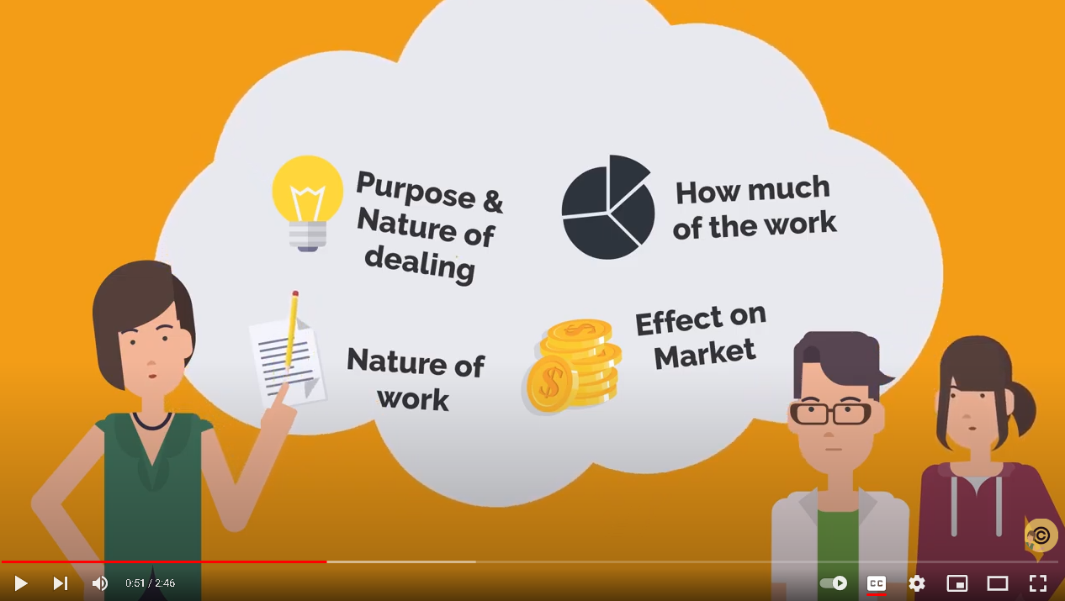
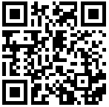
Video Watching
Image:Freepik.com
Scan the QR Code or access the video with the link below to learn more about copyright issues at school:
https://www.youtube.com/watch?v=0uSdqB-QJa8
Watch other videos in the series to know more about copyrights.
Notes:
Source of picture: https://www.freepik.com/free-vector/digital-device-mockup_4122511.htm
https://www.youtube.com/watch?v=0uSdqB-QJa8
Teacher may refer students to the video series The Copyright Classroom <https://www.youtube.com/@thecopyrightclassroom-hku2643> to learn more about copyrights.

Slide 13
Group Discussion
Can you think of an example of copyright infringement in your daily/school life?
What are the consequences of copyright infringement?
As a teenager and student, what can you do to show your respect for intellectual property rights?
empathy
respect
law-abidingness
responsibility
Image:Freepik.com
Notes:
Some suggested answers to the questions:
Possible copyright infringement activities include: selling and producing counterfeit items, making copies of TV programmes, films, music videos or songs for circulation without copyright owners’ consent, copying ideas from sources without acknowledgements, photocopying the entire reference book, etc.
Efforts of the artists and authors are unrewarded, which will demotivate them from producing more creative work. Creativity and innovation cannot flourish. Income of the copyright owner may be affected.
Stealing others’ ideas and works is morally, ethically and legally wrong and is liable to legal punishment.
Teenagers and students can abide by the copyright law, stop buying pirated copies of creative work , avoid illegal downloading or file sharing and photocopying the entire book. They should also uphold academic honesty and integrity by making proper acknowledgements when using or borrowing others’ ideas in their work.
Source of the picture:
https://www.freepik.com/free-vector/organic-flat-people-asking-questions-set_13404888.htm#page=2&query=question&position=0

Slide 14
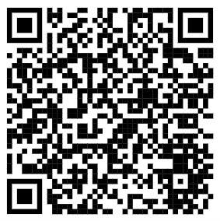
"I Pledge" Campaign
Scan the QR code or access the website through the link below to join the “I Pledge” Campaign:
https://www.ipd.gov.hk/eng/promotion_edu/i_pledge.htm
Participant's Obligations:
I pledge never to get involved in Internet piracy activities;
I pledge never to purchase or use pirated and counterfeit goods;
I pledge to respect the intellectual property rights of others ; and
I pledge to support and participate in anti-piracy and anti-counterfeiting activities.
Source: Intellectual Property Department
Notes:
The “I Pledge” Campaign is included here to motivate students to take action and put the positive value of law-abidingness into practice from today.

