Slide 1

Be a Responsible Online Citizen
Learning and Teaching Resources on Law-abidingness for KS3
English Language Education Section
Curriculum Development Institute
Education Bureau
2023

Slide 2

Module | Unit | Topic
Rights and Responsibilities/ Technology | Be a responsible online user | Stand Against Cyber-bullying
Content Objectives
To learn the importance of respecting others and abiding by the law in the cyber world through understanding the following:
What is cyber-bullying?
What are the impacts of cyber-bullying?
Ways to be a responsible online user
Language Objectives
Values and Attitudes
To develop language knowledge and skills, e.g.
To nurture in students the following positive values and attitudes:
English Language
Education
Priority Values and Attitudes
Cyber-bullying
text features of a leaflet
language focuses:
  the use of imperatives
  the use of the simple present tense to present facts
Law-abidingness
Respect for others
Integrity
Notes:
Source of image:
https://www.pcpd.org.hk//english/resources_centre/publications/files/stop_cyberbully.pdf

Slide 3

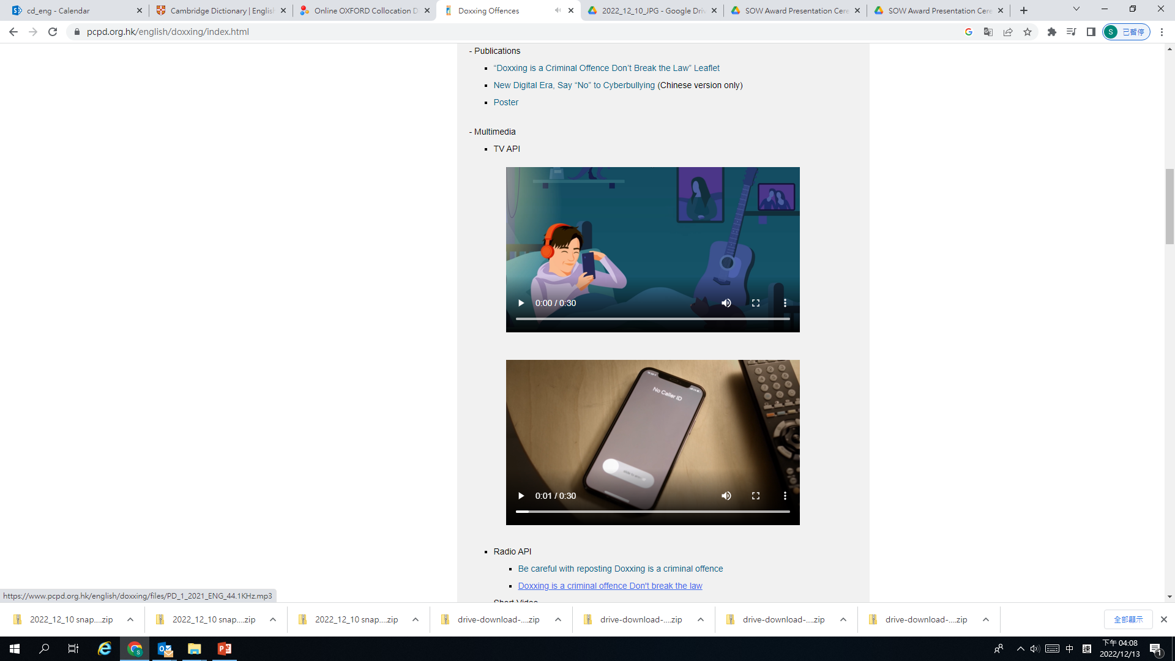
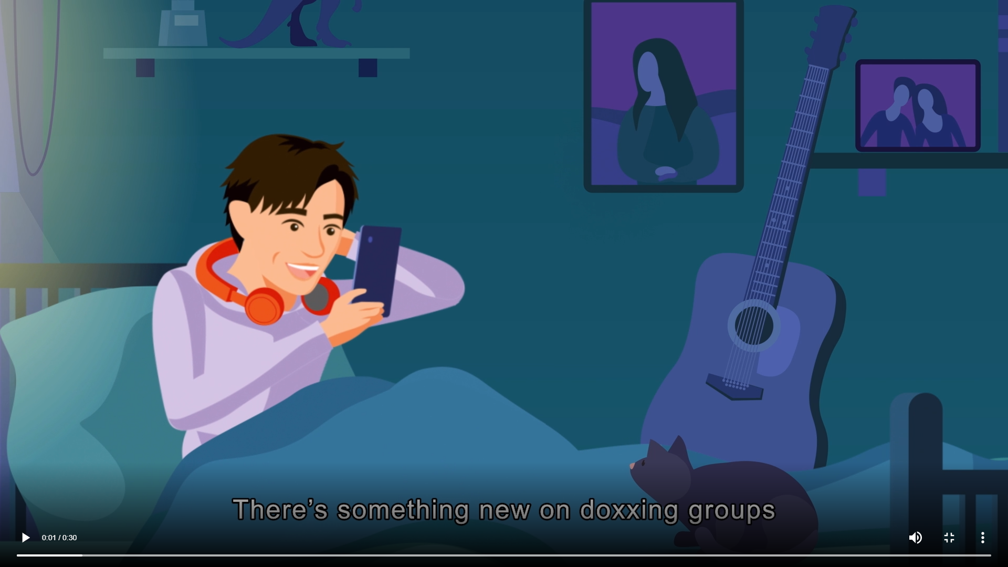
Pre-viewing
Find out how much students know about cyber-bullying.
While-viewing
Watch two videos about cyber-bulling to raise students’ awareness that doxing, a type of cyber-bullying, is a criminal offence.
Post -viewing
Explore the ways to be a responsible online user.
Reflect on the things to be done by different stakeholders to fight against cyber-bullying through designing a leaflet.
Analyse the common text features and language items of a leaflet.
Read a leaflet on cyber-bullying to deepen students’ understanding about different behaviours related to cyber-bullying.
Discuss the importance of respecting others and abiding by the law in the cyber world.
Discuss the unlawful acts of doxxing through anaylsing a scenario.
Videos on “Doxxing Offences”
A Leaflet on “Information Security Guide – Stop Cyber-bullying”

Slide 4

What is cyber-bullying?
  Find out how much students know about cyber-bullying.
Pre-viewing
1)
What do you want to know?
What have you learnt?
What do you know?
What do you know?
2)
What have you learnt?
What do you want to know?
Source of image:
https://www.pcpd.org.hk/english/doxxing/files/antidoxxing_leaflet_e.pdf

Slide 5
What is doxxing?
  Find out how much students know about doxxing.
Pre-viewing
Do you know what doxxing is?
Take a look at the definition of doxxing. Fill in the blanks with the words provided in the box.
disclosure personal data social media family members
What is doxxing?
personal data
In general, doxxing refers to the gathering of the ________________ of target person(s) or related person(s) (such as ________________ members, relatives or friends) through online search engines, social platforms and discussion forums, public registers, anonymous reports, etc., and ________________ of the personal data on the Internet, ________________ or other open platforms (such as public places).
family
disclosure
social media
Source:
Privacy Commissioner for Personal Data, Hong Kong. Doxxing Offences.
https://www.pcpd.org.hk/english/doxxing/index.html

Slide 6
What is doxxing?
  Discuss the unlawful acts of doxxing through anaylsing a scenario.
Pre-viewing
Group discussion – Did Peter break the law?
In groups, discuss and explain if Peter broke the law in the following scenario.
Discussion Questions
What was the problem when Peter posted Mary’s personal information online?
2. Did Peter break the law?
3. How about Peter’s friends?
Scenario
Peter had a quarrel with his friend Mary. He felt so angry that he created a private post on the social media platform saying something nasty about Mary. Apart from the nasty comments, Peter also included Mary’s photo, telephone number and home address on the post.
Peter’s friends saw the post and reposted it on a public online forum.
Mary was feeling scared and threatened when she found out that her personal information was disclosed. She confronted Peter and Peter argued that he had done nothing wrong because he merely posted Mary’s information on a private post where only their friends can see.
Notes:
Source of image:
https://www.pcpd.org.hk/english/doxxing/files/antidoxxing_leaflet_e.pdf

Slide 7
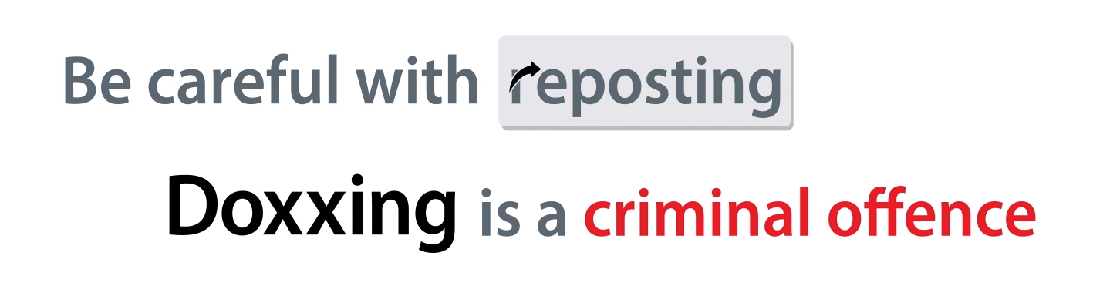
Doxxing offences
  Play video (1).
  Go through the questions about the video and highlight that doxxing is a criminal offence.
  Get students to empathise with a victim of doxxing and remind them of the negative impacts of doxxing.
While-viewing
“Doxxing Offences”
Video (1)
After watching the video on doxxing offences, discuss the following:
What is the key message of the video?
Posting someone’s personal information online without consent may cause lots of harm to the victim. Give some examples mentioned in the video.
(3) What is the maximum penalty for doxxing?
If you were doxxed, how would you feel?
Source:
Privacy Commissioner for Personal Data, Hong Kong. Doxxing Offences.
https://www.pcpd.org.hk/english/doxxing/index.html

Slide 8
Doxxing offences
Suggested Answers
  Play video (1).
  Go through the questions about the video and highlight that doxxing is a criminal offence.
  Get students to empathise with a victim of doxxing remind them of the negative impacts of doxxing.
While-viewing
“Doxxing Offences”
Video (1)
After watching the video on doxxing offences, discuss the following:
What is the key message of the video?
To educate the public that doxxing is a criminal offence
(2) Posting someone’s personal information online without consent may cause lots of harm to the victim. Give some examples mentioned in the video.
Harassment, molestation, pestering, threat, intimidation
(3) What is the maximum penalty for doxxing?
A fine of $1 million and imprisonment for 5 years
Source:
Privacy Commissioner for Personal Data, Hong Kong. Doxxing Offences.
https://www.pcpd.org.hk/english/doxxing/index.html
If you were doxxed, how would you feel?

Slide 9
Doxxing offences
  Play video (2).
  Reinforce the message that doxxing is unlawful and get students to reflect on the importance of respecting others in the cyber world.
While-viewing
“Doxxing Offences”
Video (2)
After watching the video on doxxing offences, discuss the following:
Based on the video, decide if the following statements are TRUE or FALSE.
(a) Posting someone’s ID number or address online is
not a crime.
(b) I am not the first one who posted the doxxing
message, so I have not committed a crime.
(2) Why should you get someone’s consent before posting
or reposting their personal information?
Some people believe that committing a crime online is not as serious as in the real world.
Is that true?
Source:
Privacy Commissioner for Personal Data, Hong Kong. Doxxing Offences.
https://www.pcpd.org.hk/english/doxxing/index.html

Slide 10
Doxxing offences
  Play video (2).
  Reinforce the message that doxxing is unlawful and get students to reflect on the importance of respecting others in the cyber world.
Suggested Answers
While-viewing
“Doxxing Offences”
Video (2)
After watching the video on doxxing offences, discuss the following:
Based on the video, decide if the following statements are TRUE or FALSE.
(a) Posting someone’s ID number or address online is
not a crime. (FALSE)
(b) I am not the first one who posted the doxxing
message, so I have not committed a crime. (FALSE)
(2) Why should you get someone’s consent before posting
or reposting their personal information?
We should respect others’ privacy.
Some people believe that committing a crime online is not as serious as in the real world.
Is that true?
Source:
Privacy Commissioner for Personal Data, Hong Kong. Doxxing Offences.
https://www.pcpd.org.hk/english/doxxing/index.html

Slide 11
  Use the leaflet “Information Security Guide – Stop Cyber-bullying” to consolidate students’ understanding of cyber-bullying.
  Guide students to predict the content of the leaflet by studying the pictures and icons (e.g. the facial expression of the girl, the broken heart, the angry face) on the cover of the leaflet.
Post-viewing
Predicting the content of a leaflet
Take a look at the cover of the leaflet and discuss the following with your classmates:
From the facial expression of the girl, how does she feel?
What do you think the following icons represent? What do you think the girl has encountered?
Look at the arm reaching out from the screen of the notebook computer. What do you think it represents?
How would you feel if you were the girl?
What is the purpose of the leaflet?
Source:
Privacy Commissioner for Personal Data, Hong Kong. (December 2021). Information Security Guide – Stop Cyber-bullying. https://www.pcpd.org.hk//english/resources_centre/publications/files/stop_cyberbully.pdf

Slide 12
  Read the speech bubbles under “What is cyber-bullying?”.
  Develop students’ discussion and research skills by guiding them to give examples of different behaviour of cyber-bullying.
Post-viewing
Illustrating what cyber-bullying is through examples
In groups, discuss with your classmates and give examples about different behavior and effects of cyber-bullying. Fill in the table below. Conduct research online to find out more examples.
Behaviour of cyber-bullying | Examples
Harassment
Doxxing
Threat
Trickery
Source:
Privacy Commissioner for Personal Data, Hong Kong. (December 2021). Information Security Guide – Stop Cyber-bullying. https://www.pcpd.org.hk//english/resources_centre/publications/files/stop_cyberbully.pdf
Effects of cyber-bullying on victims | Examples
Psychological harm
Emotional harm
Physical harm

Slide 13
  Read the speech bubbles under “What is cyber-bullying?”.
  Develop students’ discussion and research skills by guiding them to give examples of different behaviour of cyber-bullying and reflecting on the negative impacts of cyber-bullying .
Post-viewing
Suggested Answers
Illustrating what cyber-bullying is through examples
In groups, discuss with your classmates and give examples about different behavior and effects of cyber-bullying. Fill in the table below. Conduct research online to find out more examples.
Behaviour of cyber-bullying | Examples
Harassment | Making offensive phone calls
Doxxing | Posting and reposting personal information without consent (e.g. ID number and address of other people)
Threat | Blackmailing the victim by posting his/her private photos online
Impersonation | A fake social media account including wrong and embarrassing information is created for the victim.
Source:
Privacy Commissioner for Personal Data, Hong Kong. (December 2021). Information Security Guide – Stop Cyber-bullying. https://www.pcpd.org.hk//english/resources_centre/publications/files/stop_cyberbully.pdf
Effects of cyber-bullying on victims | Examples
Psychological harm | Anxiety, depression, low self-esteem, low self-image
Emotional harm | Stress, fear, feeling isolated
Physical harm | Self-harm, insomnia, harmful eating habits, suicidal thoughts

Slide 14
  Reflect on the negative impacts of cyber-bullying.
  Discuss the ways to prevent cyber-bullying and to be a responsible online user.
Post-viewing
Reflecting on the negative impacts of cyber-bullying and ways to prevent cyber-bullying
Study the seven suggestions for preventing cyber-bullying in the leaflet. Discuss the following with your classmates:
What are the problems if someone’s personal information is being disclosed online?
What are the problems of joining a heated online discussion?
What should you do before sharing information or reposting messages on social media platforms?
Source:
Privacy Commissioner for Personal Data, Hong Kong. (December 2021). Information Security Guide – Stop Cyber-bullying. https://www.pcpd.org.hk//english/resources_centre/publications/files/stop_cyberbully.pdf
What are some other ways to prevent cyber-bullying?

Slide 15
  Guide students to identify the common text features and language items of a leaflet.
Post-viewing
Label the following on the leaflet with the students:
Text features:
Catchy cover
Use of headings and sub-headings
Use of bullet points
Use of icons
Language items:
Use of imperatives
Use of the simple present tense to present facts
Source:
Privacy Commissioner for Personal Data, Hong Kong. (December 2021). Information Security Guide – Stop Cyber-bullying. https://www.pcpd.org.hk//english/resources_centre/publications/files/stop_cyberbully.pdf

Slide 16
  Guide students to identify the common text features and language items of a leaflet.
Post-viewing
Suggested Answers
Label the following on the leaflet with the students:
Text features:
Catchy cover
Use of headings and sub-headings
Use of bullet points
Use of icons
Language items:
Use of imperatives (e.g. “Do not”, “Seek”, Report”)
Use of the simple present tense to present factual information (e.g. “Do not disclose unnecessary information”, “seek assistance from parents”)
Source:
Privacy Commissioner for Personal Data, Hong Kong. (December 2021). Information Security Guide – Stop Cyber-bullying. https://www.pcpd.org.hk//english/resources_centre/publications/files/stop_cyberbully.pdf

Slide 17
  Building on students’ understanding of cyber-bullying, the text features and the language features learnt, instruct students to design a leaflet to educate the public on the ways to stop cyber-bullying by different stakeholders.
Post-viewing
Designing a leaflet on “Stand Against Cyber-bullying”
To raise students’ awareness of the harm of cyber-bullying, your school is organising an activity week called “Put a halt to cyber-bullying. Be a responsible online user.”
Design a leaflet to be distributed to students and parents to promote the activity week. You may include the following:
  Why is it crucial to stop cyber-bullying?
  What can different stakeholders (e.g. schools, parents, government) do to stop cyber-bullying and help the victims of cyber-bullying?
  How to be a responsible online user?
  What are the important positive values and attitudes to be nurtured to create a safe online environment?
A Leaflet on “Information Security Guide – Stop Cyber-bullying
Videos on
“Doxxing Offences”
Notes:
Reference for extended reading:
https://www.studenthealth.gov.hk/english/internet/recommendations/files/recommendations_secondary_school_students_wa.pdf
https://www.youthcan.hk/en/theme/bullying/infograph_1.html
https://www.pcpd.org.hk/english/resources_centre/publications/files/cyberbullying_e.pdf

