Slide 1
Be a Responsible Road User
Learning and Teaching Resources for KS1/KS2
2023
English Language Education Section
Curriculum Development Institute
Education Bureau

Slide 2
Learning Focuses
Suggested Modules/Units
The learning and teaching resources can be incorporated in the following modules/units:
KS1 Caring and Sharing
(I am a good citizen)
KS2 My Neighbourhood
(Rules and behaviours)
Learning Activities
Learning Objectives
Understand the safety rules for cycling by watching a video
Learn the vocabulary and language items related to road facilities and safety rules
Engage students in a role play to develop their speaking skills and problem solving skills
Engage students in a group discussion to understand the importance of law-abidingness
Activity 1: Watch a video about safe cycling “Enjoy Cycling Safety First”
Activity 2: Conduct a role play about being a responsible road user
Activity 3: Group discussion
Values and Attitudes
Promote Values Education through nurturing in students the following priority values and attitudes:
Law-abidingness
Responsibility
Respect for others

Slide 3
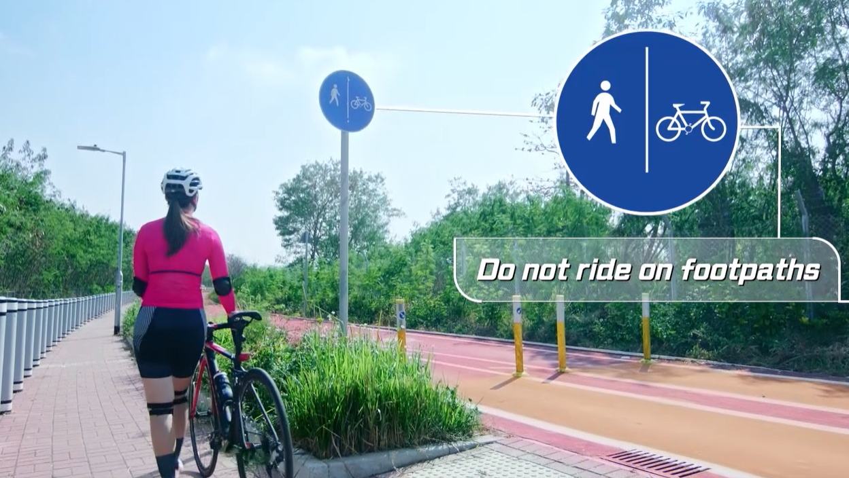
Activity 1: Watch a video “Enjoy Cycling Safety First”
Watch the video and write down the safety rules for cycling:
Be aware of traffic and __________ signs.
Do not ride on ______________.
Follow the __________. Dismount and push your bike across roads.
Give way to other __________ __________.
traffic
footpaths
signs
road
users
Source of video and images (video “Enjoy Cycling Safety First”): Transport Department
https://www.td.gov.hk/filemanager/en/content_4554/ge023eng.mp4

Slide 4
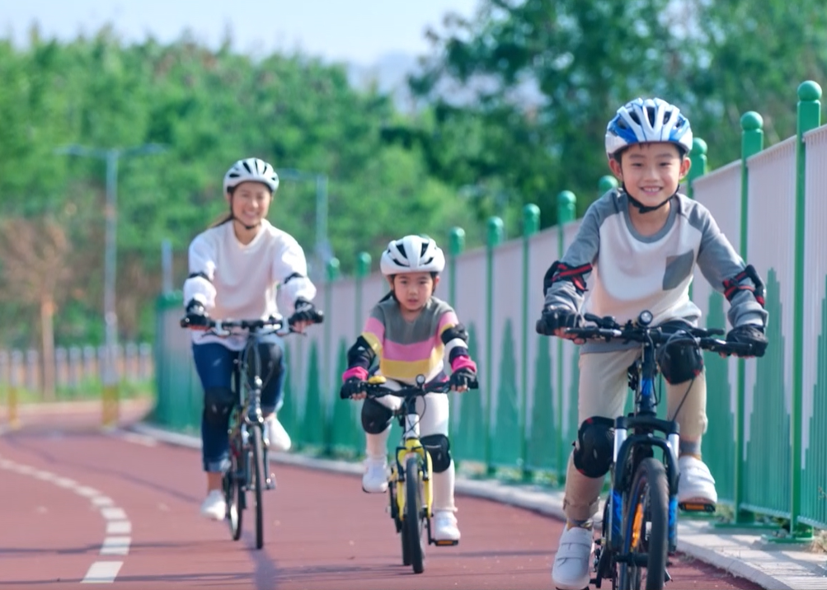
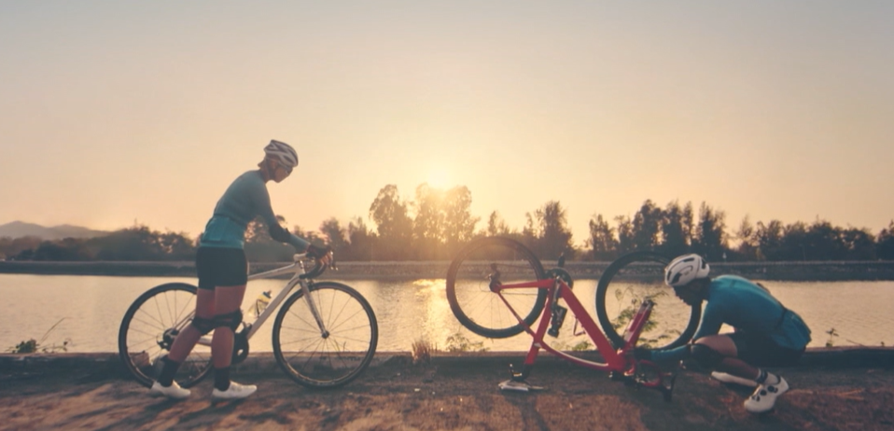
Activity 1: Watch a video “Enjoy Cycling Safety First”
Watch the video and write down the safety rules for cycling:
_________ ________ and _________ your ________ by braking on steep cycleways.
______________ and walk if needed. Cycle __________ your __________.
Wear a safety __________ and other
personal ______________ _______________.
Make sure your bike is suitable and __________ ______ _________.
Slow
down
control
speed
Dismount
within
ability
helmet
protective
equipment
safe
to
ride
Source of video and images (video “Enjoy Cycling Safety First”): Transport Department
https://www.td.gov.hk/filemanager/en/content_4554/ge023eng.mp4

Slide 5
Activity 2: Conduct a role play about being a responsible road user
Work in groups of four. Think about the ending of the story and finish the role play.
KS1
Narrator: You meet your friends near a park. They are cycling along the cycle track.
Friend A: Hello! How nice to see you here.
You: Yes! What a surprise to meet you all. My father taught me how to cycle two weeks ago. I love cycling too.
Friend B: Let’s go cycling together!
You: Thanks for inviting me… but I’m still not skillful enough. I feel a bit scared of riding on the cycle track.
Friend C: You can ride on footpaths. It’s safer.
You: …
Situation: You know how to ride a bicycle. Your friends invite you to go cycling together.
You are not very skillful. Your friends ask you to ride on footpaths.

Slide 6
Activity 2: Conduct a role play about being a responsible road user
Work in groups of four. Think about the ending of the story and finish the role play.
Narrator: You meet your friends near a park. They are cycling along the cycle track.
Friend A: Hello! How nice to see you here.
You: Wow! What a surprise to meet you all. You should have told me about the gathering! I want to join you too.
Friend B: It’s not late to join us now. Come on, rent a bicycle at the shop nearby.
You: Thanks for inviting me… but I don’t have any safety equipment.
Friend C: It’s not a big problem. It’s very safe to ride on the cycle track.
You: …
KS2
Situation: You meet your friends in a park. They invite you to go cycling together.
You do not have any safety equipment.

Slide 7
Activity 3: Group Discussion
In groups, discuss why it is important to ride on the cycle track or at a bicycle park.
Some footpaths are narrow and crowded with pedestrians. They may not be …
You may fall off …
KS1
the bicycle and hurt yourself.
suitable for cycling.
Problems of riding on footpaths
Situation: You know how to ride a bicycle. Your friends invite you to go cycling together.
You may hit …
?
You are not very skillful. Your friends ask you to ride on footpaths.
Pedestrians may feel uncomfortable when a bicycle passes by.
the pedestrians and cause an accident.
Solutions
We should …
be a responsible road user;
follow the safety rules for cycling; and
ride on the cycle track or at a bicycle park to protect ourselves and other road users.

Slide 8
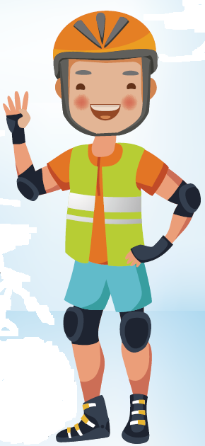
Activity 3: Group Discussion
In groups, discuss why it is important to have the safety equipment before cycling with your friends.
It is important to follow safety rules and put on the safety helmet, pads and gloves to protect yourself when you are riding a bicycle.
KS2
Situation: You meet your friends in a park. They invite you to go cycling together.
What are the possible dangers of cycling without a safety helmet?
What are the possible dangers of not wearing safety gloves and pads?
The safety helmet can help avoid severe head injuries. ...
When there is an accident and you fall over, the helmet can protect your head and prevent a direct hit on your skull.
You do not have any safety equipment.
Safety gloves and pads can protect your…
hands, elbows, arms and knees. The gloves can help you control the bike handlebars and protect your hands in case of a crash. Also, you may fall off when cycling. The elbow pads and knee pads can provide good protection for your arms and knees.
Source of image (Leaflet “Tips for Cycling Safety”): Transport Department
https://www.td.gov.hk/filemanager/en/content_182/rs_bulletin_51.pdf

Slide 9
Conclusion
It is important to be a responsible road user and a law-abiding cyclist.
It is necessary to follow the safety rules for cycling to protect ourselves and other road users.

Slide 10
Acknowledgements
Information and images / pictures in this set of materials are taken from the website of the Transport Department:
The video “Enjoy Cycling Safety First” https://www.td.gov.hk/filemanager/en/content_4554/ge023eng.mp4
The leaflet “Tips for Cycling Safety” https://www.td.gov.hk/filemanager/en/content_182/rs_bulletin_51.pdf
Notes:
More videos on “Safe Cycling: Rules and tips” are available here:
https://www.td.gov.hk/en/road_safety/safe_cycling_rule_and_tips/index.html

