Slide 1
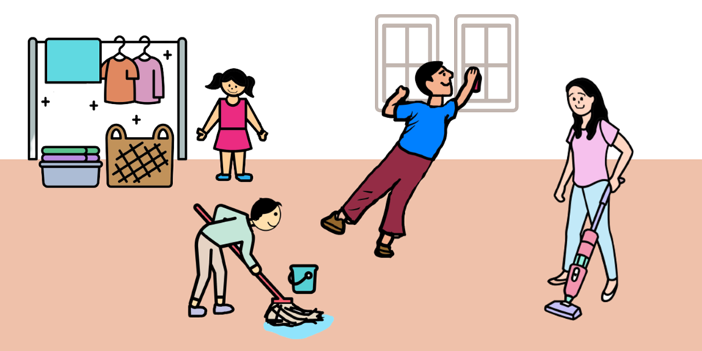
Keep your home clean
KS1
English Language Education Section
Curriculum Development Institute
Education Bureau
2023

Slide 2
An Overview of the Learning Task
Content Objectives
  To identify and reflect on cleanliness problems at home
  To learn about what children can do to keep their home clean
  To develop positive values and attitudes (e.g. responsibility, care for others)
Language Focuses
  To develop reading skills (e.g. locating specific information)
  To learn vocabulary related to ways to keep your home clean
  To learn the use of imperatives to give advice
  To develop speaking skills (e.g. participating in simple interactions)

Slide 3
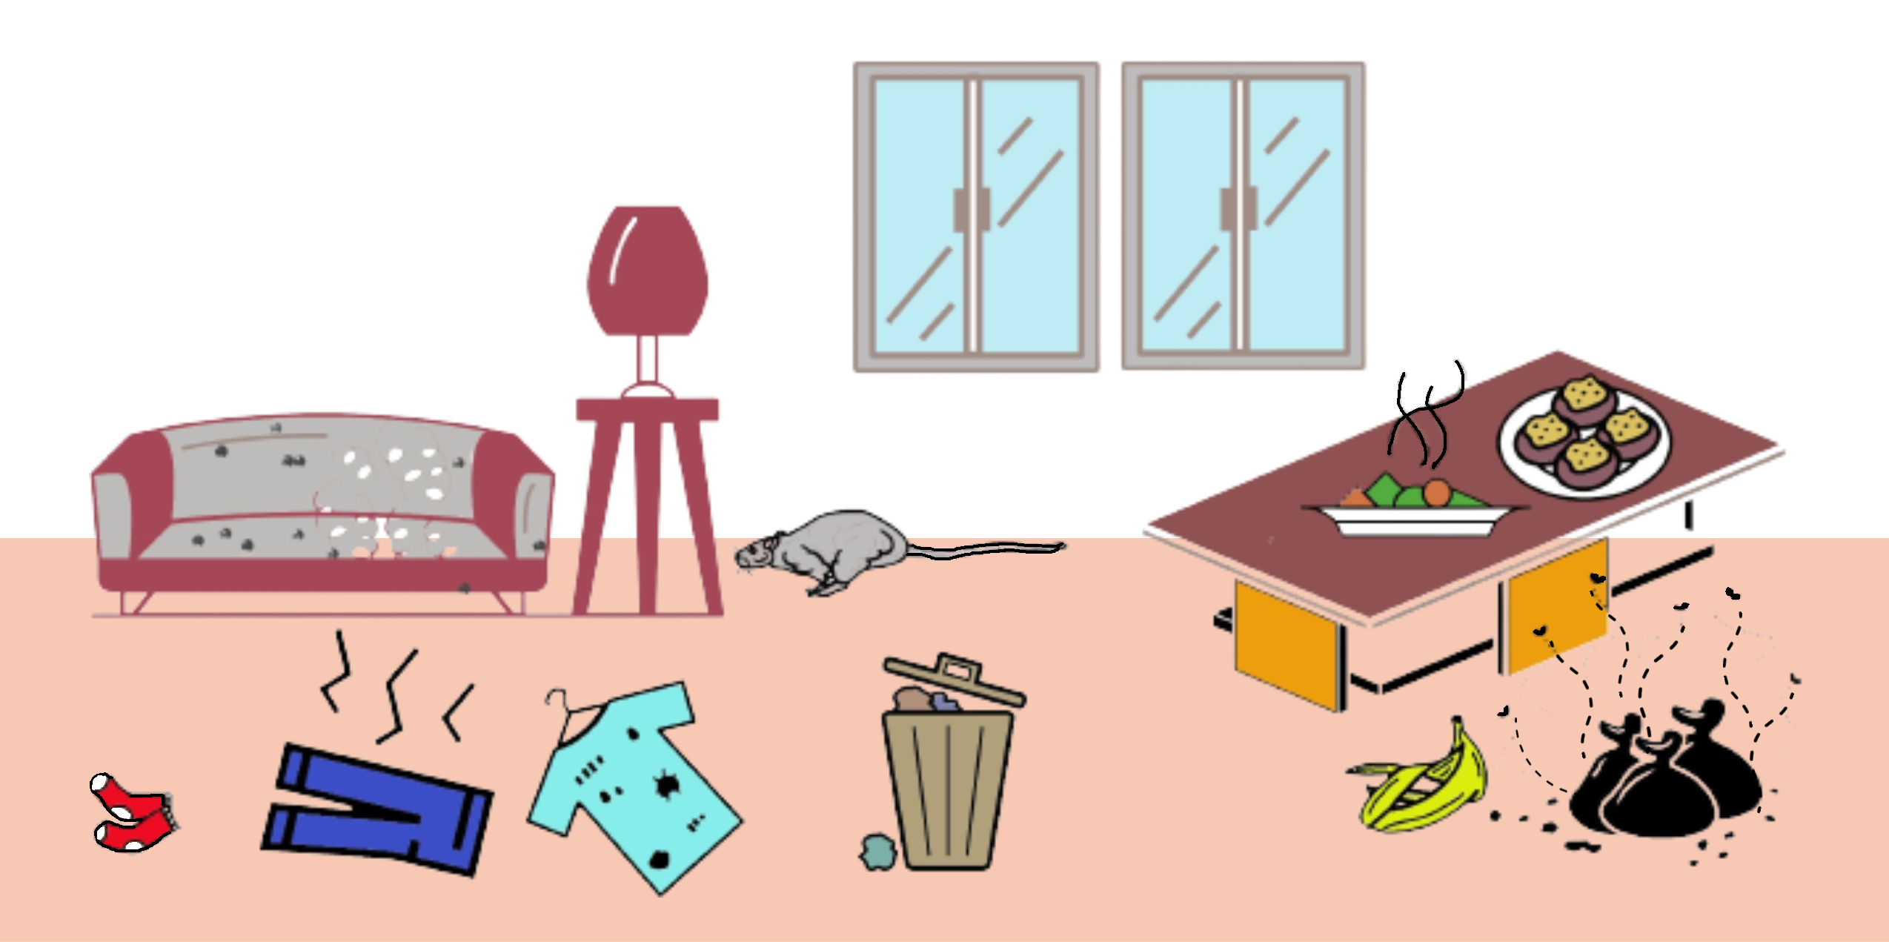
Identify cleanliness problems in the living environment.
Tom is your classmate. The picture shows Tom’s home. There are a lot of cleanliness problems. Circle the problematic areas.

Slide 4


Work in pairs. Predict what may happen to Tom.
The food is not covered properly. It is unsafe to eat.
Yes, I agree with you. Tom may have a stomach ache.

Slide 5


One day, Aunt Lucy visits Tom. They talk about the cleanliness problems at Tom’s home. Read their conversation.
Poor Tom, I’m sorry to hear that you are sick. How are you feeling now?
I’m still sick. I just went to see a doctor with Mum because I had a terrible stomach ache yesterday.
What did you eat, Tom?
Mum bought me some meat and vegetables for lunch yesterday. I could not finish them all, so I left them on the table. Then I visited Grandma with Mum. I ate the food after I went back home at night.
Did you put the food in the refrigerator, cover it with plastic wrap and reheat it before eating?
Oh! I just put the food on the table for a few hours without covering or wrapping it. I didn’t wash my hands before I ate the food because I was so hungry.
Continue your reading on slide no.6

Slide 6
One day, Aunt Lucy visits Tom. They talk about the cleanliness problems at Tom’s home. Read their conversation.
Don’t leave the food at room temperature for a long time. Put the food in the refrigerator and cover it with plastic wrap. Remember to ask an adult to reheat it before eating.
I’m sorry. I was too lazy to handle the food properly.
Wash your hands before eating, after disposing of rubbish and returning home. There may be germs in your dirty hands. You may eat the germs together with the food.
I’m really sorry, Aunt Lucy. What else can I do to keep my home clean?
Continue your reading on slide no.7

Slide 7
One day, Aunt Lucy visits Tom. They talk about the cleanliness problems at Tom’s home. Read their conversation.
Don’t close all the windows when you are at home. Open the windows to have more fresh air.
Always clean the furniture and the floor. Keep different places in your home tidy such as the toilet, bathroom, bedrooms and kitchen.
Don’t put your clothes or things everywhere. Put them back in the wardrobe or boxes tidily.
There are food scraps in your bed. Never eat in the bedroom and don’t drop food scraps on the floor. Rodents can smell the food scraps and sneak into your home through holes in the walls.
Oh, yes! I saw two rodents biting an open rubbish bag and eating some food scraps in the backstairs last week. Mum found a rodent in the living room this morning!
Continue your reading on slide no.8

Slide 8
One day, Aunt Lucy visits Tom. They talk about the cleanliness problems at Tom’s home. Read their conversation.
Rodents bring diseases to people. That’s why you got sick. Remember to put the rubbish bag in the rubbish bin with a well-fitting lid. Tie up the rubbish bag when it is full and take it to the refuse room. Don’t forget to empty the rubbish bin at home at least once a day.
Thank you very much, Aunt Lucy! I can help Mum with it.
Good! You can also tell your friends and neighbours to work together.
That’s a good idea! Let me write down what we can do to keep our home clean.
End of the conversation

Slide 9
What can Tom do to keep his home clean? Read the conversation in slides number 6, 7 and 8 again. Complete the mind map with the key words taken from the conversation.
Hands
Food
Problem (✗)
eat with __________ hands
Solution (✓)
__________ hands ___________
eating, after disposing of __________
and returning ________________
Problems (✗)
put the food at ________ temperature for a long time
eat the food that is not covered with __________ __________
Solutions (✓)
cover the food and put it in the ___________
__________ the food before eating
room
dirty
wash
before
plastic
wrap
rubbish
home
refrigerator
reheat
Ways to keep Tom’s home clean
Rooms at home
Rubbish
Problems (✗)
________ all the windows with no fresh air coming into the house
drop food __________ on the floor
put clothes and things ___________
Solutions (✓)
keep windows __________ when people are at home
__________ the furniture and the floor
put the clothes and things ___________
Problems (✗)
do not cover the rubbish ______ properly
keep full _______ _______ at home
Solutions (✓)
put the rubbish bag in the rubbish bin with a ____________ lid
_____ _____ the rubbish bag and take it to the refuse room when it is full
__________ the rubbish bin at home at least once a day
close
bin
scraps
rubbish
bags
everywhere
well-fitting
open
tie
up
clean
empty
tidily

Slide 10

Work in pairs. Discuss what you can do to keep your home clean.
What can we do to keep our home clean? Do you have any ideas?
I can fold the clothes and put them in the wardrobe. How about you?
……
Wow! We have many ideas to keep our home clean. Let’s turn our ideas into action.
Good. Let’s start today.

Slide 11
Acknowledgements
Information and images/pictures in this set of slides are taken from the following resources:
1. Poster on “3 Ways to Eliminate Rodent Nuisance from Food, Harbourage and Passages (Household setting)” – the Food and Environmental Hygiene Department
https://www.fehd.gov.hk/english/pestcontrol/library/pdf_pest_control/poster/Anti-rodent_Poster- Household.pdf
2. A pamphlet on “A Guide to Personal, Home and Environmental Hygiene” (Keep Clean Be Healthy) – the Food and Health Bureau, the Department of Health and the Food and Environmental Hygiene Department
https://www.chp.gov.hk/files/her/a_guide_to_personal_home_and_environmental_hygiene_keep_clean_be_healthy_booklet.pdf

