Slide 1
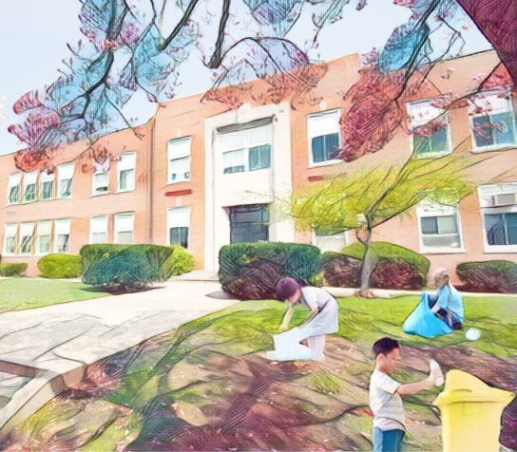
Keep the school environment clean
KS2
English Language Education Section
Curriculum Development Institute
Education Bureau
2023

Slide 2
An Overview of the Learning Task
Content Objectives
  To reflect on the littering problem in Hong Kong
  To learn about the special features of rodents (rats) and problems or hazards caused by them
  To understand ways to eliminate rodent nuisance to keep the school environment clean
  To develop positive values and attitudes (e.g. responsibility, care for others)
Language Focuses
  To develop reading skills (e.g. identifying main ideas)
  To understand the use of conditional sentences with “if” to describe the result of a certain condition
  To learn the use of the modal verb “should” to give suggestions

Slide 3

Watch a video about people dumping rubbish everywhere
Your teacher, Mr. Wong, notices that more and more students litter in school. He forms a cleanliness team to raise students’ awareness of keeping the school environment clean. Mr. Wong shows students a video clip. Watch the clip.
Source of the video clip (“Let’s Keep Hong Kong Clean”): Information Services Department
https://youtu.be/64CM9osDfNY

Slide 4

Reflect on the littering problem in Hong Kong
How do you feel when people dump rubbish everywhere? What do you want to say to them?
What will happen if there are no janitors in school or cleaners in Hong Kong? What do you want to say to those people who keep schools and the environment clean?

Slide 5
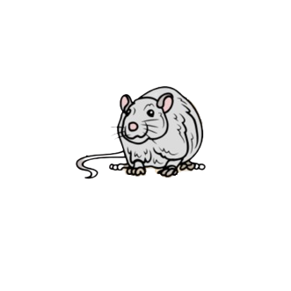

Learn about the special features of rodents
Rodents thrive in dirty and untidy places. Mr. Wong tells students some characteristics of rodents. Read what he says and choose the best words provided to summarise the relevant descriptions.
good climbers good jumpers good swimmers
nocturnal social animals can dive
Rodents love to live in groups. They make friends with other rodents easily.
1. They are _________ __________.
social
animals
2. Rodents are very active at night. They wait until dark to look for food or move about.
2. They are ___________.
nocturnal
3. Rodents can run up to different places such as walls or top of bookshelves to stay away from people.
3. They are _________ __________.
good
climbers

Slide 6
Learn about the special features of rodents
Rodents thrive in dirty and untidy places. Mr. Wong tells students some characteristics of rodents. Read what he says and choose the best words provided to summarise the relevant descriptions.
good climbers good jumpers good swimmers
nocturnal social animals can dive
4. Rodents can bounce and leap very well. This helps them get to a safe place quickly when they are in danger.
4. They are _________ __________.
good
jumpers
5.Rodents often travel through sewage pipes to get to our homes.
5. They are _________ __________.
good
swimmers
6. Rodents can stay under the water for some time without getting drowned.
6. They _______ _________.
can
dive

Slide 7
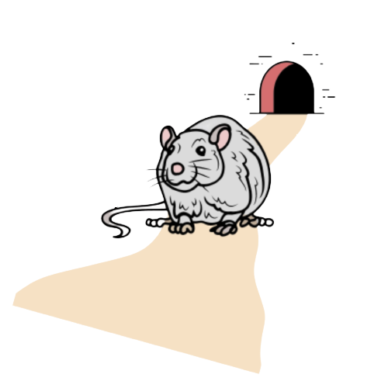
Learn about problems or hazards caused by rodents
The cleanliness team plays the role of rodents to help schoolmates understand some major hazards caused by rodents. Read the conversation and choose the best words from the relevant texts to complete the subheadings.
1. Spreading ____________ to people
diseases
We usually live in dirty places such as back lanes and ditches. We have a good sense of smell. If you drop food scraps on the ground, leave food containers like lunch boxes uncovered, or do not cover rubbish bins with well-fitting lids, we will sneak into your school to find food. If you don’t want to get diseases from us, you should handle food and rubbish properly.

Slide 8
Learn about problems or hazards caused by rodents
2. Losing ______________
property
We have sharp teeth, so we can gnaw furniture easily. We may even bite electric wires such as computer cables, which can cause fire and loss of property. If you messily put books and stationery everywhere, or even put snacks in wrong places such as bookshelves in the classrooms, we will have a lot of good places to hide and food to eat. If you don’t want us to be in your classrooms or school, you should keep your things neat and tidy.
3. Biting _______________
people
We may bite people especially those who cannot move quickly, such as babies, old people or people who are asleep. You should keep your school clean if you don’t want us to bite you.

Slide 9
Learn about ways to eliminate rodent nuisance to keep the school environment clean
To cultivate in schoolmates a sense of responsibility and encourage them to care for others, the cleanliness team writes some rules for them to follow. Use the words provided in the brackets to complete the rules below. You may add some ideas to enrich these rules.
I should be a responsible and caring student!
Handling personal things
e.g. We should not put snacks in the bookshelves.
We should _________________________________________________.
(books and stationery)
put books and stationery neatly
Handling food and snacks
e.g. We should not drop food scraps on the floor.
We should _________________________________________________.
(food container)
place the food in a food container with a cover on it
Handling rubbish and bins
e.g. We should not dump rubbish everywhere and have janitors do the clean-up.
We should _________________________________________________.
(rubbish bin)
cover the rubbish bin with a well-fitting lid

Slide 10
Acknowledgements
Information and images/pictures in this set of slides are taken from the following resources:
1. . A video clip on “Let’s Keep Hong Kong Clean” – Information Services Department
https://youtu.be/64CM9osDfNY
2. An information sheet on “Rodent Pests and Their Control” – Food and Environmental Hygiene Department
https://www.fehd.gov.hk/english/pestcontrol/risk-pest-rodents.html
3. A pamphlet on “Prevent Disease Eliminate Rodent Nuisance (Household setting)” – Food and Environmental Hygiene Department https://www.fehd.gov.hk/english/pestcontrol/library/pdf_pest_control/rodent_householdset_lft_e.pdf

