Slide 1

Let’s Make Our Community Clean
Learning and Teaching Resources on Cleanliness for KS3
English Language Education Section
Curriculum Development Institute
Education Bureau
2023

Slide 2
Module | Unit | Topic
Rights and Responsibilities/ Protecting the Environment | Making our community clean | Environmental hygiene
Learning Objectives
  Through watching a video, reading a text and group discussions, students:
  understand the importance of maintaining a hygienic environment in the community
  reflect on their responsibilities to help keep Hong Kong clean
  explore measures to improve environmental hygiene
  learn the vocabulary items related to hygiene problems and measures to improve environmental hygiene
  explore the techniques used to create an effective poster
Values and Attitudes Covered
  Responsibility
  Care for others
Notes:
Source of image:
https://www.pcpd.org.hk//english/resources_centre/publications/files/stop_cyberbully.pdf

Slide 3
Discuss the following questions with a partner.
Spotting the Hygiene Problems
Do you feel comfortable living in this building.
Why or why not?
2. Identify three problems related to cleanliness in
the building.
3. What are the problems if citizens live in an
unhygienic environment?
  Suggested answers for Q2
  Water dripping from air conditioners, seepage of sewage from drainage pipes, watering of plants without using a saucer, improper disposal of litter on the canopy, odour and germs from the overflowing bin, rodent infestation
  Suggested answers for Q3
  Higher risks of health problems, poorer living standard, anxiety

Slide 4
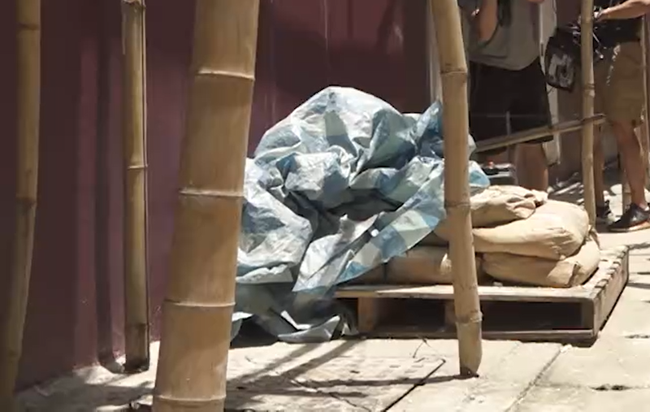
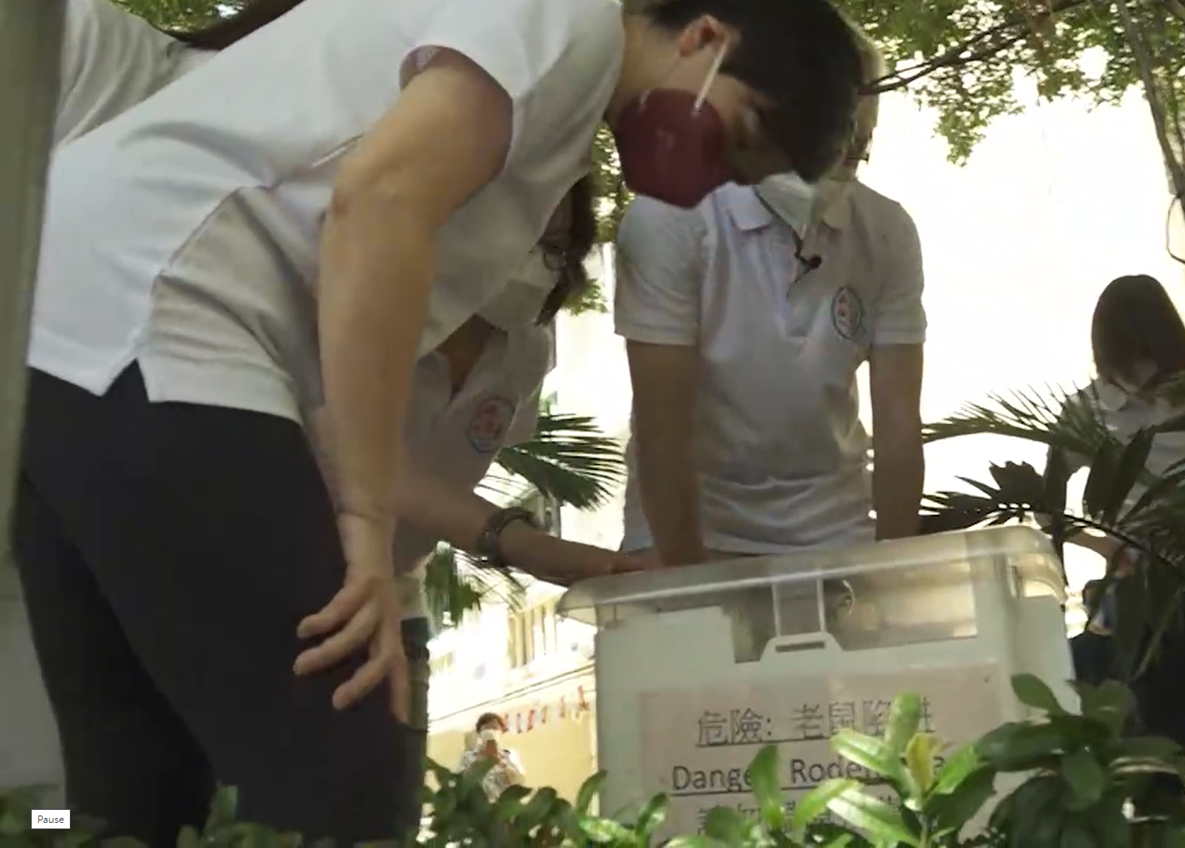
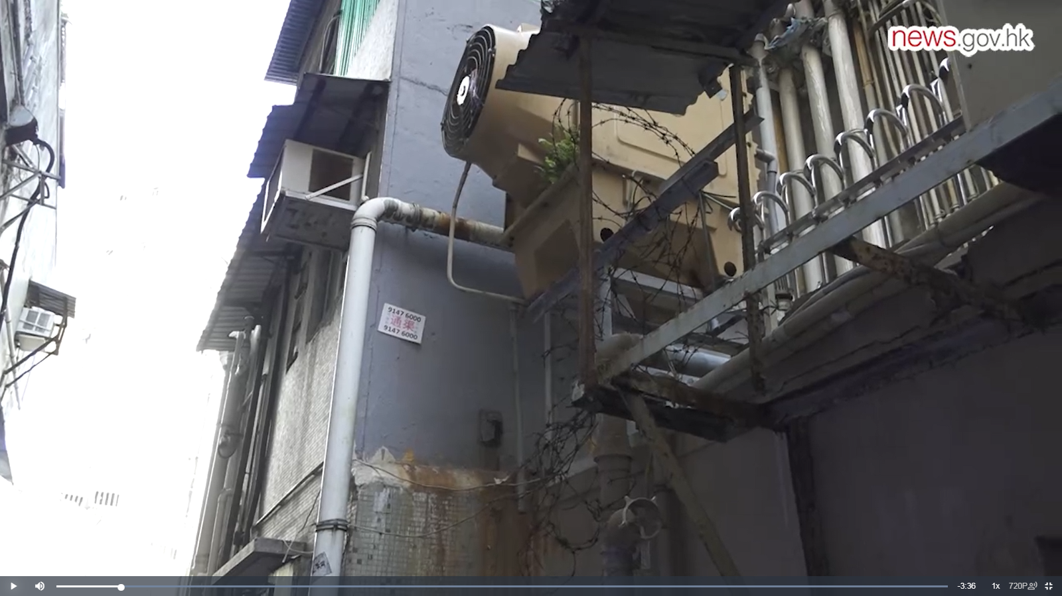
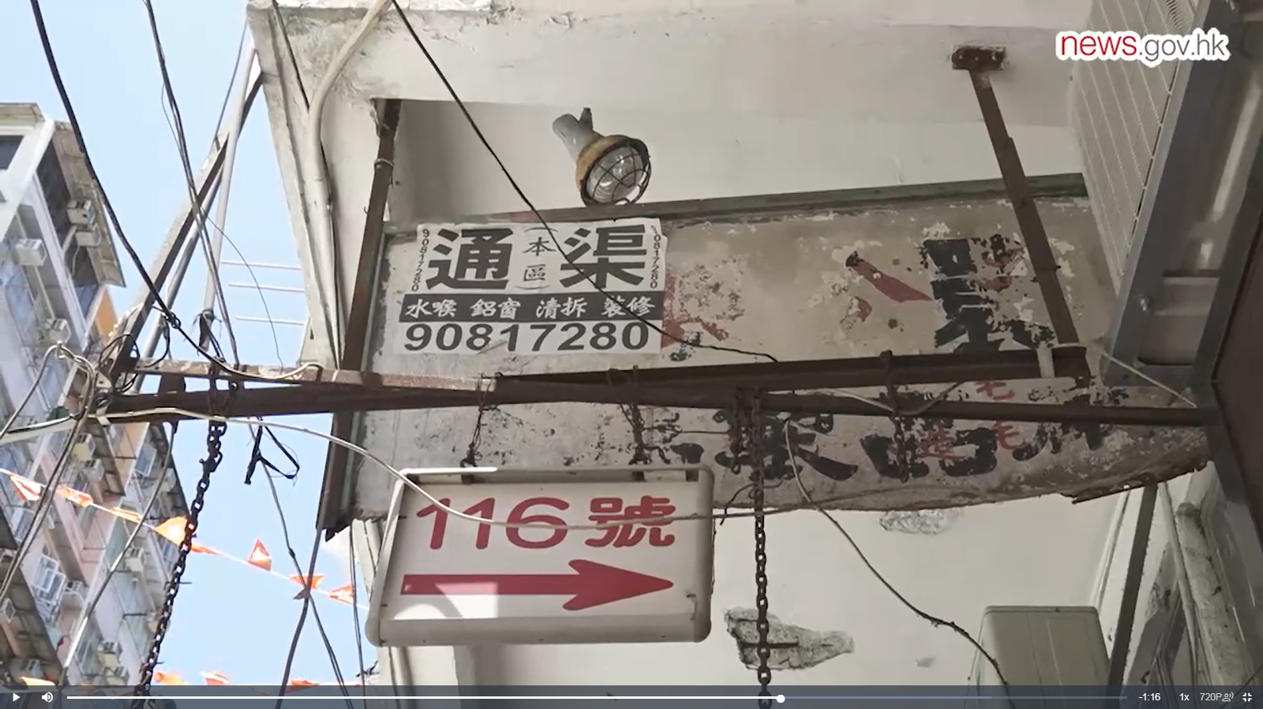
Hygiene Problems in Our Community
Watch a video about the hygiene problems in Hong Kong.
https://www.news.gov.hk/eng/2022/08/20220814/20220814_155216_217.html
What are the hygiene problems mentioned in the video?
2. Rodent
problems
1.
3.
4.

Slide 5
Hygiene Problems in Our Community
Suggested Answers
Watch a video about the hygiene problems in Hong Kong.
https://www.news.gov.hk/eng/2022/08/20220814/20220814_155216_217.html
What are the problems at the hygiene black spot?
2. Rodent
problems
1. Piling up of construction waste
3. Leakage from the drainage pipes
4. Dangerous and abandoned signboards

Slide 6
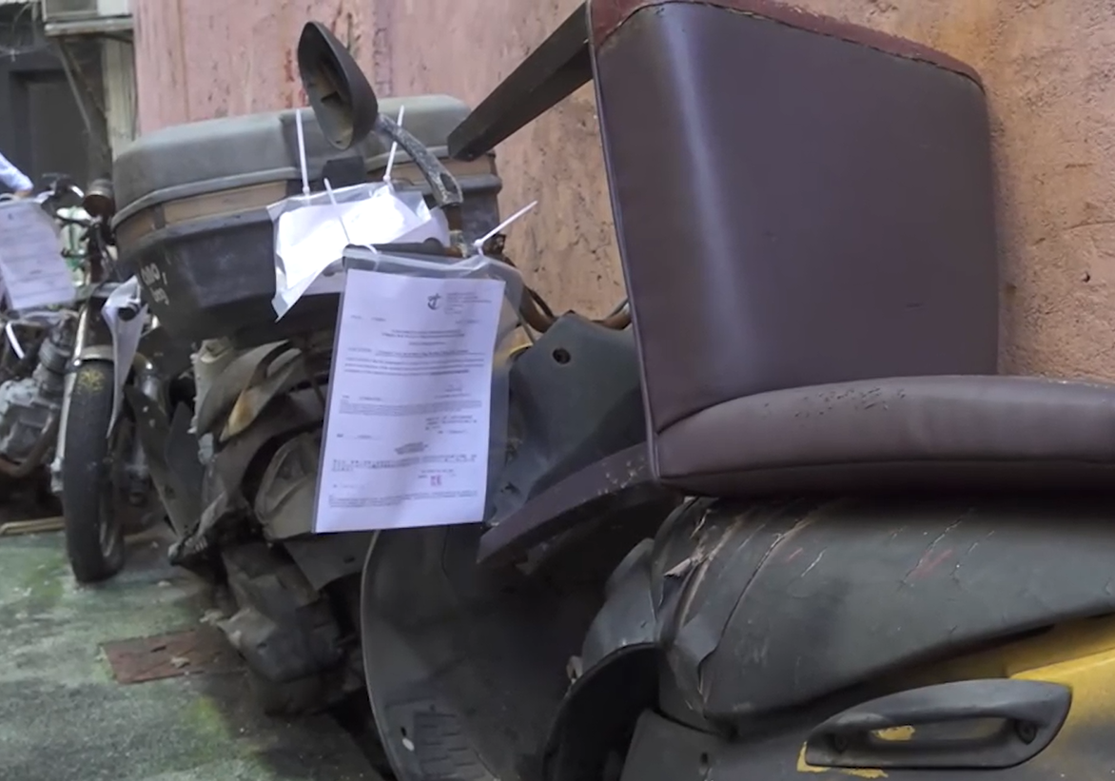
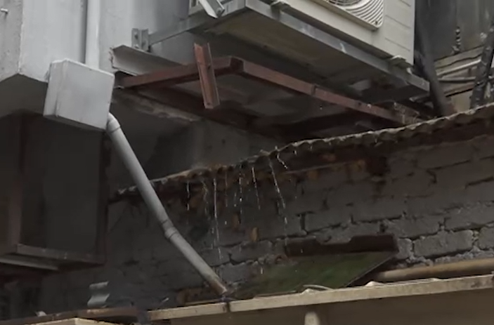
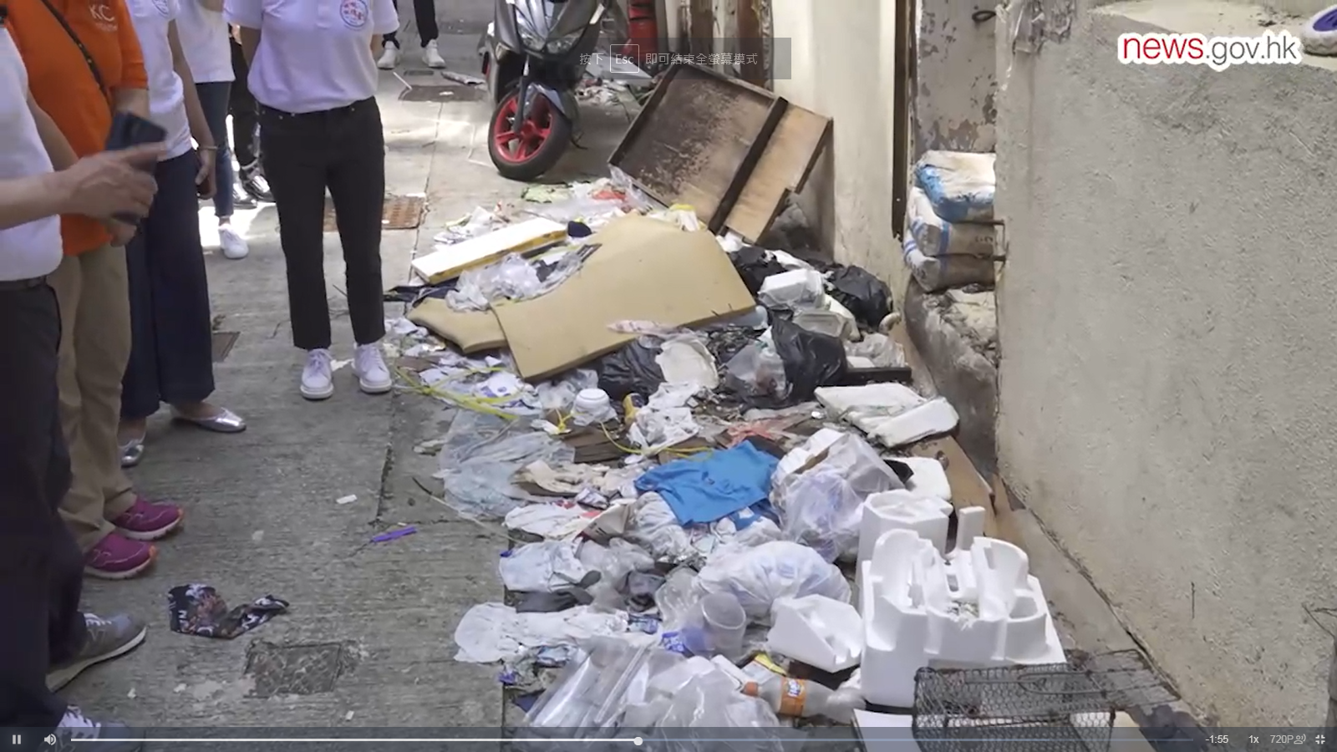
Label the other hygiene problems at the hygiene black spot and back lane captured in the video.
Hygiene Problems in Our Community
1.
2.
3.

Slide 7
Label the other hygiene problems at the hygiene black spot and back lane captured in the video.
Hygiene Problems in Our Community
Suggested Answers
1. Improper disposal of unwanted vehicles
2. Water dripping from air conditioners
3. Littering/ Improper disposal of domestic waste

Slide 8
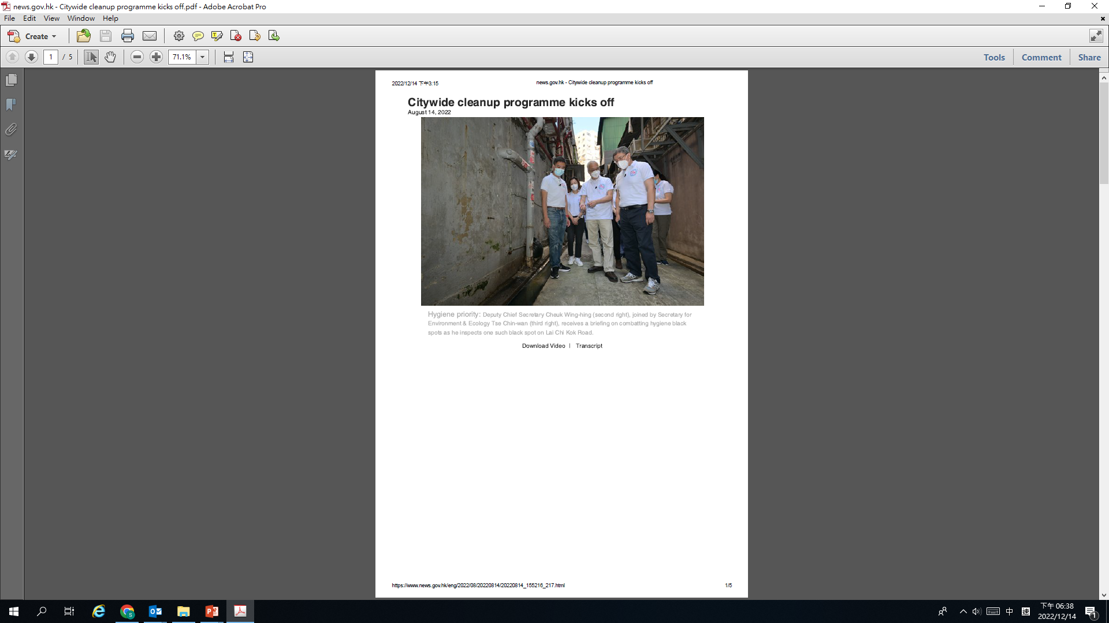
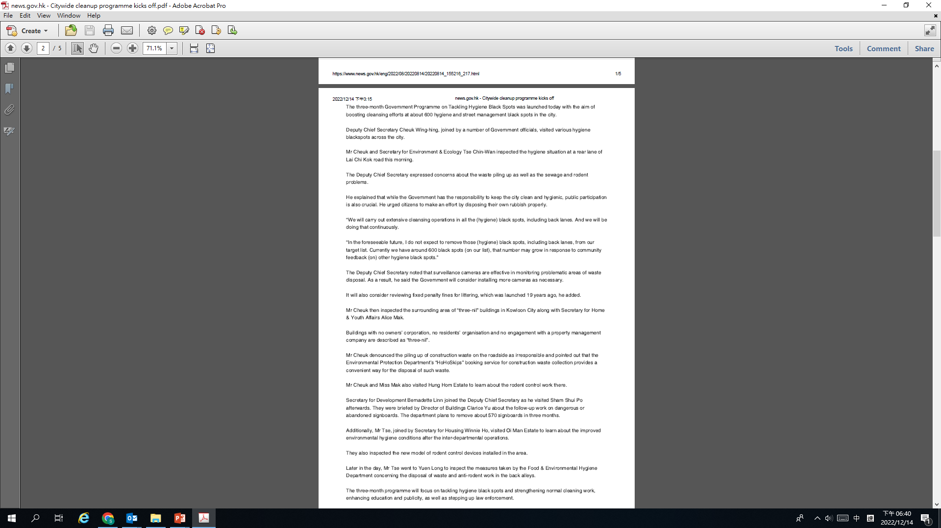
Government Measures to Tackle Hygiene Problems
Read the article “Citywide cleanup programme kicks off”. Complete the diagram about the proposed government measures to tackle the hygiene problems.
Government Measures to Tackle the Hygiene Problems
Click here to read the article.

Slide 9
Government Measures to Tackle Hygiene Problems
Read the article “Citywide cleanup programme kicks off”. Complete the diagram about the proposed government measures to tackle the hygiene problems.
Suggested Answers
Government Measures to Tackle the Hygiene Problems
Installing more surveillance cameras
Reviewing fixed penalty fines for littering
Installing a new model of rodent control devices
Stepping up law enforcement
Enhancing education and publicity
Strengthening normal cleaning work
Click here to read the article.

Slide 10
Discussion and Reflection
How can we help make Hong Kong clean?
 | Discussion Questions
1. | How does poor hygiene affect the citizens and society at large?
2. | Who holds the biggest responsibility in maintaining public hygiene? The general public, schools or the government?
3. | What can be done at the following three levels to promote public hygiene? The individual The family The community
Reflection
Great things start from small beginnings. All of us can contribute ourselves to make Hong Kong clean.
List five things which you will do to help make our community clean.
_______________________________
2. ________________________________
3. ________________________________
4. ________________________________
5. ________________________________

Slide 11
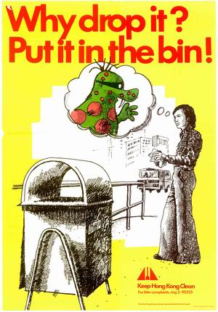

Analysing the Features of a Poster
This is a poster used in the “Keep Hong Kong Clean Campaign” in the 1970s to raise public awareness of environmental cleanliness.
“Lap Sap Chung”, a cartoon litterbug, was used to remind people of the inconsiderate acts (e.g. littering) to be avoided.
This is a poster used to urge citizens to take actions to keep Hong Kong clean.
Ah Tak, a dinosaur-like creature in green, is the Keep Clean Ambassador. His name relates to the idea of “good virtues” (“德”) and the mascot aims to appeal to and educate the public on maintaining a hygienic cityscape.
Work in pairs and discuss the following.
Do these posters attract you? Which poster do you like more? Why?
How does a mascot help in the Keep Hong Kong Clean Campaign?
Name some characteristics of an appealing poster.

Slide 12
Characteristics of an Appealing Poster
Image
Eye-catchy graphics
Content
Short and simple messages
A call to action
Language
Rhymes
Alliteration
Metaphors
Questions
Imperatives
Second person pronouns “you”, “we”, “us”
Capitalisation of key words
Varying the font size and colour
A memorable slogan
Parallelism
Identify the content and language features used in the following slogans.
Put waste in the right place. [A call to action, rhyme, imperatives]
Don’t litter. It makes the world bitter. [Rhyme]
A clean city is a haven. [Metaphor]
A clean city charms the citizens. [Alliteration]
Let us go green to get our planet clean. [A call to action, rhyme, imperatives, second person pronouns]
Pick it up. Clean it up. [Parallelism, imperatives]
Why drop it? Put it in the bin. [Question]

Slide 13
Designing a poster and a mascot for the citywide cleanup campaign
Your English teacher has asked you to help raise schoolmates’ awareness of the importance of making Hong Kong clean. He/She has asked you to do the following:
Design a poster to be distributed to students to encourage them to support the campaign.
Design a new mascot for the campaign. Create a name for it and include it in the poster.
(c) Prepare a 2-min individual presentation to introduce the key message(s)
of the poster and the new mascot.
Remember to create a catchy slogan and make use of different features to make your poster more appealing.

Slide 14
Acknowledgements
Picture: Spotting the hygiene problems https://www.fehd.gov.hk/english/research_education/heerc/fun_game/colouring_home.pdf
Video and Article: “Citywide cleanup programme kicks off” https://www.news.gov.hk/eng/2022/08/20220814/20220814_155216_217.html
Photos: Hygiene Problems in Our Community (Extracted from the video) https://www.news.gov.hk/eng/2022/08/20220814/20220814_155216_217.html
Poster “Why drop it? Put it in the bin.” https://www.grs.gov.hk/ws/Posters/html/clean4.htm
Poster “Keep Hong Kong Clean. We Can Do It!” https://www.fehd.gov.hk/english/pleasant_environment/library/keepHKclean/keepClean_weCan.pdf

