Slide 1
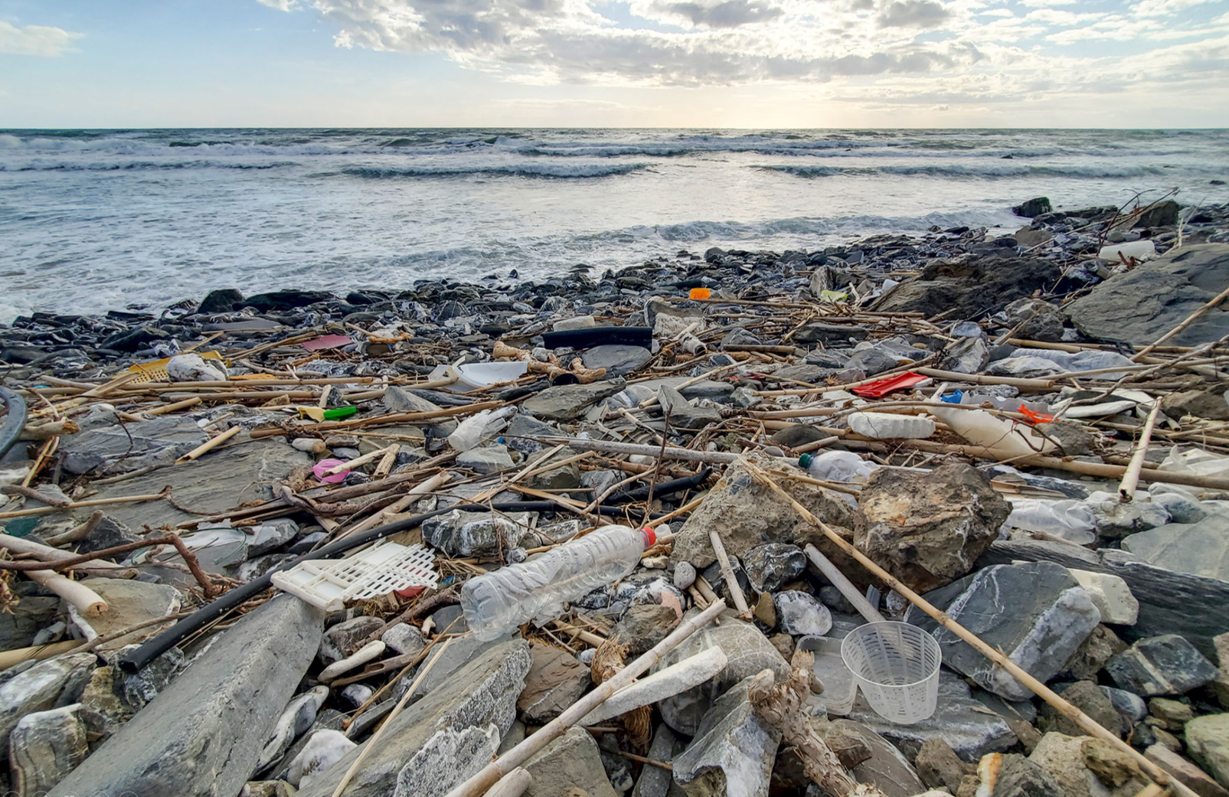
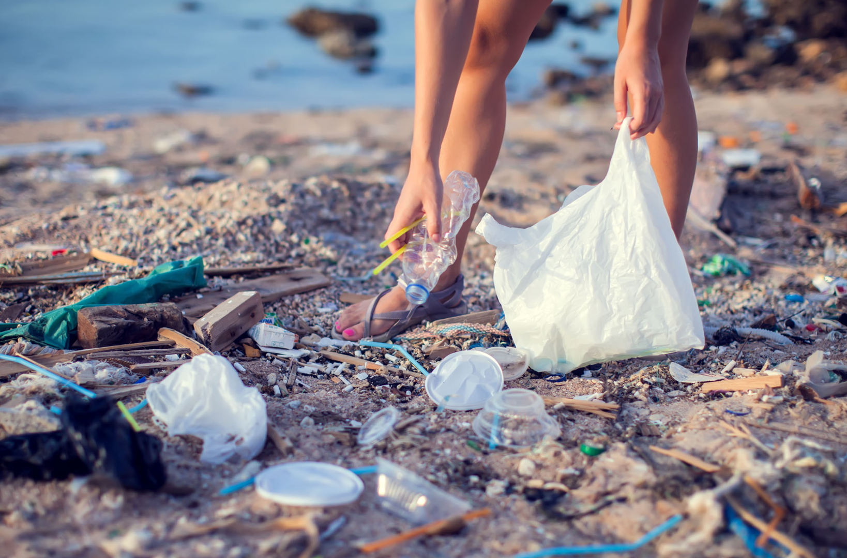
Cleanliness – Marine Littering
Live here, love here
Curriculum Development Institute, Education Bureau
© 2023

Slide 2
Learning Objectives
Values Education:
Understand the importance of marine and coastal cleanliness
Understand the responsibility as a Hong Kong citizen to help maintain coastal and marine cleanliness and abide by the law
English Language Education:
Understand the organising structure of a speech of appeal
Learn how to use and present statistical findings to enhance persuasion and logical appeal
Learn how to use literary techniques (e.g. rhetorical questions, parallelism) to enhance emotional appeal

Slide 3
Lead in
Watch this video clip and answer the following questions.
Adventure Clean-up Challenge: Filipino domestic workers volunteer to clean Hong Kong beaches (2’43”)
(Source: South China Morning Post)
Why do the Filipinos volunteer to clean up the Hong Kong beaches? Choose the correct answer(s).
A. They can do something meaningful while enjoying outdoor activities.
B. They can get an extra day off.
C. They see Hong Kong as their second home.
D. They feel depressed about the massive amount of coastal pollution.
What are the three common types of rubbish found on the beaches?
What other types of rubbish do you usually find on beaches?
Do you want to join the “Clean-up Challenge”? Why or why not?

Slide 4
Situation
You are Sam Wong, a volunteer of an environmental group called “Green Grin” Group.
Seeing the seriousness of marine littering, a secondary school would like to invite your organisation to give a speech to raise students’ awareness of coastal cleanliness. The project manager, William Tsang, has asked you to draft a speech of about 400 words with the information collected and some tips on speech writing.

Slide 5
Email from the Project Manager
Dear Sam,
We are invited by a secondary school to give a speech about coastal cleanliness. I would like you to draft the speech for me. The speech doesn’t have to be very long. Around 400 words will do. Please include the following:
Opening
Engage students by asking them some interesting questions. (You may refer to the PPT slides on “Tips on Writing a Speech” for more ideas.)
Body
Explain what marine refuse refers to
Provide some basic information about the major composition and sources of marine refuse (both shoreline and floating refuse)
Remind students to be responsible and law-abiding citizens! (May quote the penalty of marine littering for students’ information)
Suggest what students can do to prevent marine littering
Ending
Reiterate the key message and encourage students to join our “Lap Sap Wan Beach Clean-up” activity. Please think up a slogan to make the activity more impressive.
The information attached below may help you draft the speech. I have also attached some tips on speech writing and the speech on “Air Con Abuse” we gave in ABC School last week for your reference. Thanks for your help.
Regards,
William
From: williamtsang@greengrin.org.hk
To:
samwong@greengrin.org.hk
To:
Subject:
A speech about coastal cleanliness
An Information Sheet on Marine Littering in HK Excerpts from the Marine Refuse Study Report Legislation and Penalty | 4. A Leaflet on Preventing Marine Littering 5. Poster for “Lap Sap Wan Beach Clean-up” 6. PPT slides on “Tips on Writing a Speech” 7. Speech for ABC School on “Air Con Abuse”

Slide 6
Task analysis
Writer’s role
Target readers
Text-type
Tone
Topic
Purpose of writing
A volunteer of an environmental group
Secondary school students
Speech (of appeal)
Semi-formal
Marine littering
To persuade and promote

Slide 7
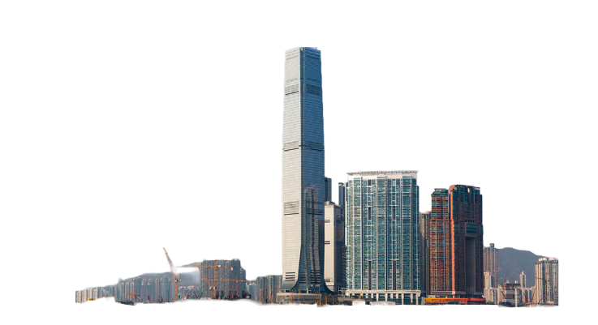
An Information Sheet on Marine Littering in Hong Kong
The statistics may help illustrate the seriousness of the problem
Marine pollution is threatening the world and Hong Kong is certainly no exception. The city’s beaches are awash with litter, with microplastic levels reaching as high as 5,600 pieces per square metre – 40 % higher than the global average.
Weighing about 130 tonnes in total
As heavy as 9 whale sharks
5.2 million plastic bottles
are thrown away in Hong Kong every day
2050
ICC
By 2050, there may be more plastic than fish in the sea.
Just let it be?
More than enough to fill an Olympic-sized swimming pool
Stacked on top of one another, they would measure over 2,200 times the height of the International Commerce Centre (ICC) – Hong Kong’s tallest skyscraper
Data derived from https://multimedia.scmp.com/native/infographics/article/3160919/cleaning-hong-kong-waters/

Slide 8
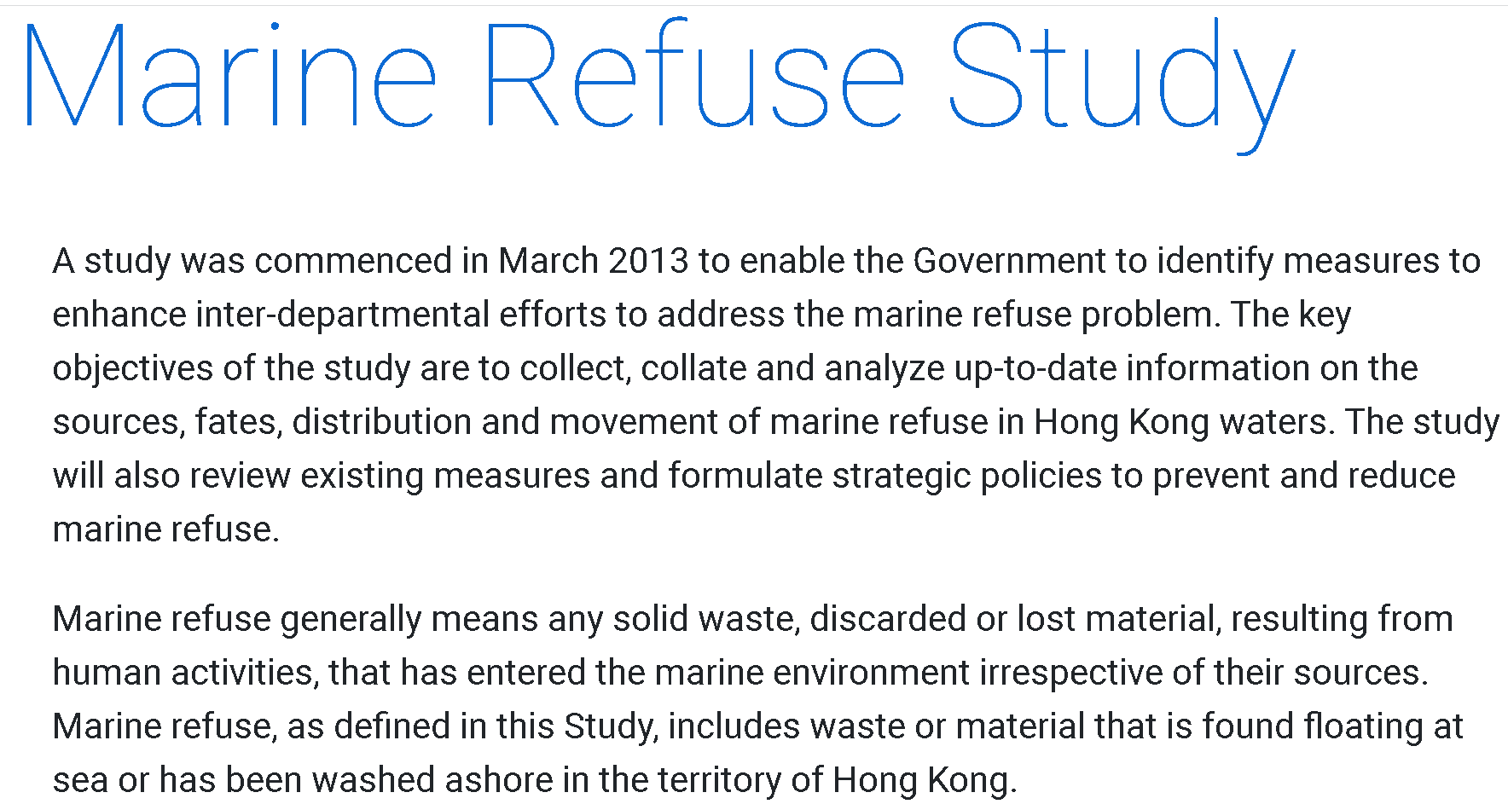
Excerpts from the Marine Refuse Study Report
What is marine refuse?
Common types of marine refuse
Adapted from: https://www.epd.gov.hk/epd/clean_shorelines/marine_refuse_study.html
Adapted from: https://www.epd.gov.hk/epd/clean_shorelines/files/common2015/MarineRefuseStudyReport_ENG_Final.pdf

Slide 9
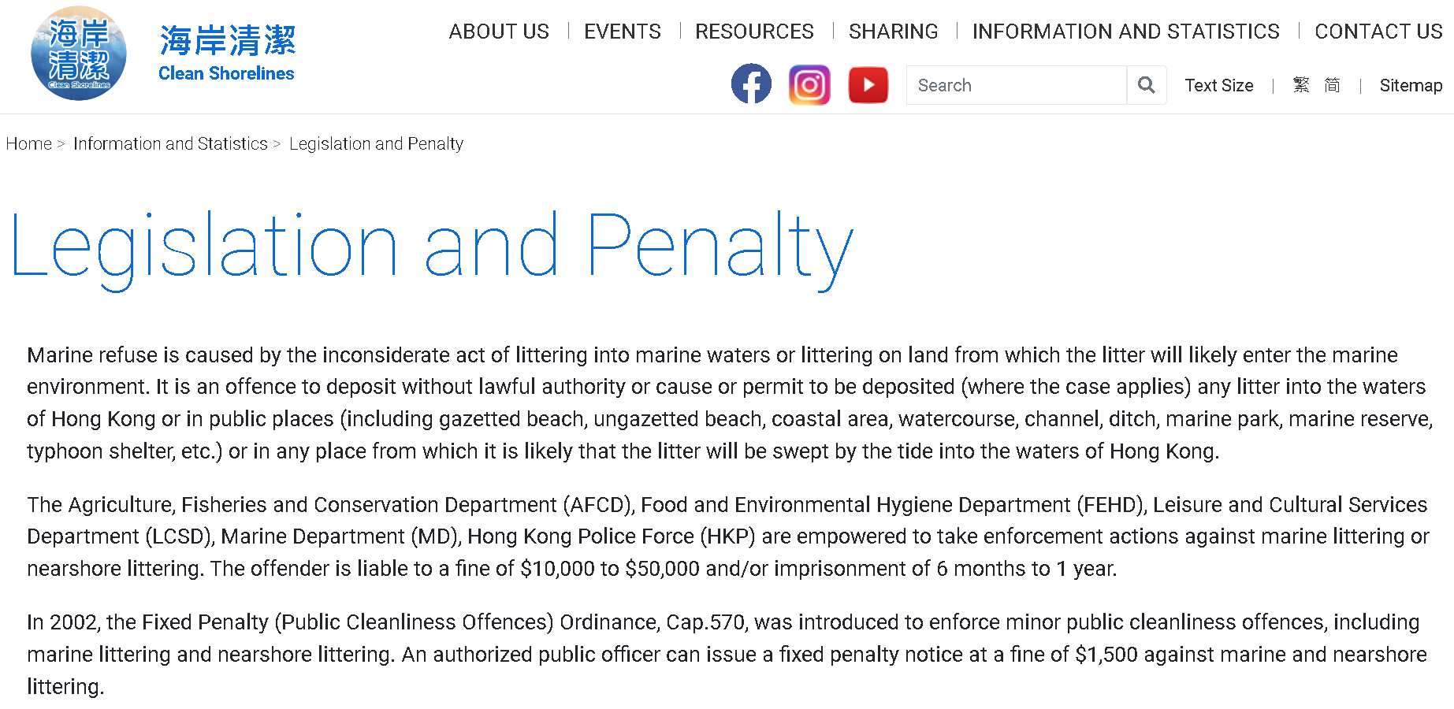
Must remind students to be responsible and law-abiding citizens! Marine littering can incur severe penalty!
Source: https://www.epd.gov.hk/epd/clean_shorelines/legislation_and_penalty.html#

Slide 10
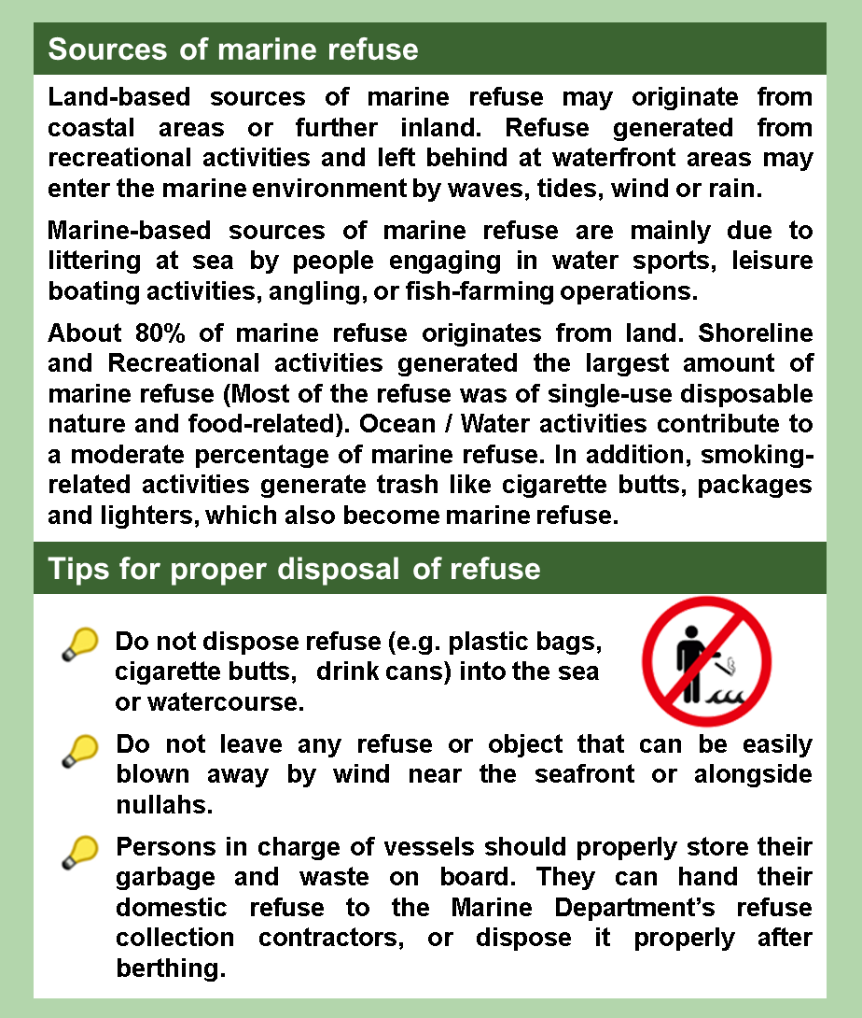
A Leaflet on Preventing Marine Littering
Poster for “Lap Sap Wan Beach Clean-up”
Sources of marine refuse can be
land-based or marine-based. 80% originates from land, so proper disposal of refuse is crucial!
This is our draft poster.
Can you think up a slogan to go with it to make it more impressive?
Adapted from: https://www.mardep.gov.hk/en/pub_services/ocean/pdf/pcu_harbourclean.pdf

Slide 11
Tips on Writing a Speech
Structure of a speech – A speech usually include three basic parts:
Parts
Purposes
• To elaborate the key message using the “3S” strategy
- State the idea (e.g. use a topic sentence or a question)
- Support the idea (e.g. give definition(s), example(s), statistics)
- Summarise the idea
• To remind students to be responsible and law-abiding citizens
• To recap the key message(s)
• To call to action (e.g. join a beach clean-up activity)
• To hook the audience
(e.g. ask a rhetorical question, use startling statistics, tell a brief anecdote/story, guide the audience to “imagine” a scenario)
• To state the theme/key message (e.g. maintain coastal cleanliness)
Opening
Body
Ending

Slide 12
Structure of a Speech
Opening
Body
Ending
Try to think of a good opening to start your speech. A good opening usually involves a hook, which is a presentation-opening tactic, to engage the audience and get their attention.
Ask a rhetorical question
e.g. Do you want to swim in a litter-filled sea, contaminated by man-made waste?
Use startling statistics
e.g. Every year, 15,000 tonnes of marine refuse on average are collected by the Hong Kong Government.
Tell a brief anecdote/story
e.g. Last summer, I went for a stroll near the sea, but instead of seeing crystal clear seawater glistening, I was shocked to find…
Guide the audience to “imagine” a scenario
Imagine seeing more plastics than fish when you go sea bathing. How do you feel?
1
How to hook?
2
Strategies to hook your audience
3
4

Slide 13
State the idea
Support the idea
Summarise the idea
Structure of a Speech
Opening
Body
Ending
Make the key idea clear and concise by using a topic sentence.
e.g. Marine littering is a serious problem locally and globally.
OR turn the key idea into a question, which you are ready to answer using different types of supporting ideas.
e.g. Do you think marine littering has nothing to do with you as you never go sea bathing?
Provide supporting details such as:
Definition(s)
e.g. Definition of marine litter
Statistics
e.g. Amount of marine litter collected to show the seriousness of the problem
example(s)
e.g. - Examples of marine litter
- Actions one can take to reduce marine refuse
Wrap up the key idea.
If you introduce your idea as a question, your summary should provide an answer.
Poster on Describing statistics

Slide 14
Structure of a Speech
Opening
Body
Ending
An effective speech ending helps to reinforce your message and give your speech unity. In the ending, you can:
reiterate the key message
include a call to action (i.e. encourage students to join the “Beach Clean-up” activity)
e.g. The problem of marine littering must be tackled without delay.
We must observe the law and be responsible citizens.
e.g. Hong Kong is our home. Let’s clean up our beaches together. Every piece of rubbish removed matters and makes a difference.

Slide 15
Speech for ABC School on “Air Con Abuse”
Opening
Body
Ending
Address the host and other important guests
Greet the audience
Principal Wong, Ms Chan, teachers and students,
Before I start, let me ask you a question. Have you ever heard that Hong Kong has become a “giant refrigerator”? Why is that?
Hook the audience by asking a rhetorical question
Metaphor

Slide 16
Opening
Body
Ending
Air-conditioners are “abused” in Hong Kong. Very often, travellers to Hong Kong are warned of its arctic shopping arcades and icy restaurants. Some popular shopping destinations were purportedly as low as 15°C. Living in a city with sub-tropical climate, many locals find air-conditioners a necessity, and an indoor jacket is usually regarded as an essential as air-conditioners are blasted, even in the midst of winter. However, while enjoying the soothing indoor temperatures, you might think differently after listening to the following figures and special “AC” culture. In Hong Kong, air-conditioning accounts for about one third of the total energy consumption, over three times the global average, and surging to 60% in summer. In fact, in some cases, the functions of air-conditioners go beyond regulating indoor temperatures. Why? To encourage customers’ entry and patronage, some shopping malls intentionally create a more “prestigious” shopping atmosphere by lowering its temperature. The lower, the “cooler”. This “cool” vibe is also believed to be effective in promoting winter clothing such as sweaters, jackets, scarfs, and the like.
State the key idea by using a topic sentence
Support the key idea by giving examples
Support the key idea by quoting statistics
Compare local and global figures
Explain why air-conditioners are abused in Hong Kong

Slide 17
Opening
Body
Ending
State and explain the consequences of abusing air-conditioners
Abusing ACs does not only result in a high electricity bill, it also creates a vicious cycle. When ACs are turned on, huge amounts of heat-trapping gases like carbon dioxide are produced and these gases warm up the surface temperature of earth, making the whole city as hot as an oven, and this feeds the need for more air-conditioning. According to some statistics, it takes a mature tree three months to absorb the carbon emissions created by just one regular air con unit in eight hours. This is definitely eco-unfriendly! What will you do after knowing the truth?
Simile
Support the idea by quoting statistics
Provoke thinking by asking a question

Slide 18
Opening
Body
Ending
All this can start with a change in our attitude. In 2022, 90,000 households took part in “No Air Con Night”. That’s a very good start, but not the end. If we can all join the next “No Air Con Night”, not just Hong Kong, but the whole world, will suffer less.
So turn off your ACs, take off your indoor jackets and take up a green lifestyle. Just be cool and free yourself from the freezing fridge. Thank you.
Call to action – change our attitude and join “No Air Con Night”
Parallelism – Repetition of a structure to enhance the rhythm and
make the message more powerful
Use of imperatives to appeal to action
Alliteration – Repetition of the initial letter sound “f” to help catch attention of audience

Slide 19
Outline of your speech
Opening
Body
Ending

Slide 20
Lead in – Answer Key
Adventure Clean-up Challenge: Filipino domestic workers volunteer to clean Hong Kong beaches
Why do the Filipinos volunteer to clean the Hong Kong beaches? Choose the correct answer(s).
A. They can do something meaningful while enjoying outdoor activities.
B. They can get an extra day off.
C. They see Hong Kong as their second home.
D. They feel depressed about the massive amount of coastal pollution.
2. What are the three common types of rubbish found on the beaches?
Styrofoam, plastic bottles and flip flops. (1:44 – 2:02)
What other types of rubbish do you usually find on beaches?
(Free answer) Examples: plastic bags, food packaging, cigarette butts, plastic cutlery, aluminium cans, plastic straws, glass bottles
Do you want to join the “Clean-up Challenge”? Why or why not?
(Free answer)

