Slide 1

Part 2:
Effective Dictation Activities
Development of Phonics Skills
Development of Grammar and Vocabulary Knowledge
Development of Note-taking and Writing Skills
Notes:
1
Effective dictation activities can enhance pupils’ language skills and knowledge. For example, phonics dictation can improve pupils’ phonics skills. Theme-based free dictation helps develop their vocabulary building skills. Picture dictation and ‘Bad Cold’ dictation help consolidate their grammar and vocabulary knowledge. Music dictation, running dictation, dicto-comp / dictogloss and keywords dictation can build up their note-taking and writing skills. In Part 2, these kinds of dictation activities are introduced.

Slide 2
1) Development of Phonics Skills
Phonics Dictation
Phonics dictation is a useful means to help pupils consolidate the learning of the basic letter-sound relationships and apply the knowledge in listening, spelling and writing.
Pupils are asked to fill in the target letter sounds as they hear the words in context.
Notes:
2
2
Phonics dictation can help develop pupils’ phonics skills. It allows pupils to focus on specific consonant or vowel sounds in order to develop their phonological awareness. Pupils need to fill in the target letter sounds as they hear the words in context. This activity helps pupils consolidate the learning of the basic letter-sound relationships and apply this knowledge in listening, spelling and writing.

Slide 3
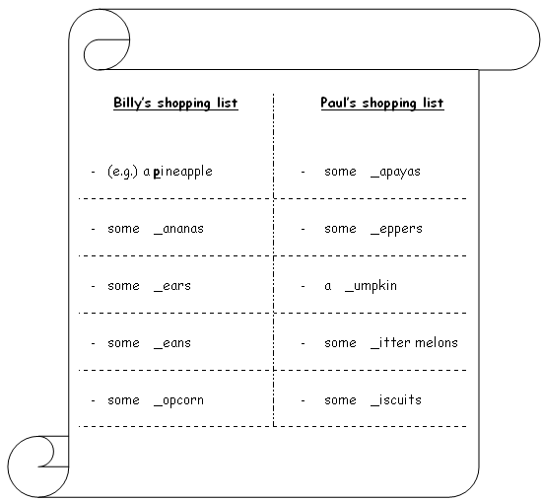
Phonics Dictation – Example (1)
Billy and Paul are talking about their shopping lists. Listen and fill in the blanks with ‘p’ or ‘b’. Follow the example.
‘b’ or ‘p’
Notes:
3
This phonics dictation shows two shopping lists which contain food items with either the initial consonant ‘b’ or ‘p’. Pupils have to discriminate between the initial consonants ‘b’ and ‘p’. Apart from revising the vocabulary pupils have learnt, they are also given the opportunity to apply their phonics skills to work out the spelling of the less familiar words (e.g. popcorn, peppers).
Please refer to LT 1.1 in Appendix A for the dictation worksheet.

Slide 4
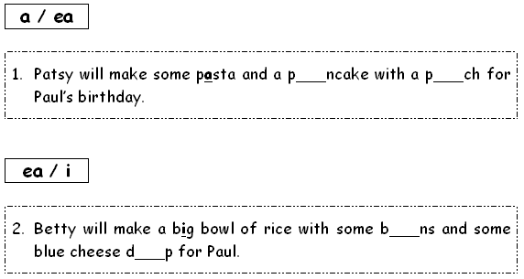
Phonics Dictation – Example (2)
Part 1: It is Paul’s birthday. Patsy and Betty will make some food for him. Listen and fill in the blanks with the letters given.
Notes:
4
In Part 1 of this phonics dictation, the teacher introduces the idea of tongue twisters and draws pupils’ attention to their features (e.g. repetition of the initial sounds of the words). Then, pupils listen to two tongue twisters about the food Paul’s friends, Patsy and Betty, will make for his birthday party, and fill in the correct vowel sounds (e.g. ‘a’ as in ‘pancake’, ‘ea’ as in ‘beans’).

Slide 5


Phonics Dictation – Example (2) & Extended Activities
Part 2: Paul’s teacher will join Paul’s birthday party. Listen and find out what food his teacher wants to make for him. Complete the tongue twister.
Part 3: What would you like to make for Paul? Write your own tongue twister in the spaces provided.
Part 4: Present your tongue twister in groups. Then, present it in the class competition.
Notes:
5
In Part 2, pupils listen to a tongue twister about the food that Paul’s teacher will make for him. They have to write the names of the food items as they listen.
Extended activities could be conducted to consolidate pupils’ writing and speaking skills. In Part 3, pupils are asked to model on the example given and apply their phonics skills in a fun way by creating their own tongue twisters. Instead of only focusing on the spelling of words, pupils are encouraged to express their ideas creatively and apply the target letter sounds through writing the tongue twisters.
In Part 4, pupils are asked to present the tongue twisters they have created to consolidate the learning of the letter sounds. A competition could be organised to actively engage the pupils. Teachers should guide pupils not just to focus on the speed, but to read it aloud correctly. This could help raise pupils’ awareness of different consonant and vowel sounds and improve their pronunciation through practice.
Please refer to LT 1.2 in Appendix A for the dictation worksheet.

Slide 6
2) Development of
Grammar and Vocabulary Knowledge
Dictation activities can be used to consolidate pupils’ grammar and vocabulary knowledge.
Theme-based free dictation encourages pupils to collect more vocabulary related to the theme they are learning.
Picture dictation provides opportunities for pupils to demonstrate their understanding of the target grammar and vocabulary items through drawing or completing a picture.
‘Bad Cold’ dictation requires pupils to think of suitable words using their grammar and vocabulary knowledge to fill the gaps in the dictation passage.
Notes:
6
Three kinds of dictation activities are introduced here. They are theme-based free dictation, picture dictation and ‘Bad Cold’ dictation. These dictation activities can help develop pupils’ grammar and vocabulary knowledge.

Slide 7
Theme-based Free Dictation
Theme-based free dictation is a commonly used activity to promote autonomy in learning and consolidate the learning of vocabulary under different themes.
Apart from studying the assigned materials from a textbook, pupils are encouraged to collect more vocabulary related to the themes on their own.
Notes:
7
Theme-based free dictation is a means to develop pupils’ vocabulary building skills. It is a commonly used activity to promote independent learning and consolidate the learning of vocabulary under different themes.
In theme-based free dictation, pupils are encouraged to write as many words as possible related to a topic / theme. To enhance motivation, bonus marks are usually given to the correct answers. Through this activity, pupils not only study the assigned materials from a textbook, but are also encouraged to collect more vocabulary related to different themes on their own.

Slide 8
Theme-based Free Dictation – Example (1)
Part 1: Listen and write down the sentences about Lucy.
___________________________________________________
___________________________________________________
___________________________________________________
___________________________________________________
Part 2: Write down things you do at school in the boxes provided below.
(e.g.) read storybooks
1. | 2. | 3.
4. | 5. | 6.
7. | 8. | 9.
10. | 11. | 12.
13. | 14. | 15.
Notes:
8
This dictation combines controlled dictation and theme-based free dictation. Pupils listen and write down the sentences about Lucy. Then, they relate to their own experience and list the activities they do at school in the boxes provided. Through writing the activities in phrases rather than single words, pupils’ awareness of word collocation (e.g. read storybooks, play football) can be developed.
Before conducting this dictation, the teacher could ask pupils to study the assigned passage to consolidate the learning of the target vocabulary. In addition, he / she could encourage pupils to think of as many things that they do at school as possible and write the things down in their notebooks to promote autonomy in learning.
Please refer to LT 2.1 in Appendix A for the dictation worksheet.

Slide 9



Theme-based Free Dictation – Example (2)
Preparation
Find out about the clubs in your school by visiting the school’s web page and walking around the campus.
Write down the English names of the clubs in your notebooks.
1. visiting the school’s web page
2. walking around the campus
3. writing down the English names of the clubs
Notes:
9
Before conducting this theme-based free dictation, the teacher asks pupils to find out about the clubs in their school by visiting the school’s web page and walking around the campus. Pupils have to write down the English names of the clubs in their notebooks.

Slide 10
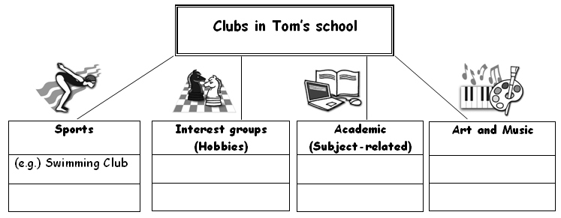
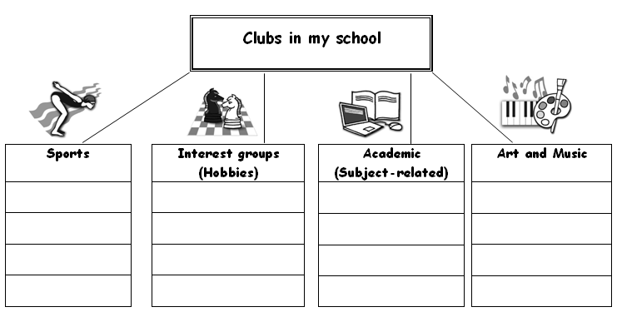
Theme-based Free Dictation – Example (2)
Part 1: You are going to hear the names of some clubs in Tom’s school. Decide which group they belong to and write them in the boxes of the tree diagram below.
Part 2: Think about the clubs in your school and write them in the boxes below.
Notes:
10
In this dictation, pupils write down the names of the clubs in their school. First, pupils listen to the names of some clubs in Tom’s school in random order and write those names under appropriate categories. Then, they are encouraged to write as many names of the clubs available in their own school as possible.
To cater for learner diversity, the less able pupils could be allowed to refer to their notebooks for the names of the clubs they have collected.

Slide 11
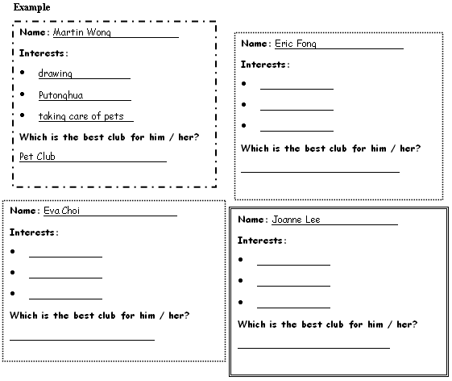
Theme-based Free Dictation – Example (2) Extended Activity 1
Four students are talking to David, a student helper, about their interests and hobbies. Take notes about what you hear and write down the most suitable clubs for them. The first one has been done for you as an example.
Clubs in School
Drama Club
Sports Club
Art Club
Pet Club
Music Club
English Club
Notes:
11
Different extended activities could be conducted to further develop pupils’ thinking and language skills. In this extended activity, pupils listen to four students talking to a student helper about their interests and hobbies. They have to pay attention to who is talking and write down the key words in the appropriate spaces in the forms as they listen to the dialogues. To further develop pupils’ thinking skills, pupils are asked to infer from what they have heard and choose the most suitable club for the students.
To cater for learner diversity, less familiar words, such as ‘painting’ and ‘gardening’, could be provided for the less able pupils.

Slide 12
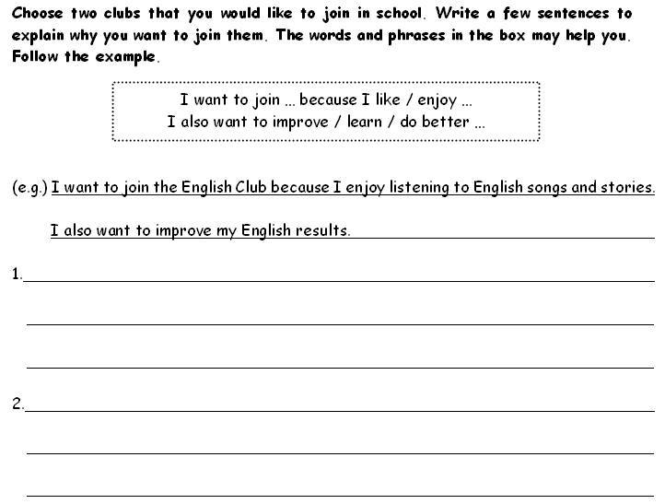
Theme-based Free Dictation – Example (2) Extended Activity 2
Notes:
12
An extended activity could also be conducted to develop pupils’ writing skills. Pupils are asked to choose two clubs they would like to join in school and write the reasons for choosing the clubs in a few sentences.
To cater for learner diversity, teachers could give some useful phrases to help the less able pupils express their ideas and preferences.
Please refer to LT 2.2 in Appendix A for the dictation worksheets.

Slide 13
Picture Dictation
Picture dictation can help teachers check whether pupils understand the listening text.
Instead of writing down words, pupils are asked to draw or complete a picture based on what the teacher reads to them.
It is an interesting way to consolidate pupils’ learning of the target vocabulary and language items.
Notes:
13
Picture dictation helps teachers check whether pupils understand the listening text. Instead of writing down words, pupils are asked to draw or complete a picture based on what the teacher reads to them. The teacher has to make sure that enough time is given to pupils to finish drawing one object before moving onto the next one.

Slide 14

Picture Dictation – Example (1)
Listen and draw the mask of a clown.
Notes:
14
In this picture dictation, while listening to the descriptions about the mask of a clown, pupils need to draw the eyes, ears, mouth and nose which are of different shapes (e.g. circles, triangles). Through drawing the different facial features on the mask, pupils demonstrate their understanding of the different shapes they have learnt.

Slide 15
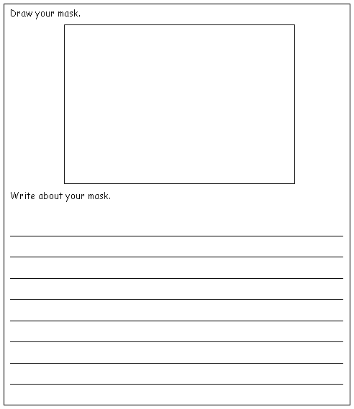
Picture Dictation – Example (1) Extended Activity
Make a mask for a clown and describe it to your classmates.
Notes:
15
Extended activities could be conducted to promote creativity as well as to develop pupils’ writing and speaking skills. Pupils could be asked to make a mask for a clown using different shapes. Then, they describe their mask to their classmates using the target vocabulary (e.g. names of shapes) and language items (e.g. it is / they are, there is / are).
Please refer to LT 2.3 in Appendix A for the dictation worksheets.

Slide 16
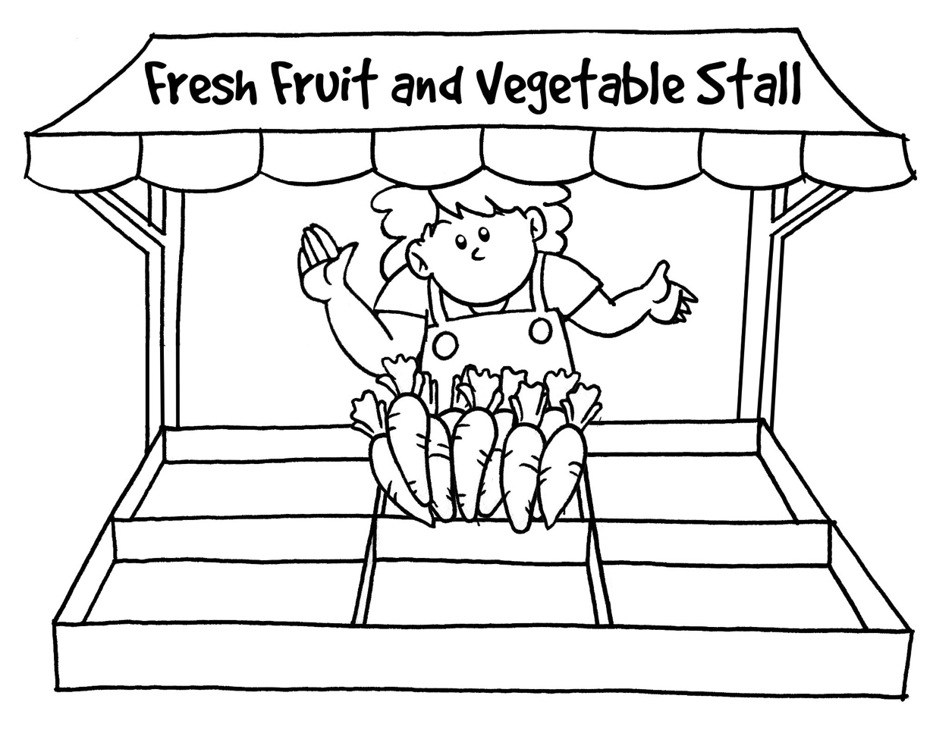
Picture Dictation – Example (2)
Aunt Mary is going to tell you the fruit and vegetables she can see on a stall. Listen and complete the picture of the stall.
Notes:
16
Apart from shapes, picture dictation can involve drawing of other objects. In this picture dictation, Aunt Mary describes the things she can see on Fresh Fruit and Vegetable Stall. Pupils need to complete the picture by drawing the missing details as they listen to the descriptions.
Through completing the picture, pupils demonstrate their understanding of the vocabulary items (e.g. names of fruit and vegetables), determiners (e.g. a few, some, many) and prepositional phrases (e.g. in front of, next to, on the right).

Slide 17
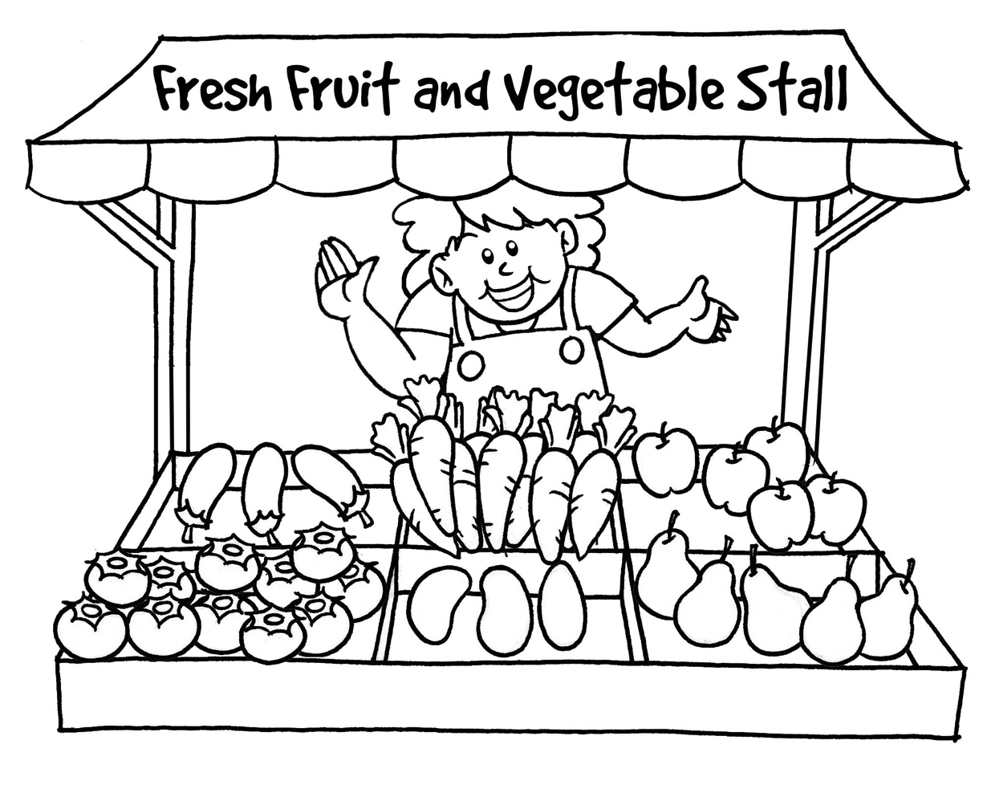
Picture Dictation – Example (2) Extended Activities
Listen and colour the picture.
2. Label the picture.
3. Write about the picture.
Notes:
17
Teachers could conduct extended activities by asking pupils to colour and write about the picture to consolidate their learning. Here are a few examples of extended activities for teachers’ reference:
1. Listen and colour the picture – The teacher could ask pupils to colour the picture based on his / her instructions. This provides an opportunity for pupils to develop their listening skills and consolidate their learning of colour words.
2. Label the picture – The teacher could ask pupils to label some parts of the picture to consolidate their learning of the target vocabulary items (e.g. the names of the fruit and vegetables).
3. Write about the picture – To consolidate the vocabulary and language items learnt as well as to develop pupils’ writing skills, the teacher could ask pupils to write about the fruit and vegetables in the picture.
Please refer to LT 2.4 in Appendix A for the dictation worksheets.

Slide 18
‘Bad Cold’ Dictation
While conducting ‘Bad Cold’ dictation, the teacher sneezes or coughs at certain points and leaves out some of the words.
Apart from writing down the words the teacher has read out, pupils have to think of appropriate words to fill the gaps by applying their grammar and vocabulary knowledge.
Notes:
18
In ‘Bad Cold’ dictation, the teacher dictates a text to pupils as usual. However, certain words are left out. In place of these words, the teacher sneezes or coughs. In addition to writing down the words the teacher has read out, pupils have to apply their grammar and vocabulary knowledge to think of suitable words to fill the gaps. ‘Bad Cold’ dictation is also called whistle gap dictation in which the teacher replaces certain words in a dictation text with a whistle.
To make the dictation more manageable for pupils, the words that are left out could be of the same part of speech (e.g. nouns, adjectives, prepositions) and the teacher could tell pupils about this beforehand. To make the dictation more challenging, the missing words can be of different parts of speech.

Slide 19
An Example of ‘Bad Cold’ Dictation
Listen and write down the sentences about the Wong family. Fill in any appropriate word when you hear your teacher sneeze or cough.
________________________________________________________________________________________________________________________________________________________________________________________________________________________________________________________________________________________________________________________________________________________________________________________________________________
Notes:
19
In this example, the teacher reads out the dictation text as usual. However, he / she sneezes or coughs at certain points and leaves out some of the nouns. Pupils are asked to apply their grammar and vocabulary knowledge to think of appropriate nouns to fill the gaps.
When pupils have acquired more grammar and vocabulary knowledge, they could be asked to provide words of different parts of speech (e.g. nouns, verbs).
Please refer to LT 2.5 in Appendix A for the dictation worksheet.

Slide 20
3) Development of
Note-taking and Writing Skills
Note-taking is an important language development strategy to record key information and ideas.
Pupils can learn note-taking skills and develop writing skills through some dictation activities, e.g. music dictation, running dictation, dicto-comp / dictogloss and keywords dictation.
Notes:
Teachers can make use of both music dictation and running dictation to guide pupils to write key words, short phrases and sentences. Music dictation requires pupils to write down key words and phrases while listening to songs. In running dictation, pupils write down sentences and short texts through group work and games.
To further develop pupils’ note-taking and writing skills, teachers can conduct dicto-comp / dictogloss in which pupils are required to reconstruct the text using key phrases and main ideas noted down.
Keywords dictation provides an opportunity for pupils to apply the vocabulary learnt in a new context. It also facilitates the development of writing skills.

Slide 21
Music Dictation
Music dictation is an interesting note-taking activity as pupils can learn English through songs.
Pupils are asked to fill in the missing words and phrases in the lyrics while listening to the songs.
As the key messages are repeated in different verses of the song and recurrent sentence structures are used, music dictation helps pupils listen for the key words and consolidates the learning of the target language structures.
Notes:
In order to conduct music dictation smoothly, teachers should select songs with lyrics that are clearly comprehensible and decide how much text could be given and how much be left blank based on the level and abilities of the class. Pupils are asked to fill the gaps in the lyrics while listening to the songs.
Before listening to the song and doing the dictation, teachers could provide some background information about the song or the song title to activate pupils’ prior knowledge and experience. This can also enhance pupils’ engagement in the activity.

Slide 22
Running Dictation
Running dictation is an integrative learning activity which involves reading, speaking, listening and writing.
In running dictation, pupils work in groups to read and take notes in meaningful chunks.
Notes:
Running dictation is an activity for pupils who enjoy moving around and working in teams. They have to read and memorise a short text, tell the phrases / sentences to the other group member who will write down the text. Running dictation is also called wall dictation since a short printed text is usually posted on the wall. It can be used to practise dialogues, role-plays and grammatical structures – anything pupils would find interesting. It provides an opportunity for pupils to develop their reading, speaking, listening and writing skills.
Since it is a race, pupils tend to get excited. They may run very fast and make a lot of noise. To maintain classroom discipline, adaptations could be made and rules could be set beforehand. For example, pupils could be asked to walk instead. To keep the noise down, no shouting is allowed.

Slide 23
Running Dictation
The ‘runner’ reads and memorises a short phrase or sentence of a text posted on the wall, runs to the ‘writer’ and tells him / her the phrase or sentence.
The ‘writer’ writes down what he / she has heard from the ‘runner’. The ‘writer’ can ask the ‘runner’ relevant questions about words, spelling and punctuation if necessary.
The first group that finishes writing with the most accurate information wins the game.
Notes:
There are different ways of conducting running dictation. Here are a few suggestions for teachers’ reference:
1. Instead of reading the text posted on the wall, the ‘runners’ run to the teacher who will read out loud a sentence of the text, i.e. they listen and remember.
2. Instead of reading texts, pictures can be used. The ‘runners’ run, look at the picture and then describe what they see to the ‘writers’ who will draw the picture or write about it.
3. The text is cut into discrete sentences. These cut-up texts are placed around the classroom in different locations. When the group has written down all the sentences, the members have to work together to sequence the sentences to make a complete and coherent text.
4. For more able classes, the teacher can read aloud the text once for the class to get a general understanding of the text. Then, some notes are posted on the wall. The ‘writers’ jot down the notes read by the ‘runners’. The ‘runners’ and ‘writers’ then work together to make sentences from the notes, and share their sentences with the class.

Slide 24
An Example of Running Dictation
Work in groups. One pupil from each group plays the role of the ‘runner’ and the others the ‘writers’.
The ‘runner’ reads a phrase / sentence and retells it to the ‘writers’. The ‘writers’ note down the phrase / sentence heard from the ‘runner’ in the spaces provided.
____________________________________________________________________________________________________________________________________________________________________________________________________________________________________________________________________________________________________________
Notes:
A short dictation text is posted on the wall far away from the ‘writers’. Pupils work in groups. Each time the ‘runner’ memorises a phrase or a sentence of the dictation text and retells it to the ‘writers’. The role of the ‘writers’ is to write down the whole text based on what they have heard. Depending on the pupils’ abilities, the teacher could decide the number of times the ‘runner’ can go and read the text. The ‘writers’ of the same group may compare what they have written to come up with an agreed version of the text.

Slide 25
Dicto-comp / Dictogloss
Dicto-comp / Dictogloss is a combination of dictation and composition.
Pupils listen to the teacher reading a short text at normal speed twice. During the first reading, they try to understand the meaning of the text. During the second reading, they note down the key words.
Then they share their information / ideas in groups and reconstruct the text, using the words they have written down.
Notes:
25
Teachers should pay attention to the following points when conducting dicto-comp / dictogloss:
Allow time for pupils to discuss the topic before the activity. It is helpful for them to revisit or acquire some vocabulary and language items in the process.
Read the text at normal speed for pupils to understand the meaning of the text in the first reading.
Read the text again at normal speed for pupils to take notes.
Ask pupils to work in groups to reconstruct the text from the notes.
With the teacher as the facilitator, pupils compare and discuss the text in groups, paying attention to language accuracy. Through the process, pupils are guided to apply their grammar knowledge to write the text.

Slide 26
Adaptations of Dicto-comp / Dictogloss to Suit the Primary Classroom in Hong Kong
The text can be read aloud more than twice to make it easier for pupils.
Pupils could be asked to note down and re-organise sentences read to them in a jumbled order.
Pupils could be asked to give their opinions about the reconstructed text.
Notes:
To suit the primary classroom in Hong Kong, adaptations could be made to dicto-comp / dictogloss. Below are some suggestions:
The text can be read aloud more than twice to make it easier for pupils, but not to such an extent that pupils have time to write down every single word. Teachers should make it clear to pupils that they are not expected to write every word down and they may use their own words.
Pupils could be asked to note down sentences read to them in a jumbled order and then re-organise the sentences. It provides an opportunity for pupils to be more aware of the organisation of texts.
The teacher reads aloud a thought-provoking text. After reconstructing the text as in dicto-comp / dictogloss, pupils are asked to give their opinions about it by either adding a new paragraph at the end or inserting their opinions within the reconstructed text.
26

Slide 27
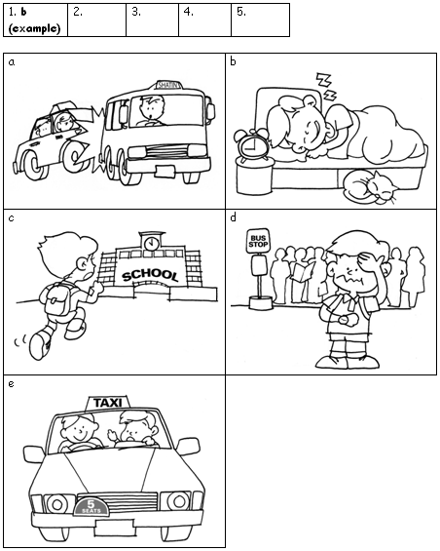
Dicto-comp / Dictogloss – Example (1)
Part 1: Listen to Andrew’s story and arrange the following pictures in the correct order.
Notes:
Dicto-comp / dictogloss may be challenging to some pupils during the first listening. The teacher could provide support (e.g. pictures) to help pupils understand the story. Through arranging the pictures in the correct order, pupils can have a better understanding of the sequence of events before they start taking notes.
27

Slide 28
Dicto-comp / Dictogloss – Example (1)
Part 2: Listen to Andrew’s story again. Write down the key words in the spaces provided.
e.g.
woke up late
Notes:
During the second listening, pupils are guided to take notes using a sequence chart. They only write down the key words as they listen to Andrew’s story.
Pupils should be reminded to use short forms, abbreviations and symbols where appropriate. To cater for learner diversity, less familiar words (e.g. rushed) could be provided to pupils. The teacher could also play the recording one more time for the less able pupils.
28

Slide 29
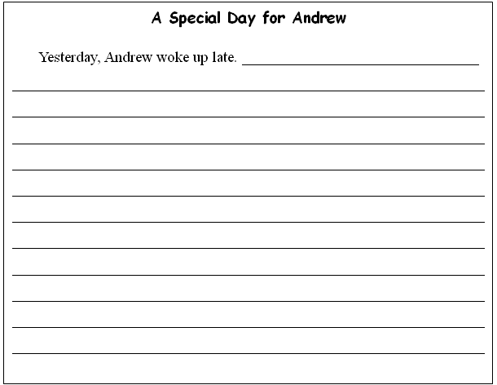
Dicto-comp / Dictogloss – Example (1)
Part 3: Work in pairs to revise the notes and help each other fill in any missing points.
Part 4: Write Andrew’s story in the spaces provided.
Notes:
29
Pupils are asked to work in pairs to share the notes taken in Part 3. It facilitates the development of collaborative learning skills and allows pupils to learn from each other. Then they finish the writing independently.
Please refer to LT 3.1 in Appendix A for the dictation worksheets.

Slide 30
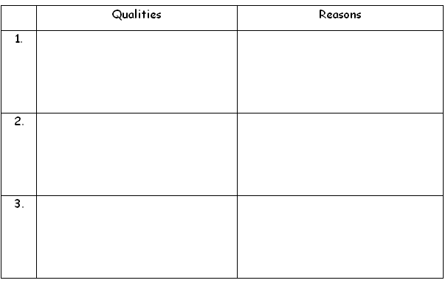
Dicto-comp / Dictogloss – Example (2)
Part 1: Listen to the descriptions about Miss Lee and try to understand
the main ideas.
Part 2: Listen to the descriptions again and take notes in the following
table.
What makes Miss Lee a good teacher?
Notes:
Pupils listen to an oral presentation about a teacher called Miss Lee. To prepare pupils for the dicto-comp / dictogloss, a table is provided for them to take notes. Pupils have to note down the main ideas (i.e. the qualities that make her a good teacher) and the supporting details (i.e. the reasons).
30

Slide 31
Dicto-comp / Dictogloss – Example (2)
Part 3: Write about Miss Lee using the notes you have taken. You can use the original wording or your own words.
My Favourite Teacher ______________________________________________________________________________________________________________________________________________________________________________________________________________________________________________________________________________________________________________________________________________________________
Part 4: Discuss with your neighbour and help each other revise the
work.
Notes:
31
Pupils use the original wording or their own words to reconstruct the text. Finally, they are asked to help each other revise their work.
Please refer to LT 3.2 in Appendix A for the dictation worksheets.

Slide 32
Dicto-comp / Dictogloss – Example (3)
Part 1: Listen to the descriptions about cooking scrambled eggs and try to understand the main ideas.
Part 2: Listen to the descriptions again and note down the key words in the spaces provided.
1.________________________________________________2.________________________________________________3.________________________________________________4.________________________________________________5.________________________________________________6. ________________________________________________
Notes:
32
Pupils listen to a procedural text (e.g. cooking scrambled eggs) in a jumbled order twice. They try to understand the text during the first listening and write down the key words during the second listening.

Slide 33

Dicto-comp / Dictogloss – Example (3)
Part 3: Write the sentences about cooking scrambled eggs with the help of key words.
Part 4: Discuss in pairs / groups and put the sentences in the right order.
Notes:
33
In Part 3, pupils write the sentences about cooking scrambled eggs with the help of key words.
In Part 4, pupils compare their notes with their partner / group members and discuss the correct order of the sentences by considering the logical development of the text and the cohesive devices used. It is a good way to develop pupils’ organisation skills and improve their writing skills.
Please refer to LT 3.3 in Appendix A for the dictation worksheets.

Slide 34
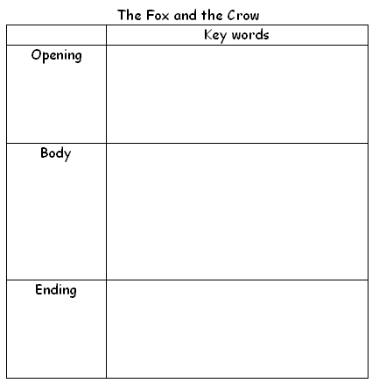
Dicto-comp / Dictogloss – Example (4)
Part 1: Listen to the story about the Fox and the Crow and try to understand the main ideas.
Part 2: Listen to the story again and note down the key words in the spaces provided.
Notes:
34
Pupils listen to the story about the Fox and the Crow twice. They get an understanding of the story during the first listening and write down the key words during the second listening.

Slide 35
Dicto-comp / Dictogloss – Example (4)
Part 3: Work in groups and help each other revise the notes taken.
Part 4: Write the story using the notes you have taken and add your own opinions.
The Fox and the Crow ________________________________________________________________________________________________________________________________________________________________________________________________________________________________________________________________________________________________________________________________________________________________________________________________________________
Notes:
35
Pupils compare their notes in groups and reconstruct the story individually in the spaces provided. After reconstructing the text, pupils are asked to comment on the behaviour of the animals, using adjectives they have learnt, e.g. ‘I think the fox is cunning and the crow is foolish.’
Please refer to LT 3.4 in Appendix A for the dictation worksheets.

Slide 36
Keywords Dictation
Keywords dictation is a good way to encourage pupils to use the vocabulary they have learnt in a new context.
The teacher dictates some key words or phrases related to a theme to pupils. The pupils have to write a new text using the words provided.
Notes:
36
The idea of keywords dictation is that some key words or phrases (about 15 – 20) are chosen from an interesting text or a short story. The teacher dictates these words to pupils in exactly the same order and the original form without showing them the text. Based on these key words, pupils write a new text which they will share with the class. Keywords dictation is a good way to encourage pupils to use the vocabulary in a new context and they can learn from their peers when they share their work.
The dictation activity can be adapted to suit the ability of primary pupils. For instance, pupils could be taught the target language and vocabulary items related to the topic in advance. For the less able and average pupils, they can use some or all the key words or phrases to write about the same topic. As for the more able pupils, they could be encouraged to write about a new topic using the key words provided. To provide more flexibility, pupils could be allowed to change the word forms if necessary.

Slide 37
An Example of Keywords Dictation
Part 1: Listen and write down the key words / phrases about a tourist attraction.
________________________________________
________________________________________
________________________________________
________________________________________
________________________________________
Notes:
After introducing the text about Stanley Market and learning the topic of tourist attractions in Hong Kong, the teacher dictates fifteen key words and phrases related to the text to pupils. Based on the key words provided, pupils have to write about a tourist attraction they like most.
Reference Reading Text
Stanley Market
Hong Kong is a nice place for tourists. I am amazed by the big shopping centres and beautiful beaches. Among the many attractions in Hong Kong, I think Stanley Market is a must-go place because the market town is very interesting and the sea view is wonderful.
Last Sunday, I visited Stanley Market. It was crowded with many tourists and shoppers. I bought some Chinese paintings and souvenirs at reasonable prices. Then I enjoyed a delicious seafood meal on the waterfront. I looked at people playing water sports. I also took photos of the beautiful beach and the old buildings.
Stanley is certainly the best place to spend a relaxing day.
(The key words and phrases selected from the text are underlined.)
37

Slide 38
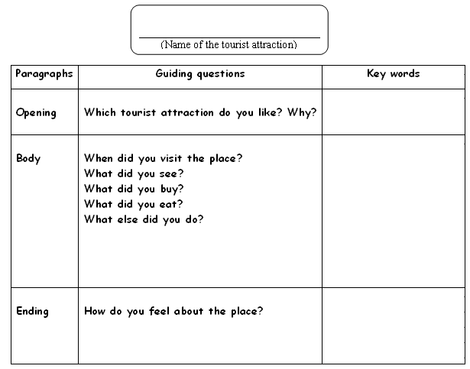
An Example of Keywords Dictation
Part 2: Use the outline below to help you write about the tourist attraction you like most.
Notes:
38
To help pupils make good use of the key words, a writing framework could be provided. Some guiding questions are given for them to write each paragraph with a clear focus. Pupils should think about when to use the key words, e.g. in the opening paragraph, the body or the ending paragraph.

Slide 39
An Example of Keywords Dictation
Part 3: Write about a visit to the tourist attraction you like.
________________________
(Name of the tourist attraction)
______________________________________________________________________________________________________________________________________________________________________________________________________________________________________________________________________________________________________________________________
Notes:
39
After drafting their ideas, pupils write about a visit to a tourist attraction in Hong Kong. They could write about Stanley Market or any tourist attraction they like using the key words provided.
Pupils should be reminded to proofread their writing before submission as the word forms of the key words provided may need to be changed to suit the new context.
Please refer to LT 3.5 in Appendix A for the dictation worksheets.

