Slide 1
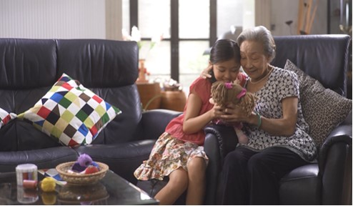
Short Film Appreciation -
My Grandmother

Slide 2
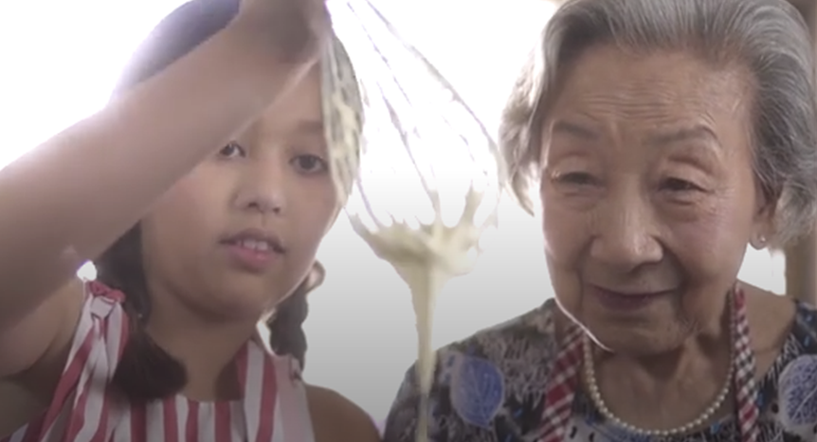
Learning Objectives
To develop an awareness of and capacity for critical appreciation of films
To learn about film techniques and how they are used in films
To develop an aesthetic awareness and understanding of films
Literature in English Critical Appreciation of Films

Slide 3
Programme Outline
This short film explores the relationship between a granddaughter and her grandmother. The positive and gentle outlook of her grandmother instils in her optimism and confidence in life. The use of flashback in the video brings her back to her fond memory of her late grandmother.

Slide 4
The ETV Programme
Activity Sheets
Suggested Answers
Suggested Activities

