Slide 1

English Language Resource Materials on
National Security Education at the Secondary Level
An Example of Learning and Teaching Activities
WATER ISSUES

Slide 2
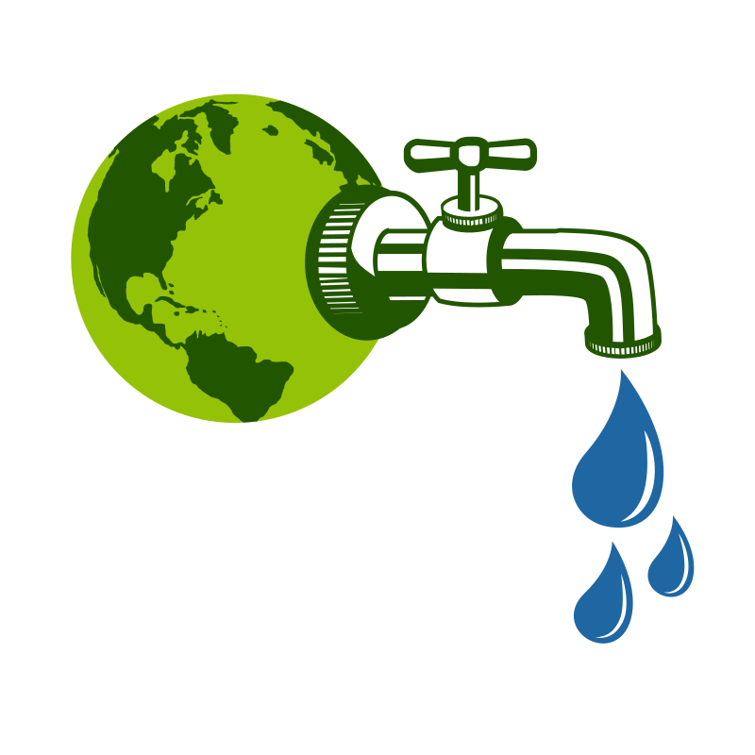


Module | Unit | Topic
Nature and Environment | Resources and energy conservation | Water Issues
Content Objectives
To explore concepts related to resource security, e.g.
the water issues in our country
China's water challenges and our role in water conservation
Language Objectives
To develop language knowledge and skills, e.g.
listening, speaking, reading/viewing and writing skills
text structures (e.g. video, article)
the use of the passive voice and mathematical presentations to express factual information
English Language
Education
Water
Issues
National Security
Education

Slide 3

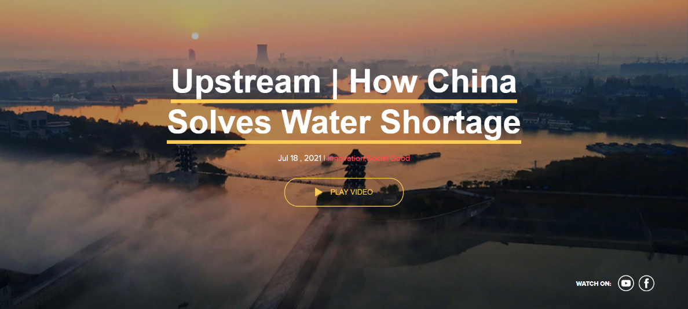
Pre-viewing
Find out how much students know about water issues in our country.
While-viewing
Play the video.
Post -viewing
Use the article “Water security crucial for a beautiful and green China” as a follow-up to reinforce students’ understanding of China's water challenges and their role in water conservation.
Engage students in finding out China's water challenges, reasons for water shortage in specific areas, and the government's efforts to address them.
Guide students to develop the language knowledge and skills through integrating information and ideas from the video and the article on China's water challenges.
A Video on
“Upstream | How China Solves Water Shortage”
Source: The China Current:
https://chinacurrent.com/story/22291/upstream-how-china-solves-water-shortage

Slide 4

About Water Shortage…
  Find out how much students know about water issues in our country.
Pre-viewing
1)
What do you want to know?
What have you learnt?
What do you know?
What do you know?
2)
What have you learnt?
What do you want to know?
Let’s explore: China Water Risk

Slide 5

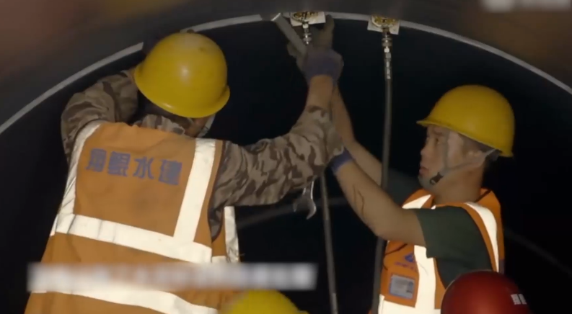
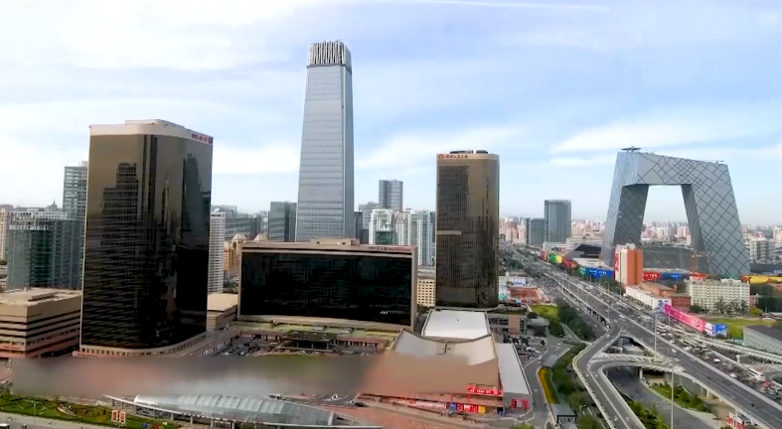
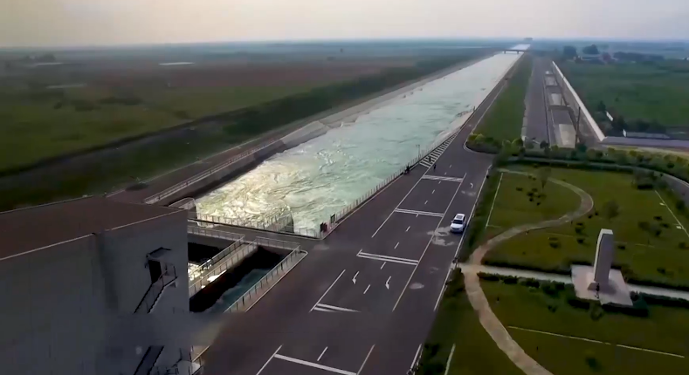
A Video on
“Upstream | How China Solves Water Shortage”
  Play the video.
  Engage students in exploring China's water challenges, reasons for water shortage in specific areas, and the government's efforts to address them.
While-viewing
Video Time: 00:00 – 00:37
Video Time: 00:38 – 01:34
Video Time: 01:35 – 02:54
  What are the water challenges faced by China?
  What are the reasons for water shortage in some areas of our country?
  How does the Chinese government tackle the water challenge?
Water shortage / drought /
lack of clean water
Uneven distribution of water resources between North and South / drought
To carry out the South-North Water Transfer Project
Source: The China Current:
https://chinacurrent.com/story/22291/upstream-how-china-solves-water-shortage

Slide 6

Reflection on Resource Security
How does water scarcity in China contribute to conflicts and tensions between different regions or neighbouring countries?
Why is resource security, particularly the availability of sufficient water, crucial for the sustainable development of our country's economy and society?
Impact of Water Security
Do you know any other innovative technologies or solution that can help address water problems in our country?

Slide 7
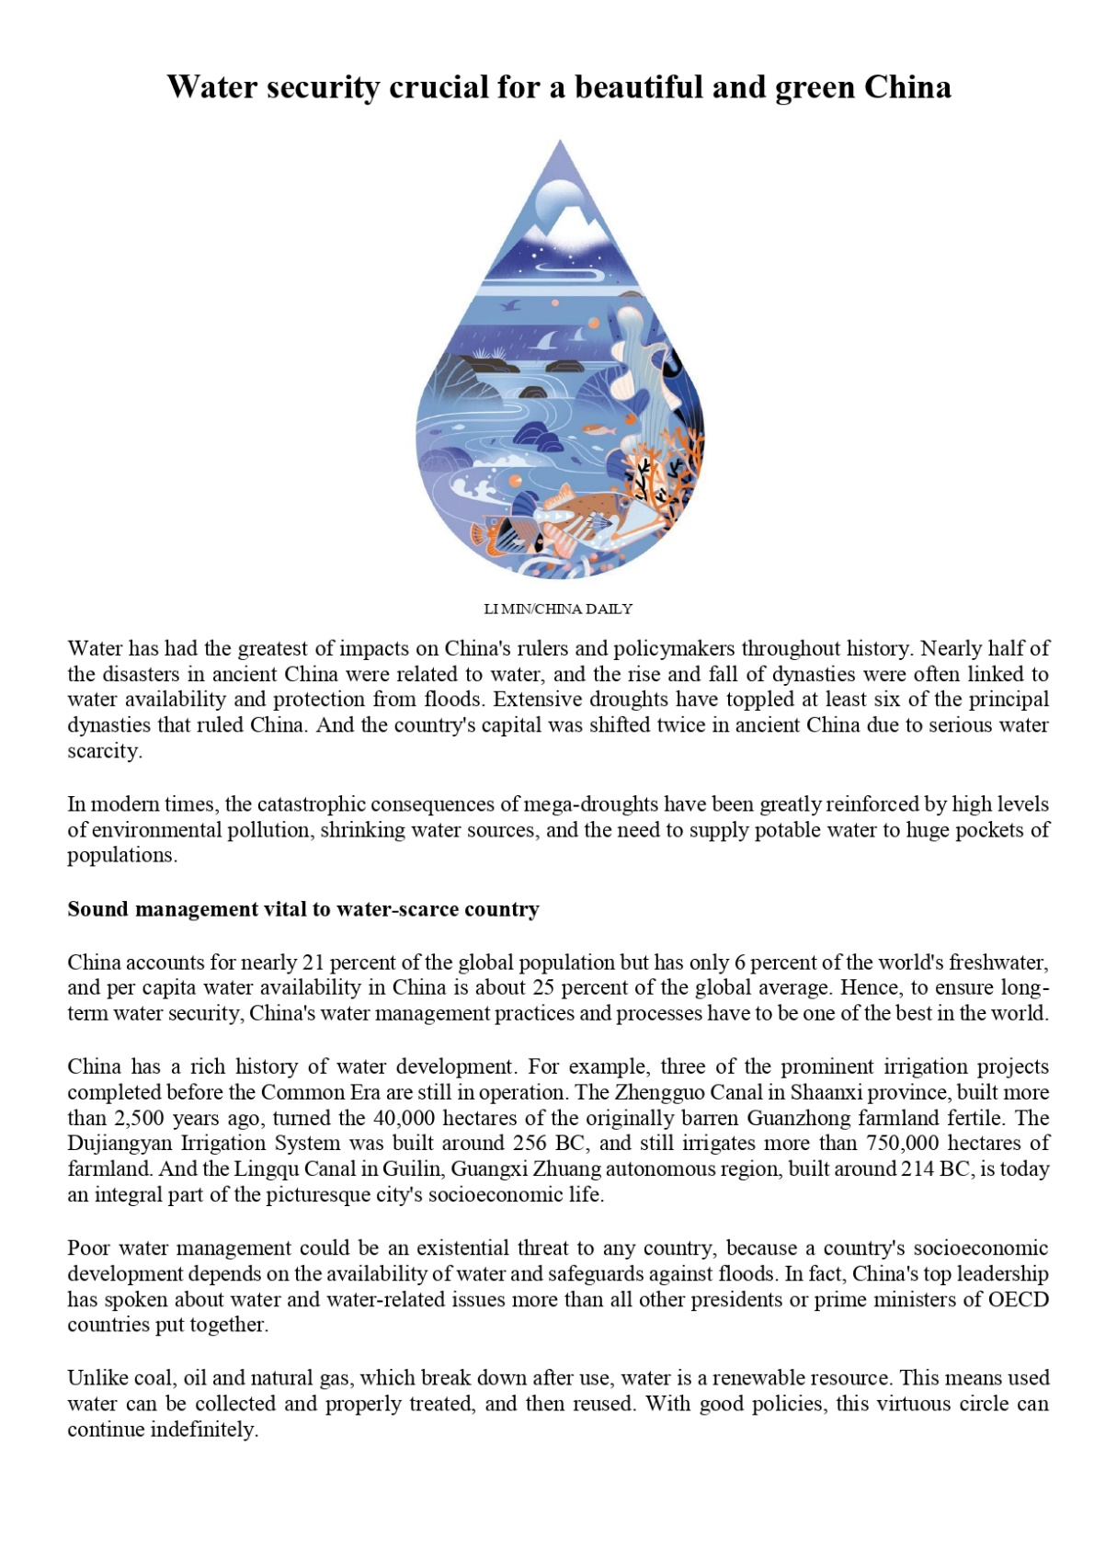
An Article on “Water Security Crucial for a Beautiful and Green China”
  Use the article “Water security crucial for a beautiful and green China” as a follow-up to reinforce students’ understanding of China's water issues.
Post-viewing
Organisation of the Article
Match the most appropriate summary heading with each section of the article on the next page.
ⓐ
China’s history of water development
ⓑ
Future outlook and optimism
ⓒ
Historical significance of water in China
ⓓ
Modern challenges and consequences
ⓔ
Challenges in ensuring water security
ⓕ
Current water management practices
Please click here to download the text.
Source (Text of the article)
Asit K. Biswas, Cecilia Tortajada and Zhao Changsen. (2024, January 13). Water security crucial for a beautiful and green China. China Daily. Retrieved from: https://www.chinadaily.com.cn/a/202401/13/WS65a1db44a3105f21a507c11d.html

Slide 8
An Article on “Water Security Crucial for a Beautiful and Green China”
Organisation of the Article
Para
1
ⓒ Historical significance of water in China
Para
2-3
ⓓ Modern challenges and consequences
Para
4-5
ⓐ China’s history of water development
Para
6-11
ⓔ Current water management practices
Para
12-14
ⓕ Challenges in ensuring water security
Para ​
15-19
ⓑ Future outlook and optimism
Please click here to download the text.
Source (Text of the article)
Asit K. Biswas, Cecilia Tortajada and Zhao Changsen. (2024, January 13). Water security crucial for a beautiful and green China. China Daily. Retrieved from: https://www.chinadaily.com.cn/a/202401/13/WS65a1db44a3105f21a507c11d.html

Slide 9
An Article on “Water Security Crucial for a Beautiful and Green China”
Complete the following summary of the article with a word taken from the text.
China's history and development have been deeply influenced by water ① __________, with ancient dynasties impacted by water-related disasters. Despite representing 21% of the global population with only 6% of ② __________, China has a rich tradition of water management, with ancient ③ __________ systems still in use. Modern challenges include balancing supply and demand, managing industrial wastewater, and coping with ④ __________ weather events exacerbated by climate change. Technological advancements in forecasting and infrastructure support proactive measures against ⑤ __________, but drought prediction remains uncertain. Our country has improved water ⑥ __________ since 2005, giving hope for the future.
security
freshwater
irrigation
extreme
floods
management
Please click here to download the text.
Source (Text of the article)
Asit K. Biswas, Cecilia Tortajada and Zhao Changsen. (2024, January 13). Water security crucial for a beautiful and green China. China Daily. Retrieved from: https://www.chinadaily.com.cn/a/202401/13/WS65a1db44a3105f21a507c11d.html

Slide 10
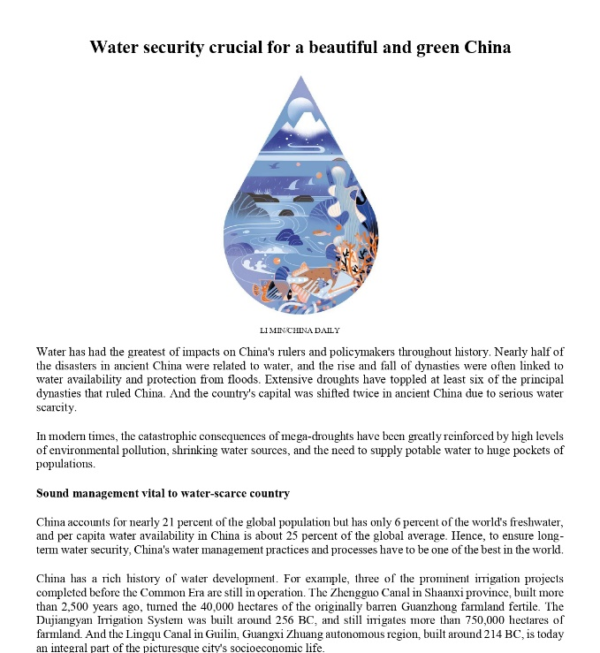


  Guide students to develop the language knowledge and skills through integrating information and ideas from the video and the article on China's water issues.
Post-viewing
Ways to Solve Water Issues in Our Country​
1)
Water use reduction
Improved water management
Infrastructure & forecasting
Awareness & education
2)
Gradually increase water prices to reduce per capita water use
Implement policies and techniques for the circular use of water
Video Time: 01:35 – 02:54
4)
3)
A Video on
“Upstream | How China Solves Water Shortage”
Educate the public about the impact of water-related issues
Develop and maintain reservoirs and dams for water storage and flood control
An Article on “Water Security Crucial for a Beautiful and Green China”

Slide 11



  Guide students to identify the use of the passive voice and mathematical presentations to express factual information.
Post-viewing
Language Focuses
To describe trends and distributions
To talk about how things are treated by humans
A Video on
“Upstream | How China Solves Water Shortage”
An Article on “Water Security Crucial for a Beautiful and Green China”
Mathematical presentations and statistics
Passive voice

Slide 12
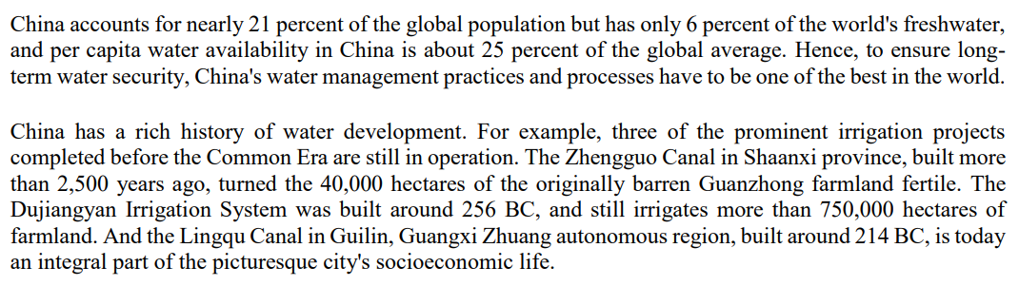
Language Focuses
The following is an excerpt from the article, and a transcript of part of the video respectively. Identify the language items (i.e., the passive voice, mathematical presentations), underline an example of each, and explain their communicative functions.
Using a series of canals, scientists studied the amount of water that could be safely diverted from cities and regions up in the country’s north. It’s estimated that already 13.5 million people have more access to clean water because of the project, and by 2050, officials hope to build capacity to transfer 44.8 billion cubic meters of water per year, about half the amount of water California uses annually.
Video Time: 01:43 – 02:13
Language Items | Communicative Functions | Examples (article) | Examples (video)
Passive voice
Mathematical presentations and statistics
To talk about how things are treated by humans
The Dujiangyan Irrigation System was built around 256 BC
It’s estimated that …
To describe trends and distributions
nearly 21 percent of the global population
about half the amount of water

Slide 13
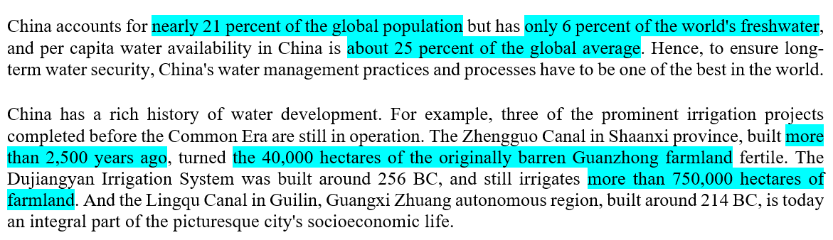
Language Focuses
More examples of mathematical presentations, statistical trends and distributions

Slide 14
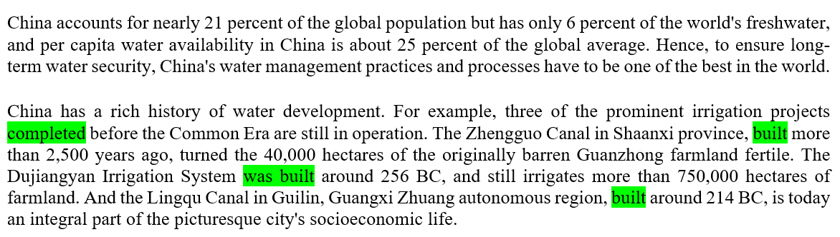
Language Focuses
More examples of the passive voice

Slide 15
Reflection on Resource Security
How can individuals promote water conservation within their communities?
What do you do to save water?
Impact of Water Security
Apart from saving water, what else can you or other teenagers do to safeguard resource security of our country?
What role can Hong Kong play in addressing water challenges in China?

Slide 16
Extended Learning Activities
Arrange an excursion to a waterworks facility, such as a guided tour of the Ex-Sham Shui Po Service Reservoir organised by the Water Supplies Department. This will provide students with opportunities to explore the historical background and significance of the facility, enhance their knowledge of water resources, and raise their awareness of water conservation and hence resource security.
Engage students in collecting data from the trip on the waterworks facility, focusing on the following details:
  the historical background and development of the facility;
  the features of the facility; and
  its role in water conservation in Hong Kong.
Invite students to create a short video similar to Instagram reels or YouTube shorts to present highlights of their work and share them with the class.
Let’s explore: Information on Guided Tour to Ex-Sham Shui Po Service Reservoir (GovHK Water Supplies Department)
https://www.waterconservation.gov.hk/en/ex-sspsr/index.html

Slide 17
About China's water issues…
  Ask students to reflect on their learning experiences and write down what they have learnt from this unit.
Post-viewing
What do you want to know?
What have you learnt?
What do you know?
What do you know?
What have you learnt?
What do you want to know?

