Slide 1
English Language Resource Materials on
National Security Education at the Secondary Level
An Example of
Learning and Teaching Activities
Societal Security

Slide 2
Module | Unit | Topic
Rights and Responsibilities | In a Group (Cyberspace) | Online Scams
Content Objectives
To explore concepts related to societal security, e.g.
the relationship between online scams and societal security
the common scam tactics and online safety
the importance of safeguarding societal security of our country
Language Objectives
To develop language knowledge and skills, e.g.
English Language
Education
National Security
Education
Online Scams
listening, speaking, reading/viewing and writing skills
text structures (e.g. poster, video, news article)
the use of modal verbs
the use of modifiers (i.e. participial phrases)

Slide 3
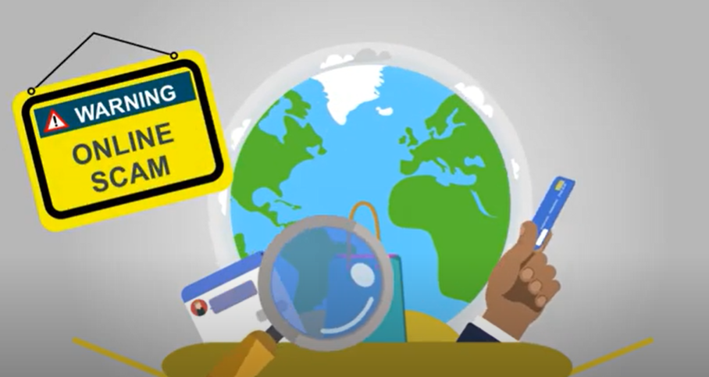
Pre-viewing
Find out how much students know about online scam vulnerability.
While-viewing
Play the video.
Post -viewing
Use the news article on scams in Hong Kong as a follow-up to engage students in reflecting on the seriousness of online scams and the importance of societal security.
Engage students in understanding phishing tactics and online safety.
Introduce the different types of scams.
Guide students to reflect on and explore what they can do to safeguard societal security in their daily life.
A Video on
“[Digital Literacy Series] English - 1. Protect from Phishing”
Source: CyberDefender “[Digital Literacy Series] English - 1. Protect from Phishing”:
https://www.youtube.com/watch?v=RYWTW2P0kjk

Slide 4
Find out how much students know about online scam vulnerability.
Pre-viewing
List all the platforms where you have public profiles.
Circle the platform(s) you have received messages from people you do not know.
Put a star next to the platform you have shared personal information (e.g. school, location, hobbies).
Hi there! I’m Chris!
How easily could someone use this information to pretend they know you?

Slide 5
Find out how much students know about online scam vulnerability.
“Too Good to Be True”
Experiences
Pre-viewing
What made you suspicious or trusting in these situations?
How did you decide whether to engage or ignore?
Have you or your friends ever:
been offered an amazing deal that seemed unusually generous?
seen ads for easy ways to make money online?
been approached by strangers online offering opportunities?

Slide 6
Introduce the different types of scams.
Pre-viewing
1.
Telephone deception
Romance scam
Employment fraud
Phishing scam
Fake investment applications scam
1. What are the five types of scams featured in the poster?
2. It refers to the enormous amount of money that has been stolen through scams.
2. What does it mean by “BILLIONS SWINDLED”?
3. We need to "STAY ALERT" because scammers are constantly active, using various techniques as shown in the poster to deceive people. And billions of dollars have already been swindled from victims.
3. Why do we need to “STAY ALERT”?
What does the illustrations in the poster tell you about the scammers? Why?
Source: Anti-Deception Coordination Centre – The Five Scammers:
https://www.police.gov.hk/offbeat/1207/images/e1.jpg

Slide 7
2. Apart from online scams, what other major threats to societal security should we be concerned about?
Reflection on Societal Security
1. Do you think technology plays a role in societal security? Why?
3. Why is it important to safeguard societal security?

Slide 8
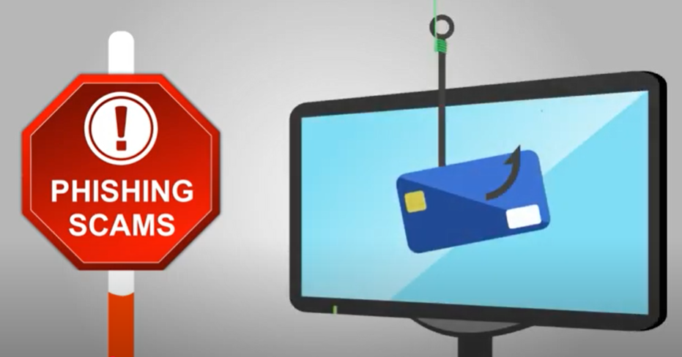
A Video on
“[Digital Literacy Series] English - 1. Protect from Phishing”
While-viewing
Play the video.
Engage students in understanding phishing tactics and online safety.
Video Time: 00:00 – 00:51
Video Time: 00:56 – 02:10
Video Time: 02:10 – 02:45
What is phishing?
What should we do when providing information online?
What can we do to ensure our electronic devices are safe from scams?
Source: CyberDefender “[Digital Literacy Series] English - 1. Protect from Phishing”:
https://www.youtube.com/watch?v=RYWTW2P0kjk

Slide 9
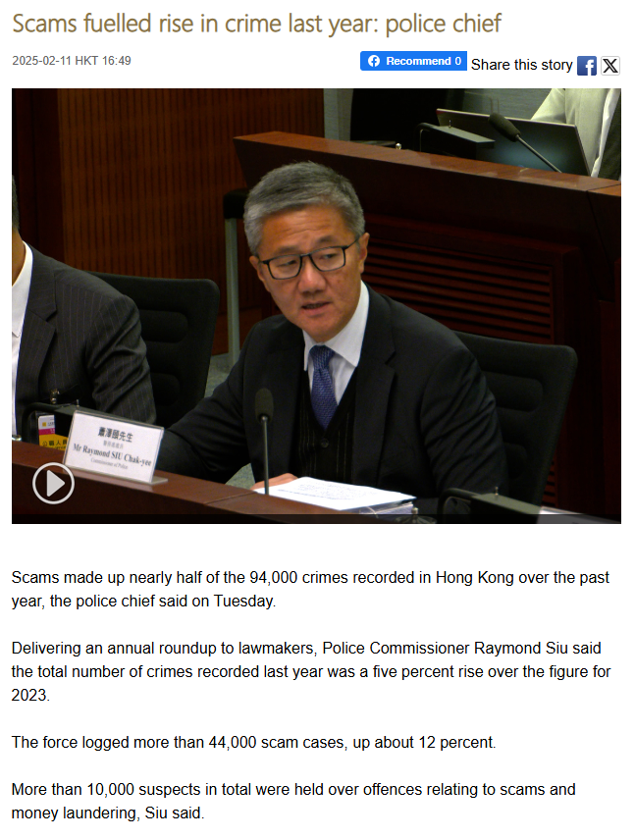
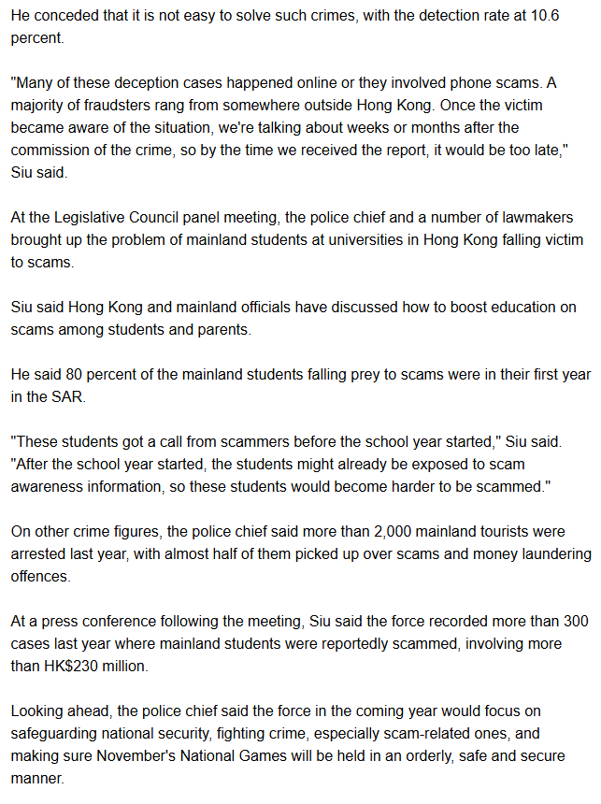
Use the news article on scams in Hong Kong as a follow-up to engage students in reflecting on the seriousness of online scams and the importance of societal security.
Post -viewing
Source: RTHK English News: Scams fuelled rise in crime last year: police chief:
https://news.rthk.hk/rthk/en/component/k2/1791183-20250211.htm

Slide 10
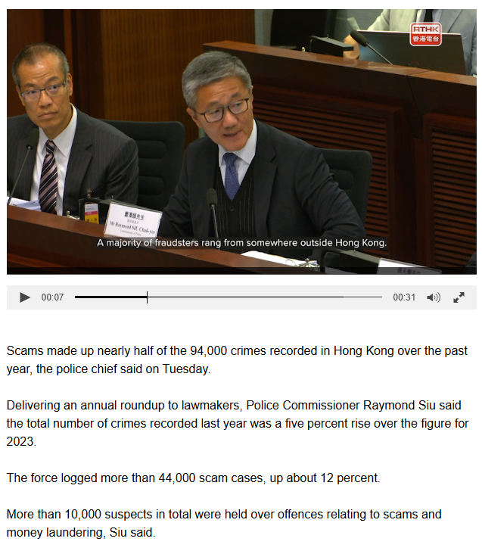
Use the news article on scams in Hong Kong as a follow-up to engage students in reflecting on the seriousness of online scams and the importance of societal security.
Post -viewing
Scams fuelled rise in crime last year: police chief
SCAMS IN HONG KONG: FACT SHEET
Read the news article and complete this fact sheet by filling in the blanks using information from the text.
1. SCAM STATISTICS
Scams made up about ________% of all crimes in Hong Kong last year.
Total number of scam cases: ________________
This represents a ________% increase from the previous year.
Police detection rate for scams: ________%
47
more than 44,000
12
10.6
Source: RTHK English News: Scams fuelled rise in crime last year: police chief:
https://news.rthk.hk/rthk/en/component/k2/1791183-20250211.htm

Slide 11
Use the news article on scams in Hong Kong as a follow-up to engage students in reflecting on the seriousness of online scams and the importance of societal security.
Post -viewing
Scams fuelled rise in crime last year: police chief
SCAMS IN HONG KONG: FACT SHEET
Read the news article and complete this fact sheet by filling in the blanks using information from the text.
2. WHY SCAMS ARE DIFFICULT TO SOLVE (Tick all that apply.)
Scammers use advanced technology.
Most fraudsters operate from outside Hong Kong.
Victims often report crimes weeks or months later.
The police has not boosted education on scams.
✓
✓
Source: RTHK English News: Scams fuelled rise in crime last year: police chief:
https://news.rthk.hk/rthk/en/component/k2/1791183-20250211.htm

Slide 12
Use the news article on scams in Hong Kong as a follow-up to engage students in reflecting on the seriousness of online scams and the importance of societal security.
Post -viewing
Scams fuelled rise in crime last year: police chief
SCAMS IN HONG KONG: FACT SHEET
Read the news article and complete this fact sheet by filling in the blanks using information from the text.
3. LIST TWO WAYS AUTHORITIES ARE ADDRESSING THE PROBLEM
4. REFLECTION QUESTIONS
Why might first-year mainland students be particularly vulnerable to scams?
How do you think widespread scams affect societal security and public trust?
Mainland and Hong Kong officials have discussed how to boost education on scams among students and parents.
The police force will focus on fighting crime, especially scam-related ones, in the coming year.
Source: RTHK English News: Scams fuelled rise in crime last year: police chief:
https://news.rthk.hk/rthk/en/component/k2/1791183-20250211.htm

Slide 13
A Video on
“[Digital Literacy Series] English - 1. Protect from Phishing”
Use information from both the video and news article to complete the mind-map below.
Scams fuelled rise in crime last year: police chief
Online Scams & Safety
Common Scam Tactics
Warning Signs
Protection Strategies
bait
Never share personal information through _______________
_____________ website URLs and look for HTTPS before sharing information
Keep all software and systems ______________ with security patches
Install ______________ software and think before clicking
Boost ______________ on scams among students and parents
“Phishing” - using ________to trick victims (like fishermen)
Pretending to be _____________ organisations or people
Creating ________ websites with similar-looking URLs
Targeting vulnerable groups (e.g. New ___________ students)
Happening ______________ or on the phone
Suspicious messages requesting _____________ information
Websites with ________________ spelling of company names
Messages with ____________ or unsecured websites (e.g. no HTTPS)
Calls from somewhere ___________ Hong Kong
messages/emails
personal
Check
trusted
incorrect/wrong
fake
errors
updated
Mainland
anti-malware
outside
online
education

Slide 14
Guide students to develop the language knowledge and skills through integrating information from the video and the article on scams in Hong Kong.
Language Focus 1:
Modal Verbs
Post -viewing
Modal verbs appear throughout the video and news article. Identify their functions in safety communication by completing the table below.
Example | Function
We can talk to others, make purchases online, and do personal business from one place. These four practices can help protect you. | Shows ______________, ability or potential to do something
If you give them the information or click the hyperlink, you will be hooked. November’s National Games will be held in an orderly, safe and secure manner. | Shows ______________ about future events or strong predictions
By the time we received the report, it would be too late. These students would become harder to be scammed. | Shows hypothetical situations or ________________ results
These students might already be exposed to scam awareness information. | Shows _____________________ about something
Let's talk about a popular online scam that you should be aware of. | Shows necessity or strong _______________________
possibility
A Video on
“[Digital Literacy Series] English – 1. Protect from Phishing”
Scams fuelled rise in crime last year: police chief
certainty
conditional
likelihood/uncertainty
recommendation
Sources:
1. RTHK English News: Scams fuelled rise in crime last year: police chief: https://news.rthk.hk/rthk/en/component/k2/1791183-20250211.htm
2. CyberDefender “【Digital Literacy Series】English - 1. Protect from Phishing”: https://www.youtube.com/watch?v=RYWTW2P0kjk

Slide 15
Language Focus 2:
Participial Phrases/Clauses
Guide students to develop the language knowledge and skills through integrating information from the video and the article on scams in Hong Kong.
Post -viewing
Participle phrases are used to provide additional information in both the video and news article. Identify these modifiers and analyse how they function in both texts to convey information.
A Video on
“[Digital Literacy Series] English - 1. Protect from Phishing”
2. Participial Phrases:
(From the video)
This is special software designed to protect your computer from harmful software and hackers.
Function: to describe the function of the special software
(From the article)
b. “Delivering an annual roundup to lawmakers, Police Commissioner Raymond Siu said”
Function: to explain the context in which the police commissioner made his statement, indicating both the occasion (annual roundup) and the audience (lawmakers)
Scams fuelled rise in crime last year: police chief
Sources:
1. RTHK English News: Scams fuelled rise in crime last year: police chief: https://news.rthk.hk/rthk/en/component/k2/1791183-20250211.htm
2. CyberDefender “【Digital Literacy Series】English - 1. Protect from Phishing”: https://www.youtube.com/watch?v=RYWTW2P0kjk

Slide 16
Reflection on Societal Security
2. Besides the police, who else should help prevent scams? Think about schools, parents, friends, and businesses.
1. What challenges does our country face in combating scams?
3. What can we do to safeguard societal security?
16

Slide 17
Extended Learning Activities
Hong Kong has faced a rise in scams targeting young people, especially students. As informed citizens, students can help protect the community and safeguard societal security by raising awareness. Arrange students into groups and engage them in suggesting ideas for organising an Anti-Scam Day to improve the situation.
1. Anti-Scam Day Station Design
Engage students to design an interactive learning station focused on a specific type of scam.
The station should:
clearly demonstrate how to identify and respond to the scam
include at least one hands-on activity for participants
be educational while remaining creative and interesting for your peers
contribute to societal security by equipping more citizens with scam prevention knowledge
2. Station Implementation Plan
Based on the station design, have students develop a practical implementation plan that explains how the station would operate during the actual Anti-Scam Day.
The implementation plan should include:
why the chosen scam type is relevant to Hong Kong students, including recent statistics or examples that demonstrate why students need specific awareness in this area
a step-by-step explanation of how the station activities will run
a list of all materials, technology and volunteers needed
evaluation methods

