Slide 1



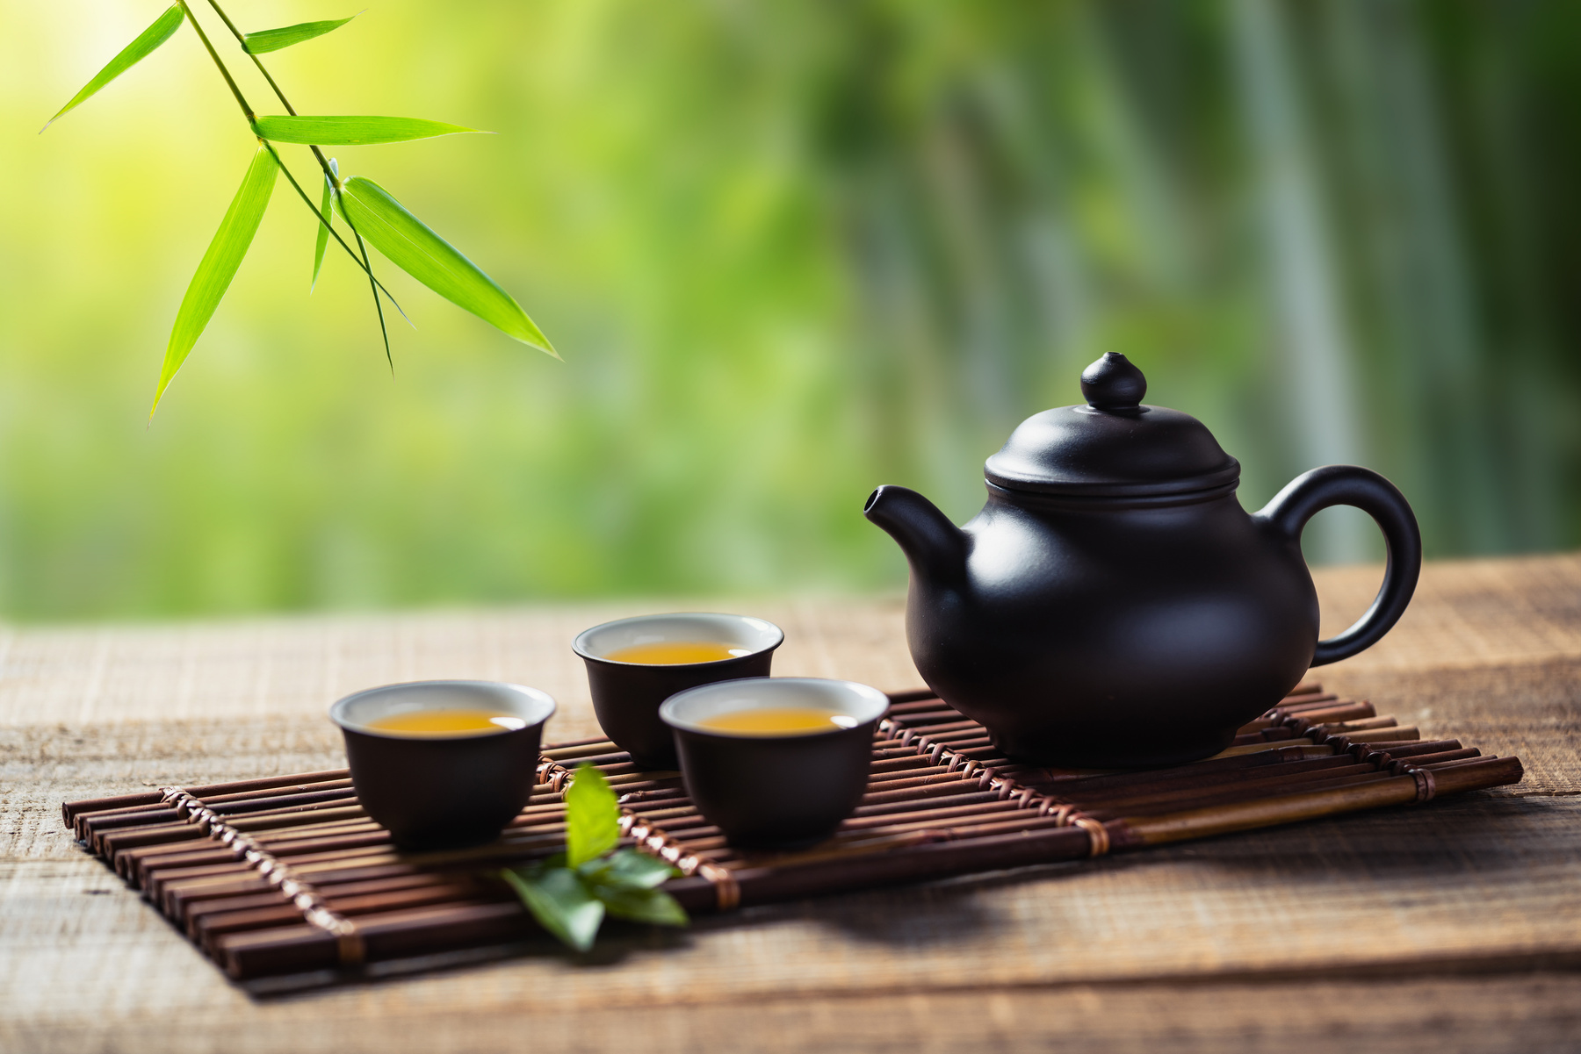

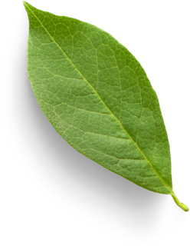

English Language Resource Materials on
National Security Education at the Secondary Level
An Example of Learning and Teaching Activities
INTANGIBLE CULTURAL HERITAGE:
CHINA’s TEA CULTURE

Slide 2
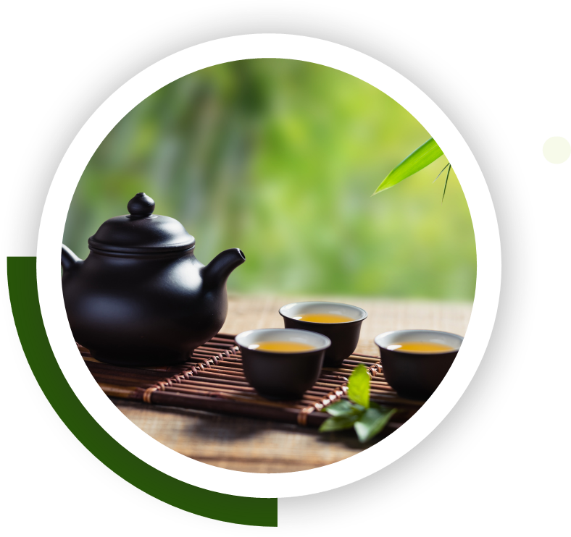


Module | Unit | Topic
Wonderful Things | Intangible Cultural Heritage | China’s Tea Culture
Content Objectives
To explore concepts related to intangible cultural heritage:
China’s tea culture;
the values promoted;
its development and impact in the modern world
Language Objectives
To develop language knowledge and skills, e.g.
listening, speaking, reading/viewing and writing skills
text structures (e.g. video, article, infographic)
vocabulary building strategies:
word collocations
semantic mapping
English Language
Education
National Security
Education
China’s Tea Culture

Slide 3
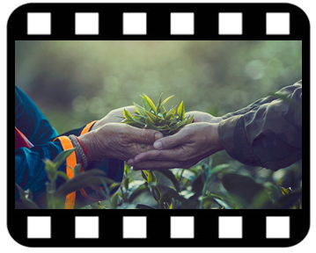
A Video on
“Tea-making: China’s Intangible Cultural Heritage”
Pre-viewing
Connect students' prior experiences with Chinese tea in their everyday life.
While-viewing
Post -viewing
Use the article “Traditional Tea Processing Techniques and Associated Social Practices in China” as a follow-up to reinforce students’ understanding of China’s tea culture.
Guide students to integrate and organise information and ideas from the video and the article on China’s tea culture by completing an infographic.
Play the video.
Engage students in knowing more about the origin, and culture of Chinese tea.
Source: The China Current:
Tea-making: China’s Intangible Cultural Heritage
(Click to view)

Slide 4


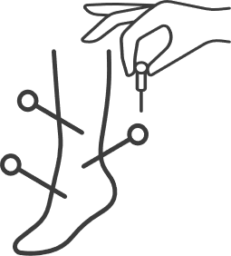




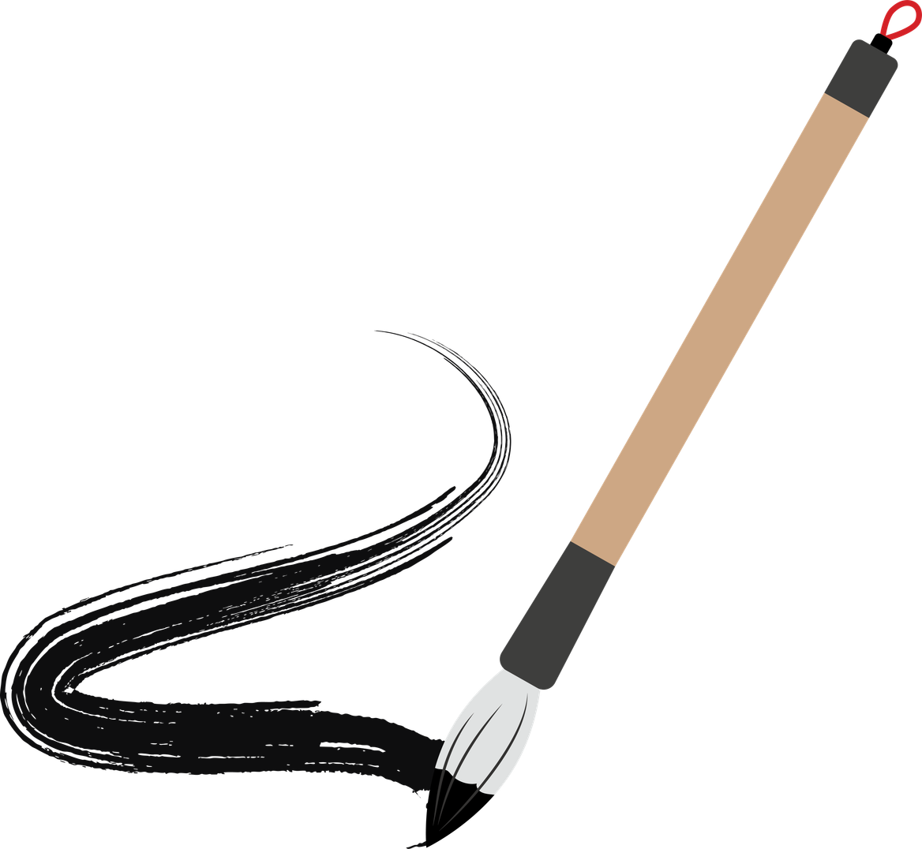
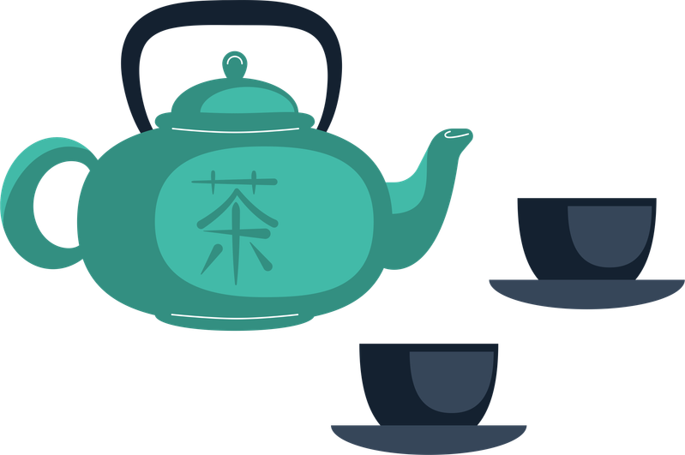


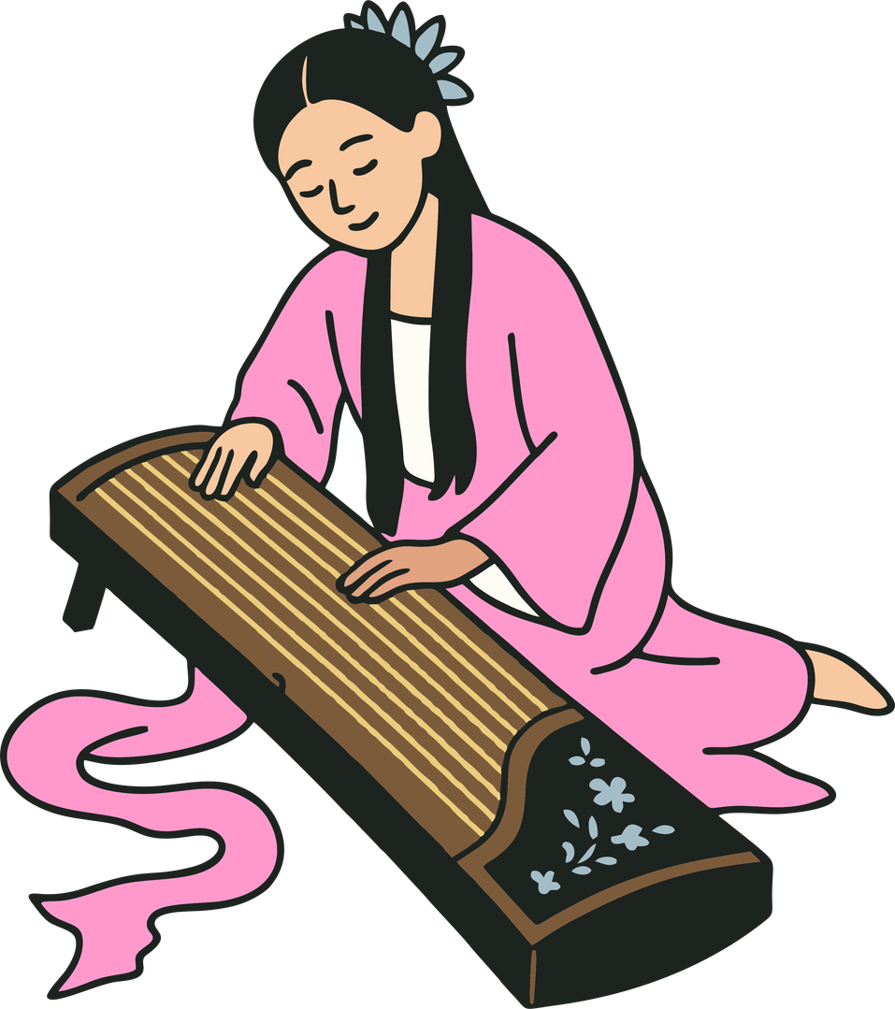
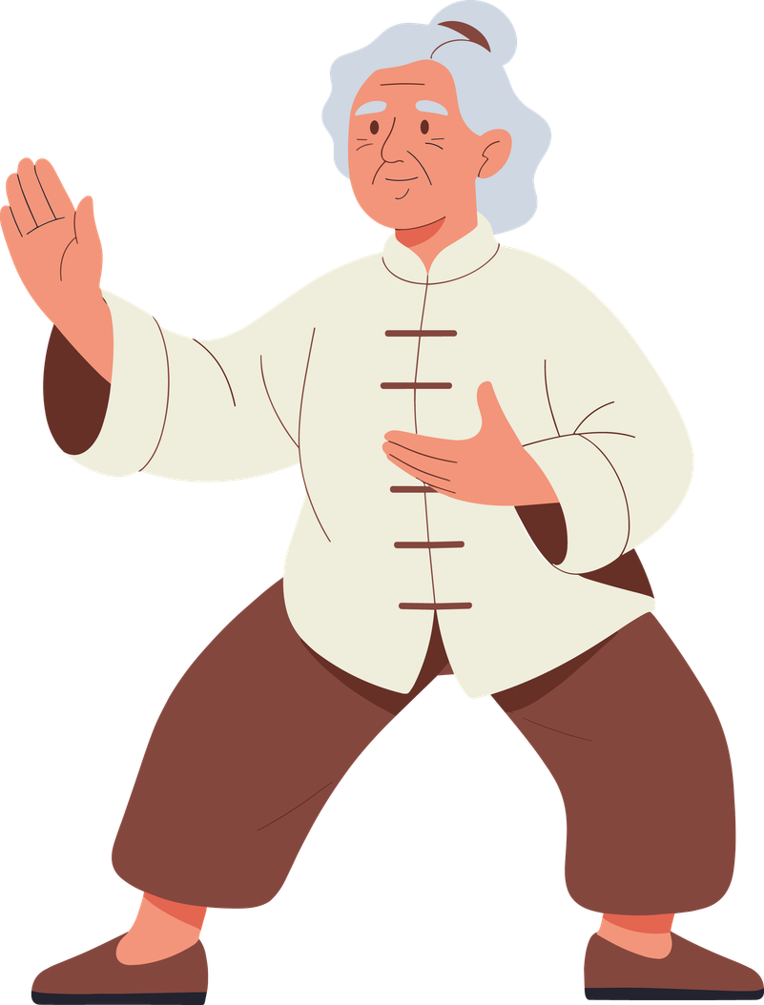
Can you name a few examples of China’s UNESCO intangible cultural heritage?
1.
2.
Acupuncture and moxibustion of traditional Chinese medicine
Chinese paper-cut
6.
3.
UNESCO INTANGIBLE CULTURAL HERITAGE IN CHINA
Traditional tea
processing techniques and associated social practices
Chinese calligraphy
5.
4.
Guqin and its music
Taijiquan
Notes:
UNESCO
United Nations Educational, Scientific and Cultural Organization (UNESCO) is a specialized UN agency founded in 1945, headquartered in Paris, aiming to foster peace through international cooperation in education, sciences, and culture. It protects world heritage, promotes education, and drives scientific collaboration among 194 member states.

Slide 5
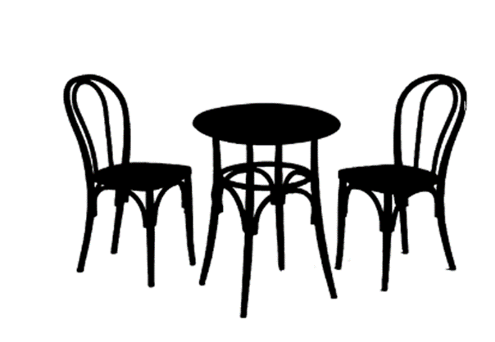

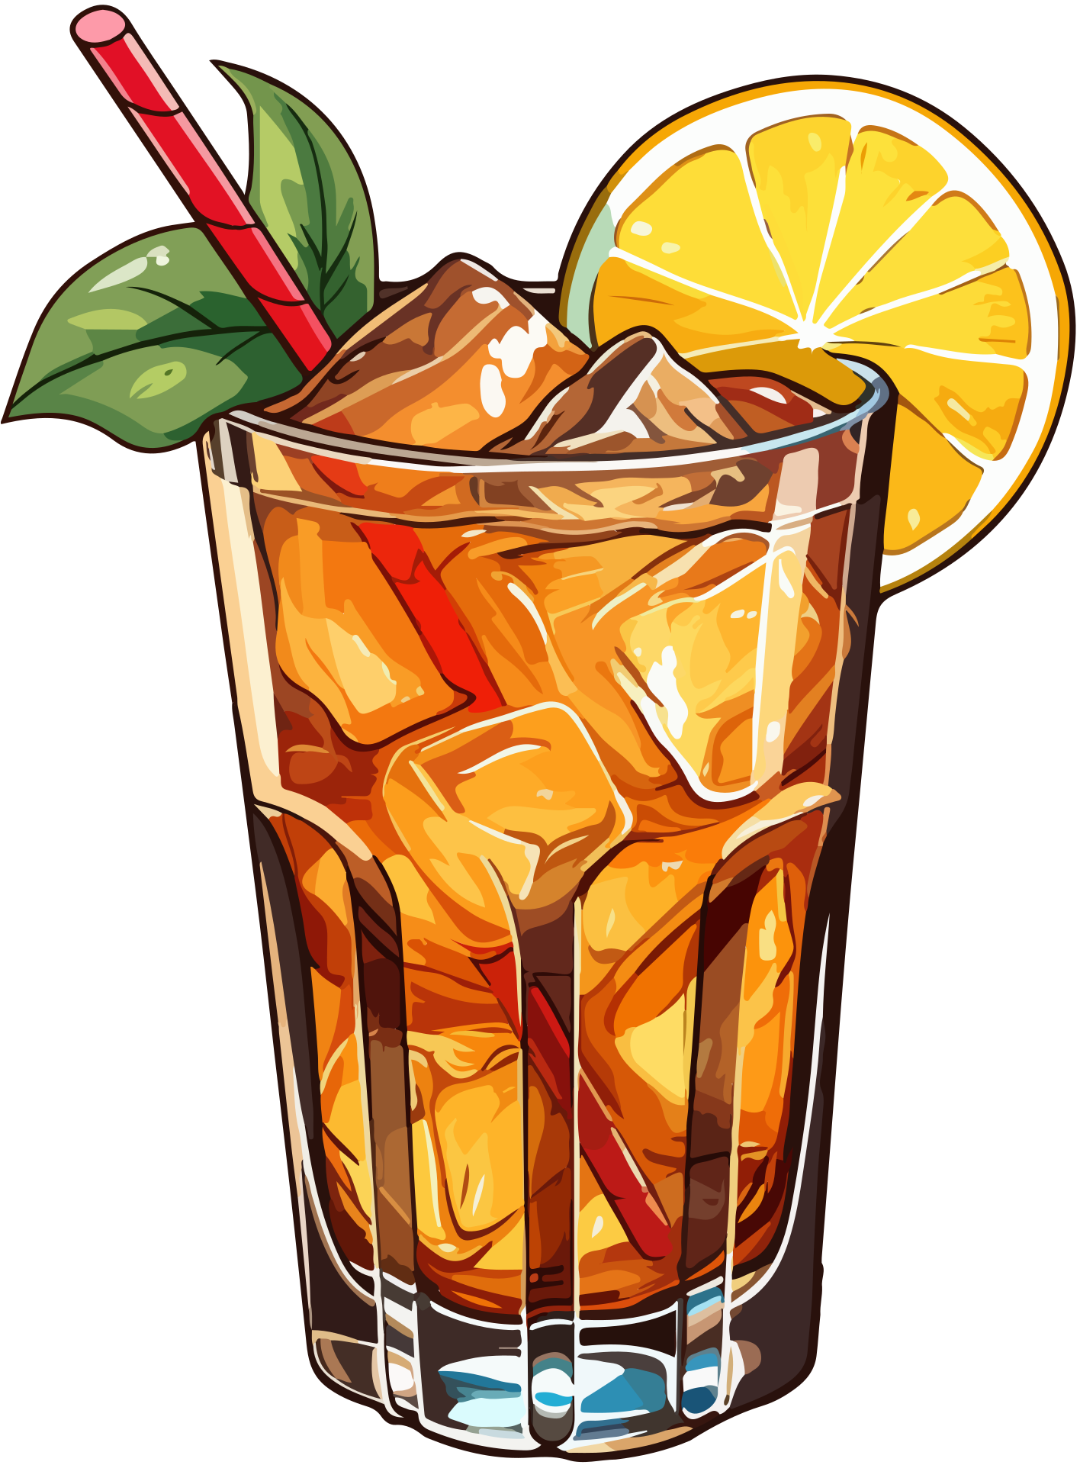
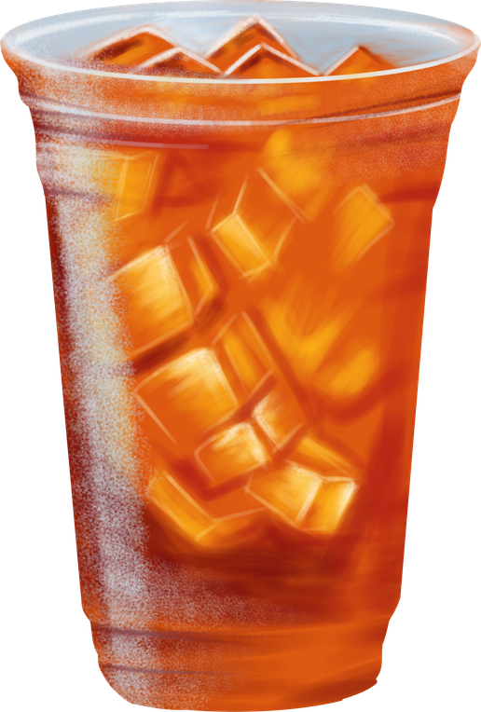
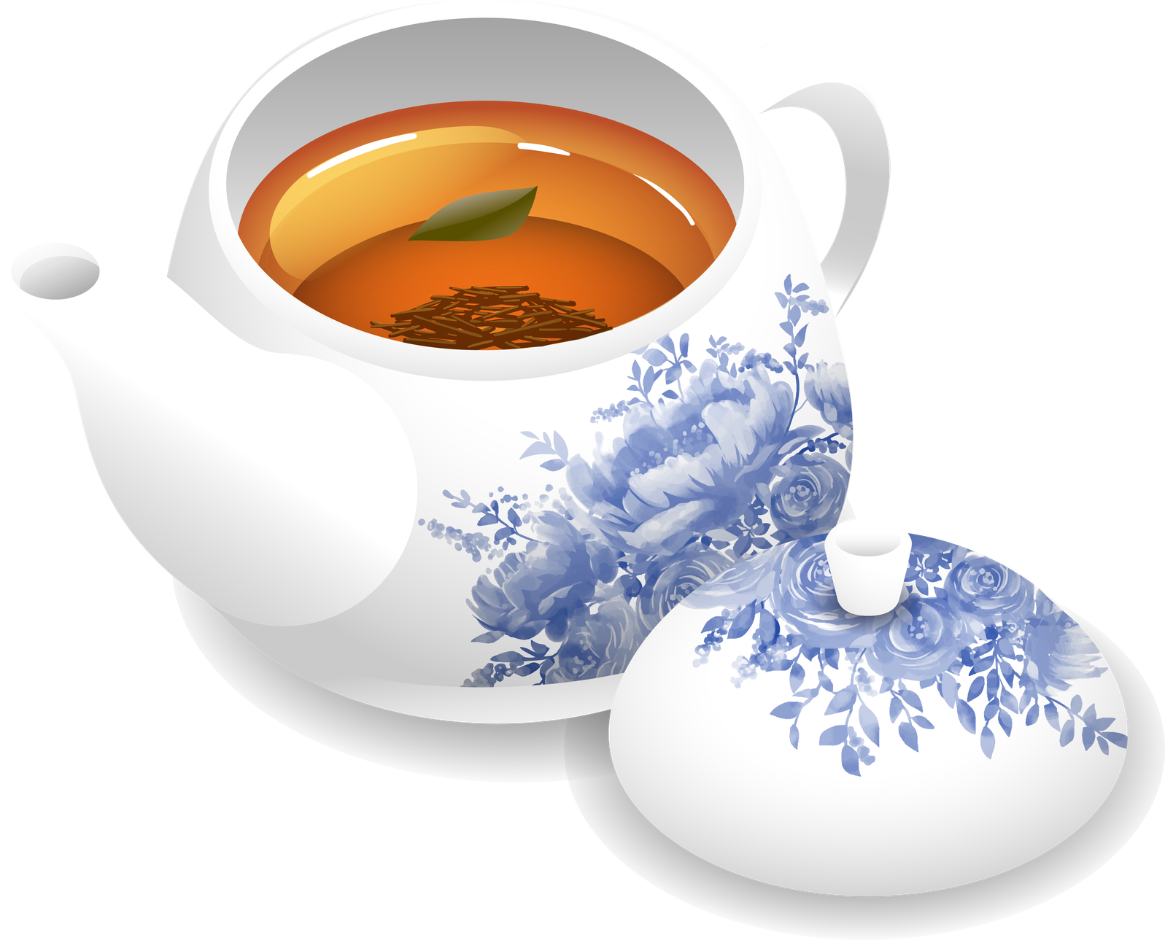


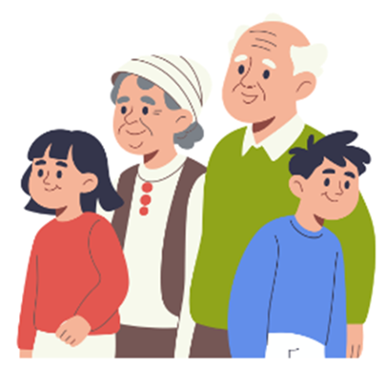
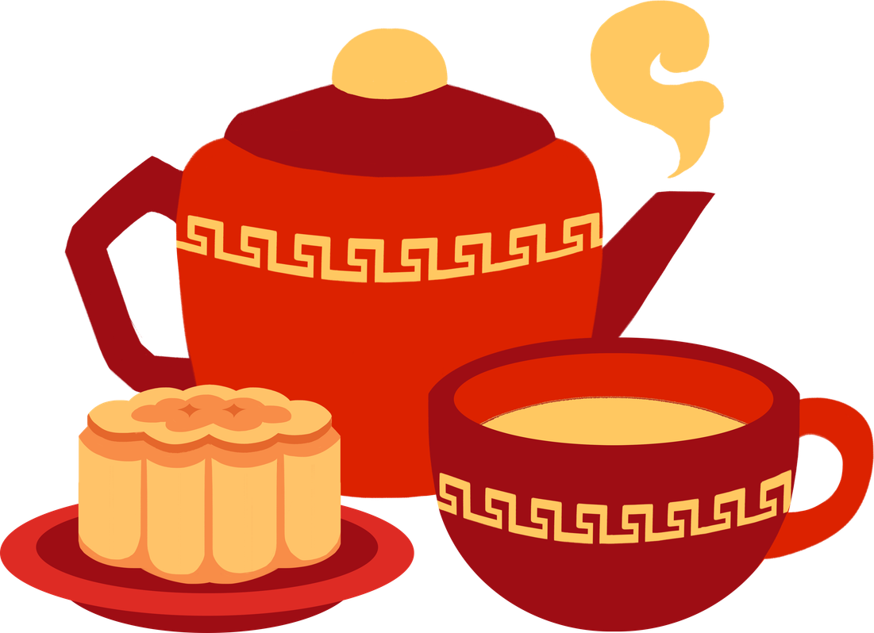
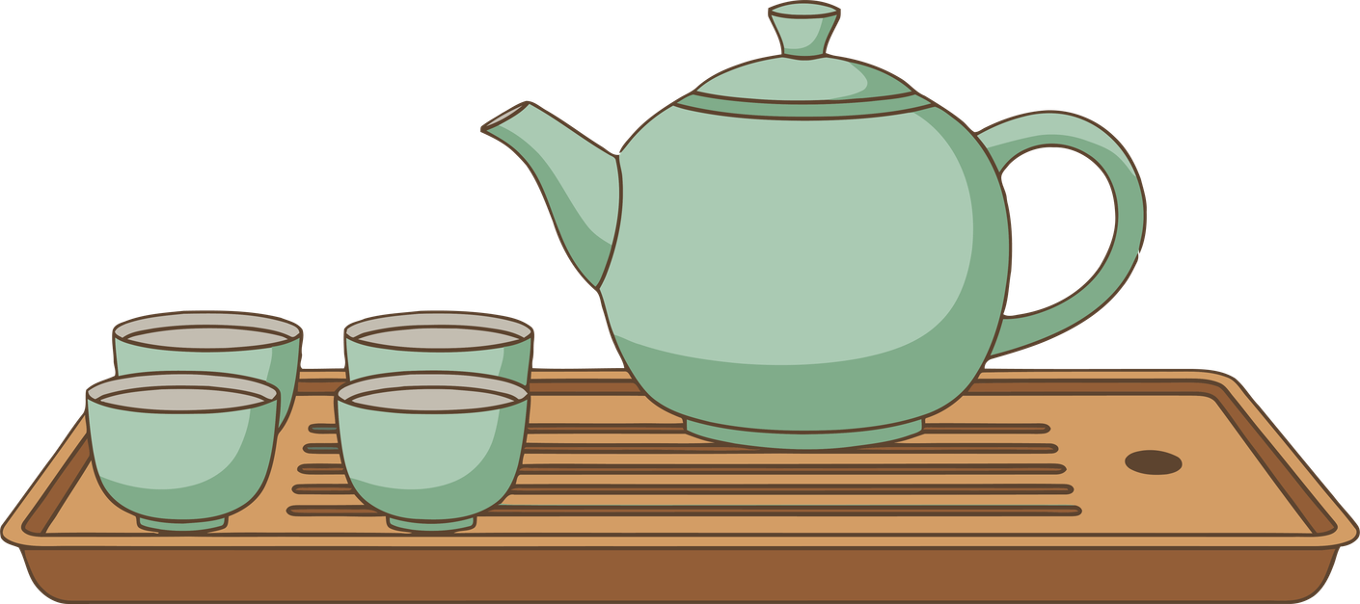
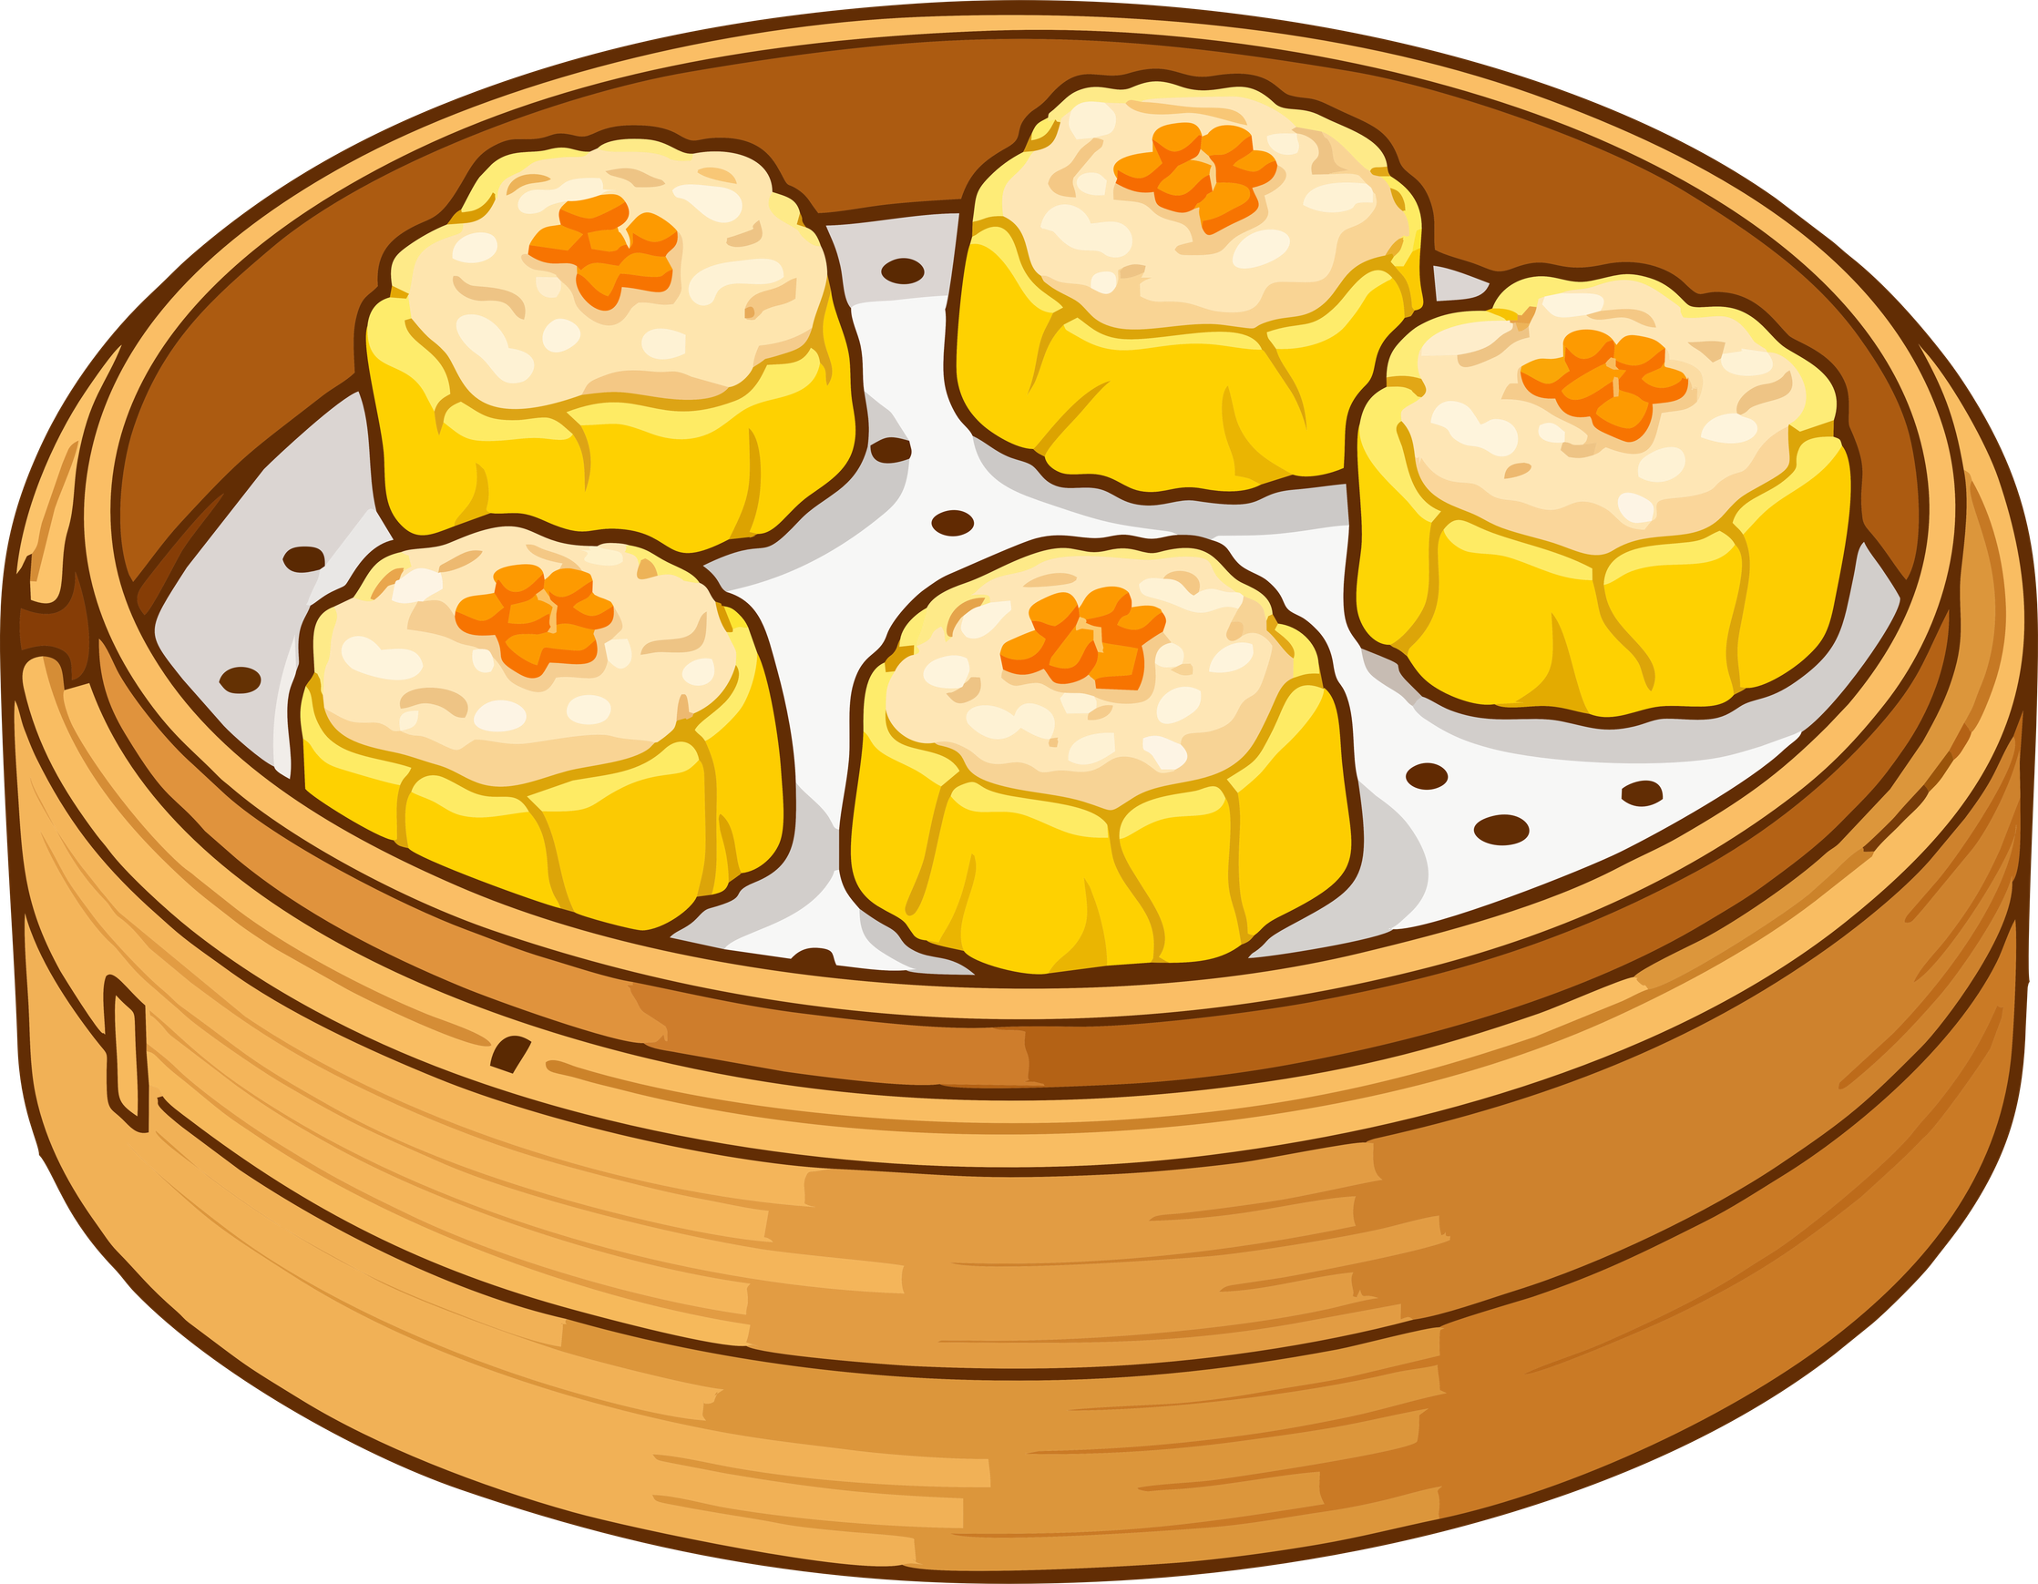
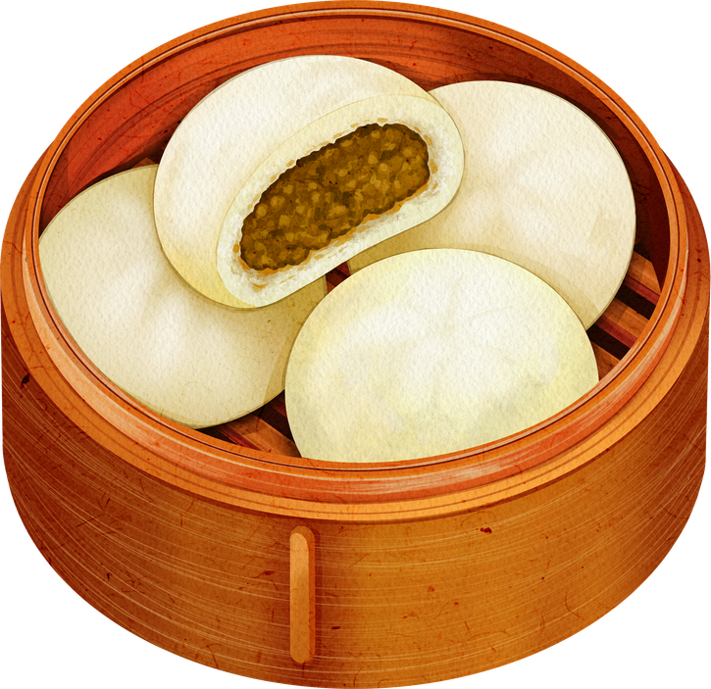
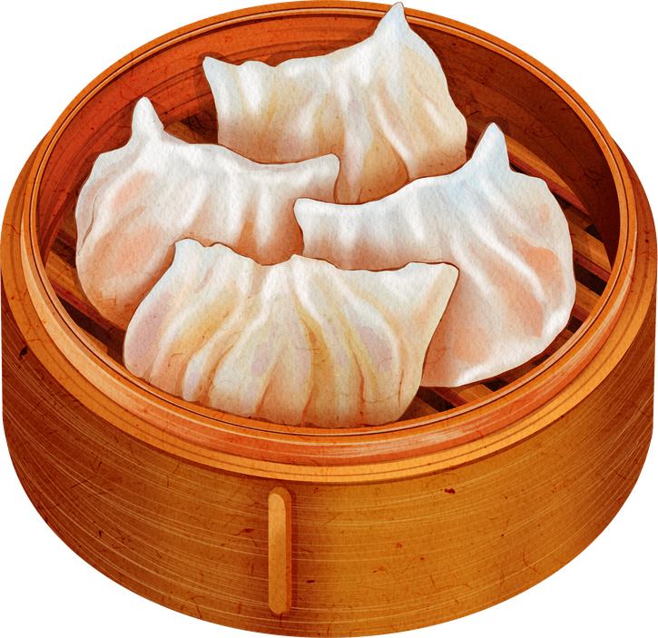
What is the place of Chinese tea in your everyday Life? Please give some examples.
Connect students' prior experiences with Chinese tea in their everyday life.
Pre-viewing
Where?
1.
2.
What (type(s) of tea )?
4.
With whom?
When? (e.g. What occasions?)
3.

Slide 6



Reflection on Cultural Security
The Role of China’s Tea Culture in your Everyday Life
2. How can we promote China’s tea culture in the modern world?
1. How does Chinese tea connect you to your family/friends/the world?

Slide 7
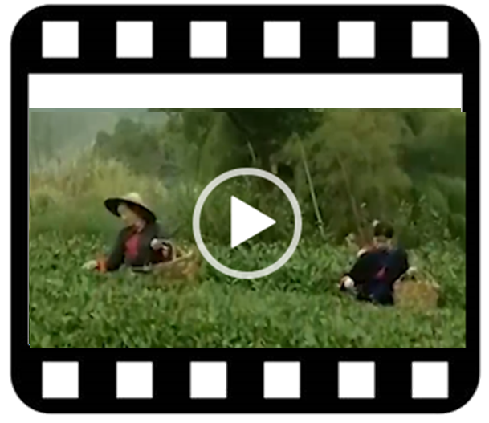
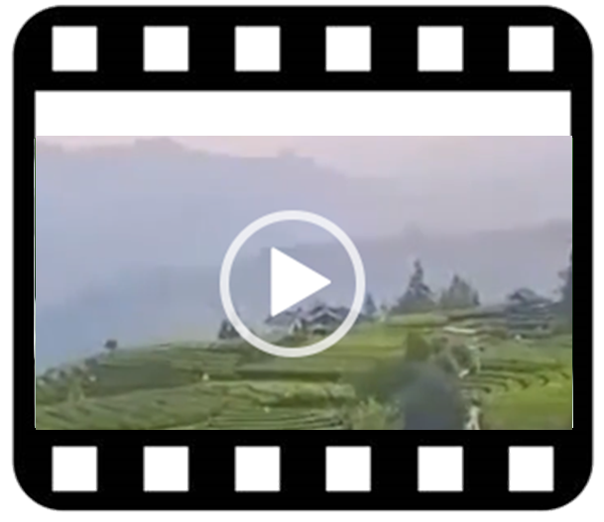
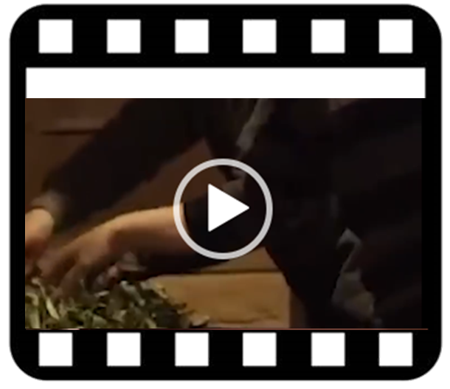
A Video on
“Tea-making: China’s Intangible Cultural Heritage”
Play the video.
Engage students in knowing more about the origin and culture of Chinese tea.
While-viewing
1
2
3
Video Time: 00:00 – 00:39
Video Time: 00:40 – 01:13
Video Time: 01:14 – 02:19
a) What is the role of China’s tea culture in global connection?
a) Where is Chinese tea originated from?
b) Can you name some of the key elements of China’s tea culture?
a) What are the six categories of Chinese tea?
b) How are they produced?
Source: The China Current:
Tea-making: China’s Intangible Cultural Heritage
(Click to view)
Notes:
https://chinacurrent.com/story/25023/tea-making-chinas-intangible-cultural-heritage

Slide 8
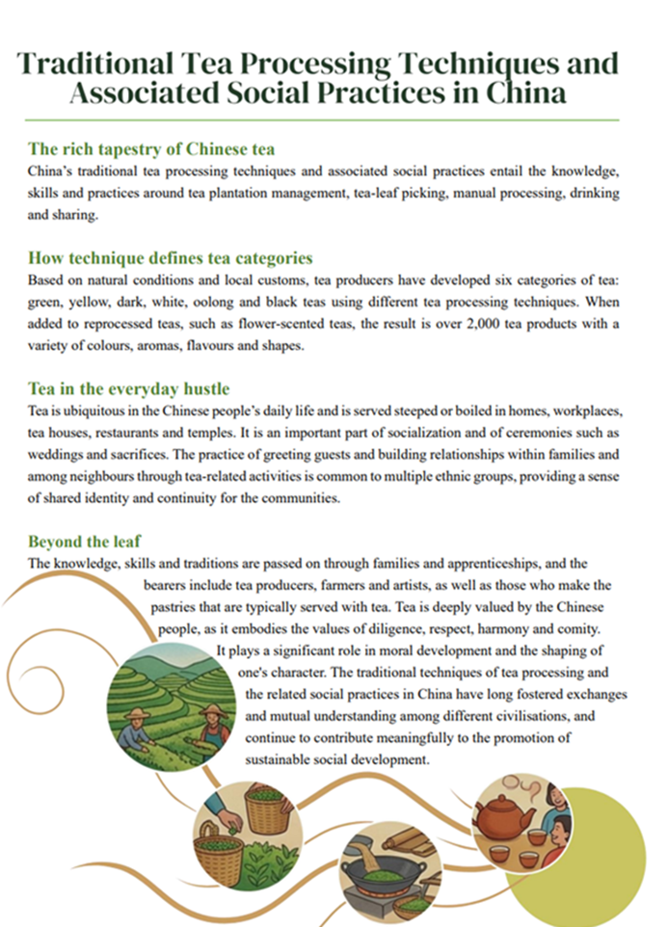
(Click to view)
Use the article “Traditional Tea Processing Techniques and Associated Social Practices in China” as a follow-up to reinforce students’ understanding of China’s tea culture.
Post-viewing
Paragraph 1
Match the sub-headings to the article:
Paragraph 2
How technique defines tea categories
Beyond the leaf
The rich tapestry of Chinese tea
Tea in the everyday hustle
Paragraph
2
Paragraph 3
Paragraph
4
Paragraph 4
Paragraph
1
Paragraph
3
Adapted from:
Source: UNESCO Intangible Cultural Heritage (2022) Traditional tea processing techniques and associated social practices in China (Nomination No. 01884). Reproduced for non-commercial educational purposes. The original content is available at: https://ich.unesco.org/en/RL/01884
(Click to view)
Notes:
Para 1: The rich tapestry of Chinese tea
Para 2: How technique defines tea categories
Para 3: Tea in the everyday hustle
Para 4: Beyond the leaf

Slide 9
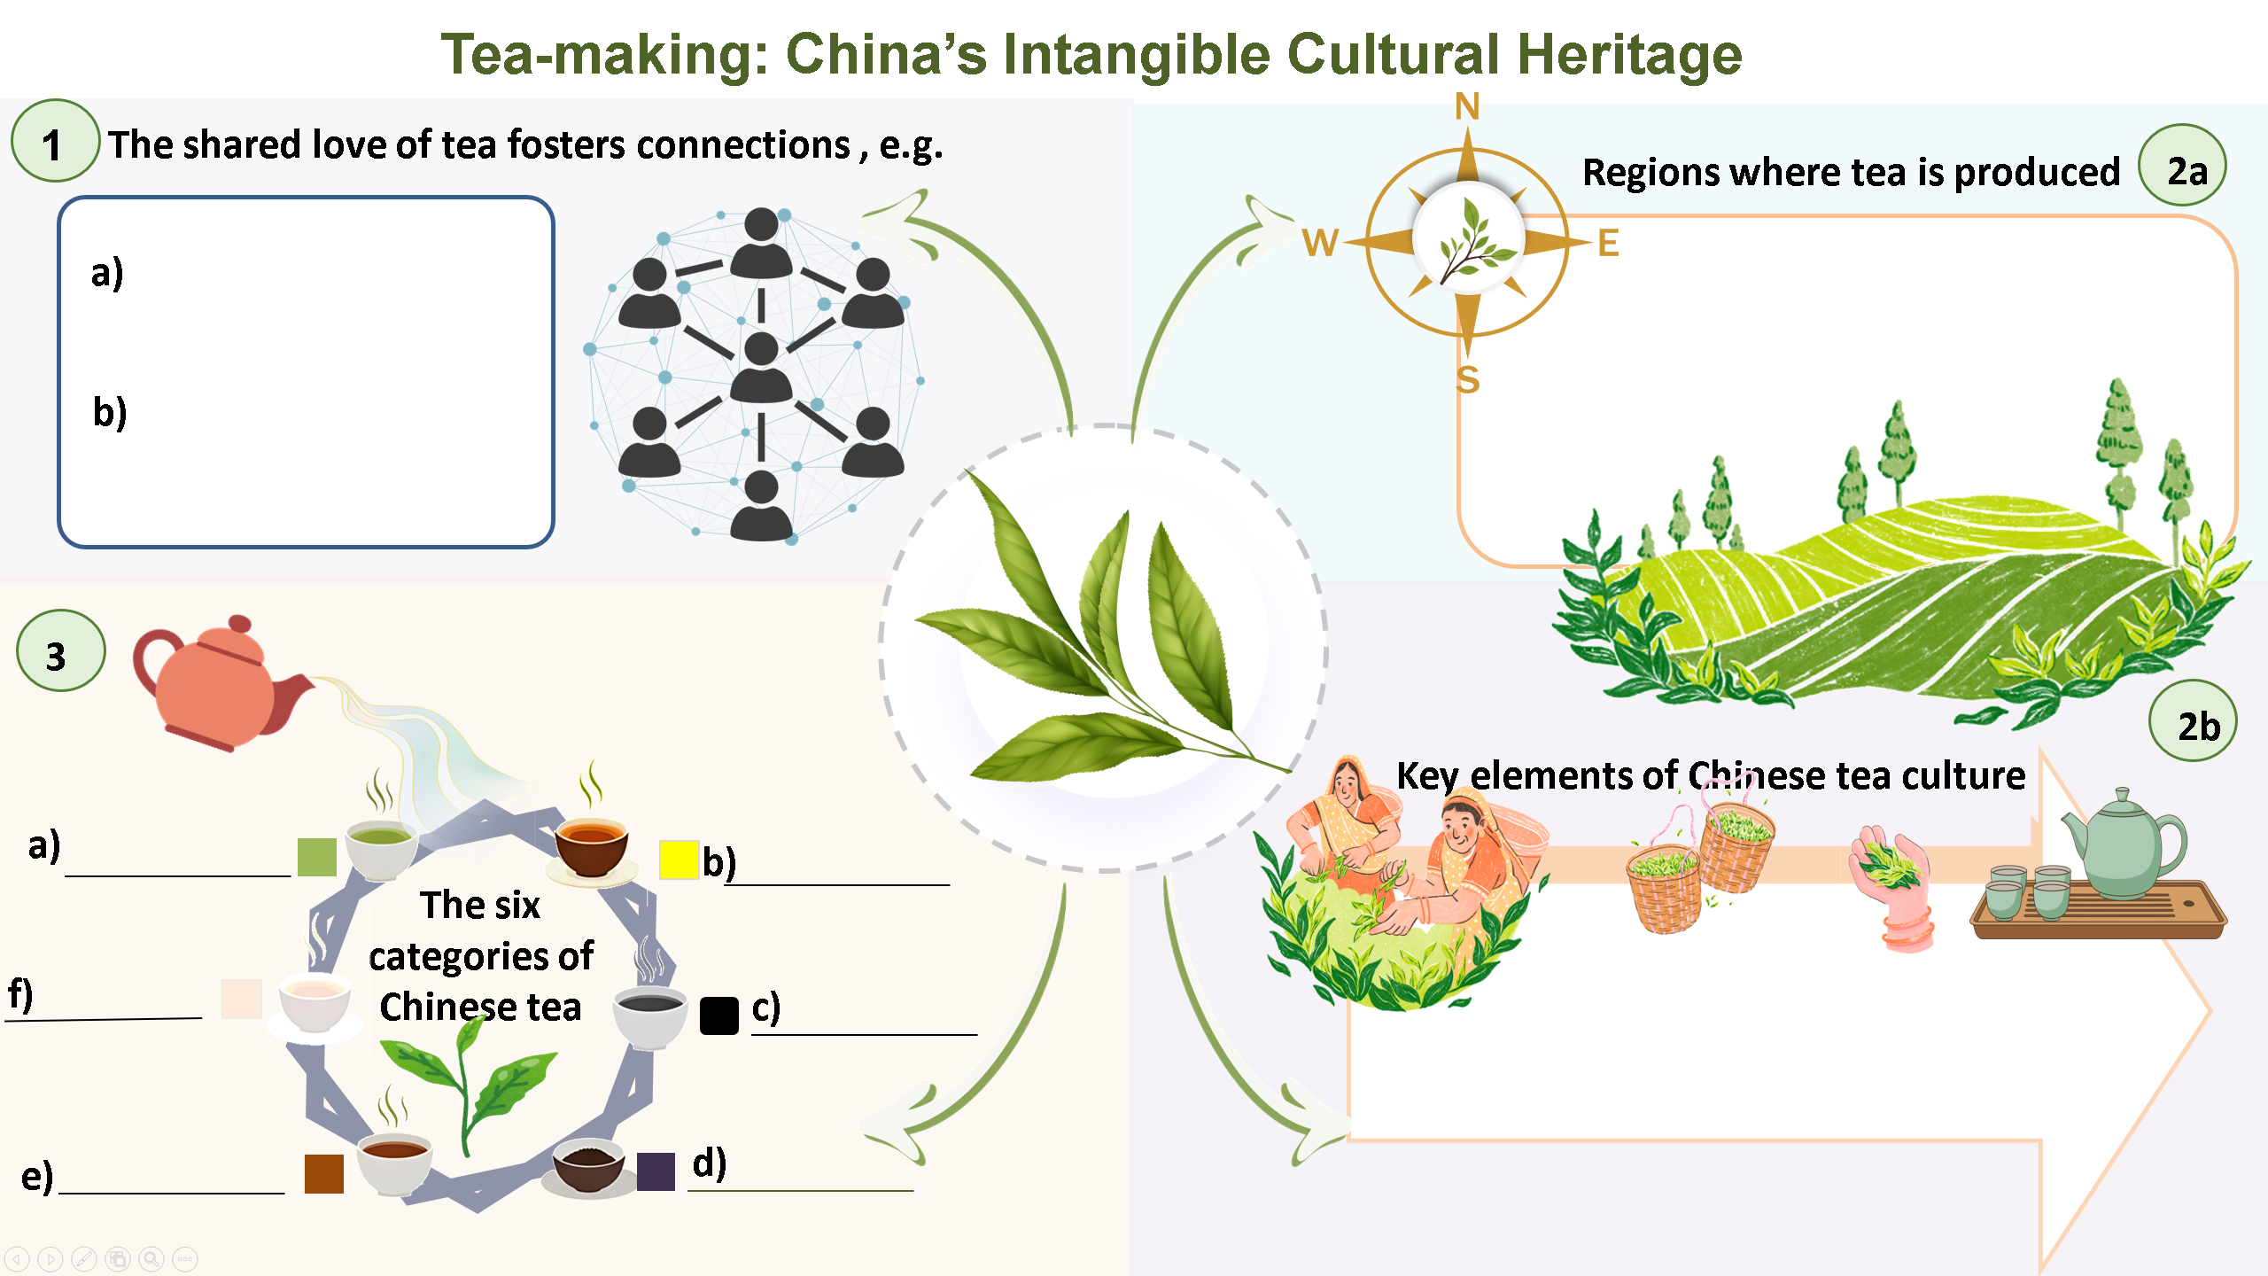
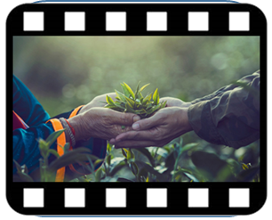
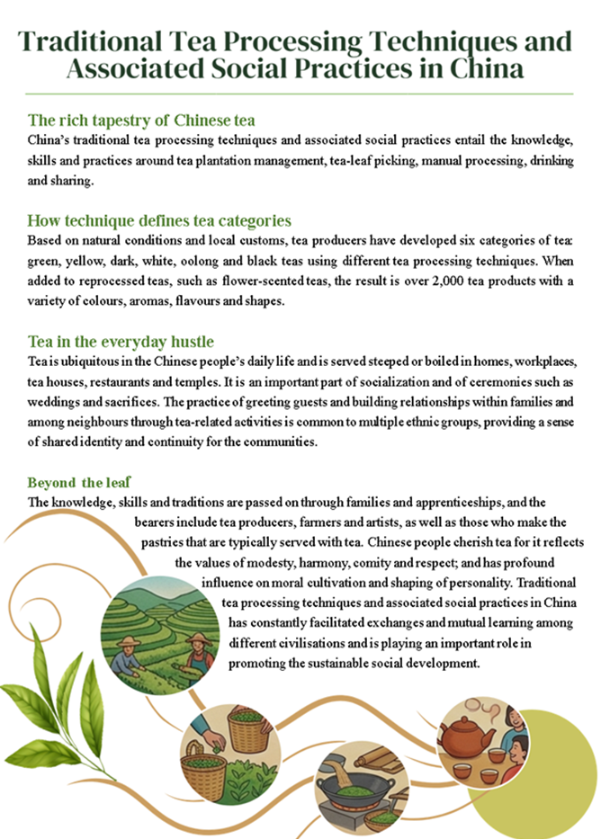
Guide students to integrate and organise information and ideas from the video and the article on China’s tea culture by completing the infographic below.
Post-viewing
A Video
An Article

Slide 10



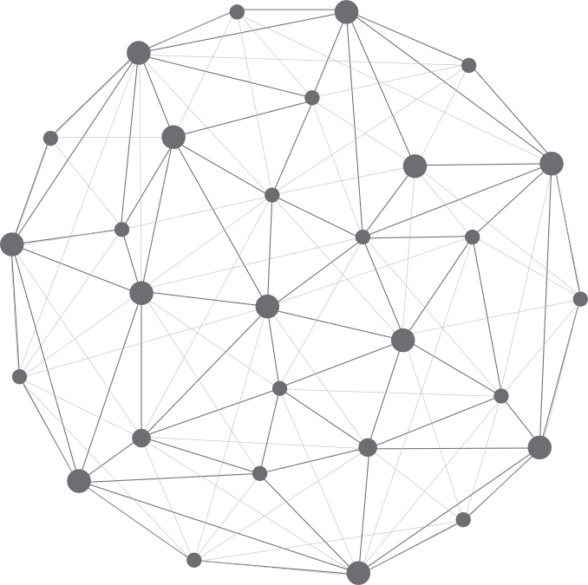




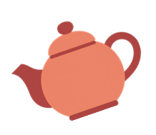

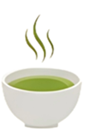

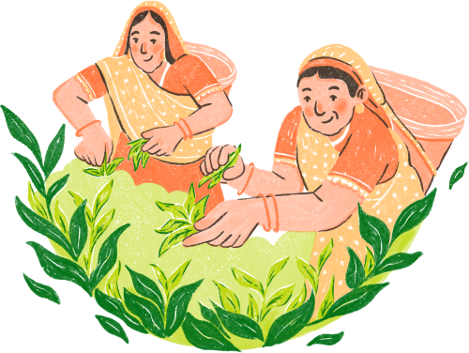
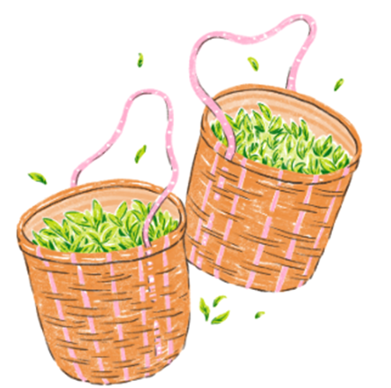
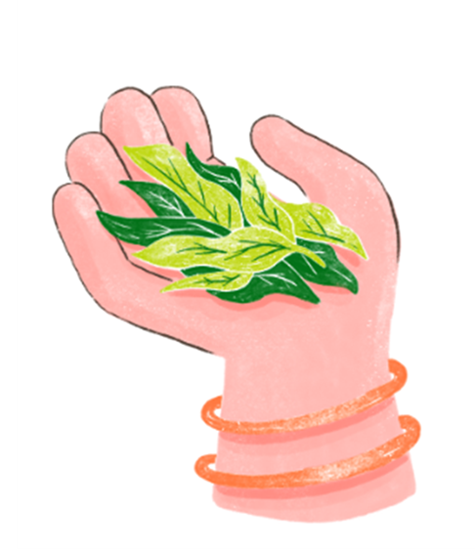

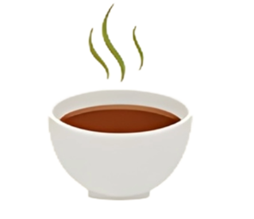
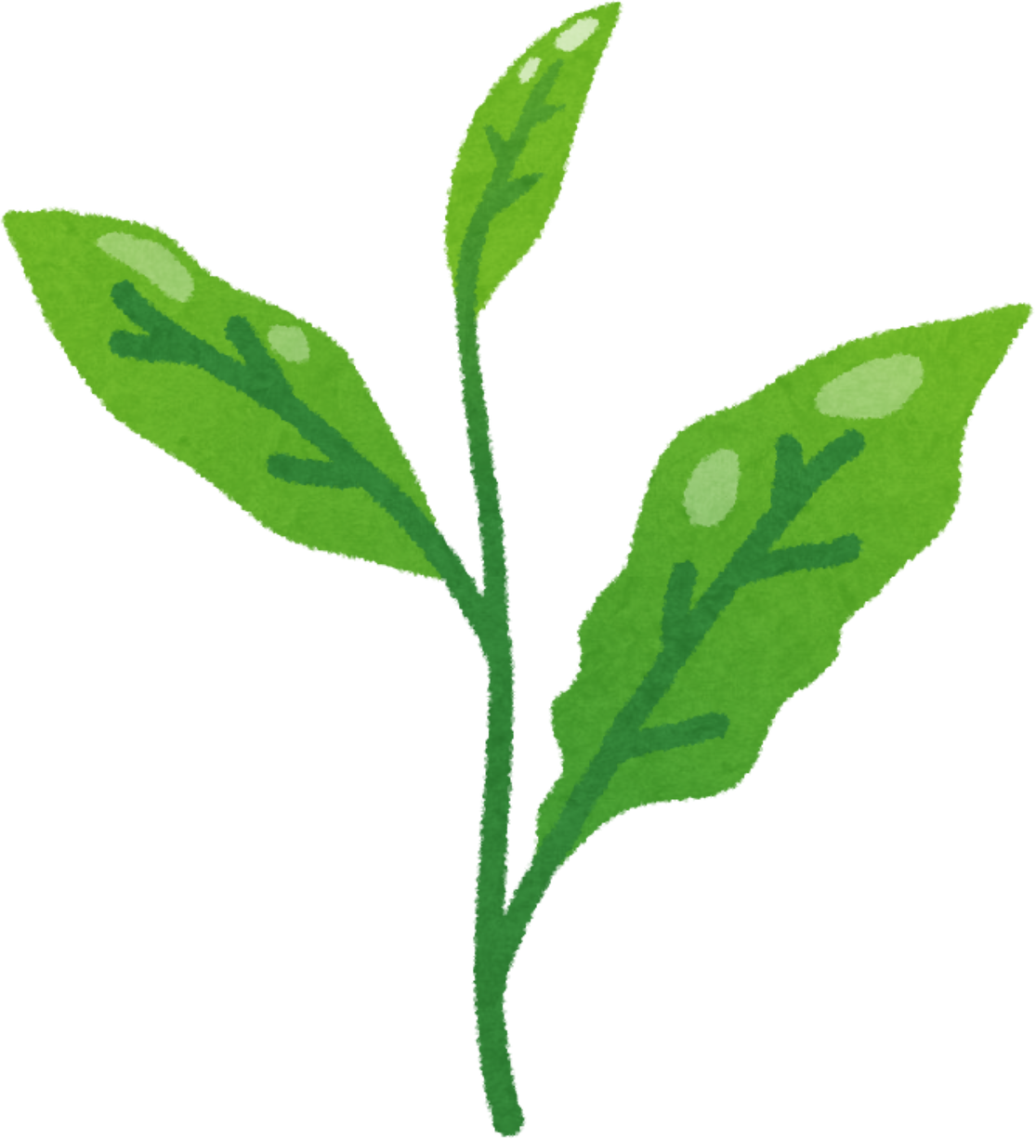
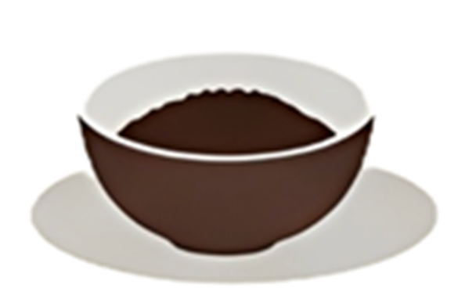
Tea-making: China’s Intangible Cultural Heritage
1
The shared love of tea fosters connections , e.g.
2a
Regions where tea is produced
a)
b)
3
2b
Key elements of China’s tea culture
a)
b)
The six categories of Chinese tea
f)
c)
e)
d)

Slide 11
Tea-making: China’s Intangible Cultural Heritage
1
The shared love of tea fosters connections , e.g.
2a
Regions where tea is produced
a)
bonding different cultures
North and south of the Yangtze River,
Southern China
Southwestern China
b)
becoming a bridge between China and the world
3
2b
Key elements of China’s tea culture
a)
Green tea
b)
Yellow tea
The six categories of Chinese tea
Leaf picking
Managing production
Hand-crafting/manual processing
Ceremony/sharing
f)
White tea
c)
Black tea
e)
Oolong tea
d)
Dark tea

Slide 12
Reflection on Cultural Security
The Significance of China’s Tea Culture in the Modern World
1. Do you think ancient tea rituals (e.g. serving tea at different occasions) still matter in the modern world? Why ?
3. What role can Chinese tea play in bridging Eastern and Western cultures through shared daily habits?
2. How do you compare the place of China’s tea culture with modern drinks like coffee or soft drinks?

Slide 13
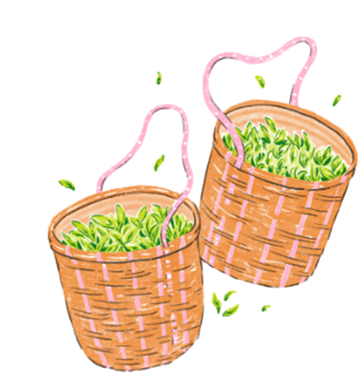
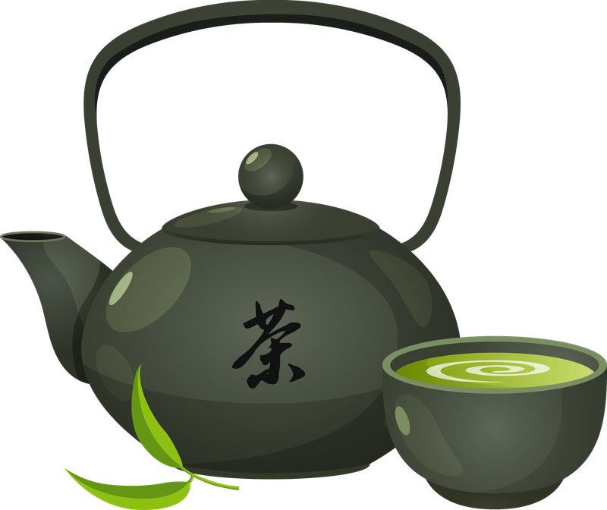
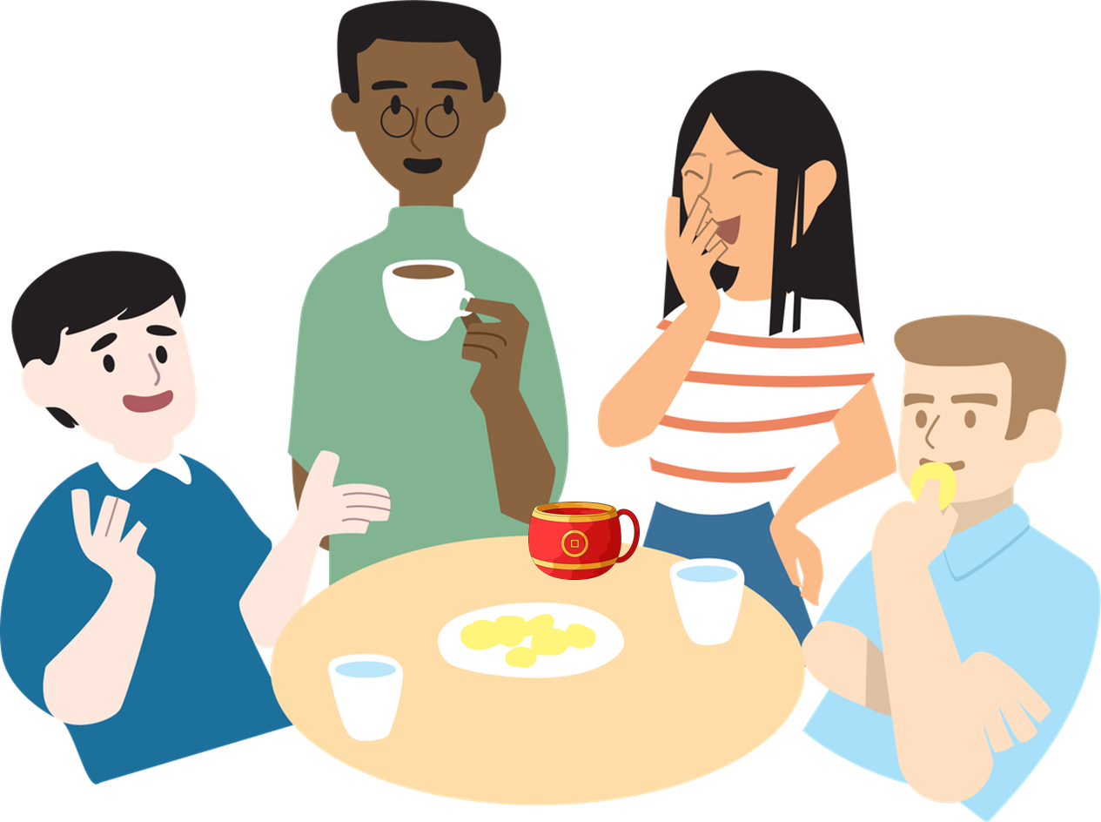
A Semantic Map
Identify vocabulary items from the texts and organise them under the three categories below.
Tea-processing techniques
The social world
Values and attitudes
1)
diligence, respect, harmony, comity
2)
Picking, manual, boiling, leaf, plantation
3)
Ceremonies, guests, identity, neighbours, socialisation

Slide 14
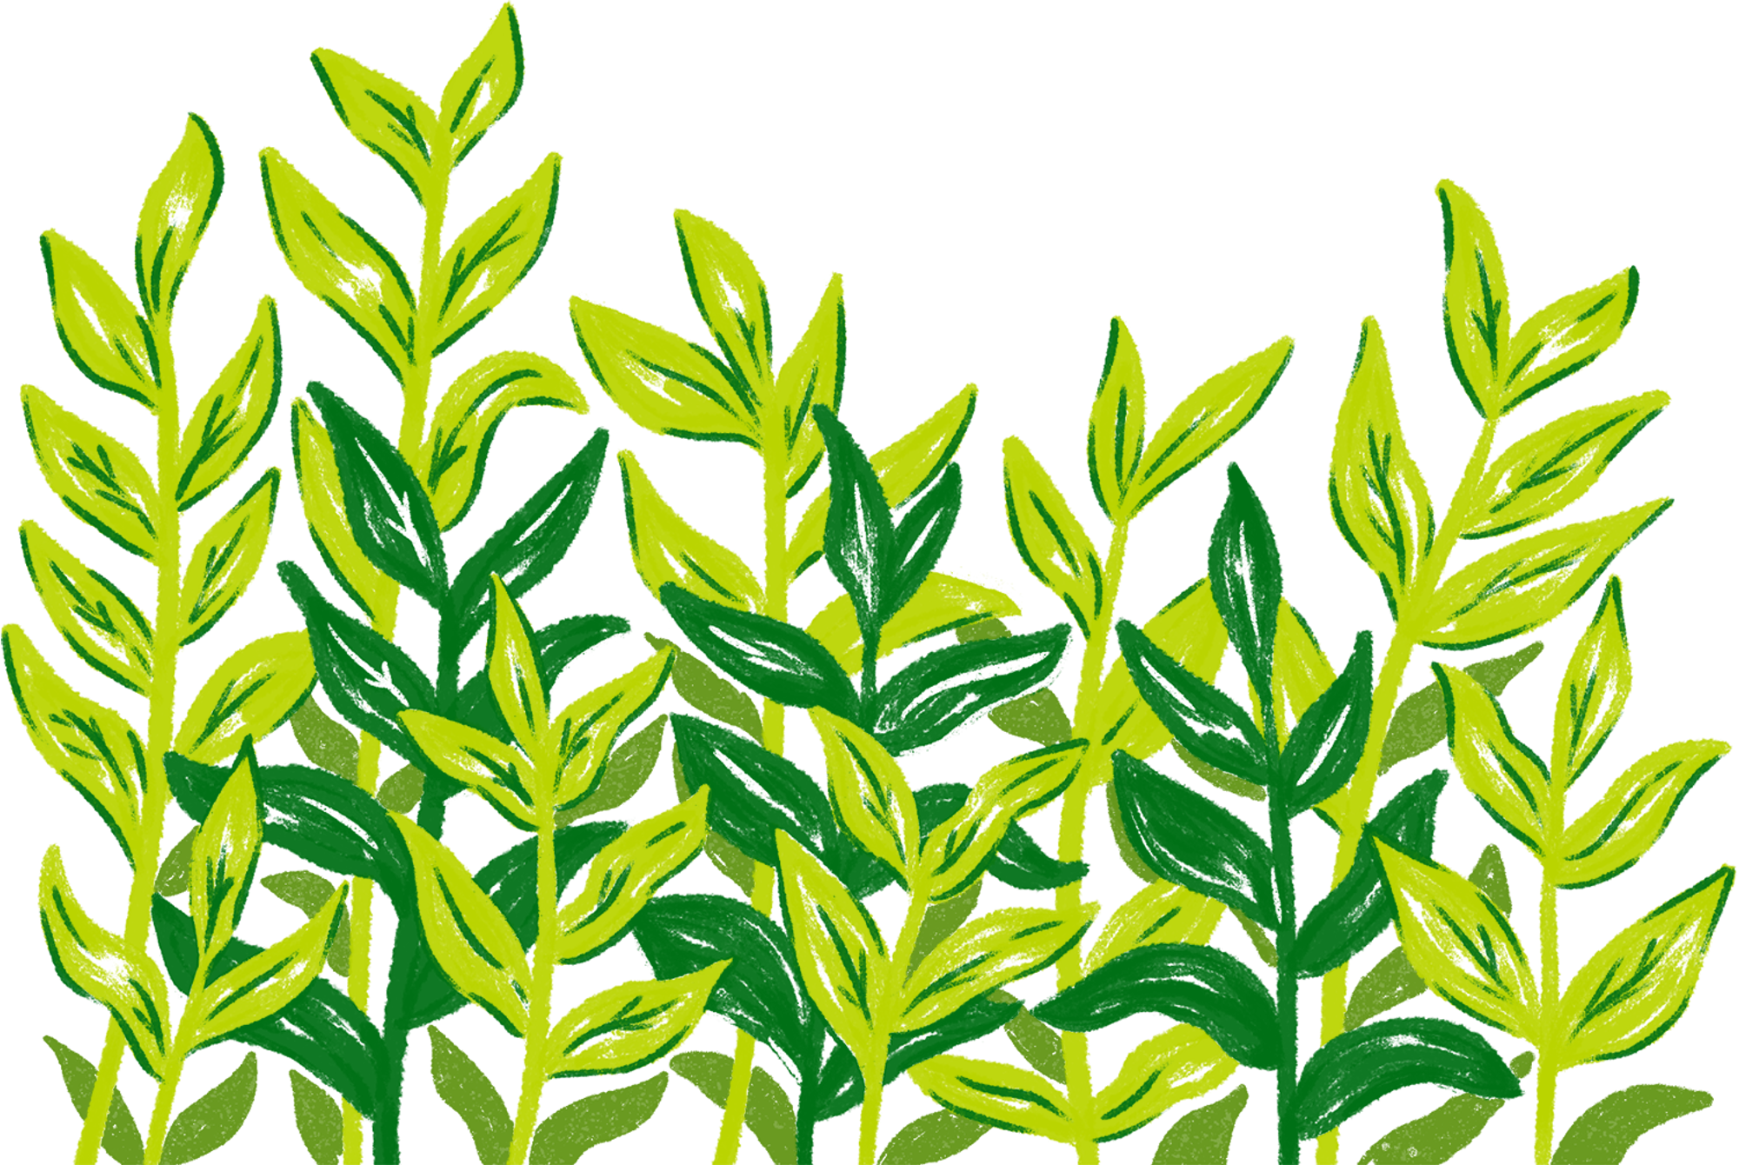
Word Collocations
Identify word pairs of verb-noun collocations that describe the impact of China’s tea culture and complete the table below.
Verb | Noun
e.g. promote | development
build relationship
embody values
shape one’s character
foster exchanges

Slide 15
The following values introduced in the video/article are promoted in China’s tea culture. Can you identify the social practices associated. Explain with examples.
Values | Associated Social Practices | Examples (From the text or your own experience)
Diligence
2) Respect
3) Harmony
4) Comity
a)
Leaf picking/Manual processing
(Paragraph 1/Video Time: 01:45-01:52)
Accept any reasonable answers.
b)
Ceremony
Greeting guests
Accept any reasonable answers.
(Paragraph 3)
c)
Sharing tea
Building relationships within families and neighbors (Paragraph 3)
Accept any reasonable answers.
d)
Socialisation and mutual learning among different civilisations
(Paragraphs 3 & 4/
Video Time: 00:28-00:39)
Accept any reasonable answers.

Slide 16
Reflection on Cultural Security
The Global Impact of China’s Tea Culture
1. How could you introduce China’s tea culture to international friends using social media?
2. If you became an ambassador for Chinese tea, what modern twist would you add to attract young people worldwide?

Slide 17
Connecting Heritage to
Innovation and Global Relevance
Extended Learning Activities
1. Explore the history, art, and health benefits of Chinese tea at the Flagstaff House Museum of Tea Ware in Hong Kong. The available resources include online pamphlets (e.g. Panda Brews Tea Too, Education Pamphlet of Tea Ware form Yixing), exhibitions and online talks.
2. Design a modern tea-inspired beverage integrating the essence of Chinese tea and tastes of the modern world to promote China’s tea culture globally.
3. Write a proposal to introduce the beverage including the following details:
its historical connection;
the tea art influence (e.g. the design of tea pots/tea cups);
its health benefits; and
global promotion
4. Present the design to the class. You may include photos, video clips or presentation slides in the presentation.

