Slide 1
Implementing National Security Education
in the Junior Secondary English Language Curriculum
An Example of Learning and Teaching Activities
Topic: Chinese Festival – Mid-Autumn Festival

Slide 2
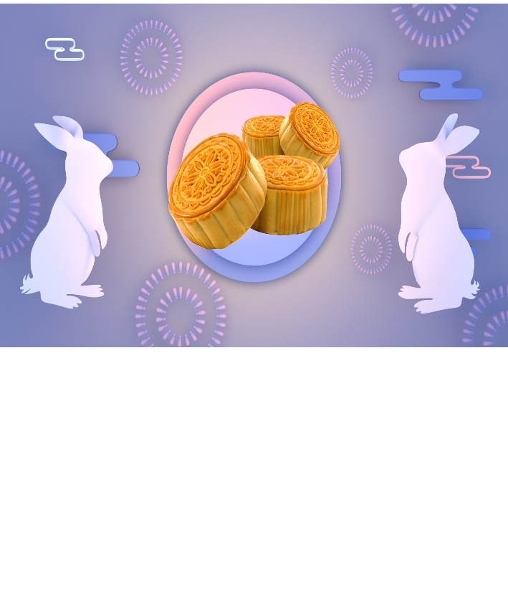
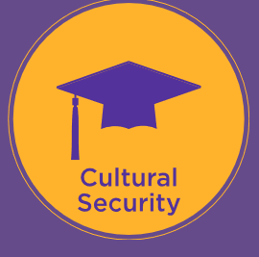
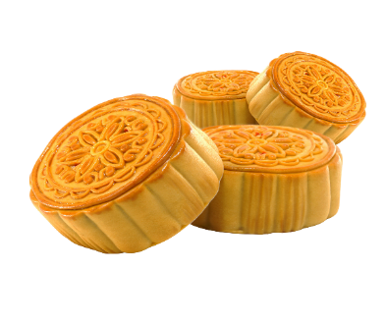


Module | Unit | Topic
Cultures of the World | Customs, Clothing and Food of Different Places | Chinese Festival
Content Objectives
To explore concepts related to cultural / ecological security, e.g.
the history and culture of traditional Chinese festivals
learning activities to strengthen traditional Chinese culture to enhance cultural strength and competitiveness
waste reduction and recycling
Language Objectives
To develop language knowledge and skills, e.g.
listening, speaking, reading/viewing and writing skills
text structures (i.e. a video, an article, story elements)
tenses:
  the use of the simple present tense to present facts; and
  the use of the simple past tense to talk about past events / events of a story
English Language
Education
Chinese Festival
National Security
Education

Slide 3

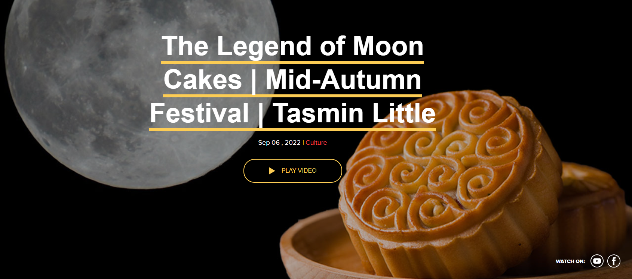
Pre-viewing
Find out how much students know about the Mid-Autumn Festival.
While-viewing
Play the video.
Post -viewing
Use an article on the Mid-Autumn Festival as a follow-up to reinforce students’ understanding of the festival and their role in waste reduction and recycling in festive celebrations.
Engage students in finding out the traditions, the legend and how the festival is celebrated nowadays.
Guide students to develop the language knowledge and skills through integrating information and ideas from the video and the article on the Mid-Autumn Festival.
A Video on
“The Legend of Moon Cakes –
Mid-Autumn Festival”
Source: The China Current:
https://chinacurrent.com/story/23958/the-legend-of-moon-cakes-mid-autumn-festival-tasmin-little

Slide 4

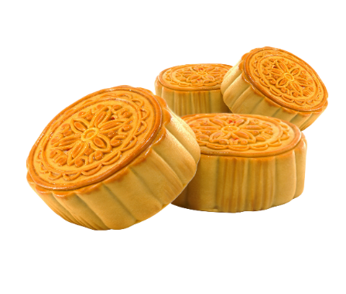
About Mid- Autumn Festival…
  Find out how much students know about the Mid-Autumn Festival.
Pre-viewing
1)
What do you want to know?
What have you learnt?
What do you know?
What do you know?
2)
What have you learnt?
What do you want to know?

Slide 5
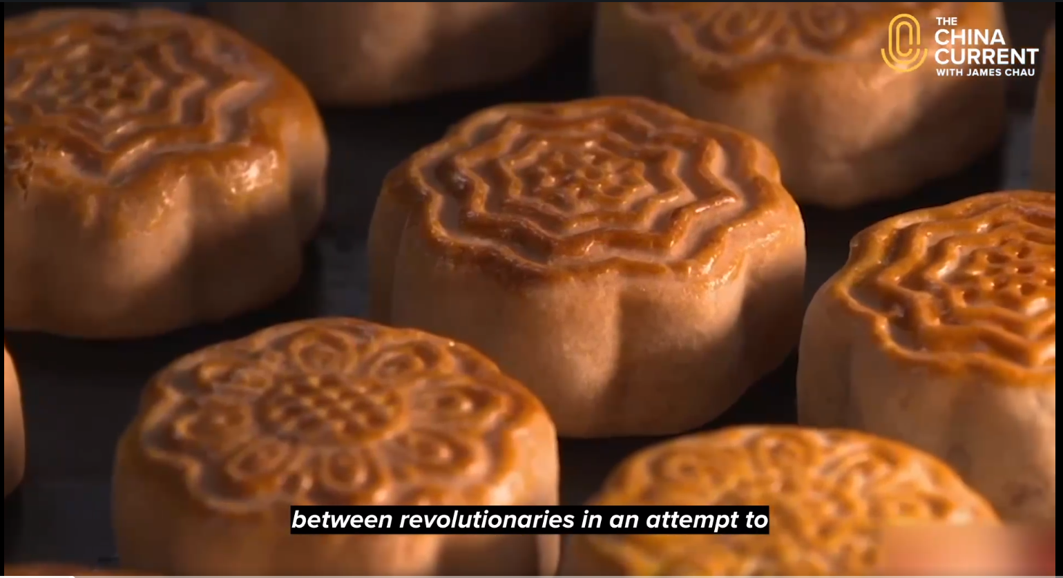
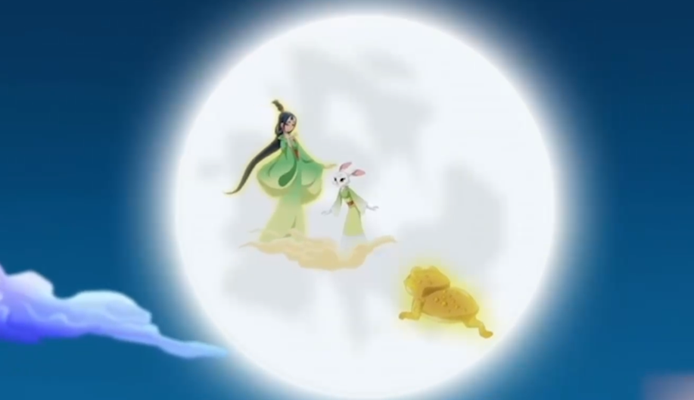
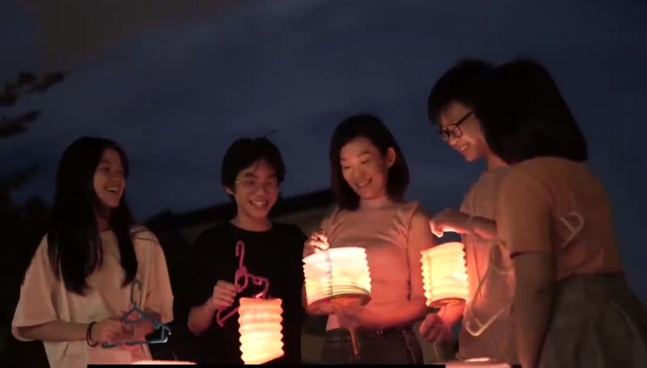
A Video on
“The Legend of Moon Cakes –
Mid-Autumn Festival”
  Play the video.
  Engage students in finding out the traditions, the legend and how the festival is celebrated nowadays.
While-viewing
Video Time: 00:00 – 01:21
Video Time: 01:22 – 04:25
Video Time: 04:26 – 06:15
  What are the traditions of the Mid-Autumn Festival?
  What is the legend of the Mid-Autumn Festival about?
  How do people celebrate the Mid-Autumn Festival nowadays?
Source: The China Current:
https://chinacurrent.com/story/23958/the-legend-of-moon-cakes-mid-autumn-festival-tasmin-little

Slide 6
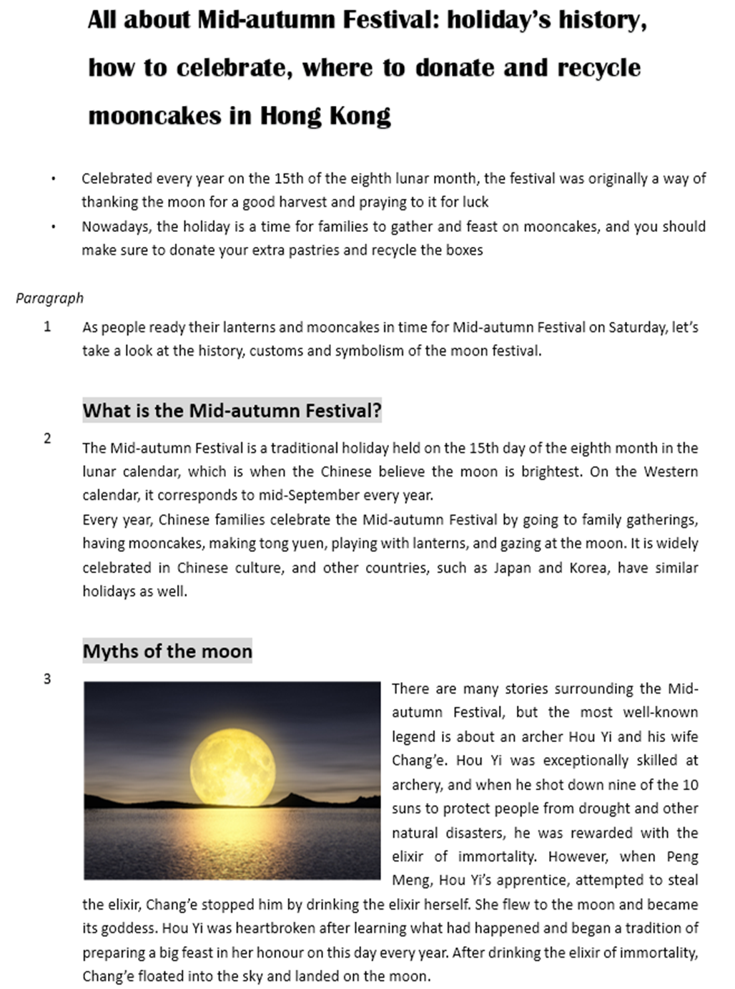
An Article on the
Mid-autumn Festival
  Use the article “All about Mid-autumn Festival: holiday’s history, how to celebrate, where to donate and recycle moon cakes in Hong Kong” as a follow-up to reinforce students’ understanding of the festival.
Post-viewing
Organisation of the Article
What is the Mid-Autumn Festival?
The myths and history of the Mid-Autumn Festival
How is the Mid-Autumn Festival celebrated?
Where can I donate extra moon cakes and recycle the packaging?
Paragraph
2
Paragraphs
3-5
Paragraphs
6-9
Paragraph
10
Please click here to download the text.
Source (Text of the article)
Kwok, Teresa. (2022, September 9). All about Mid-autumn Festival: holiday’s history, how to celebrate, where to donate and recycle moon cakes in Hong Kong. Young Post. Retrieved from: https://yp.scmp.com.

Slide 7
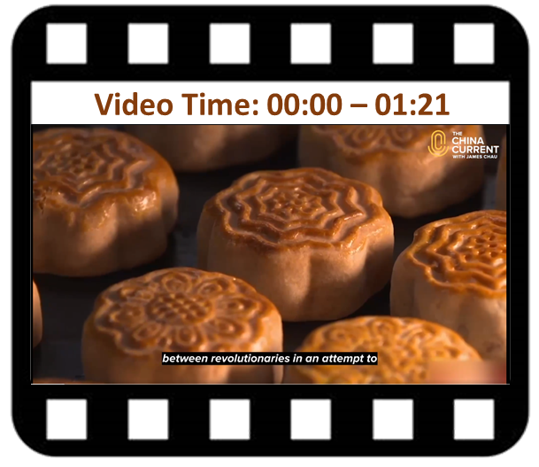
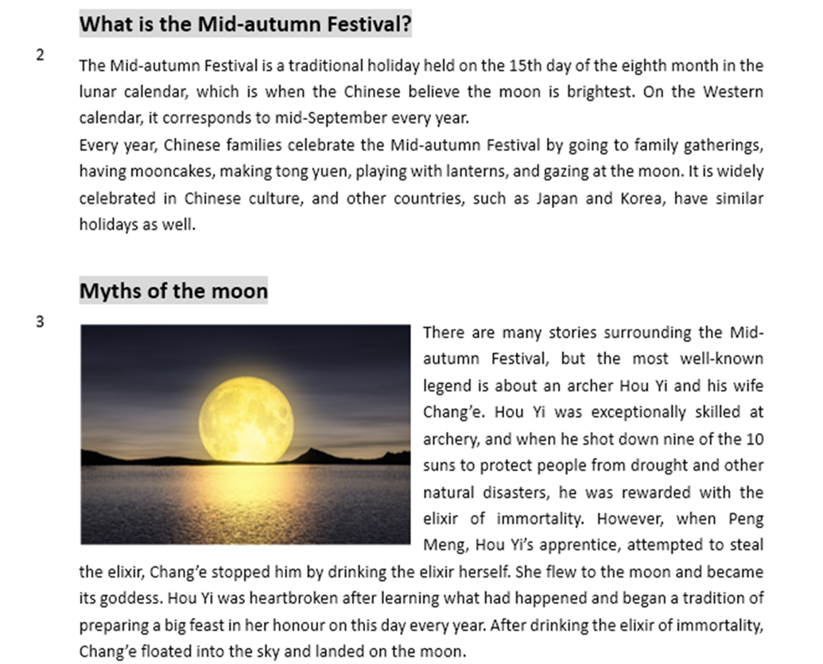
  Guide students to develop the language knowledge and skills through integrating information and ideas from the video and the article on the Mid-Autumn Festival.
Post-viewing
1)
2)
Date
Origins
What is the Mid-Autumn Festival about?
4)
3)
Activities
Reasons for celebrations
A Video on
“The Legend of Moon Cakes –
Mid-Autumn Festival”
An Article on the
Mid-Autumn Festival

Slide 8
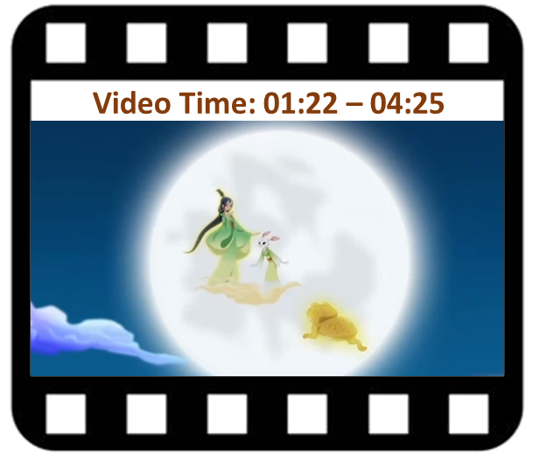
  Guide students to develop the language knowledge and skills through integrating information and ideas from the video and the article on the Mid-Autumn Festival.
Post-viewing
The story about the legend of the Mid-Autumn Festival
(1)
(2)
Setting
Key Events
Ending
Characters
Story Elements
(4)
(3)
A Video on
“The Legend of Moon Cakes –
Mid-Autumn Festival”
An Article on the
Mid-Autumn Festival

Slide 9
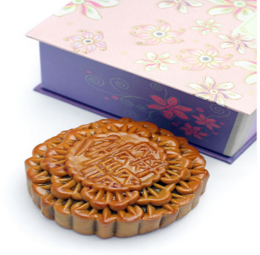
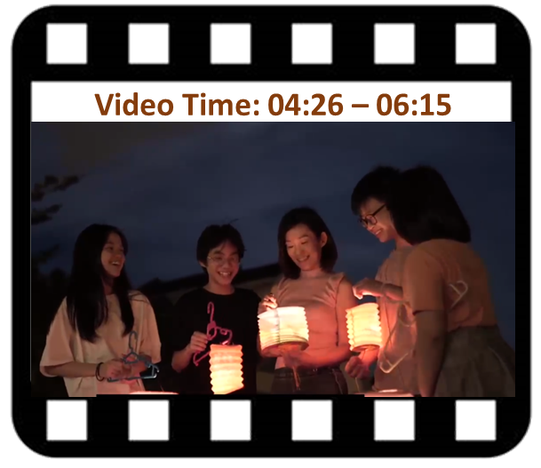
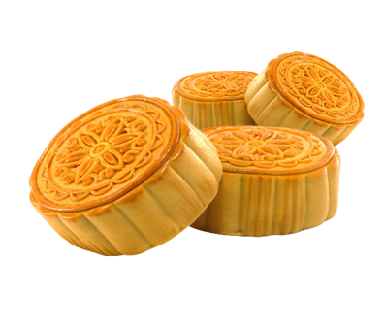
  Guide students to develop the language knowledge and skills through integrating information and ideas from the video and the article on the Mid-Autumn Festival.
Post-viewing
1) How do people celebrate the festival nowadays?
2) Where can I donate extra moon cakes and recycle the packaging?
A Video on
“The Legend of Moon Cakes –
Mid-Autumn Festival”
An Article on the
Mid-Autumn Festival
Let’s explore: Waste Reduction Programmes (by Environmental Protection Department )
https://www.wastereduction.gov.hk/en/assistancewizard/participate_waste_red.htm

Slide 10
  Guide students to identify the use of
  the simple present tense to present facts about the festival; and
  the simple past tense to talk about past events/events of a story.
Post-viewing
Language Focuses
To describe the traditions of the festival
To talk about the history of the festival/events of the legend
To describe how people celebrate the festival nowadays
A Video on
“The Legend of Moon Cakes –
Mid-Autumn Festival”
An Article on the
Mid-Autumn Festival
Simple present tense
Simple past tense
Simple present tense

Slide 11
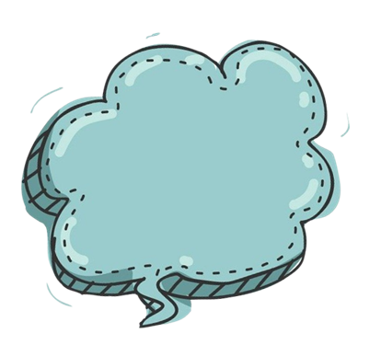


  Building on students’ understanding of the Mid-Autumn Festival, engage students in reflecting on their learning experiences and explore the cultural features of other traditional Chinese festivals.
Post-viewing
Do you think
it is important to preserve traditional Chinese festivals in
Hong Kong?
Why or why not?
How can we help preserve traditional Chinese festivals to safeguard cultural security?
What do you enjoy most about the Mid-Autumn Festival?
Can you suggest a school activity to strengthen students’ understanding of the history and meaning of the Mid-Autumn Festival?
Understanding the impact of the waste created from extra moon cakes and packaging, what can we do to protect our country’s ecological balance while celebrating the festival?
Do festivals bring people from different cultures together?

Slide 12
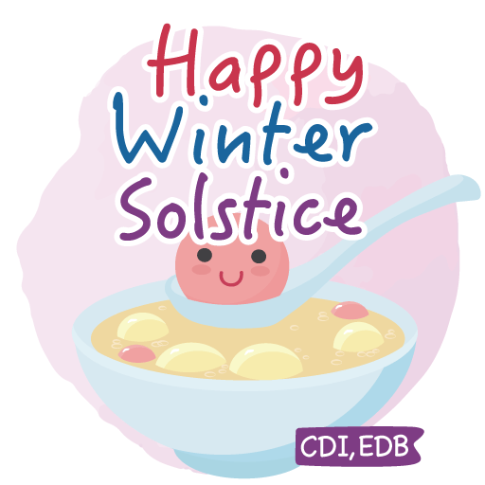
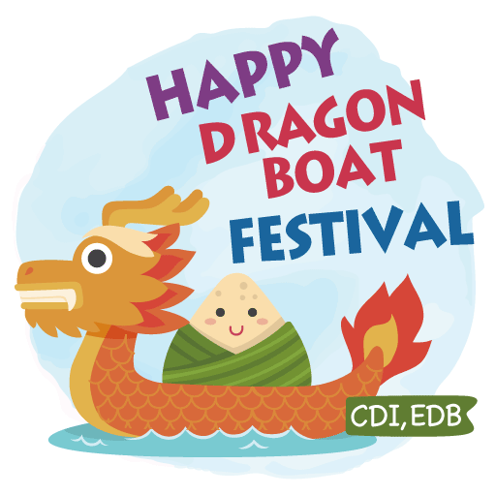
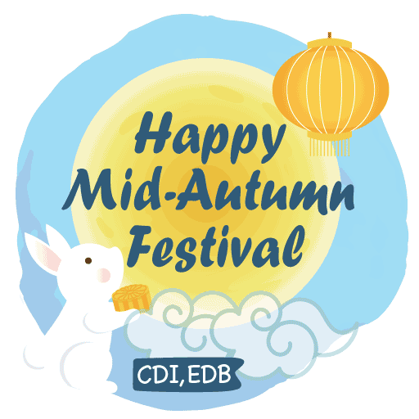
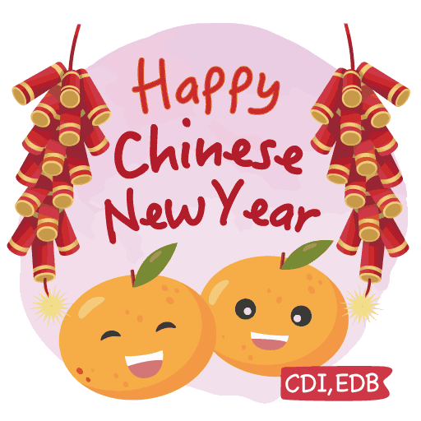
Extended Learning Activities
Arrange a museum tour to the Hong Kong Heritage Museum and/or the Hong Kong Museum of History to provide opportunities for students to explore more on Chinese traditional festivals.
Engage students in identifying a Chinese festival and
collect data from the museum tour; and
write an article on the festival including the following details:
  the traditions and history/origin of the festival;
  how it is celebrated nowadays; and
  their role in recycling and waste reduction in festive celebrations.
Invite students to present highlights of their work and present them to the class. They may include photos, video clips or presentation slides in their presentation.

Slide 13
About Mid-Autumn Festival…
  Ask students to reflect on their learning experiences and write down what they have learnt from this unit.
Post-viewing
What do you want to know?
What have you learnt?
What do you know?
What do you know?
What have you learnt?
What do you want to know?

