Slide 1
Implementing National Security Education
in the Junior Secondary English Language Curriculum
An Example of Learning and Teaching Activities
Topic: Famous Scientist – Tu Youyou

Slide 2



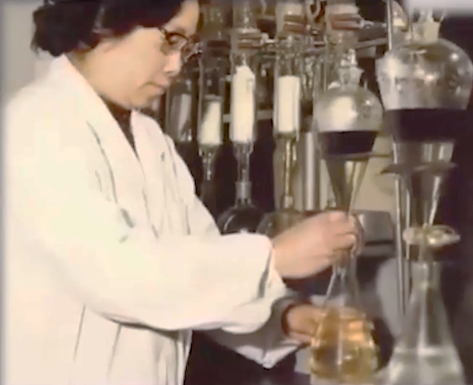
Module | Unit | Topic
Wonderful Things | Successful people and amazing deeds | Famous Scientists
Content Objectives
To explore concepts related to biosecurity/science and technology security, e.g.
the impacts of diseases
scientific breakthroughs
how scientists help improve people’s physical wellbeing
English Language
Education
National Security
Education
Language Objectives
To develop language knowledge and skills, e.g.
listening, speaking, reading/viewing and writing skills
text structures (i.e. a video, an article, a timeline, a presentation)
the use of simple past tense to talk about past events
the use of the passive voice
Famous Scientists

Slide 3

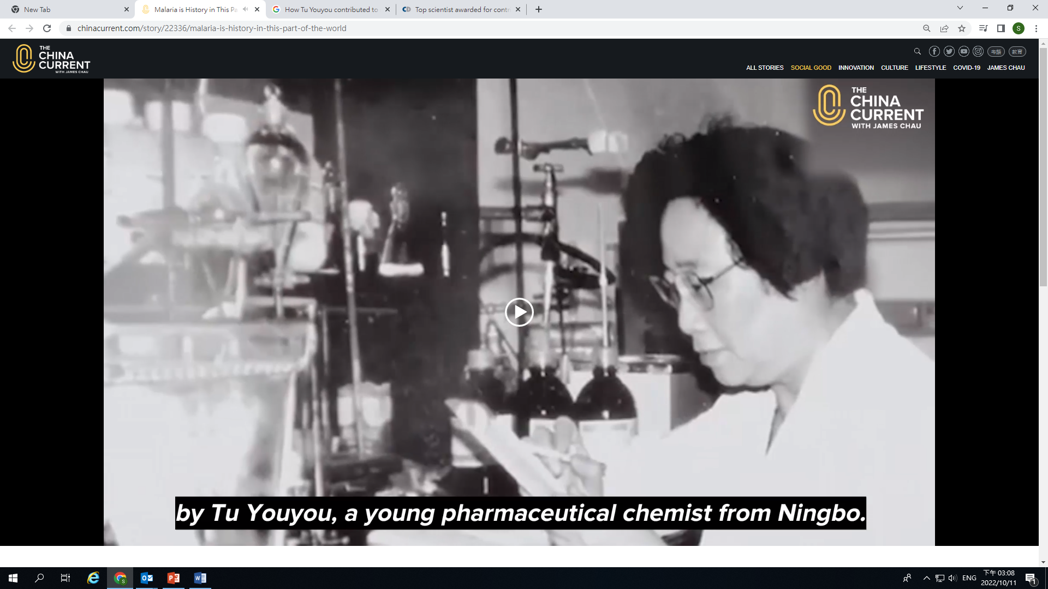
Pre-viewing
Find out how much students know about the disease malaria and the scientist Tu Youyou.
While-viewing
Play the video.
Post -viewing
Engage students in finding out what malaria is, how China fought against malaria, and Tu Youyou’s contributions in tackling malaria.
Use the article “Top scientist awarded for contribution” to discuss the accomplishments of Tu Youyou in reducing the threat of malaria.
Guide students to develop the language knowledge and skills through integrating information and ideas from the video and the article on malaria and Tu Youyou.
A Video on “Malaria is history in this part of the world: Learning more about Tu Youyou”
Source: The China Current:
https://chinacurrent.com/story/22336/malaria-is-history-in-this-part-of-the-world

Slide 4
  Find out how much students know about the disease malaria and the scientist Tu Youyou.
Making predictions on malaria and Tu Youyou before watching the video:
Pre-viewing
What is malaria?
Who is Tu Youyou?
1) Malaria is a disease transmitted by
□ mosquitoes.
□ mice.
People who are infected with malaria
□ will have fever only.
□ may die in severe cases.
3) Malaria is a problem
□ found in China only.
□ worldwide.
Tu Youyou is a □ doctor □ scientist. She is the first female □ Nobel Prize □ Oscar winner in China.
I think Tu Youyou has made the following contribution to improve the health of people:
___________________________________________________________________________________________________________________________

Slide 5
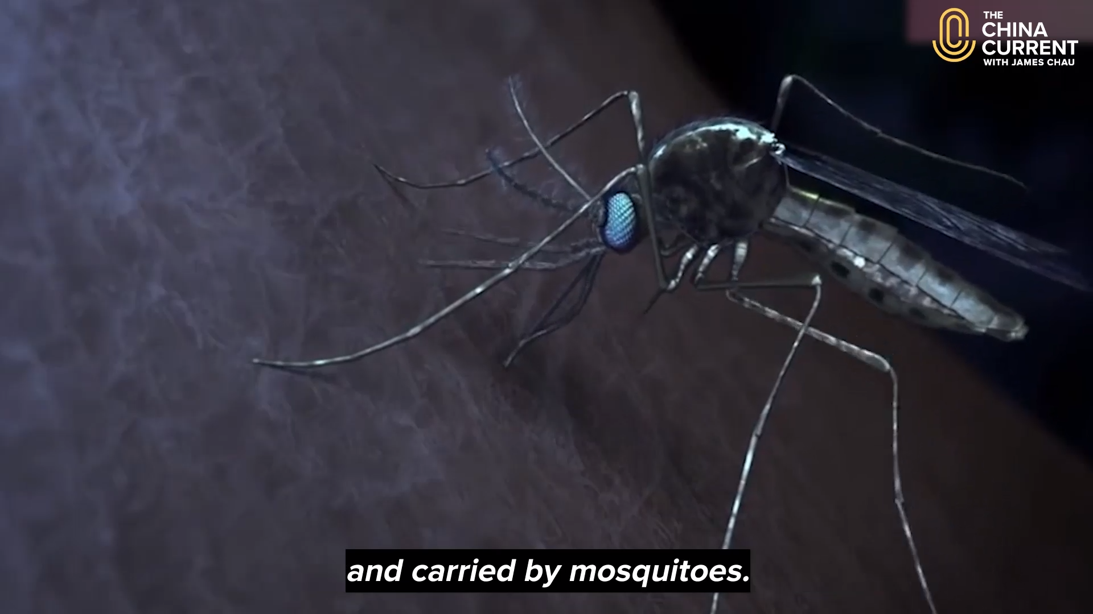
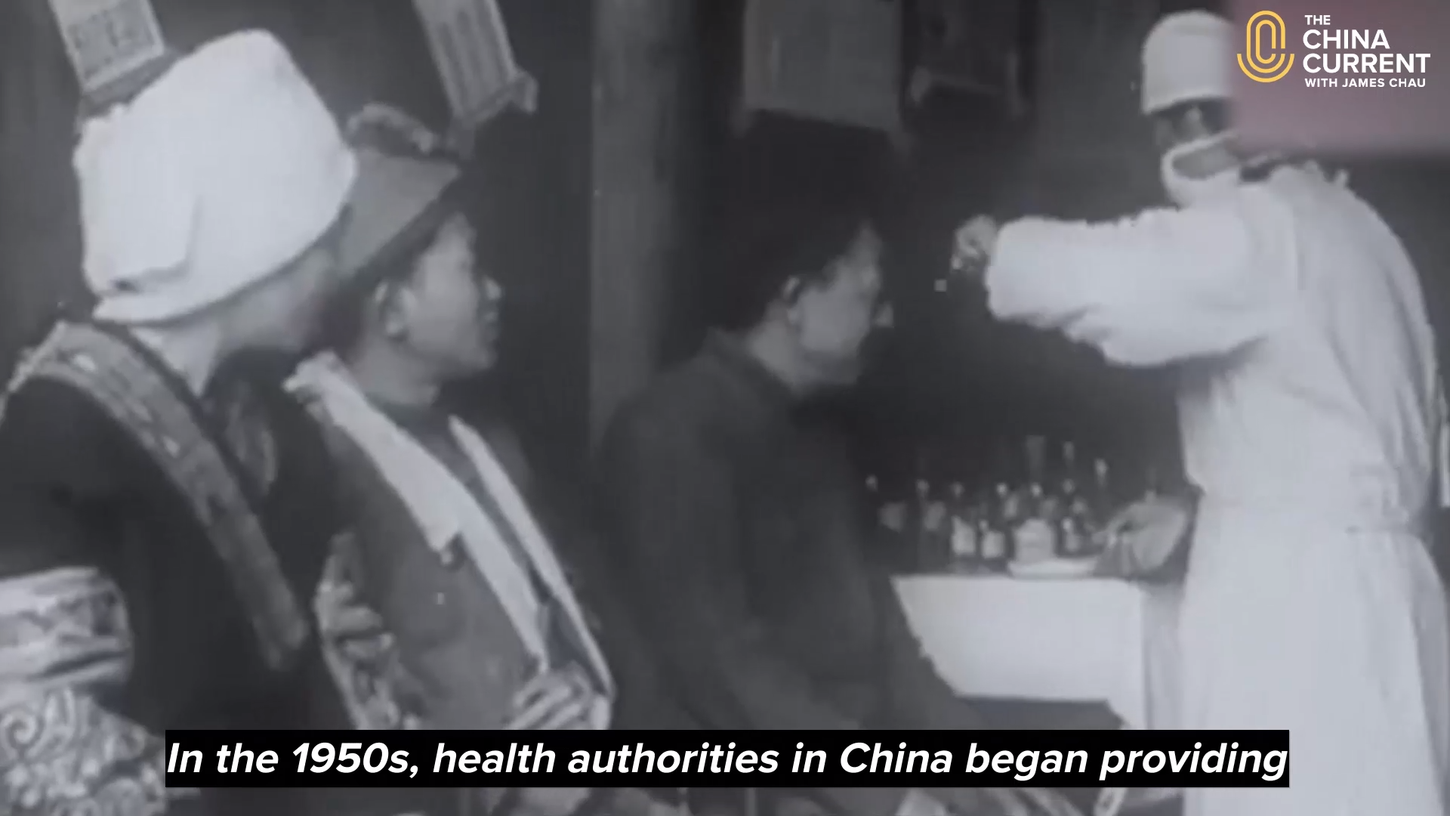
Play the video.
Engage students in finding out what malaria is, how China fought against malaria, and Tu Youyou’s contributions in tackling malaria.
While-viewing
A Video on “Malaria is history in this part of the world: Learning more about Tu Youyou”
Video Time: 00:00 – 00:39
Video Time: 00:40 – 2:54
Video Time: 02:55 – 03:53
  What is malaria?
  What are the impacts of malaria?
  How many people were killed by malaria in 2019?
  How did China fight against malaria since the 1930s before being certified by the WHO to be malaria-free?
  Who is Tu Youyou?
  How did she contribute to the curing of malaria?
Source: The China Current:
https://chinacurrent.com/story/22336/malaria-is-history-in-this-part-of-the-world

Slide 6
Use the article “Top scientist awarded for contribution” to discuss the accomplishments of Tu Youyou in reducing the threat of malaria.
Post-viewing
Guide students to identify and summarise the important accomplishments of Tu Youyou using a timeline and understand the use of the simple past tense and the passive voice.
An Article on “Top scientist awarded for contribution”
The Preeminent Science and Technology Award – the highest award in China for recognising an individual scientist’s contribution – was given to Tu Youyou.
Tu was elected chair of a government project aimed at eradicating malaria.
1955
2015
1969
2017
Source:
Cheng, Y. (2017, January 10). “Top scientist awarded for contribution”. China Daily.
Tu graduated from the department of pharmaceutics at Beijing Medical College and then worked for the China Academy of Traditional Chinese Medicine.
Tu shared the Nobel Prize in physiology or medicine with Irish William Campbell and Japanese Satoshi Omura for developing therapies against malaria and infections caused by roundworm parasites.

Slide 7
Guide students to develop the language knowledge and skills through integrating information and ideas from the video and the article on malaria and Tu Youyou.
Post-viewing
Guide students to arrange the significant events in fighting against malaria in China in chronological order and understand the use of the simple past tense and the passive voice.
China’s efforts in fighting against malaria
Video Time: 00:40 – 2:54
1940s
1950s
1960s
1970s
1980s
1990s
2000s
2010s
2020s
Health authorities in China began providing medicines to prevent further spread of malaria
Discovery of artemisinin by Tu Youyou and her team
China innovated the use of mosquito nets, which was then made to a global standard for malaria control by the World Health Organisation (WHO)
30 million Chinese were infected with malaria annually
117, 000 cases of malaria in China annually
Headed by Tu Youyou, the elite group “Project 523” involved 500 of China’s best scientists to find new treatments for malaria
Tu Youyou was the first female scientist to be awarded the Nobel Prize
In June 2021, WHO certified China malaria-free
Malaria killed 209,000 people worldwide in 2019
Video Time: 02:55 – 03:53
Article on “Top scientist awarded for contribution”
Answers: D→A→F→B→C→E→G, I→H

Slide 8
Guide students to develop the language knowledge and skills through integrating information and ideas from the video and the article on malaria and Tu Youyou.
Post-viewing
Have students conduct further research on Tu Youyou and give an oral presentation on her contribution to our country and to the world.
Who is she?
When and where was she born?
Education
Why is she so important?
Her contribution to curing malaria
Video Time: 00:00 – 03:53
Article on “Top scientist awarded for contribution”
Famous scientist –
Tu Youyou
What awards did she receive ?
What can you learn from her?
Language focus of the presentation:
Use of the simple past tense to talk about the significant events of malaria and the achievements of Tu Youyou
Present ideas in chronological order

Slide 9
Guide students to develop the language knowledge and skills through integrating information and ideas from the video and the article on malaria and Tu Youyou.
Post-viewing
Have students reflect on what they have learnt from the accomplishments of Tu Youyou and the importance of biosecurity/science and technology security.
What have you learnt from Tu Youyou’s achievements?
Video Time: 00:00 – 03:53
Article on “Top scientist awarded for contribution”
What do you think are some important values and attitudes of a successful scientist?
Why is safeguarding biosecurity/science and technology security important to our country?
How had the contribution of Tu Youyou and her team of scientists helped safeguard biosecurity/science and technology security in our country and worldwide?

Slide 10


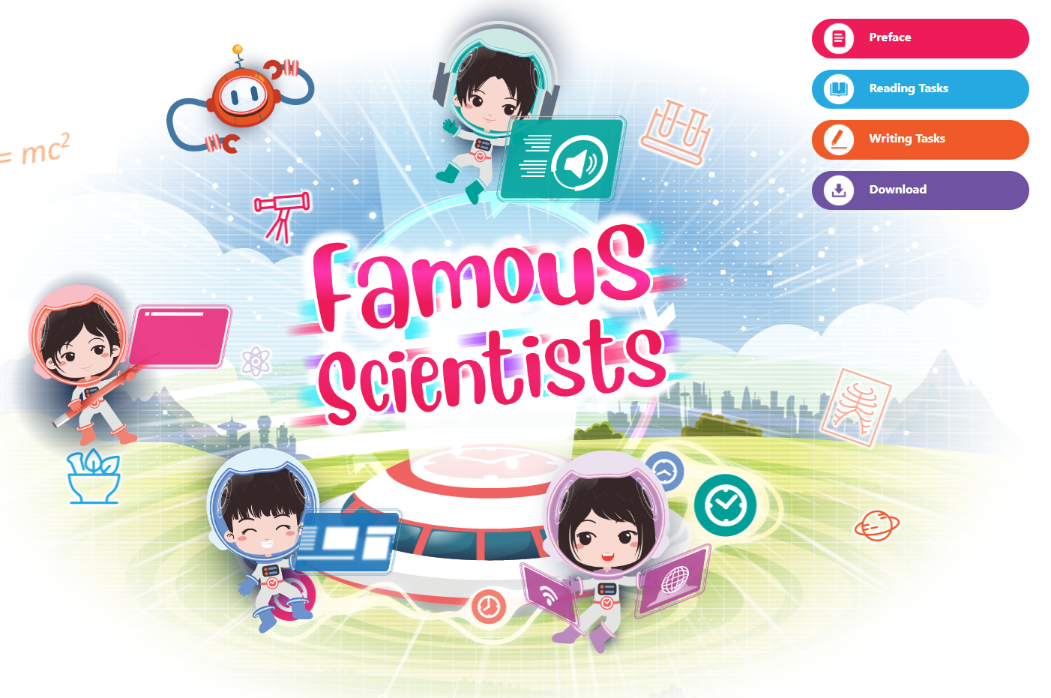

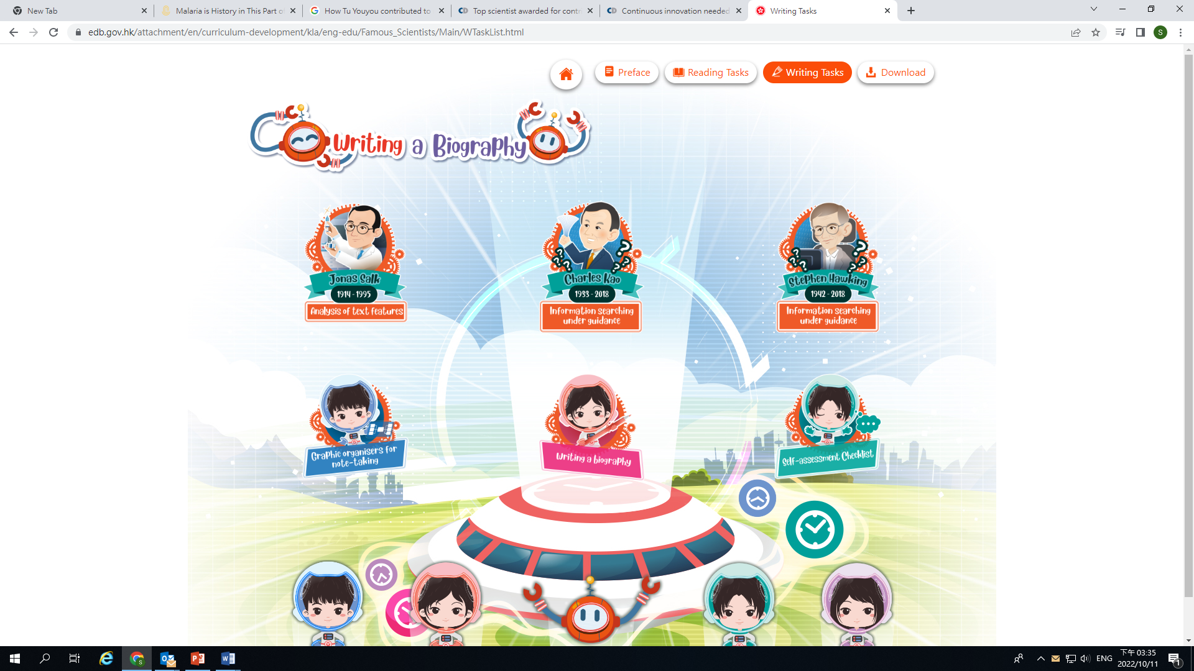
Extended Learning Activities
Activity 1: Research on famous scientists
Have students conduct further research on other famous scientists from different sources (e.g. websites, books, magazine articles).
Design an infographic / a biography to illustrate the great deeds done by him/her and what we can learn from him/her.
References and Resources
E-book “Famous Scientists”
Resource Kit on Promoting Positives Values and Attitudes through English Sayings of Wisdom
Self-learning reading and writing tasks on famous scientists
Activity 1: Creative Writing Activities on Biographies/Autobiographies (pp.10-12)
Activity 2: Research on Famous Failures – Learning from Stories about People Who Embraced Failures with Grit (pp.13-16)
http://www.edu.gov.hk/Famous_Scientists
http://www.edu.gov.hk/Hope_RK

Slide 11
Extended Learning Activities
Activity 2: Museum visit
A cross-curricular (e.g. Science, History) experiential learning activity – paying a visit to Hong Kong Museum of Medical Sciences
A visit to
Hong Kong Museum of Medical Sciences
To explore more on the development of health and medical sciences in Hong Kong
Giving a presentation on the diseases and scientific breakthrough in improving people’s health in Hong Kong that students learnt at the museum
https://www.hkmms.org.hk/en/exh/exhibitions/
To include facts, history and development about the health and medical sciences in Hong Kong in fighting against major diseases (e.g. SARS, smallpox)

