Slide 1

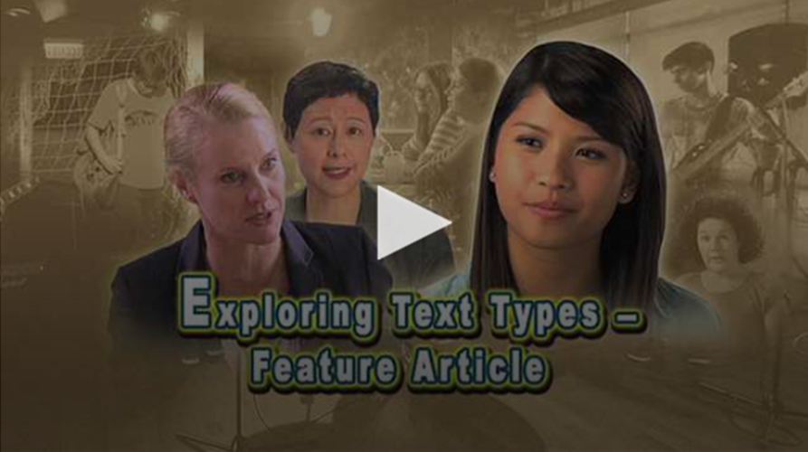
Exploring Text Types at the Secondary Level (II) –
Feature Article

Slide 2
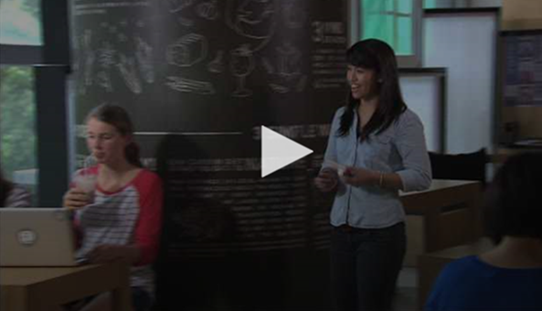
Learning Objectives
To learn about the stylistic features and the organisation of feature articles
To develop an interest in journalistic writing
To learn more about the impact of social media on teenagers
Module
Study, School Life and Work
Unit
Media and Communication

Slide 3
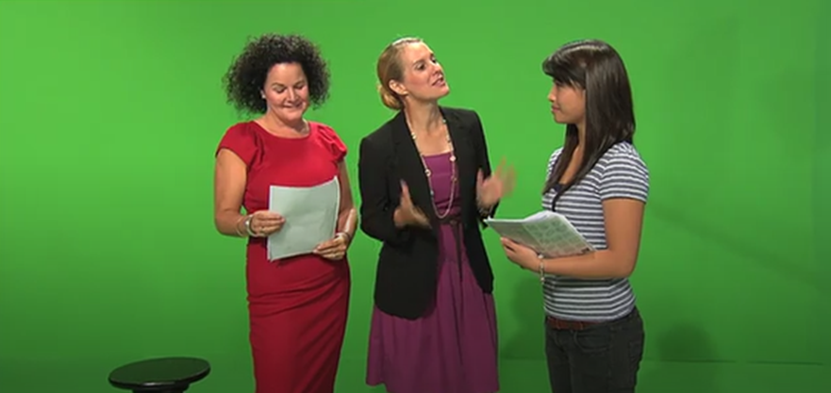
Programme Outline
This programme features the process of Charlotte, a teenaged girl, working as a summer intern in a TV production company, learning how to write a feature article for a news documentary programme. Faced with the challenge of writing the feature article from her demanding boss, Charlotte has learnt about the importance of the basics of writing: thorough and comprehensive research, a clear and coherent structure, different but balanced perspectives and the inclusion of examples and details to support one’s line of argument. She also benefits from having the opportunity to talk to a famous news anchor who gives her invaluable advice on how to write a good feature article.

Slide 4
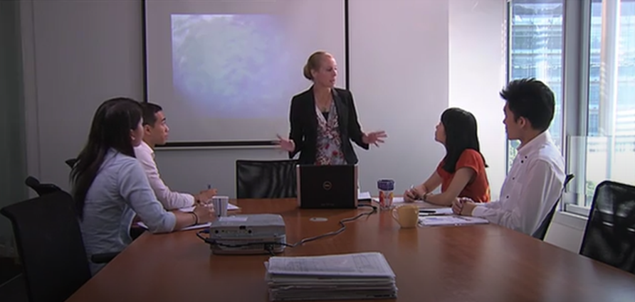
The ETV Programme
Activity Sheets
Suggested Answers
Related Programmes
Persuasive Writing
News Report and Editorial
Suggested Activities

