Slide 1

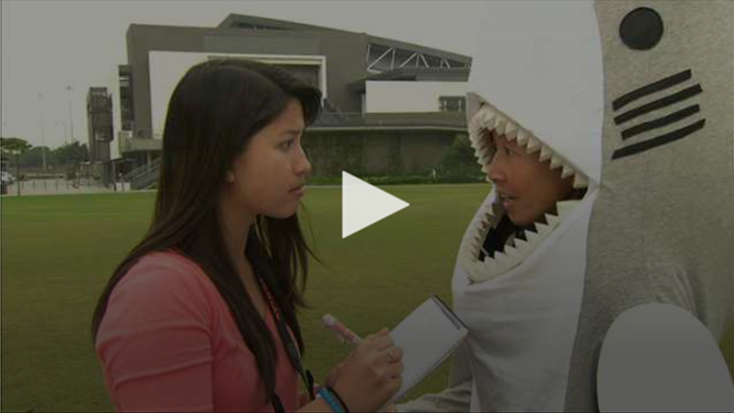
Exploring Text Types at the Secondary Level (III) –
News Report and Editorial

Slide 2
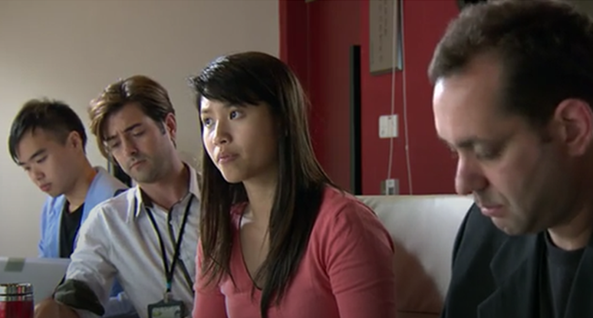
Learning Objectives
To learn about the stylistic features and organisation of news reports and editorials
To develop an interest in journalistic writing
To learn more about the importance of marine conservation
Module
Study, School Life and Work
Unit
Media and Communication

Slide 3
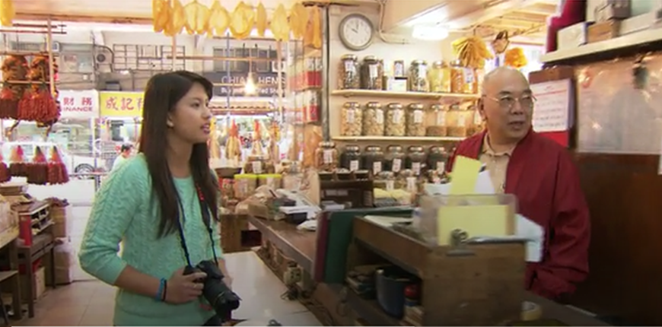
Programme Outline
This programme features the process of Charlotte, a teenaged girl, working as a summer intern in a newspaper publishing house, learning how to write an online newspaper article for a news documentary programme. Thanks to the support of a senior reporter, she has learnt how to do research on a current issue and the stylistic features and tone of a news report and editorial. More importantly, she has also learnt the importance of having good organisational, co-operative and communication skills.

Slide 4
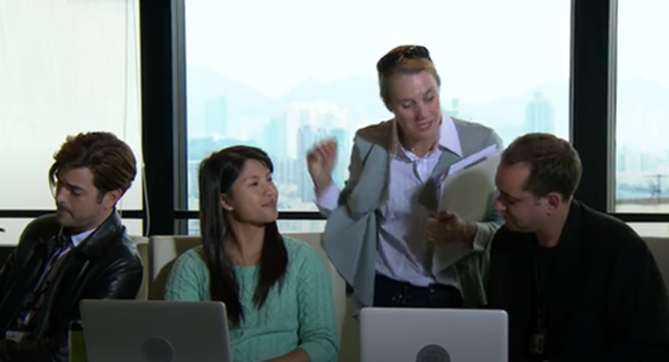
The ETV Programme
Activity Sheets
Suggested Answers
Related Programmes
Persuasive Writing
Feature Article
Suggested Activities

