Slide 1

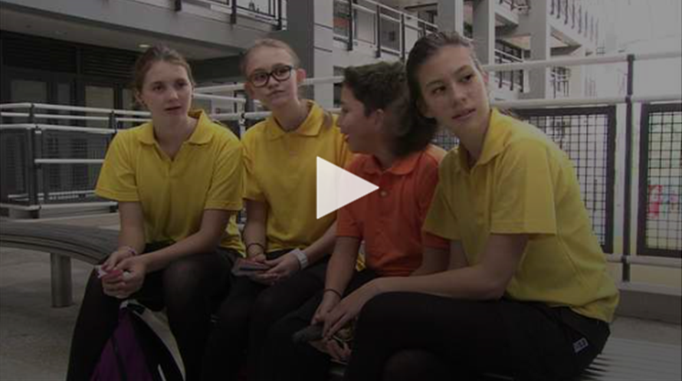
Exploring Text Types at the Secondary Level (I) –
Persuasive Writing

Slide 2
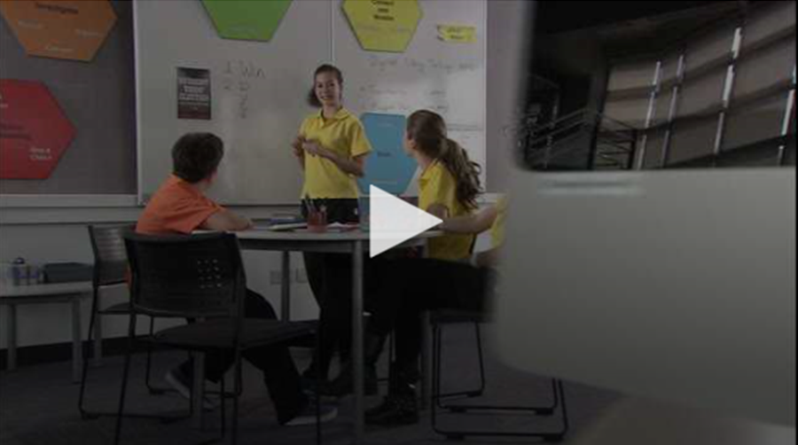
Learning Objectives
To learn about the stylistic features of persuasive writing, the organisation of persuasive texts and development of paragraphs in persuasive texts
To develop an interest in persuasive writing
To learn more about the techniques to convince the audience to accept his or her viewpoints
Module
Rights and Responsibilities
Unit
At School

Slide 3
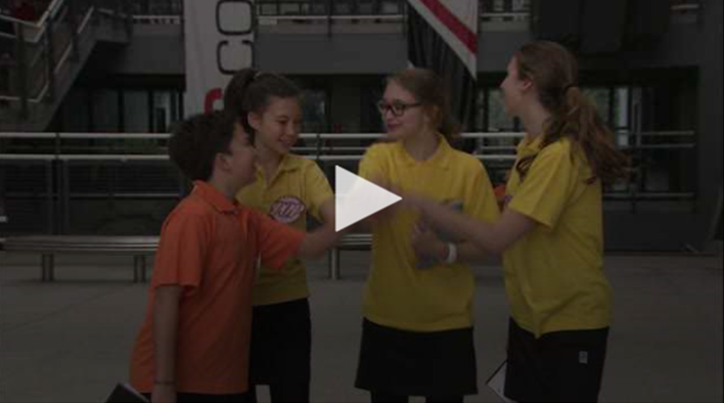
Programme Outline
This programme features the process of Charlotte and her classmates learning how to write a persuasive text in the form of a speech to appeal to their schoolmates for their support in the Student Union Election. Faced with the challenge of writing a persuasive speech, Charlotte has learnt about the different techniques to persuade the audience to support her viewpoints. She also benefits from talking to her father who gives her invaluable advice on how to write a good persuasive speech.

Slide 4
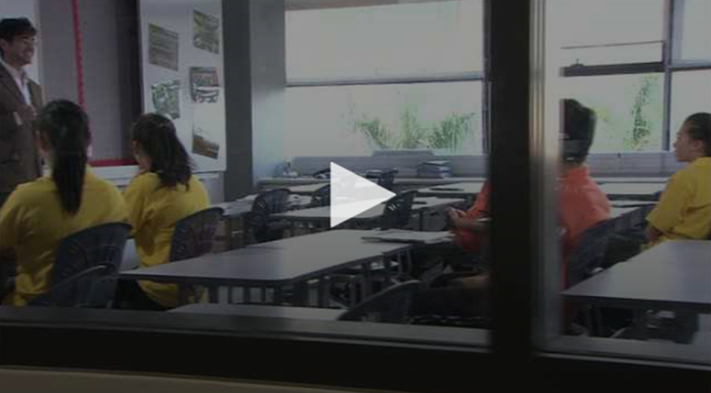
The ETV Programme
Activity Sheets
Suggested Answers
Related Programmes
Feature Article
News Report and Editorial
Suggested Activities

