Slide 1

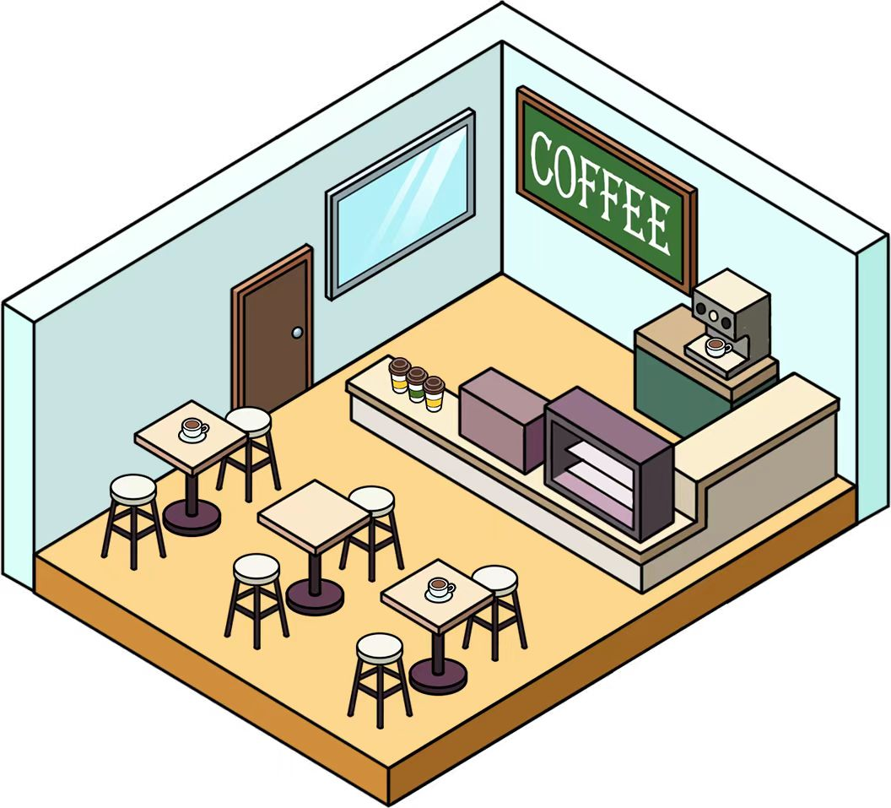
Transforming a School Activity Room into a Café Corner

Slide 2

Imagine transforming an activity room in your school into a comfortable café corner where students and teachers can gather, chat, and relax. How exciting would that be!
Your mission is to act as an interior designer and design this unique café corner. You will use mathematical modelling to plan the arrangement of tables and chairs and prepare a budget report for the cost of the furniture.
This activity not only enhances your creativity but also develops your ability to use mathematical modelling for practical planning and budgeting.

Slide 3
Activity 1
To describe mathematically the comfort level of a space and create an initial floor plan for the café corner.

Slide 4
Activity 1
To describe mathematically the comfort level of a space and create an initial floor plan for the café corner.
On the Internet, we often see customer ratings for different restaurants, which typically include the “comfort level” of the restaurant decor. For example:
RATING
Taste
Decor
Service
Before designing the café corner, propose some factors that might affect the “comfort level” of the café corner.
Which of these are more directly related to mathematics?

Slide 5
Activity 1
To describe mathematically the comfort level of a space and create an initial floor plan for the café corner.
Factors less directly related to mathematics:
The size of the café corner
The number of customers accommodated at one time
The numbers of tables and chairs
The distance between two sets of tables and chairs
Factors less directly related to mathematics:
Background music
Decoration
Colours

Slide 6
Activity 1
To describe mathematically the comfort level of a space and create an initial floor plan for the café corner.
We will explore two factors that can help quantify the comfort level in a space.
2. Factor 1: Passage Width
How do you think the passage width can affect the comfort level?

Slide 7
Activity 1
To describe mathematically the comfort level of a space and create an initial floor plan for the café corner.
How do you think the passage width can affect the comfort level?
Generally speaking, the larger the passage width, meaning the more spacious the passage, and the higher the comfort level.
Conversely, the smaller the passage width, meaning the more cramped the passage, and the lower the comfort level.

Slide 8
Activity 1
To describe mathematically the comfort level of a space and create an initial floor plan for the café corner.
We will explore two factors that can help quantify the comfort level in a space.
2. Factor 1: Passage Width
Based on the current setting of the activity room, measure the passage width between two sets of tables and chairs.
Hence, recommend an optimal passage width suitable for the café corner.

Slide 9
Activity 1
To describe mathematically the comfort level of a space and create an initial floor plan for the café corner.
We will explore two factors that can help quantify the comfort level in a space.
2. Factor 1: Passage Width
During site visits, if we quantify the comfort level in a café corner or restaurant using the passage width, what difficulty might we encounter? How can we resolve?

Slide 10
Activity 1
To describe mathematically the comfort level of a space and create an initial floor plan for the café corner.
During site visits, if we quantify the comfort level in a café corner or restaurant using the passage width, what difficulty might we encounter? How can we resolve?
Difficulty: Typically, there are multiple passages with varying widths in a café corner or restaurant.
Solution: We can formulate strategies to identify the most representative passage width, such as calculating the mean, modal class, or median of all passage widths in the space.

Slide 11
Activity 1
To describe mathematically the comfort level of a space and create an initial floor plan for the café corner.
We will explore two factors that can help quantify the comfort level in a space.
3. Factor 2: Free-space Ratio
We define the free-space ratio as:
Free-space ratio =
If the activity room is nearly fully occupied by tables, chairs, and equipment (i.e., the area occupied is close to the total area), the free-space ratio will approach 0.
Conversely, if very little space in the activity room is occupied by tables, chairs, and equipment (i.e., the area occupied is close to 0), the free-space ratio will approach 1.
Total area-Area occupied
Total area

Slide 12
Activity 1
To describe mathematically the comfort level of a space and create an initial floor plan for the café corner.
We will explore two factors that can help quantify the comfort level in a space.
3. Factor 2: Free-space Ratio
What problems may arise if the free-space ratio is close to 0 or close to 1?

Slide 13
Activity 1
To describe mathematically the comfort level of a space and create an initial floor plan for the café corner.
What problems may arise if the free-space ratio is close to 0 or close to 1?
If the free-space ratio is close to 0, the activity room becomes overcrowded, making customers’ movement difficult.
Conversely, if the free-space ratio is close to 1, it can result in a feeling of emptiness and underutilisation of the space.

Slide 14
Activity 1
To describe mathematically the comfort level of a space and create an initial floor plan for the café corner.
We will explore two factors that can help quantify the comfort level in a space.
3. Factor 2: Free-space Ratio
By measuring the activity room and the area occupied by the furniture inside, calculate the free-space ratio of the current setting.
Hence, recommend an optimal free-space ratio suitable for the café corner.

Slide 15
Activity 1
To describe mathematically the comfort level of a space and create an initial floor plan for the café corner.
We will explore two factors that can help quantify the comfort level in a space.
3. Factor 2: Free-space Ratio
During site visits, if we quantify the comfort level in a café corner or restaurant using the free-space ratio, what difficulty might we encounter? How can we resolve?

Slide 16
Activity 1
To describe mathematically the comfort level of a space and create an initial floor plan for the café corner.
During site visits, if we quantify the comfort level in a café corner or restaurant using the free-space ratio, what difficulty might we encounter? How can we resolve?
Difficulty: Accurately measuring dimensions in an operating café corner or restaurant can be difficult due to the movement of customers and staff within the space.
Solution: We can employ estimation techniques, such as measuring specific areas of the café corner or restaurant and then using these results to estimate the size of the entire space.

Slide 17
Activity 1
To describe mathematically the comfort level of a space and create an initial floor plan for the café corner.
We will explore two factors that can help quantify the comfort level in a space.
3. Factor 2: Free-space Ratio
What are the limitations regarding the factor of the free-space ratio?

Slide 18
Activity 1
To describe mathematically the comfort level of a space and create an initial floor plan for the café corner.
What are the limitations regarding the factor of the free-space ratio?
The free-space ratio does not adequately reflect the effect of furniture shape and position or orientation on the comfort level.
Besides, the free-space ratio is a 2D indicator and does not fully capture the extent of occupancy in a 3D space.

Slide 19
Activity 1
To describe mathematically the comfort level of a space and create an initial floor plan for the café corner.
Based on the dimension of the activity room and the following existing equipment, create an initial floor plan for the café corner, thereby presenting the layout arrangement of tables and seating.
The dimensions of the existing equipment are as follows:
Coffee machine with its desk: 300 cm (L) × 80 cm (W) × 160 cm (H)
Microwave oven with its desk: 70 cm (L) × 50 cm (W) × 120 cm (H)
Washing station: 250 cm (L) × 80 cm (W) × 90 cm (H)
Also, discuss the comfort level of the café corner by considering Factors 1 and 2 or other relevant factors.

Slide 20
Activity 2A
Observe variables that affect the café corner design and customer experience through site visits.

Slide 21
Activity 2A
Observe variables that affect the café corner design and customer experience through site visits.
Visit some nearby café corners or restaurants and take notes on the following aspects.
i. The number of customers accommodated at one time.
ii. The number of different types of tables available.
iii. The passage width and measurement strategy.
iv. The free-space ratio and measurement strategy.
v. Your perceived “comfort level” as a customer.

Slide 22
Activity 2A
Observe variables that affect the café corner design and customer experience through site visits.
Considering your data collected during the site visits, what conditions do you think a comfortable café corner has to fulfil? How would you refine the values in the design in Activity 1 (Question 4) for Factor 1 (passage width) and Factor 2 (free-space ratio)?
A comfortable café corner has to fulfil the following conditions:
The number of customers ≤ 30
The number of tables ≤ 15
Factor 1: The passage width ≥ 1.5 m
Factor 2: The free-space ratio ≈ 0.5

Slide 23
Activity 2B
Collect data about the furniture that best suit the school’s new café corner.

Slide 24
Activity 2B
Collect data about the furniture that best suit the school’s new café corner.
When collecting data of the furniture for the new café corner, considering the comfort level and budget of the café corner, what data/information would you collect?
Data/information related to the comfort level and budget:
Dimension
Function
(e.g., the number of people per table)
Comfort level
(e.g., the heights and materials of the tables and chairs)
Price

Slide 25
Activity 2B
Collect data about the furniture that best suit the school’s new café corner.
Visit a nearby furniture store (or browse an online retailer) to collect information on several types of tables and chairs that could be considered for the café corner.
Dimension
Comfort level
Brand and product model
Price
Others

Slide 26
Activity 2B
Collect data about the furniture that best suit the school’s new café corner.
Based on the collected data, discuss the price ranges of different furniture and estimate the furniture costs based on the initial coffee corner design developed in Activity 1.
A typical small café corner that can provide 15 to 30 seats has a furniture cost of approximately $120,000 to $250,000. This includes a corresponding number of tables, chairs, and sofas, with the reference costs for each piece of furniture as follows:
Chairs/stools: $800 to $5,500 each
Tables (for 2 or 4 people): $3,000 to $12,000 each
Sofas/booths (for 2 to 4 people): $8,000 to $25,000 each
Bar counter (6 to 10 feet): $30,000 to $80,000 each

Slide 27
Activity 3
Considering the outcomes from Activity 2 regarding the comfort level of the café corner and the furniture costs, create a refined design for the café corner in the form of a scaled floor plan and establish a budget for the café corner’s furnishings.
Observe different designs through group presentations and think about how to optimise one’s own design.

Slide 28
Activity 3
Referring to the following steps, create a scaled floor plan of the café corner.

Slide 29
Step iii
Based on the observations from Activity 2A, discuss how to arrange the furniture to enhance the comfort level of the café corner while also considering the operational needs of the café corner.
Step i
Using the measurements in Activity 1, set the dimensions of the floor plan with a scale (e.g., 1:100) on the graph paper.
Step iv
Based on the data in Activity 2B, decide the types and quantities of tables and chairs that you are going to use.
Step ii
If necessary, discuss whether to change the positions of the existing equipment in the café corner (see Question 4 in Activity 1).
Step v
Draw a scaled floor plan of the café corner that includes the layout of the entrance and furniture.

Slide 30
Activity 3
Based on the floor plan of the café corner designed in Question 1, calculate or estimate:
the maximum number of customers accommodated at one time,
(b) the passage width of the café corner,
(c) the free-space ratio of the café corner,
(d) the total cost for the furniture.
Also, evaluate whether the design meets the conditions for a comfortable café corner as proposed in Activity 2.

Slide 31
Activity 3
Referring to your classmates’ café corner designs, how would you optimise the original conditions for a comfortable café corner (Activity 2) and its design (Activity 3)?
Create an optimised design for the café corner (e.g., enhancing the comfort level without increasing furniture costs).

