Slide 1


Predicting the Social Media Follower Counts of Singers

Slide 2

Background
Monitoring trends in social media follower counts is crucial, as it offers valuable information about public interest and support on singers. In today’s digital world, a singer’s social media presence can influence their career opportunities and overall popularity. As a manager of several singers, predicting these trends is essential for making decisions regarding marketing strategies, concert promotions, and public relations.
Imagine you are the manager of several singers, responsible for monitoring their social media follower counts. Your task involves predicting how many followers each singer will have in the future. These predictions will not only help you assess their performance but also facilitate discussions with potential partnerships.
Using mathematical modelling, you will analyse historical follower count data to make predictions and identify patterns across various trends. Get ready to become a professional manager who can leverage social media data for success!

Slide 3
Activity 1
To conduct preliminary analysis on the modelling context and make simple predictions.

Slide 4

To conduct preliminary analysis on the modelling context
and make simple predictions.
What factors do you think can influence
  the follower counts of singers on social media?
Factors related to the singer themselves,
  such as the singer’s age, personal charisma, and frequency of public appearances.
Factors related to social media,
  such as the quality of posts, posting frequency, interaction with fans on social media, and social media algorithms.

Slide 5
To conduct preliminary analysis on the modelling context
and make simple predictions.
The following table shows the social media
  follower counts of Singers A and B from January to May.
Singer | Jan | Feb | Mar | Apr | May
Singer A | 30 | 55 | 80 | 105 | 130
Singer B | 20 | 40 | 80 | 160 | 320

Slide 6

To conduct preliminary analysis on the modelling context
and make simple predictions.
Singer | Jan | Feb | Mar | Apr | May
Singer A | 30 | 55 | 80 | 105 | 130
Singer B | 20 | 40 | 80 | 160 | 320
2(a). If we can only use this data to predict the social
media follower counts of Signers A and B in the
coming months, what assumptions should we make?
2(b). With the assumptions in (a), predict the social media
follower counts of Singers A and B in June and
explain your answer.

Slide 7
To conduct preliminary analysis on the modelling context
and make simple predictions.
Singer | Jan | Feb | Mar | Apr | May
Singer A | 30 | 55 | 80 | 105 | 130
Singer B | 20 | 40 | 80 | 160 | 320
2(a).We should make assumptions:
1. The primary governing factor is
the previous numbers of followers.
2. Consistent growth patterns.
3. Linear growth for Singer A,
while exponential growth for Singer B.

Slide 8
To conduct preliminary analysis on the modelling context
and make simple predictions.
Singer | Jan | Feb | Mar | Apr | May
Singer A | 30 | 55 | 80 | 105 | 130
Singer B | 20 | 40 | 80 | 160 | 320
2(b). Predict the social media follower counts of
Singers A and B in June and explain your answer.
For Singer A, the follower count of each month is greater than that of its previous month by 25.
The social media follower count of Singer A in June = 130 + 25
= 155

Slide 9
To conduct preliminary analysis on the modelling context
and make simple predictions.
Singer | Jan | Feb | Mar | Apr | May
Singer A | 30 | 55 | 80 | 105 | 130
Singer B | 20 | 40 | 80 | 160 | 320
2(b). Predict the social media follower counts of
Singers A and B in June and explain your answer.
For Singer B, the follower count of each month is double that of its previous month.
The social media follower count of Singer B in June = 320 × 2
= 640

Slide 10

Activity 2
To explore modelling approaches applicable to linear trends.

Slide 11
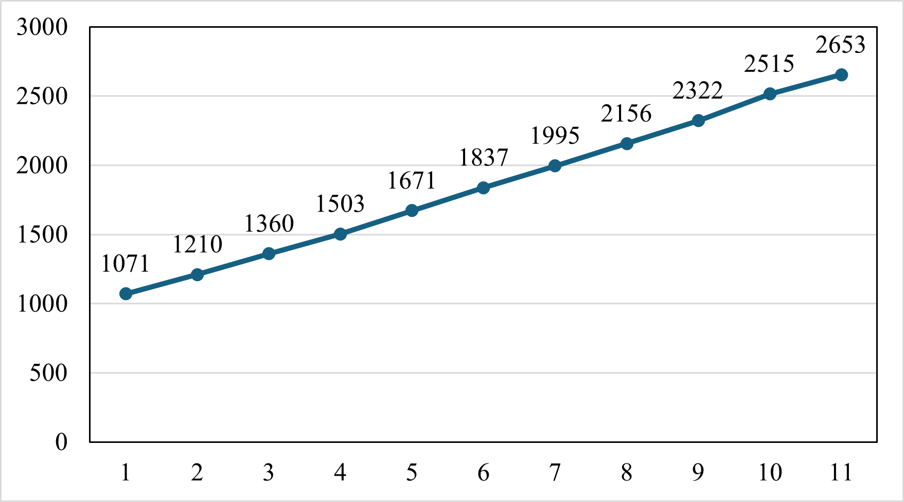
To explore modelling approaches applicable to linear trends.
The following figure shows the social media
  follower counts of Singer H from Jan to Nov 2023.
Count
Month

Slide 12
To explore modelling approaches applicable to linear trends.
Count
Month
Please suggest some ways to predict Singer H’s follower count in Dec 2023.

Slide 13
To explore modelling approaches applicable to linear trends.
Please suggest some ways to predict Singer H’s follower count in Dec 2023.
1. Consider the change
for the last two months;
and then use this change to
predict the follower count
in December.
2. Consider the changes
from month to month and
calculate an average;
and then use this average to
predict the follower count
in December.
Count
Month

Slide 14
To explore modelling approaches applicable to linear trends.
In the following table, calculate the changes
  in the follower counts between months.
Month | Change
Jan to Feb
Feb to Mar
Mar to Apr
Apr to May
May to Jun
Month | Change
Jun to Jul
Jul to Aug
Aug to Sep
Sep to Oct
Oct to Nov

Slide 15
To explore modelling approaches applicable to linear trends.
In the following table, calculate the changes
  in the follower counts between months.
Month | Change
Jan to Feb | 139
Feb to Mar | 150
Mar to Apr | 143
Apr to May | 168
May to Jun | 166
Month | Change
Jun to Jul | 158
Jul to Aug | 161
Aug to Sep | 166
Sep to Oct | 193
Oct to Nov | 138

Slide 16
To explore modelling approaches applicable to linear trends.
We can calculate these changes using MS Excel.

Slide 17
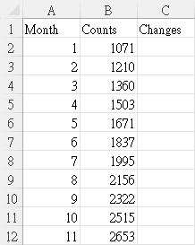
To explore modelling approaches applicable to linear trends.
i
Step
Input the data to
MS Excel as in the figure.

Slide 18
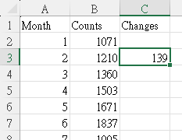
To explore modelling approaches applicable to linear trends.
ii
Step
Column C: Changes
In Cell C3, input
= B3 – B2
This means:
Current count – previous count
Rest your cursor in the lower-right
corner of Cell C3 so that it turns
into a “+” sign
Drag the fill handle
to fill Cells C4 to C12 based on Cell C3

Slide 19
To explore modelling approaches applicable to linear trends.
The following discusses four possible modelling approaches to predicting Singer H’s follower counts in the future.
3. Modelling approach 1:
This approach only considers the change
between the most recent two months
(i.e., Oct and Nov 2023).
It assumes that the change
between Nov and Dec 2023 is equal to
that between Oct and Nov 2023.

Slide 20
To explore modelling approaches applicable to linear trends.
3(a). Circle the data used for prediction.
Month | Change
Jan to Feb | 139
Feb to Mar | 150
Mar to Apr | 143
Apr to May | 168
May to Jun | 166
Month | Change
Jun to Jul | 158
Jul to Aug | 161
Aug to Sep | 166
Sep to Oct | 193
Oct to Nov | 138

Slide 21
To explore modelling approaches applicable to linear trends.
3(b). Predict Singer H’s follower counts
in Dec 2023 and Jan 2024.
Month | Change
Oct to Nov | 138
Dec 2023： 2653 + 138 = 2791
Jan 2024： 2653 + 138×2 = 2929

Slide 22
To explore modelling approaches applicable to linear trends.
3(c). Hence, formulate a mathematical model
(Model 1) to mathematically express the
predicted follower count at the n-th month
after Nov 2023.
Month | Change
Oct to Nov | 138
2653 + 138n

Slide 23
To explore modelling approaches applicable to linear trends.
3(d). What are the strengths and weaknesses of
Model 1?
1. This model is easy to comprehend.
2. This model can reflect the singer’s current popularity.
1. This model overlooks the overall trend that includes earlier months.
2. The change between the most recent two months can be unusually high or low due to specific events, which can result in overestimation or underestimation.
3. This model assumes that the follower counts change according to a mono-pattern.
Strengths
Weaknesses

Slide 24
To explore modelling approaches applicable to linear trends.
4. Modelling approach 2:
This approach considers all of the changes
between months (i.e., Jan to Feb, Feb to Mar, …,
and Oct to Nov).
It calculates the mean of these changes to obtain
the average change per month and assumes that
the change between Nov and Dec 2023
is equal to this average change per month.

Slide 25
To explore modelling approaches applicable to linear trends.
4(a). Circle the data used for prediction.
Month | Change
Jan to Feb | 139
Feb to Mar | 150
Mar to Apr | 143
Apr to May | 168
May to Jun | 166
Month | Change
Jun to Jul | 158
Jul to Aug | 161
Aug to Sep | 166
Sep to Oct | 193
Oct to Nov | 138

Slide 26
To explore modelling approaches applicable to linear trends.
4(b). Predict Singer H’s follower counts
in Dec 2023 and Jan 2024.
Average change
Dec 2023： 2653 + 158 = 2811
Jan 2024： 2653 + 158×2 = 2969

Slide 27
To explore modelling approaches applicable to linear trends.
4(c). Hence, formulate a mathematical model
(Model 2) to mathematically express the
predicted follower count at the n-th month
after Nov 2023.
2653 + 158n

Slide 28
To explore modelling approaches applicable to linear trends.
4(d). What are the strengths and weaknesses of
Model 2?
This model considers changes between months over a longer period, providing a more comprehensive analysis of the overall trend.
Considering a longer time frame can mitigate the influence of short-term anomalies.
Strengths
1. Because this model relies on historical data over a longer period, it may not fully reflect the signer’s current popularity.
2. This model assumes that the follower counts change according to a mono-pattern.
Weaknesses

Slide 29
To explore modelling approaches applicable to linear trends.
5. Modelling approach 3:
This approach only considers the most recent
three changes between months
(i.e., Aug to Sep, Sep to Oct, and Oct to Nov).
It calculates the mean of these changes during
this period to obtain the average change
per month and assumes that the change
between Nov and Dec 2023 is equal to
this average change per month.

Slide 30
To explore modelling approaches applicable to linear trends.
5(a). Circle the data used for prediction.
Month | Change
Jan to Feb | 139
Feb to Mar | 150
Mar to Apr | 143
Apr to May | 168
May to Jun | 166
Month | Change
Jun to Jul | 158
Jul to Aug | 161
Aug to Sep | 166
Sep to Oct | 193
Oct to Nov | 138

Slide 31
To explore modelling approaches applicable to linear trends.
5(b). Predict Singer H’s follower counts
in Dec 2023 and Jan 2024.
Average change
Dec 2023： 2653 + 166 = 2819
Jan 2024： 2653 + 166×2 = 2985

Slide 32
To explore modelling approaches applicable to linear trends.
5(c). Hence, formulate a mathematical model (Model 3)
to mathematically express the predicted follower
count at the n-th month after Nov 2023.
2653 + 166n

Slide 33
To explore modelling approaches applicable to linear trends.
5(d). What are the strengths and weaknesses of
Model 3?
1. Considering the most recent changes can reflect the singer’s current popularity.
2. Considering the average change over a four-month time frame can mitigate the influence of short-term anomalies.
Strengths
1. The rationale for considering the three most recent changes is not clear.
2. This model assumes that the follower counts change according to a mono-pattern.
Weaknesses

Slide 34
To explore modelling approaches applicable to linear trends.
6. What are the common assumption and limitation
of Models 1 to 3?
These models assume that changes in follower counts are of a mono-pattern and follow a linear pattern.
Assumption
These models do not take into account important factors, such as the singer’s posting frequency and public appearances.
Limitation

Slide 35
To explore modelling approaches applicable to linear trends.
In the following, we attempt to incorporate the concept of “weight” to analyse Models 1 to 3.
7. For example, Model 1 only considers the change
between the most recent two months
(i.e., Oct and Nov 2023).
Therefore, the weight assigned to this change is 1,
while the weights for all other changes are set to 0.
Month | Change | Weight
Jan to Feb | 139 | 0
Feb to Mar | 150 | 0
Mar to Apr | 143 | 0
Apr to May | 168 | 0
May to Jun | 166 | 0
Month | Change | Weight
Jun to Jul | 158 | 0
Jul to Aug | 161 | 0
Aug to Sep | 166 | 0
Sep to Oct | 193 | 0
Oct to Nov | 138 | 1

Slide 36
To explore modelling approaches applicable to linear trends.
Model 2 considers all of the changes between
months (i.e., Jan to Feb, Feb to Mar, …, and Oct
to Nov).
Therefore, the weights for all changes are set to 1.
Month | Change | Weight
Jan to Feb | 139 | 1
Feb to Mar | 150 | 1
Mar to Apr | 143 | 1
Apr to May | 168 | 1
May to Jun | 166 | 1
Month | Change | Weight
Jun to Jul | 158 | 1
Jul to Aug | 161 | 1
Aug to Sep | 166 | 1
Sep to Oct | 193 | 1
Oct to Nov | 138 | 1

Slide 37
To explore modelling approaches applicable to linear trends.
Model 3 only considers the most recent three
changes between months (i.e., Aug to Sep,
Sep to Oct, and Oct to Nov).
In the following table, write down the weight of
each corresponding change.
Month | Change | Weight
Jan to Feb | 139
Feb to Mar | 150
Mar to Apr | 143
Apr to May | 168
May to Jun | 166
Month | Change | Weight
Jun to Jul | 158
Jul to Aug | 161
Aug to Sep | 166
Sep to Oct | 193
Oct to Nov | 138

Slide 38
To explore modelling approaches applicable to linear trends.
Model 3 only considers the most recent three
changes between months (i.e., Aug to Sep,
Sep to Oct, and Oct to Nov).
In the following table, write down the weight of
each corresponding change.
Month | Change | Weight
Jan to Feb | 139 | 0
Feb to Mar | 150 | 0
Mar to Apr | 143 | 0
Apr to May | 168 | 0
May to Jun | 166 | 0
Month | Change | Weight
Jun to Jul | 158 | 0
Jul to Aug | 161 | 0
Aug to Sep | 166 | 1
Sep to Oct | 193 | 1
Oct to Nov | 138 | 1

Slide 39
To explore modelling approaches applicable to linear trends.
8. Modelling approach 4:
This approach considers the weights of changes
between months.
It calculates the weighted mean of these changes
to obtain the weighted average change per month.

Slide 40
To explore modelling approaches applicable to linear trends.
8(a). Propose the weights of these changes and
complete the following table.
Explain your answers.
Month | Change | Weight
Jan to Feb | 139
Feb to Mar | 150
Mar to Apr | 143
Apr to May | 168
May to Jun | 166
Month | Change | Weight
Jun to Jul | 158
Jul to Aug | 161
Aug to Sep | 166
Sep to Oct | 193
Oct to Nov | 138

Slide 41
To explore modelling approaches applicable to linear trends.
8(a). Propose the weights of these changes and
complete the following table.
Explain your answers.
Month | Change | Weight
Jan to Feb | 139 | 0
Feb to Mar | 150 | 0
Mar to Apr | 143 | 0
Apr to May | 168 | 0
May to Jun | 166 | 0
Month | Change | Weight
Jun to Jul | 158 | 0
Jul to Aug | 161 | 0
Aug to Sep | 166 | 1
Sep to Oct | 193 | 2
Oct to Nov | 138 | 3

Slide 42
To explore modelling approaches applicable to linear trends.
8(a). Explain your answers.
To reflect the extent of influence that more recent data has on the predictions, the most recent change is assigned the highest weight of 3.
The second and third most recent changes are given weights of 2 and 1, respectively, indicating their lesser extent of influence.
Changes other than these months are assigned a weight of 0, as they are considered no longer relevant.

Slide 43
To explore modelling approaches applicable to linear trends.
8(b). Predict Singer H’s follower counts
in Dec 2023 and Jan 2024.
Average change
Dec 2023: 2653+161=2814
Jan 2024: 2653+161×2 = 2975

Slide 44
To explore modelling approaches applicable to linear trends.
8(c). Hence, formulate a mathematical model (Model 4)
to mathematically express the predicted follower
count at the n-th month after Nov 2023.
2653+161n

Slide 45

Activity 3
To explore modelling approaches applicable to exponential trends.

Slide 46
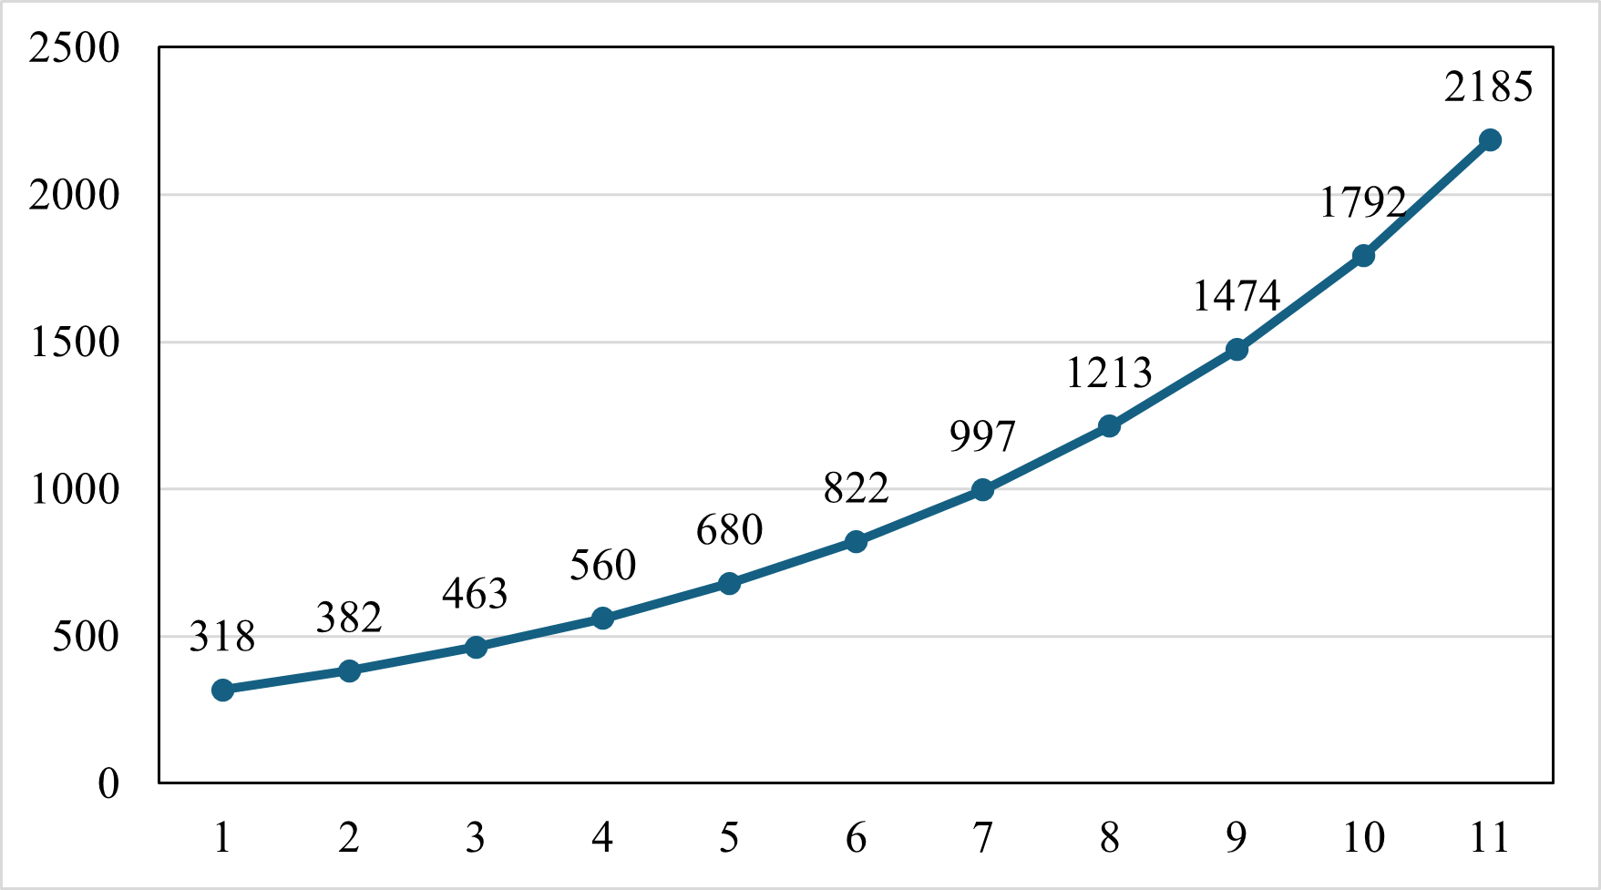
To explore modelling approaches applicable to exponential trends.
1. The following figure shows the social media
follower counts of Singer K from Jan to Nov
2023.
Count
Month

Slide 47
To explore modelling approaches applicable to exponential trends.
Count
Month
Is it suitable to use Models 1 to 3 in Activity 2 to predict Singer K’s follower count in Dec 2023?
Explain your answer.

Slide 48
To explore modelling approaches applicable to exponential trends.
Is it suitable to use Models 1 to 3 in Activity 2 to predict Singer K’s follower count in Dec 2023? Explain your answer.
Count
Unlike the data in Activity 2, the monthly changes in Singer K’s follower counts are clearly inconsistent. Furthermore, the graph shows an accelerating growth in the follower counts.
Given this non-linear trend, Models 1 to 3 may not be suitable for prediction.
Month

Slide 49
To explore modelling approaches applicable to exponential trends.
2. In the following table, calculate the percentage
changes in the follower counts between months.
Correct your answer to 2 decimal places.
Month | Percentage Change
Jan to Feb
Feb to Mar
Mar to Apr
Apr to May
May to Jun
Month | Percentage Change
Jun to Jul
Jul to Aug
Aug to Sep
Sep to Oct
Oct to Nov

Slide 50
To explore modelling approaches applicable to exponential trends.
2. In the following table, calculate the percentage
changes in the follower counts between months.
Correct your answer to 2 decimal places.
Month | Percentage Change
Jan to Feb | 20.13%
Feb to Mar | 21.20%
Mar to Apr | 20.95%
Apr to May | 21.43%
May to Jun | 20.88%
Month | Percentage Change
Jun to Jul | 21.29%
Jul to Aug | 21.66%
Aug to Sep | 21.52%
Sep to Oct | 21.57%
Oct to Nov | 21.93%

Slide 51

To explore modelling approaches applicable to exponential trends.
We can calculate these percentage changes using MS Excel.

Slide 52
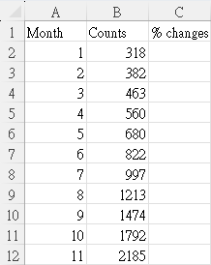
To explore modelling approaches applicable to exponential trends.
i
Step
Input the data to
MS Excel as in the figure.

Slide 53
To explore modelling approaches applicable to exponential trends.
ii
Step
Column C: Percentage changes
In Cell C3，input
= (B3 – B2)/B2
This means：
Current count – previous count
Previous count

Slide 54

To explore modelling approaches applicable to exponential trends.
ii
Step
Column C: Percentage changes
Use the tools under “Home”
  Set the format as a percentage
  Show two decimal places

Slide 55
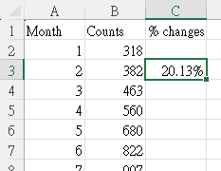
To explore modelling approaches applicable to exponential trends.
ii
Step
Column C: Percentage changes
Rest your cursor in the lower-right corner of Cell C3
so that it turns into a “+” sign
Drag the fill handle to fill Cells C4 to C12 based on Cell C3

Slide 56
To explore modelling approaches applicable to exponential trends.
The following discusses four possible modelling approaches to predicting Singer K’s follower counts
in the future.
3. Modelling approach 5:
This approach only considers the percentage
change between the most recent two months
(i.e., Oct and Nov 2023).
It assumes that the percentage change between
Nov and Dec 2023 is equal to that
between Oct and Nov 2023.

Slide 57
To explore modelling approaches applicable to exponential trends.
3(a). Circle the data used for prediction.
Month | Percentage Change
Jan to Feb | 20.13%
Feb to Mar | 21.20%
Mar to Apr | 20.95%
Apr to May | 21.43%
May to Jun | 20.88%
Month | Percentage Change
Jun to Jul | 21.29%
Jul to Aug | 21.66%
Aug to Sep | 21.52%
Sep to Oct | 21.57%
Oct to Nov | 21.93%

Slide 58
To explore modelling approaches applicable to exponential trends.
3(b). Predict Singer K’s follower counts
in Dec 2023 and Jan 2024.
Month | Percentage Change
Oct to Nov | 21.93%
Dec 2023： 2185(1 + 21.93%) = 2664
Jan 2024： 2185(1 + 21.93%)² = 3248

Slide 59
To explore modelling approaches applicable to exponential trends.
3(c). Hence, formulate a mathematical model
(Model 5) to mathematically express the
predicted follower count at the n-th month
after Nov 2023.
Month | Percentage Change
Oct to Nov | 21.93%
2185(1 + 21.93%)^{n}

Slide 60
To explore modelling approaches applicable to exponential trends.
3(d). What are the strengths and weaknesses of
Model 4?
This model overlooks the overall trend that includes earlier months.
The percentage change between the most recent two months can be unusually high or low due to specific events, which can result in overestimation or underestimation.
3. This model assumes that the follower counts change according to a mono-pattern.
1. This model is easy to comprehend.
2. This model can reflect the singer’s current popularity.
Strengths
Weaknesses

Slide 61
To explore modelling approaches applicable to exponential trends.
4. Modelling approach 6:
This approach considers all of the percentage
changes between months
(i.e., Jan to Feb, Feb to Mar, …, and Oct to Nov).
It calculates the mean of these percentage changes
to obtain the average percentage change per month
and assumes that the percentage change between
Nov and Dec 2023 is equal to this average
percentage change per month.

Slide 62
To explore modelling approaches applicable to exponential trends.
4(a). Circle the data used for prediction.
Month | Percentage Change
Jan to Feb | 20.13%
Feb to Mar | 21.20%
Mar to Apr | 20.95%
Apr to May | 21.43%
May to Jun | 20.88%
Month | Percentage Change
Jun to Jul | 21.29%
Jul to Aug | 21.66%
Aug to Sep | 21.52%
Sep to Oct | 21.57%
Oct to Nov | 21.93%

Slide 63
To explore modelling approaches applicable to exponential trends.
4(b). Predict Singer K’s follower counts
in Dec 2023 and Jan 2024.
Average percentage
change
Dec 2023： 2185(1 + 21.26%) = 2650
Jan 2024： 2185(1 + 21.26%)² = 3213

Slide 64
To explore modelling approaches applicable to exponential trends.
4(c). Hence, formulate a mathematical model
(Model 6) to mathematically express the
predicted follower count at the n-th month
after Nov 2023.
2185(1 + 21.26%)^{n}

Slide 65
To explore modelling approaches applicable to exponential trends.
4(d). What are the strengths and weaknesses of
Model 6?
This model considers percentage changes between months over a longer period, providing a more comprehensive analysis of the overall trend.
2. Considering a longer time frame can mitigate the influence of short-term anomalies.
Strengths
1. Because this model relies on historical data over a longer period, it may not fully reflect the signer’s current popularity.
2. This model assumes that the follower counts change according to a mono-pattern.
Weaknesses

Slide 66
To explore modelling approaches applicable to exponential trends.
5. Modelling approach 7:
This approach only considers the most recent
three percentage changes between months
(i.e., Aug to Sep, Sep to Oct, and Oct to Nov).
It calculates the mean of these percentage changes
to obtain the average percentage change per month
and assumes that the percentage change between
Nov and Dec 2023 is equal to this average
percentage change per month.

Slide 67
To explore modelling approaches applicable to exponential trends.
5(a). Circle the data used for prediction.
Month | Percentage Change
Jan to Feb | 20.13%
Feb to Mar | 21.20%
Mar to Apr | 20.95%
Apr to May | 21.43%
May to Jun | 20.88%
Month | Percentage Change
Jun to Jul | 21.29%
Jul to Aug | 21.66%
Aug to Sep | 21.52%
Sep to Oct | 21.57%
Oct to Nov | 21.93%

Slide 68
To explore modelling approaches applicable to exponential trends.
5(b). Predict Singer K’s follower counts
in Dec 2023 and Jan 2024.
Average percentage
change
Dec 2023： 2185(1 + 21.67%) = 2658
Jan 2024： 2185(1 + 21.67%)² = 3235

Slide 69
To explore modelling approaches applicable to exponential trends.
5(c). Hence, formulate a mathematical model
(Model 7) to mathematically express the
predicted follower count at the n-th month
after Nov 2023.
2185(1 + 21.67%)^{n}

Slide 70
To explore modelling approaches applicable to exponential trends.
5(d). What are the strengths and weaknesses of
Model 7?
1. Considering the most recent percentage changes can reflect the singer’s current popularity.
2. Considering the average percentage change over a four-month time frame can mitigate the influence of short-term fluctuations.
Strengths
1. The rationale for considering the three most recent changes is not clear.
2. This model assumes that the follower counts change according to a mono-pattern.
Weaknesses

Slide 71
To explore modelling approaches applicable to exponential trends.
6. Modelling approach 8:
Similar to Modelling approach 4,
this approach considers the weights of percentage
changes between months.
It calculates the weighted mean of these
percentage changes to obtain the weighted average
percentage change per month.

Slide 72
To explore modelling approaches applicable to exponential trends.
6(a). Propose the weights of these percentage changes and complete the following table. Explain your answers.
Month | % Change | Weight
Jan to Feb | 20.13%
Feb to Mar | 21.20%
Mar to Apr | 20.95%
Apr to May | 21.43%
May to Jun | 20.88%
Month | % Change | Weight
Jun to Jul | 21.29%
Jul to Aug | 21.66%
Aug to Sep | 21.52%
Sep to Oct | 21.57%
Oct to Nov | 21.93%

Slide 73
To explore modelling approaches applicable to exponential trends.
6(a). Propose the weights of these percentage changes and complete the following table. Explain your answers.
Month | % Change | Weight
Jan to Feb | 20.13% | 0
Feb to Mar | 21.20% | 0
Mar to Apr | 20.95% | 0
Apr to May | 21.43% | 0
May to Jun | 20.88% | 0
Month | % Change | Weight
Jun to Jul | 21.29% | 0
Jul to Aug | 21.66% | 0
Aug to Sep | 21.52% | 1
Sep to Oct | 21.57% | 2
Oct to Nov | 21.93% | 3

Slide 74
To explore modelling approaches applicable to exponential trends.
6(a). Explain your answers.
To reflect the extent of influence that more recent data has on the predictions, the most recent percentage change is assigned the highest weight of 3.
The second and third most recent percentage changes are given weights of 2 and 1, respectively, indicating their lesser extent of influence.
Percentage changes other than these months are assigned a weight of 0, as they are considered no longer relevant.

Slide 75
To explore modelling approaches applicable to exponential trends.
6(b). Predict Singer K’s follower counts
in Dec 2023 and Jan 2024.
Average change
Dec 2023: 2185(1 + 21.74%) = 2660
Jan 2024: 2185(1 + 21.74%)² =3238

Slide 76
To explore modelling approaches applicable to exponential trends.
6(c). Hence, formulate a mathematical model
(Model 8) to mathematically express the
predicted follower count at the n-th month
after Nov 2023.
2185(1 + 21.74%)^{n}

Slide 77
To explore modelling approaches applicable to exponential trends.
7. What are the common assumption and limitation
of Models 5 to 8?
Assumption
These models assume that changes in follower counts are of a mono-pattern and follow an exponential trend.
These models do not take into account important factors, such as the singer’s posting frequency and public appearances.
Limitation

Slide 78

Activity 4
To further explore more complicated trends.

Slide 79
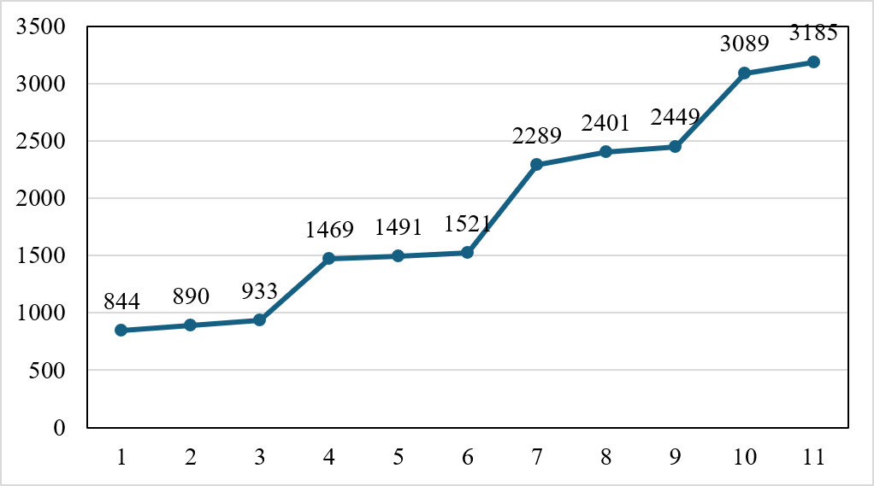
To further explore more complicated trends.
1. The following figure shows the social media
follower counts of Singer G from Jan to Nov
2023.
Count
Month

Slide 80
To further explore more complicated trends.
Count
Month
1(a). State your observations regarding the above trend.
1(b). Hence, make assumptions of modelling and predict
Singer G’s follower counts in Dec 2023 and
Jan 2024.

Slide 81
To further explore more complicated trends.
Count
Month
1(a). State your observations regarding the above trend.
Observations: Singer G’s follower counts would experience a significant increase after every three months of relatively small growth.

Slide 82
To further explore more complicated trends.
1(b). Hence, make assumptions of modelling and predict
Singer G’s follower counts in Dec 2023 and
Jan 2024.
Assumptions: The trend follows patterns observed in the past, and more recent data has higher importance (weight).
Consider:
Change from Mar to Apr = 1469 – 933 = 536
Change from Jun to Jul = 2289 – 1521 = 768
Change from Sep to Oct = 3089 – 2449 = 640
Change from Oct to Nov = 3185 – 3089 = 96

Slide 83
To further explore more complicated trends.
1(b). Hence, make assumptions of modelling and predict
Singer G’s follower counts in Dec 2023 and
Jan 2024.
Dec 2023: 3185 + 96 = 3281
Jan 2024:

Slide 84
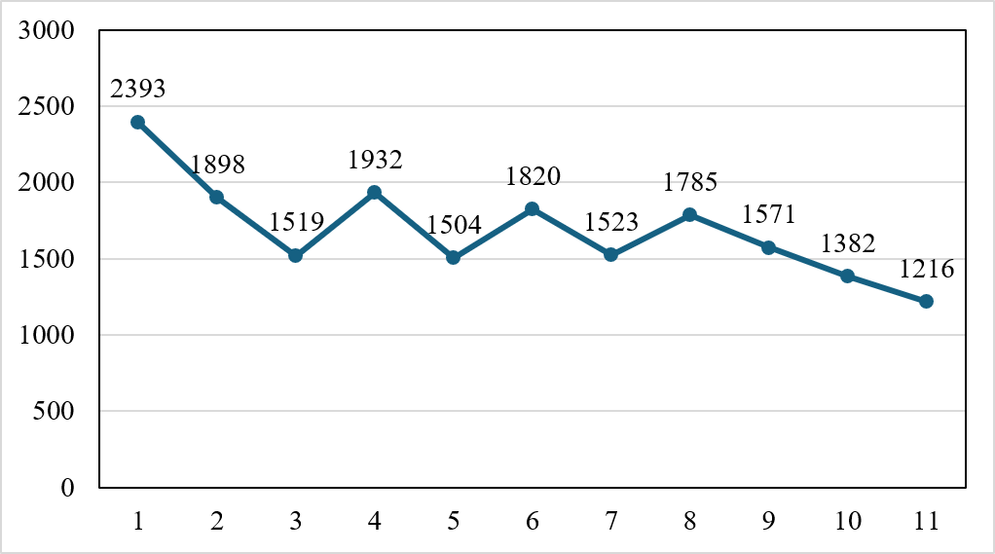
To further explore more complicated trends.
2. The following figure shows the social media
follower counts of Singer Q from Jan to Nov
2023.
Count
Month

Slide 85
To further explore more complicated trends.
Count
Month
2(a). State your observations regarding the above trend.
2(b). Hence, make assumptions of modelling and predict
Singer Q’s follower counts in Dec 2023 and
Jan 2024.

Slide 86
To further explore more complicated trends.
Count
Month
2(a). State your observations regarding the above trend.
Observations: From Jan to Aug, Singer Q’s follower counts show a downward trend but do not exhibit a clear pattern. However, starting from Aug, the follower counts decline following an exponential trend.

Slide 87
To further explore more complicated trends.
2(b). Hence, make assumptions of modelling and predict
Singer Q’s follower counts in Dec 2023 and
Jan 2024.
Assumptions: Due to the lack of a clear pattern in the changes from Jan to Aug, we exclude these data when formulating the model. Then, we assume that the follower counts will continue to decrease according to the pattern observed after Aug.
Consider:
Percentage change from
Aug to Sep
Percentage change from
Sep to Oct
Percentage change from
Oct to Nov

Slide 88
To further explore more complicated trends.
2(b). Hence, make assumptions of modelling and predict
Singer Q’s follower counts in Dec 2023 and
Jan 2024.
Dec 2023: 1216(1 – 12.0%) = 1070
Jan 2024: 1216(1 – 12.0%)² = 942

