Slide 1
The Battle of the Bogue：
Weaknesses of the Guangdong Coastal Defense
Introduction
During the Qing Dynasty, since the time of the Emperor Qianlong (乾隆帝), Europeans and American merchants were limited to the port of Guangzhou. When these foreign ships sailed towards Guangzhou from the Pearl River, they had to pass a series of forts. The narrow waterway of the “Bogue” (虎門) was one of the most substantially defended areas. Forts on both sides of this waterway defended it tightly. The Qing Dynasty ruled that no foreign armed ships were permitted to enter the Bogue. Otherwise the ships would be bombarded. The Bogue became the battleground for the First Opium War with Britain from the early to mid 1840s. The result of this battle was the crushing defeat of the Qing army. The Battle of the Bogue was the First Opium War’s most important military campaign. The results of this battle forced the Qing Dynasty to open more ports to foreign trade, marking the beginning of Chinese modern history.
II. The Circumstances behind the Battle of the Bogue
In order to open up China‘s market and solving the trade deficit problem, the British smuggled opium to China and causing serious harm to Chinese society. Lin Zexu (林則徐) submitted a memorial to Emperor Daoguang (道光帝) condemning a suggestion that the trade be legalized. Emperor Daoguang agreed with Lin and appointed him to Guangdong to take measures that would eliminate the opium trade. Facing the Chinese government's anti-smoking policy, the British government waited for the opportunity to launch the Opium War. To understand the circumstances behind the Battle of the Bogue, one must first understand the terrain of the battlefield and the Qing army deployments.

Slide 2
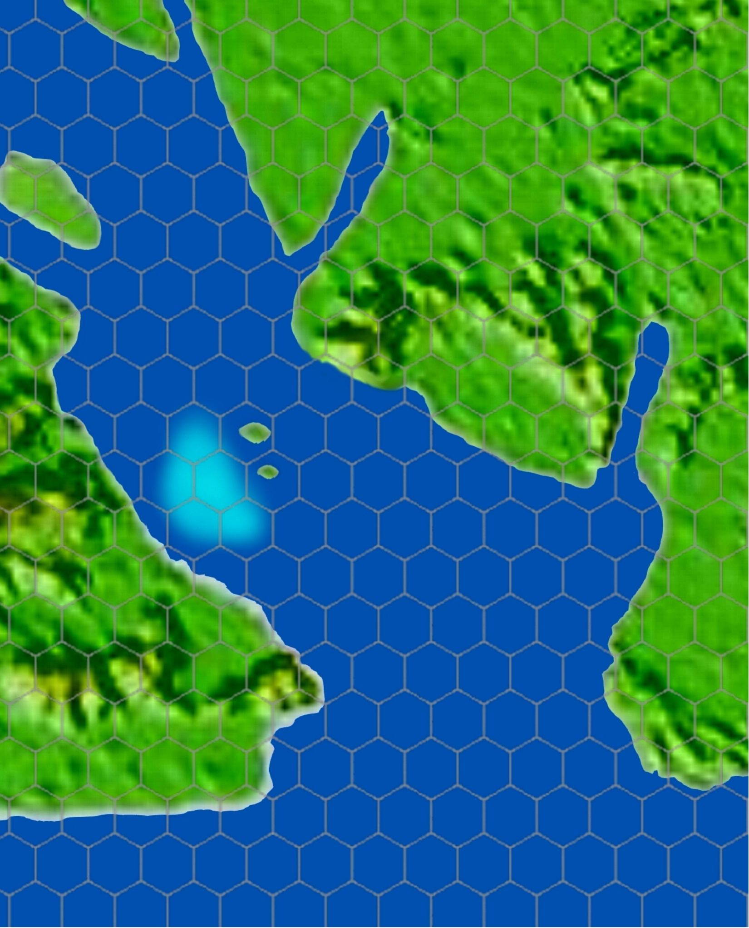
Shizi Channel
Bogue Village
A. The Strategic Terrain of the Battle of the Bogue
Taiping market
Quiz: Please examine the map of the Battle of Bogue’s strategic terrain and fill in the place names on the diagram on the right.
Please fill in the place names below in the corresponding empty boxes:
1 Sanmenkou (waterway) 三門口 (水道)
2 Upper Hengdang (island) 上橫檔 (島)
3 Lower Hengdang (island) 下橫檔(島)
4 Dajiao Hill 大角山
5 Dahu Hill 大虎山
6 Lingding Channel 伶仃洋
7 Shajiao Hill 沙角山
8 A’niangxie 阿娘鞋
9 Shizi Channel 獅子洋
10 Yanchen Bay 晏臣灣

Slide 3
Shizi Channel
Bogue Village
Quiz:
The strategic terrain map of the Battle of the Bogue (answers)
Dahu Hill
A’niangxie
Taiping Market
Sanmenkou
Upper Hengdang
Yanchen Bay
Lower Hengdang
Shajiao Hill
Dajiao Hill
Lingding Channel

Slide 4
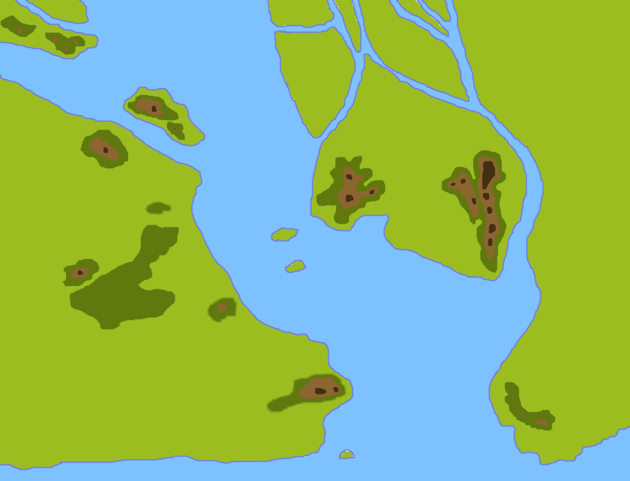
B. Qing Army
Defense
Towards Guangzhou
Third line of defense
The Qing army at the Bogue installed three defensive lines. (see the diagram on the right)
Dahu Fort (大虎炮台)
Zhenyuan fort (鎮遠炮台)
(永安炮台)
Yong’an fort
Jingyuan fort (靖遠炮台)
Second line of defense
Weiyuan fort (威遠炮台)
Gonggu fort
(鞏固炮台)
Upper Hengdang fort
(橫檔炮台)
First line of defense
Dajiao fort
(大角炮台)
Shajiao fort
(沙角炮台)

Slide 5
The Qing arranged three lines of coastal defences at the Bogue, of which the second line was the tightest. If the British army wanted to defeat the Qing, they had to break through these three defensive lines firstly.
Even though British ships had a strong advantage through their cannons, they could not simply charge ahead. This was because even if victory was achieved British losses would be inevitably heavy.
How did British battleships in 1841 suffer minimal losses, take the infamously impenetrable Bogue fort of the Qing, acquire the right to sign the Treaty of Nanjing the next year and thus obtain many types of benefits?
Towards Guangzhou
Third line of defense
Dahu Fort
Zhenyuan fort
Second line of defense
Yong’an fort
Jingyuan fort
Weiyuan fort
Gonggu fort
Upper Hengdang fort
First line of defense
Dajiao fort
Shajiao fort
Think: If you were the British army, how would you break through these defensive networks?

Slide 6
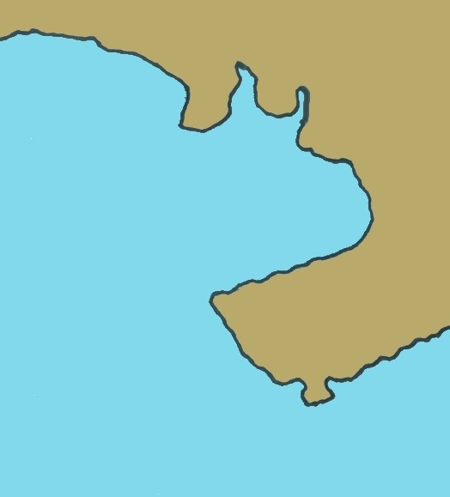
III. Chinese and British Military Power, The Process and Outcome of the Battle of the Bogue
British troops began to attack in January 1841
Yanchen Bay
The Battle of Shajiao Fort
(7 January 1841)
Shajiao fort

Slide 7
The Battle of Shajiao Fort
(7 January 1841)
The battle began. A merchant ship named the Nemesis was recruited by the British navy for use. Nemesis was a merchant ship owned by the East India Company and it was mainly used for transporting goods. Therefore, the cannons installed on it were not so powerful. The largest cannons had a calibre of 32 pounds and these were installed on the front and back of the ship. On both sides of the ship, there were also two 6 pound cannons. If the Nemesis and Qing forts bombarded each other, it was not definite whether the ship could retreat intact. However, this equipment was more than enough for dealing with the pirates of the South China Sea. The Nemesis was unique in that it relied on steam to sail and therefore it did not need to be affected by seasonal winds. In terms of global naval battles, this was historically unprecedented.
On 7 January 1841, the Nemesis’ main mission was to transport 1,400 British troops to land and make an amphibious assault against the defending Qing soldiers at Chuanbi Bay behind Shajiao fort.
Result: British victory, Shajiao fort and its opposite bank’s Dajiao fort were occupied and destroyed.
Yanchen Bay
Shajiao fort
Nemesis

Slide 8
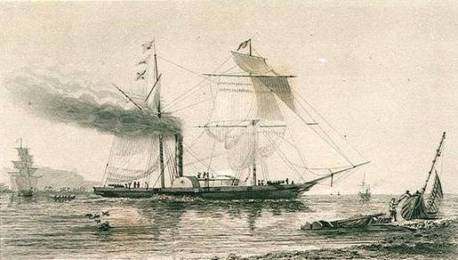
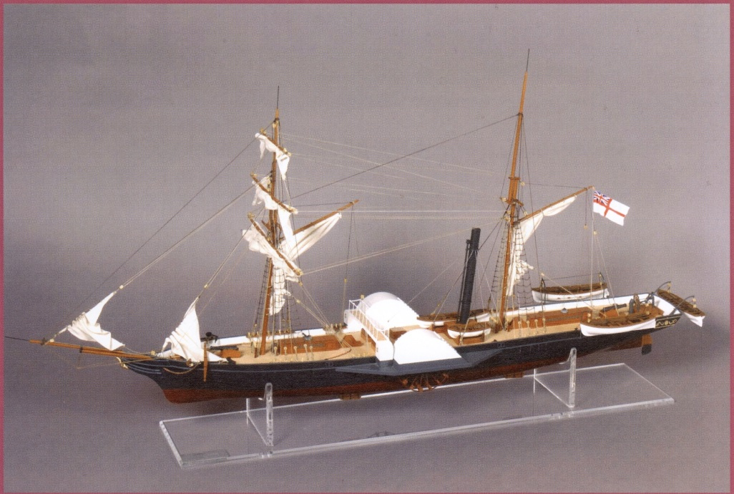
A drawing of the Nemesis
A model of the Nemesis
Source: Wikipedia-Nemesis（1839）
Photo taken from: The Hong Kong Museum of Coastal Defence display
After Shajiao fort was lost, Dajiao fort on the opposite bank was also immediately destroyed. Thus, the Qing army’s first defensive line of the Bogue had lost its purpose.
After the loss of Shajiao fort, the British demanded several conditions as part of surrender including the cession of Hong Kong Island. The Liangguang (Guangdong and Guangxi) Governor General Qi Shan (琦善) only replied that he would send their proposal to Emperor Daoguang. However, the emperor was extremely angered. He sacked Qi Shan and took all his possessions. He then sent Yi Shan (奕山) as his replacement to hurry to the Guangdong frontline to fight the war. So, the Sino-British war reignited.
After the first line of defense was taken, the second line of defense came next. However, let us first examine the strength of two sides.

Slide 9
The Military Power of the British Army
The ships used in the war by the British fleet.
Quiz: The British army in the Battle of the Bogue had, in total, 3 battleships, each with 74 cannons. Apart from the HMS Wellesley, please find the other two ships from the image.
The HMS Wellesley was fitted with 74 cannons, distributed between two levels of the hold of the ships on the left and right sides. It was the one of the strongest battleships in the Battle of the Bogue.
British flag
Sir Humphrey Fleming Senhouse’s Career
1781: He was born. His father was a naval
lieutenant.
1797: He joined the British navy.
1839: He was promoted to Sino-British
navy second-in-command, and at the
same time became the captain of the
HMS Blenheim.
1841: He was the commander in the Battle
of the Bogue.
East India Company flag

Slide 10
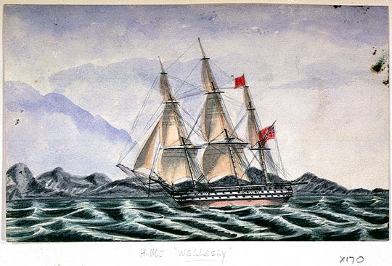
Quiz: British army had 3 battleships each with 74 cannons in total in the Battle of Bogue. From the image, please find another two ships other than the HMS Wellesley and fill them in the table below.
HMS Wellesley
Battleship
1. HMS Wellesley
2. HMS Blenheim
3. HMS Melville
Image source: Wikipedia: HMS Wellesley

Slide 11
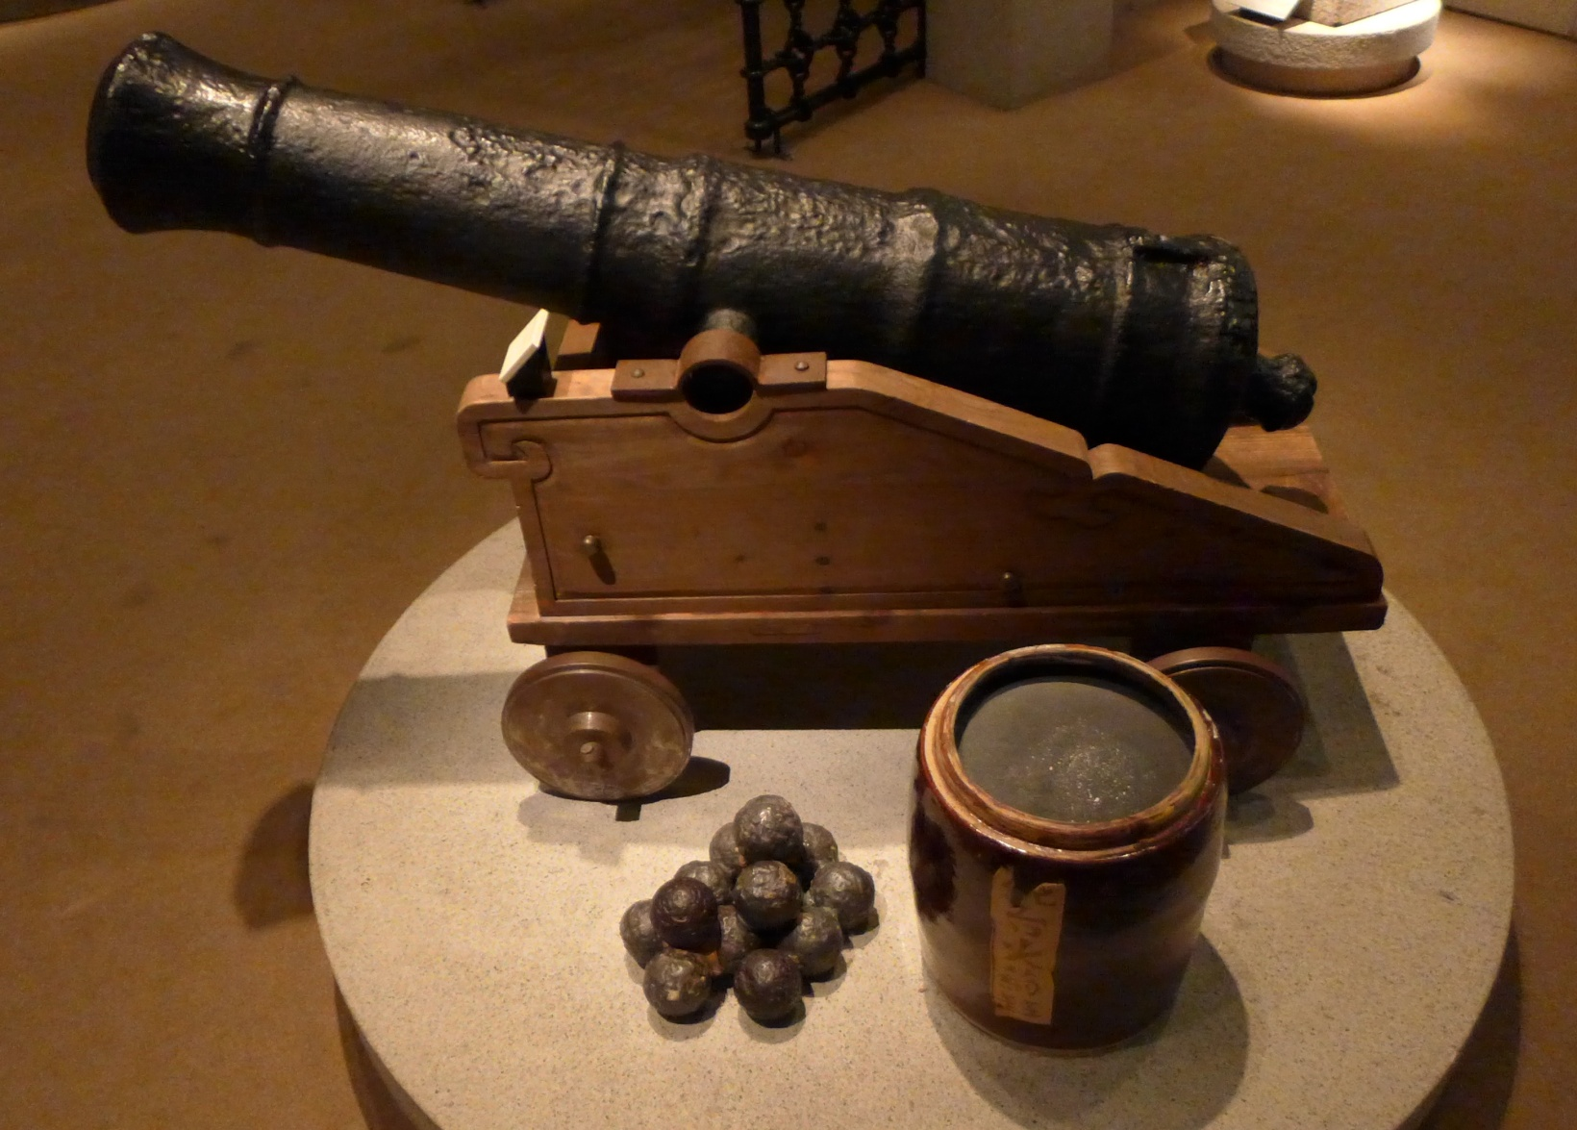
Britishcast 6 pound muzzle-loading cannon (Exhibit of The Hong Kong Museum of History)
Cannon structure
Please examine the cannon installation and outfitting
“Trunnions” fixed the cannon barrel on the top of the gun carriage.
The wheels were relatively small because they were installed onto the ships and therefore did not need to be moved much.
The gun carriage was made of wood instead of metal. Other than saving money (wood was cheaper), it could prevent disintegrated metal pieces (shrapnels) from injuring the soldiers operating the cannons during a bombardment.
“6 pound cannon” means that this cannon’s iron artillery shells weighed 6 pounds each.
Gunpowder

Slide 12
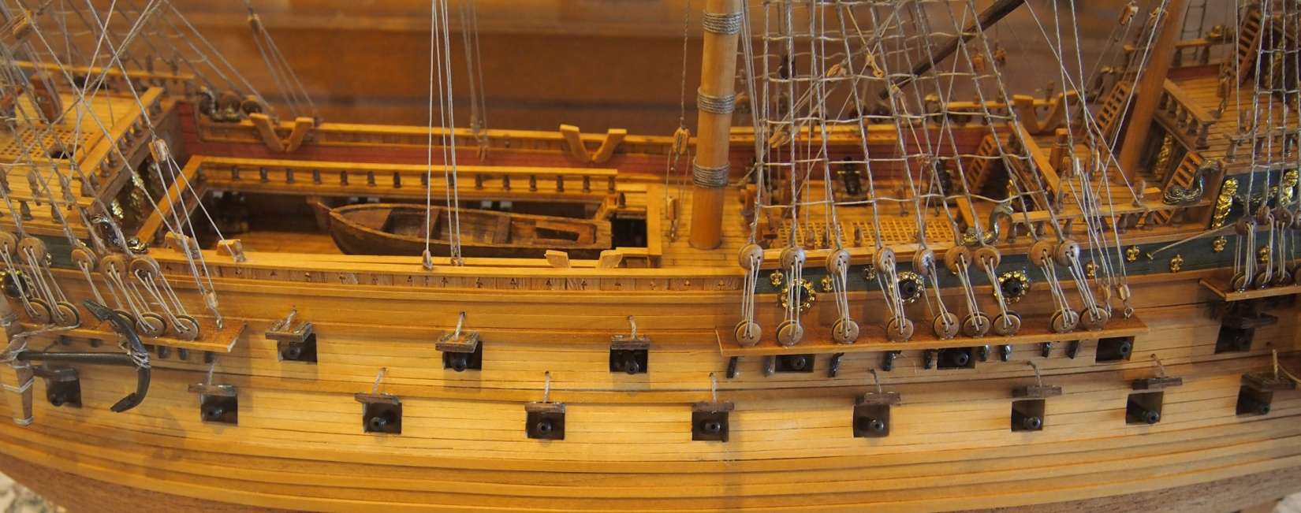
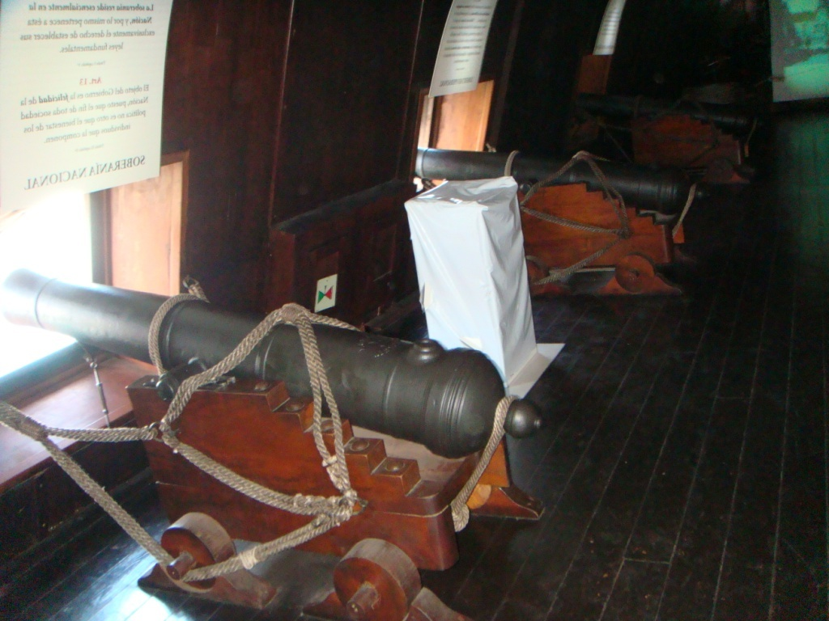
Cannons on a Ship
When operating, cannons could easily break away from the artillery cart due to recoil. Therefore, coarse hemp rope needed to be used to tie the cannon to the artillery cart.
Hemp rope also had another use. Soldiers could put it through the iron ring on both sides of the cannon and hold the rope tightly to control the recoil distance after firing.
Iron ring

Slide 13
In the Napoleonic war (1803-1815), British soldiers already divided their ships into different grades depending on their loads. Since cannons were mostly placed inside the ship holds, the more space a ship’s hold had, the more cannons there would be inside. For example, in the best grade of warship, the hold of that ship had three levels. In contrast, the third grade of warship only had two levels.
Quiz: Among the British warships in the Battle of the Bogue, which grade did the strongest warships (HMS Wellesley, for instance) belong to?
Third grade
Warship Grade | 42 pound cannon | 32 pound cannon | 24 pound cannon | 18 pound cannon | 12 pound cannon | 9 pound cannon | Total cannons
First grade | 28 |  | 28 |  | 30 | 18 | 104
Second grade |  | 28 |  | 30 | 40 |  | 98
Third grade |  | 28 |  | 28 |  | 18 | 74

Slide 14
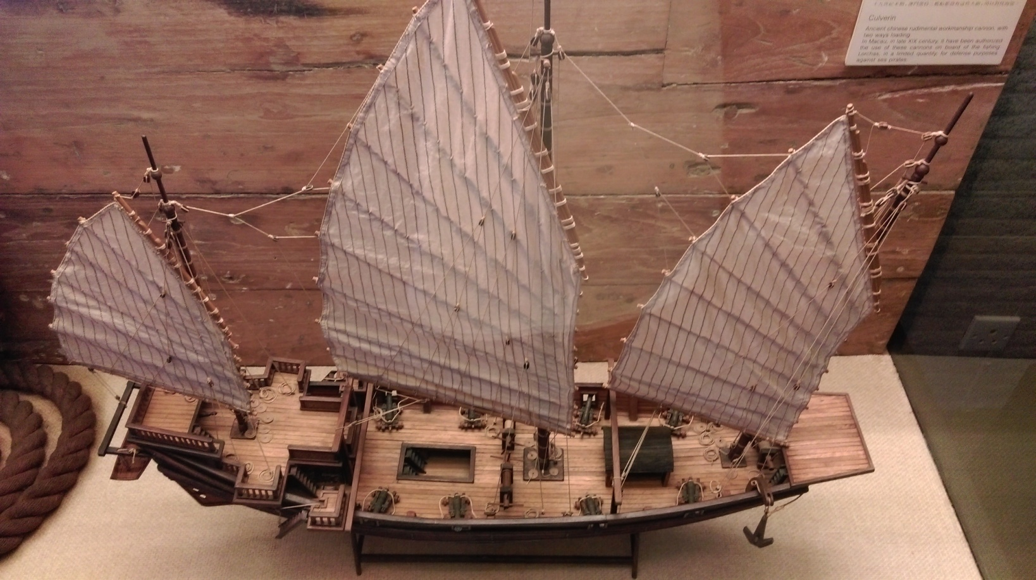
The Military Power of the Qing Army
Qing Dynasty navy warship
Model from the Macau Maritime Museum
The Qing Dynasty naval warships were all basically fishing boats which had been remodelled into small warships. Even if they had cannons, cannons could only be placed on the deck and each ship would not have more than 20 cannons.
Guan Tianpei (關天培) ’s Career
1781: He was born in Jiangsu province and had a military family background.
1834: He became Guangdong navy commander.
1839: After Commissioner Li Zexu banned the smoking of opium at
Guangdong, Guan Tianpei strengthened the defense of the Bogue.
The Bogue’s defensive network consisting of three defensive lines
was precisely Guan Tianpei’s masterpiece. Emperor Daoguang praised
his contributions and awarded him the title of Baturu (巴圖魯 meaning
“warrior” in Manchu).
My army at the Pearl River Delta has already arranged cannons in a triple gateway formation. It can probably stop the British from advancing into Guangzhou effectively.
Guangdong navy commander
Guan Tianpei
Think: When the warships of the two armies exchanged fire in the battle, which side do you think would win?

Slide 15
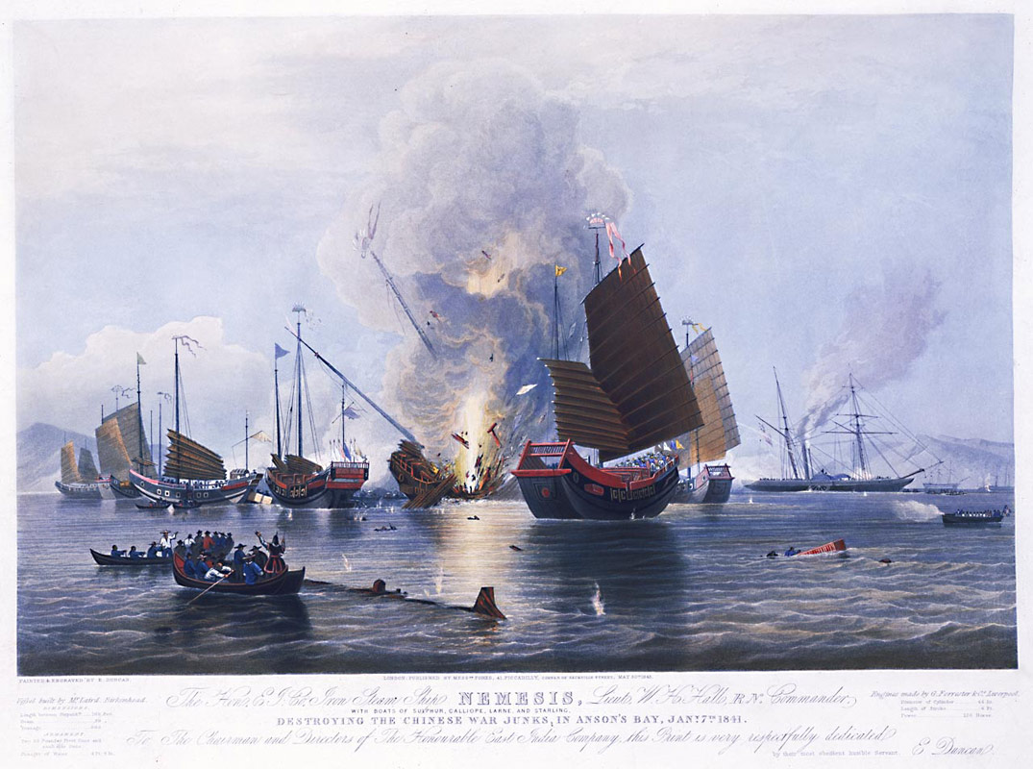
Image source: The First Opium War, Wikipedia
The Qing navy’s small battleships had no way of defending themselves from the large British warships. The above watercolour image, from the British artist Edward Duncan which was painted in 1843 depicting the Battle of Shajiao Fort on 7 January1841, shows how the Qing battleships were rapidly destroyed by the British battleships.
However, the Qing navy still had the Bogue forts. On February 26, having already passed the Bogue forts’ first defensive line, the British army at the Shajiao-Dajiao defensive line advanced towards the Weiyuan- Hengdang defensive line. However, this defensive line was also the most secure in the entire Bogue’s area, where the cannon allocation was the densest.

Slide 16
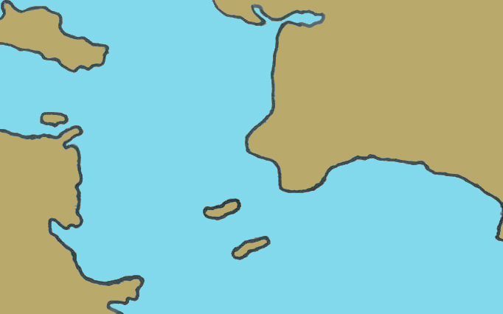
E. The Fire of War Reignited: The Battle of Weiyuan Fort
Cannon allocation: The Weiyuan waterway was defended tightly especially.
Fort Names | Total Number of Cannons | Number of Cannons Weighing Over 5000 Catties
Weiyuan fort | 40 | 20
Zhenyuan fort | 40 | 19
(Upper) Hengdang fort | 40 | 19
Jingyuan fort | 60 | Not clear
Dahu fort | 31 | 13
Yong’an fort | 40 | 4
Gonggu fort | 20 | 2
Dahu fort
Main defensive zone
Zhenyuan fort
Jingyuan fort
Gonggu fort
Hengdang fort
Weiyuan fort
Yong’an fort
These riverways were relatively shallow and did not allow large warships to pass through easily. Hence, defense could be relatively relaxed.

Slide 17
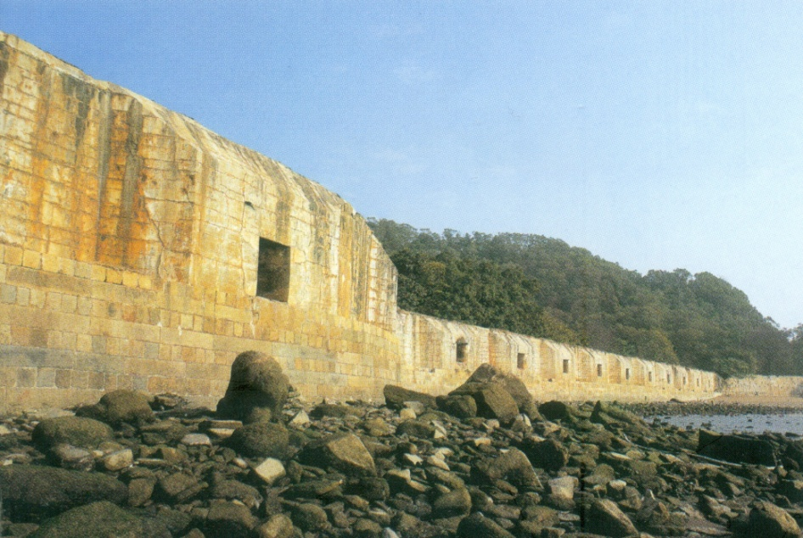
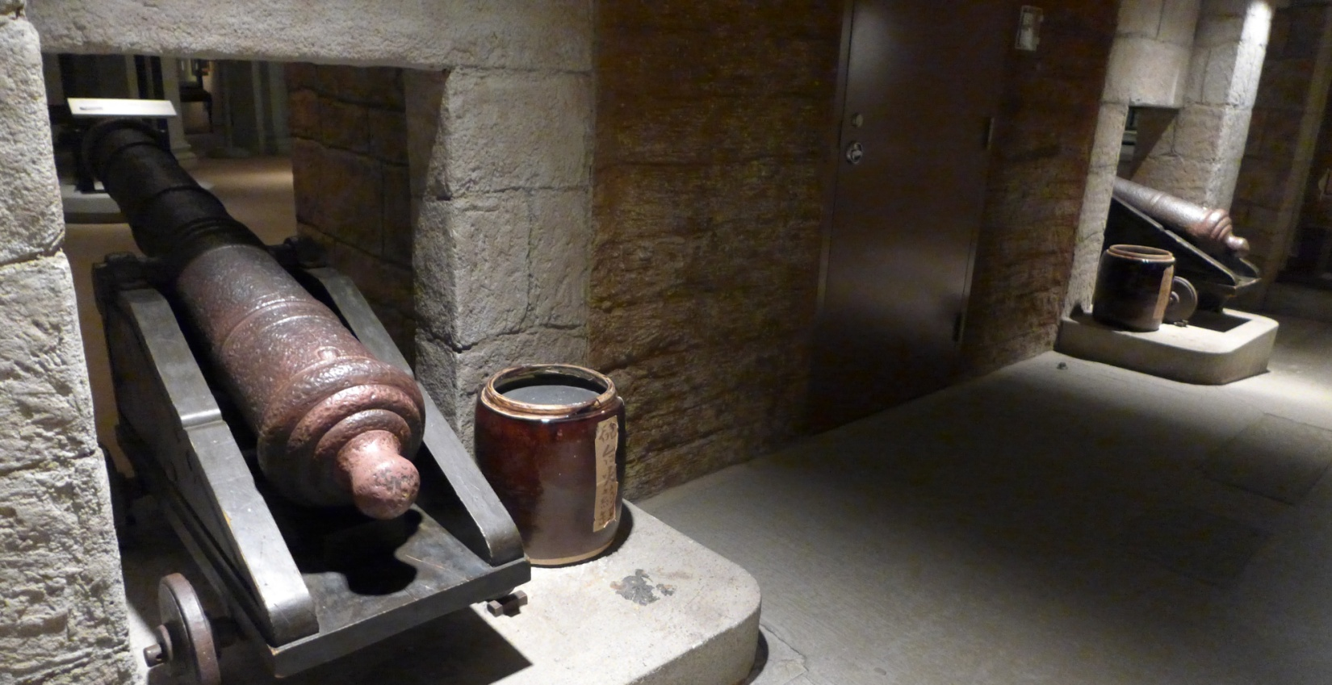
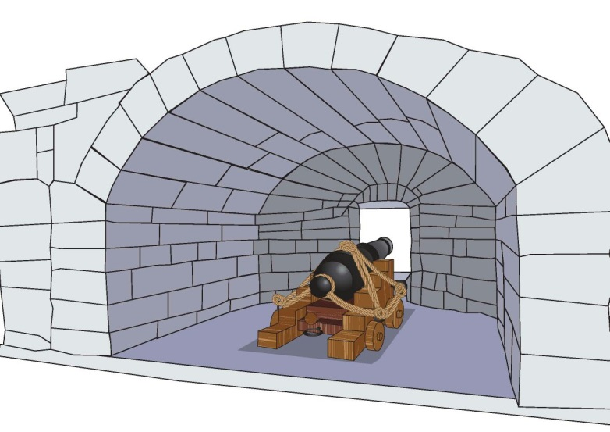
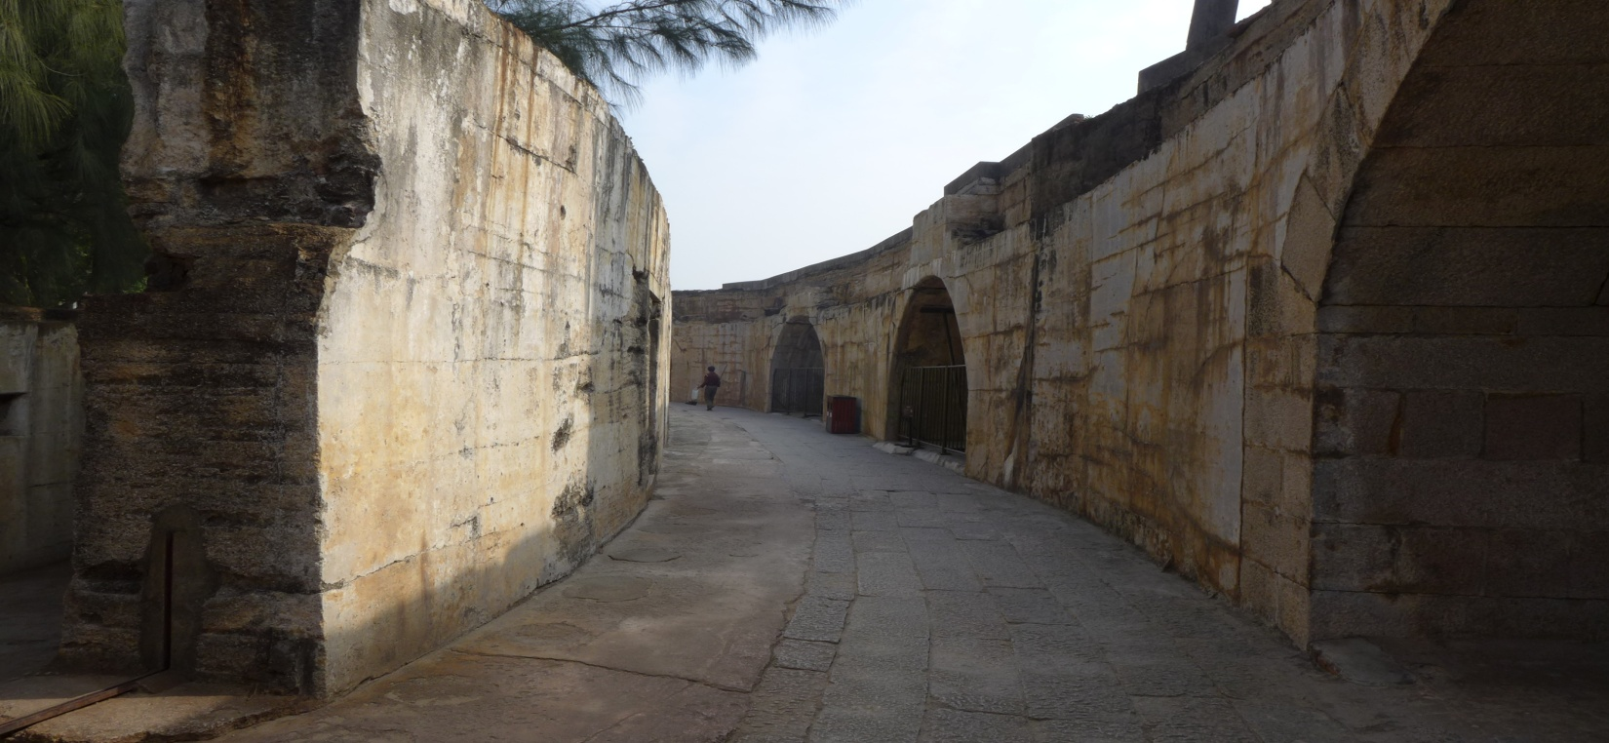
Deconstructing the forts
This era’s cannons had a short firing range. Therefore, when firing, it was important to aim accurately at enemies and fire directly. Thus, cannons were placed close to the sea surface.
Weiyuan Fort
Constructed: Built by Commander Guan Tianpei in 1835
Cannons: 40
Cannon opening
Civilian tunnel
Exhibit of The Hong Kong Museum of History
Layers of walls
Cannon operation area
Gateway between walls
Cannon opening
Walls
Cannon operating area (non-military civilians were not permitted inside)
Positioning of the cannon

Slide 18
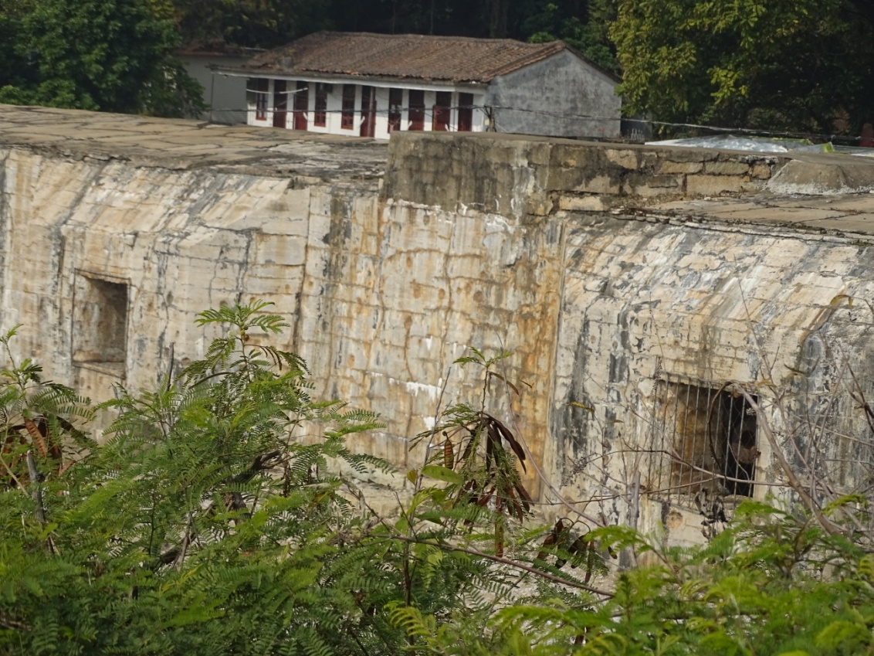
Cannon openings
The Deadly Point of the Bogue Fort
Think: Having seen the structure of the cannon forts and the arrangement of the cannon openings, what were the weak points in the Qing army’s defense?
Cannons could not protect each other due to the space between them.

Slide 19
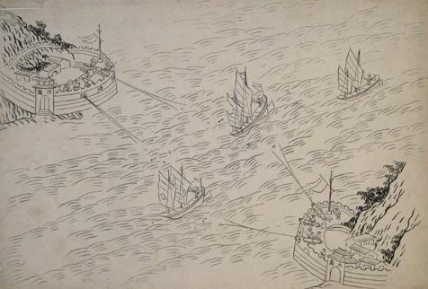
The Qing navy also understood Weiyuan fort’s flaws. They constructed (Upper) Hengdang fort at the small island opposite Weiyuan fort so that the two groups of forts could mutually protect each other. The navy commander, Guan Tianpei, then placed metal chains to block the sea between these two groups of forts. The area became instantly as safe as an impregnable district.
Weiyuan fort
Enemy warships
Even though Chinese cannons are numerous, forts cannot protect each other. Each and every one can be destroyed. There is no defence at the Lower Hengdang island which is an even bigger flaw.
British naval second-in-command
Humphrey Fleming Senhouse
Hengdang fort
Quiz: How did the British army defeat the impregnable Bogue stronghold in the end?
Even if the river was not blocked with metal chains, enemy warships were subjected to a crossfire from Weiyuan fort and Hengdang fort immediately when they passed through the Bogue. (Source: Wikipedia: The Battle of the Bogue）

Slide 20
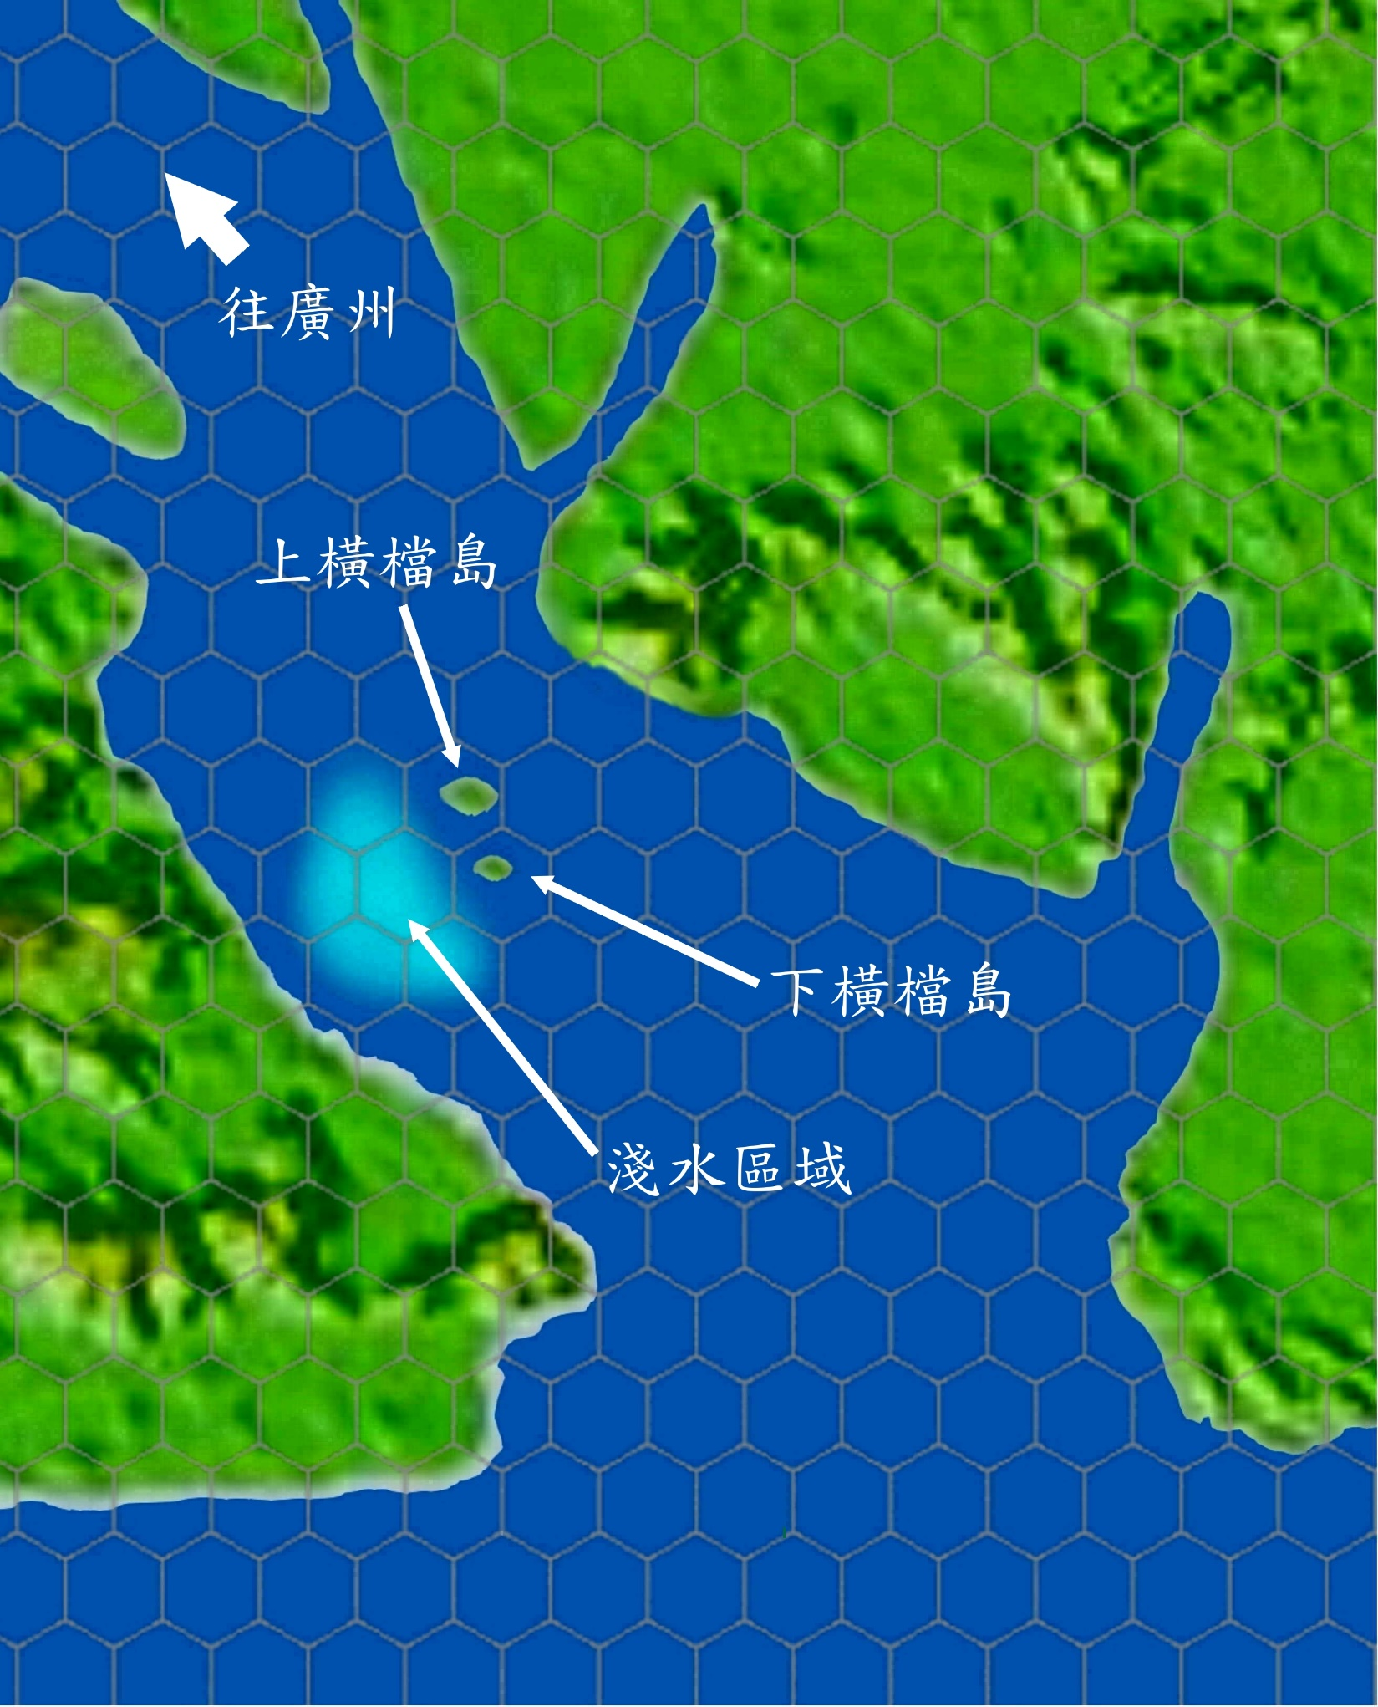
The Fire of War Reignited
Towards Guangzhou
Emperor Daoguang sent Yi Shan to hurry to Guangdong front lines for combat. On 27 January 1841, the Qing Dynasty declared war on Britain.
Upper Hengdang Island
Lower Hengdang island
Shallow water area

Slide 21
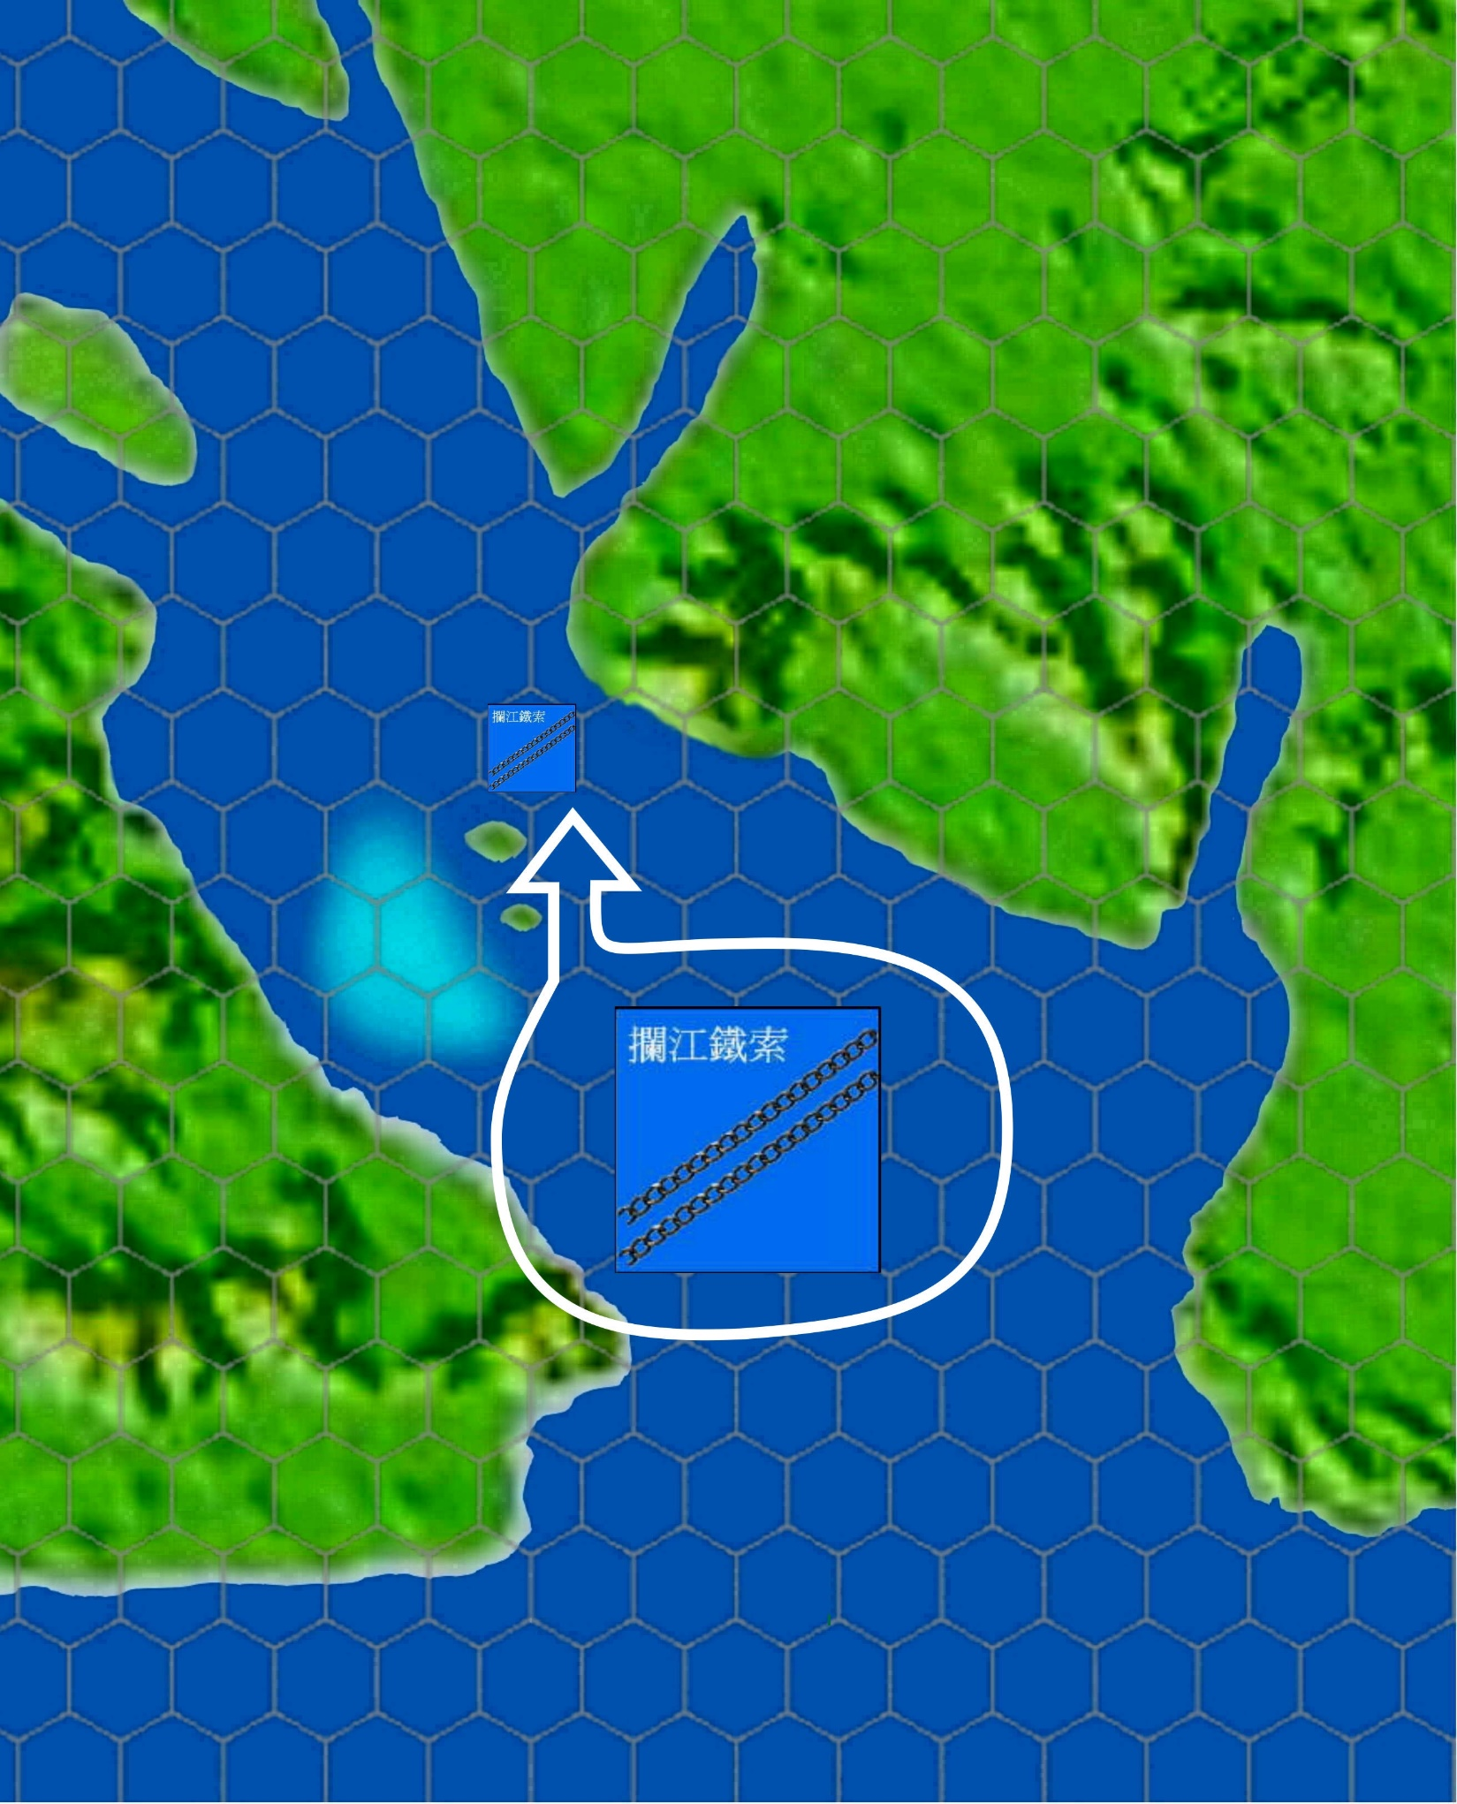
The Fire of War Reignited
Lan river metal chains
Deployed defense (1): Metal chains

Slide 22
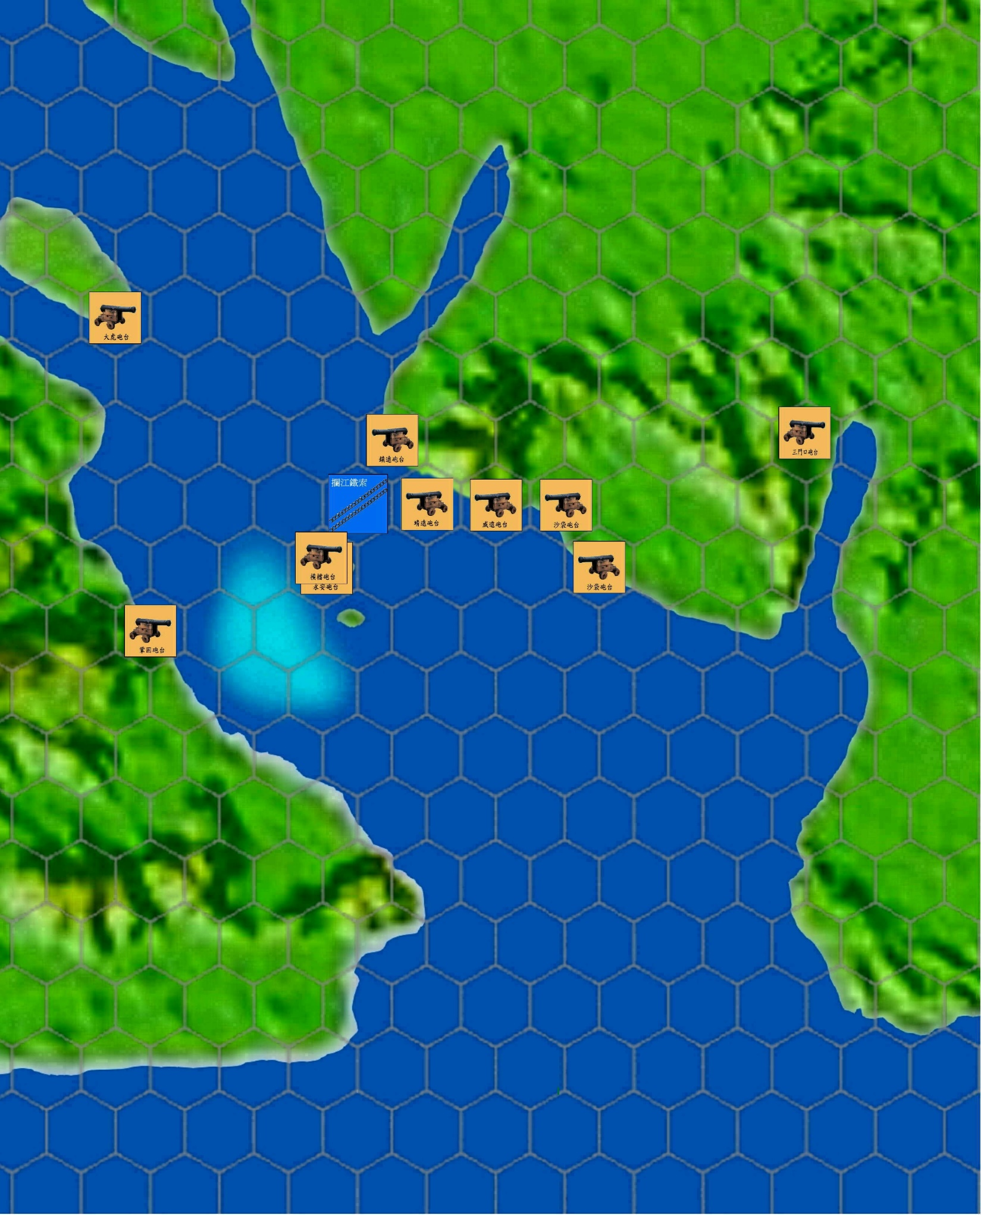
The Fire of War Reignited
Deployed defense (2): Forts

Slide 23
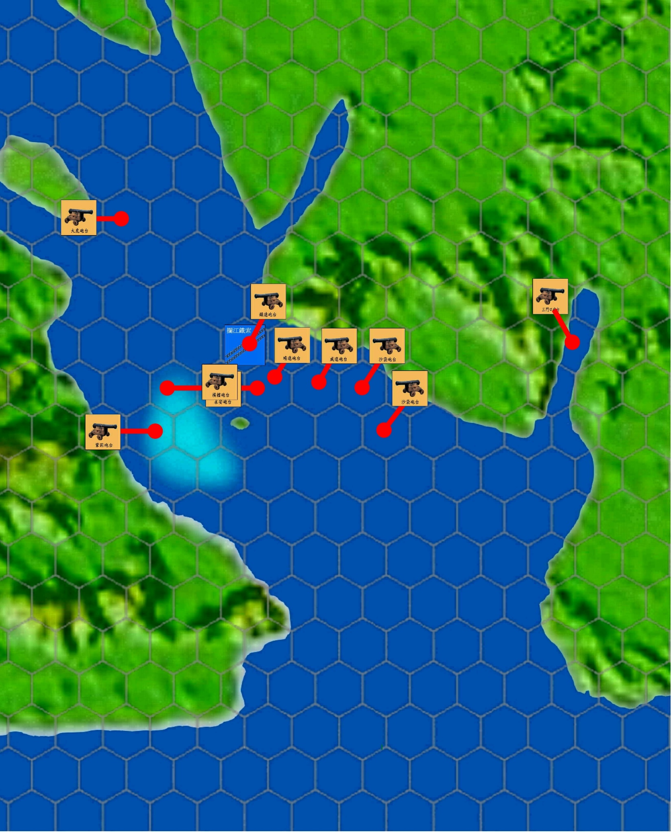
The Fire of War Reignited
Fort firepower coverage

Slide 24
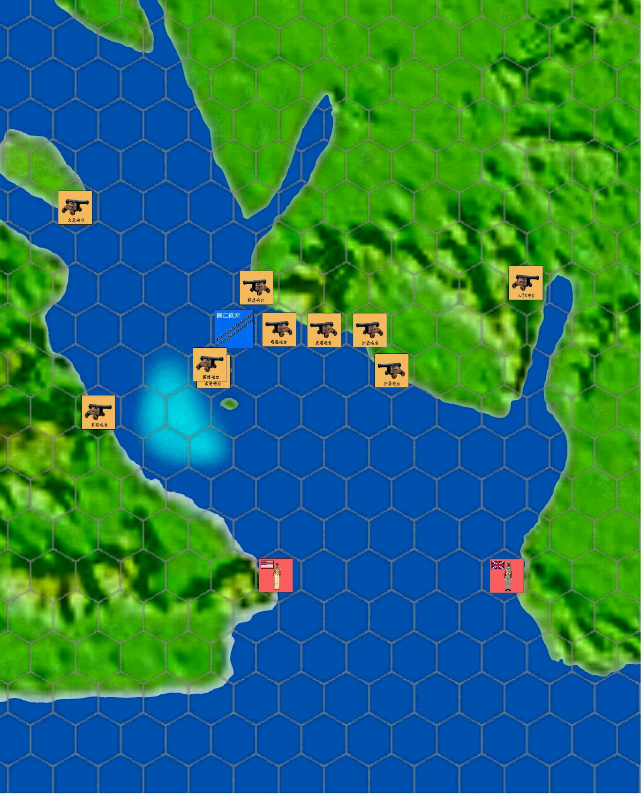
The Fire of War Reignited
23 February 1841
British army began to attack.

Slide 25
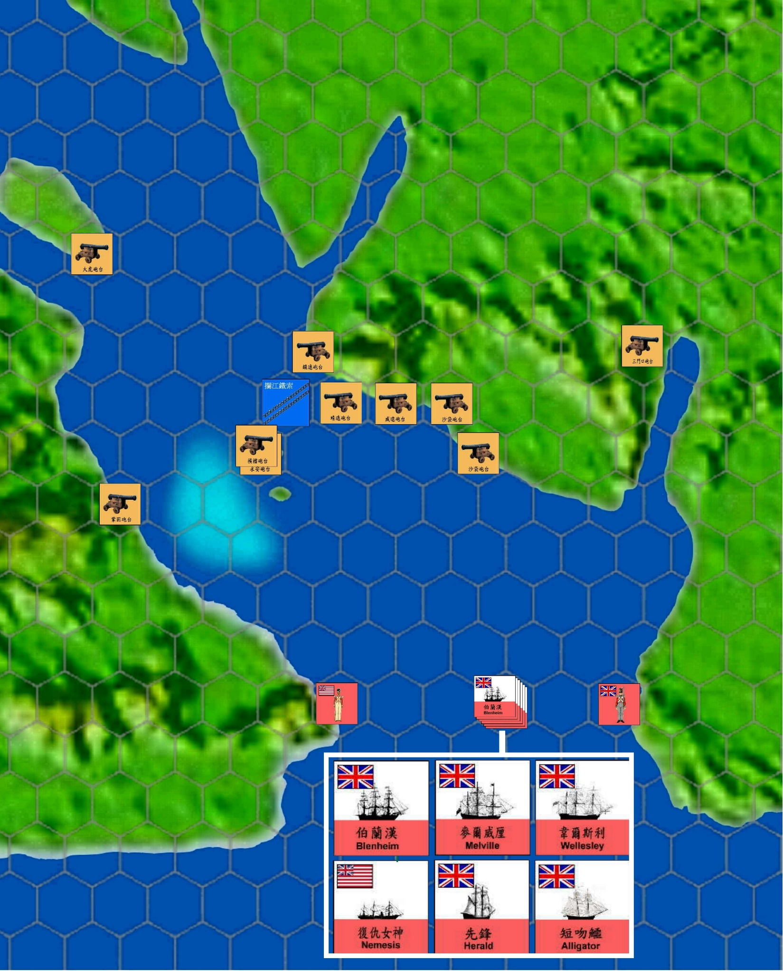
The Fire of War Reignited
23 February 1841
Sanmenkou fort
Metal Chains
Lower Hengdang island
The British army sent out warships and entered the Sanmenkou waterway. The Sanmenkou fort was destroyed.

Slide 26
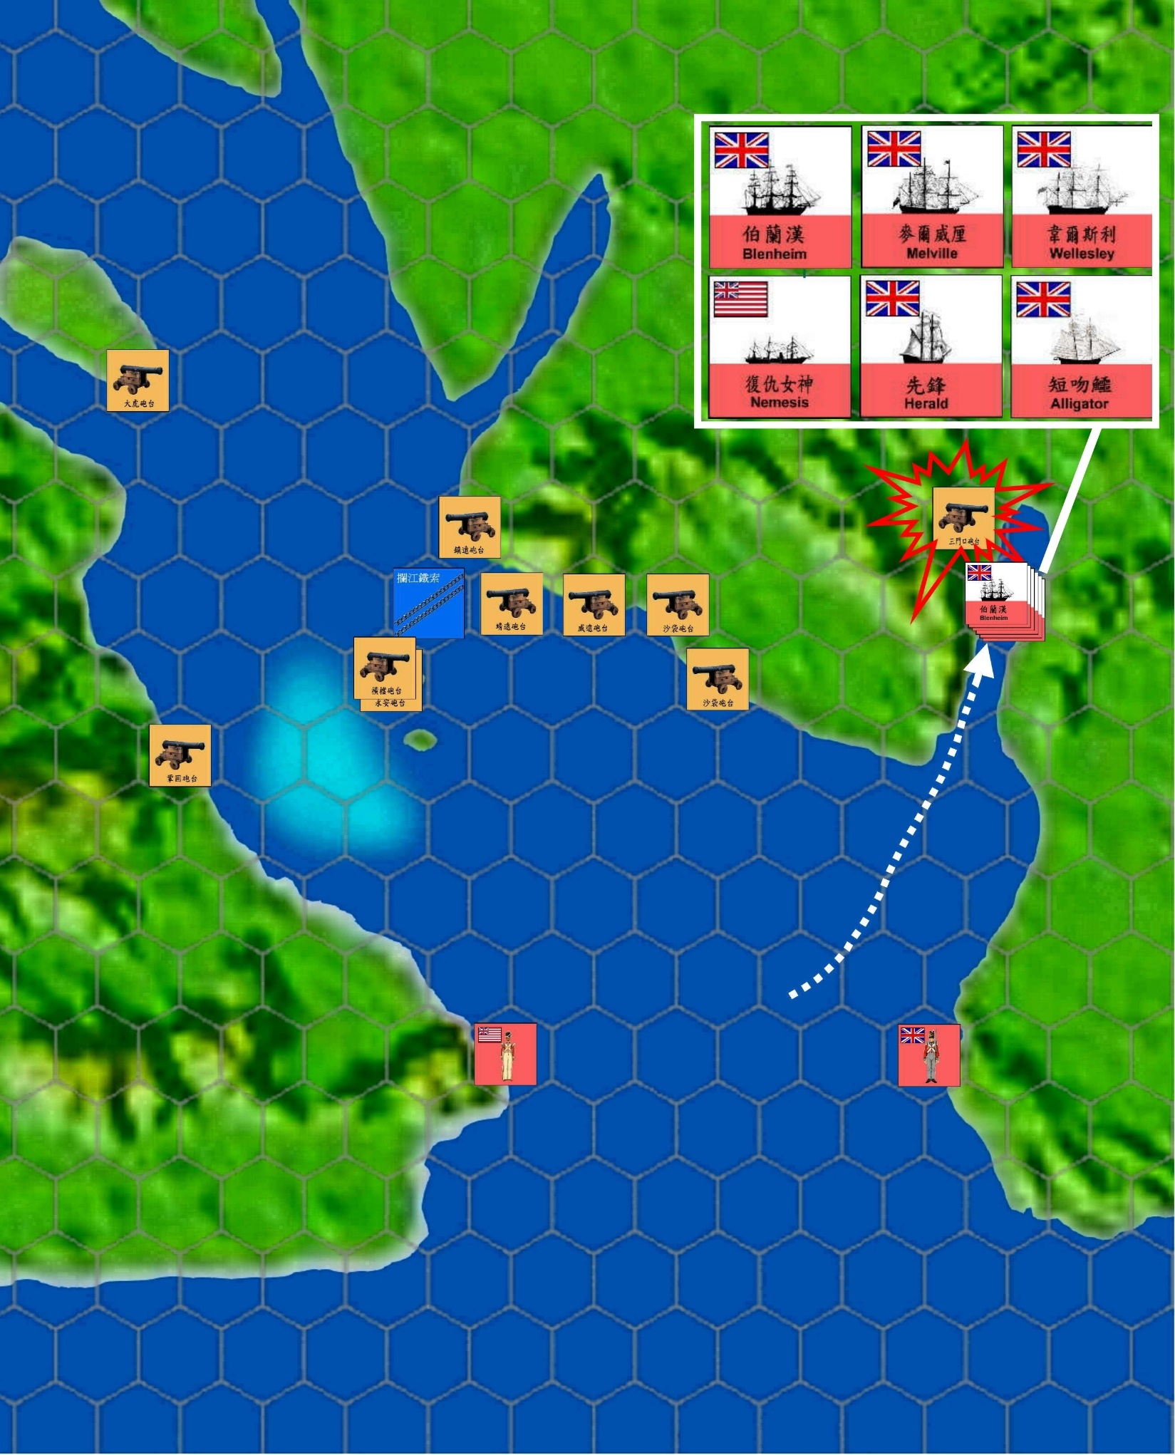
The Fire of War Reignited
23 February 1841
Lan river metal chains
Sanmenkou fort
Lower Hengdang island
Lower Hengdang island, lacking defenses, became the British army’s next objective.

Slide 27
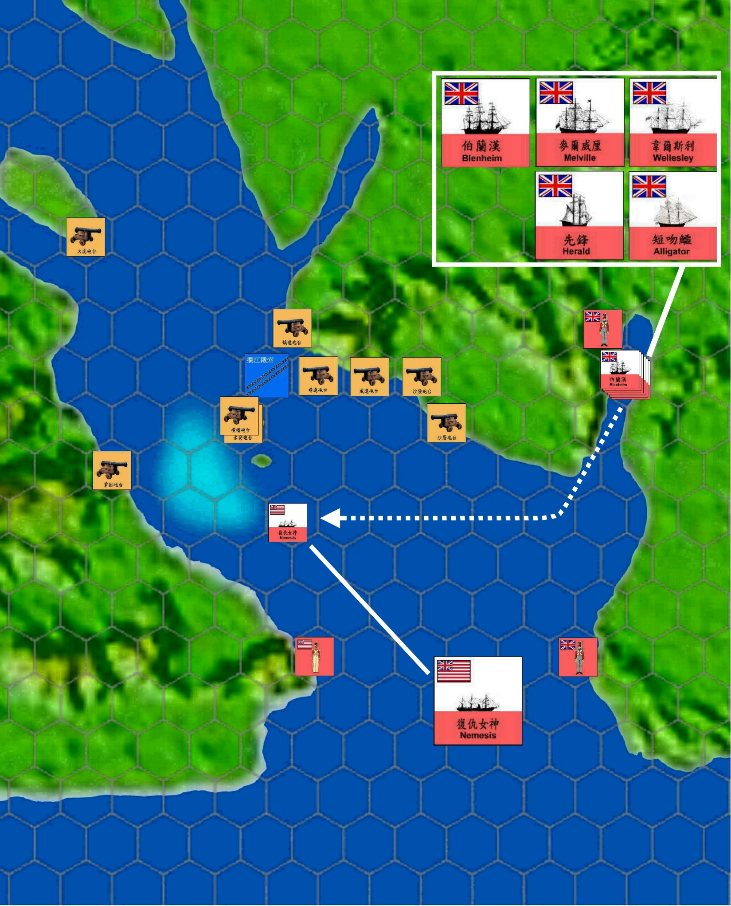
The Fire of War Reignited
25 February 1841
Upper Hengdang island fort
The Nemesis carried artillery soldiers and 130 infantry to Lower Hengdang island.

Slide 28
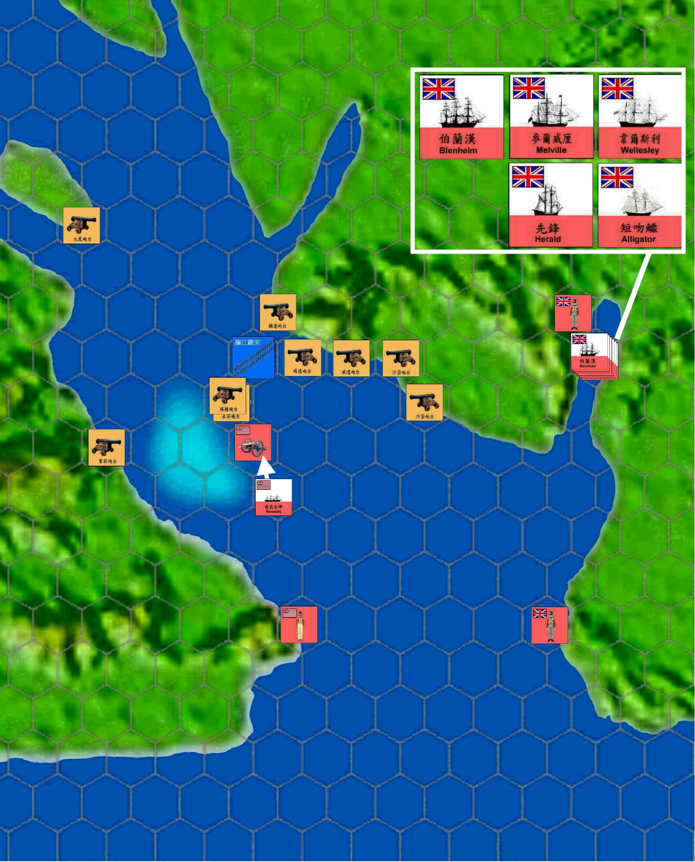
The Fire of War Reignited
25 February 1841
(Upper) Hengdang island fort
British troops set up field guns at a high spot on Lower Hengdang island and aimed at the Qing army forts of Upper Hengdang island.

Slide 29
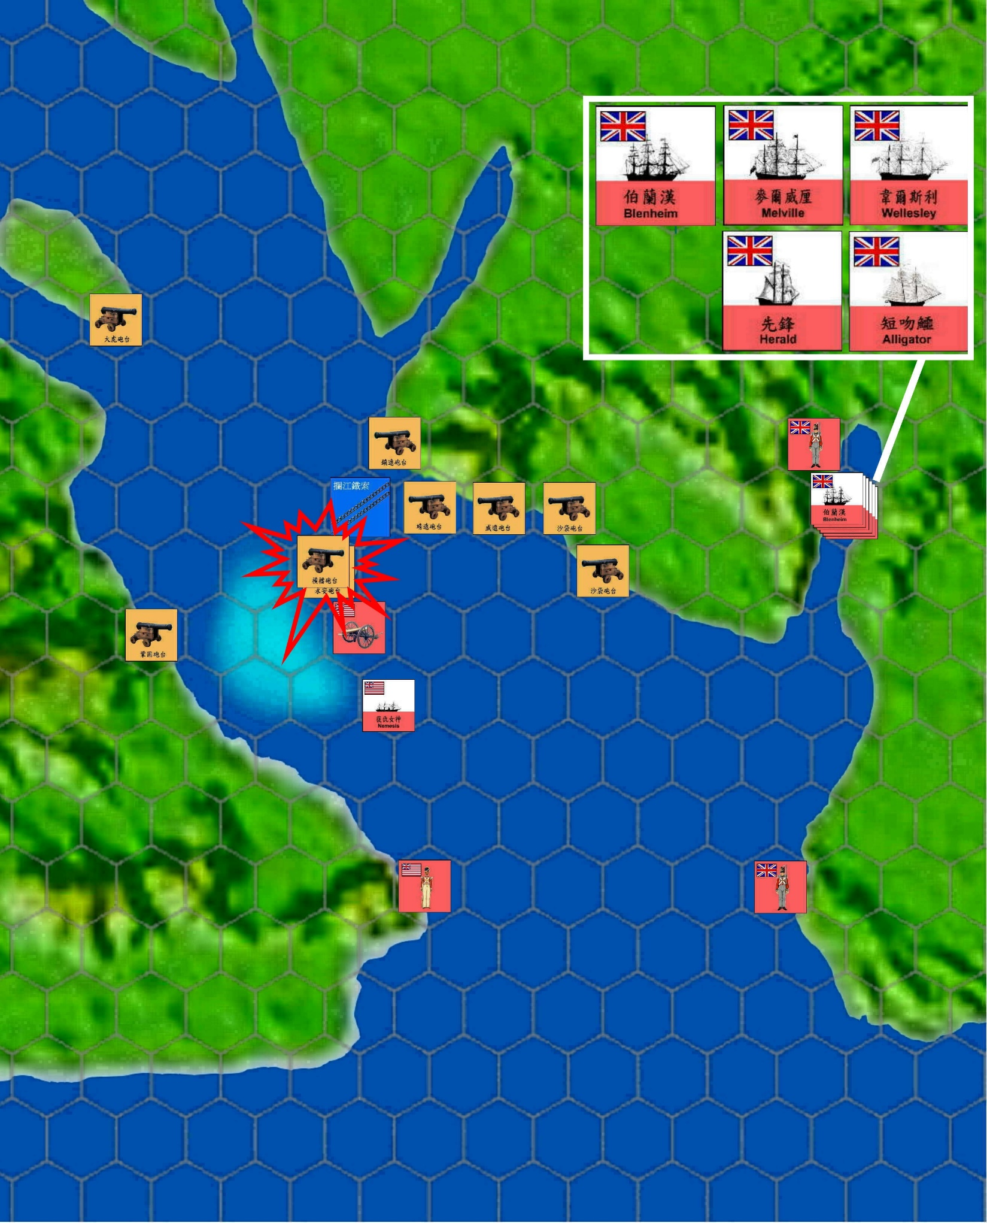
The Fire of War Reignited
25 February 1841
(Upper) Hengdang island fort
The British soldiers on Lower Hengdang island bombarded Upper Hengdang island. Since Upper Hengdang islands forts all faced east, they were unable to return fire and could only be fired on passively. In the end, they were defeated and the Bogue stronghold’s crossfire network became ineffective.

Slide 30
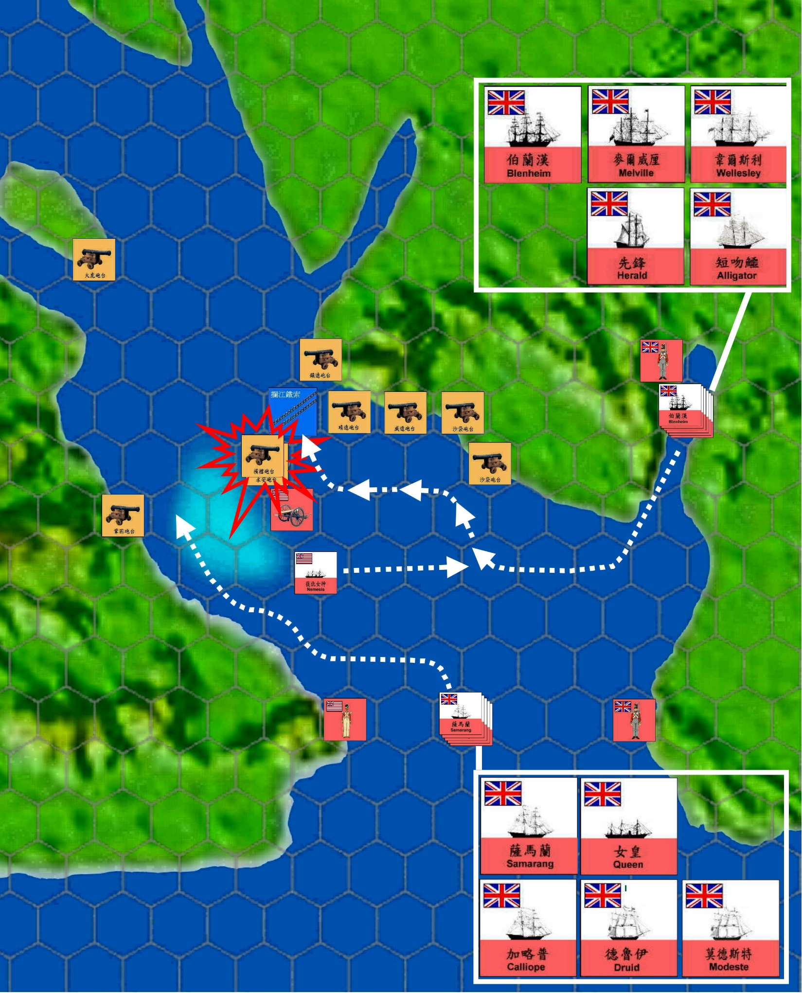
The Fire of War Reignited
25 February 1841
(Upper) Hengdang island fort
When the British army bombarded Upper Hengdang island’s Qing army forts, another two fleets prepared to advance in order to destroy the Qing army forts on both shores at the same time.

Slide 31
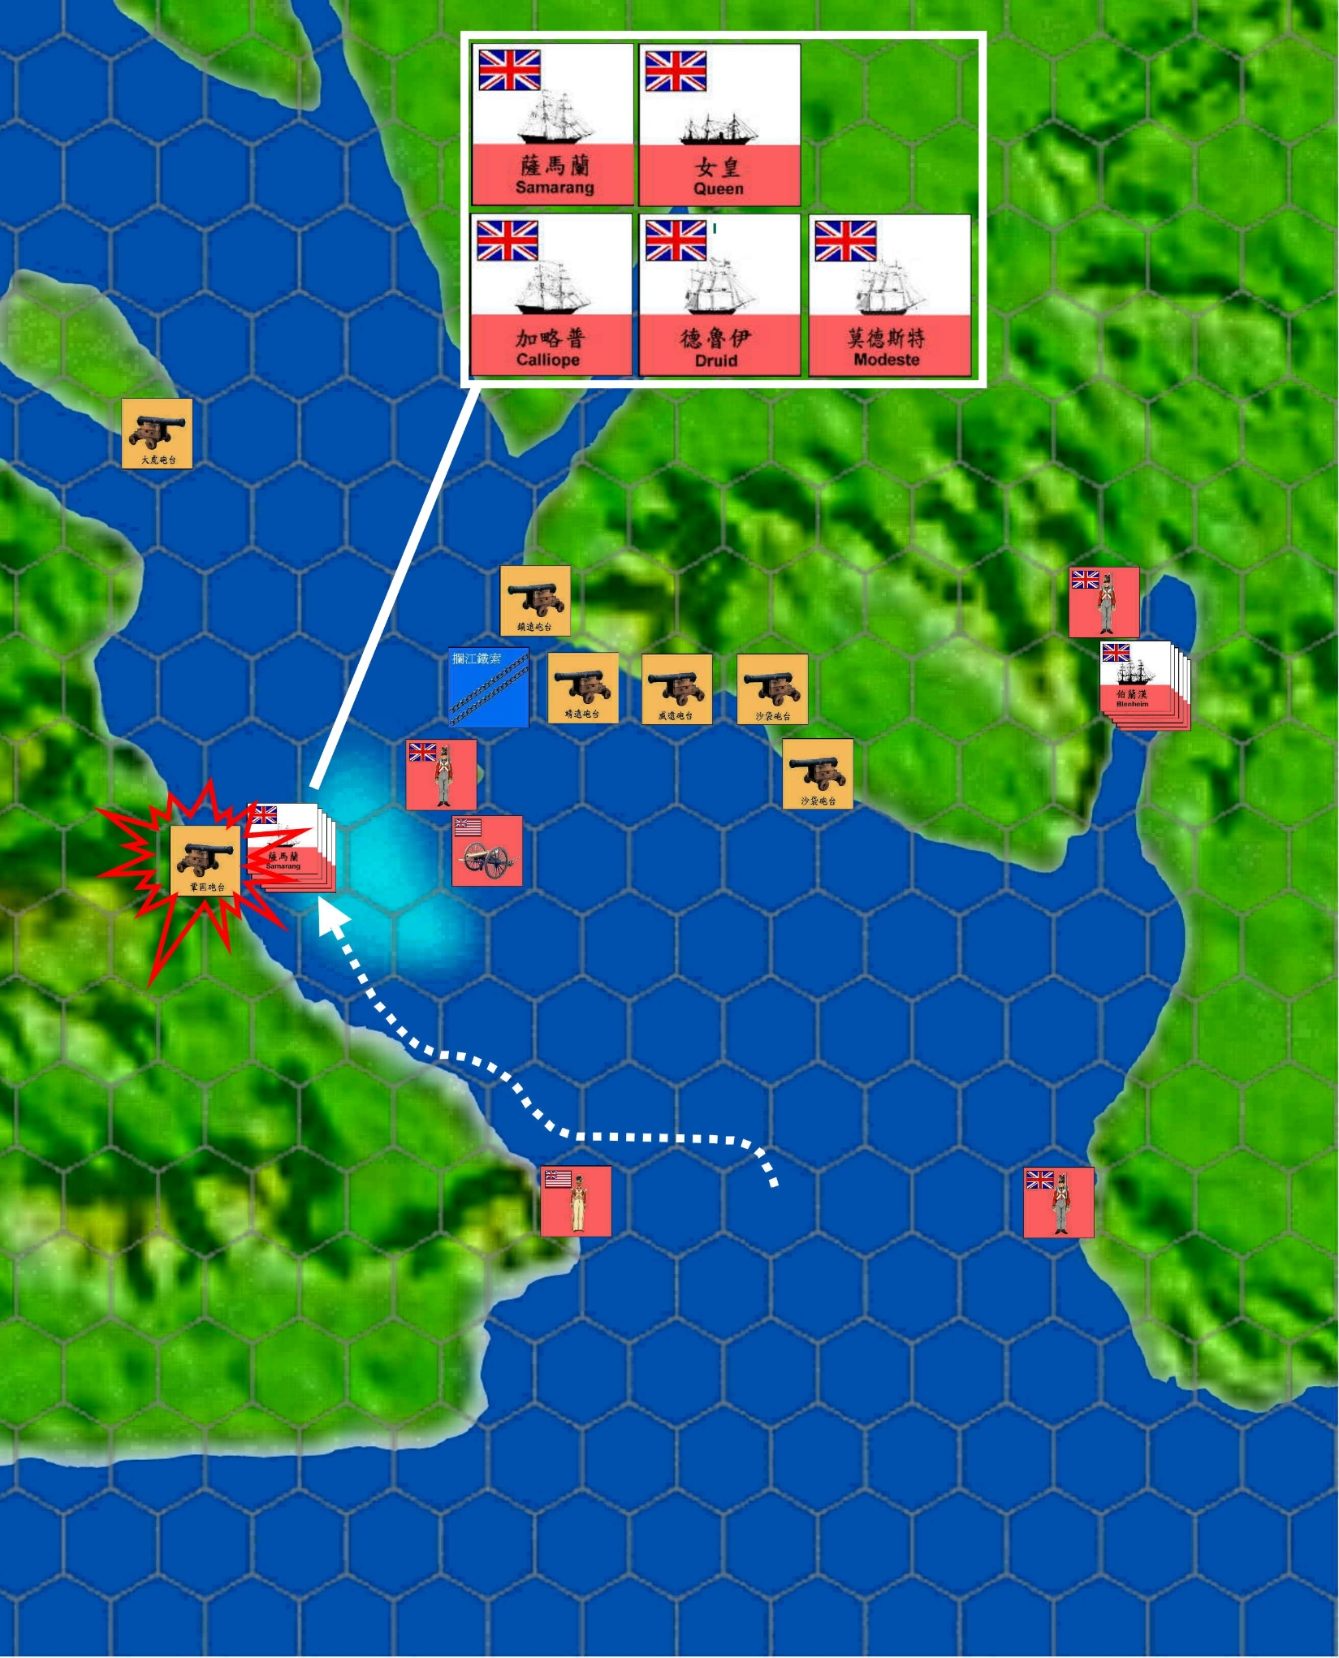
The Fire of War Reignited
26 February 1841
The British army sent out a light fleet to enter the shallow water area on the west route. It was to bombard and annihilate the Qing army’s forts.

Slide 32
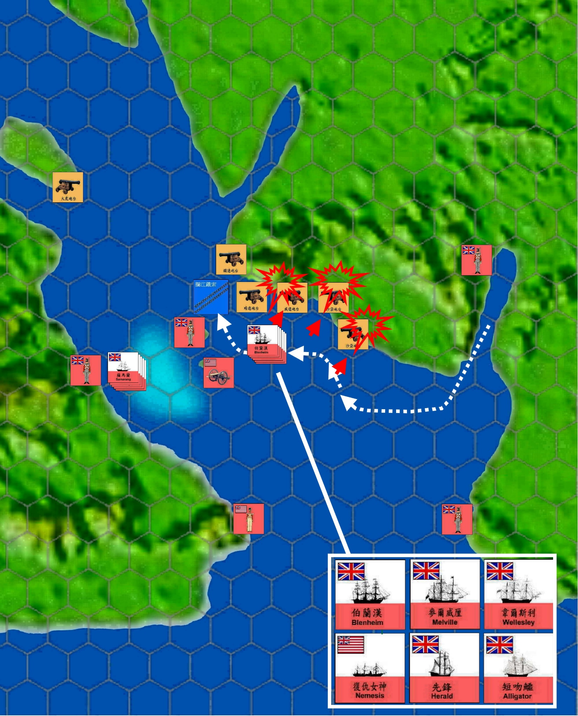
The Fire of War Reignited
26 February 1841
The main force of the British army was on the eastern route. From an advantageous firing angle, the British army attacked all Weiyuan, Jingyuan, and Zhenyuan forts.

Slide 33
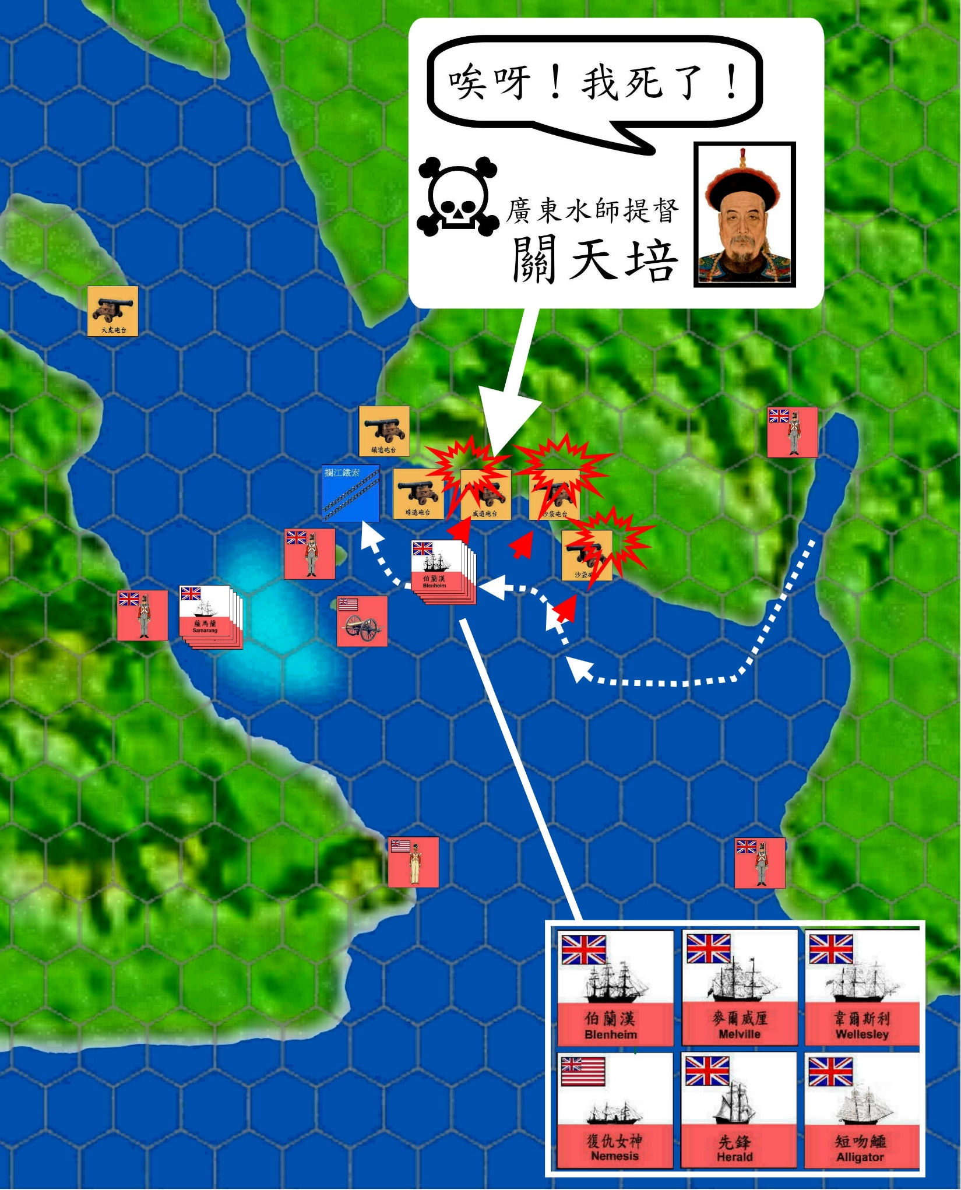
Oh! I die!
The Fire of War Reignited
Guangdong Navy Commander,
Guan Tianpei
26 February 1841
At that time, Guan Tianpei was guarding the Jingyuan fort and died in the battle.

Slide 34
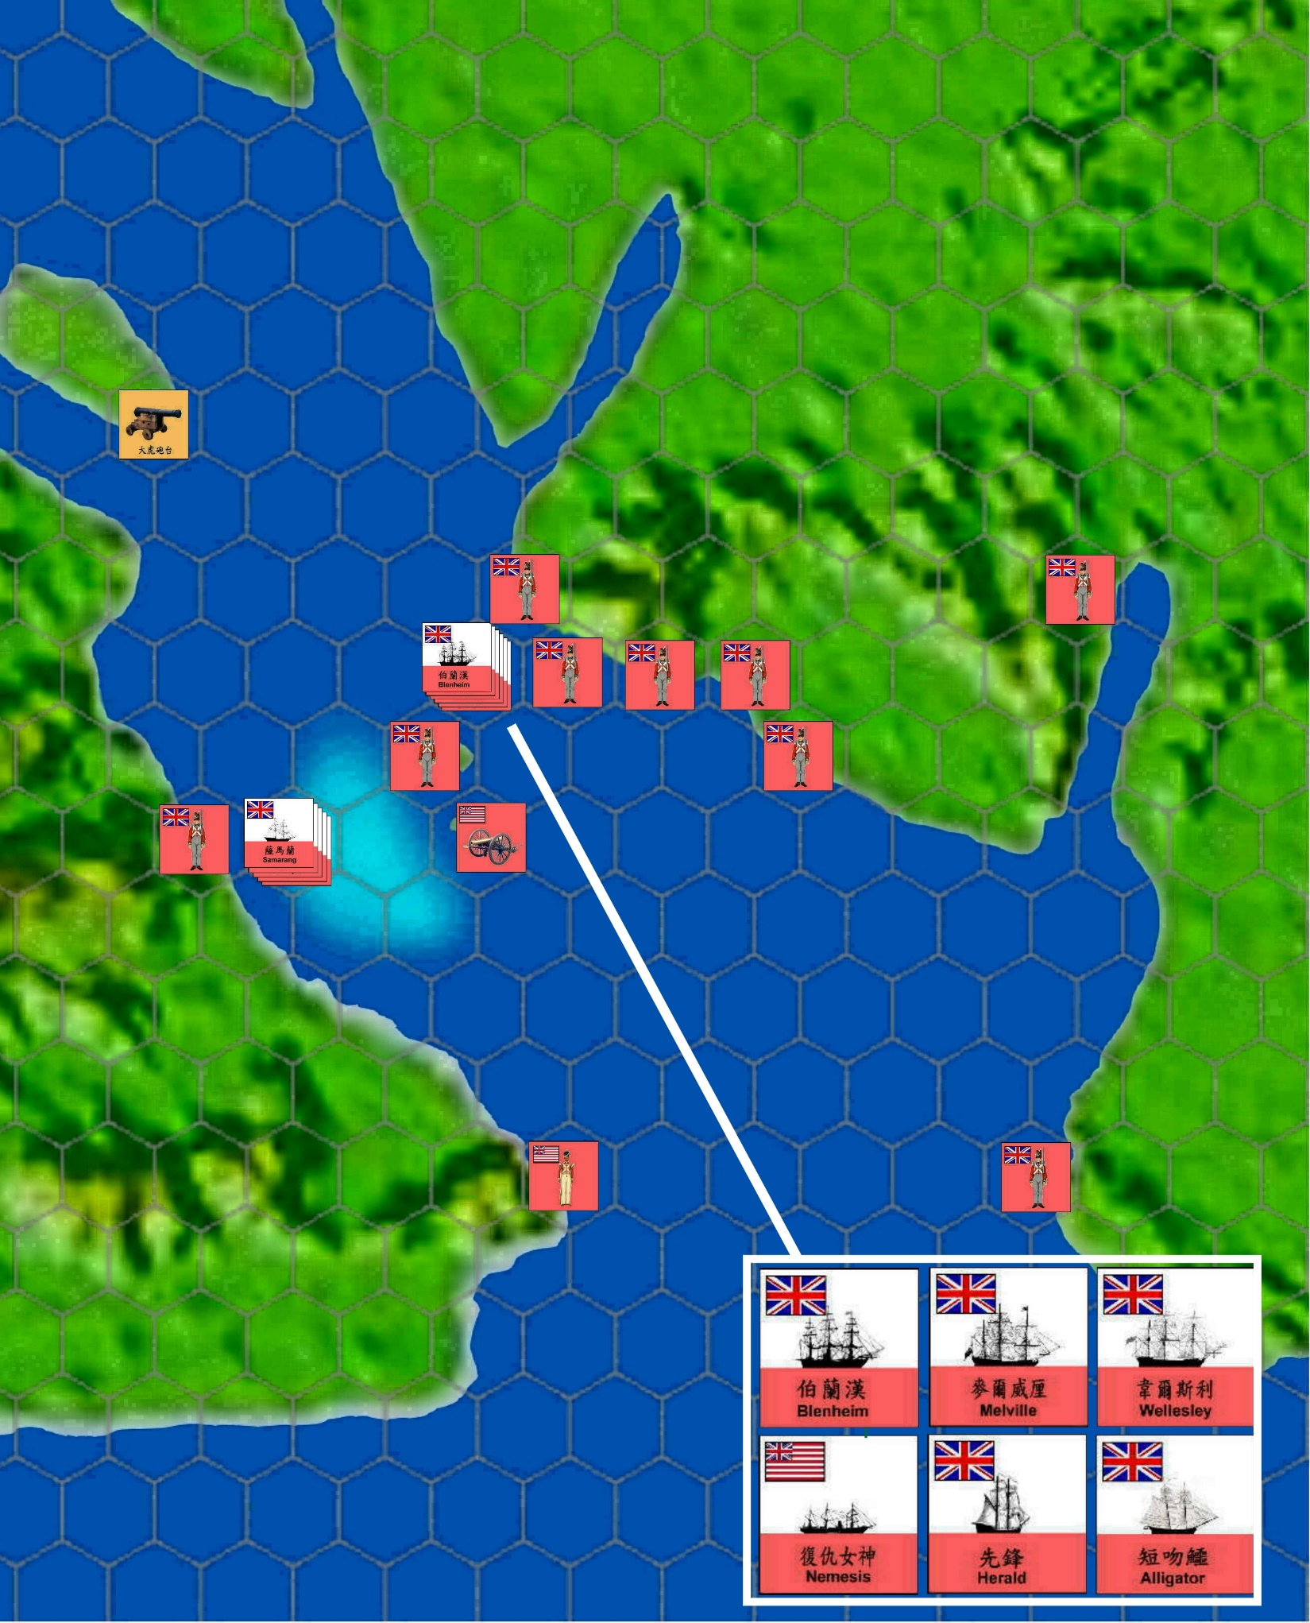
Dahu Fort
The Fire of War Reignited
26 February 1841
The Qing army retreated to Guangzhou because the two defensive lines of the Bogue had been destroyed and the Dahu fort alone was unable to defend the Bogue. The Battle of the Bogue ended.

