Slide 1
The Battle of Changping: A total war that devoted the effort of the whole country
The Background of the Battle of Changping (長平)
In 356BC, the Qin state (秦國) appointed Shang Yang (商鞅) to carry out reforms. Consequently, the Qin state became increasingly wealthy and powerful, and the Han, its neighbouring state, became the main invasion target for the Qin state.
In 263BC, Qin armies invaded the Han state (韓國). To prevent war, King Huanhui (韓桓惠王) of Han tried to offer Shangdang (上黨) county (located in modern day Hebei province), containing 17 cities, to the Qin state. However, Feng Ting (馮亭), the governor of Shangdang county, was unwilling to submit to the Qin state. Feng Ting instead proposed to give the county to the Zhao state (趙國). If the Zhao state accepted Shangdang county, the Qin state would be provoked and then declare war on the Zhao state. The Zhao state would then become the ally of the Han state and the Han state would be able to resist against the invasion of the Qin state.
The cause of the Battle of Changping was therefore the contest over Shangdang county between the Qin state and the Zhao state. If the Qin state occupied Shangdang county, they could control the strategically important Taihang Mountains (太行山) and threaten Handan (邯鄲), the capital of the Zhao state. If the Zhao state occupied Shangdang county, the area could then be used to defend against the Qin invasion of Handan. In the end, King Xiaocheng of Zhao (趙孝成王) accepted the occupation of Shangdang county.

Slide 2
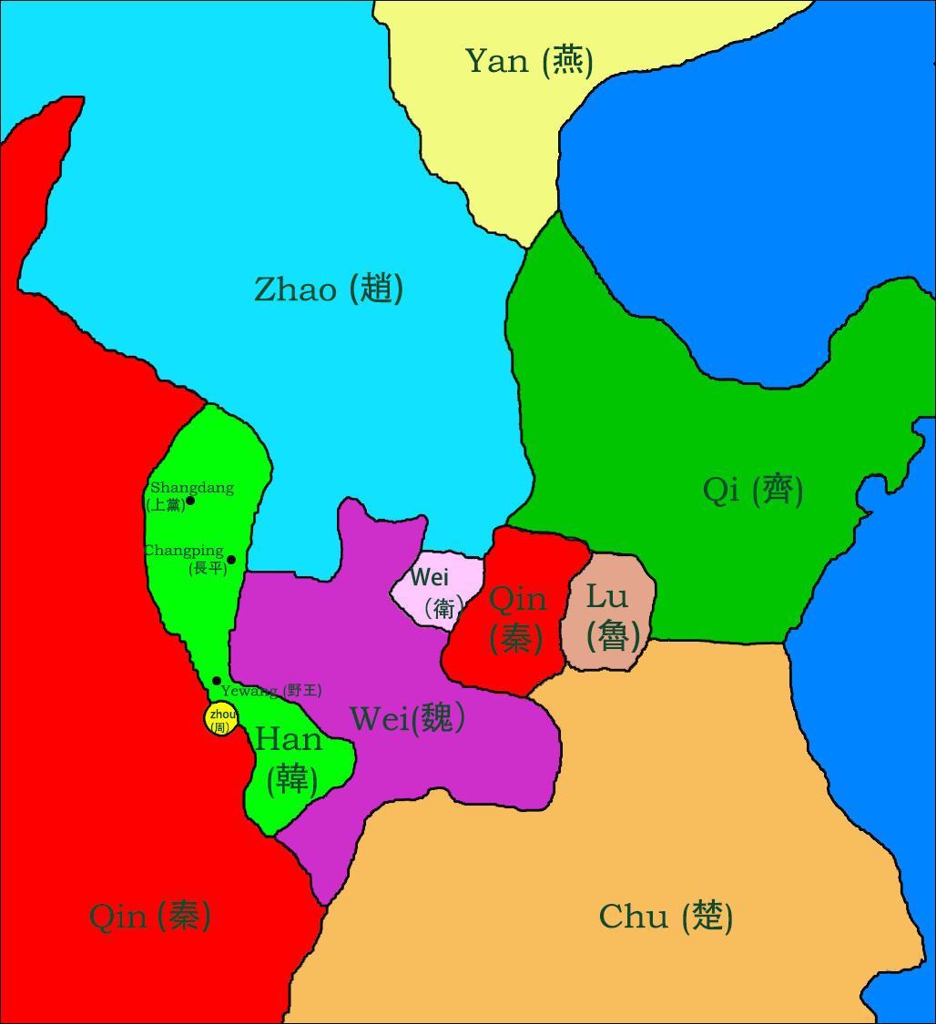
The Battle of Changping:
A Total War that devoted the effort of the Whole Country
The Battle of Changping was the most desperate battle in the Warring States period (~ 476-221BC) which ended in the defeat of the Zhao state. It enabled the Qin state to expand eastward successfully with one fewer formidable enemy and this contributed to the eventual establishment of a unified China.

Slide 3
In 262BC, the Qin state sent soldiers to attack Yewang (野王), a city in the central part of the Han state. As a result, the Han state was divided into two parts. The Qin state intended to annex the Han state slowly and separate it from Shangdang county.

Slide 4
The king of the Han state feared the Qin army would continue to attack and decided to offer Shangdang county to the Qin state. However, Feng Ting, the governor of Shangdang county, was unwilling to submit to the Qin state. Instead, he preferred to ask the neighbouring Zhao state for assistance.

Slide 5
The Zhao state wanted to occupy Shangdang and decided to accept Feng Ting’s surrender. As the Qin state witnessed the occupation of Shangdang county by the Zhao state, the Qin state sent their armies to fight against the Zhao state.

Slide 6
The Zhao state wanted to occupy Shangdang and decided to accept Feng Ting’s surrender. As the Qin state witnessed the occupation of Shangdang county by the Zhao state, the Qin state sent their armies to fight against the Zhao state. The Qin state and the Zhao state both mobilized their armies for a decisive battle at Changping.

Slide 7
II. A Comparison of the Commanders-in-Chief of Both Sides
Early period: Lian Po, a famous commander-in-chief of the Zhao state, above average
The commander-in-chief of the Zhao state: Lian Po (廉頗)
Position: Lord of Xinping, Zhao state
Family Background: Unclear
Experience in Warfare: He won in wars against the Qi state and the Wei state.
Year of Death: In his old age, the king of Zhao did not put him in important positions. In approximately 240BC, he died of unknown causes in the Chu state.
Later Evaluation: He was one of the four great generals of the Warring States period (the other three were Bai Qi, Wang Jian, Li Mu)
The commander-in-chief of the Qin state: Wang He (王齕)
Year of Death: He died in battle in 247BC.
Later Evaluation: He was ranked second amongst the six great generals in the history of the Qin State (they were Bai Qi, Wang He, Hu Shang, Si Ma Cuo, Liao, Wang Qi).

Slide 8
II. A Comparison of the Commanders-in-Chief of Both Sides
Late Period: Bai Qi, an incomparable commander-in-chief of the Qin state
The commander-in-chief of the Zhao state: Zhao Kuo (趙括)
Family Background: His father was the famous general of the Zhao state, Zhao She.
Experience in Warfare: He had abundant knowledge of war tactics and strategies from military treatises but lacked real experience in warfare.
Year of Death: He was killed after the defeat in the Battle of Changping in 260BC.
Later Evaluation: After the defeat in the Battle of Changping, he was ridiculed as just an “armchair strategist”.
The commander-in-chief of the Qin state: Bai Qi (白起)
Position: Lord of Wu An, Qin state
Family Background: He came from a family with military background.
Experience in Warfare: He was well experienced in warfare. Before the Battle of Changping, he had already participated in many battles.
Year of Death: He offended King Zhao of Qin and was ordered to commit suicide in 247BC.
Later Evaluation: He won all his battles and did not lose even one. Throughout his life, he besieged at least 70 cities and killed almost a million enemies. King Zhao of Qin ranked him as the first out of the six great generals of the Qin state. He was also one of the four great generals of the Warring states period.

Slide 9
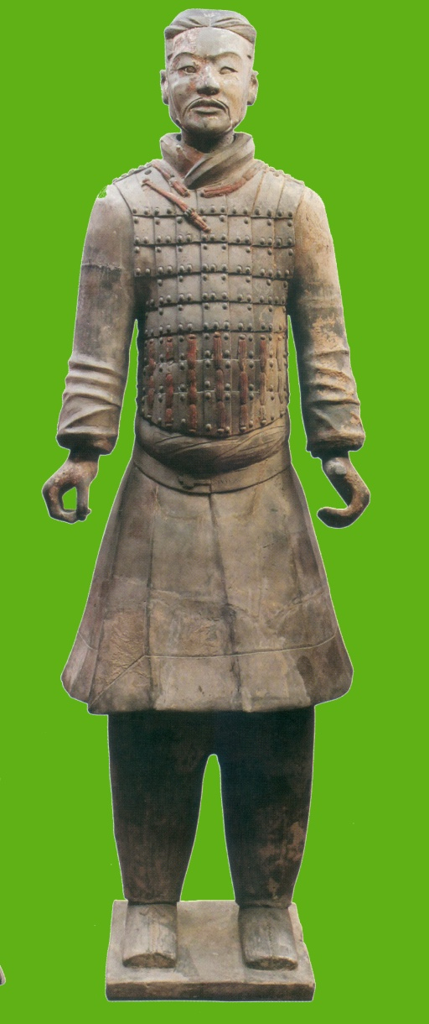
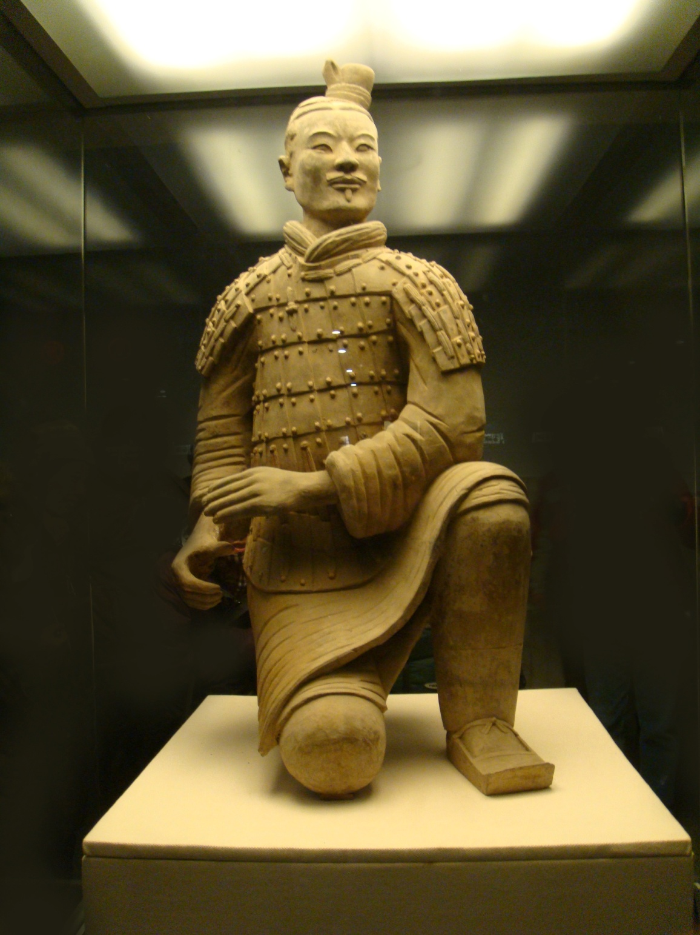
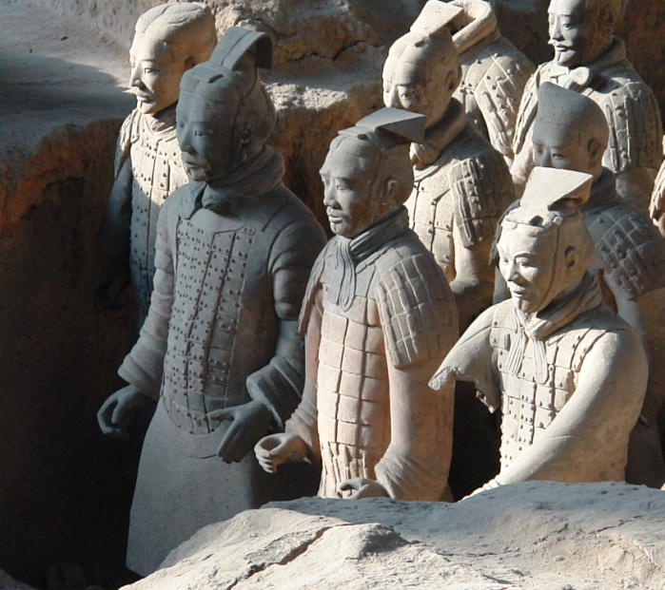
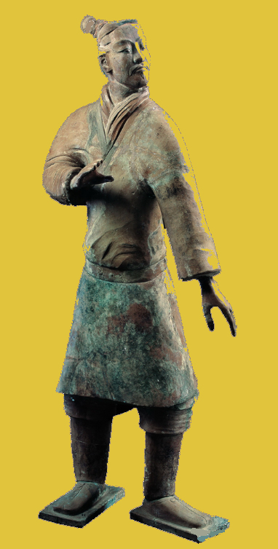
III. Different types of soldiers and weapons of the Qin State
Quiz: Different types of soldiers of the Qin state: The photos below show images of four types of Qin infantry. Try to distinguish which type of infantry these statues represent .
Chariot soldiers
Cavalry
Crossbowman
Archer
Draw lines/Pair up：
Archer
Crossbowman
Cavalry
Chariot soldiers

Slide 10
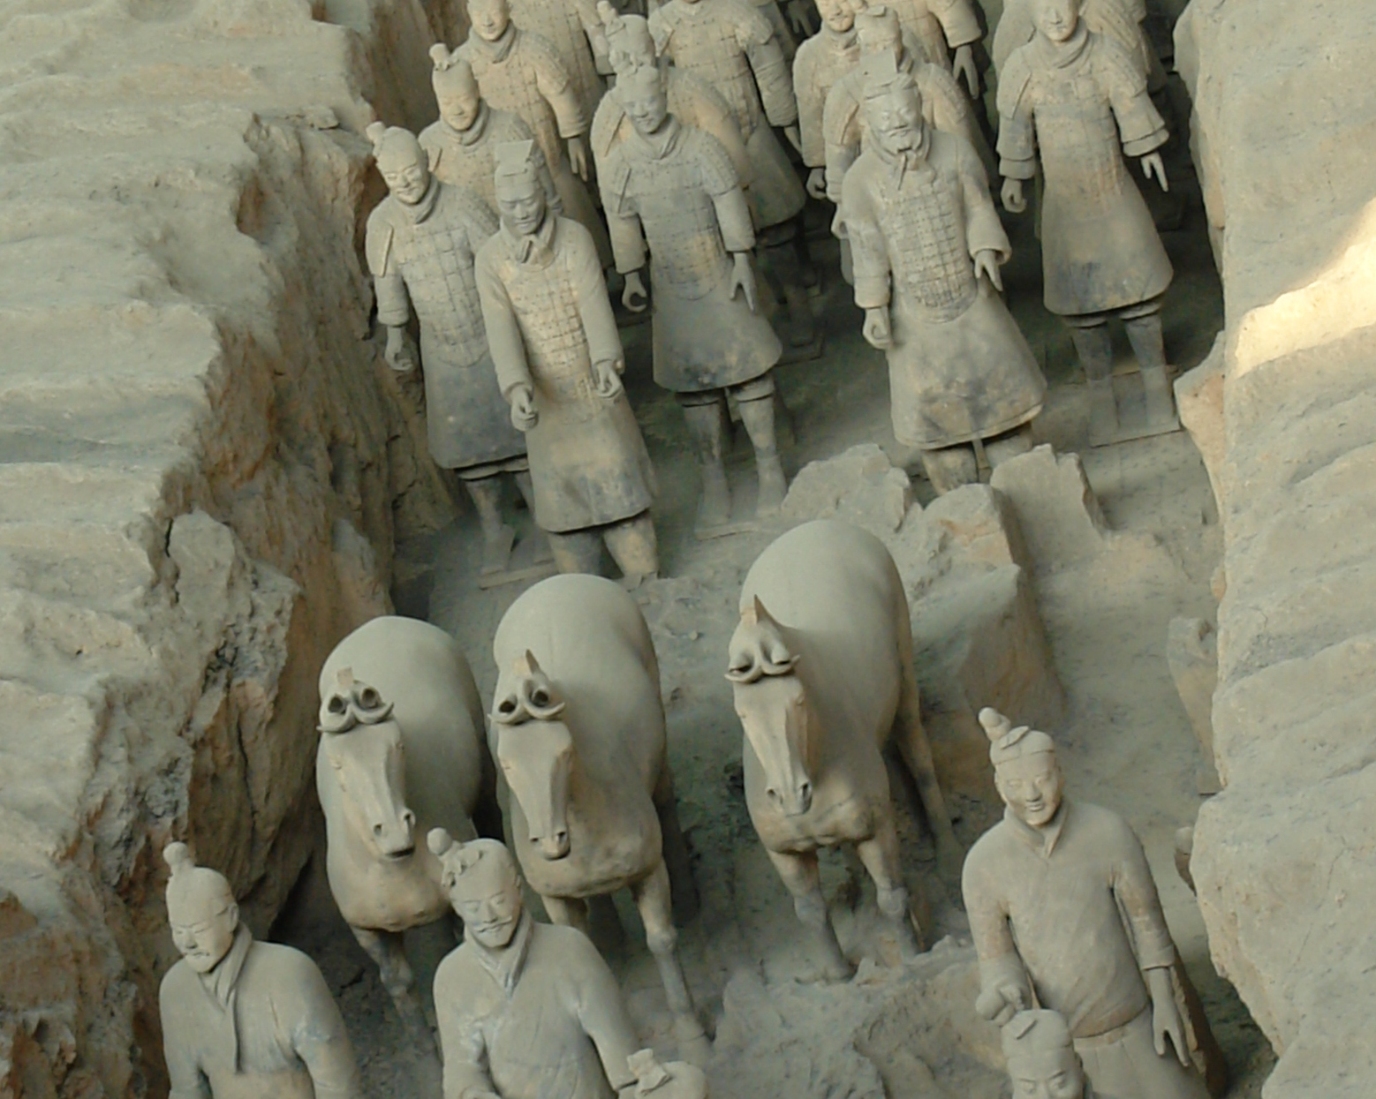
A. Chariot Soldiers
Chariot soldiers from the Qin state holding reins

Slide 11
Quiz:
The hats and the upper body armours of the chariot soldiers showed that they were a relatively important unit in the army. However, these war chariots, which were only popular for a certain period in the Spring and Autumn Period (771-476BC), were gradually withdrawn from the fighting stage. During the Battle of Changping, which was in the Warring States period (~ 476-221BC), they were not the main military force already. Can you guess the reasons behind this?
Reasons:
（1）Too expensive
（2）War chariots could not be turned around easily, and were only suitable for going straight across the battle fields. Shangdang county was surrounded by mountains. In the battle of Changping, cavalry and foot soldiers were the main types of infantry used in the battle fields. War chariots were only used by senior officials who commanded the cavalry and foot soldiers.
A photo taken in the Mausoleum of the First Qin Emperor at Xi’an

Slide 12
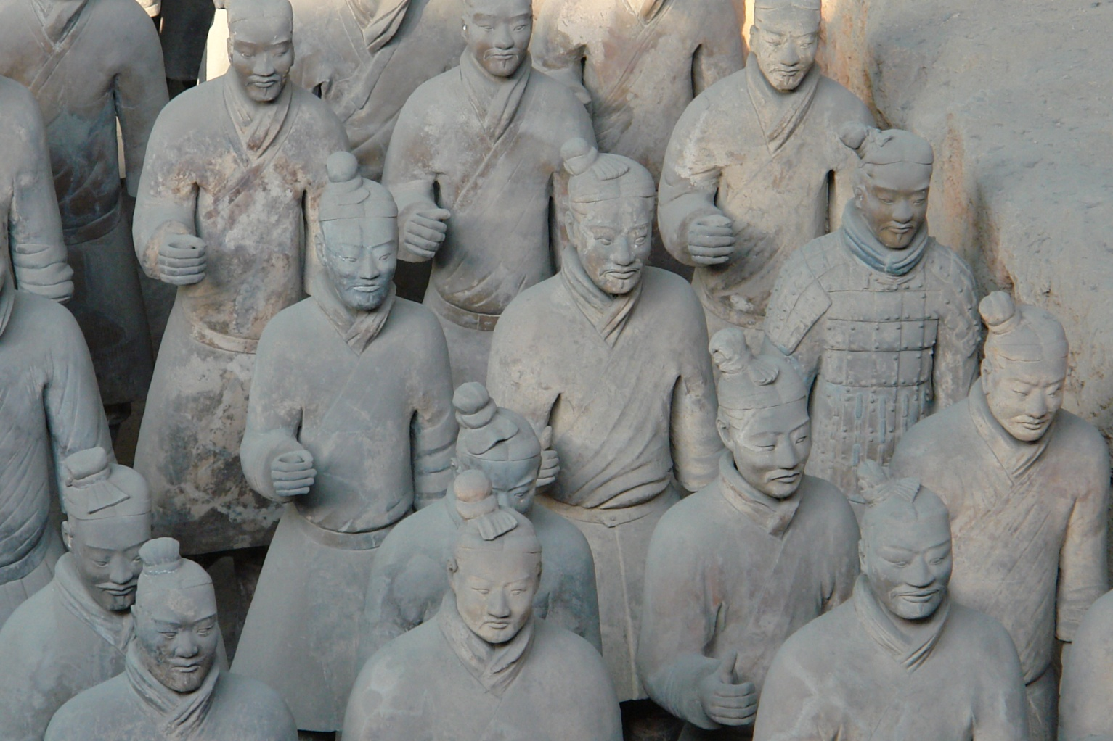
B. Archers/Light Infantry
A photo taken in the Mausoleum of the First Qin Emperor at Xi’an
Soldiers of the Warring States period could be divided into two categories, armoured and non-armoured. Non-armoured infantries were the normal combat troops in the battle fields and their chances of casualties were relatively high. There is an armoured soldier in this photo. Can you find him?

Slide 13
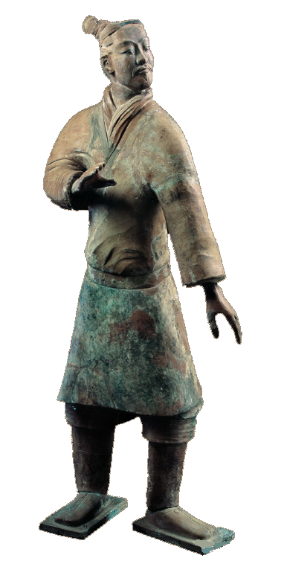
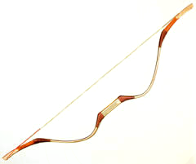
Quiz
According to this photo, a typical archer of the Warring States period did not wear armour. Why?
A typical archer of the Warring States did not wear armour. The clothing was simple since it was convenient for archers to make large movements when drawing their bows.

Slide 14
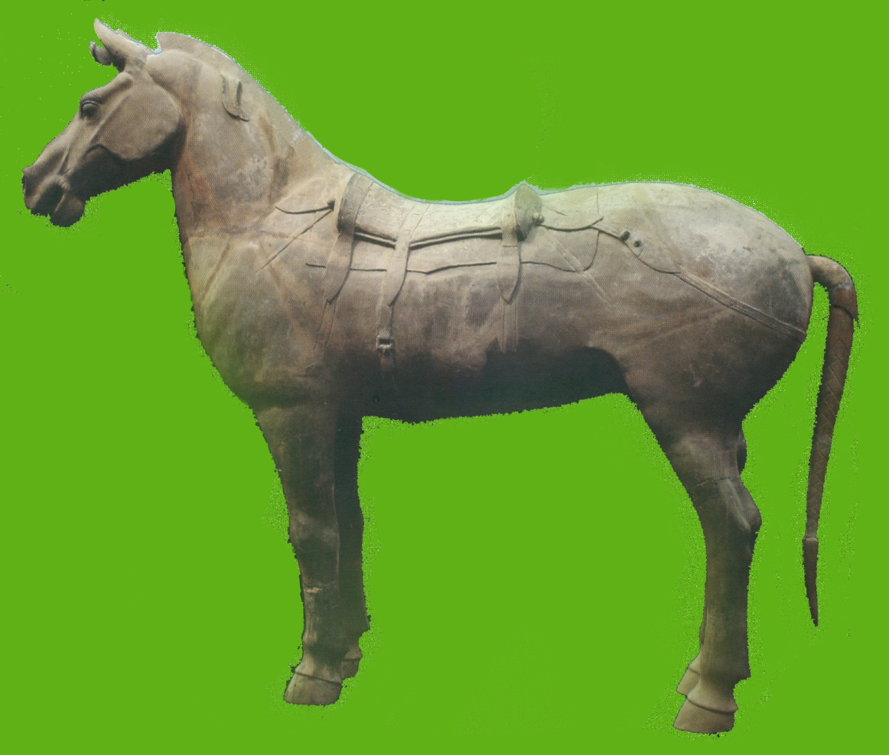
Though leather saddle pads (numnahs) had been invented, stirrups had not yet been invented. This meant that cavalry needed stricter training in this period when compared to later generations. Apart from using both thighs to press against the horse to sit and ride in a stable condition, they also needed to use both hands to control the reins and direct the horses to go forward.
C. Cavalry

Slide 15
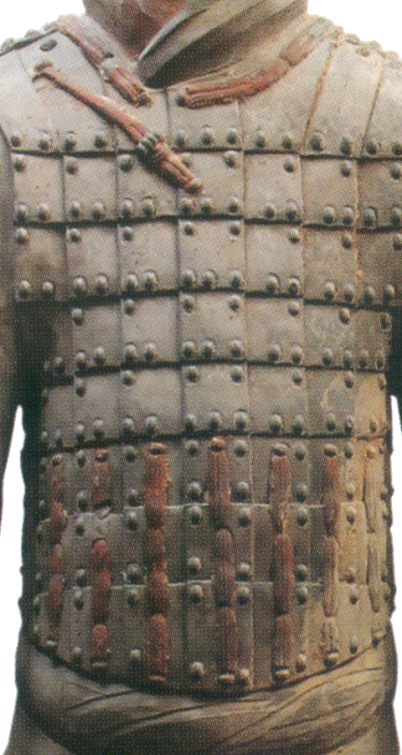
Armour was mainly made of cow leather. Red cord was used to bind different pieces together and black paint was painted on the surface of the armour so as to strengthen its toughness. Qin cavalry wore the leather armour on the upper body only so that they could ride horses conveniently.

Slide 16
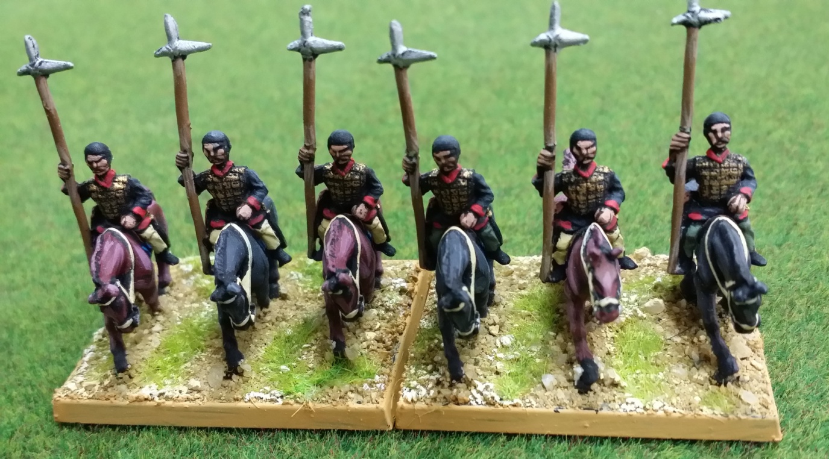
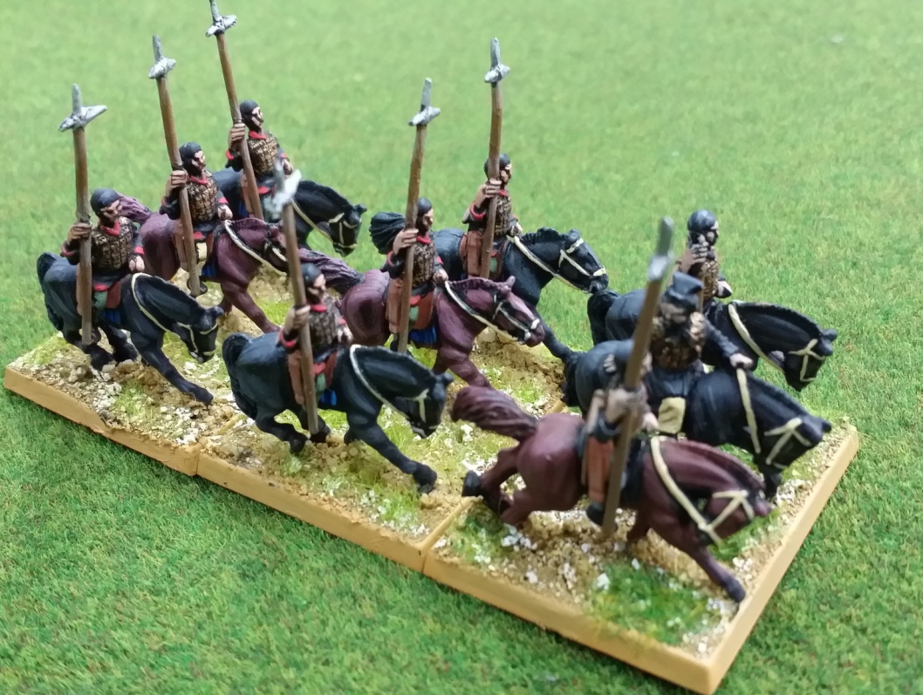
Quiz
Stirrups had not been invented in the Warring states period. Therefore, horsemen found it difficult to fight on horseback. In this photo, the horsemen hold the bridles in one hand and the halberds in the other hand. What are their roles in the war?
Stirrups had not been invented in the Warring States period and cavalry therefore found it hard to fight on horseback. However, skilled horsemen could hold the bridles in one hand and the halberds in the other hand. They could point the halberds forward and sprint forward when encountering foot soldiers.

Slide 17
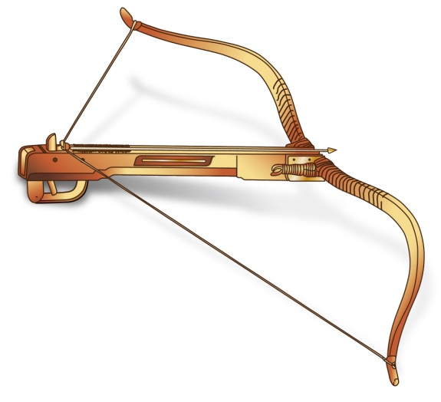
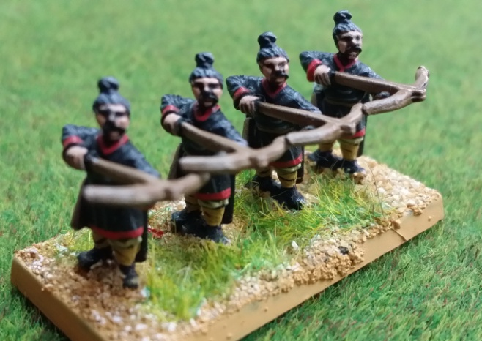
D. Crossbowmen
The distinguishing feature of the Qin army is hair tied into a bun.
A photo taken in the Mausoleum of the First Qin Emperor,
Exhibition 1: Kneeling Archer
Triangular bronze arrowheads are the distinct features of the Qin crossbowmen. The weapons can decrease air friction and increase both the firing range and penetrative power.
Armour (upper body)
Gown
Shorts
The crossbow was a new weapon in the Warring States period and crossbowmen were a special force in the Qin army. Their importance in the army was shown by the leather armour that protected their upper bodies and shoulders and this increased the combat ability of the army. As the use of crossbows made defence easier, both Qin and Zhao armies at Changping dared not to attack hastily.

Slide 18
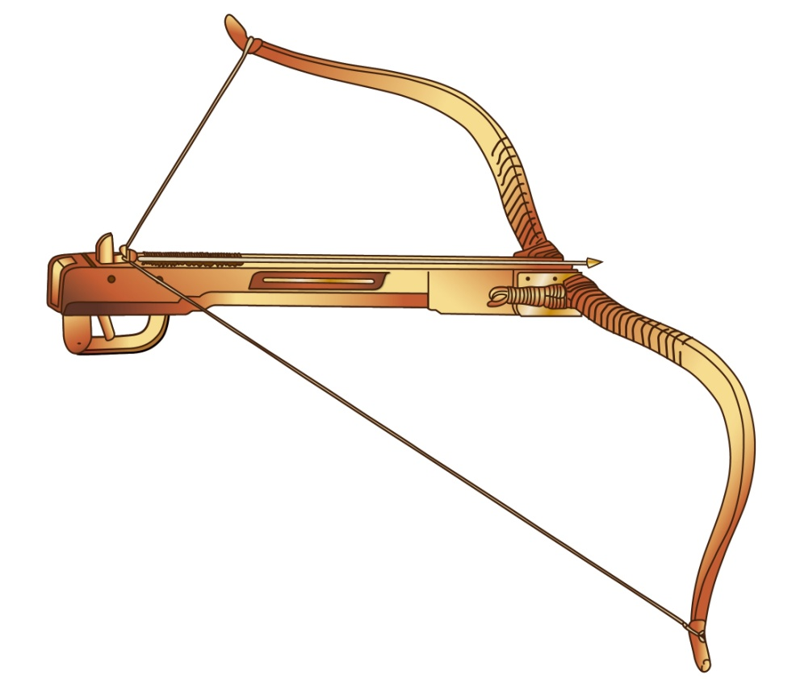
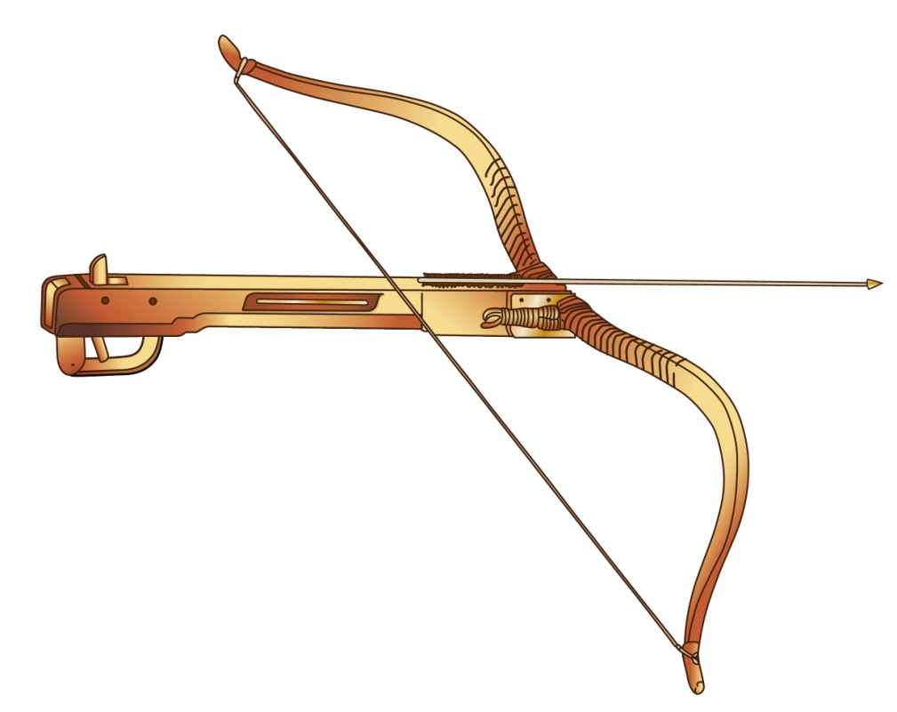
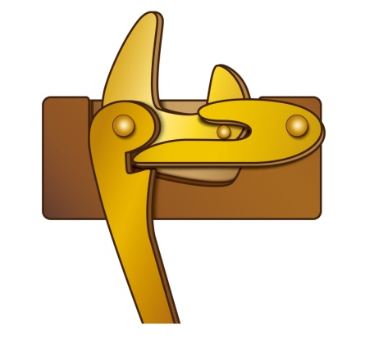
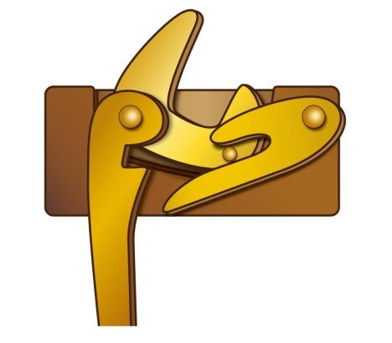
E. Warring States New Weapons: Crossbow
Arrow armed on the crossbow
Pulling the trigger releases and shoots the arrow
Source: Tushuo Zhongguo Wuqi Jicheng (An Illustrated Guide to Chinese Weapons), p.59
Quiz
Which is more powerful, crossbow or bow?
Crossbow is far more powerful than bow. Please make reference to The Majesty of All Under Heaven - The Eternal Realm of China's First Emperor, or visit the online exhibition of the Hong Kong Museum of History: http://hk.history.museum/web_1006/

Slide 19
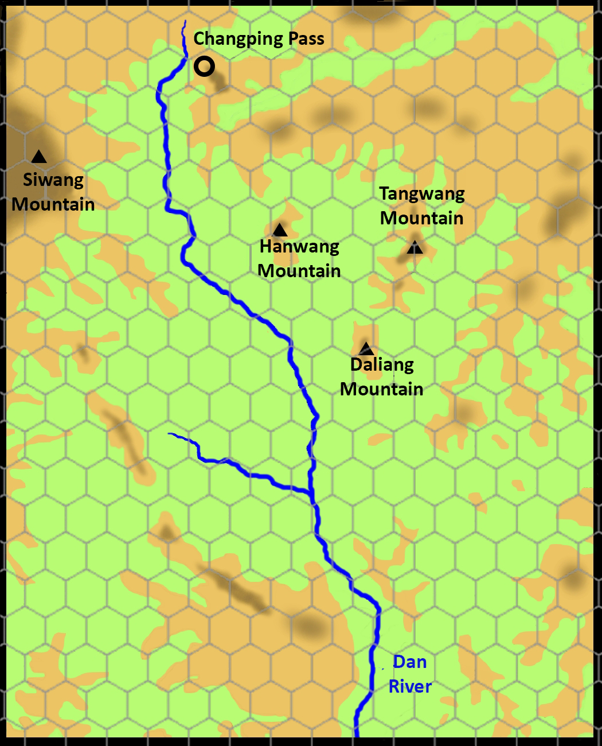
IV. The Course of the Battle of Changping
In 261BC, the Qin state sent Wang He to lead soldiers to Shangdang county. The Zhao state sent Lian Po to lead 200,000 soldiers to rescue the county.
Before the arrival of the army of Lian Po at the front line, Shangdang county had already been taken by the Qin army. Lian Po took over an unfavourable battle for the Han state and the army of Lian Po retreated to the east bank of the Dan River (丹水).

Slide 20
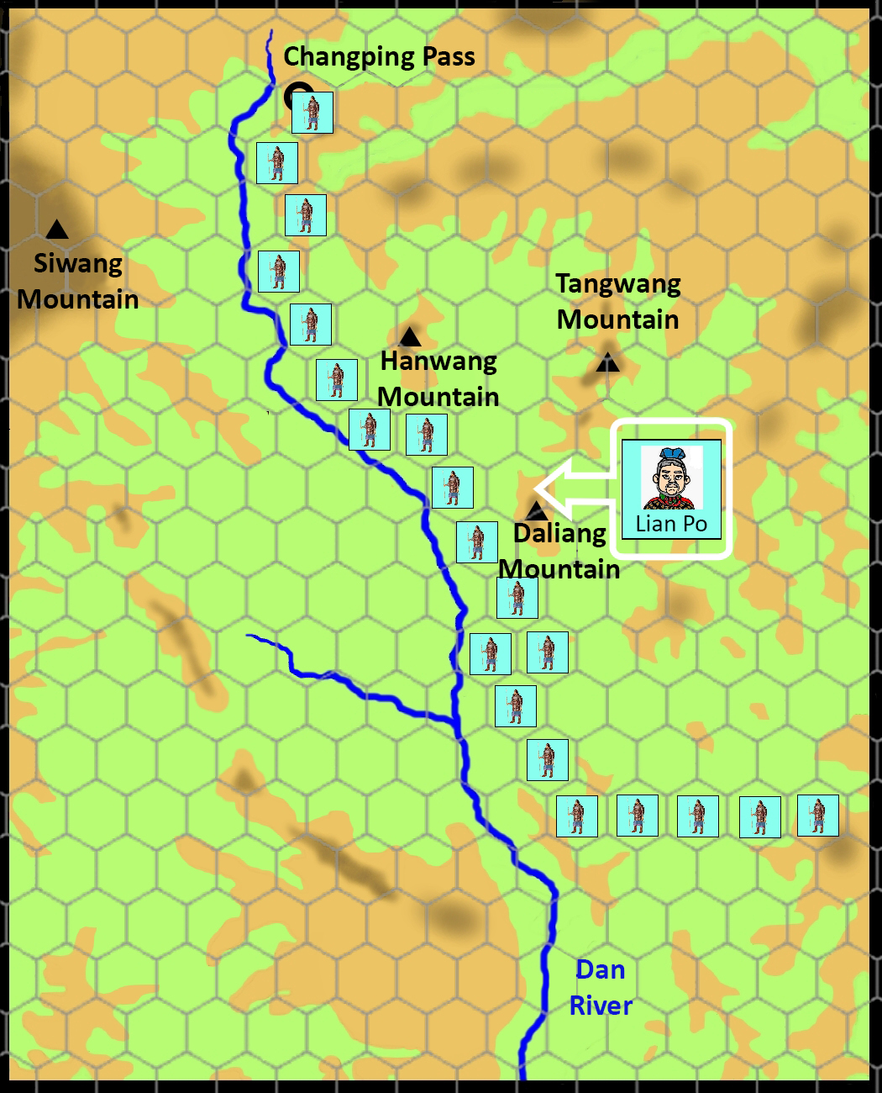
IV. The Course of the Battle of Changping
In 261BC, the Qin state sent Wang He to lead soldiers to Shangdang county. The Zhao state sent Lian Po to lead 200,000 soldiers to rescue the county.
Lian Po led his army to attack the invaders, but to no avail. Then, he retreated to the east bank of the Dan River, and at the same time controlled the Daliang Mountain (大糧山) and the Hanwang Mountain (韓王山). From these two high points, the Zhao soldiers could clearly detect the movements of their enemies who were on the opposite bank of the Dan River.

Slide 21
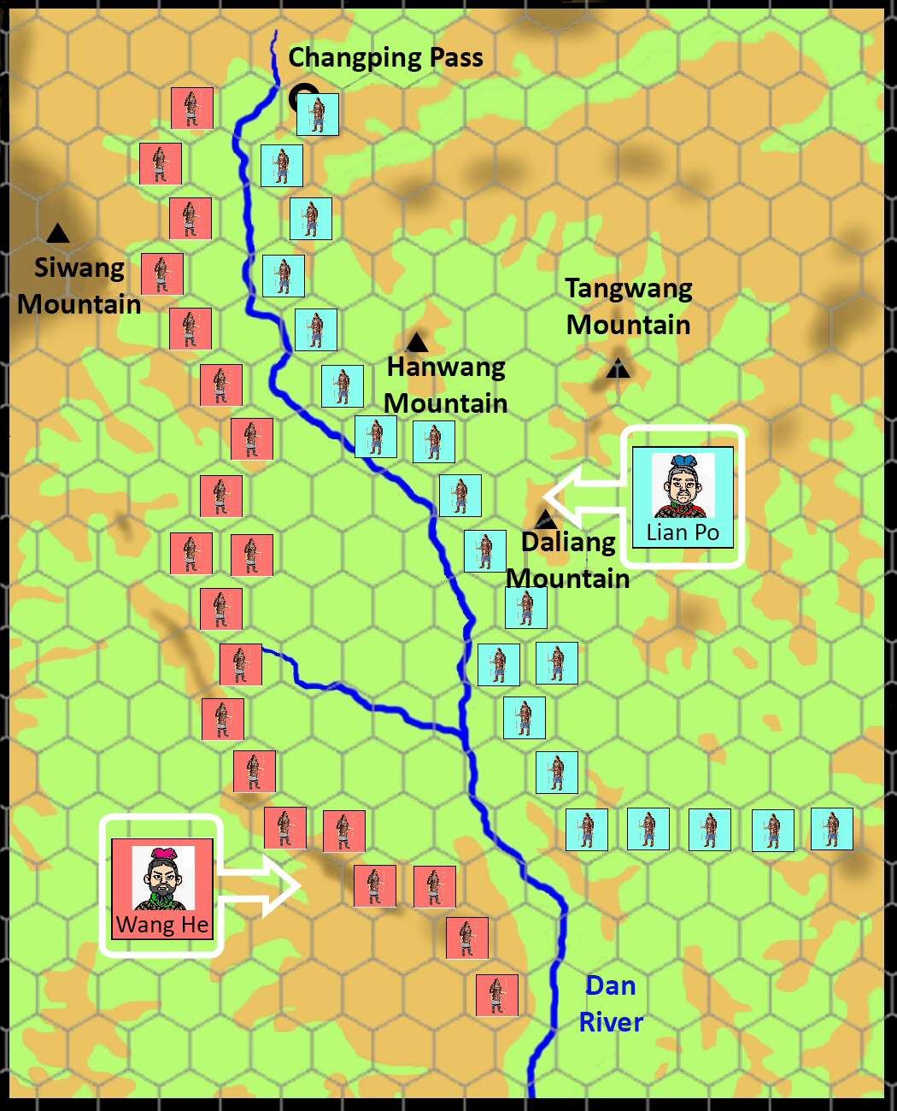
The Zhao army used the favourable terrain to defend their positions so that the Qin army, though with greater military power, had no way to win. The Qin army tried to goad the Zhao army into coming out but the Zhao army refused.
IV. The Course of the Battle of Changping
In 261BC, the Qin state sent Wang He to lead soldiers to Shangdang county. The Zhao state sent Lian Po to lead 200,000 soldiers to rescue the county.

Slide 22
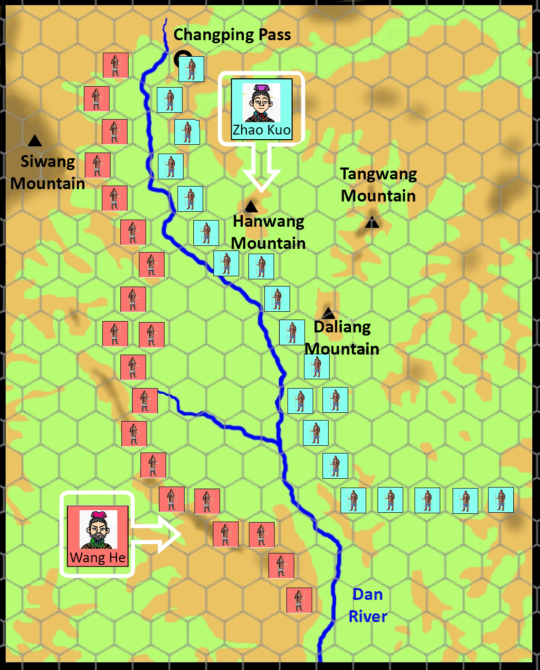
IV. The Course of the Battle of Changping
The Qin army had no way to make progress in the battlefield and so they began to spread rumours at Handan, the capital of the Zhao state. The rumours stated that “The Qin army fears Zhao Kuo only; Lian Po is too easy to handle.” The king of Zhao fell into the trap and replaced Lian Po with Zhao Kuo as the commander of the Zhao army.

Slide 23
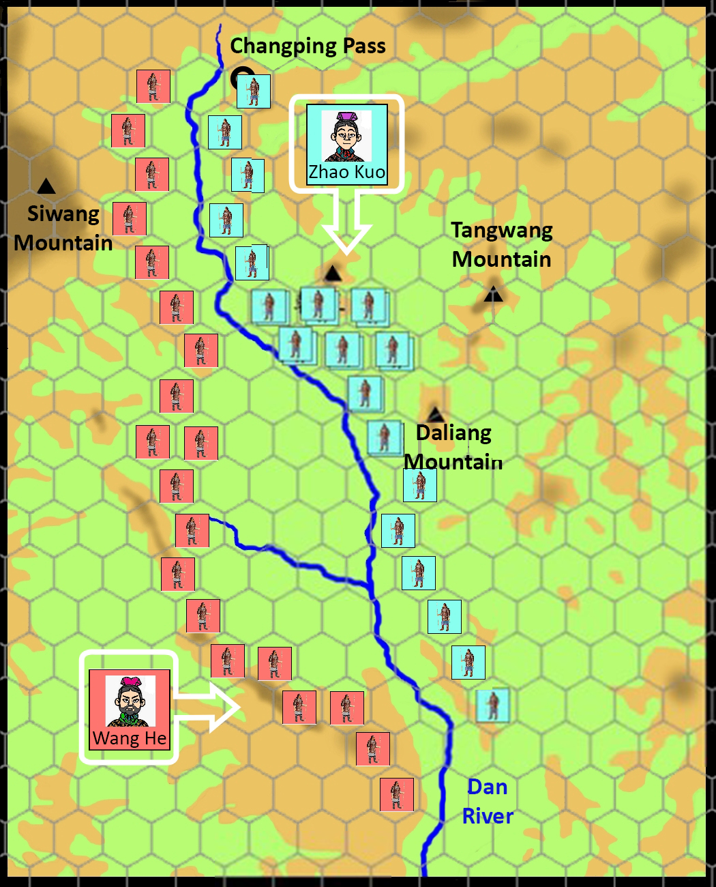
The Zhao army in Changping, counting both the frontline and reinforcements, totalled 450,000. When Zhao Kuo took over as the commander of the Zhao army, he immediately changed the original defensive plan by concentrating his forces together in order to attack the Qin army.
IV. The Course of the Battle of Changping
The Qin army had no way to make progress in the battlefield and so they began to spread rumours at Handan, the capital of the Zhao state. The rumours stated that “The Qin army fears Zhao Kuo only; Lian Po is too easy to handle.” The king of Zhao fell into the trap and replaced Lian Po with Zhao Kuo as the commander of the Zhao army.

Slide 24
IV. The Course of the Battle of Changping
The Qin army had no way to make progress in the battlefield and so they began to spread rumours at Handan, the capital of the Zhao state. The rumours stated that “The Qin army fears Zhao Kuo only; Lian Po is too easy to handle.” The king of Zhao fell into the trap and replaced Lian Po with Zhao Kuo as the commander of the Zhao army.
The Qin state heard that Lian Po had been replaced and secretly sent Bai Qi, one of the famous generals of the Qin state, to replace Wang He to command the Qin army.

Slide 25
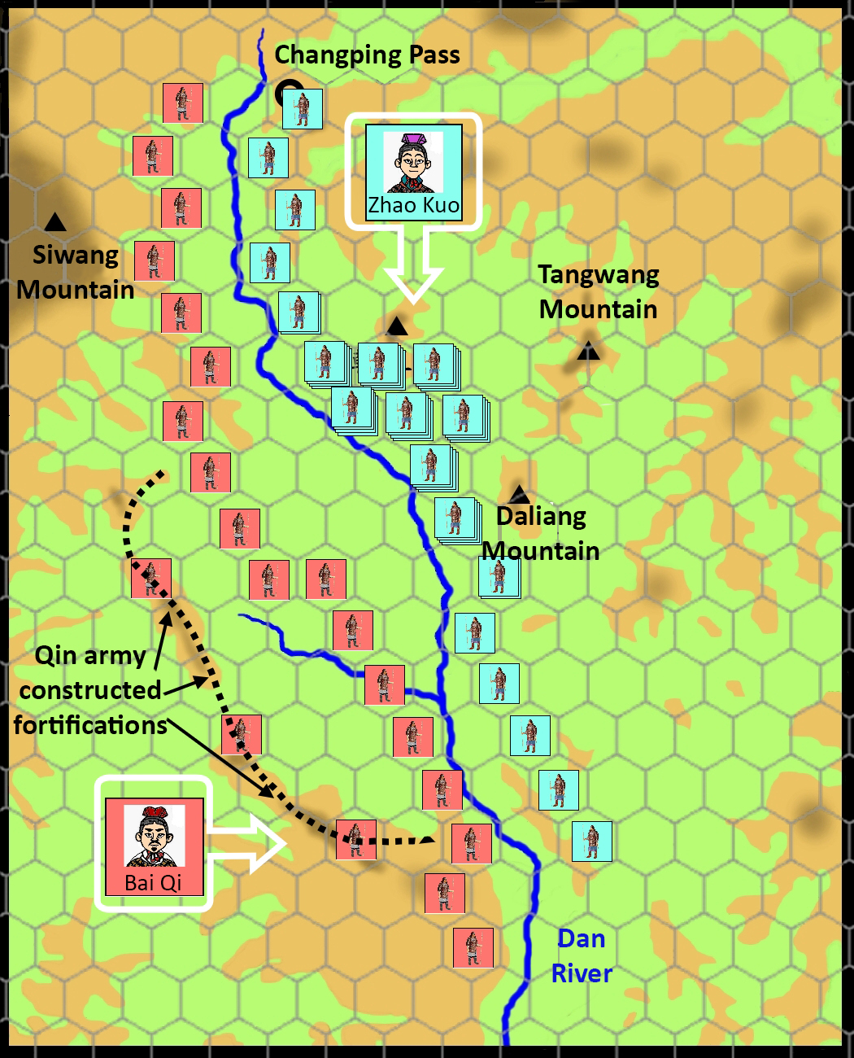
IV. The Course of the Battle of Changping
The Qin army had no way to make progress in the battlefield and so they began to spread rumours at Handan, the capital of the Zhao state. The rumours stated that “The Qin army fears Zhao Kuo only; Lian Po is too easy to handle.” The king of Zhao fell into the trap and replaced Lian Po with Zhao Kuo as the commander of the Zhao army.
Bai Qi noticed the Zhao army pulled back troops and prepared to attack. He began to construct an 18km defensive line in preparation. It was parallel with the frontline of the Zhao army, and stretched along the east bank of the Dan river.

Slide 26
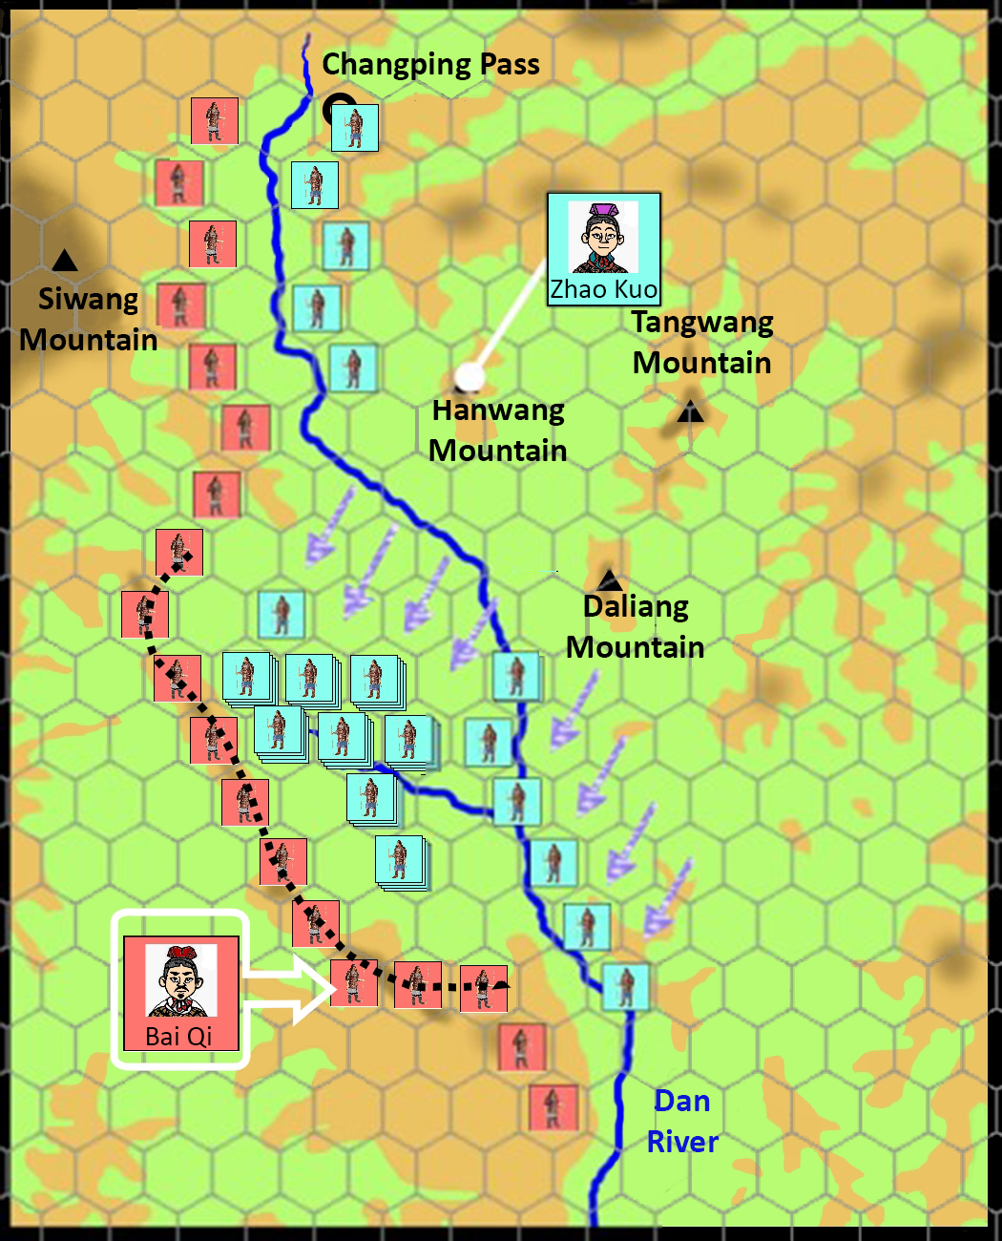
IV. The Course of the Battle of Changping
The Zhao army began to attack. They were quickly ambushed and surrounded by the Qin soldiers.
The main forces of the Zhao army began to attack the Qin army. The Qin army, following Bai Qi’s plans, pretended to retreat and the pursuing Zhao army was drawn into a pre-arranged battlefield. Zhao Kuo, who did not know about the trap, ordered his whole army to storm the Qin army’s defensive front but was unable to break through.
Quiz
Why did the Qin army need to force the Zhao army into the battle?
The Qin army’s route to replenish supplies was longer than that of the Zhao army. The Zhao army had already stored large quantities of provisions for a long time (please note that the name of the Daliang Mountain means abundant provisions). Therefore, they decided to bide their time and wait for the Qin army to run out of provisions. At that moment, the Qin army had to retreat.

Slide 27
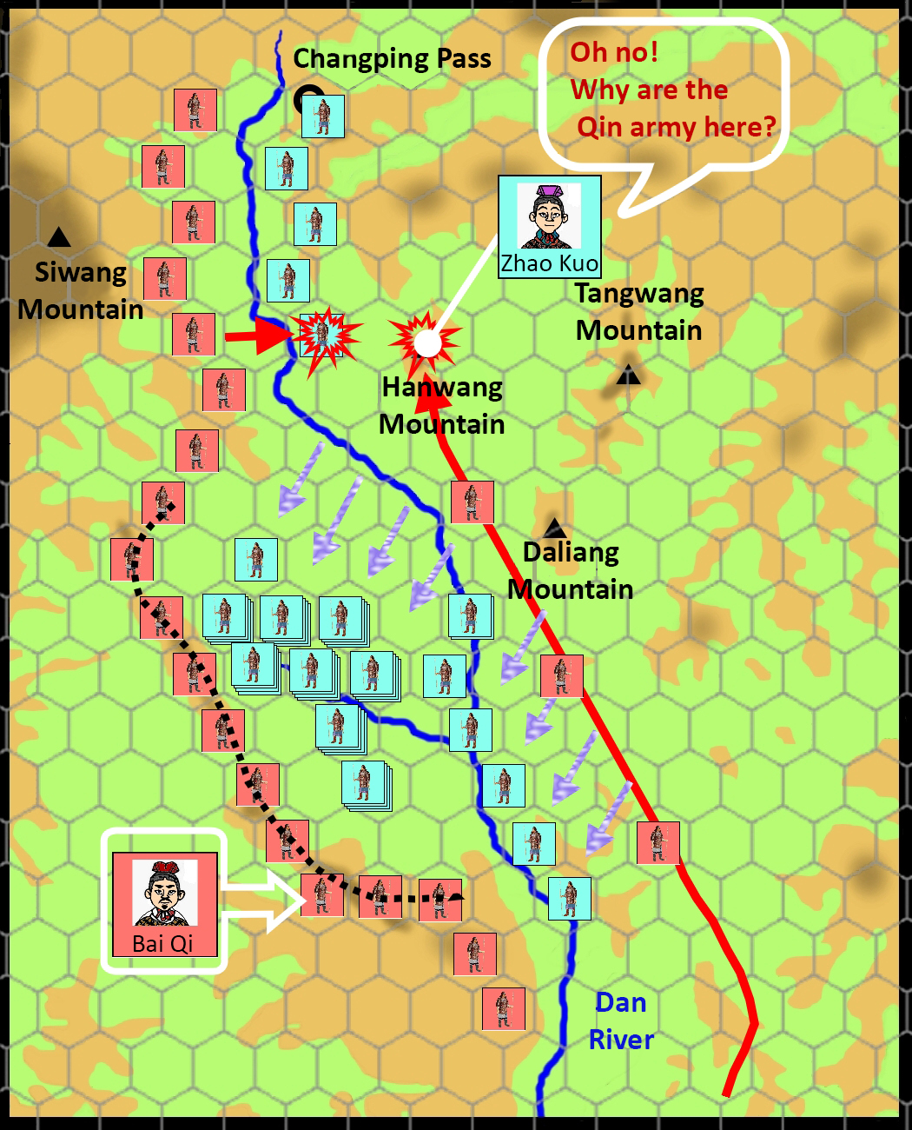
IV. The Course of the Battle of Changping
The Zhao army began to attack. They were quickly ambushed and surrounded by the Qin soldiers.
25,000 infantry
Behind the defensive line of the Qin army, 25,000 Qin infantry and 5,000 Qin cavalry rushed in to attack the Zhao army. Two weakened sides of the Zhao army were therefore quickly pushed to Hanwang Mountain, and both their paths to retreat and contact with the rear were cut. The Zhao army was split. Hence, the attacking force lost the protection of the logistics behind them. As the remaining units of the Zhao army had to protect the provisions, they could not back up the attacking force.
5,000 cavalry

Slide 28
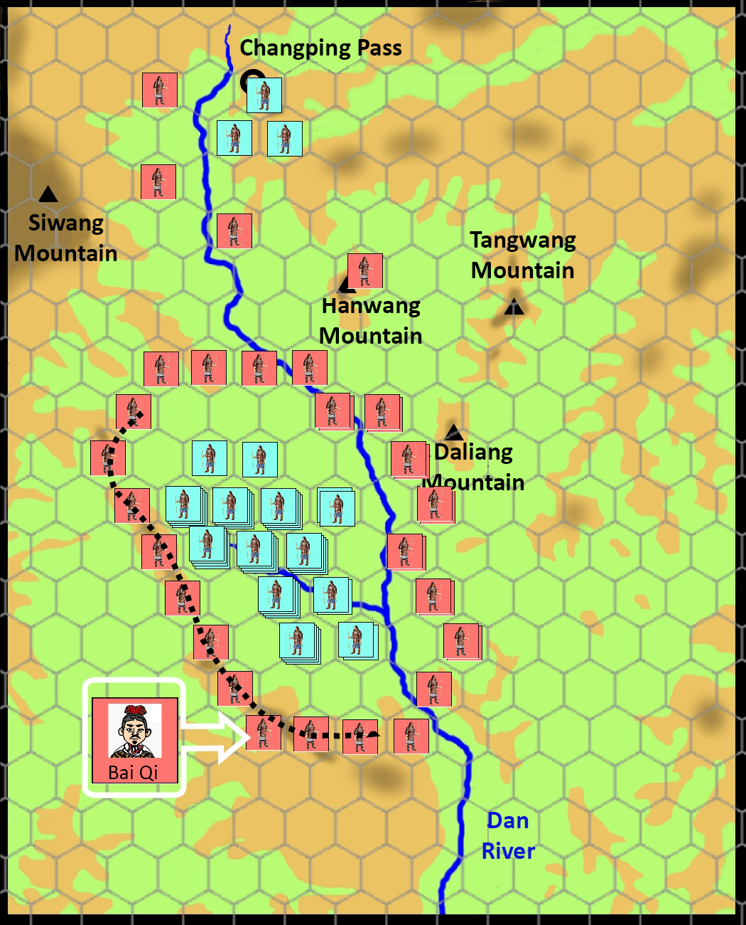
When Zhao Kuo, commander-in-chief of the Zhao army, tried to break out of the siege at Hanwang Mountain, he was shot to death by the Qin soldiers.
IV. The Course of the Battle of Changping
The operation of the Qin army in surrounding the Zhao army
Please conclude the factors that led to the defeat of the Zhao state by the Qin state.
In your opinion, who should bear the greatest responsibility for the defeat of the Zhao state?
The Qin army surrounded and trapped the main forces of the Zhao army in a well defended valley. To stop the Zhao soldiers from breaking out of the siege, the king of the Qin state sent all men aged 15 or above to assist in the battle. After 46 days of siege by the Qin army, the main forces of the Zhao army, with great casualties, hunger, and collapsed morale, was no match against the Qin army. They surrendered and the Qin army captured nearly 200,000 Zhao soldiers. Another 200,000 Zhao soldiers had already died in the battle.

Slide 29
V. Conclusion of the Battle of Changping
Time: The Battle of Changping, which lasted for three years (262-260BC), was one of the largest battles in the Chinese history.
Result: This battle ended in the victory of the Qin army and the defeat of the Zhao army. The surrendered Zhao army was all buried alive.
Numbers of Army of the Both Sides: The Qin state mobilised an army of approximately 600,000; the Zhao state mobilised an army of 450,000. After the defeat and the surrender of the Zhao army, the numbers of Zhao soldiers who were massacred reached 400,000.
Importance: After the Battle of Changping, the Qin state continued its expansion to the east. Therefore, this battle was an important milestone in the unification of the whole of China by the Qin state afterwards.

Slide 30
Appendix
History’s Unsolved Case 1
The mystery of Bai Qi’s burial of 450,000 Zhao soldiers alive
A hundred years after the Battle of Changping, Sima Qian (司馬遷 a Chinese historian, 145-86BC) wrote that Bai Qi only let the youngest 240 Zhao soldiers returned to the Zhao state while the rest were buried alive after 450,000 Zhao soldiers had surrendered. As Sima Qian’s grandfather had participated in this military campaign by the Qin side, this story was generally accepted by historians for a long time.
However, some historians have doubted the descriptions of Sima Qian. At the beginning of the battle, there were at most 450,000 Zhao soldiers. After three years of the battle, many Zhao soldiers might have died or run away. Therefore, it is impossible that there were 450,000 Zhao soldiers.
In 1995, the Shanxi Province Archaeology Research Institute carried out archaeological excavations at the ancient Changping battlefield and found skeleton pits of Zhao soldiers everywhere. However, there were not many skeletons in each pit. In one of the earliest skeleton pits (skeleton pit 1) there were only a little more than 60 skulls.

Slide 31
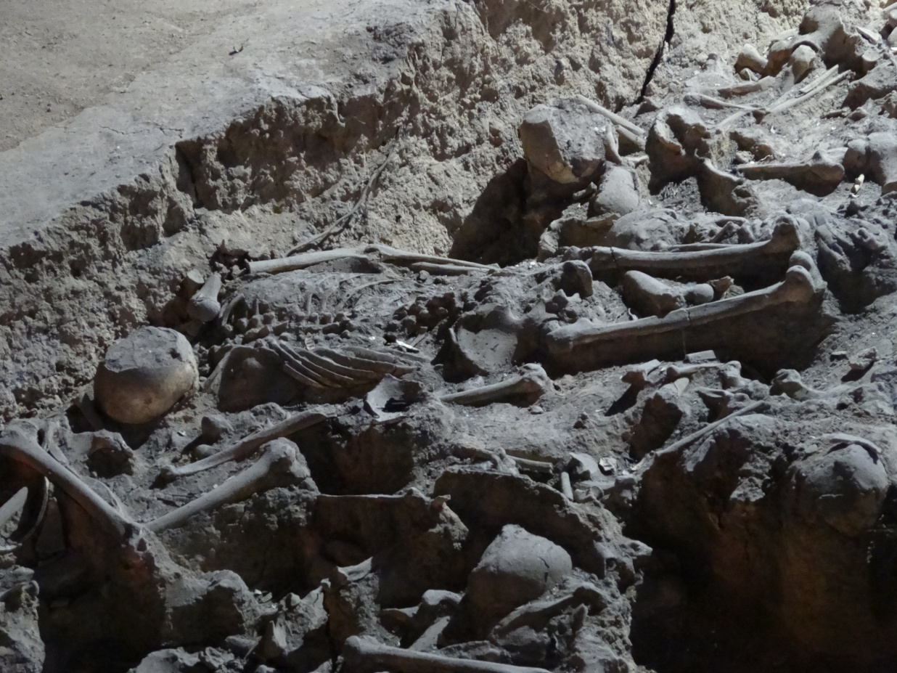
Appendix
History’s Unsolved Case 1
The mystery of Bai Qi’s burial of 450,000 Zhao soldiers alive
Skeleton Pit 1
Another important discovery was that the dead were not buried alive. According to the arrangement of the bodies and examination of injuries, most of the dead were killed before being buried. Most died from injuries of various weapons such as arrows and swords and it is very likely they died in the battle.

Slide 32
Appendix
History’s Unsolved Case 2
Zhao Kuo’s Death
According to Sima Qian (a Chinese historian, 145-86BC), Zhao soldiers were surrounded by the Qin army for “over 40 days. The soldiers were starving and Zhao Kuo broke out of the siege with a group of Zhao soldiers. Qin troops shot Zhao Kuo to death”. If this was true, Zhao Kuo died west of the Dan River where the Qin army was surrounded. However, the above descriptions are doubted by scholars in recent years.
Wang Shuxin’s edited volume Zhanguo Changping zhizhan Xinkao (New Assessments of the Battle of Changping in the Warring States Period) believes that Zhao Kuo as the commander-in-chief of the Zhao army, must have stayed at Hanwang Mountain’s base. Thus, the locations where he broke out and was killed should be at the base of Hanwang Mountain. Jin Hesheng and Xie Hongxi’s Changping Zhizhan - Zhongguo Gudai Zuida Zhanyi de Yanjiu (The Battle of Changping: Research into Ancient China’s Biggest Battle) also has a similar viewpoint.
Where was I killed?

Slide 33
Fun Fact
When the king of the Zhao state summoned the Zhao Kuo, “armchair strategist”, to Changping, both Lin Xiangru (藺相如), the prime minister of the Zhao state, and the mother of Zhao Kuo were against the decision. Zhao Kuo’s mother did not have confidence in her son and she even tried to persuade the king to change his mind. The king refused. She then requested the king that she would not be executed if Zhao Kuo was defeated in the battle. She was successful and obtained the king’s approval.
Quiz
Bai Qi buried alive all surrendered prisoners of war and became notorious because of this incident. Why do you think he needed to do this? (ans.: food, potential danger)

