Slide 1
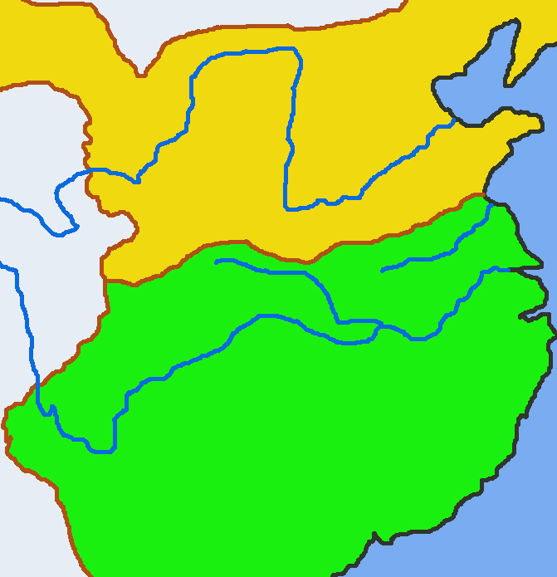
The Battle of Fei River：The Defeat of the Nomadic Cavalry
Introduction
The Battle of Fei River (淝水) was a battle in the Chinese history in which a small army defeated a much larger one. In AD383, the Former Qin (前秦) empire attempted to unify China and sent soldiers southwards to attack the Eastern Jin (東晉) empire. The two sides battled at the Fei river. The result was that the Eastern Jin’s 80,000 soldiers defeated the Former Qin’s army of 800,000. The success of the Eastern Jin at the Battle of Fei River prevented nomadic tribes from invading the south but also ensured that China remained divided.
Former Qin
Chang’an
Fei River
Jiankang
Eastern Jin

Slide 2
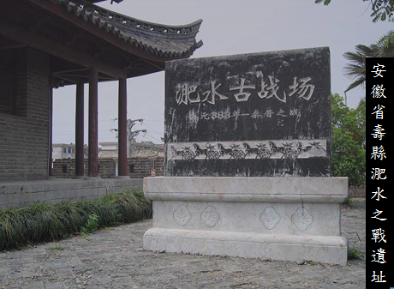
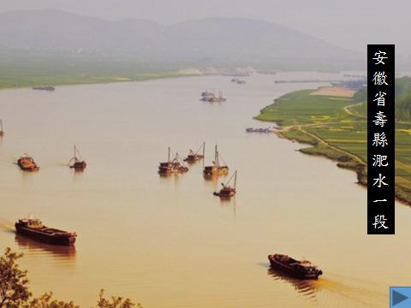
Site of the Battle of Fei River in Shou county, Anhui province
A section of the Fei River in Shou county, Anhui province

Slide 3
II. Comparison of the Former Qin and Eastern Jin Commander-in-chiefs
Quiz: Compare the information on the two commanders-in chief and fill in the information below in the blank spaces.
Former Qin | State | Eastern Jin
 | Commander-in-Chief
AD320-385 | Lifespan | AD338-385
 | Hometown
 | Ethnicity
 | Family Background
 | Achievements
 | After the Battle of Fei River
He was killed by his generals after the war.
Han (漢)
Di (nomad 氐)
Linwei, Lueyang (略陽臨渭) (Today’s Qinan, Gansu 甘肅秦安)
Yangxia, Chen commandery (陳郡陽夏) (Today’s Taikang, Henan 河南太康)
AD370: He defeated the Former Yan (前燕) empire.
AD376: He defeated the Western Liang (西涼) and Dai (代) state to unify the north.
AD383: The Battle of Fei River. He achieved an overwhelming victory against the Former Qin.
AD357: He began a coup d‘etat and killed the emperor of the Former Qin, Pu Sheng (苻生). He became the new Former Qin ruler, not under the name of emperor but as the Great Qin’s Heavenly King.
After the battle, his reputation grew. The emperor became suspicious of him and he received no rewards.
AD383: He went south to invade Eastern Jin but lost the Battle of Fei River.
He was a noble. In AD357 (aged 19), he inherited his father’s position as King of the Eastern Sea (東海王).
He was from a northern noble family and had migrated to the eastern Yangzi valley.
He was a famous prime minister for Emperor Sima Yao 司馬曜 (or Emperor Xiaowu 孝武帝).

Slide 4
Former Qin | Empire | Eastern Jin
Pu Jian (苻堅) | Commander-in-Chife | Xie An (謝安)
AD320-385 | Lifespan | AD338-385
Linwei, Lueyang (Today’s Qinan, Gansu) | Hometown | Yangxia, Chen commandery (Today’s Taikang, Henan)
Di (nomad) | Ethnicity | Han
He was a noble. In AD357 (aged 19), he inherited his father’s position as King of the Eastern Sea. | Family Background | He was from a northern noble family and had migrated to the eastern Yangzi valley.

Slide 5
Former Qin | Empire | Eastern Jin
AD357: He began a coup d'etat and killed the emperor of the Former Qin, Pu Sheng. He became the new Former Qin ruler, not under the name of emperor but as the Great Qin’s Heavenly King. AD370: He defeated the Former Yan empire. AD376: He defeated the Western Liang and Dai state to unify the north. AD383: He went south to invade Eastern Jin but lost the Battle of Fei River. | Achievements | He was a famous prime minister for Emperor Sima Yao (or Emperor Xiaowu). AD383: The Battle of Fei River. He achieved an overwhelming victory against the Former Qin.
He was killed by his generals after the war. | After the Battle of Fei River | After the battle, his reputation grew. The emperor became suspicious of him and he received no rewards.

Slide 6
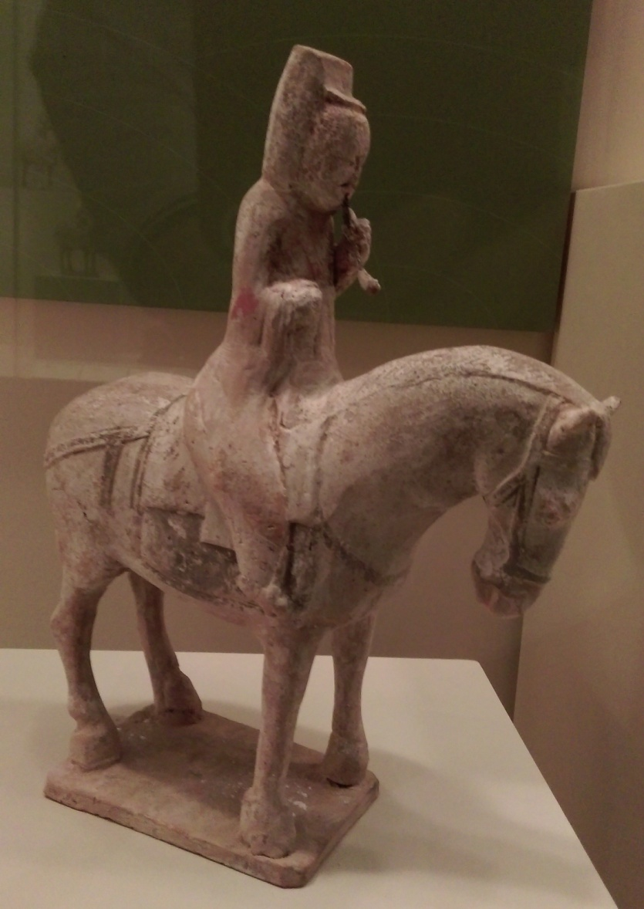
III. Cavalry Developments in the Period of the Battle of Fei River
Cavalry Developments in the Fourth Century
The image on the right is from approximately the fourth century and shows a member of the Northern civil service. His two legs are on stirrups. His right hand holds the reins so that he can control the horse easily.
Photo from the Hong Kong Museum of History’s “Hanwu Shengshi” (The Rise of the Celestial Empire) exhibition. You may browse the exhibition online: http://www.lcsd.gov.hk/CE/Museum/History/han_empire/

Slide 7
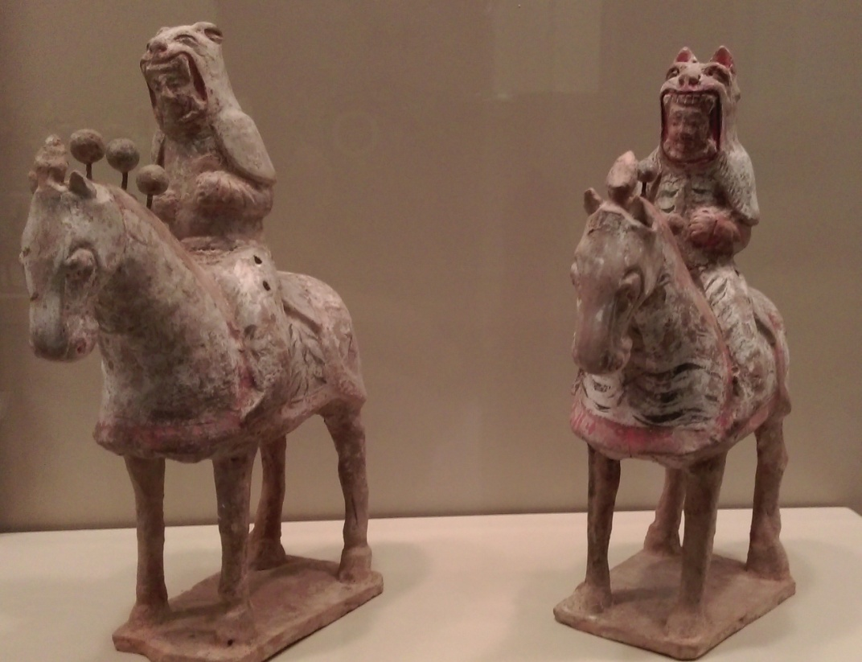
These are the heavy cavalry pottery figures from the Northern Wei (北魏) empire. The warriors wear tiger-head shaped helmets. The horses wear armours as well. Even though the Northern Wei came a little later than the Former Qin, this type of armour was similar to that used in the Battle of Fei River by the Former Qin’s elite cavalry. (Photo from the Hong Kong Museum of History’s “The Rise of the Celestial Empire” exhibition)
Quiz: After the invention of stirrups, how did the role of horses on the battlefield change? What impact did soldiers riding horses in the battles have?
The invention of stirrups on battles had a far-reaching impact. Previously, horses were mainly used to send soldiers quickly to and from the battles and then soldiers would dismount to shoot arrows or fight. The introduction of stirrups allowed horsemen to use their legs to control their horses and at the same time to stand, shoot arrows and hold pikes while sprinting forwards at the enemy. This enormously strengthened the battle capabilities of cavalry.

Slide 8
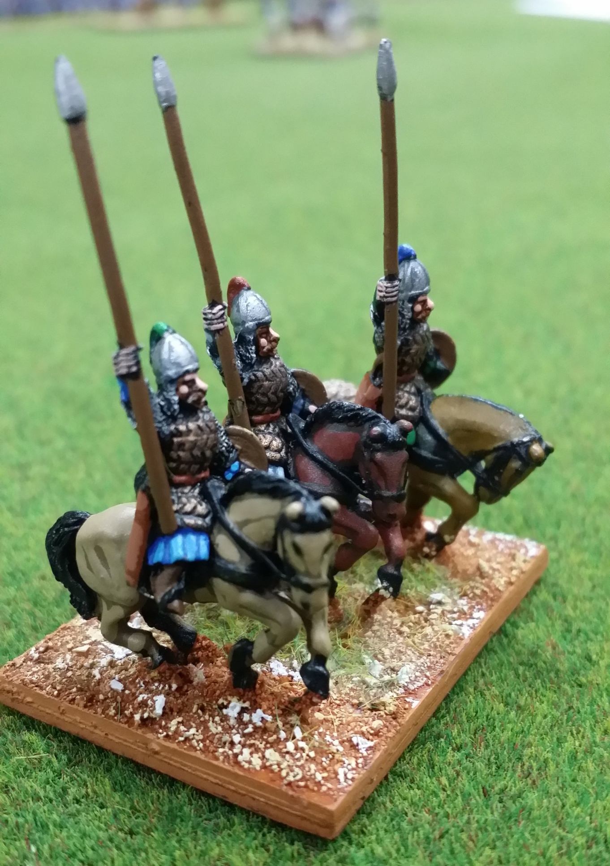
Former Qin cavalry
After the invention of stirrups, horsemen could ride and shoot at the same time. Therefore the arrow pouch became a necessary equipment for the cavalry.

Slide 9
IV. Former Qin and Eastern Jin’s Respective Plans:
Pu Jian’s Plan
Total of 880,000. However, please note that these numbers were from Pu Jian’s early planning when the local manpower available was not yet confirmed. In reality, the numbers successfully recruited and rushed to the frontline were not more than a quarter of this number.
Nomadic Soldiers
Leader: Pu Rong (苻融)
Zhang Hao (張蠔)
Pu Fang (苻方)
Liang Cheng (梁成)
Murong Wei (慕容暐)
Murong Chui (慕容垂)
Types of Soldiers: Cavalry, infantry
Source of Soldiers: Private armies of the above mentioned leaders
Targeted Recruitment Numbers: 250,000
Elite Guard
Leader: Zhao Shengzhi (趙盛之)
Types of Soldiers: Cavalry
Source of Soldiers: Nobility
Targeted Recruitment Numbers: 30,000
Local Army
Types of Soldiers: Infantry
Source of Soldiers: forcefully recruited
Targeted Recruitment Numbers : 600,000
Xie An’s Plan
Total of 185,000. Even though this was an exaggerated number, it should be comparable to real numbers.
Jiangsu and Anhui Defensive Perimeter: Beifu army
Leader: Xie Xuan (謝玄)
Xie Yan (謝琰)
Types of Soldiers: Cavalry, infantry
Source of Soldiers: Xie Shi of Chen county’s privately recruited army
Targeted Recruitment Numbers : 80,000
Navy
Leader: Hu Bin (胡杉)
Targeted Recruitment Numbers : 5,000
Jingzhou Defensive Line: Private Units
Leader: Huan Chong (桓沖)
Huan Shiqian (桓石虔)
Yang Liang (楊亮)
Liu Bo (劉波)
Huan Shi Min (桓石民)
Types of Soldiers : Cavalry, infantry
Targeted Recruitment Numbers : 100,000
Quiz: Given the manpower of both sides, which side would have higher chances of winning according to your estimate? Please state your reason.

Slide 10
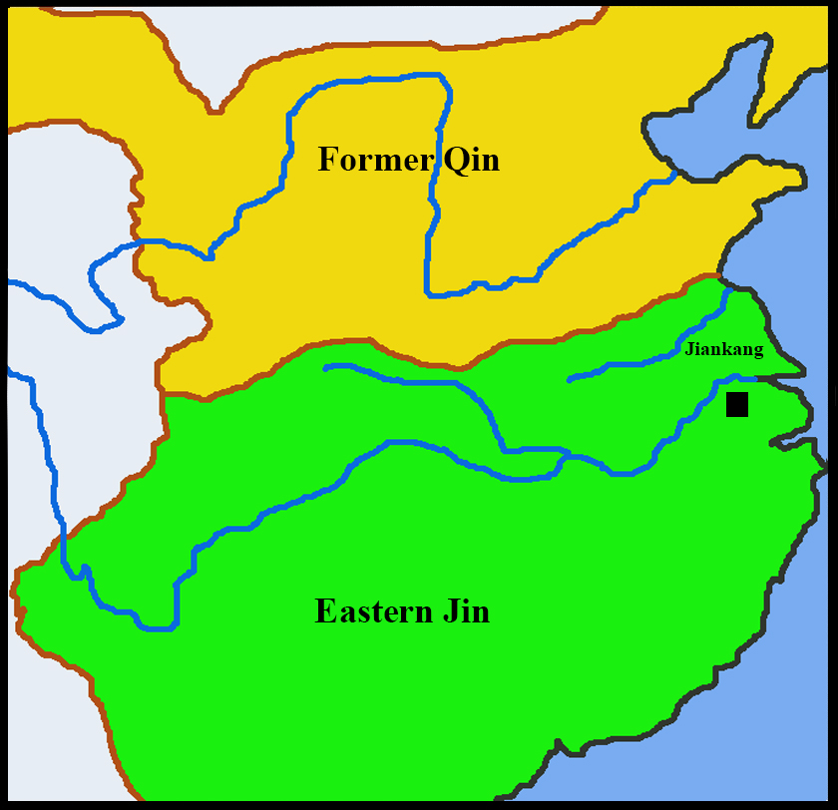
V. The Course and Result of the Battle of Fei River
In AD383, Pu Jian of the Former Qin empire planned to conquer Jiankang (建康), the capital of the Eastern Jin. He planned to invade through the following routes.
1. From north, he would follow the Huai River (淮河) southwards, crossing the Yangzi River, and then surrounding Jiankang.
Quiz: According to the information above, please draw the routes on the map.

Slide 11
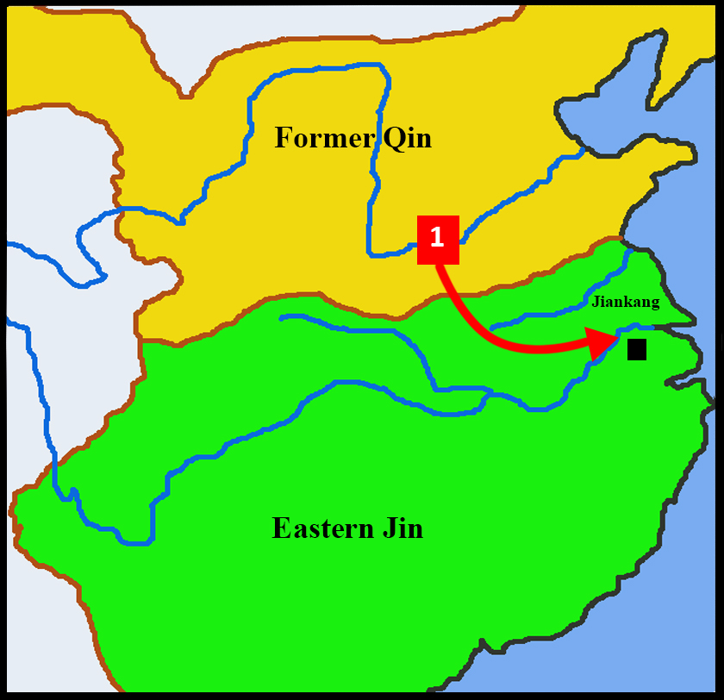
V. The Course and Result of the Battle of Fei River
In AD383, Pu Jian of the Former Qin empire planned to conquer Jiankang, the capital of the Eastern Jin. He planned to invade through the following routes.
1. From north, he would follow the Huai River southwards, crossing the Yangzi River, and then surrounding Jiankang.

Slide 12
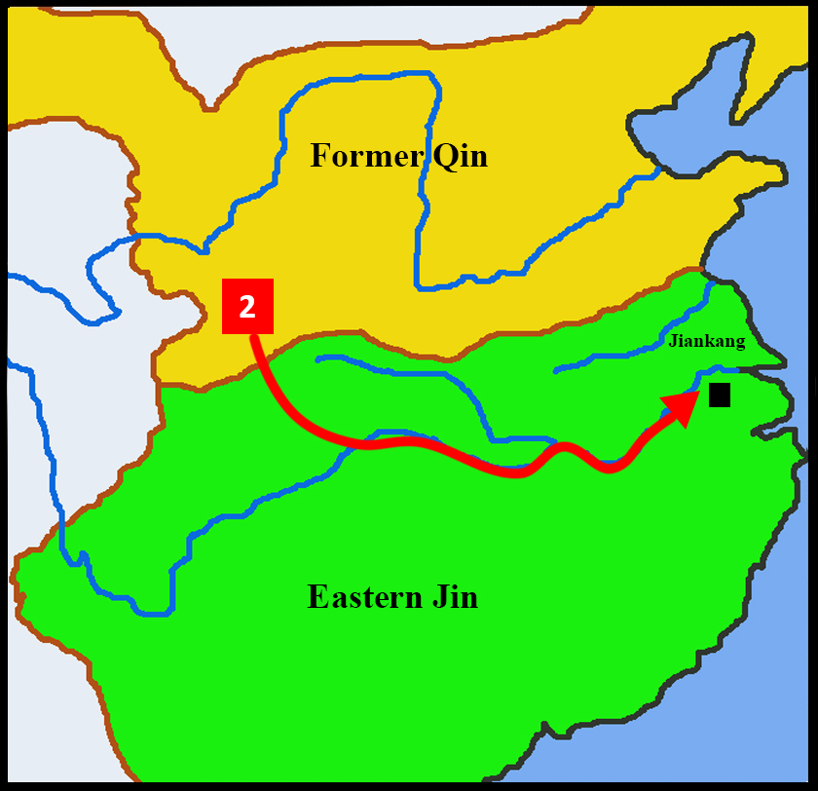
V. The Course and Result of the Battle of Fei River
In AD383, Pu Jian of the Former Qin empire planned to conquer Jiankang, the capital of the Eastern Jin. He planned to invade through the following routes.
1. From north, he would follow the Huai River southwards, crossing the Yangzi River, and then surrounding Jiankang, or,
2. From the upper Yangzi river, he would travel east along the river to attack Jiankang.

Slide 13
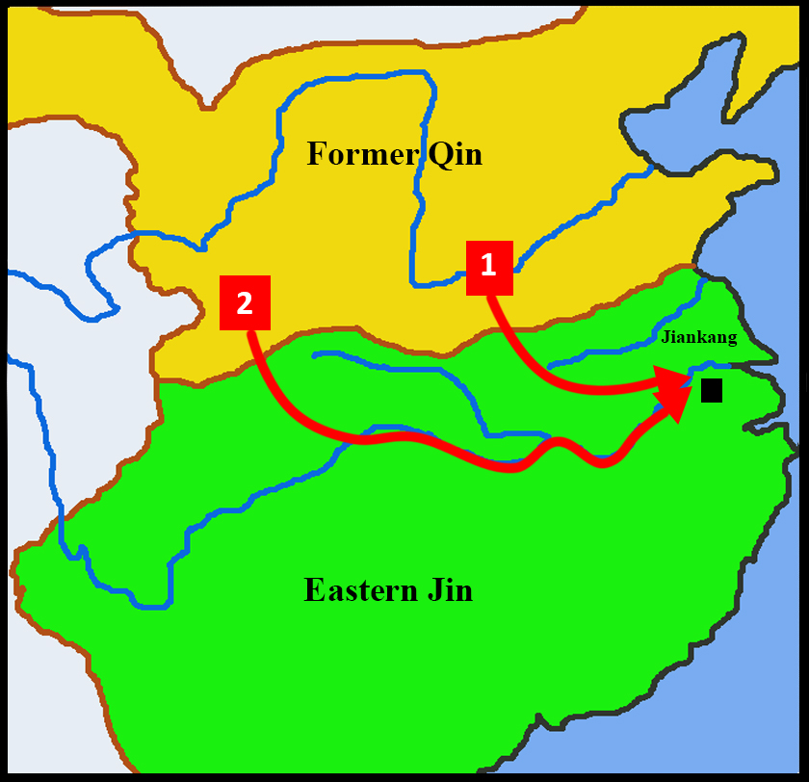
V. The Course and Result of the Battle of Fei River
In AD383, Pu Jian of the Former Qin empire planned to conquer Jiankang, the capital of the Eastern Jin. He planned to invade through the following routes.
1. From north, he would follow the Huai River southwards, crossing the Yangzi River, and then surrounding Jiankang, or,
2. From the upper Yangzi river, he would travel east along the river to attack Jiankang, or
3. Both routes at the same time.

Slide 14
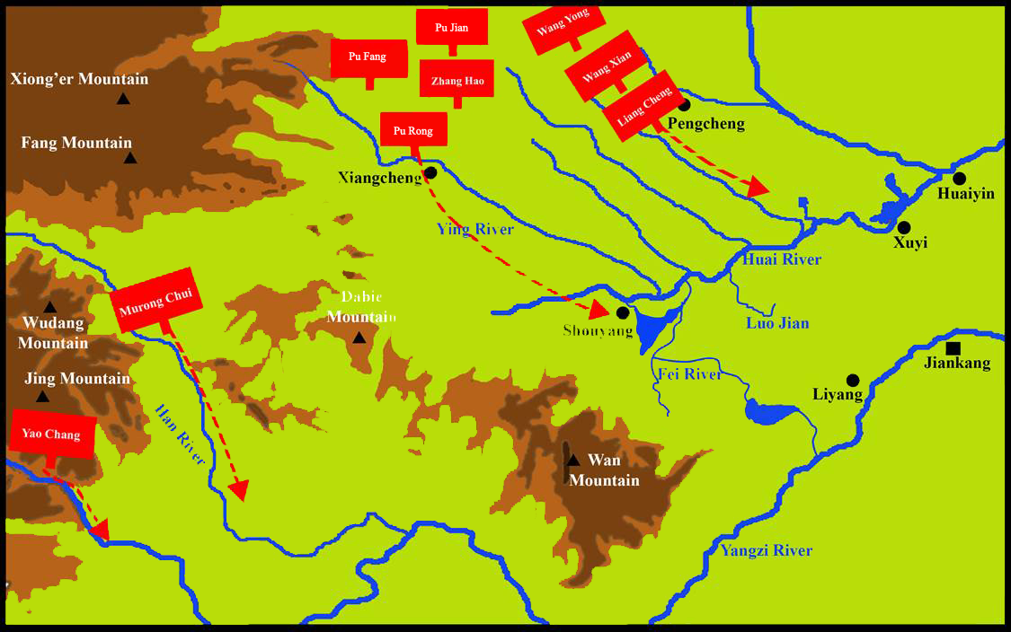
The Ninth Month of AD383: The Main Army of the Former Qin Arrived at the Border
In the ninth month of AD383, the army of the Former Qin advanced at the same time on three different routes, left, right, and centre. The main goal of the left and right armies was to stop the enemy from advancing. The centre army followed the Ying river (穎水) south as the main military force. The Former Qin had mobilized too many soldiers and as the military operation unfolded, many troops had still not yet arrived.
Right route army
Middle route army
Left route army

Slide 15
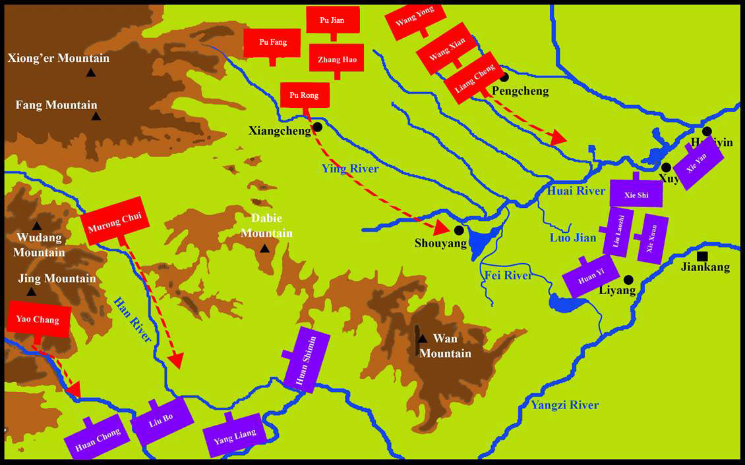
The ninth month of AD383: Former Qin main army arrived at the border
In response to the large scale invasion by the Former Qin, the Eastern Jin formed two defensive lines.
Huan’s army was the strongest and was placed in the middle of the Yangzi river, stopping the enemy from attacking Jiankang at the eastern half of the Yangzi River.

Slide 16
The ninth month of AD383: Former Qin main army arrived at the border
In response to the large scale invasion by the Former Qin, the Eastern Jin formed two defensive lines.
Xie’s Beifu army (elite soldiers) were deployed at the lower Huai River and lower Yangzi River where they set up a defensive line.

Slide 17
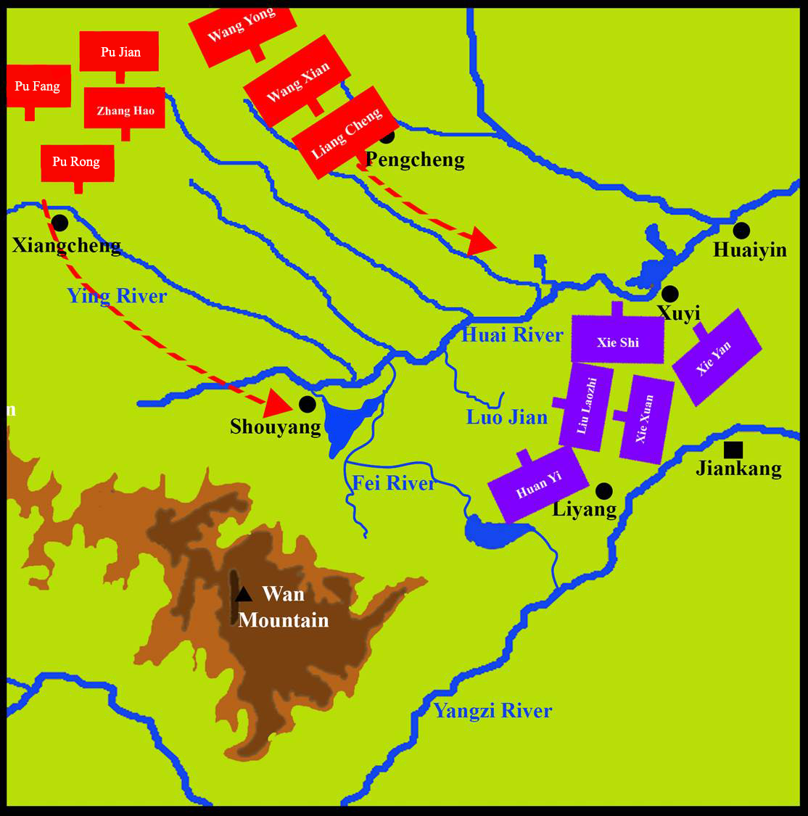
In the tenth lunar month of AD383, the middle route army of the Former Qin, the main force, went southwards along the Ying River. They attacked and occupied Shouyang (壽陽). They immediately stationed along the west bank of the Fei River.

Slide 18
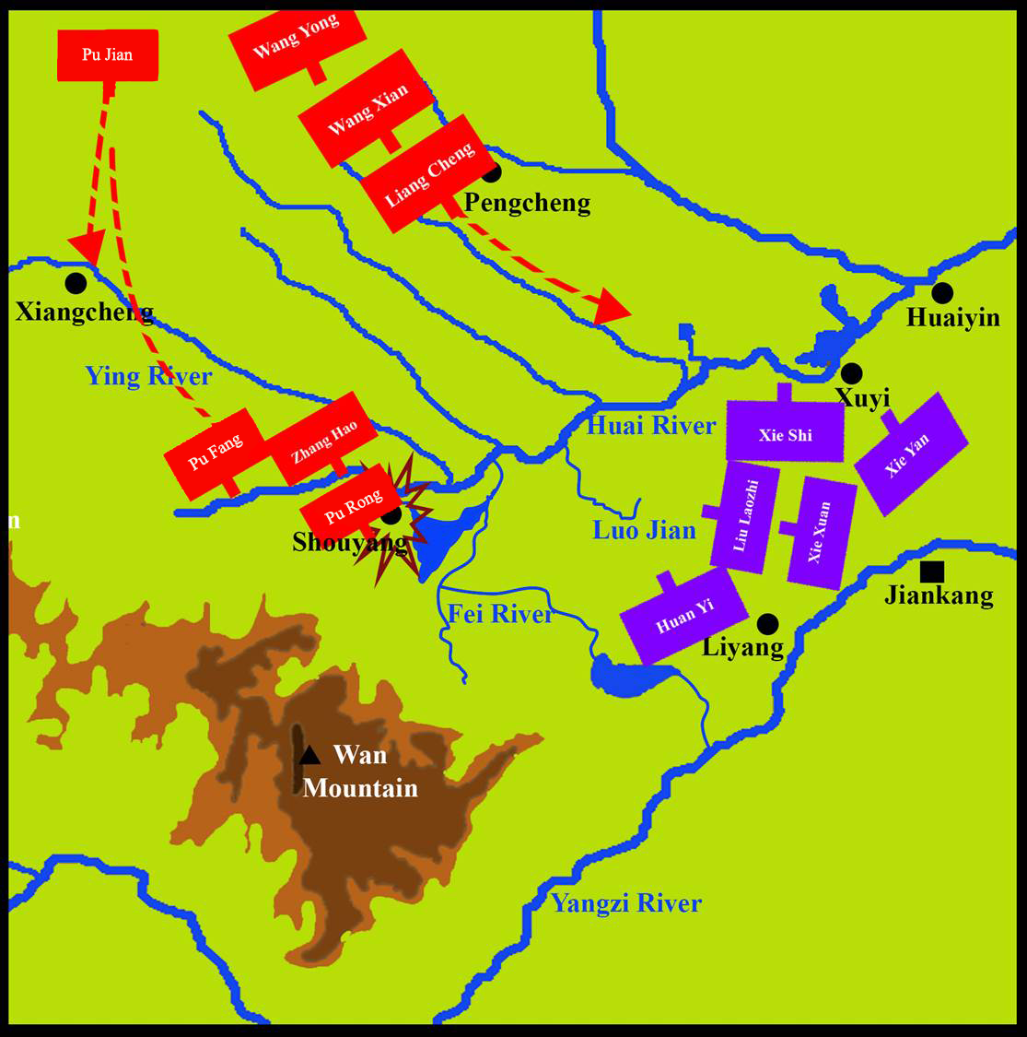
In the tenth lunar month of AD383, the middle route army of the Former Qin, the main force, went southwards along the Ying River. They attacked and occupied Shouyang. They immediately stationed along the west bank of the Fei River.

Slide 19
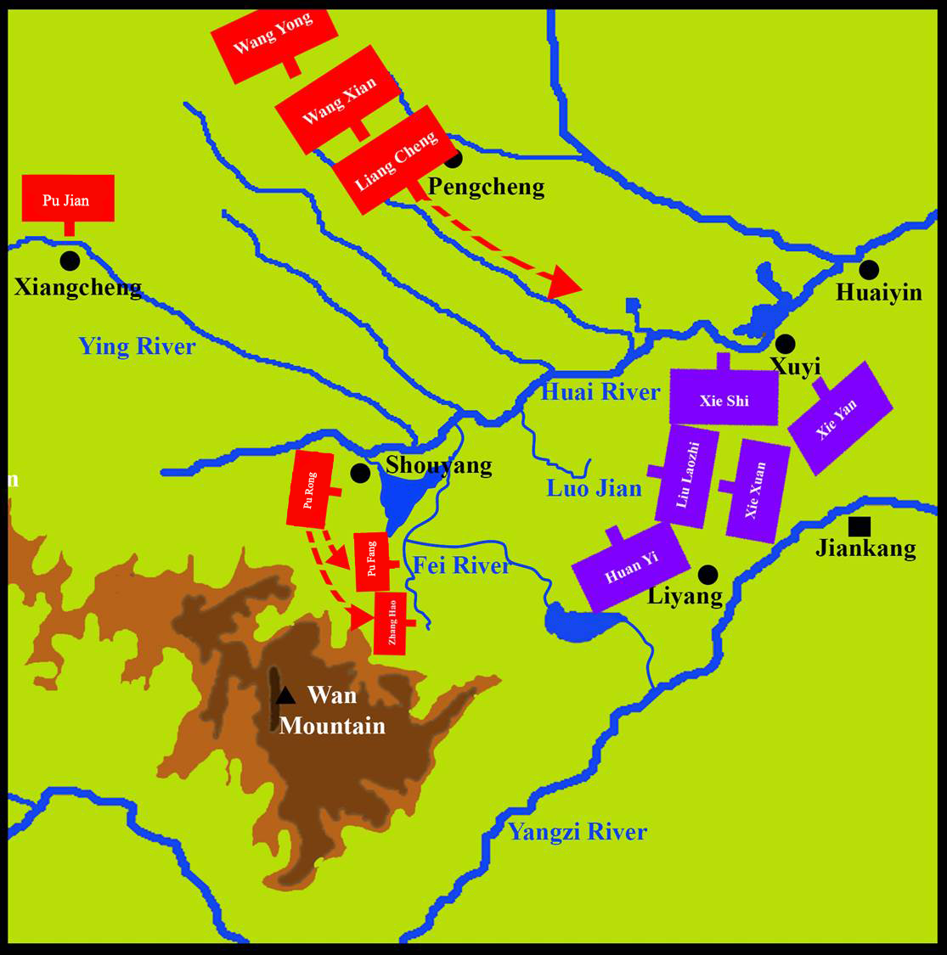
In the tenth lunar month of AD383, the middle route army of the Former Qin, the main force, went southwards along the Ying River. They attacked and occupied Shouyang. They immediately stationed along the west bank of the Fei River.

Slide 20
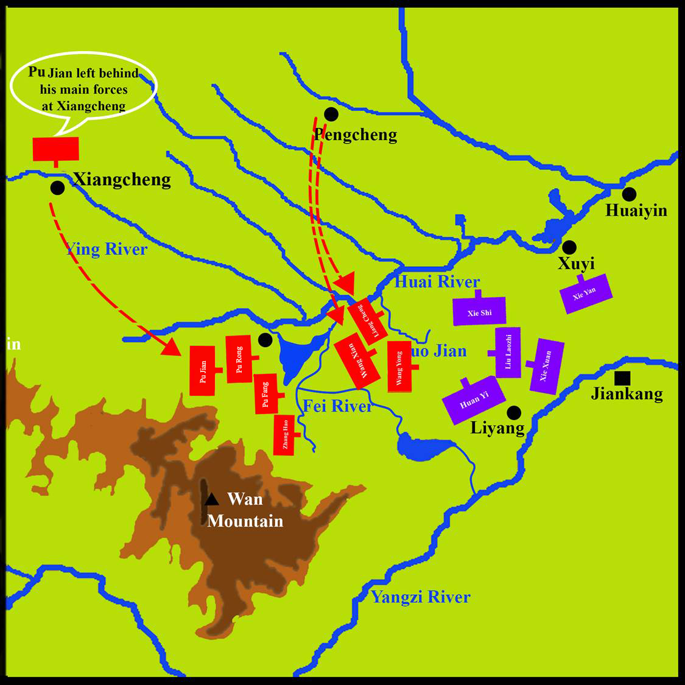
Pu Jian believed the middle route army would win and left behind his main forces at Xiangcheng (項城). He led 8,000 light cavalry to enter Shouyang. Pu Jian ordered the left route army to move soldiers to the west bank of Luo Jian (洛澗) to monitor the whole situation.
Shouyang

Slide 21
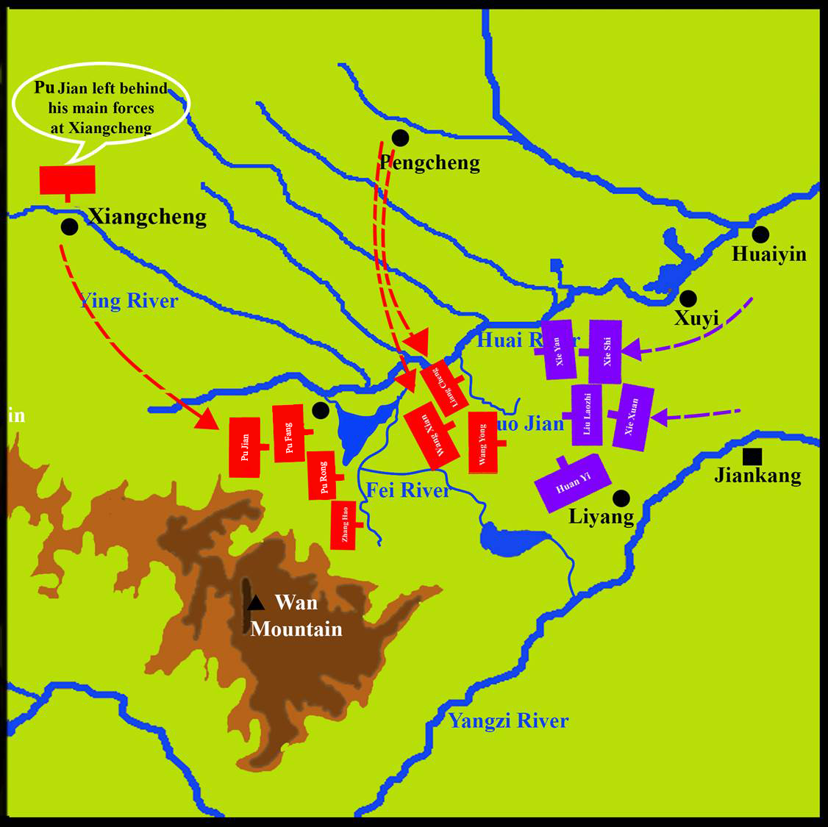
The soldiers of the Eastern Jin at Huai River saw that the left route army of the Former Qin did not advance into Huaiyin (淮陰) but instead went to Luo Jian. Therefore, the Huai River defensive line moved to Luo Jian to further bar the way. However, Xie Xuan and the other generals of the Eastern Jin feared the Former Qin. So, they stopped to defend about 25 Chinese miles or so away from Luo Jian, not daring to attack.
Shouyang

Slide 22
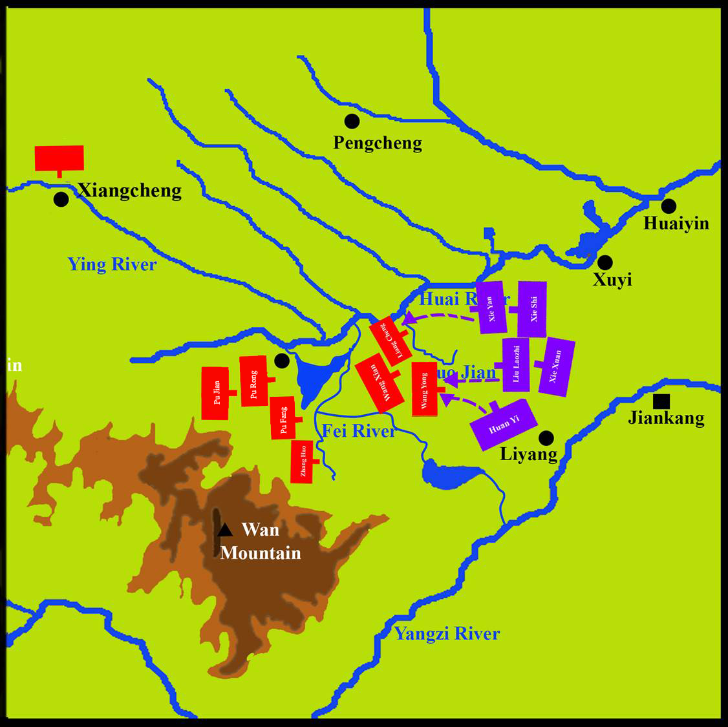
Pu Jian sent the surrendered enemy general, Zhu Xu (朱序), to advise Xie Xuan to surrender. Zhu Xu secretly told the Qin army of the situation. He recommended that they took advantage of Former Qin main forces not having finished assembling and to strike quickly. Xie Xuan and others accepted Zhu Xu’s proposal and went to the west bank of Luo Jian to confront the army of the Former Qin.
Shouyang

Slide 23
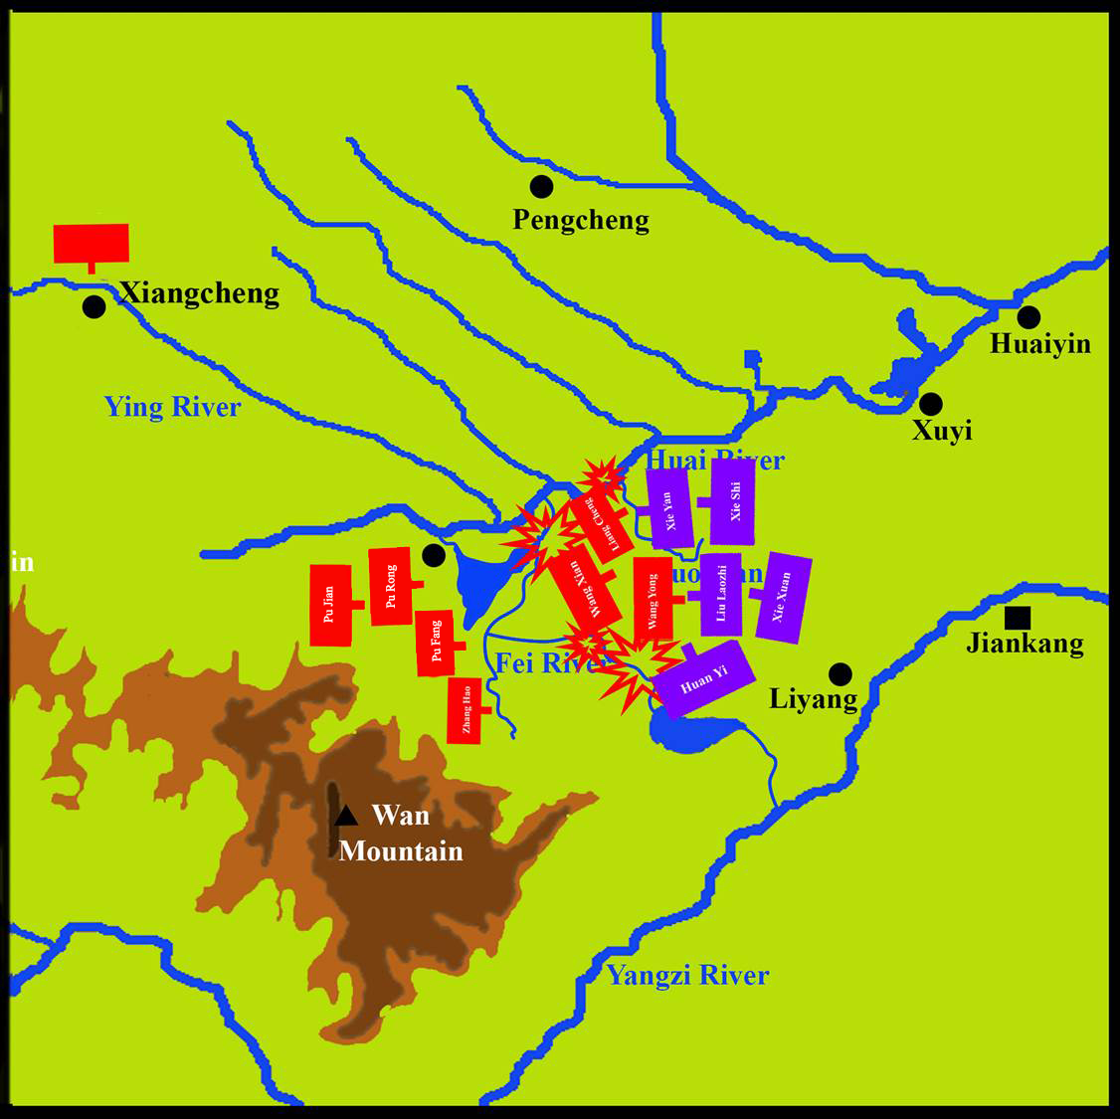
The army of the Former Qin collapsed in the battle. Captains Liang Cheng and Wang Yong (王詠) fought to death. Wang Xian surrendered.
Shouyang

Slide 24
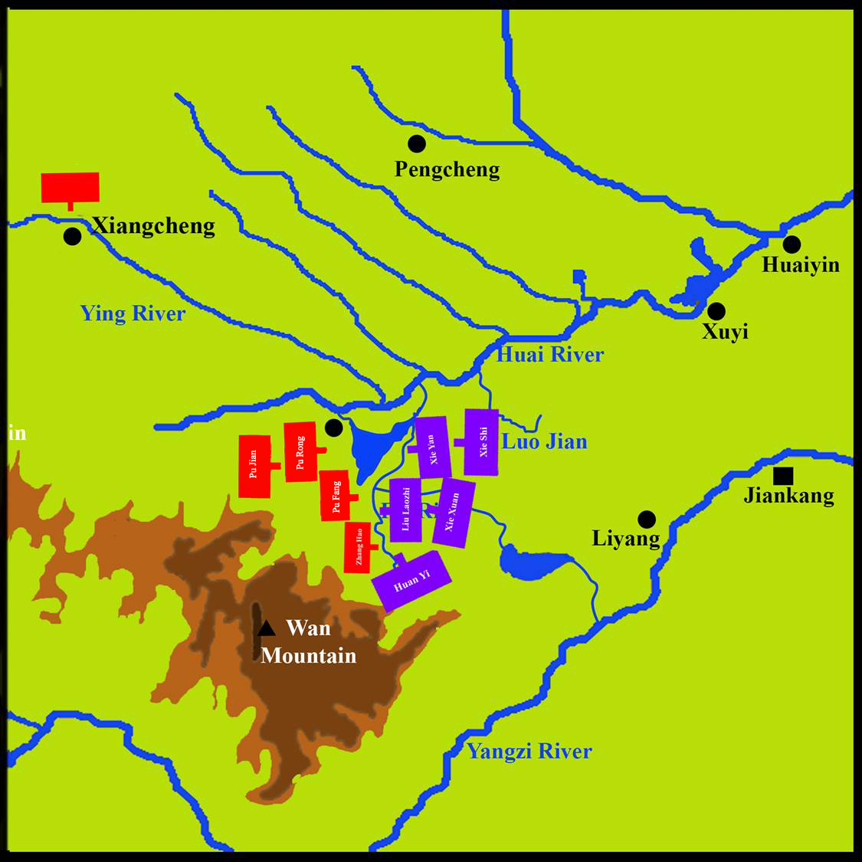
The Eastern Jin army, soon after, went to the Fei River to defend its eastern bank.
Shouyang

Slide 25
最終一戰
Xie Xuan sent an envoy to Pu Jian to make a proposal. Rather than fighting a difficult battle separated on the two shores, it was proposed that the Former Qin army retreated slightly so that the Eastern Jin army could cross the Fei River to fight with the Former Qin army. Pu Jian agreed. The Former Qin army retreated slightly and allowed space for the Eastern Jin army to cross the river.
Shouyang

Slide 26
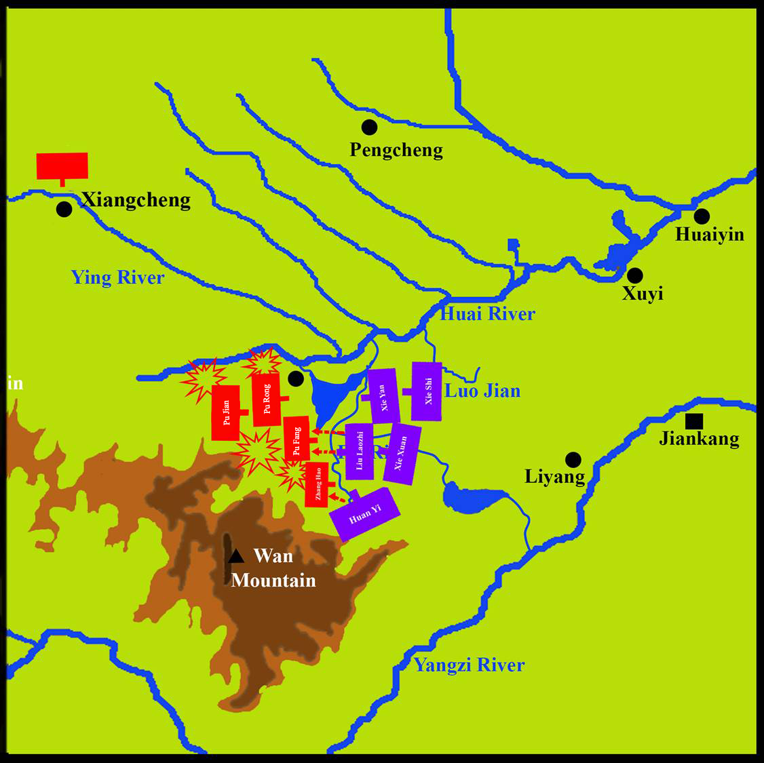
The Final Battle
When the Former Qin retreated backwards slightly, many Former Qin soldiers did not understand the situation. Zhu Xu suddenly shouted that the Former Qin had been defeated. This shocked the Former Qin soldiers into running away quickly and uncontrollably, trampling each other and countless deceased.
Shouyang

Slide 27
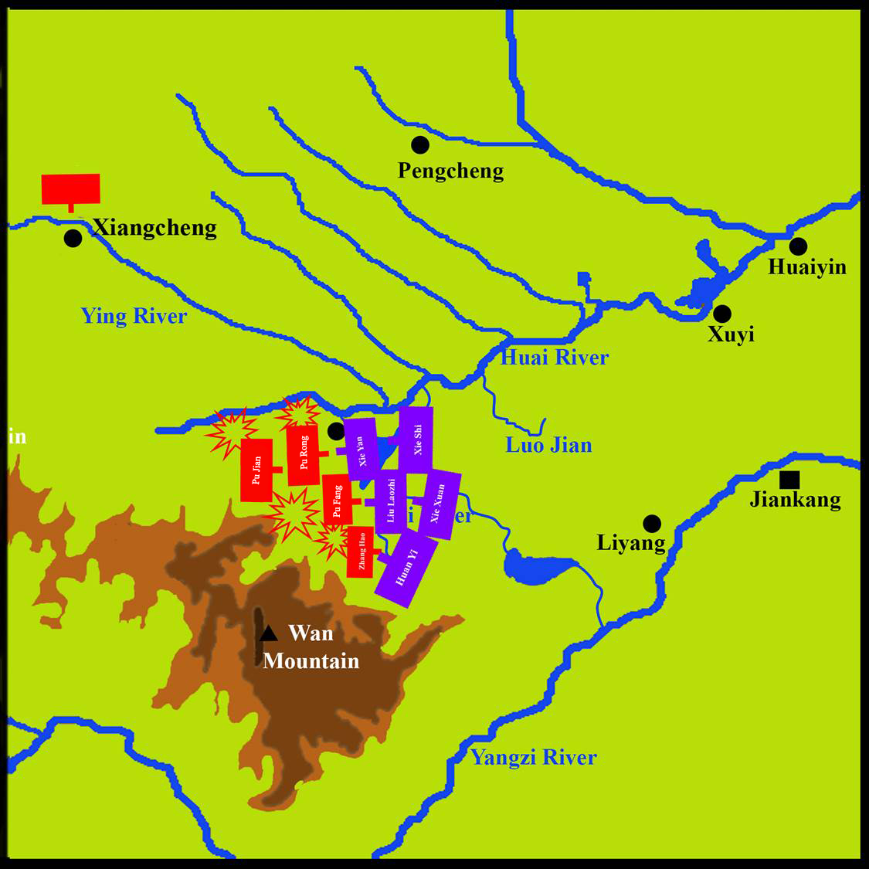
The Final Battle
When the Former Qin army got caught in the chaos, they retreated. The Eastern Jin army who had completely crossed river chased them from behind and killed them. The Former Qin army fell.
Shouyang

Slide 28
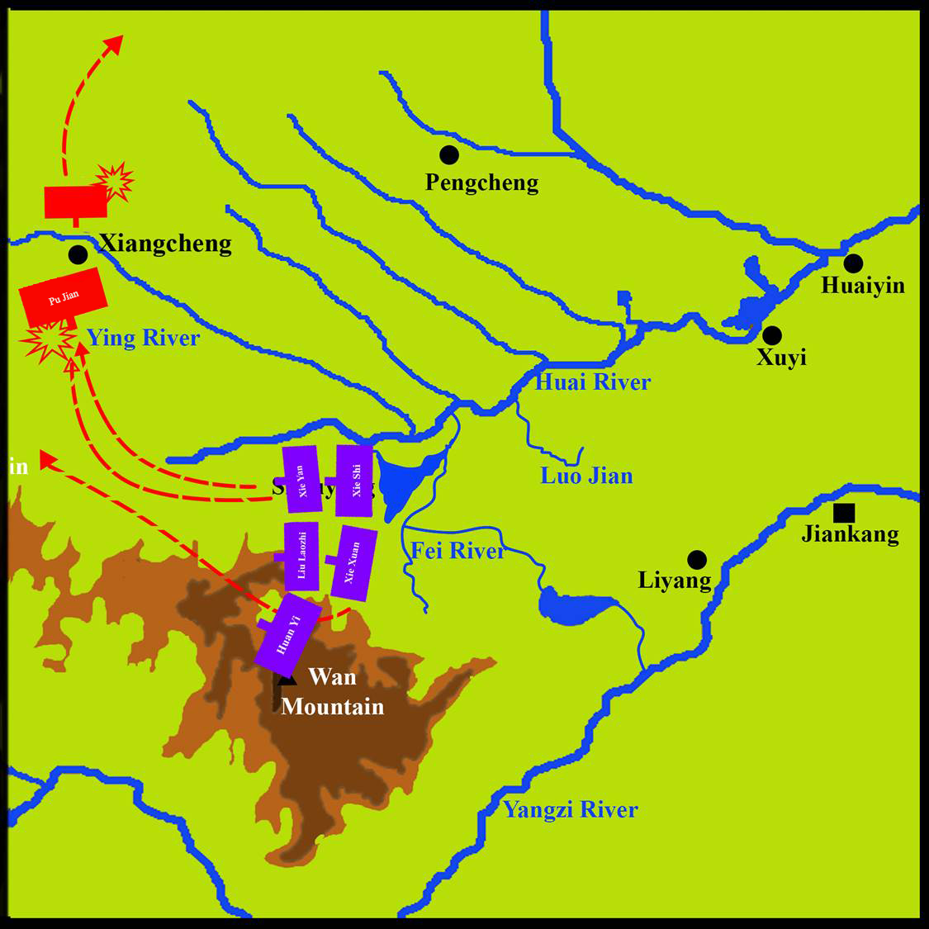
The Final Battle
Pu Jian hurriedly escaped the battlefield. The Battle of Fei River ended with the decisive victory of the Eastern Jin.

Slide 29
Quiz: What was the main cause in the Eastern Jin army’s victory? Try to conclude from the three factors of equipment, manpower and strategy.
Equipment | Former Qin army : Heavy cavalry (difficult to move)
Manpower | Former Qin army : 800,000 soldiers (most of them were poorly trained and forcefully recruited)
Strategy | Eastern Jin: Taking advantage of the Qin retreat, the Jin army quickly crossed the river and launched an attack.
WIN

