Slide 1
Field Trip for War History: Weiyuan Fort
Site of Main Importance: 1. Weiyuan Fort (威遠炮臺)
Sites of Secondary Importance: 2. The Sea Battle Museum (海戰博物館) (closed on
Tuesdays)
3. The Opium War Museum (虎門林則徐紀念館)
4. Lin Zexu Opium Destruction Pool (銷煙池)
Suggested Itinerary: one day trip, coach tour between Hong Kong and Dongguan, passing through Shenzhen Bay Port
Learning Outcome (topics suitable for student reports):
1. Manipulation of cannons
2. Understanding the Qing captain Guan Tianpei (關天培)’s preparations for the war, especially the crossfire zone between the Weiyuan Fort and the Lower Hengdang Fort designed by him. (ref.: see also the “The Battle of the Bogue” of this Teaching and Learning Aid)

Slide 2
Introduction of the Weiyuan Fort in Humen Town
The Weiyuan Fort was a coastal-defense fort in Humen, Dongguan, Guangdong province. The fort was constructed in 1835 and was in use during the Opium Wars. There were 44 cannons to defend against the British. The fort was 360 meters in length, 6.2 meters in height and 7.6 meters in width. Of all the forts in Humen, this was the biggest. This was also the headquarters of Guan Tianpei, the Superintendent of Naval Forces, during the First Opium War. (Ref.: Wang Chaobin, “Zhongguo haijiang paitai tuzhi”, Ji’nan: Shandong huabao chubanshe, 2008, p. 145; see also Wikipedia: Weiyuan Fort)

Slide 3
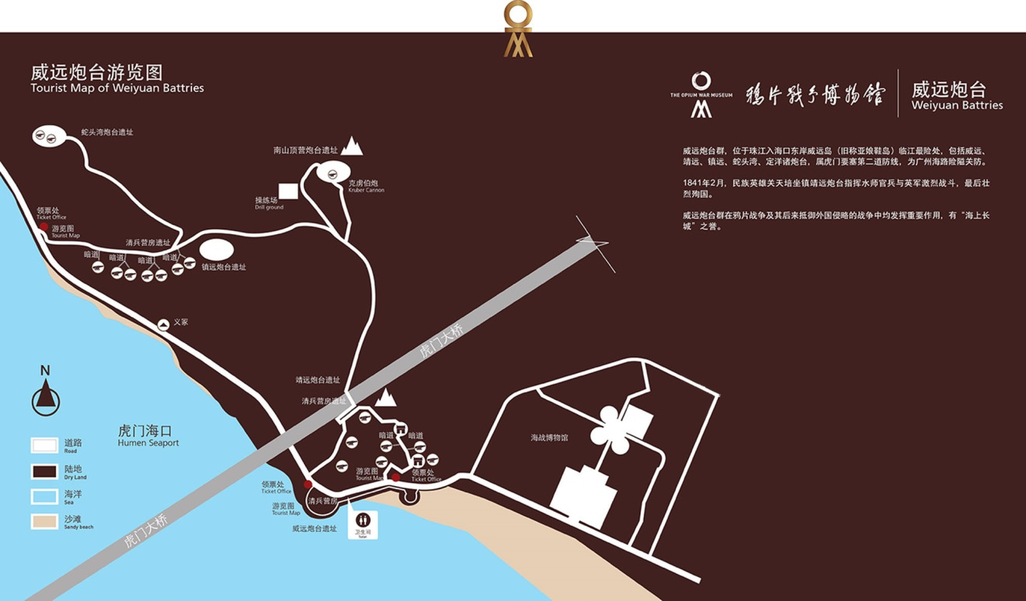
Fig. 1: Historical sites at the Weiyuan Fort

Slide 4
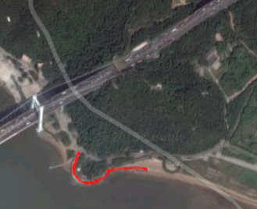
Fig. 2: Line of cannons at the Weiyuan Fort (red line)

Slide 5
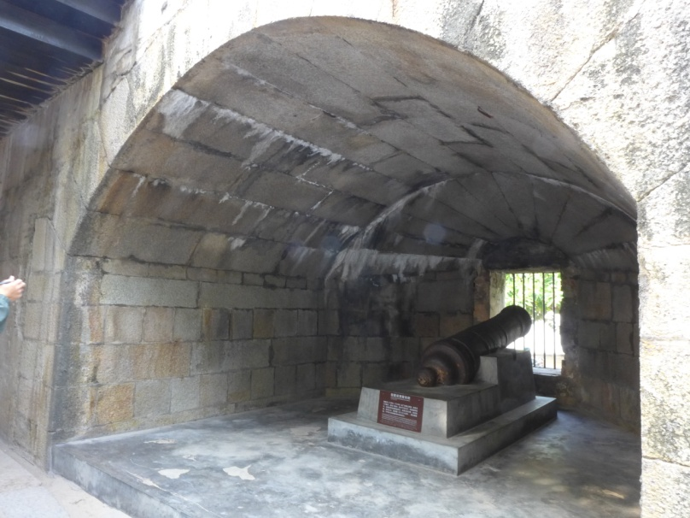
A. Operation of Cannons (Suggest teaching this part in front of a cannon on site)
In the Qing dynasty, cannons were graded by weight. Heavier cannons were more powerful. Teachers are suggested to read the character “jin” (catty, 斤) inscribed on cannons.
Teachers are suggested to teach the operation of muzzle-loading cannons.
Fig. 3: Granite pillbox
Answer:
（i）Iron bars in front of the cannon should not exist. They are installed by the museum so as to prevent accidents;
（ii）Cannon should not be fixed with cement, otherwise it would have been unable to recoil while firing.
What construction(s) in the photo should not exist in the real battles?

Slide 6
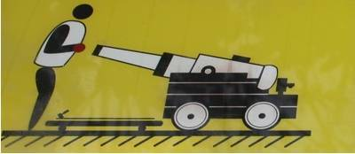
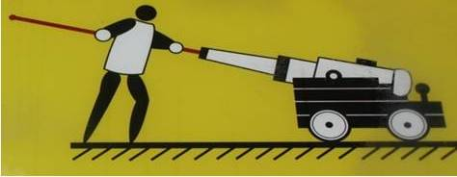
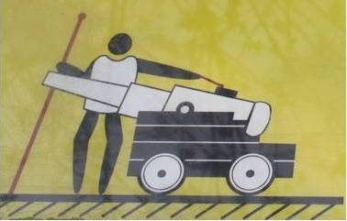
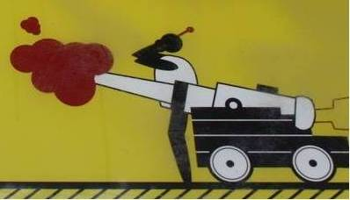
Four Steps of Firing Old Muzzle-loading Cannons:
Step 1: Place the explosive into the muzzle
Step 2: Push the cannon ball in with a rammer
Step 4: Once the gunpowder is ignited, the cannon is fired.
Step 3: Ignite the gunpowder with a torch
Source: Exhibition in Fort San Domingo, Tamsui, New Taipei.

Slide 7
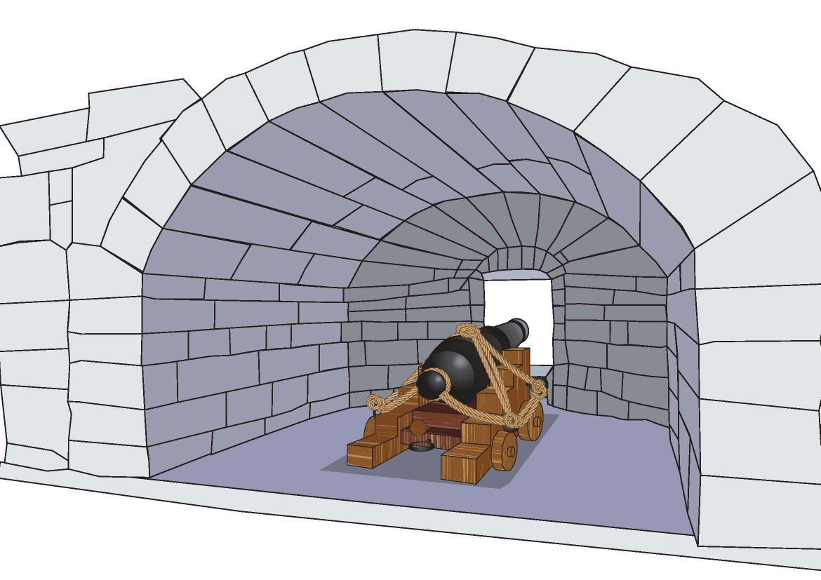
Fig. 5: Gun Carriage
In the First Opium War, the main form of artillery remained the smoothbore cannon. Each cannon, like that in Figure 5, was to be supported by a carriage consisted of two large wooden slabs called “cheeks” held apart by bracing pieces called “transoms.” Since these guns were not required to travel around, they were only provided with four small wheels called “trucks”. The main function of the trucks was to roll backward with the recoil of the gun and then allow it to be moved forward into a firing position after reloading. (see Wikipedia: Gun carriage)

Slide 8
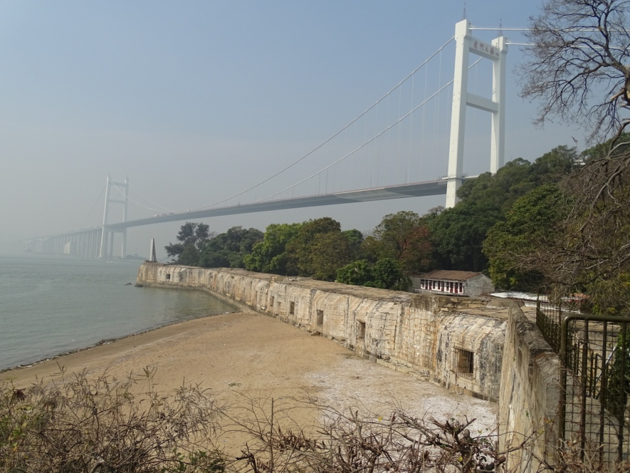
B. Crossfire tactic
Teachers may bring students to walk along the beach and examine the square holes. These were the holes where the cannonballs were shot.
Then, teachers can ask students whether they can find blind spots where they can be safe from the attacks of cannonballs. (As all cannons were installed on the same line, and they could not turn around, ships were safe when they reached here at an acute angle to the fort.)
Fig. 6: The Weiyuan Fort under the modern Humen Bridge

Slide 9
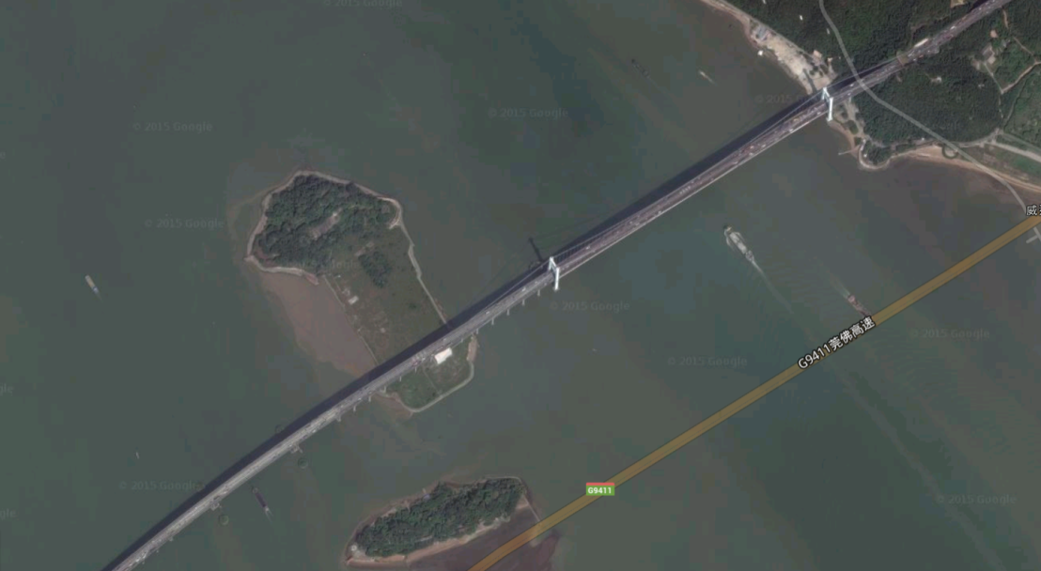
In order to defend the river effectively, the Qing navy formed a crossfire zone by fortifying the coast of the small island with cannons (the Upper Hengdang Island) opposite to the Weiyuan Fort.
Fig. 7: The Weiyuan Fort was at the right hand corner and another set of cannons were installed on the coast of the small Upper Hengdang Island (see the white dotted square) opposite to the Weiyuan Fort. The Humen Bridge which goes through the Island is a modern construction.

Slide 10
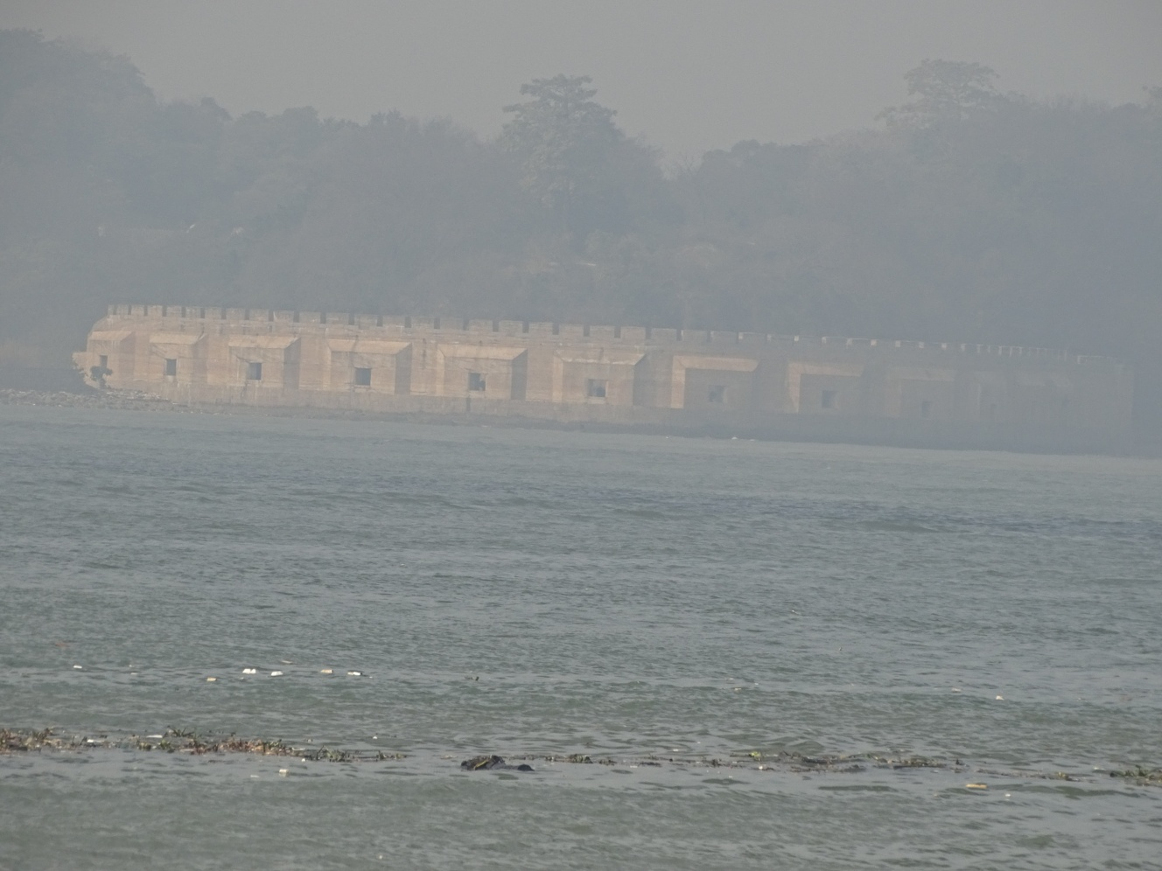
Fig. 8: Upper Hengdang Island, viewed from its opposite Weiyuan Fort. (The view would be better if the pollution is not that heavy.)

Slide 11
Share of field trip experience:
In addition to the Weiyuan Fort, visitors may also travel to other forts built nearby, like the Weishengdong Fort, Barracks, Shetouwan Fort, etc. Walking up the hill, you may also discover a huge field artillery made by the Krupp Company imported by the Qing Navy. However, these were the weapons which appeared years after the First Opium War. Therefore, if you do not have enough time, for easy management, we suggest keeping your students at the Weiyuan Fort.
The exhibition in the Opium War Museum (near the statue of Lin Zexu) is ordinary. In front of the museum building, some old cannons are displayed. It is a good idea to let your students see from their own eyes, and even touch, these cannons.
In this field trip, you can see only the coastal defence of the Qing empire. For a better understanding of the British naval power, you may also visit:
i. The Hong Kong Museum of History: containing warship models of both the Qing empire and the British empire, British cannons, model of the pool for destroying the opium confiscated by Commissioner Lin Zexu, etc.
ii. The Hong Kong Museum of Coastal Defence: containing model of the Battle of Chuenpi, model of the ship Nemesis.

Slide 12
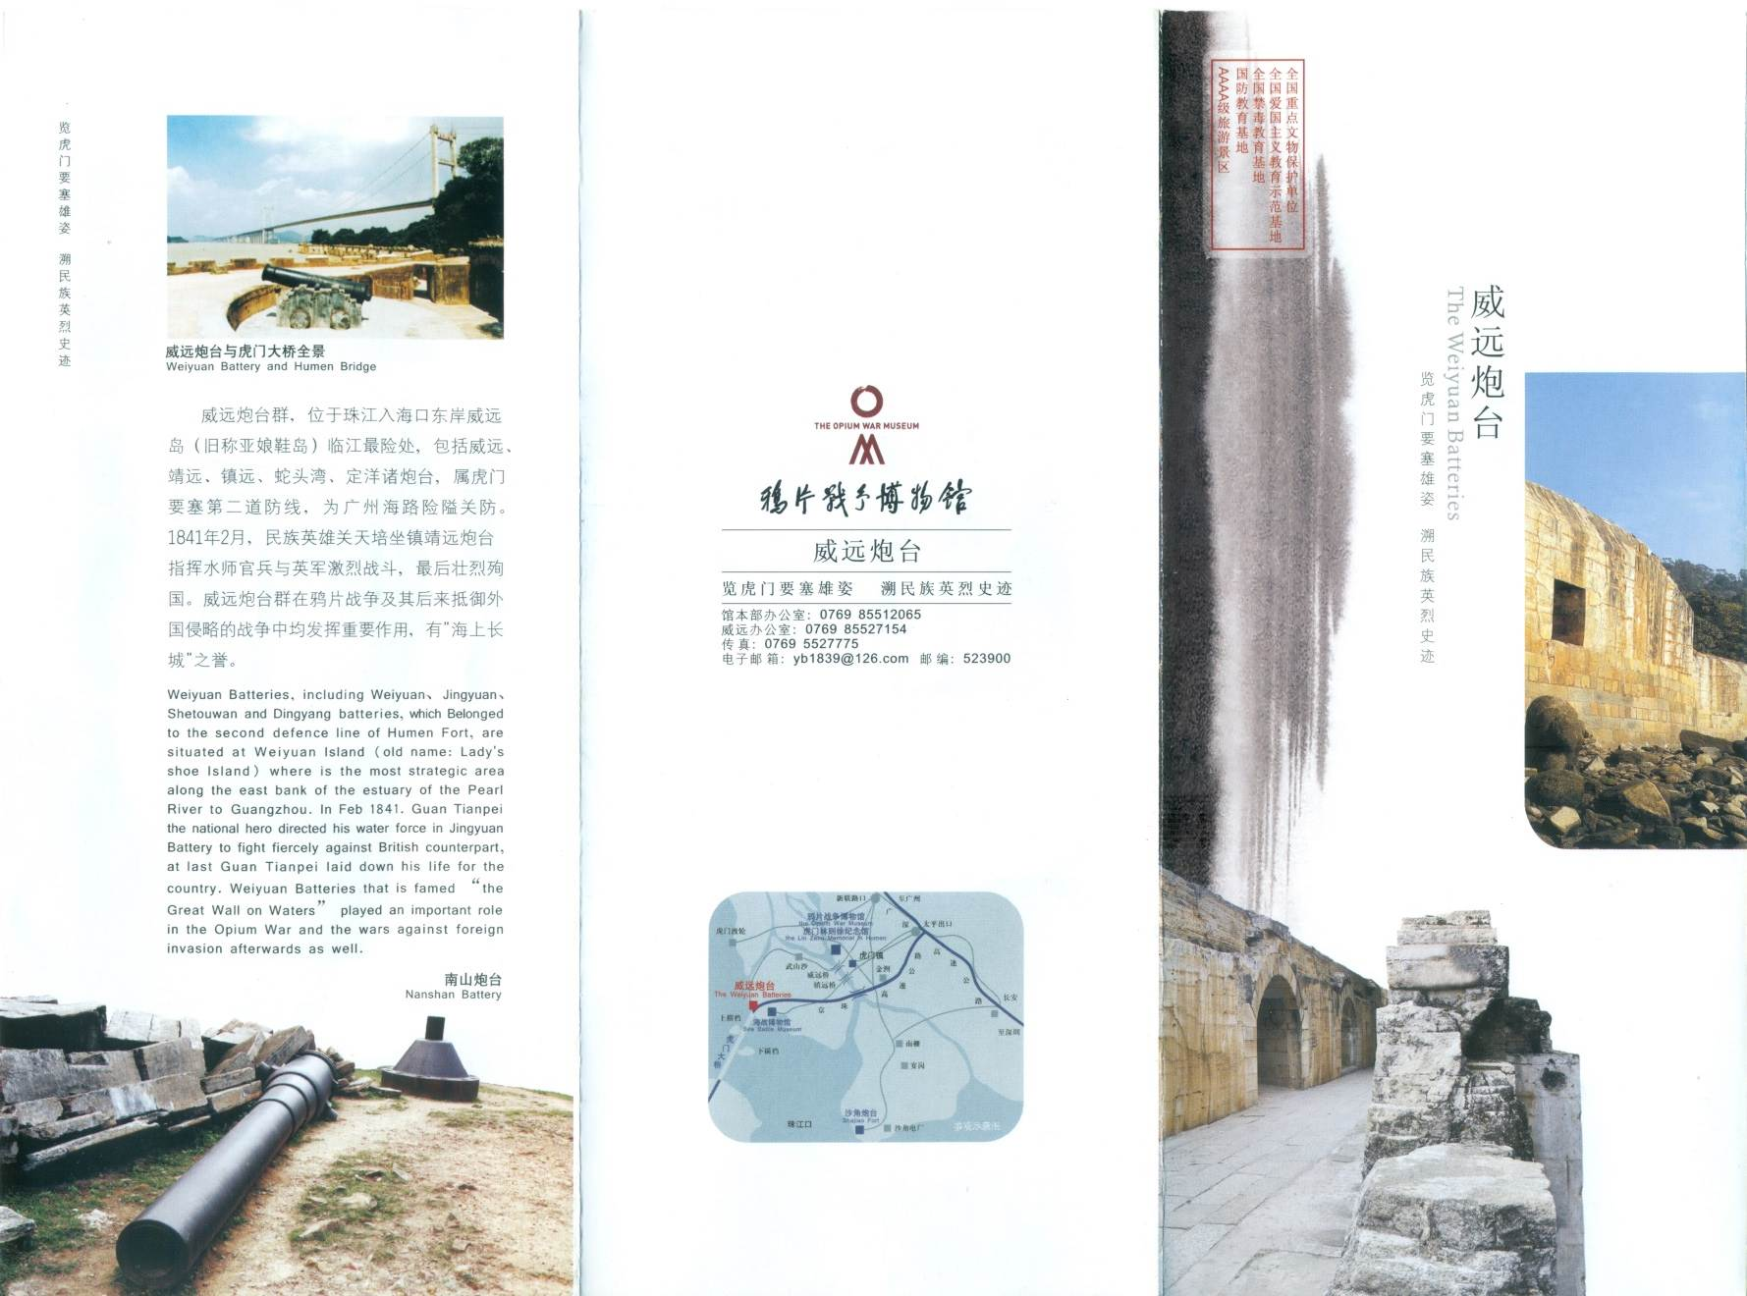
Appendix 1: leaflet of the Opium War Museum
(may distribute to students before the fieldtrip)

Slide 13
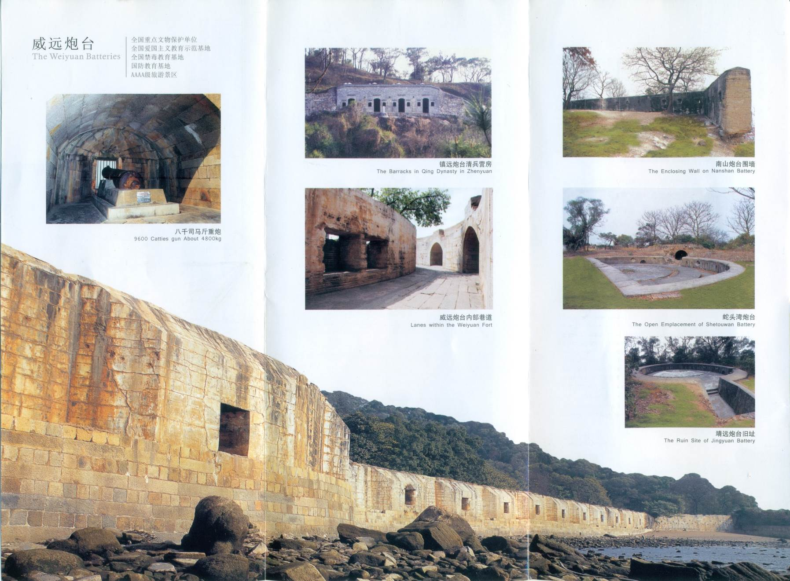

Slide 14
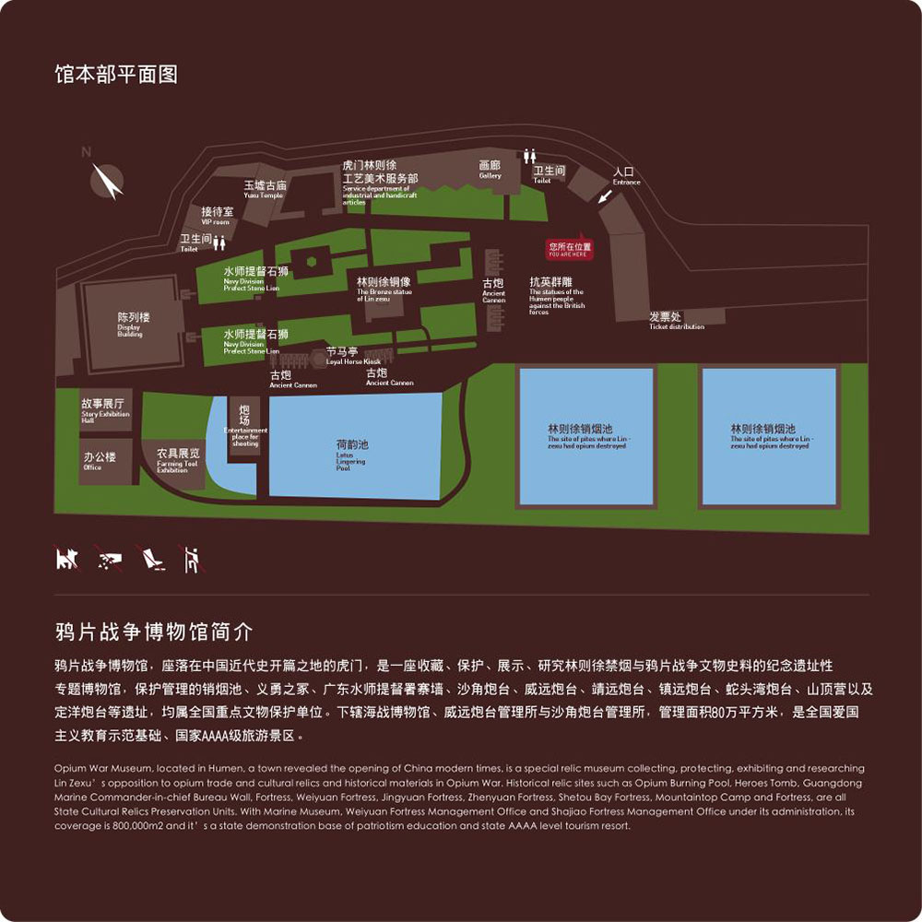
The Opium War Museum
Before the trip, teachers may introduce the website of the Opium War Museum to students so as to allow them to have some basic ideas of the place they are going to visit.（http://www.ypzz.cn/）
Fig. 9: Layout of the Museum

Slide 15
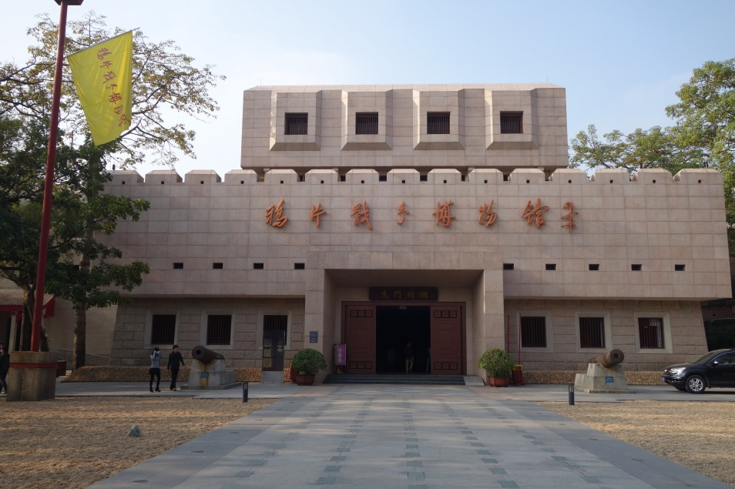
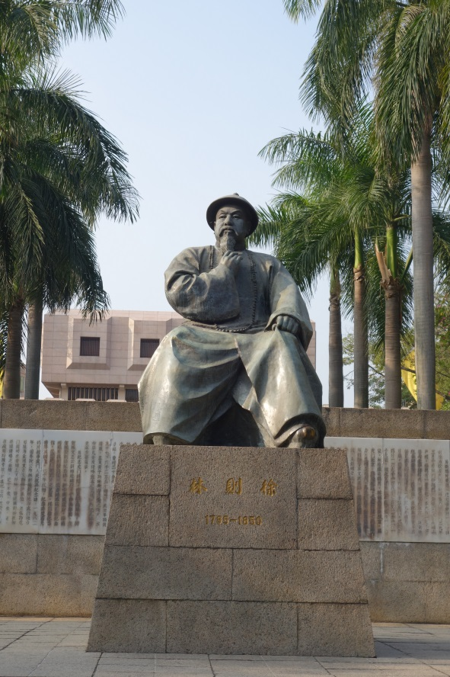
Fig. 10: The Opium War Museum
Fig. 11: In front of the museum, there is a statue of Commissioner Lin Zexu, the official who ordered to destroy all opium confiscated in 1839.

Slide 16
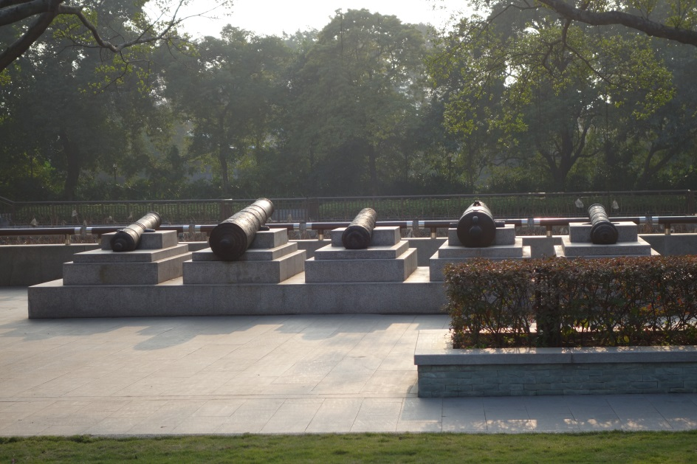
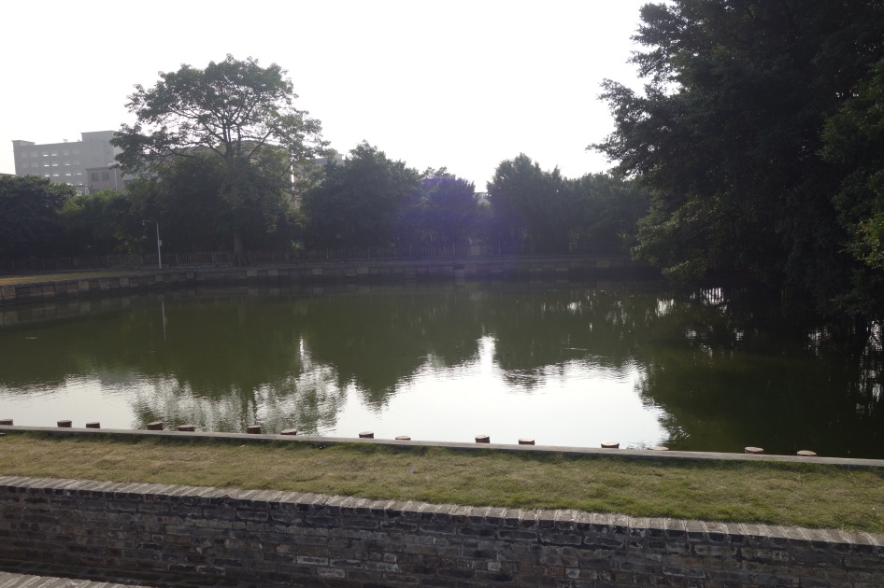
Fig. 13: Opium Destruction Pool
Fig. 12: Cannons near the museum

Slide 17
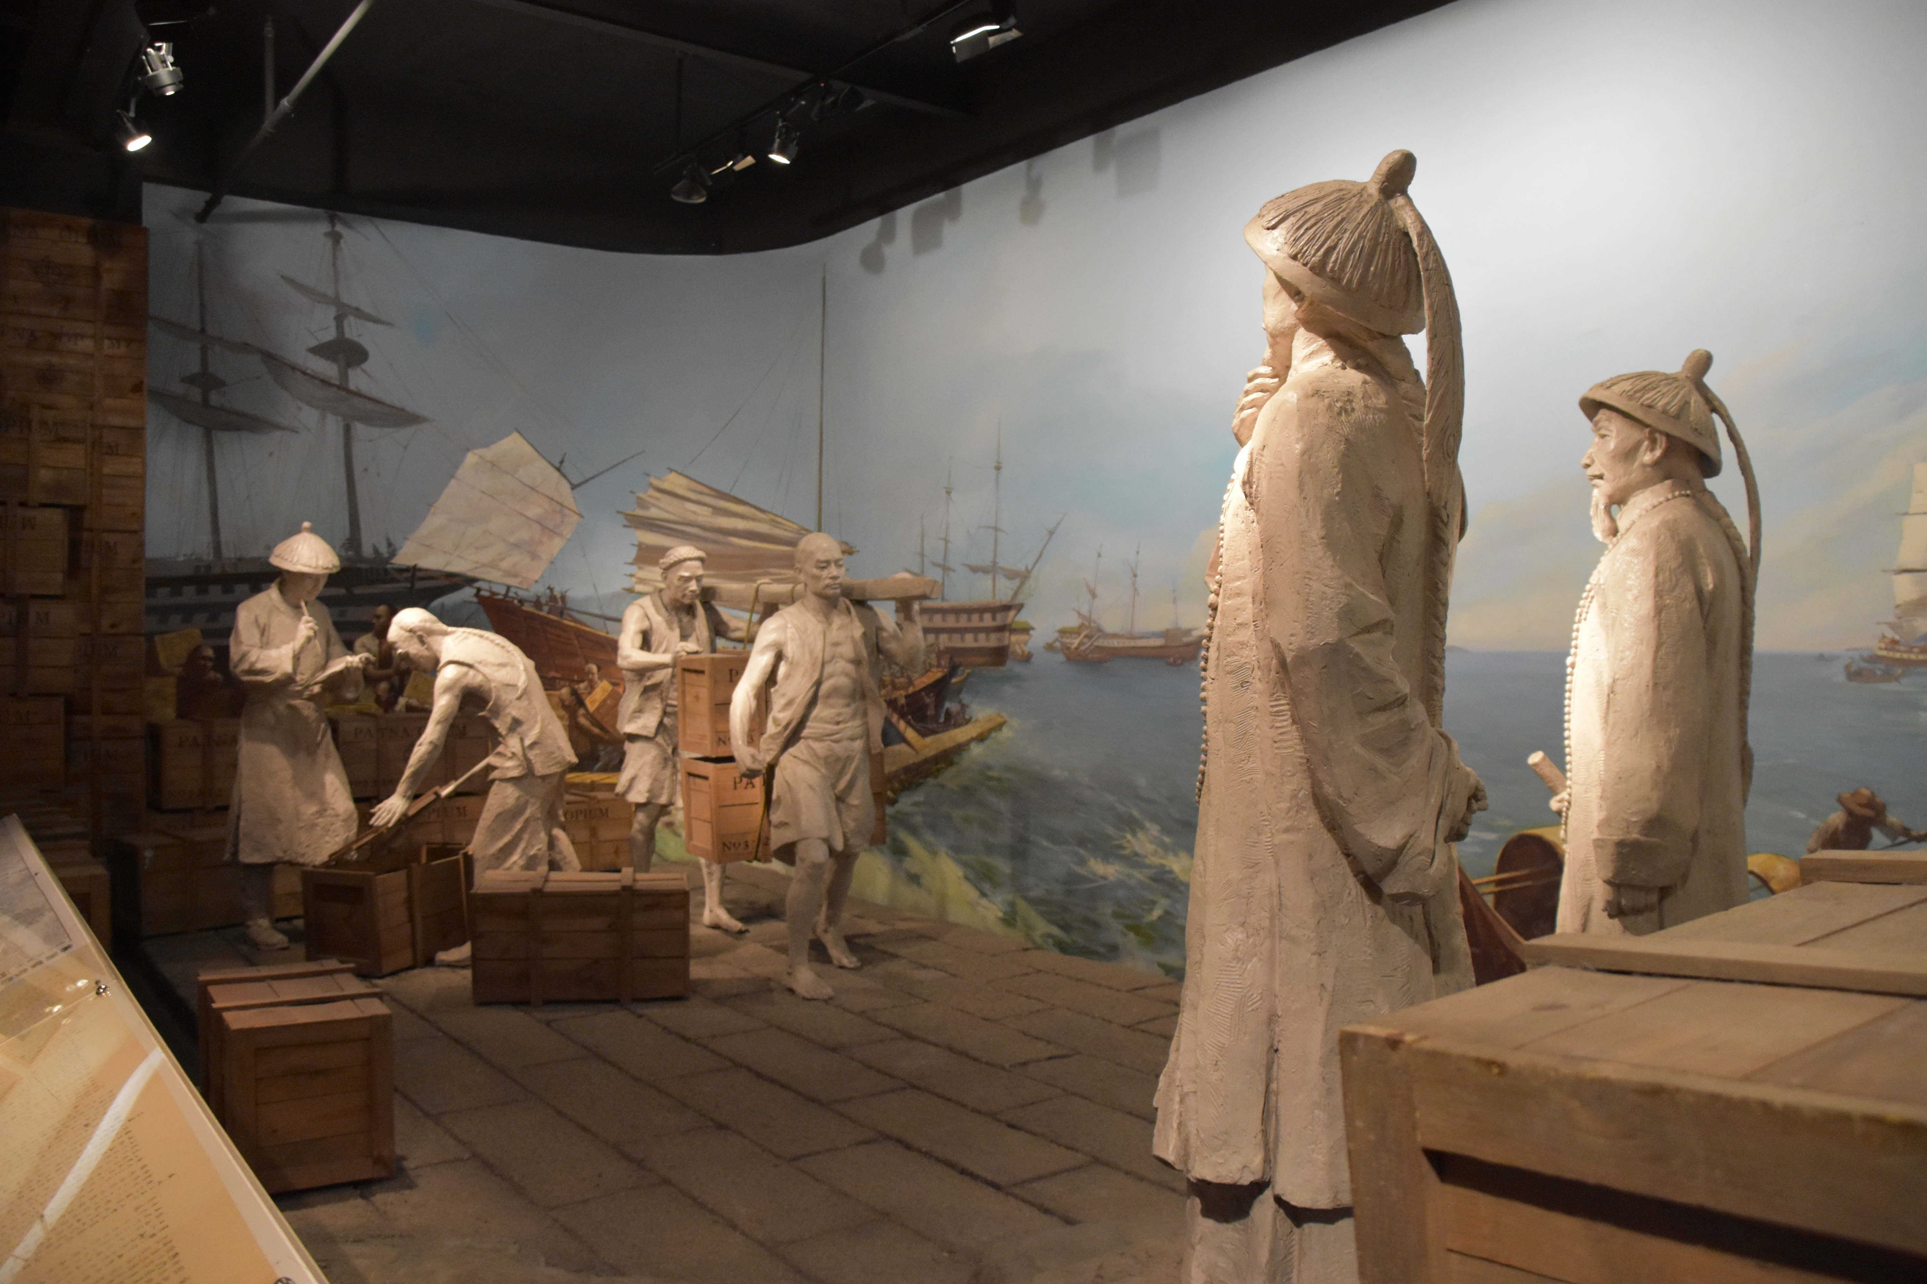
Worksheet 1: Who was he?
This is a scene in the Opium War Museum. Chinese labourers were moving chests of opium from ships to a pier under the supervision of a Qing official and his subordinates. This was the opium that the official confiscated from the British and American traders in 1839. The opium confiscated by him totaled 19,187 chests (each chest of opium was about 75 kg in weight). On 2 June 1839, this official destroyed the opium by adding lime and salt in the pools.
Questions:
1. Do you know who this official was? (Hint: you can find a statue outside the museum) Lin Zexu
2. Try to find the pools where the opium was destroyed near the museum.
3. Why did this official have to destroy the opium? What problems did this product have for health? (drug, addiction, weak health)

Slide 18
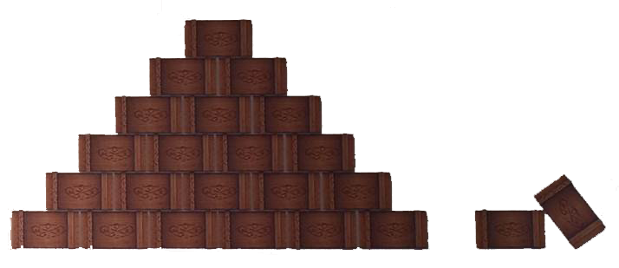
Worksheet 2
Figure 1: Import and Export of Opium in China, 1800-1839
Figure 2: Opium confiscated by Lin Zexu from British traders and American traders in 1839
Year | Import: Chest of Opium | Export: Taels of Siver
1800-1809 | 39,691 | 51,339,100.
1810-1819 | 74,135 | 95,288,153.
1820-1829 | 180,169 | 211,089,961.
1830-1839 | 344,124 | 243,958,005.
From British traders
From American traders
Questions:
1. As shown in Figure 1, Qing China exported _____ in exchange of ______.
From 1800 to 1839, the import of _____ increased/decreased (delete one) while the export of _______
increased/decreased (delete one).
Lin Zexu disliked the outflow of _____. When Lin Zexu confiscated opium in 1839, British traders/American traders (delete one) suffered the most.
In order to cover the loss of its traders and maintain the immoral trade, ________ (what country) declared war against Qing China in 1839, which became known as the First Opium War.

