Slide 1
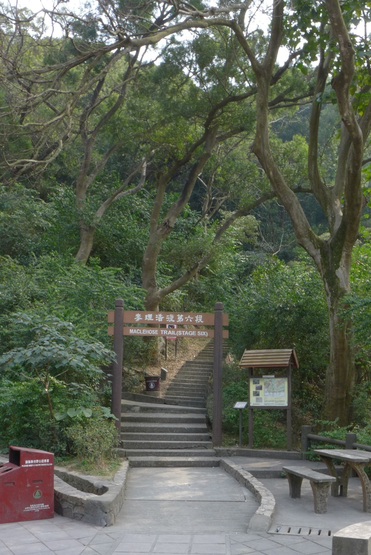
Field Trip for War History: The Shing Mun Redoubt (城門棱堡)
Site of Main Importance: Shing Mun Redoubt
Site of Main Importance: Tunnels in the Redoubt
Traffic:
Public Transport:
Take the route 82 mini-bus at Shiu Wo Street and Chung On Street near the Tsuen Wan MTR station. Get off the mini-bus at its terminus at Shing Mun Reservoir. Then, walk towards the direction of the BBQ site. Opposite to the BBQ site, you may enter the MacLehose Trail (Stage Six) and go uphill. After walking for 5 minutes, you can see the ruined tunnels which used to be the previous site of pillbox no. 402 (PB 402).
Coach：
Note that the nearest stop for coaches is Ho Fung College. You need to leave your coach there and walk for 15 minutes to the above mini-bus terminus near the Reservoir (that means more walking distances for the participants).
Fig. 1. The MacLehose Trail (Stage Six), the entrance to the previous site of PB 402

Slide 2
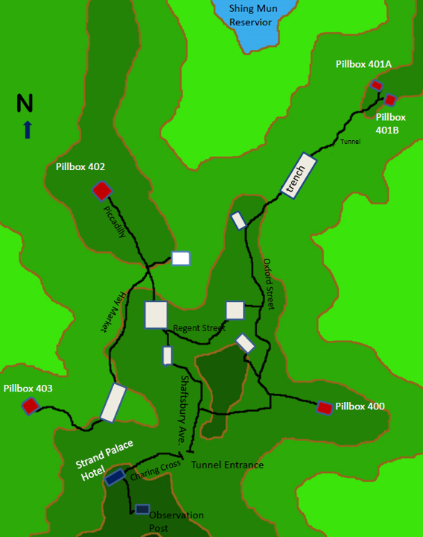
Layout of the Tunnels
in the Shing Mun Redoubt

Slide 3
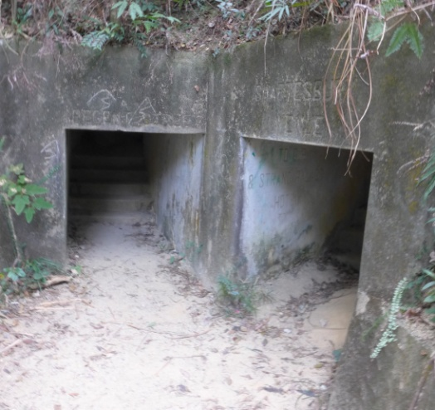
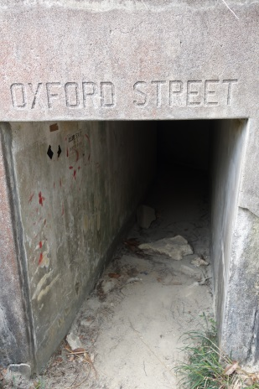
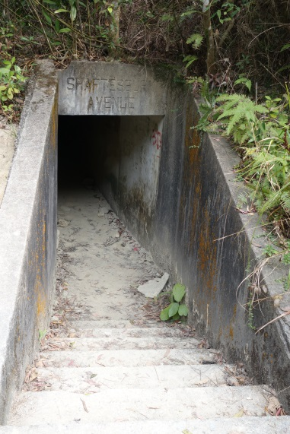
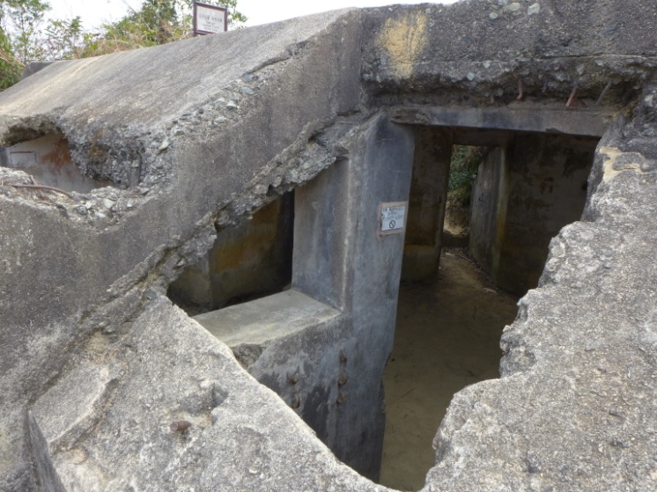
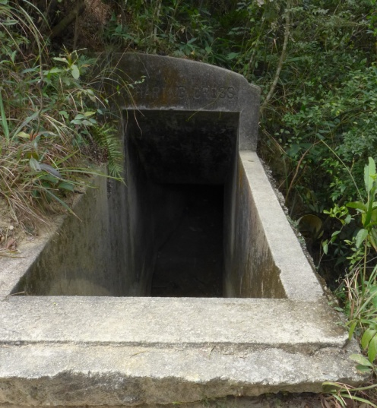
Regent Avenue
Shaftsbury Avenue
Oxford Street
The so-called Strand Palace Hotel was built on a high terrain. It was the commanding headquarters of the Redoubt.
Shaftsbury Avenue
Charing Cross
Fig. 2: Structures in the Sheng Mun Redoubt
Source: Kuang Zhiwen and Cai Yaolun (Kwong Chi Man and Tsoi Yiu Lun), “Gudu qianxian: Taipingyang zhanzhen zhong de Xianggang zhanyi” (Lonely Frontline: Battles in Hong Kong during the Pacific War), Hong Kong: Tiandi tushu, 2013, p. 186.

Slide 4
Introduction of the Shing Mun Redoubt:
The Shing Mun Redoubt was a 12-acre citadel under the northern part of Smuggler’s Ridge. The Redoubt straddles Kwai Tsing and Sha Tin districts. Planned and built as a network of tunnels, observation posts and pillboxes, the Redoubt was meant to guard the most vulnerable land route into Kowloon. The Shing Mun Redoubt formed a critical part of the Gin Drinker’s Line (醉酒灣防線) – the name given to an 18-km defense line made of a string of trenches, pillboxes and bunkers constructed in the mid-1930s against infantry attacks from the north. This 18-km long line of defense was based on the same patterns in Europe after the First World War and the most famous example was the Maginot Line. (source: the notice board erected by the Agriculture, Fisheries and Conservation Department at site)
The headquarters of the Shing Mun Redoubt, known as the Strand Palace Hotel, was square in shape. It was strongly built with steel and cement, and with walls each 15-18 inches thick. The “hotel” had a big rectangular hole in its front and this was built for the soldiers to observe the outside situation. It also had secret tunnels which linked to a store room, rest room and other pillboxes. These smaller pillboxes were all built on hill tops surrounding the headquarters and each pillbox was equipped with 2-3 heavy machine guns.

Slide 5
To allow soldiers (British and Canadian) to easily remember the tunnels, the tunnels were named using British or Canadian district names, like Oxford Street, Regent Street, Piccadilly, Hay Market, Shaftbury Avenue and Charing Cross. Of these tunnels, entrances were built at the Strand Palace Hotel (headquarters) and the segments of Oxford Street, Piccadilly and Shaftbury Avenue. There was an open-air space between Regent Street and Hay Market, which served as the kitchen and toilet. The Redoubt was surrounded with wire meshes and other obstacles to hinder the attack of enemies. On 9 December 1941, Japanese soldiers suddenly invaded and attacked the Shing Mun Redoubt. The defending soldiers were far fewer than the invaders. Although they fought bravely, they were either killed or captured eventually. Decades later, the Hong Kong government built the MacLehose Trail (Stage Six) on which the Shing Mun Redoubt became a cultural site.
Ref.: Xiao Guojian (Siu Kwok-kin), “Xianggang de lishi yu wenwu” (History and Monuments of Hong Kong), Hong Kong: Mingbao chubanshe, 1997, pp. 27-30.）

Slide 6
A share of experience:
Since all weapons (especially heavy machine guns) had been removed, the objective of the field trip is merely an opportunity for students to experience the environment (space and light, etc.) of pillboxes and tunnels.
This field trip requires teachers and students with good physical strength, and therefore may not be suitable for those without it. It is necessary to note that if a school teacher rents a coach (instead of taking a mini-bus) for his/her students as transport, the coach can only stop at Ho Fung College. Teachers and students then must walk for nearly 30 minutes to reach the entrance of the MacLehose Trail (Stage Six). Worse still, since the Redoubt is badly maintained, participants may find it difficult and even a little dangerous to walk through these tunnels. Additionally, it would be easy for them to get lost. Therefore, teachers are highly recommended to conduct a pre-trip visit, and evaluate potential risks. For example, do not attempt to take care of too many students in a single visit.
Here below you may find some photos of the Shing Mun Redoubt.

Slide 7
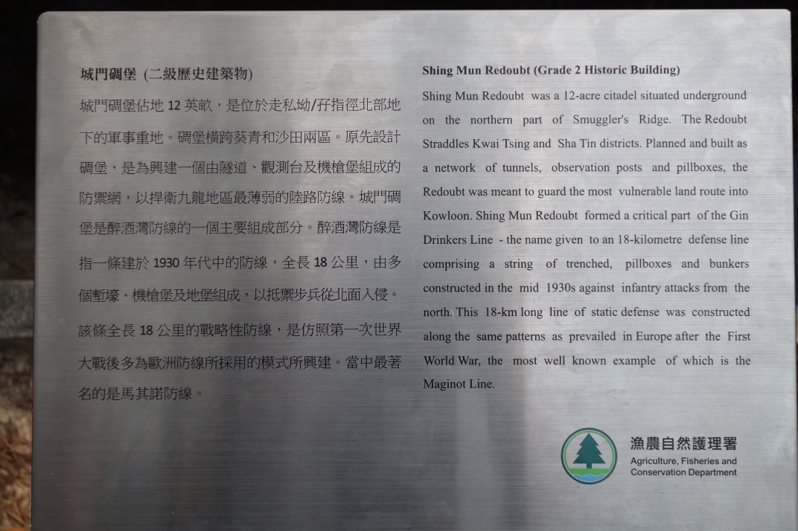
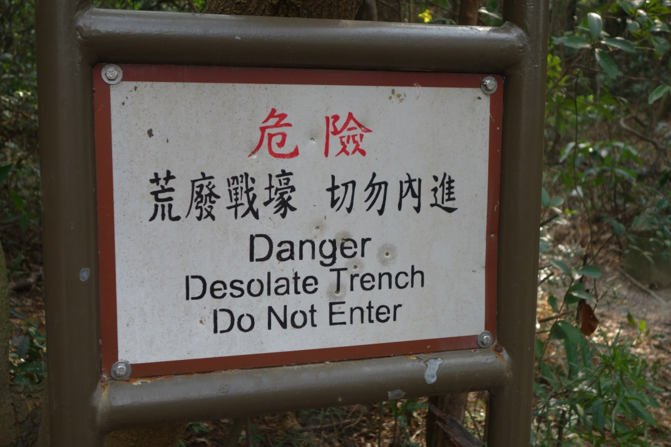
Fig. 4: Warning notice erected by the Government
Fig. 3: Introduction of the Shing Mun Redoubt by the Agriculture, Fisheries and Conservation Department.

Slide 8
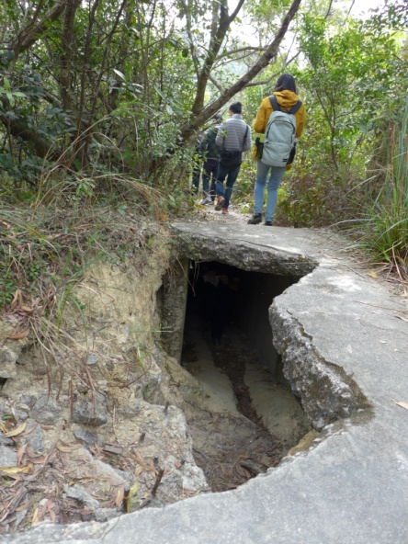
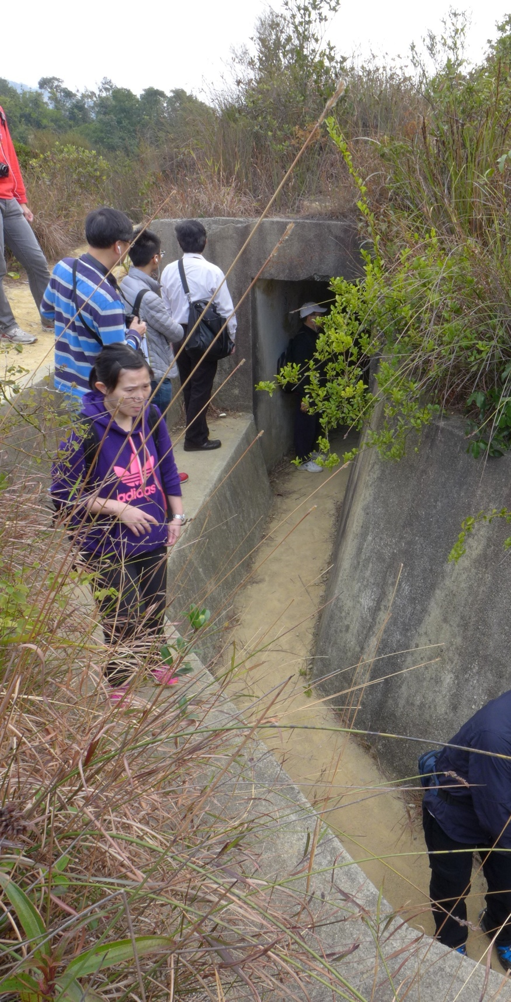
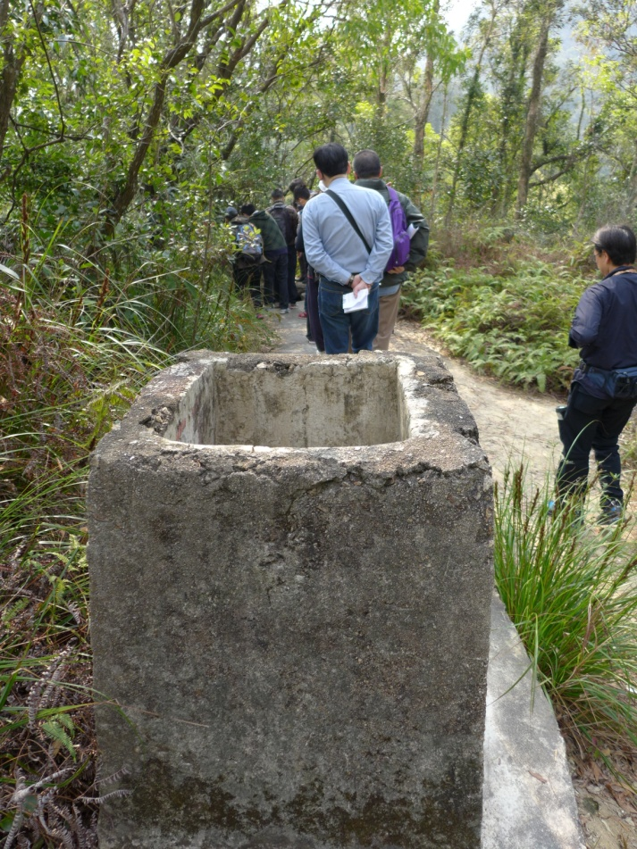
Walking path in ruins, exposing the tunnel underneath
Trench and tunnel entrance
Air vent used to send air from the surface to the tunnels.

Slide 9
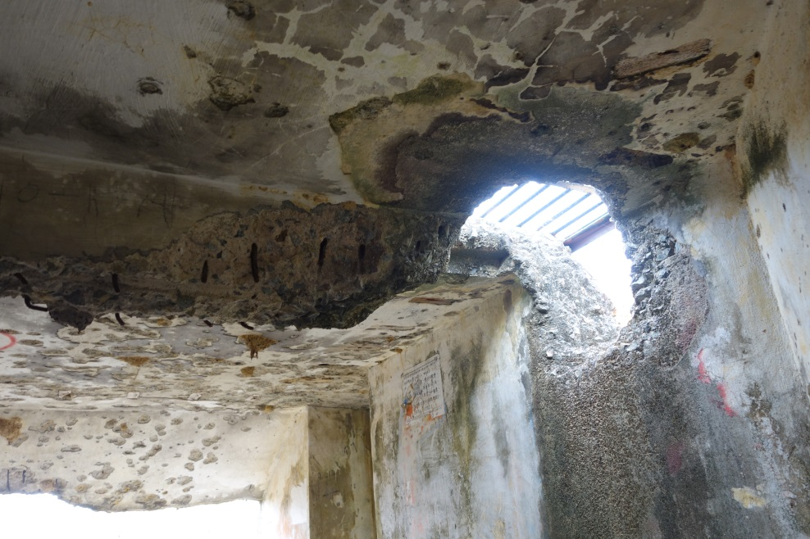
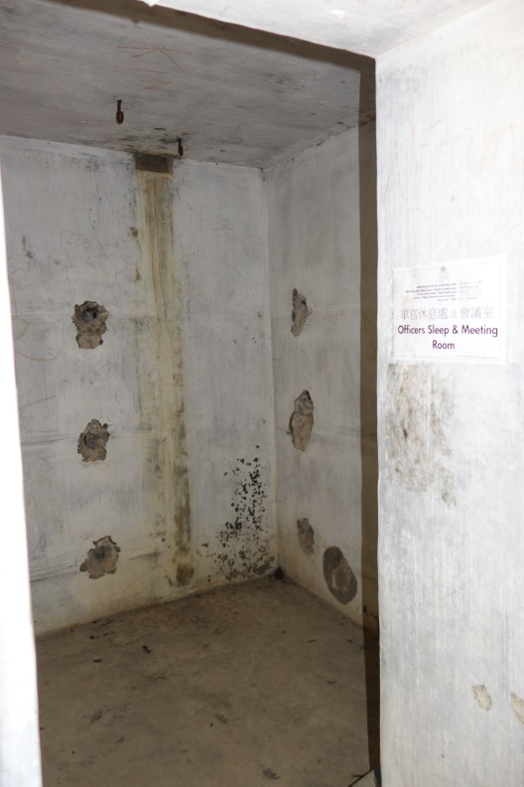
Strand Palace Hotel (the headquarters), in ruins

Slide 10
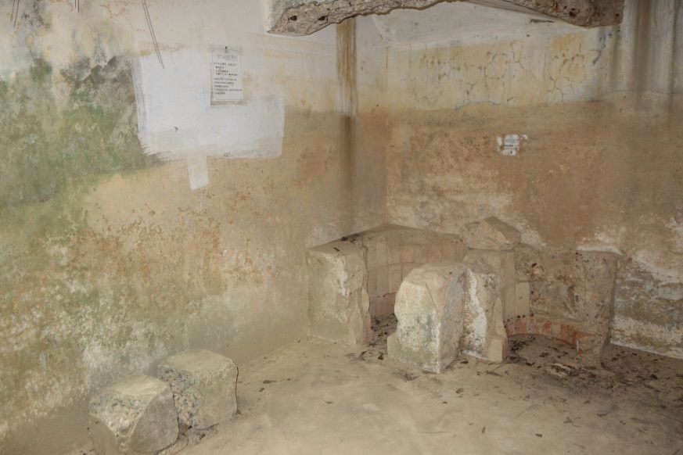
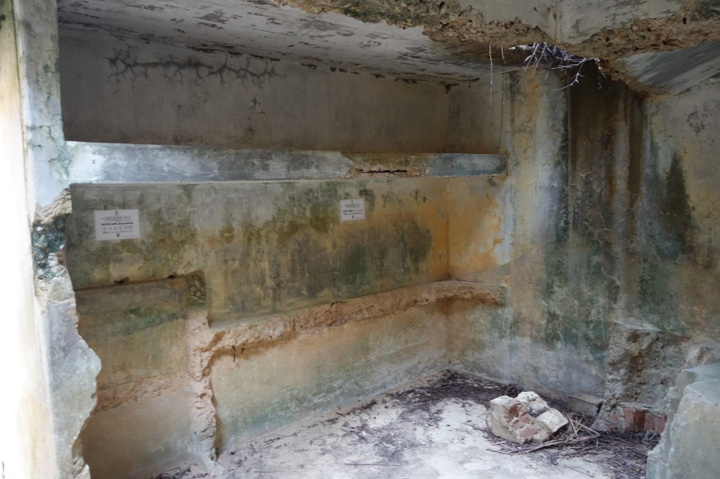

Slide 11
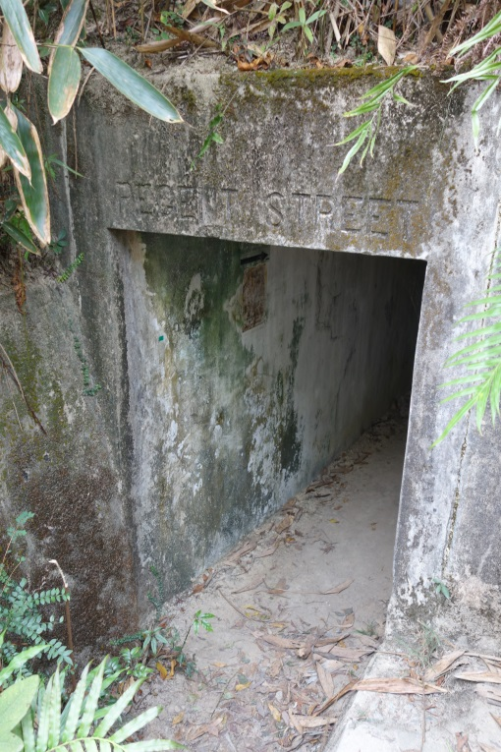
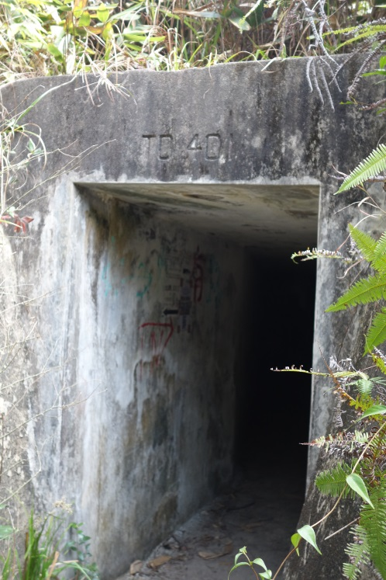
Other tunnels

Slide 12
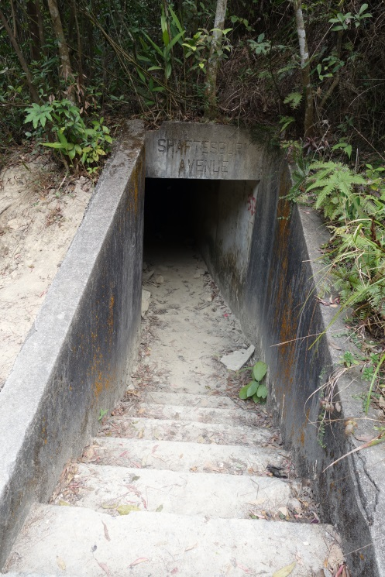
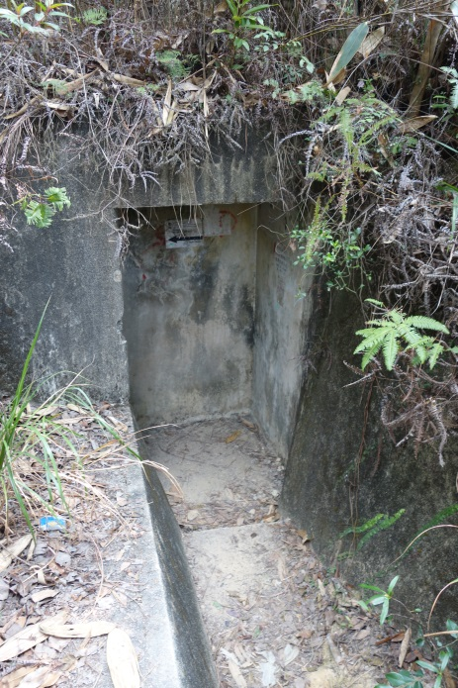

Slide 13
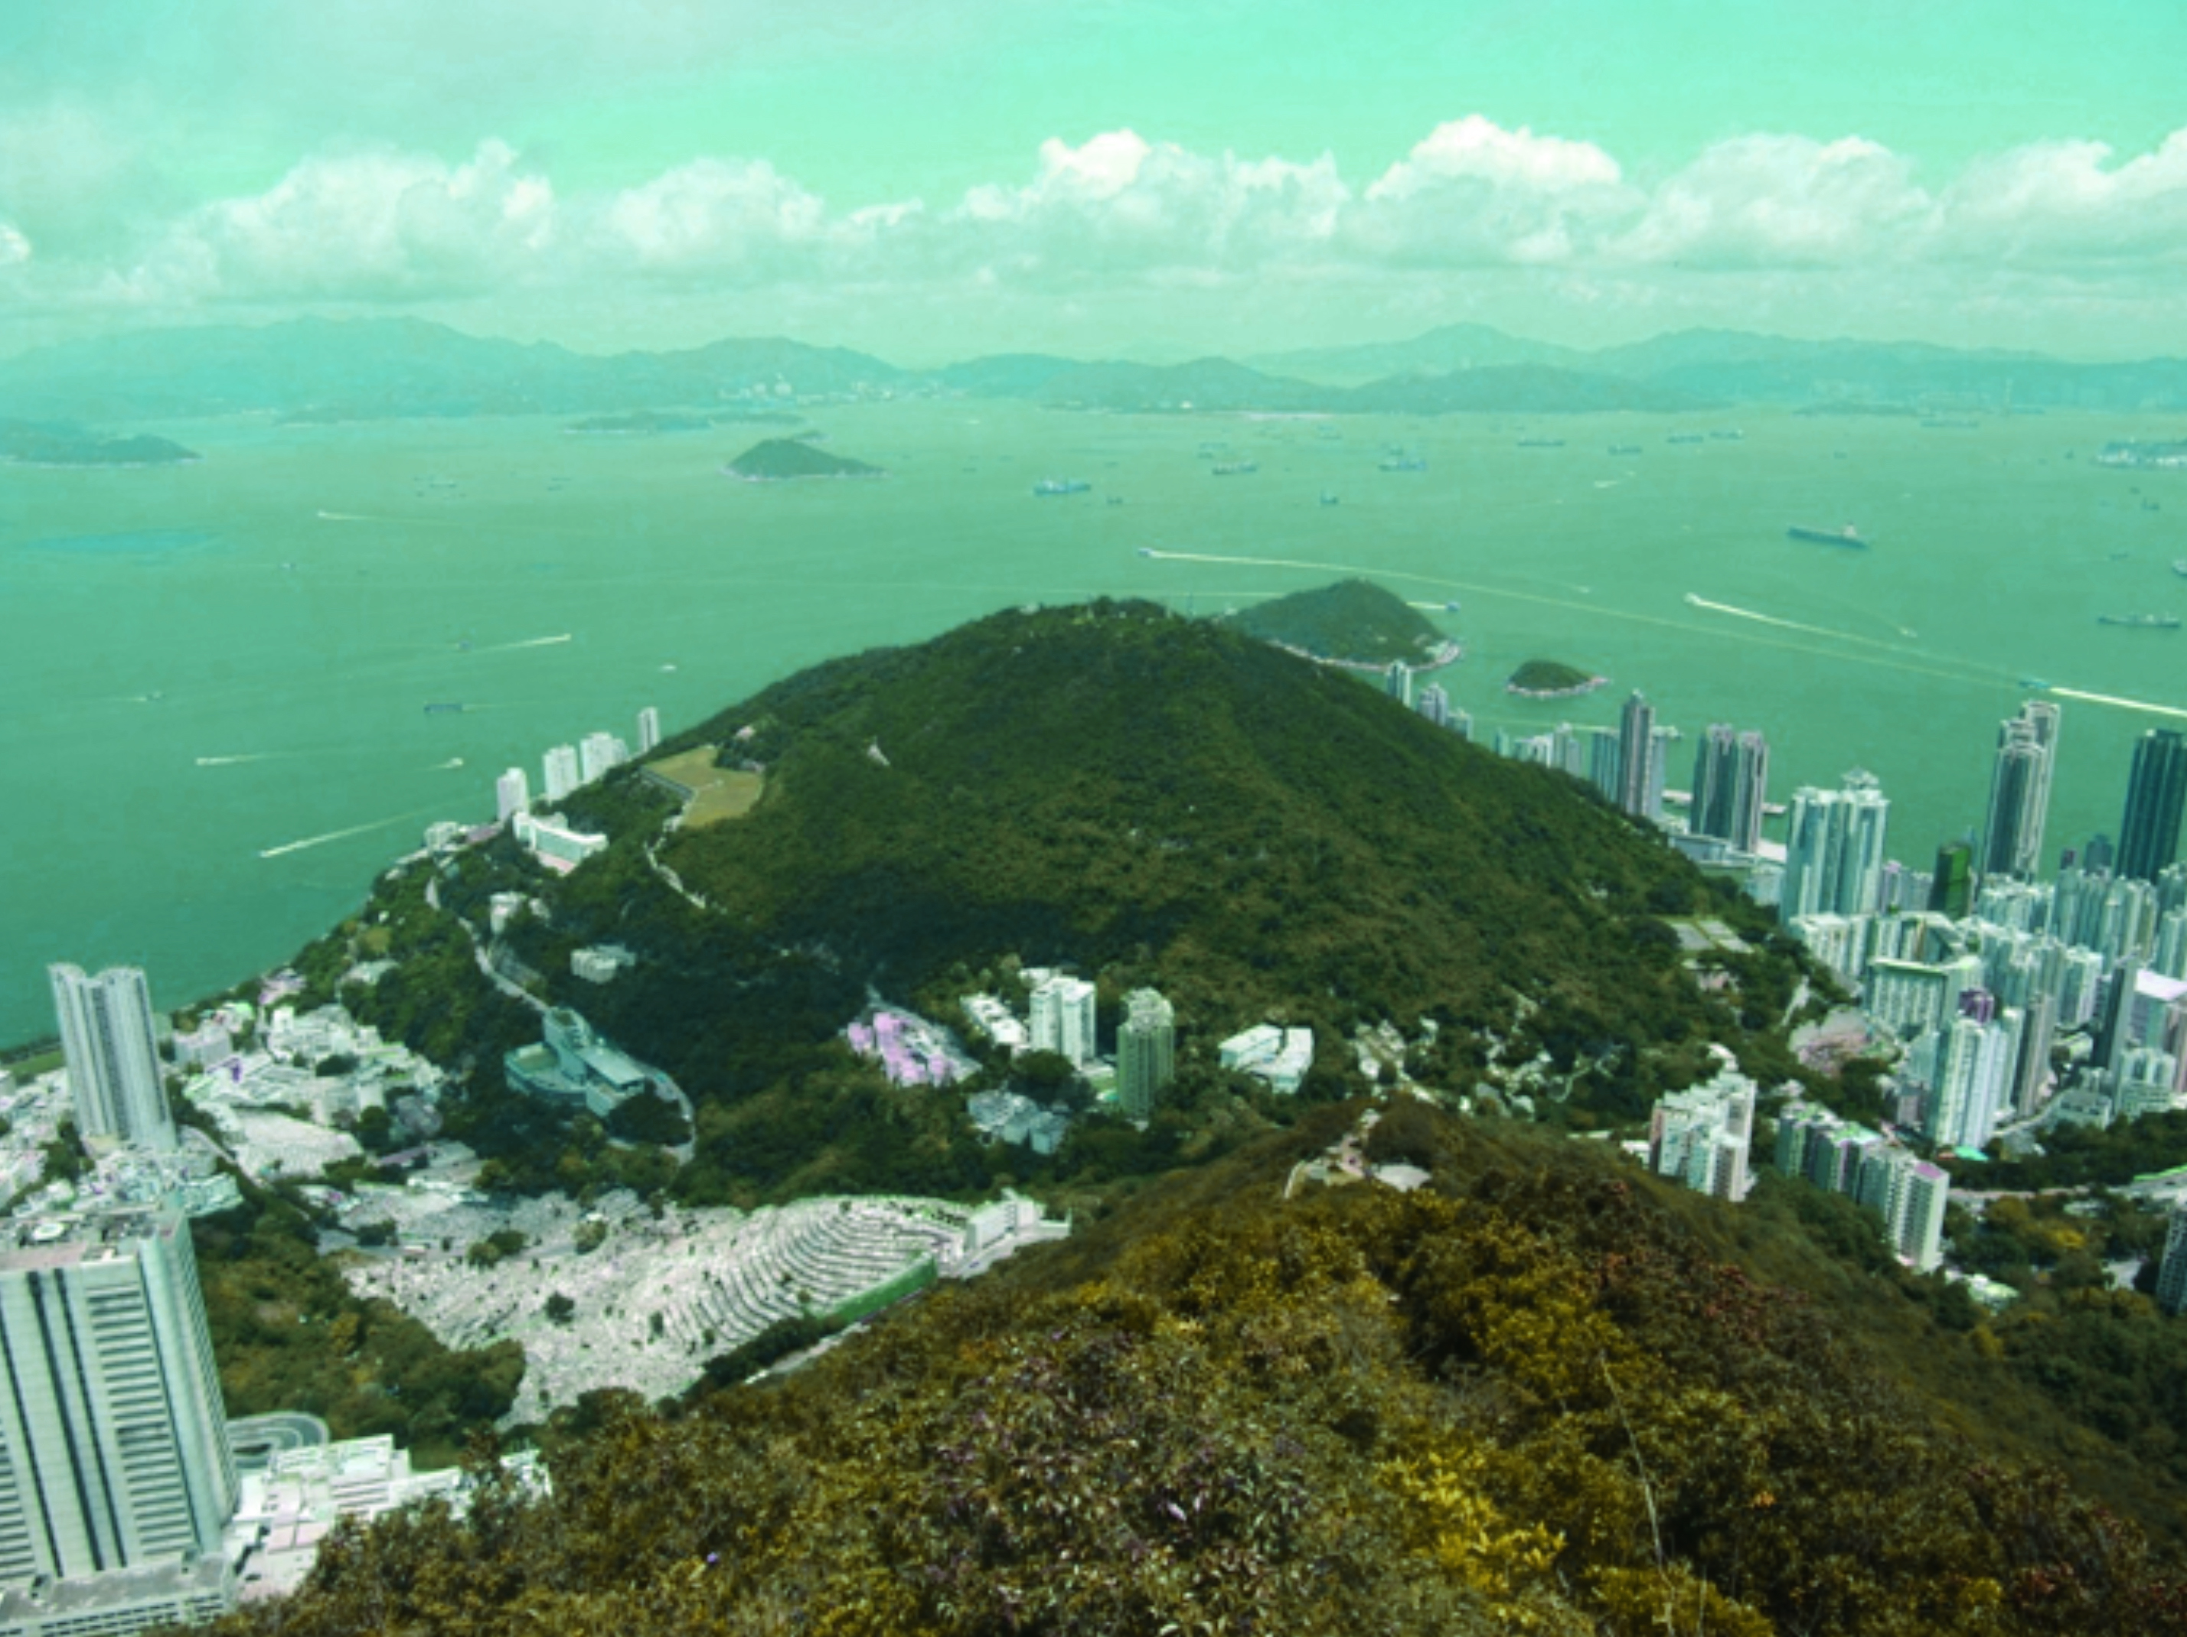
Appendix: The Mount Davis Battery (摩星嶺要塞)
The Mount Davis Battery was built in the early 20th century, serving as the headquarters of the Western Fire Command which was responsible for the defence of the western part of Hong Kong Island. The battery was heavily bombarded by the Japanese in December 1941. The battery site comprised of five places for guns, the Western Fire Command Headquarters, ammunition stores and accommodation buildings. (source: Information board at the site)

Slide 14
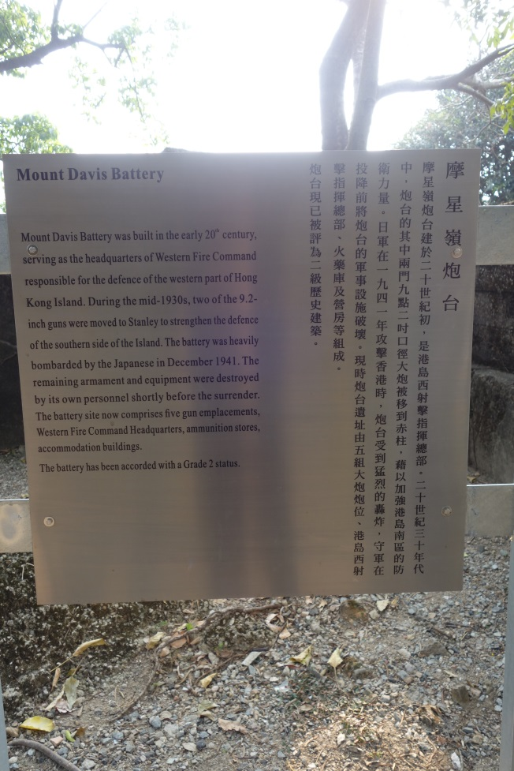
The Chronicle of the Mount Davis Battery
This battery was recommended in 1900 to be the new site for a 5 x 9.2 inch BL Mark X on mountings Barbette Mark V with the role of covering the western entrance to the harbour. This was further recommended by the Owen Committee in 1906. By 1909, the work was well advanced but the site for the fifth gun had still yet to be selected. The spur below Mount Davis was deemed suitable. By July 1910 the western gun had been mounted. Besides, the centre three guns were due for completion in November 1910 and the eastern gun was complete in August 1911. By the end of 1911, four guns were complete. The battery was complete in all respects by 1912.
The number of guns was reduced to 3 in 1935 when the defences were reorganized.
On 8 December 1941, the battery opened fire on counter-battery land targets. One gun was hit by Japanese fire on 14 December and the planning room was hit on 16 December. The battery was blown up by its personnel on 25 December 1941 just before the surrender.
The 1946 Report stated that no equipment remained and that the operational and accommodation buildings had been completely destroyed. The two Battery Observation Posts were in good conditions but were stripped of equipment. All the gun emplacements still exist but with varying degrees of damage. At the very top of the mountain was the Headquarters of Fire Command West and most of the buildings are still to be seen. There is a wall around the compound for local defence.
Basic information regarding the Mount Davis Battery provided by the Government
Ref.: Denis Rollo, “The Guns and Gunners of Hong Kong”, Hong Kong: The Gunners’ Roll of Hong Kong, n.d. (preface 1991), pp. 194-6.

Slide 15
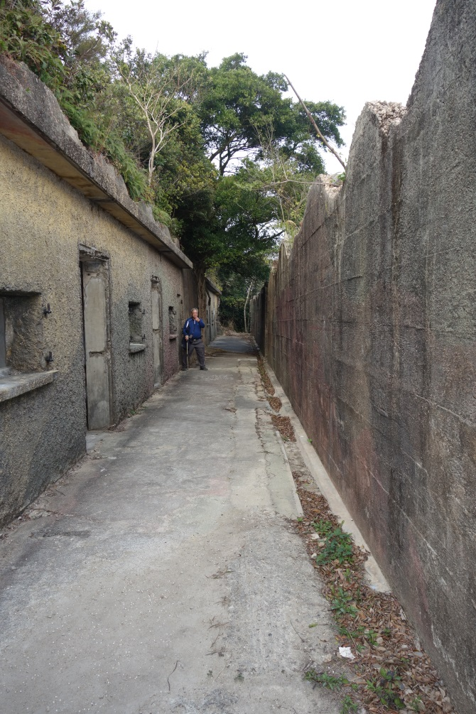
1906 Owen Committee Report
In 1906, General Sir John Owen, a Gunner, was appointed President of a Committee which was to make recommendations regarding the fixed defences of all the defended ports in the United Kingdom and the British Possessions Overseas. This was the origin of the Owen Committee Report, signed by Owen on the HMS Terrible on 6 October 1906, just after he left Hong Kong.
The Report stated that Hong Kong was the principal naval base of the fleet in the Far East and was also a commercial port of great importance. It was considered liable to Class A attack, that was the attack by battleships.
It recommended:
For the Western Entrance to Hong Kong--
Five 9.2 inch Mark X guns to be emplaced upon Mount Davis from a point near the top to approximately the 500 feet contour west of it. This would fulfil the condition that at least four guns should be capable, at any one time, of aiming at any approach to the western entrance.
Accommodation buildings for soldiers seen on the field trip. It was not “completely destroyed” as what the 1946 Report stated.

Slide 16
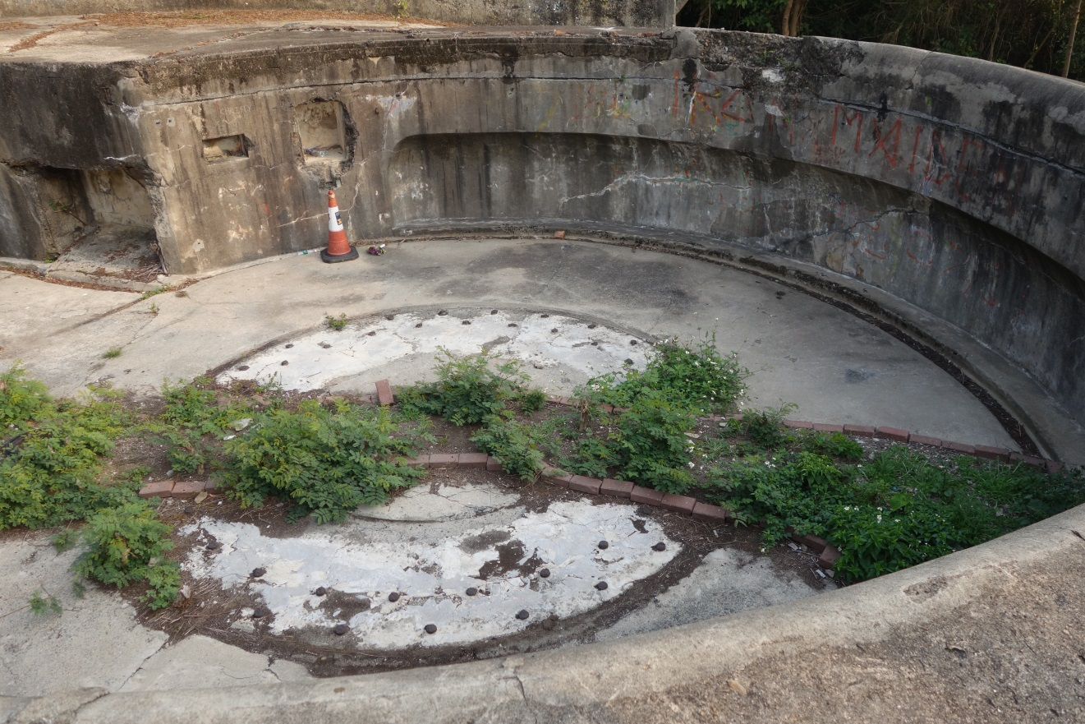
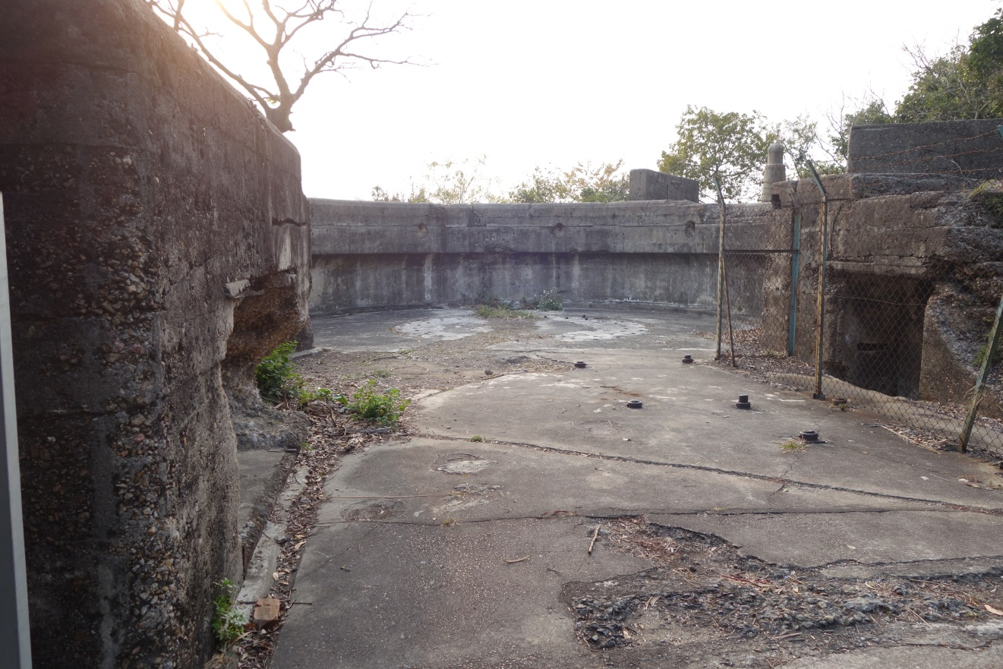
Two 9.2 inch gun emplacements (guns removed)

Slide 17
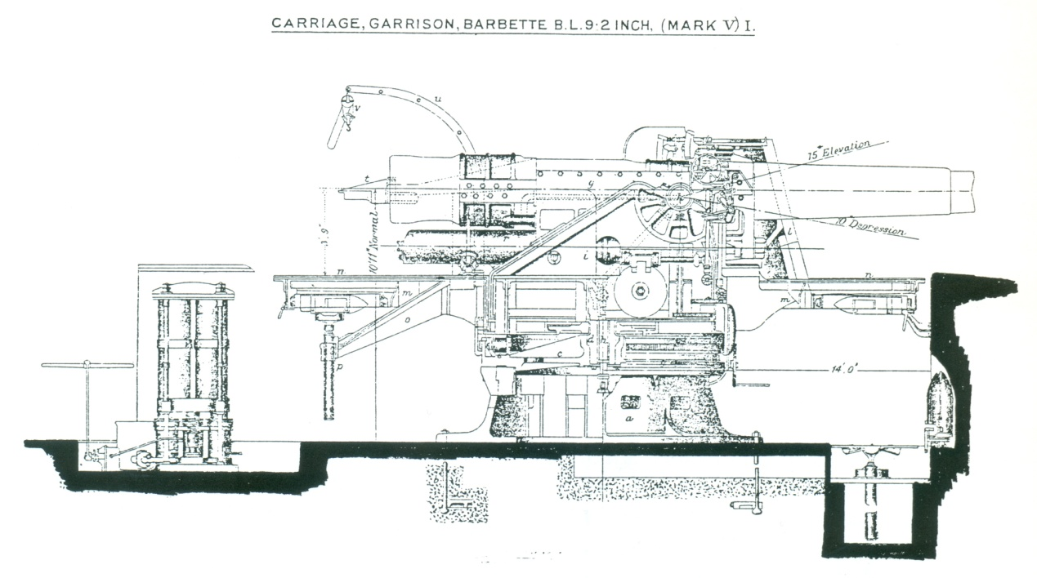

Slide 18
Construction of the Mount Davis Battery, 1909-1912
Source: Terry Gander, “Twentieth Century British Coast Defence Guns,” Fortlet, number 2, 2011, p. 7.

Slide 19
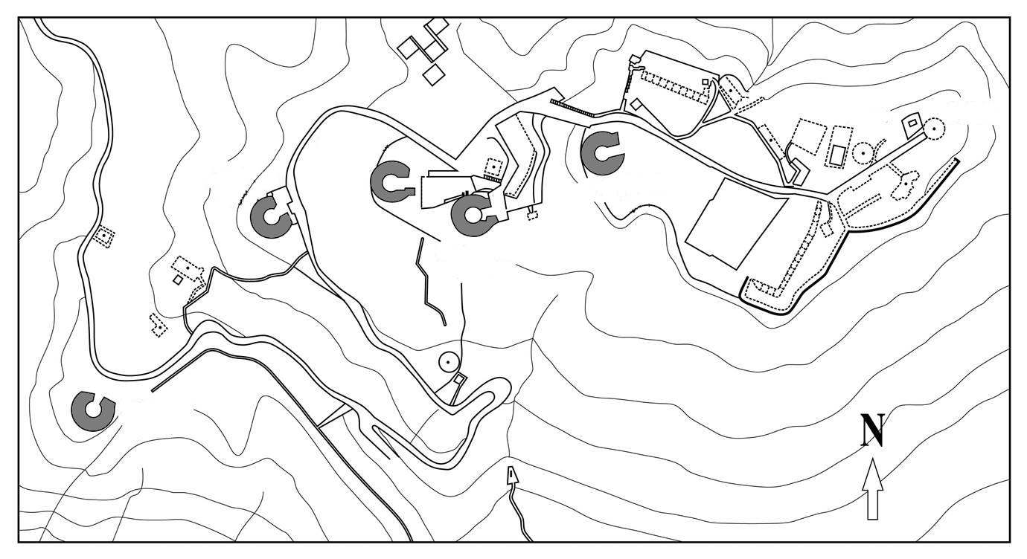
9.2 inch gun
(no. 3)
9.2 inch gun
(no. 2)
9.2 inch gun
(no. 5)
9.2 inch gun
(no. 4)
9.2 inch gun
(no. 1)
Five 9.2 inch guns in the Mount Davis Battery

Slide 20
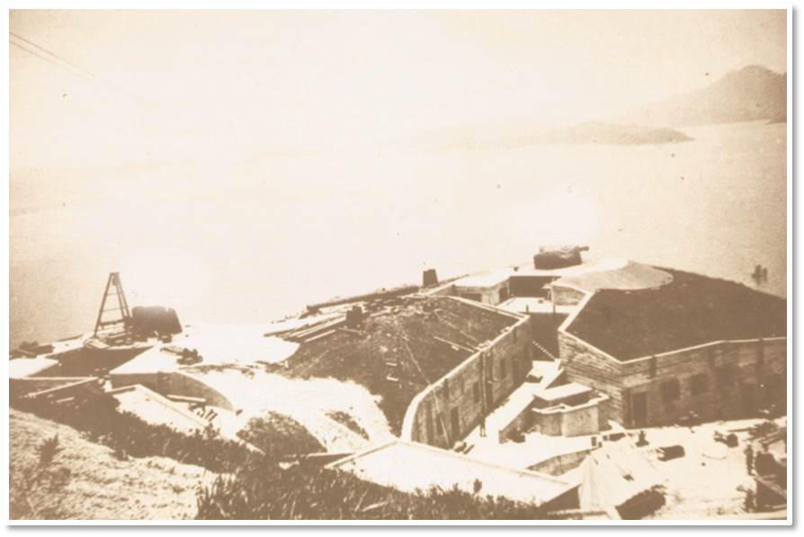
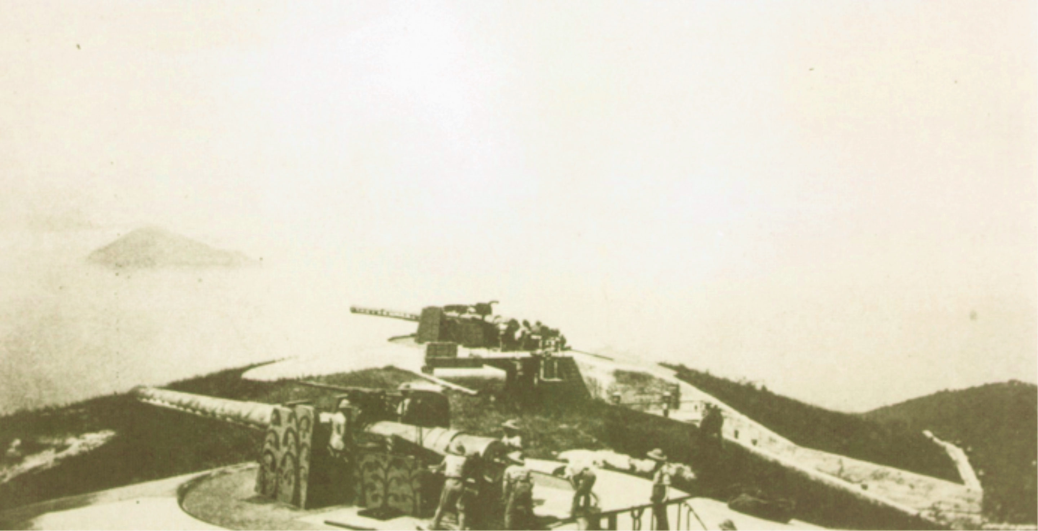
9.2 inch gun no. 3
9.2 inch gun no. 4
Mounting of the guns at Mount Davis
Construction completed

Slide 21
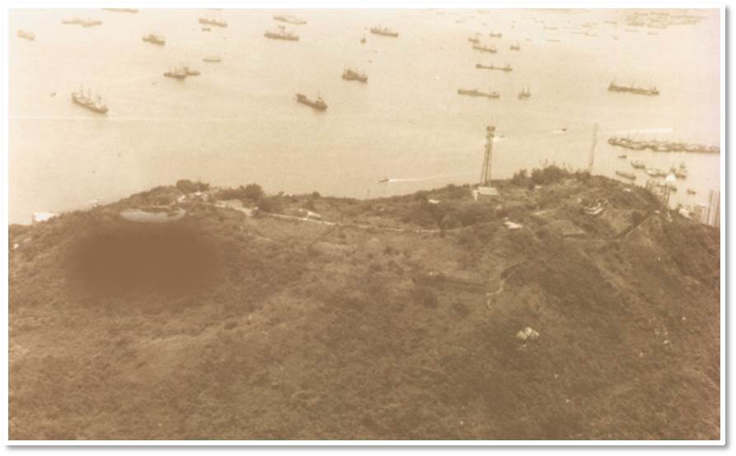
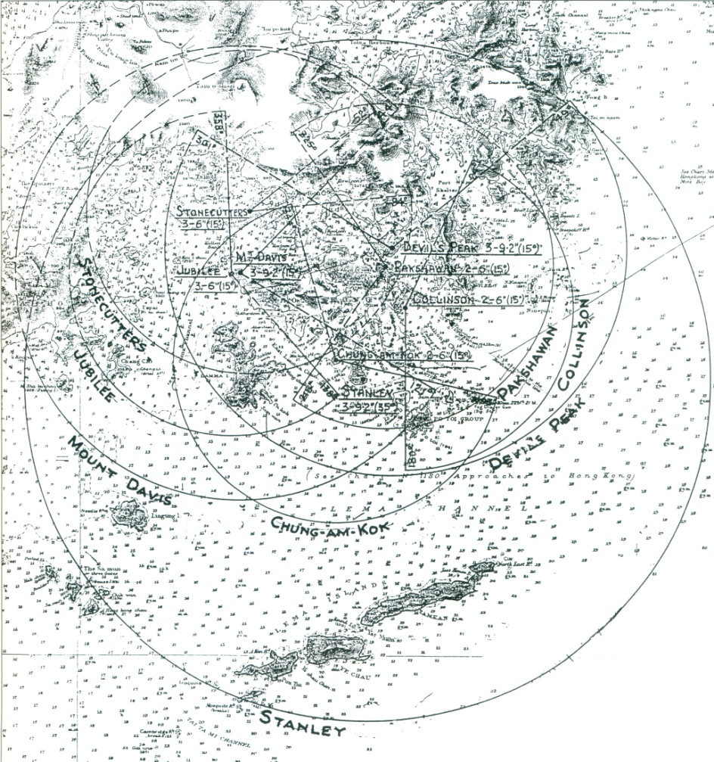
Gun no. 5, the gun on the highest point of Mount Davis
9.2 inch gun no. 5
The arc of fire and range of the Mount Davis Battery in 1938

Slide 22
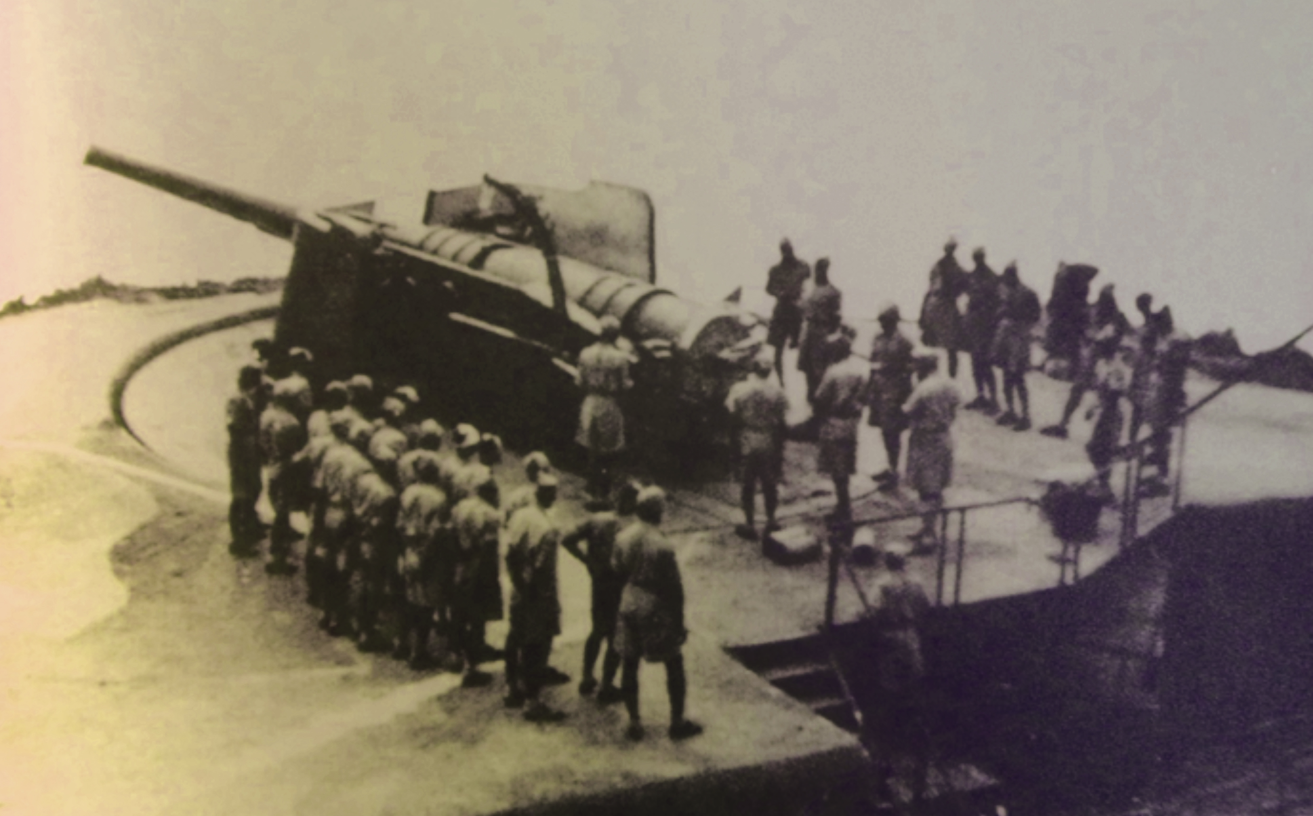
This was a photo taken in the Mount Davis Battery (time unknown), showing a 9.2 inch gun mounted on a Barbette Mark V. The Barbette Mark V was a simple design which allowed the guns to turn from 0 to 360 degrees, and elevate from 0 to 15 degrees. However, it exposed the guns to open air. In the 1910s, this design was still not a major problem, but during the Second World War when airplanes were widely used, it became the fatal weakness in the battles.
The Japanese invaded Hong Kong in December 1941, and started to attack the Mount Davis Battery on 14 December. A gun in the battery was hit. In the following two days, the battery suffered and was damaged from massive bombardments by Japanese warplanes. At last, the Governor of Hong Kong, Sir Mark Aitchison Young, surrendered Hong Kong to the Japanese General Takashi Sakai on 25 December. Hong Kong people considered that day to be “Black Christmas.”

