Slide 1
The Gin Drinker’s Line：
The Bluff of the Eastern Maginot Line
I. The Background of the Battle of Hong Kong
From 1919- to 1930, the British hoped to strengthen Hong Kong’s defense. However, limited by their lack of funds and the Washington Naval Treaty’s restrictions, defensive installations lacked much progress. From 1934 to 1938, the British finished building the Gin Drinker’s Line (醉酒灣防線). This was used to delay enemy soldiers from attacking Hong Kong Island. Using only this defensive line, the British army clearly could not defend in the long term, even though they had already predicted that the Japanese army would be attacking from the north at that time.
The Line’s name originated from Gin Drinkers Bay, a former bay in nearby Kwai Chung, New Territories. It passed through Kam Shan (金山), the Shing Mun Reservioir (城門水塘), Beacon Hill (筆架山), Lion Rock (獅子山), and Tate’s Cairn (大老山), ending at Port Shelter in Sai Kung (牛尾海). Its total length was 18 kilometers. The key points of the Gin Drinker’s Line were the stretch between Beacon Hill and Sha Tin Pass (沙田坳), and the Shing Mun Redoubt (城門棱堡). The Shing Mun Redoubt housed the command headquarters of the Line. (see Wikipedia: Gin Drinkers Line)
In 1941, Japanese soldiers invaded Hong Kong from the north and travelled across the New Territories. The Gin Drinker’s Line became Hong Kong’s main defensive network. The loss of this defensive line marked Hong Kong’s fall into enemy hands.

Slide 2
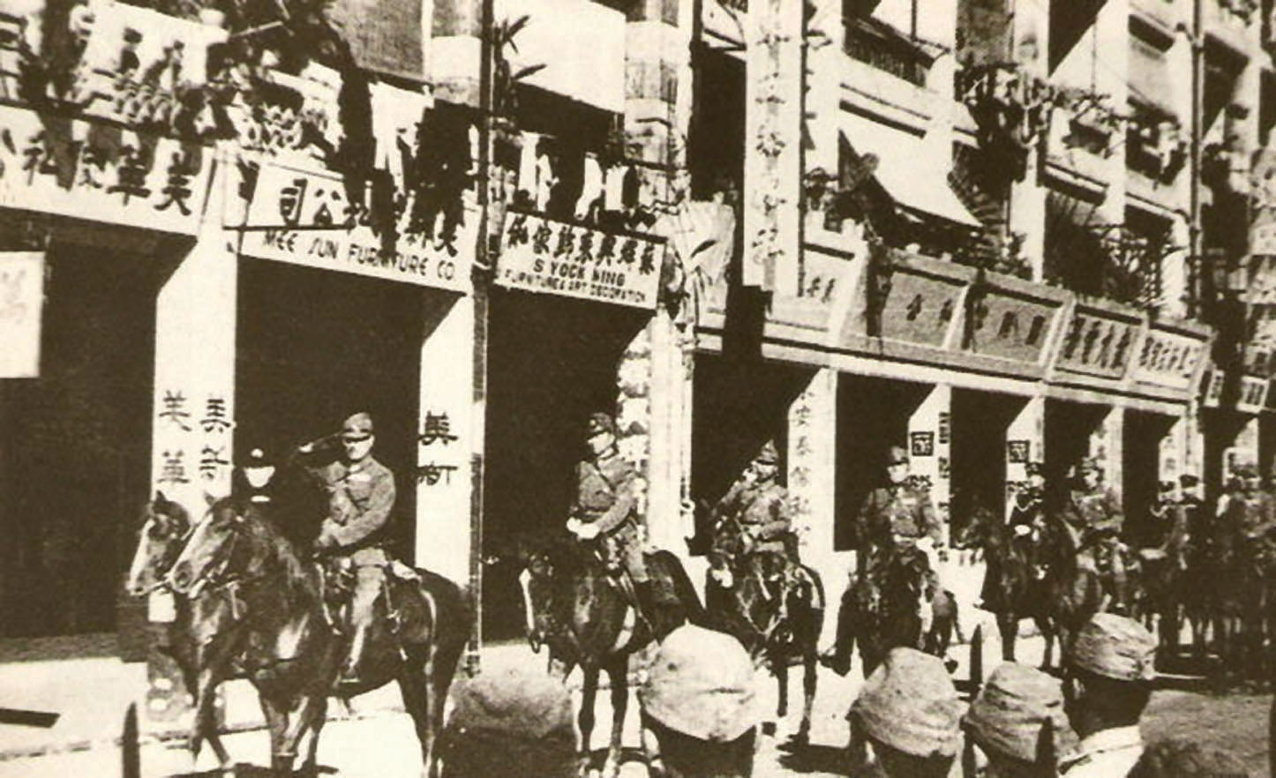
Although Japan had already begun a comprehensive invasion of China in 1937, they had never planned to attack Hong Kong. It was not until 6 November 1941 when the Japanese government suddenly told their highest commander in China that Japan would begin to attack Hong Kong.
Lieutenant-general Takashi Sakai, commander of the 23rd Army stationed in Guangzhou, immediately formulated a plan to attack Hong Kong, named “Operation C”. He planned to use ten days to occupy the entire New Territories, Kowloon and Hong Kong Island. The result was that the Japanese soldiers used eighteen days to occupy Hong Kong. Even though the former plan was slowed, the Japanese army was overwhelmingly powerful.
This piece of information shows two facts: (1) The vast difference between the military power of Japanese soldiers and the stationed British troops in Hong Kong (2) Lacking sufficient military power, the British army gave up New Territories and Kowloon, and retreated to Hong Kong Island. When the Japanese army began to attack intensively, Hong Kong Island fell into enemy hands very quickly. As a result, Hong Kong was under Japanese control for three years and eight months.
On 28 December 1941, Lieutenant-general Takashi Sakai 酒井隆中將 (second on the left) led Japanese soldiers in a formation through Wanchai, Hennessy Road as part of a ceremony which symbolized the entry of the city by victors.

Slide 3
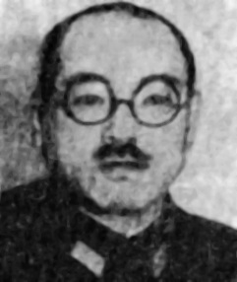
II. The Structure and Strength of the Two Sides
The 38th Division under the 23rd Army was responsible for the occupation of Hong Kong. The head of this Division was Tadayashi Sano from Shizuoka prefecture.
38th Division Office
228th infantry regiment
(3 infantry battalions totaling 3,800 people)
229th infantry regiment
(3 infantry battalions totaling 3,800 people)
Japanese army structure
230th infantry regiment
38th Division
(3 infantry battalions totaling 3,800 people)
Division
Takashi Sakai (1887-1946)
Born: Hiroshima, Japan
Educational background: Imperial Japanese Academy
Army Rank: lieutenant general
Post: Guangzhou 23rd Army commander
(15,000-17,000 people)
Field operations artillery soldiers regiment
Regiment
(2,322 people)
Scout regiment
(730 people)
Squadron
Engineer regiment
(900-1,000 people)
Battalion
Transport and Communications Regiment

Slide 4
Regiment | Origin of Recruits | Quota of Soldiers To Be Recruited | Actual Number of Soldiers Recruited
228 Infantry Regiment | Nagoya prefecture | 3,800 | 3,038
229 Infantry Regiment | Gifu prefecture | 3,800 | 2,901
230 Infantry Regiment | Shizuoka prefecture | 3,800 | 2,890
Total infantry: 8,829

Slide 5
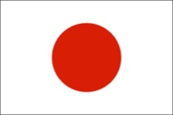
Comparison of British and Japanese Military Power
Participating Countries
Japan | Britain
Commanders
Japanese 23rd Army commander stationed in Guangzhou: Takashi Sakai | British army commander stationed in Hong Kong: Christopher Maltby

Slide 6
Participating Countries
Types of Soldiers (numbers)
38th division, infantry regiment 228 (3,038) 38th division, infantry regiment 229 (2,901) 38th division, infantry regiment 230 (2,890) 38th division, mountain artillery soldiers squadron 38 (1,887) 51st division, division 66, Sadao Araki’s division (6,000) Independent mountain artillery soldiers division 10 (2,150) 1st artillery soldiers division, heavy artillery soldiers squadron 1 (1,201) 1st artillery soldiers division, independent heavy artillery battalions 2 and 3 (1,244) 1st artillery soldiers division, field operations heavy artillery squadron 14 (991) 1st artillery soldiers division, independent mortar battalion 2 (596) 23rd air battalion (1,300) Naval ground combat battalion (600) | Royal Regiment of Scotland 2nd Battalion (769) Middlesex Regiment 1st Battalion (764) 5th Royal Artillery Anti Aircraft Defense Battalion (588) Royal Hong Kong Singapore 1st Artillery Battalion (874) Royal Artillery Soldiers 956th Defensive Squadron (174) Royal Artillery Soldiers Shore Heavy Artillery Battalion (940) Royal Navy (1,600) Royal Airforce (100) Hong Kong Volunteer Defence Corps (1,947) Military necessities, heavy wagons, transport (1,816) 7th Indian Rajput Regiment, 5th Battalion (829) 14th Indian Punjab Regiment, 2nd Battalion (1,005) Canada Winipeg Grenadiers (954) Royal Rifles of Canada (912)
Quiz:
Try to roughly assess the differences between military power on both sides. Given these differences, what kind of strategy do you think the British army could adopt?
In view of the large disparity of military strength, British army decided to use the New Territories’ Gin Drinkers Line to slow down the Japanese army. This allowed the military installations to retreat to Hong Kong Island and the British army could defend against the enemy.
Source: “30 Fenzhong Tujie Shiba Ri Xianggang Baowei Zhan” (30-minute illustrations: the Hong Kong Protective War in Eighteen Days), pp.4-5

Slide 7
III. British Army Deployments and Japanese Army Attack
British Army Deployment: The Gin Drinker’s Line
The New Territories near Shenzhen was too extensive from east to west, and therefore it was too difficult to defend. Thus, the British army withdrew from the western New Territories to Gin Drinker’s Bay, a relatively narrow defensive line, stretching from a mountain range to the eastern side’s Hebe Haven. This was also known as the “Eastern Maginot line”.

Slide 8
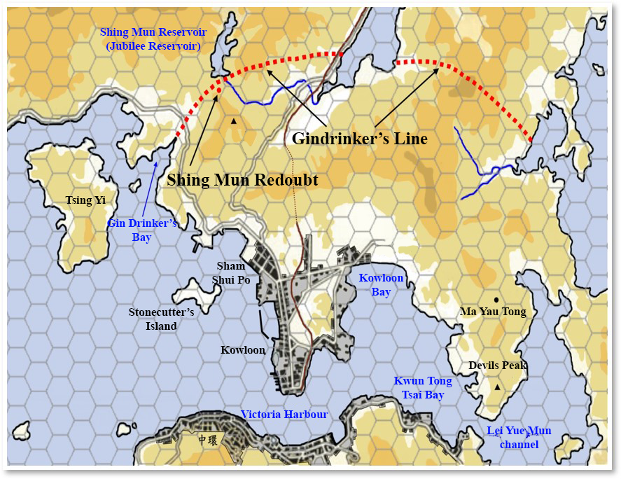
Quiz: Using the above information, can you draw the rough location of the Gin Drinker’s Line on the below diagram?
The Shing Mun reservoir was built in 1936. This year happened to be King George V’s Silver Jubilee (25th anniversary of his coronation) so it was named the Jubilee Reservoir formerly. In 1965, Hong Kong government enlarged the reservoir at Needle Hill to the south of the reservoir area, and this became known as the “Lower Shing Mun Reservoir”. The original Jubilee Reservoir then became known as the “Upper Shing Mun Reservoir”

Slide 9
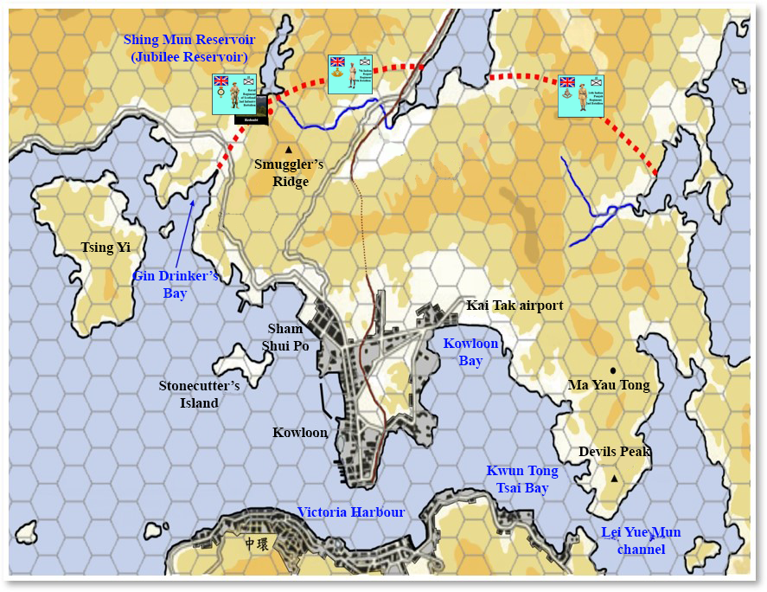
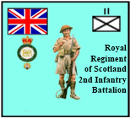
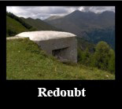
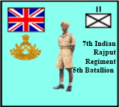
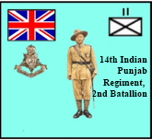
How did the British troops defend the Gin Drinker’s Line?

Slide 10
Division | Origins of Soldiers | Number of Soldiers Stationed in Hong Kong
Royal Regiment of Scotland 2nd Infantry Battalion | Scotland | 769
7th Rajput Regiment, 5th Battalion | Rajput, India | 829
14th Punjab Regiment, 2nd Battalion | Punjab, India | 1,005
British army system
Division
Regiment
Battalion
Company
Quiz: Do you think these types and numbers of stationed soldiers in addition to other defensive arrangements could resist against the advance of the Japanese army?
The numbers of soldiers of these three battalions stationed in Hong Kong were not that few. On the west side, they even had the Shing Mun Redoubt to shield them. If they defended the Gin Drinker’s Line with all their power, they could probably resist against the advance of the Japanese army consistently.

Slide 11
Quiz: According to the above map and information, what importance do you think the Gin Drinker’s Line, particularly the Shing Mun section, had for defending Hong Kong at that time?
The 1930 “Defence of Hong Kong: Report of Joint Planning Sub-committee” explained the Gin Drinker’s Line’s importance: “The Tide Cove-Gin Drinker’s Bay line is a strong defensive position. The only approaches by road both on the east and west run on the edge of the sea and the main approaches, those on the east, are exposed for some thousands of yards to fire of machine guns and light artillery south of Tide Cove. Any frontal attacks on the position must be made over country impassable except to the most mobile infantry and down slopes exposed to the fire of all arms from the main position. A considerable portion of the front is protected by the precipitous gorge of the Shing Mun River, which, if swept with machine gun fire, is capable of stopping any attack southwards from Needle Hill…”

Slide 12
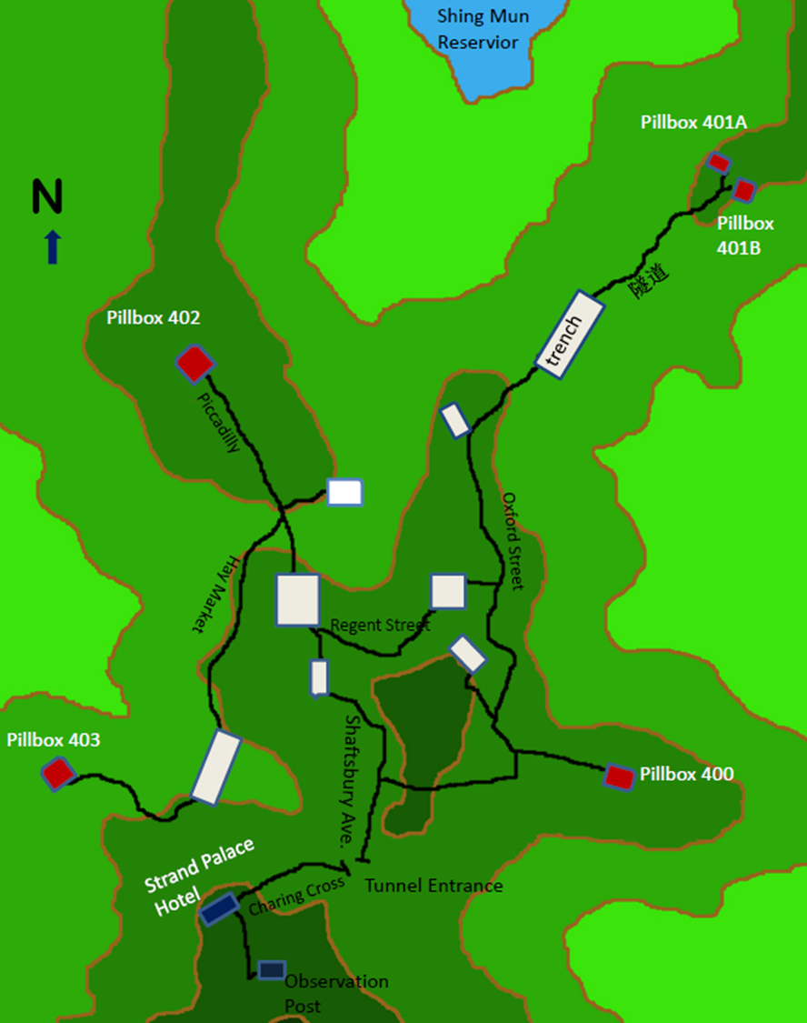
B. In what kind of environment did the Battle of Hong Kong take place ?
Shing Mun:
Pillboxes and Tunnels
The Shing Mun Redoubt was made up of one headquarters stronghold and five pillboxes (machine gun strongholds). Underground tunnels were used to connect these strongholds to each other. The geography above the Gin Drinker’s Line helped it form a solid defensive network. The tunnels were named after famous London Streets and the headquarters was named Strand Palace Hotel.
Source: Kuang Zhiwen and Cai Yaolun (Kwong Chi Man and Tsoi Yiu Lun), “Gudu qianxian: Taipingyang zhanzhen zhong de Xianggang zhanyi” (Lonely Frontline: Battles in Hong Kong during the Pacific War), Hong Kong: Tiandi tushu, 2013, p. 186.

Slide 13
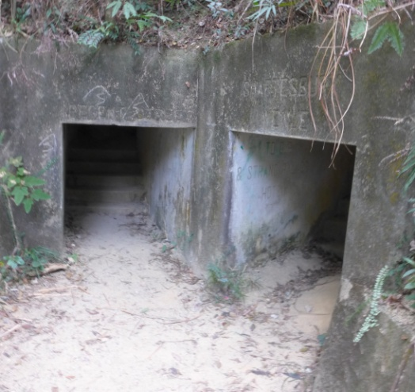
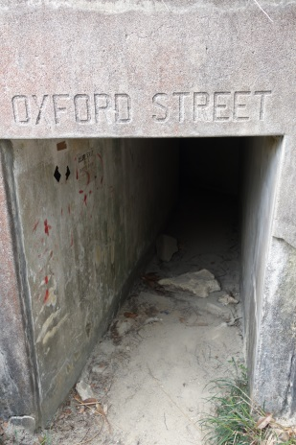
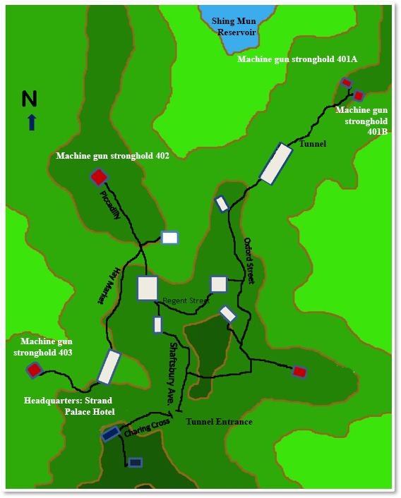
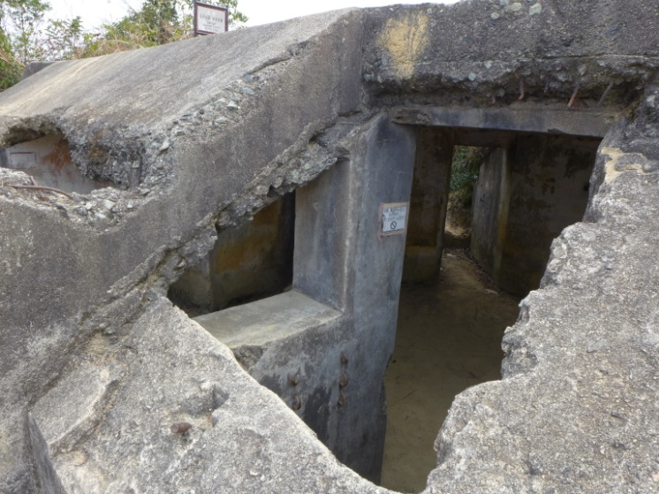
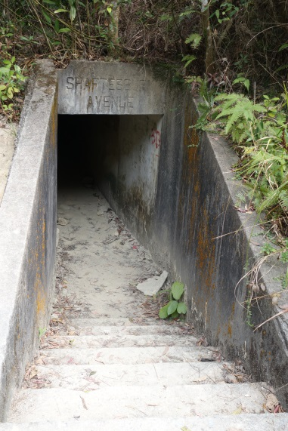
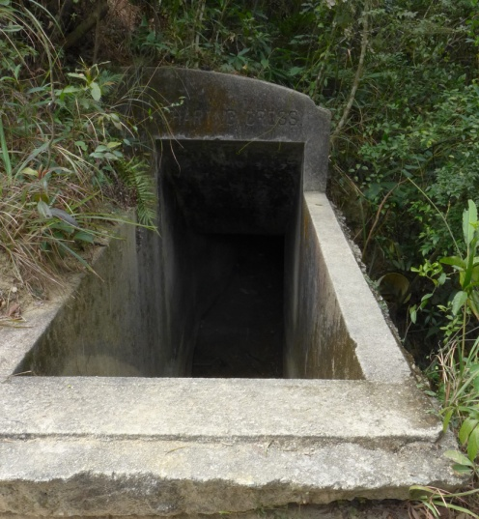
The Tunnel Entrances of the Shing Mun Redoubt
Regent Avenue
Shaftsbury
Avenue
Oxford Street
The Strand Palace Hotel, on the high ground, was the command centre of the whole Shing Mun Redoubt.
Shaftsbury Avenue
Charing Cross

Slide 14
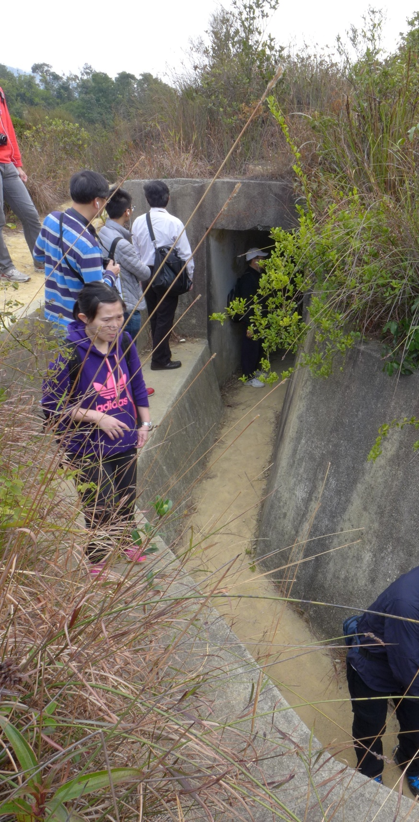
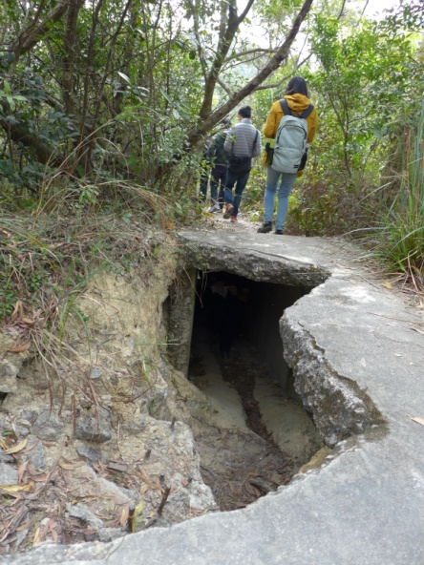
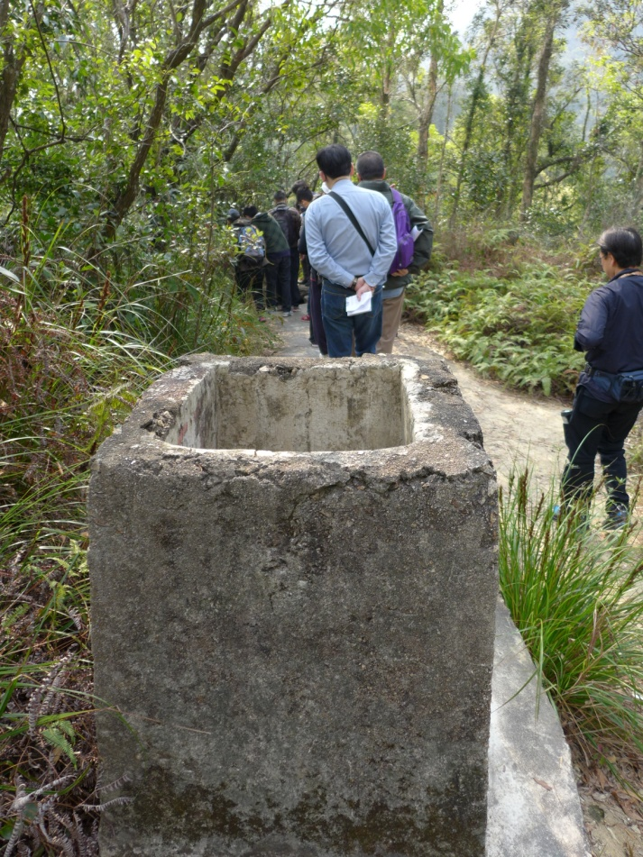
The Tunnel Entrances of the Shing Mun Redoubt
Tunnel entrance and trench
Path surface in disrepair, showing the exposed hidden tunnel
Air vents used to let air go inside tunnel

Slide 15
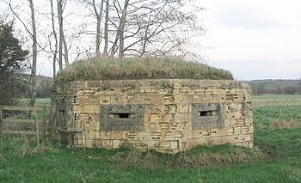
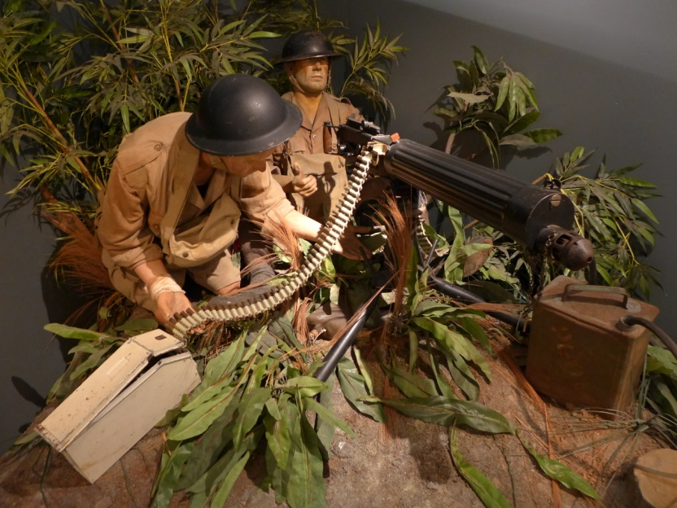
Pillbox
The pillbox was a structure that contained heavy machine guns. It was generally a simple house without a definite form. There were narrow holes on some walls so that soldiers armed with machine guns could see the situation outside and shoot the attacking enemies.
Vickers Machine gun inside a pillbox
Bullet container
Source: Wikipedia: Pillbox (military)
Water tank: used tubing to send water supply into the machine gun opening. This was used to cool off the gun barrel.
By 1941, the Shing Mun Redoubt’s pillboxes had already been destroyed by the Japanese army. It is hard to guess what the original structure would have been like. The above image shows a British pillbox.
The .303 calibre Vickers Mark 1 medium machine gun the most frequently used British machine gun in the Second World War.
（The Hong Kong Maritime Museum exhibit）
Think: Having understood the equipment and defense mechanisms of the Shing Mun Redoubt, please evaluate again whether the British army could have resisted against the Japanese army attacks.

Slide 16
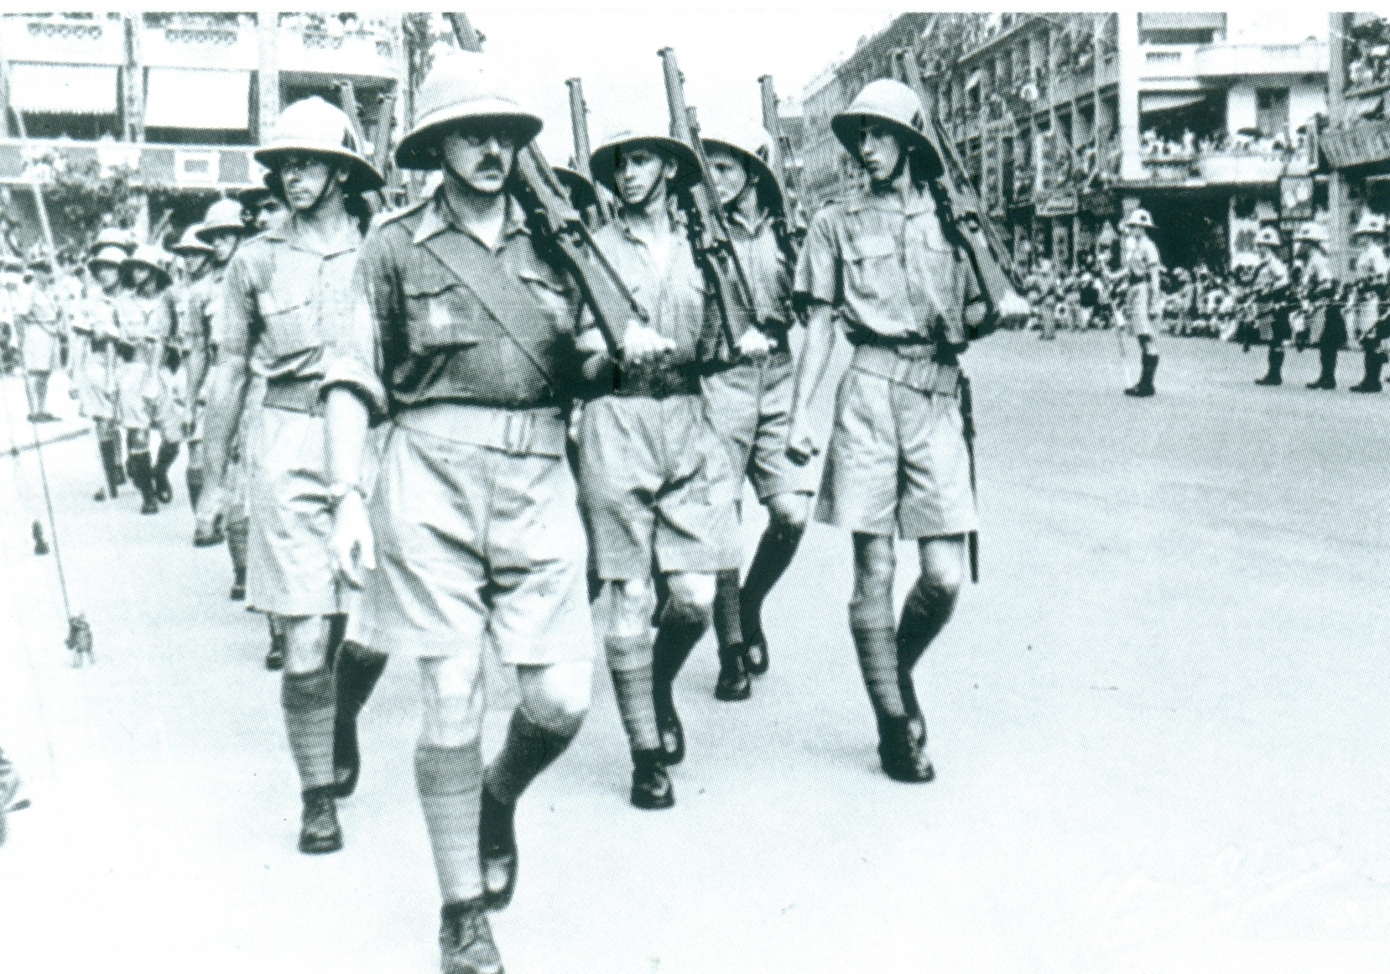
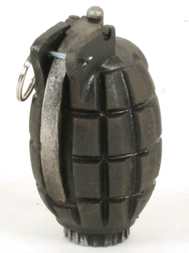
Royal Regiment of Scotland 2nd Infantry Battalion: Responsible for defending the Shing Mun Redoubt
Standard Equipment
M36 grenade
Length 10.16cm
Height 6.09cm
Weight 510g
Detonation time: 4 sec.
Photographed in December 1941, Hong Kong Island
SMLE No.1 Mk.3
Length 113.8cm
Weight 3.96kg
Advantage: High accuracy, good quality steel barrel
Ammunition: .303 British

Slide 17
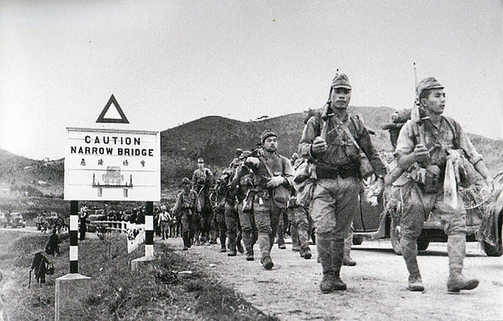
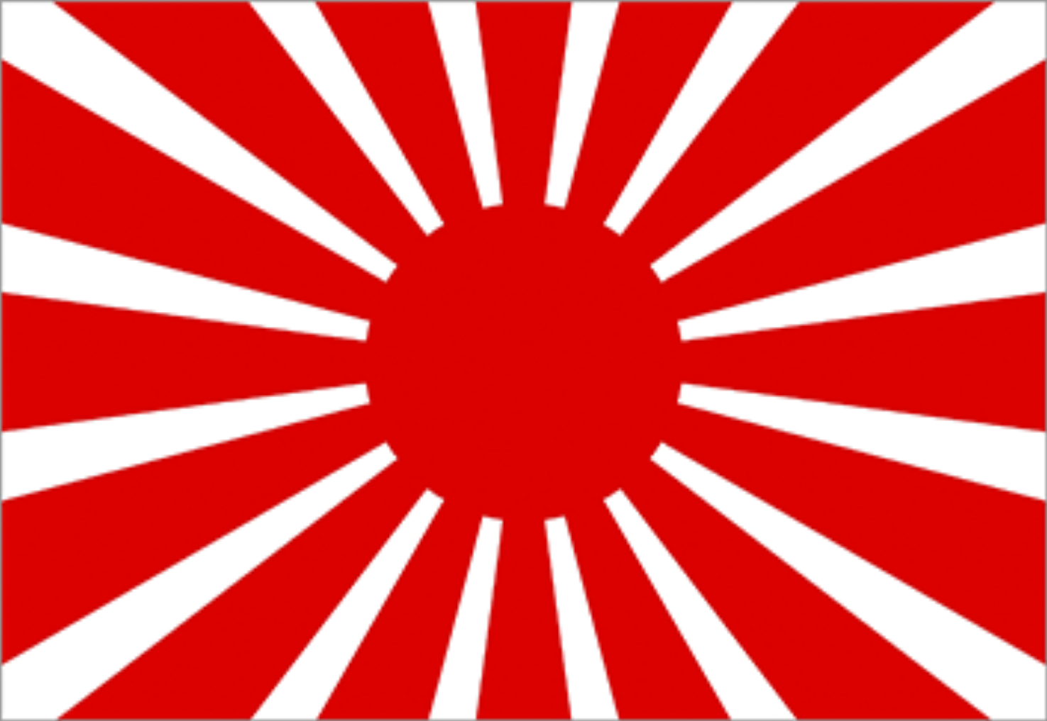
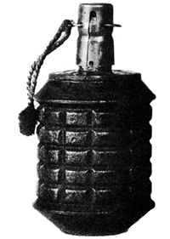
On December 8, the Japanese Land Army, the 38th Division, crossed Shenzhen River and marched towards the New Territories. The below image is the 228th regiment crossing Lo Wu and entering New Territories.
2. Japanese Army Invasion
Standard Equipment
Type 38 Rifle
Faced with the Gin Drinker’s Line, division commander Tadayoshi Sano ordered 3 regiments (228, 229, 230) to wait until every type of heavy weaponry was finished deploying before formal beginning. It was expected that they would need a week’s time and they must not advance prematurely.
Length 127.6cm (with bayonet 166.3cm)
Weight 3.73kg (with bayonet 4.1 kg)
Advantage: high accuracy, good quality steel gun barrel.
Ammunition: 6.5mm (Arisaka)

Slide 18
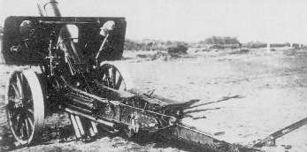
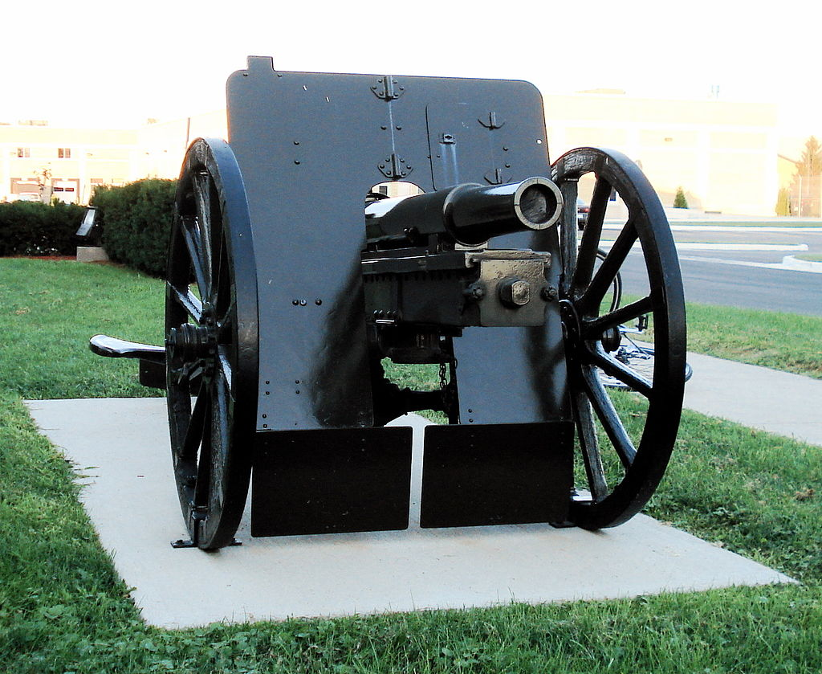
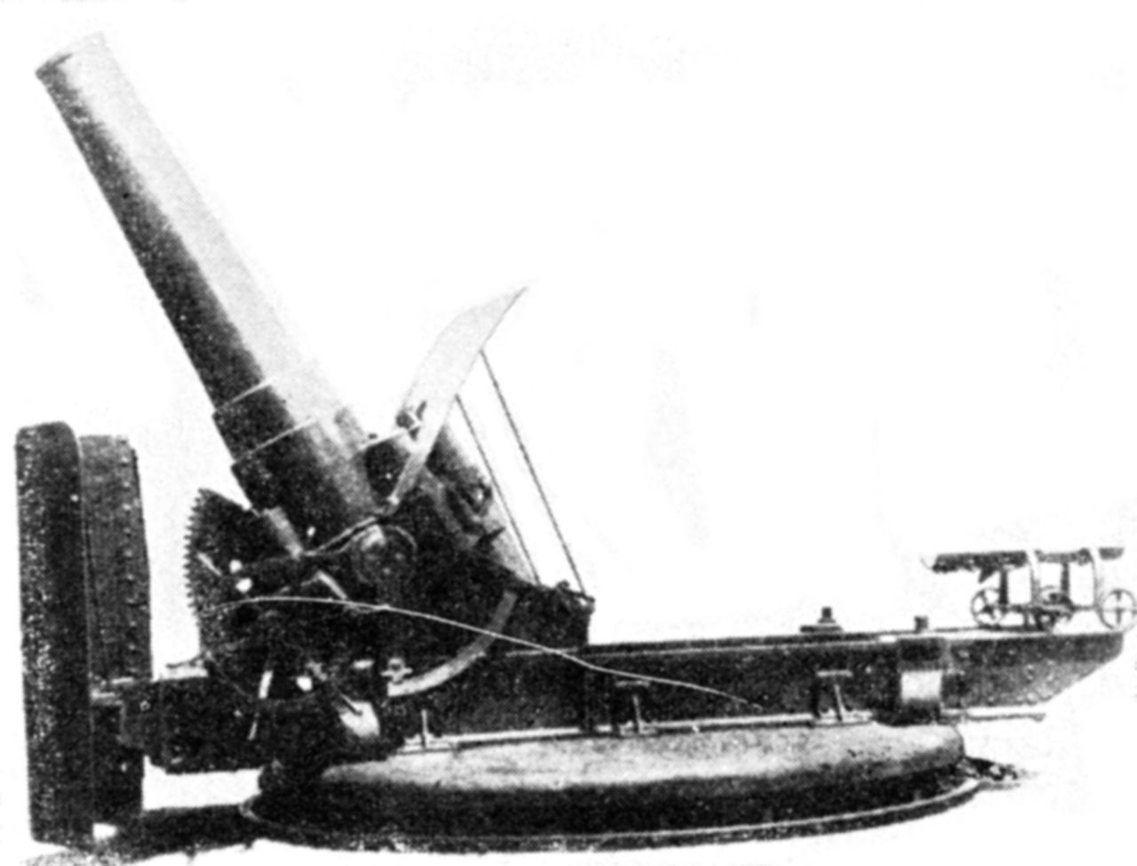
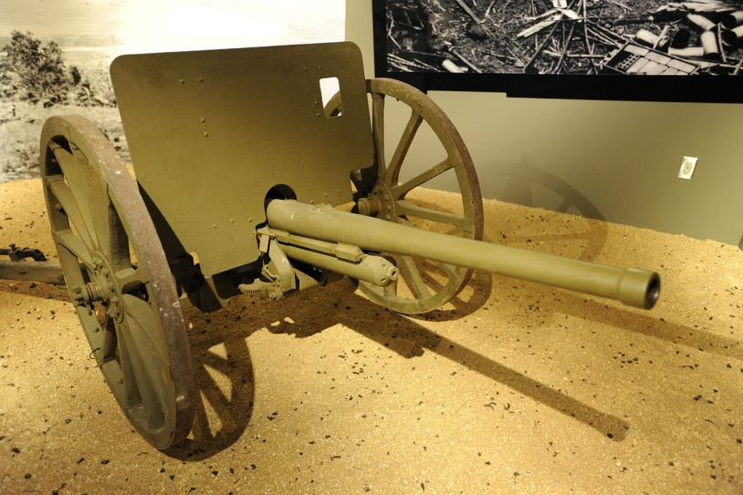
Type 4 150mm Howitzer
Type 41 75mm Mountain Gun
Japanese Heavy Weapons: Field Guns
Type 45 240mm Howitzer
Type 94 37 mm Anti-Tank Gun
Japanese Weaponry Terminology
Type 4: Represented that these weapons were produced in the fourth year of the Taisho period (1915)
Type 41: Represented that these weapons were produced in the 41st year of the Meiji period (1908)
Type 45: Represented that these weapons were produced in the 45th year of the Meiji period (1912)
Type 94: Represented that these weapons were produced in 2594 in the Japanese imperial year calendar (1934).
Source of this page’s images: Wikipedia

Slide 19
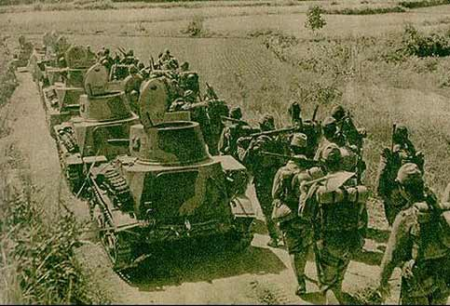
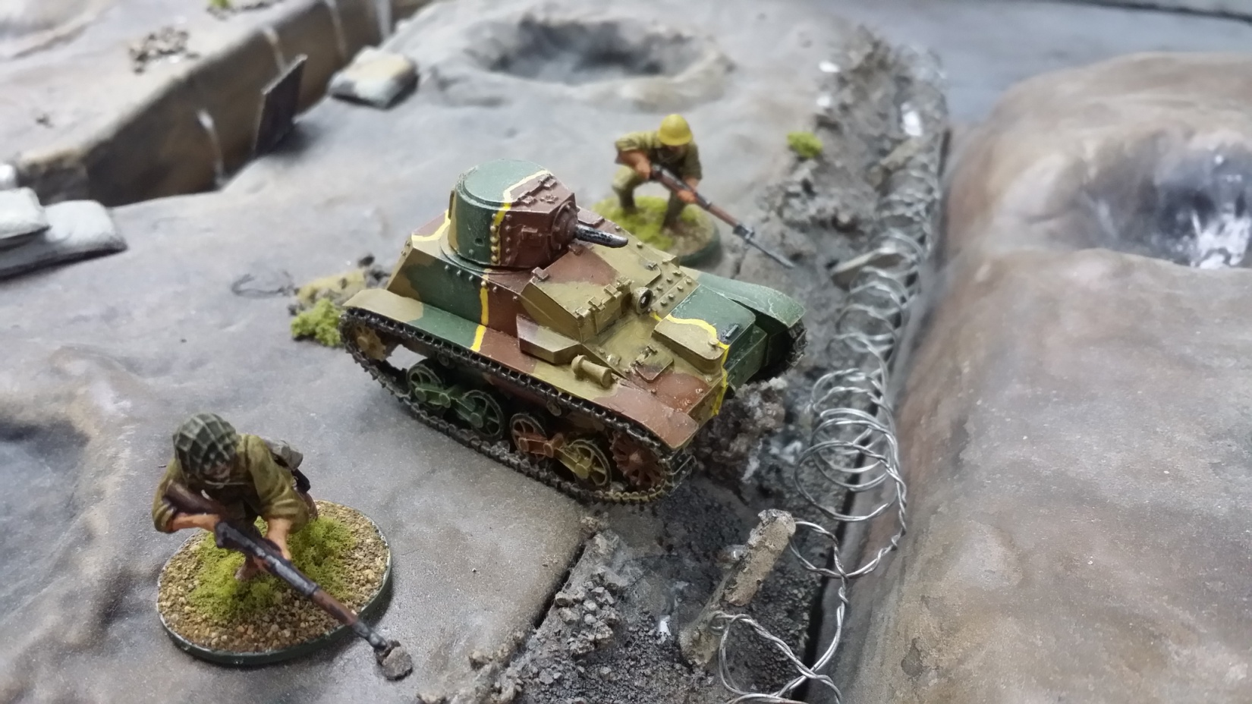
In 1938, under the cover of the Type 94 tankettes, the Japanese army invaded Wuhan, marking the beginning of the invasion of China.
Japanese Heavy Weapons
Type 97 Machine Gun
Type 94 Tankette (literally 94 type light armoured car)
Crew: 2 people
Vehicle length: 3.36m
Armour: 12mm
Speed: 40km/hr (max)
Equipment: Type 97 machine gun
Source: Wikipedia
-Type 94 Tankette;
-Type 97 Heavy Tank Machine Gun.
This type of mini tank, produced in 1933~34, was used to provide a screen for the advancing infantry.
Type 94’s firepower was weak and its armour was thin. However, on the Chinese battlefield, it was more than enough.
When the Japanese army attacked Nanjing (and immediately carried out the “Nanjing massacre”) in 1937, this type of tank was used in large numbers.

Slide 20
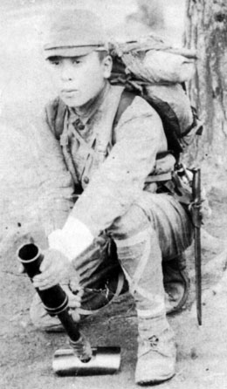
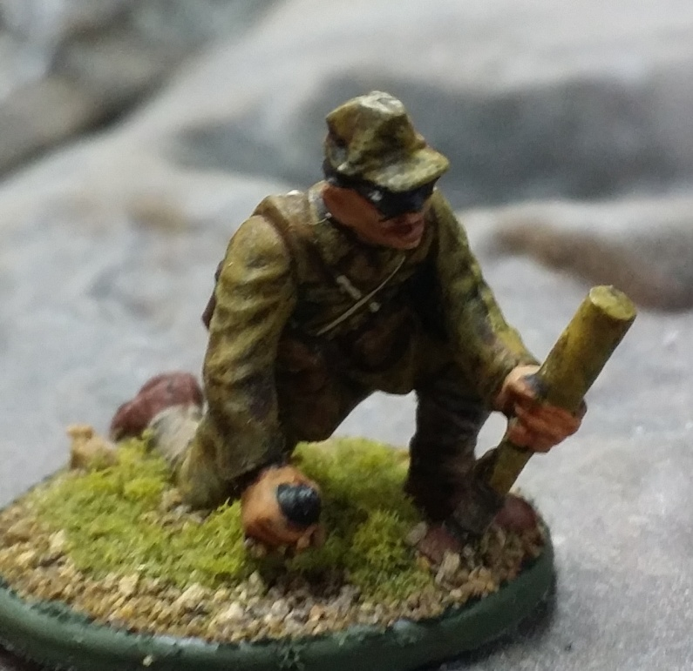
Weapon information
Length: 61cm
Total Weight: 4.7kg
Diameter of Opening: 50mm
Maximum Shooting Distance: 700m
Production Date: 1929
Type 89 Grenade Discharger
The Type 89 Grenade Discharger was a Howitzer manufactured by the Japanese army. It shot small grenades in the Second World War and was used extensively. The diameter was only 50mm, not large enough to destroy a tank but enough to kill and injure enemies or to intimidate enemies for comrades attacking the enemy position. Even though this weapon was small, its total weight still reached approximately 5kg. When it was used, it was placed on the ground and moved to the correct angle. The artillery soldier had to rely on individual experience to carry out this operation. It was said that in the era of the Second World War, the American army consistently believed that this weapon was some kind of knee mortar. When a prisoner of war was captured, he was found trying to use it on his knee. The result was that the recoil power vibrated the soldier’s thigh bone into pieces when it was shot.
Source: Wikipedia, Type 89 Grenade Discharger
Think: On average, do you find that the Japanese army’s weapons were cumbersome or light? Were they suitable for attacking the Gin Drinker’s Line?

Slide 21
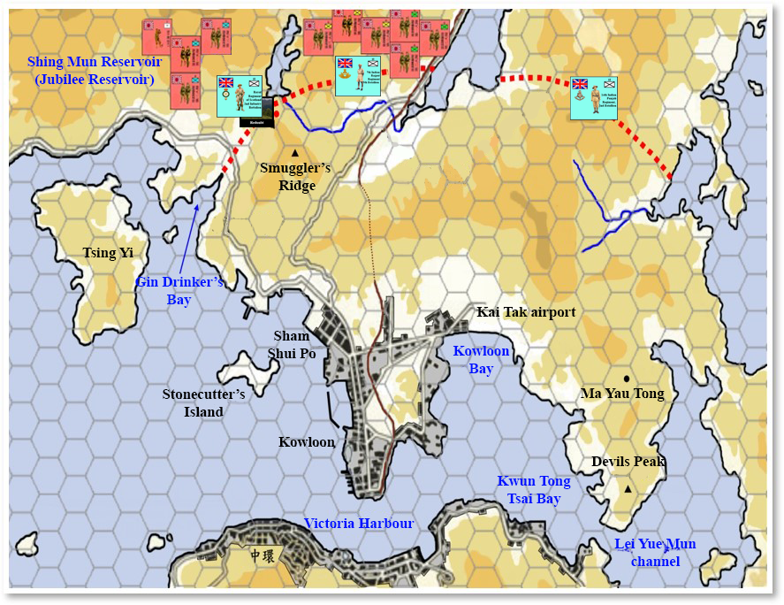
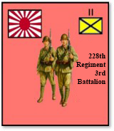
3. The Japanese Army Approached the Gin Drinker’s Line
Division commander, Tadayoshi Sano, could not have guessed that the British army had already evacuated the New Territories at that time. The number of British soldiers left behind to defend the Gin Drinker’s Line was pitifully small. The entire deployment at the Gin Drinker’s Line was just a bluff. If it was not for the fact that the 3rd battalion under the 228th regiment disobeyed orders and attacked, the Gin Drinker’s Line’s really could have held the Japanese army for one week. In reality, another team, the 230th regiment responsible for attacking the Shing Mun Redoubt, strictly complied with their regiment commanders orders and waited for orders.
The 230th regiment had the responsibility of attacking the Shing Mun Redoubt.
3 pm, December 9 : The Japanese soldiers of the 228th division had arrived at Needle Hill, which was situated at the north-east of the Shing Mun Reservoir.
This unit investigated the foot of the hills at the Shing Mun Redoubt. Although they discovered trenches, they could not see any British soldiers and there were only some clothes being hung. The 228th regiment commander, Sadashichi Doi, then understood that the Scottish infantry unit was extremely relaxed.

Slide 22
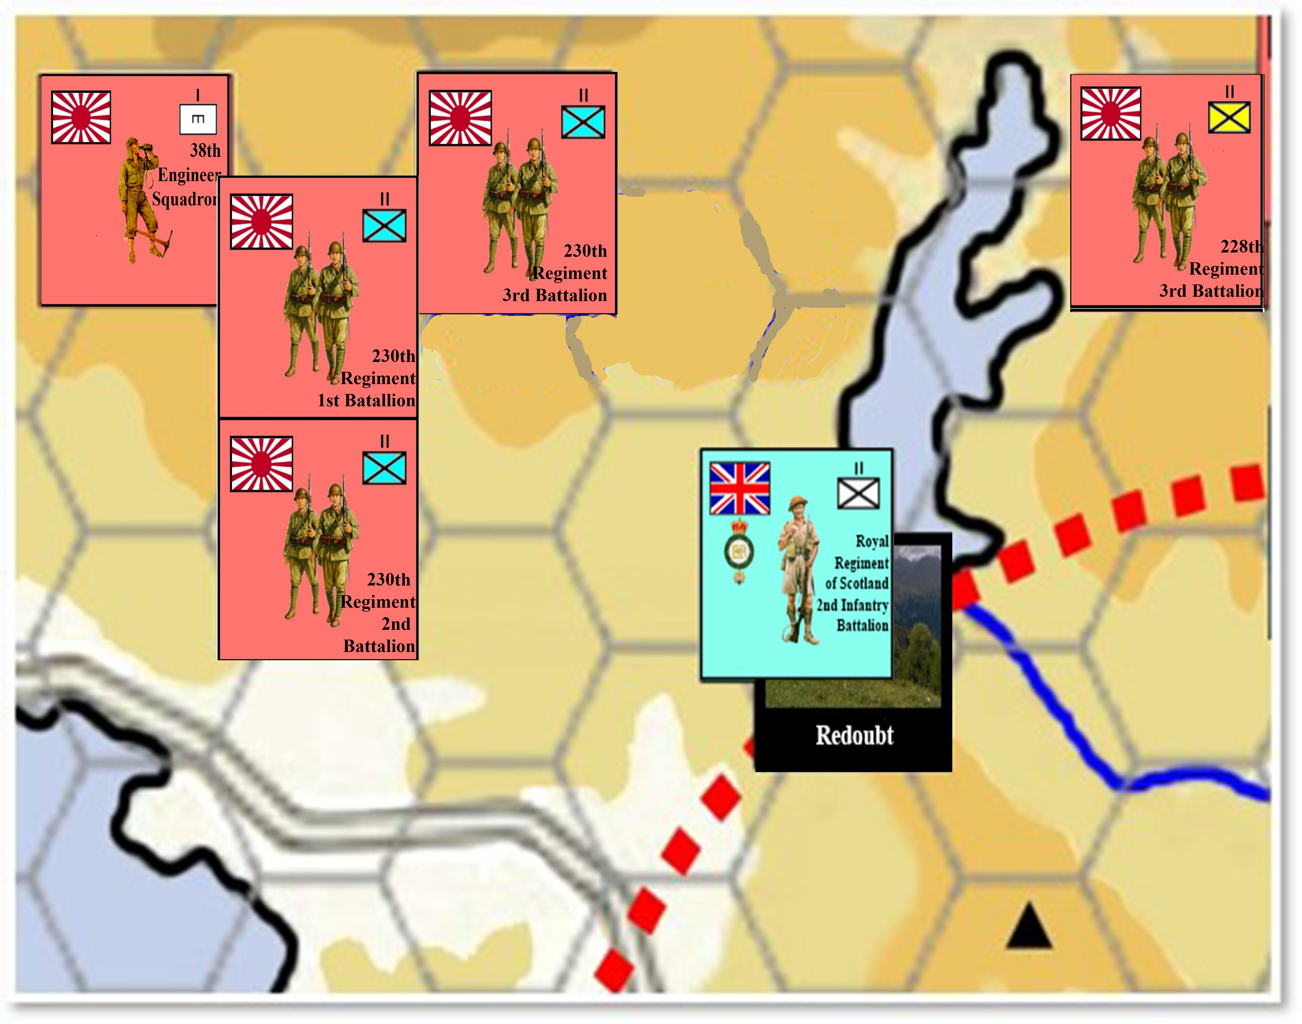
The 2nd infantry battalion of the Royal Regiment of Scotland was defending at the Shing Mun Redoubt. However, there were only a few dozen soldiers (only 3 officers and 39 infantry) of the 8th Platoon of the A Company stationed there. Not only were these numbers pitifully small but discipline was very poor and fighting power was low.
228th regiment commander, Sadashichi Doi, considered whether he should immediately begin assault. However, he had the following difficulties:
（1）Division commander, Tadayoshi Sano, had already ordered that no action was allowed earlier.
（2）The Shing Mun Redoubt was not assigned to the 228th regiment to attack. It had been assigned to the 230th regiment.
（3）Due to the thick fog, the 228th and 230th regiments lost contact with each other.

Slide 23
Quiz: If you were Sadashichi Doi, seeing that there was no time to lose, would you decide to commence the attack? Or would you stringently observe orders?
In the end, Sadashichi Doi believed that there was no time to lose and braved the risk of punishment. He sent out the 9th and 10th squadrons of the 3rd battalion in the 228th regiment to commence the attack around 7:00 pm at night.
9pm: The 9th and 10th squadrons, totaling approximately 150 infantry, crossed the main dike of the Shing Mun Reservoir and advanced. The Scotland Reigment infantry at the Shing Mun Redoubt suddenly realized the combat had begun.

Slide 24
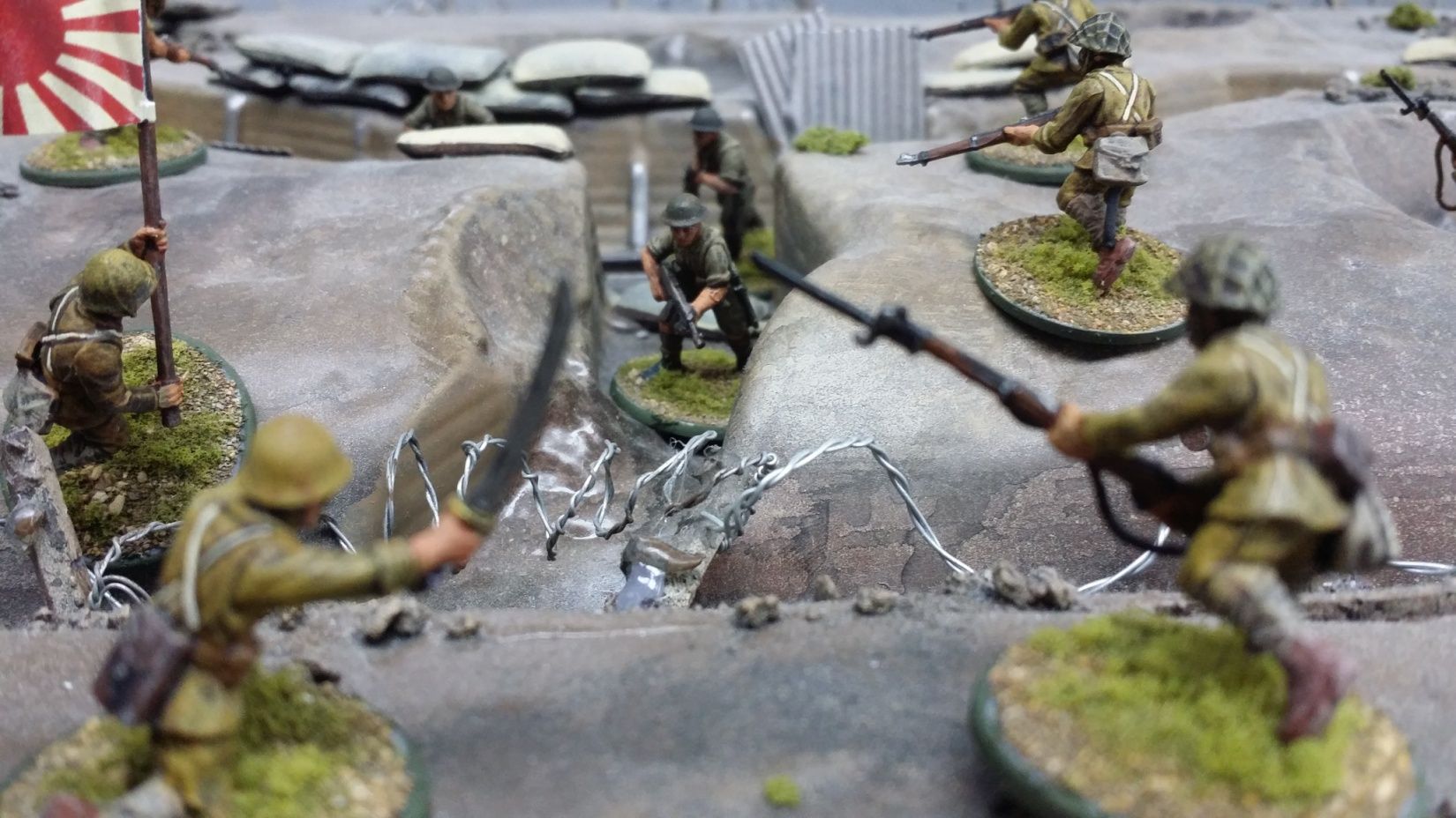
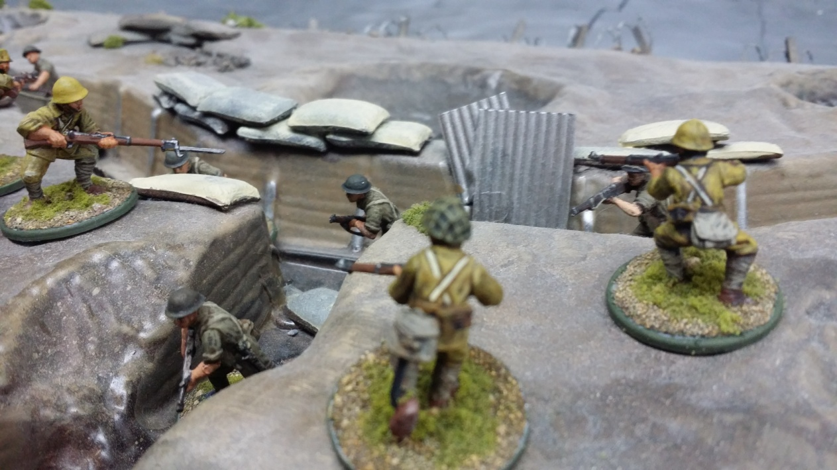
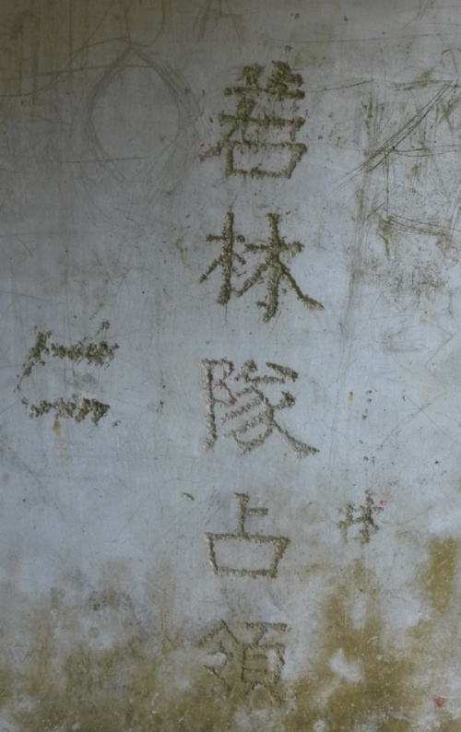
7:00pm, December 9: The Japanese army crossed the dike and arrived at the Shing Mun Redoubt. The battle officially began.
3:00am, December 10: Commander Cyril Jones of the A Company, 2nd Battalion, Royal Regiment of Scotland surrendered. The Shing Mun Redoubt fell into Japanese hands.
However, Sadashichi Doi was criticized in his army because he had disobeyed orders.
Wakabayashi Toichi (若林東一) was the Commander of the 10th Squadron, 228th regiment, on that day and played a role in taking the Shing Mun Redoubt.
On a visit to the redoubt tunnel, one will discover the words “若林隊佔領” (Occupied by Wakabayashi’s squadron), but there is no way of knowing who or when these words were carved.
Quiz:
Try to find out what the “Maginot Line” was from the internet. Do you think that it is appropriate to see the Gin Drinker’s Line as an “Eastern Maginot Line”?

Slide 25
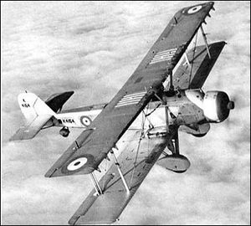
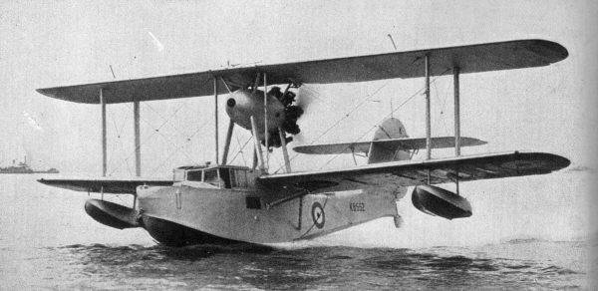
IV. Appendix: The Air Power of the British Army in Hong Kong
Apart from the war on land, the air battle was also decisive. Do you know the circumstances of the only time that the British and Japanese air forces fought in the Battle of Hong Kong?
Source 1: Air Deployment of Both Sides in the Battle of Hong Kong
Vickers Vildebeest Topedo Bomber:
Number: 3
Arms: two 7.7mm machine guns and one torpedo.
Maximum velocity: 230 km/hr.
Note: This fighter plane’s design was to attack ships at sea originally. It could not fight the battle in mid-air as it flew slowly. This was the weak point of the fighter plane.
Supermarine Walrus
Number: 2
Arms: two 7.7mm machine guns, each artillery shell was 345kg.
Maximum velocity: 215 km/hr.

Slide 26
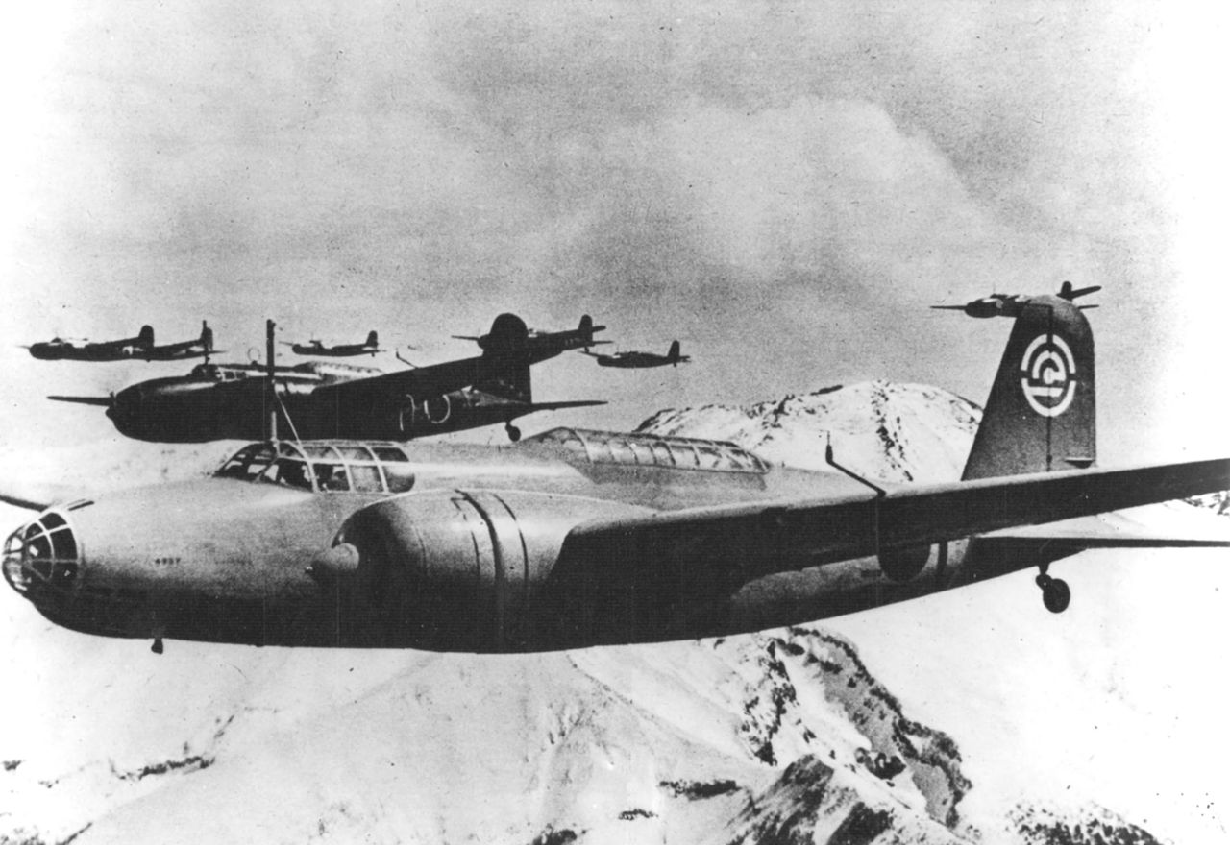
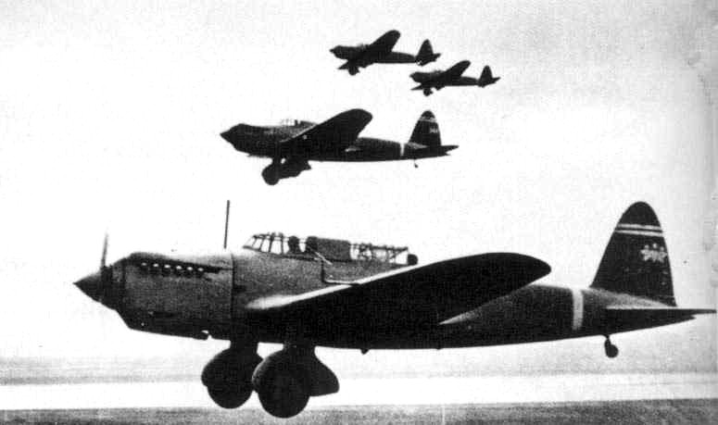
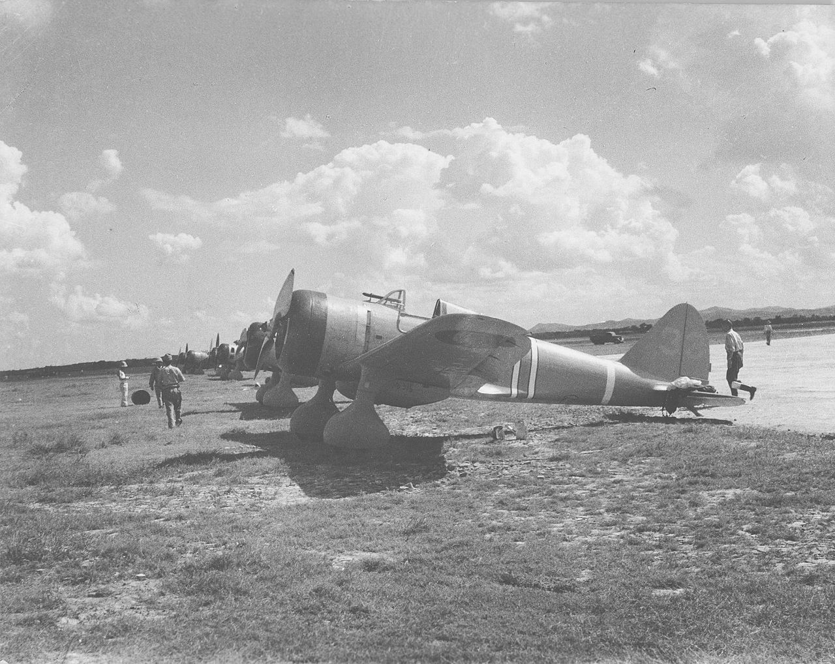
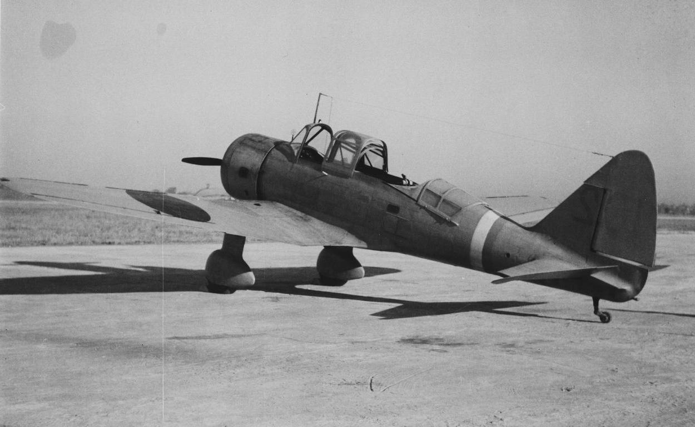
Type 97 Fighter Plane
Length: 7.53m
Arms: two 7.7mm machine guns, four 25kg artillery shells.
Maximum velocity: 460 km/hr.
Type 98 Co-operation Surveillance Aircraft
Length: 8m
Arms: two 7.7mm machine guns, ten 12.5kg artillery shells or one 500kg artillery shell.
Maximum velocity: 349 km/hr.
Type 97 Bomber Plane
Length: 16m
Arms: five 7.7mm machine guns, one 12.7mm machine gun, one 750-1000kg artillery shell.
Maximum velocity: 478 km/hr.
Type 98 Light Bomber Plane
Length: 11.5m
Arms: three 7.7mm (two in the front, one in the back), one 450kg artillery shell.
Maximum velocity: 423 km/hr.
Source: Wikipedia: “Vickers Vildebeest”, “Supermarine Walrus”；Wikiwand: “Xianggang Baowei Zhan” (The Battle of Hong Kong): “30 Fenzhong Tujie” (30-minute Illustrations), p.16

Slide 27
Source 2: Historical facts
At 8:00am on 8 December 1941, the Japanese Air Forcesent sent thirteen Type 97 Fighter Planes, six Type 98 Co-operation Surveillance Aircrafts and thirty-four Type 98 Light Bomber Planes to the Kai Tak Airport in Kowloon. They began a concentrated air raid. The air raid succeeded and Hong Kong airpower was completely paralyzed.
Question:
It was said that Hong Kong soldiers were powerless to resist during the Japanese invasion. Do you agree with this? Try to use Source 1 and 2 to support your argument.

