Slide 1
The Battle of Red Cliffs (Chibi): Naval Battle
In AD207, the warlord Cao Cao (曹操), a counsellor-in-chief of the Han dynasty, unified northern China. He did this by defeating both the army of another warlord, Yuan Shao (袁紹) in Hebei, and a frontier tribe called Wuhuan (烏桓). To defeat the southern regional powers, in the seventh lunar month of AD208, Cao Cao led his armies south and attacked Jingzhou (荊州) in the mid-Yangzi valley. One month later, the Jingzhou regional governor, Liu Biao (劉表), suddenly died. Sun Quan (孫權) , a powerful regional power in the lower Yangzi delta, discussed with the troop leaders under Liu Biao stationed near Jingzhou, especially Liu Bei (劉備), about forming an alliance to resist against Cao Cao.
The Battle of Red Cliffs (Chibi) occurred in the twelfth lunar month of AD208. Cao Cao was defeated by the allied forces formed by Sun Quan and Liu Bei. As a result, the continent of China remained divided by the regional powers of Cao, Sun and Liu. This period was referred to by historians as the Three Kingdoms era (AD220-280).
I. The Background of the Battle of Red Cliffs (赤壁 Chibi)

Slide 2
Modern photo of Red Cliffs

Slide 3
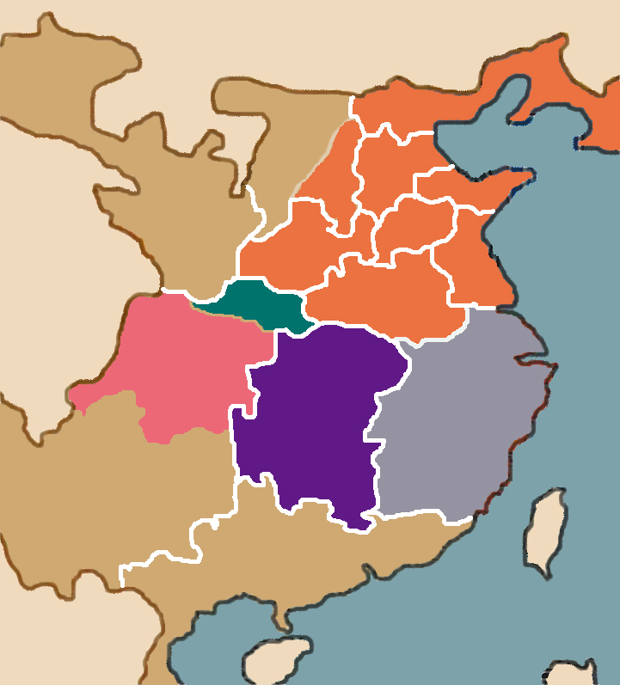
Map of the Battle of Red Cliffs (Chibi)
The Battle of Red Cliffs (Chibi) happened in 208 is the most famous naval battle on the Yangzi river in the Chinese history. At that time, Cao Cao had already defeated Yuan Shao and had become the overlord of Northern China. Cao Cao needed to finish the unification of China. He first needed to pacify Sun Quan and Liu Bei of the fertile region in the Yangzi river basin. Liu Bei at that time was still only a minor character, only under Liu Biao as an affiliated military leader and nothing more.
Cao Cao
Youzhou
Jizhou
Bingzhou
Ma Teng
Qingzhou
Liangzhou
Yanzhou
Zhang Lu
Sili
Xuzhou
Liu Bei
Yuzhou
Liu Zhang
Sun Quan
Liu Biao
Yizhou
Jingzhou
Yangzhou
Jiaozhou

Slide 4
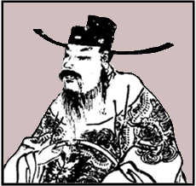
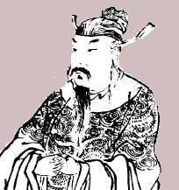
II. Information on the Generals of Both Sides
Cao Cao
• He was born in a humble family. His adoptive grandfather, Cao Teng (曹騰), was an eunuch (宦官).
• AD174: At 19 years old, he started working as a local official in some districts.
• AD192: At 37 years old, he established his own army named the Qingzhou Corps (青州兵) in Shandong (山東).
• AD194: He was appointed by the imperial court to become the regional governor of Yanzhou (兗州).
• AD200: He defeated Yuan Shao in the battle of Guandu (官渡) and was able to control northern China.
• AD208: At 53 years old, he became counsellor-in-chief. In the same year, he travelled south to pacify Jingzhou, particularly Fancheng (樊城) where Liu Bei was stationed.
AD155-220
Cao Cao
Sun Quan
• He was born in a noble family in Yangzi river delta. His brother, Sun Ce (孫策), was the most powerful warlord there.
• AD200: After Sun Ce had been assassinated, Sun Quan, at the age of 18, became the most powerful person in his family. He was appointed by the imperial court as a general and as Huiji (會稽) county governor, in charge of administering Suzhou (蘇州) and other districts in the Yangzi delta.
• AD208: When Cao Cao travelled south on an expedition, Sun Quan, at the age of 26, and Liu Bei resisted against Cao Cao.
AD182-252
Sun Quan

Slide 5
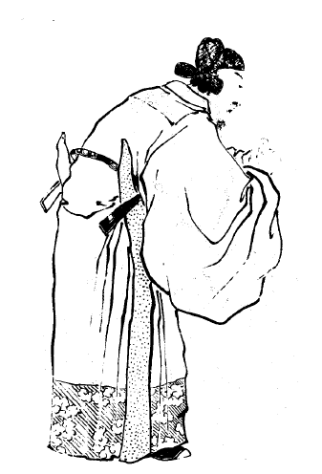
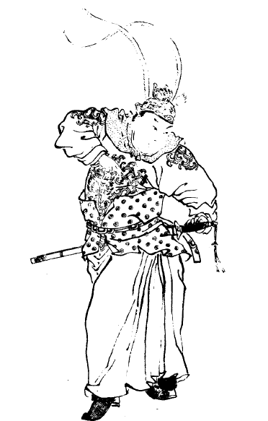
Lu Su (魯肅): In AD208, he was 36 years old. He was a distinguished diplomat working for Suan Quan. He travelled far to Hanjin (漢津) to persuade Liu Bei to form the Sun-Liu allied armies to resist against Cao.
Zhou Yu (周瑜): In AD208, he was 33 years old. He was the sworn brother of Sun Ce. After the death of Sun Ce, he assisted Sun Quan and became Sun Quan’s most important military general at the Battle of Red Cliffs (Chibi).

Slide 6
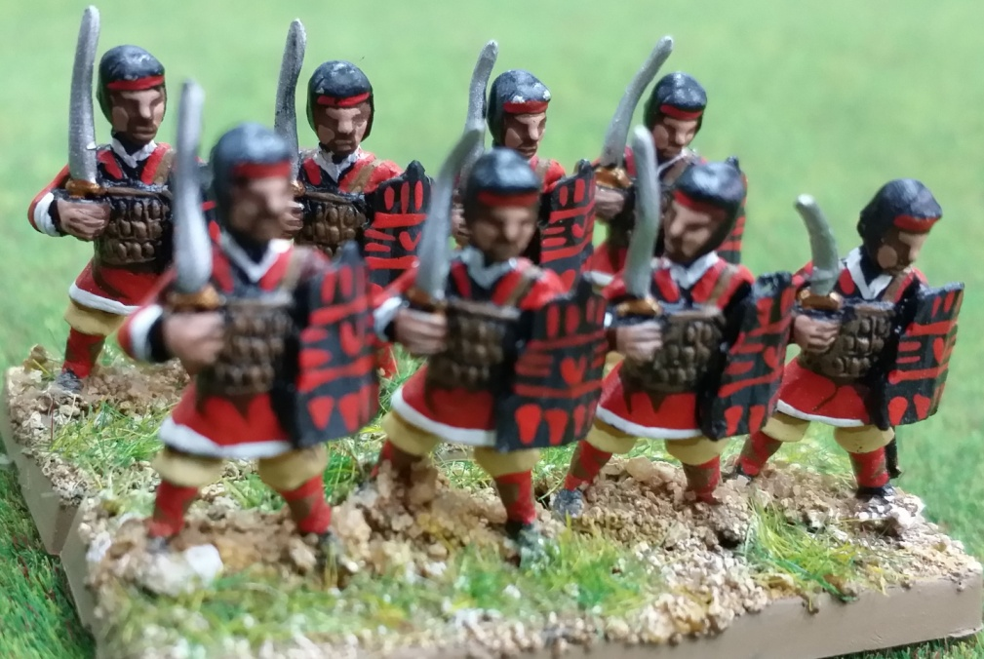
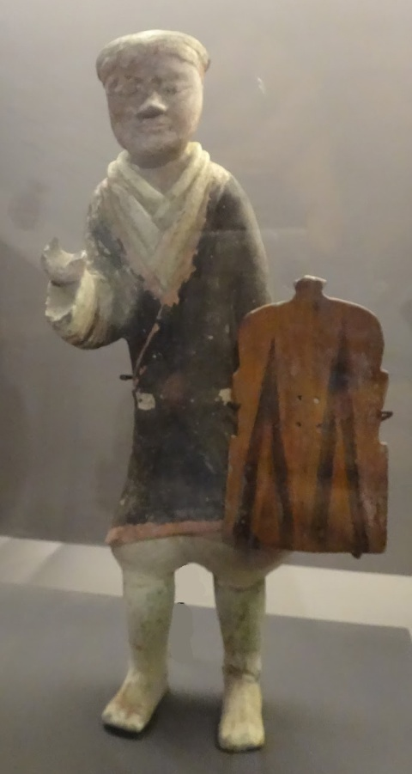
II. A Comparison Between Both Armies
A. Cao Cao’s army
Cao Cao’s Qingzhou Corps
East Han era’s infantry
The square shield was the basic defensive item for Han dynasty (202BC –AD220) and the Three Kingdoms (AD220–280) infantry. The square shield could protect armies behind infantry and stop long range arrows.
Qingzhou in Shandong was Cao Cao’s base of operations. Qingzhou people were famous for their bravery. Their square shields, body armours and helmets made them Cao Cao’s elite combat troops.
A statue of a Han dynasty soldier holding a square shield. Photo taken from the exhibition The Rise of the Celestial Empire in the Hong Kong Museum of History.

Slide 7
In AD192, the Yellow Turban Army in Qingzhou comprising of over a million local bandits surrendered to Cao Cao. Cao Cao selected 300,000 of their strongest men to form the “Qingzhou Corps”. The Qingzhou Corps became the core unit of Cao Cao’s army. They were famous for their bravery. Over the next decade or so, they defeated Yuan Shao and other northern powers.
To pay soldiers, Cao Cao implemented the military farming system (tuantian 軍屯). This meant that instead of paying soldiers in cash or food, Cao registered each soldier in a book and distributed farmland to him (and his family). This saved Cao Cao a lot of money.

Slide 8
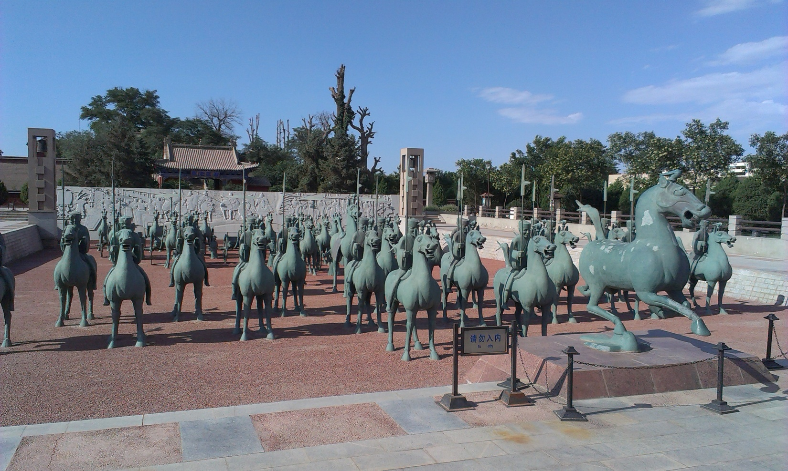
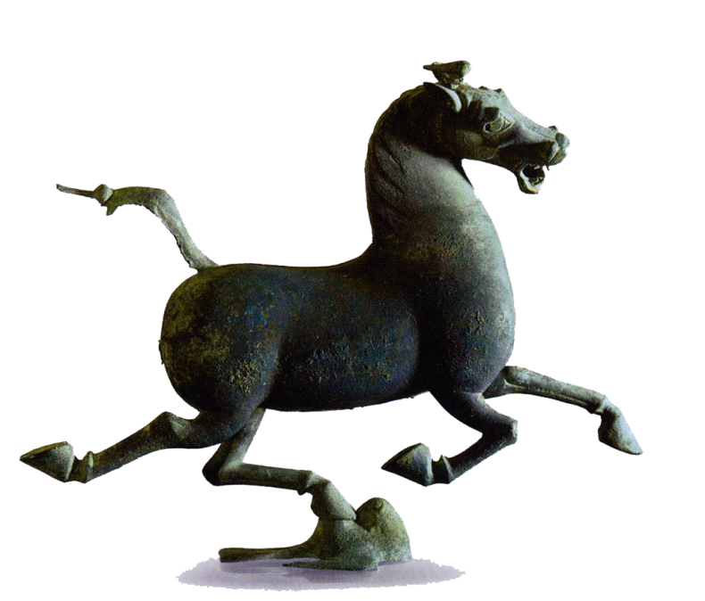
The brave Northern Cavalry
This photo is taken at the tomb at Wuwei (武威) county. The owner of the tomb was a military officer from the neighbouring county of Zhangye (張掖). Inside the tomb was 38 bronze horses, 1 bronze ox, 14 bronze chariots, 17 statues of warriors holding long halberds, and 28 slave statues. These items were buried around AD186-219, near the time of the Battle of Red Cliffs (Chibi)(AD208). The tomb statues show the importance of war horses in this era.
Bronze Running Horse (Wikipedia)

Slide 9
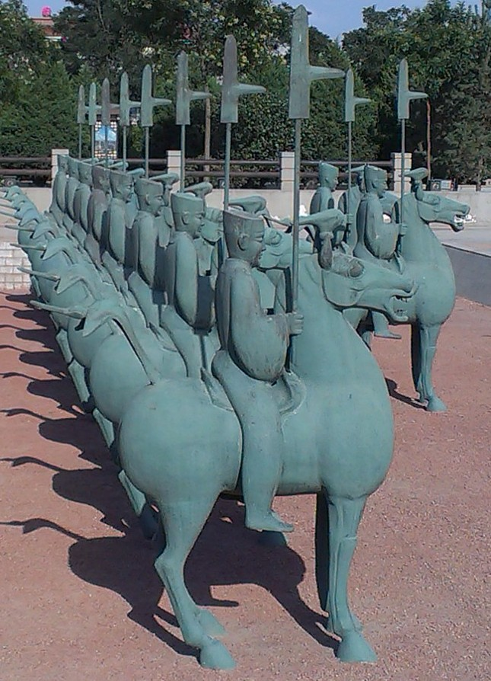
Cavalry
Quiz: What is the advantage of cavalry not wearing armour?
Since light cavalry did not wear armour, the loads of their horses could be lightened and they could run faster.
No stirrups. Horsemen held reins to control the horse in one hand and a long weapon in the other hand. They had to be very skilful.

Slide 10
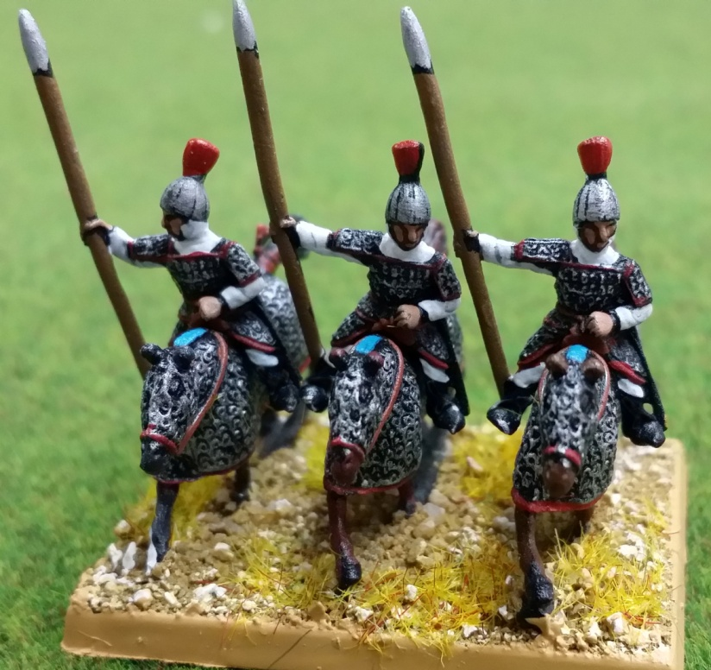
The “Tiger and Leopard Cavalry”
(虎豹騎)
The “Tiger and Leopard Cavalry” was the most elite cavalry of Cao Cao, similar to the Emperor’s Palace Guard. Only Cao relatives could be placed in charge of this army, such as Cao Chun, Cao Xiu or Cao Zhen. As it was an elite unit, historians believe the cavalry wore armour.
Think: Having seen the above information, what do you think Cao Cao’s military advantage was? (ans. Cavalry) Try to assess his chance at winning a southern military campaign.

Slide 11
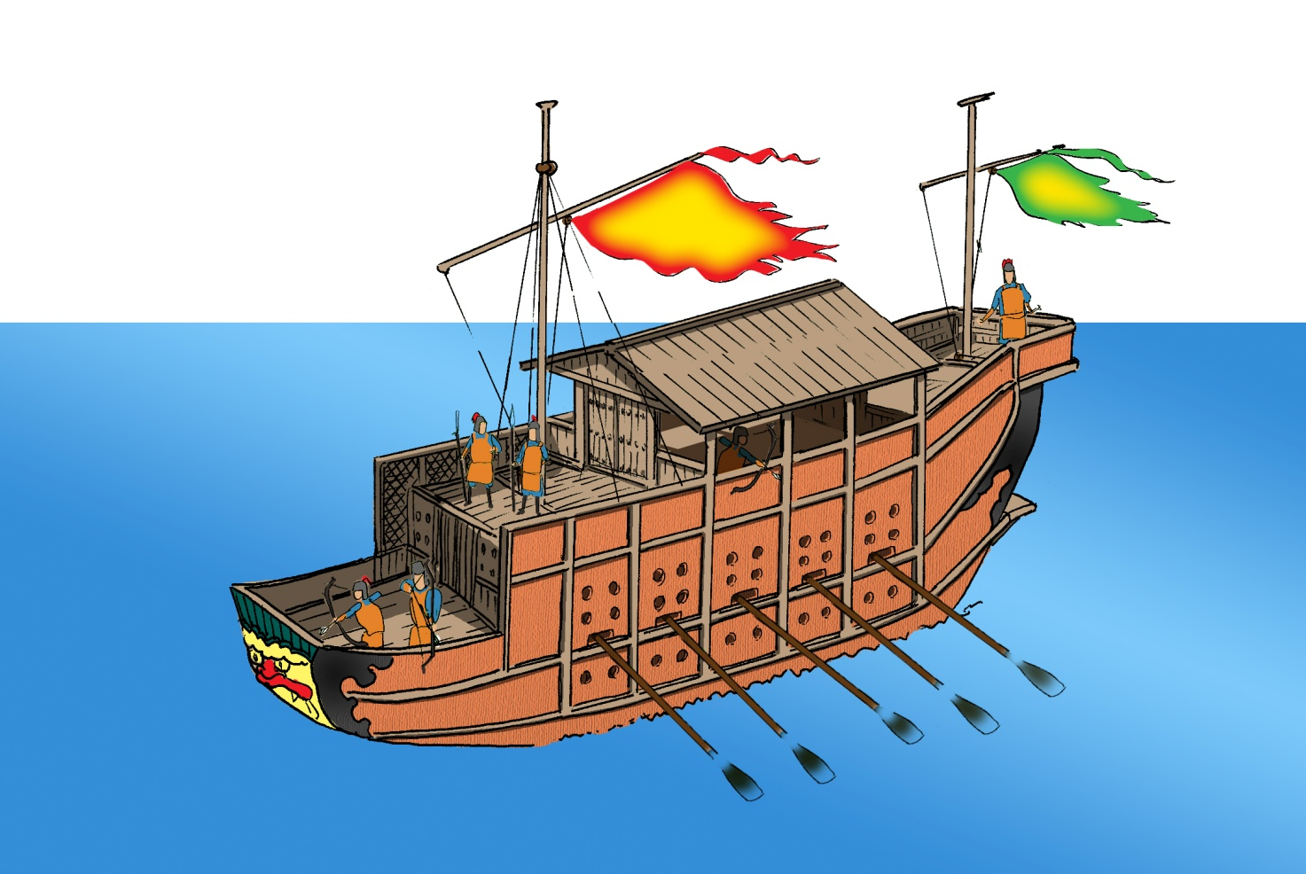
B. Sun Quan’s army
Sun Quan’s battleships: At the Yangzi river, a natural stronghold, Sun Quan built many battleships.
Mengchong (艨衝) warship: These were the large scale battleships of the Late Han period. It was gigantic and could smash the smaller enemy warships in the battles. It could also be used for commanding other warships.
Source: Tushuo Zhongguo Wuqi Jicheng (Illustrated Guide to Chinese Weapons), p.31

Slide 12
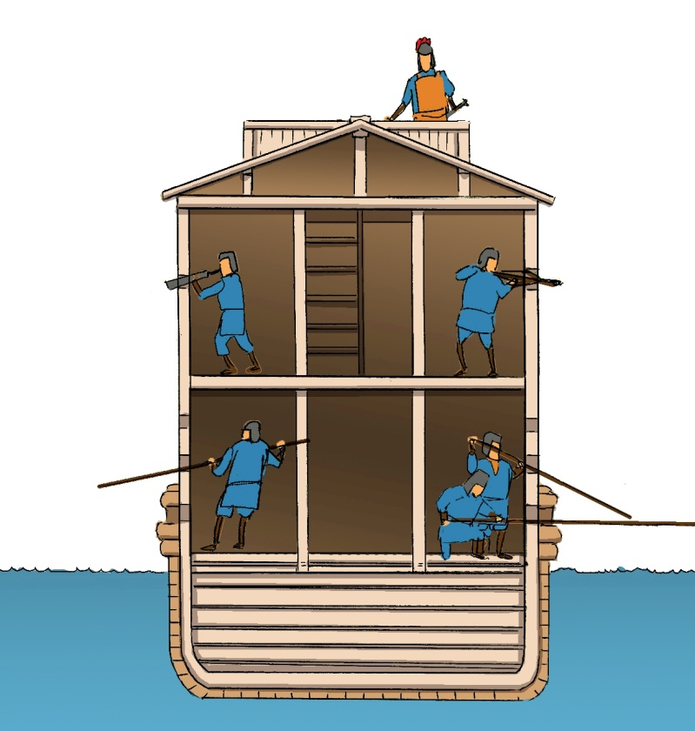
The design of the Mengchong warship prioritised the protection of soldiers inside the ship. Small holes in the hold of the ship and in the tall plank walls on the deck allowed soldiers to attack enemies while being well protected.
Source: “Tushuo Zhongguo Wuqi Jicheng,” p.31

Slide 13
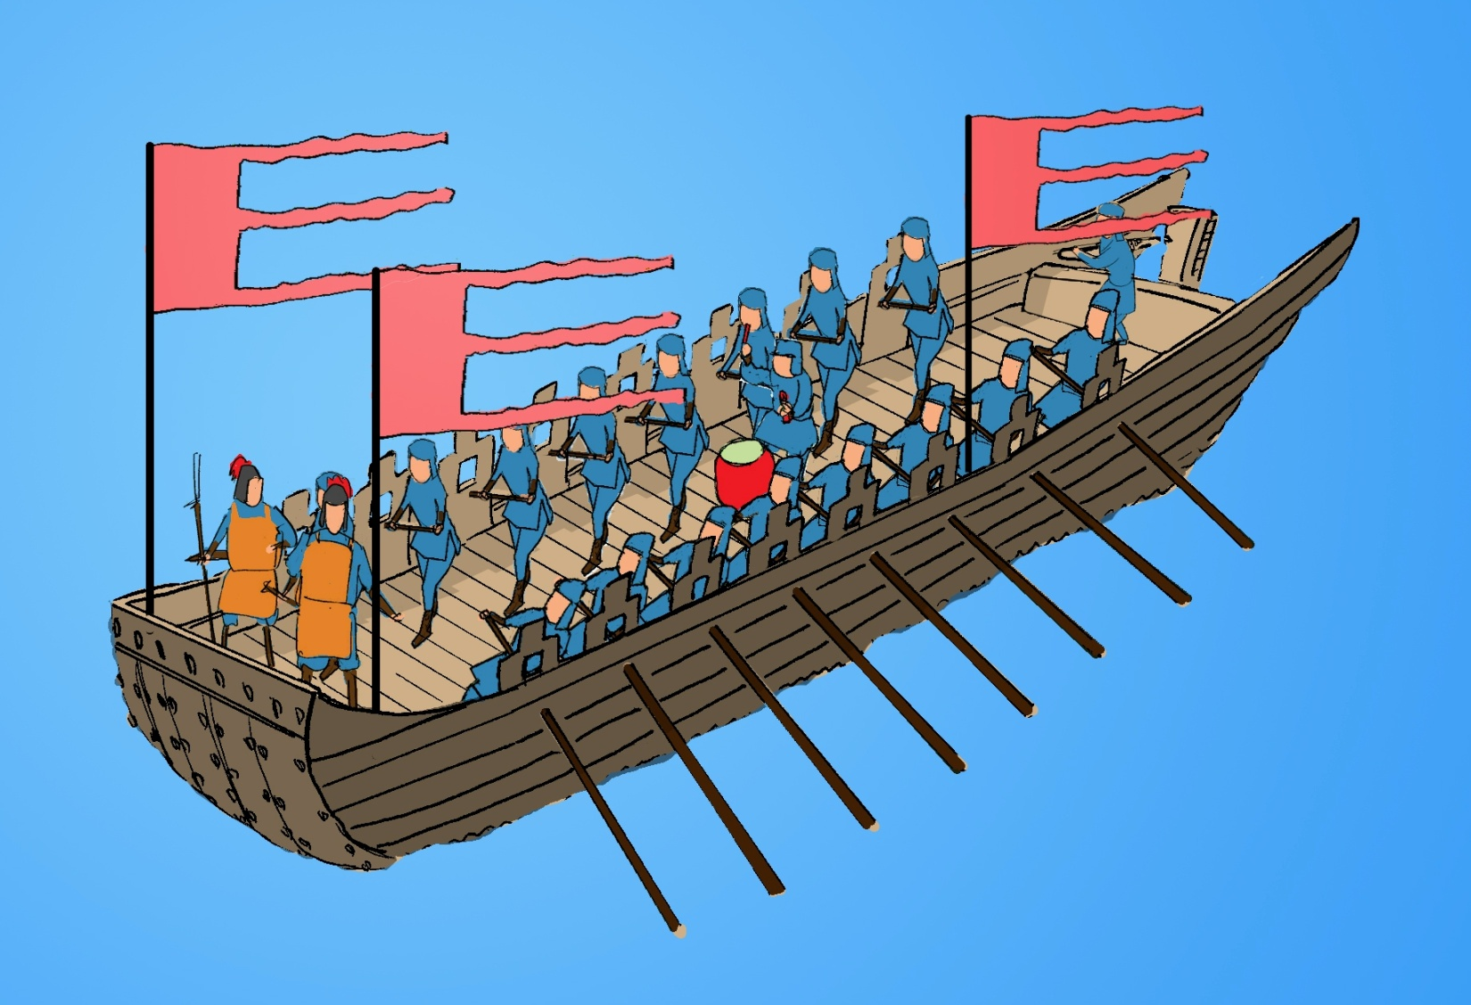
Barge (走舸): It transported infantry quickly and smoothly to the opposite bank to attack. The barge was like modern landing craft.
Source: “Tushuo Zhongguo Wuqi Jicheng,” pp.30-31

Slide 14
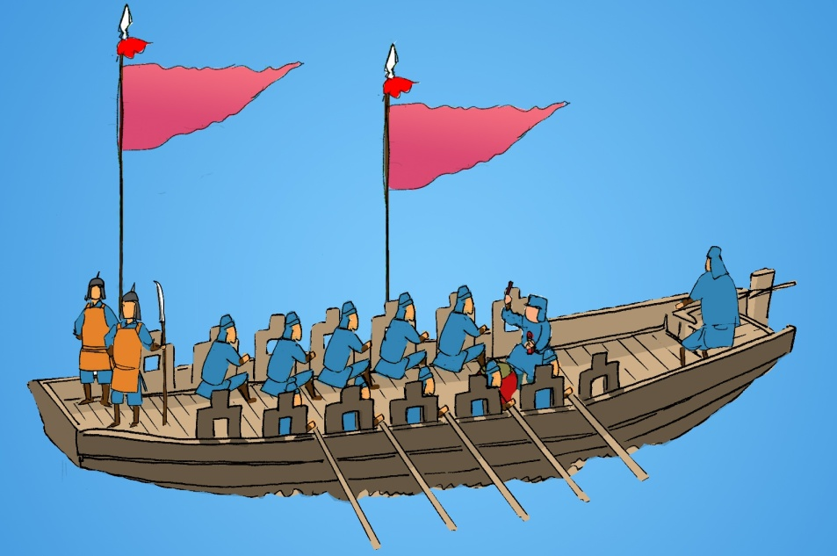
Rowboat (遊艇): Its function was the same as the barge. Since it was smaller, it offered less protection to soldiers than the barge.
Source: “Tushuo Zhongguo Wuqi Jicheng,” pp.30-31
Quiz:
What military strengths did Cao Cao and Sun Quan respectively have? Estimate their respective chances of winning the Battle of Red Cliffs (Chibi) and explain why.

Slide 15
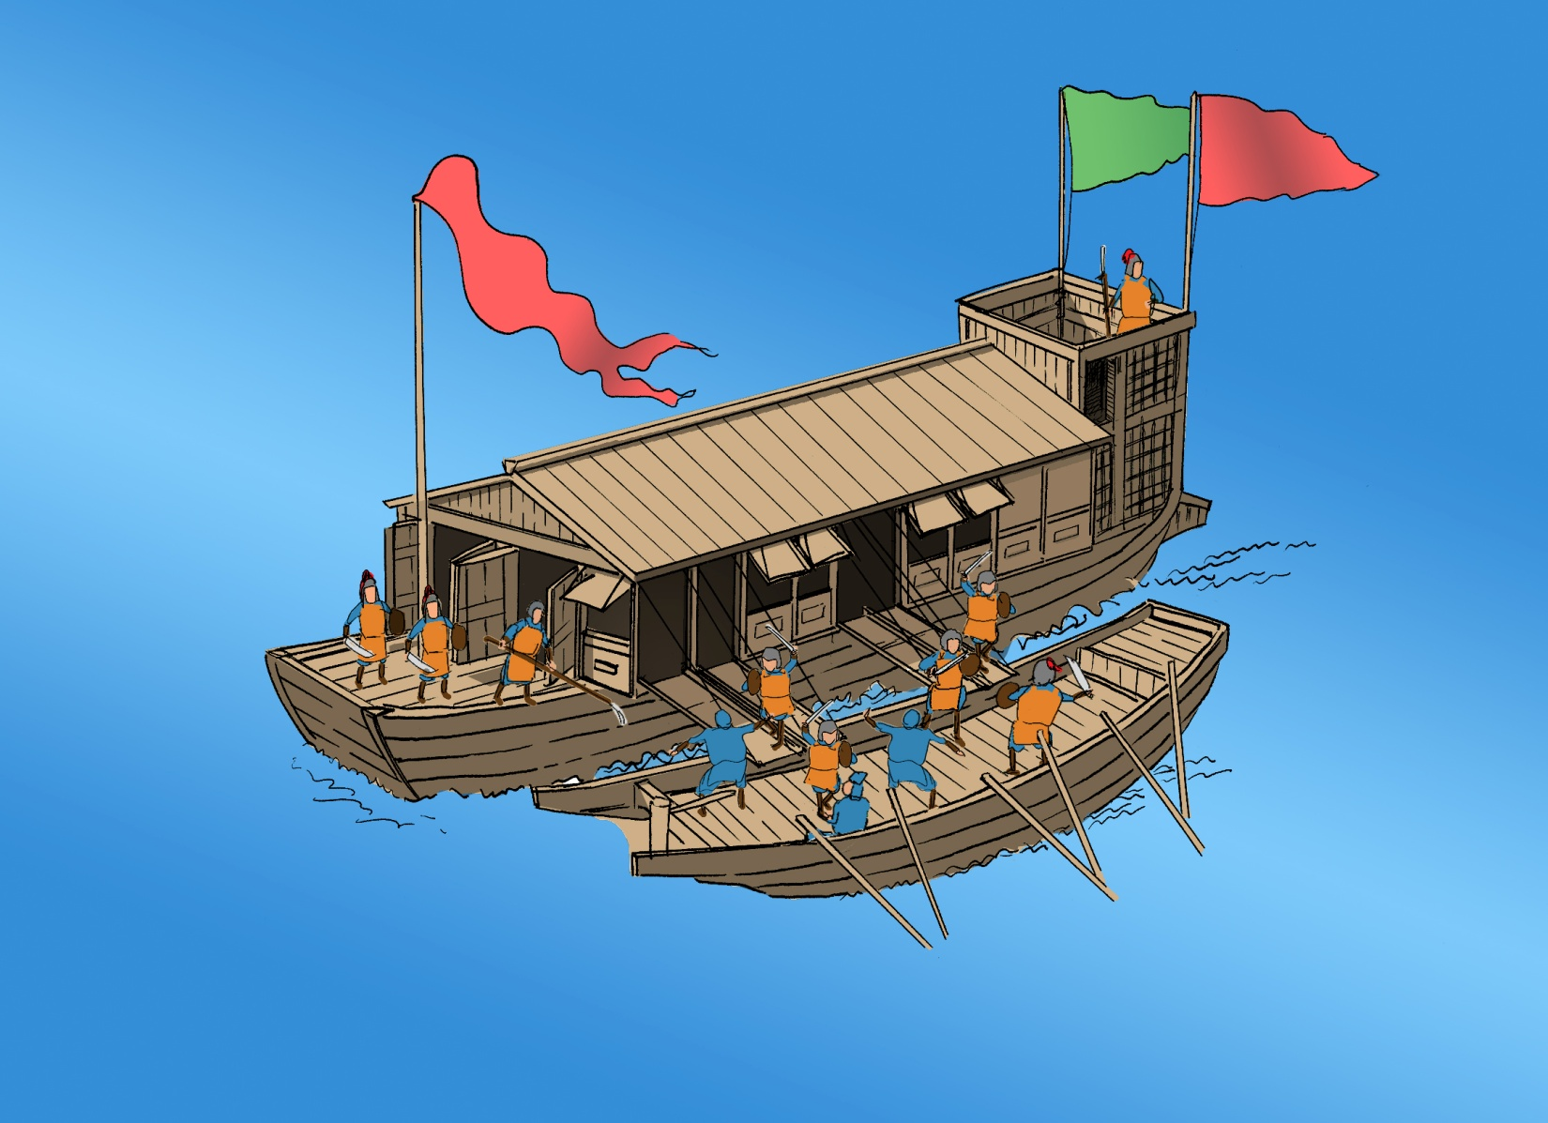
Naval battle

Slide 16
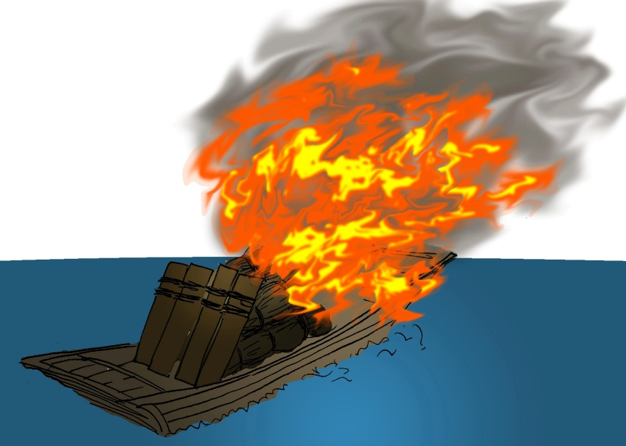
In this era, naval battles consisted mainly of two boats meeting and the infantry fighting face to face. In other words, naval battles took place on board the enemy warship, where soldiers would board the ship to fight enemy soldiers, rather than fighting the enemy warships themselves.
There were two ways to destroy an enemy warship.
The first was to use larger ships to crash into and break the enemy warship.
The second was to use fire. A small boat would be filled with firewood. The small boat would then be ignited and pushed towards the enemy warship.
This was the successful method used by the Sun-Liu allied armies at Chibi.
Larger ships could also be used to attack with fire. In the Battle of Red Cilffs (Chibi), Sun Wu used a Mengchong warship to carry out an attack with fire.

Slide 17
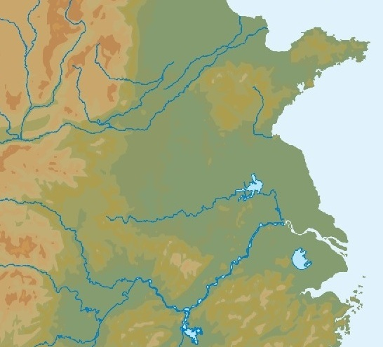
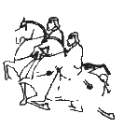
In the year of AD208:
6th month: The emperor of Han appointed Cao Cao Counsellor-in-Chief in his court out of fear of Cao Cao’s military power. Cao Cao now had a good reason to pacify the aggressive Jingzhou county controlled by Liu Biao. The cities in this county included, from north to south, Xinye (新野), Fancheng (樊城), Xiangyang (襄陽) and Jiangling (江陵).
7th month: Cao Cao travelled south to invade.
8th month: When Cao Cao’s large army approached the city of Wan (宛), Liu Biao died. Liu Biao’s second son, Liu Cong (劉琮), succeeded him as Jingzhou regional governor.
9th month: When the Cao army arrived at Xinye, Liu Cong surrendered. Liu Bei, with a garrison at Fancheng, was militarily weak but did not want to fall to Cao. He decided to retreat to Jiangling. His soldiers were split into two paths: (i) General Guan Yu (關羽) led his navy southwards and (ii) Liu Bei’s personally led infantry and cavalry set off on a land route to Jiangling. Over 100,000 Jingzhou civilians followed Liu’s retreat slowly, covering a little over ten Chinese miles. To prevent Liu Bei from taking Jiangling, Cao Cao commanded 5,000 of the Tiger and Leopard Cavalry to chase after Liu. They travelled 300 Chinese miles every day in pursuit and finally caught up at Changban (長坂 a place with a long slope)…
IV. The Course of the Battle of Red Cliffs (Chibi) and Result
Ye
Cao Cao’s army’s attack route
Wan
Xia River
Xinye
Xiangyang
Fancheng--Liu Bei’s garrison
Jiangling
Yangzi river

Slide 18
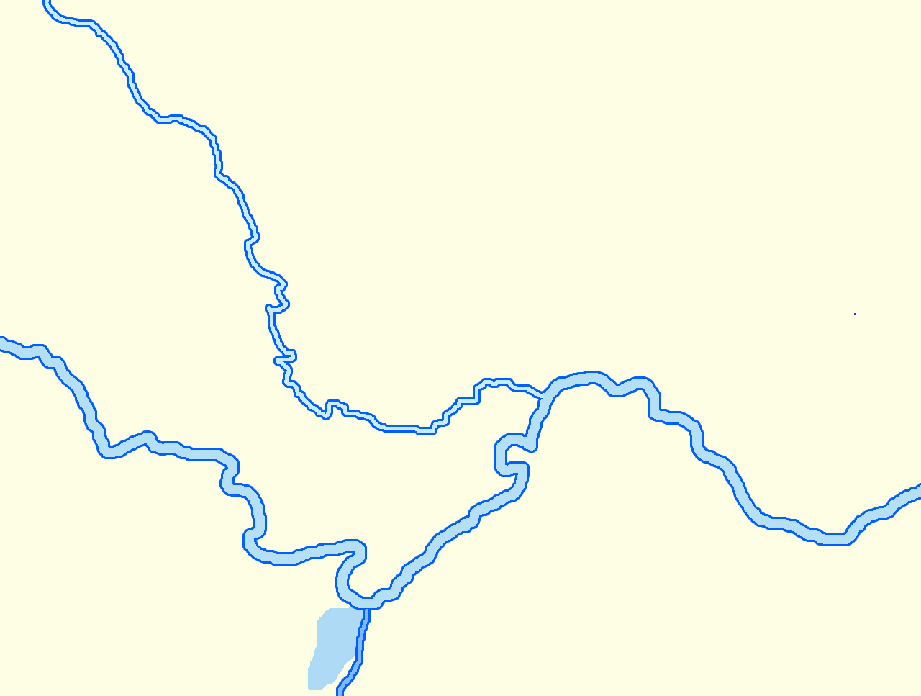
Xinye
Legend:
Cao Cao’s attack route
Liu Bei’s retreat route
Guan Yu’s retreat route
Han River
At the Changban, Cao Cao’s Tiger and Leopard Cavalry caught up Liu. Liu Bei’s army was immediately thrown into chaos and suffered heavy casualties. Liu Bei brought scores of cavalry and crossed the Han river in his east. At the riverside city of Hanjin, he met with Guan Yu. By now, Sun Quan, whose base of operations was at Chaisang (柴桑), also hoped to resist against Cao. He therefore sent Lu Su to Hanjin to welcome Liu Bei and his army to Xiakou (夏口) city to resupply and plot to stop Cao.
Fancheng
Xiangyang
Hanjin
Changban
Jiangling
Xiakou
Yangzi river
Chaisang
Dongting Lake

Slide 19
Legend:
Cao Cao’s attack route
Sun Quan’s attack route
Liu Bei’s attack route
Xinye
Han River
Fancheng
Xiangyang
Hanjin
Cao
Jiangling
Liu
Xiakou
Yangzi river
Red Cliffs
Chaisang
Sun
Dongting lake

Slide 20
Cao Cao’s army 200,000
VS
Liu Bei’s army 20,000
+
Sun Quan’s army 30,000
Cao Cao
Xun You
Xu Huang
Zhang He
Wen Pin
Liu Bei
Guan Yu
Lu Su
Zhou Yu
Huang Gai
Xu Chu
Cheng Yu
Cai Mao
Jiang Gan
Xu Shu
Zhang Fei
Zhao Yun
Kan Ze
Lu Meng
Cheng Pu
Zhang Yun
Le Jin
Zhang Liao
Mao Jie
Yu Jin
Kong Ming
Ling Tong
Gan Ning
Zhou Tai

Slide 21
A Decisive Battle
When Cao Cao’s army from northern China assembled, a plague broke out. Cao wanted to cross the Yangzi river for a decisive battle. He built many warships. In order to prevent the river from washing the warships away, he used rope to tie them to each other.
The Sun-Liu allied armies were defending at the southern banks of the river. Zhou Yu adopted fire tactics suggested by a captain called Huang Gai. On the day of the battle, Huang Gai brought tens of Mengchong warships to the northern bank of the Yangzi river to fake the Cao army’s intention to surrender. When these huge Mengchong warships arrived near the Cao naval stronghold, Huang Gai ordered his men to set them on fire. Since the winds were strong, they immediately began to burn the ships tied together, destroying the Cao naval stronghold, and affecting the Cao camp on the riverbank.
In consequence, the Cao army were defeated overwhelmingly and Cao Cao’s ambitions to unify China were, due to Sun Quan and Liu Bei, shattered. This led to the phase where China was divided between Cao, Sun and Liu. The era of the Three Kingdoms began.

Slide 22
V. Explore other problems
Timelines of the serious history “Sanguo Zhi” (History of the Three Kingdoms) and the fictional “Sanguo Yanyi” (Romance of the Three Kingdoms), part 1
 | Year (AD) | Important Event
Late Eastern Han | 184 | Yellow Turban Rebellion
 | 208 | The Battle of Red Cliffs (Chibi)
 | 221 | Cao Cao died, and his son, Cao Pi, usurped the throne of the Han dynasty, and proclaimed himself the first emperor of the Wei state.
 | 221 | Liu Bei also proclaimed himself as the emperor of the Shu (Liu claimed the name of his state as “Han” to succeed the Han dynasty) state.
Three Kingdoms | 223 | Liu Bei died, and his son, Liu Chan, succeed the throne
 | 229 | Sun Quan proclaimed himself as the emperor of the Wu state
 | 234 | Zhuge Liang ( 諸葛亮 Chancellor-in-Chief and military strategist in the Shu state) died
Western Jin | 265 | Sima Yan (司馬炎) usurped the throne of the Wei emperor and established the Western Jin | In the late third century, Chen Shou finished writing the serious history “Sanguo Zhi” (History of the Three Kingdoms)
 | 316 | The end of the Western Jin
Northern and Southern Dynasties Era

Slide 23
V. Explore other problems
Timelines of the serious history “Sanguo Zhi” (History of the Three Kingdoms) and the fictional “Sanguo Yanyi” (Romance of the Three Kingdoms), part 2
 | Year (AD) | Important Event
Sui | 589 | Yang Jian (楊堅) unified China
Tang | 618 | Li Yuan (李淵) established the Tang dynasty
 | 907 | The end of the Tang dynasty
Song | 960 | Zhao Kuangyin (趙匡胤) established the Song dynasty
 | 979 | The Song dynasty unified China
Yuan | 1271 | The Yuan dynasty began
Ming | 1368 | Zhu Yuanzhang (朱元璋) established the Ming dynasty | At the end of the fourteenth century, Luo Guanzhong (羅貫中) completed the fictional “Sanguo Yanyi” (Romance of the Three Kingdoms)
Reference: Lishi Ren (History People), 2011, p.11
Quiz: Regarding the Battle of Red Cliffs (Chibi), which book, out of Chen Shou’s “Sanguo Zhi” (History of the Three Kingdoms) and Luo Guangzhong’s “Sanguo Yanyi” (Romance of the Three Kingdoms), is more trustworthy? Consider the publication dates and explain.

Slide 24
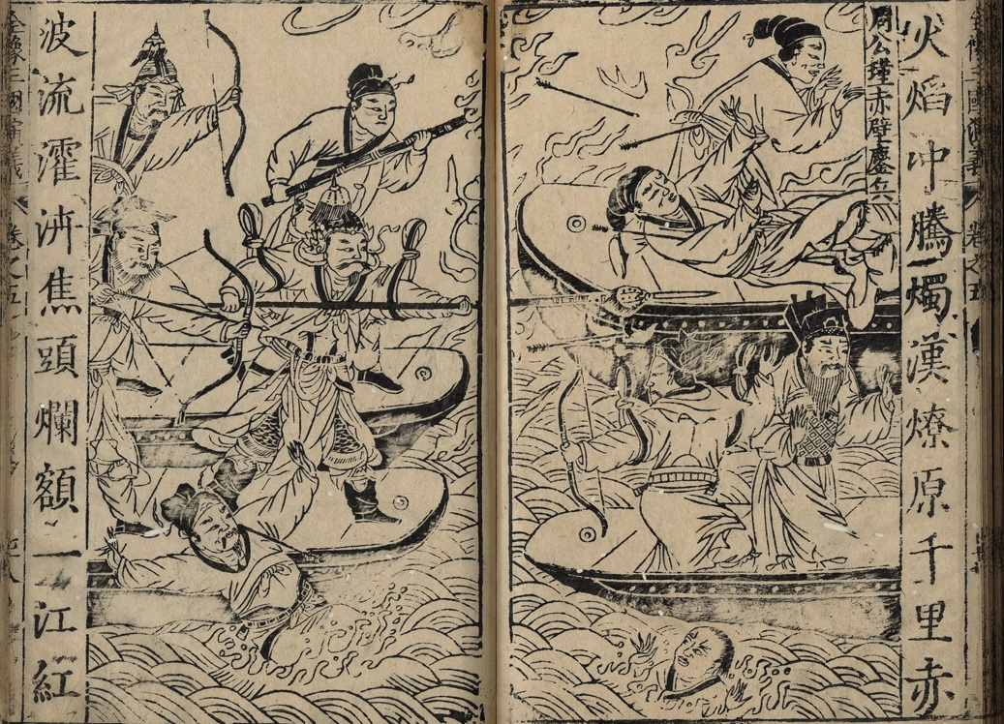
Quiz: First, look at the drawing below from Luo Guangzhong’s “Sanguo Yanyi” (Romance of the Three Kingdoms) “Burning the Linked Boats”, and then answer the question.
“Huang Gai never heard the sound of the bowstring and with one arrow in the centre of his shoulder, rolled over, and fell into the water”
“Coincidentally, Zhang Liao (a general of Cao Cao) came with a small boat and helped Cao to board the boat”
Source: Luo Guangzhong’s Sanguo Zhi Tongsu Yanyi (The Vernacular Story of the Three Kingdoms), Wanjuan Lou edition, Wanli, pp.924-925

Slide 25
There are two paragraphs of quotes below. One paragraph comes from “Sanguo Zhi” (History of the Three Kingdoms) and the other comes from “Sanguo Yanyi” (Romance of the Three Kingdoms). Both paragraphs have been translated into English.
Source 1：
“Liu Bei sent Zhuge Liang to reconcile with Sun Quan. Sun Quan sent Zhou Yu, Cheng Pu and other generals to lead tens of thousands of navies, and worked with Liu Bei to fight against Cao Cao at the Battle of Red Cliffs (Chibi). Cao Cao was defeated and his ships were burnt. Liu Bei and the Wu army advanced together on the water and persistently chased Cao Cao to the Nan commandery. During this time, plague struck and the northern armies [of Cao Cao] died in great numbers. Thus, Cao decided to take his armies back north.”
Source 2:
“The Eastern Wu warships (i.e. Sun Quan’s warships) were only two Chinese miles by water away from Cao Cao’s naval stronghold. Huang Gai forcefully waved his hand and the ships in front all caught fire. The fire took advantage of the wind’s strength and the wind assisted the flames. The boats were like flying arrows, raging flames soared into the sky. Twenty boats on fire, all neatly thrust into Cao Cao’s naval base. The Cao boats at the same time all caught fire. Encircled and trapped by iron chains, how could they break free? Intense fire spread and no boat could escape. Sounds of canons could be heard across the river, everywhere boats on fire were simultaneously arriving, and the river surface turned red. Cao Cao looked again at the camp on the shore. Smoke and fire filled the sky and penetrated the ground. Huang Gai jumped on the small boat piloted by soldiers behind him in the smoke and fire to look for Cao Cao. Cao Cao had to jump ashore to run for his life. Coincidentally, Zhang Liao came with a small boat and helped Cao Cao to board the boat. Huang Gai spotted a red gowned man standing on the ship, guessed it was Cao Cao, and urged the ship to chase him. A large knife held in his hand, he shouted, “Evil Cao, do not run! Huang Gai is here!” Cao Cao was in such a rush that he grumbled repeatedly. Zhang Liao grasped a bow and nocked an arrow. Watching Huang Gai advance, he shot the arrow. With such strong winds, Huang Gai never heard the sound of the bowstring and with one arrow in the centre of his shoulder, rolled over, and fell into the water…”

Slide 26
Which of the paragraphs is from “Sanguo Zhi” (History of the Three Kingdoms)? Which comes from “Sanguo Yanyi” (Romance of the Three Kingdoms)?
Hint: Find out which passage fits in the most with “Sanguo Yanyi” (Romance of the Three Kingdoms) illustration’s content.
Source 1: “Sanguo Zhi” (History of the Three Kingdoms)
Source 2: “Sanguo Yanyi” (Romance of the Three Kingdoms)（1. Coincidentally, Zhang Liao came with a small boat and helped Cao Cao to board the boat.
2. Huang Gai never heard the sound of the bowstring and with one arrow in the centre of his shoulder, rolled over, and fell into the water.

