Slide 1
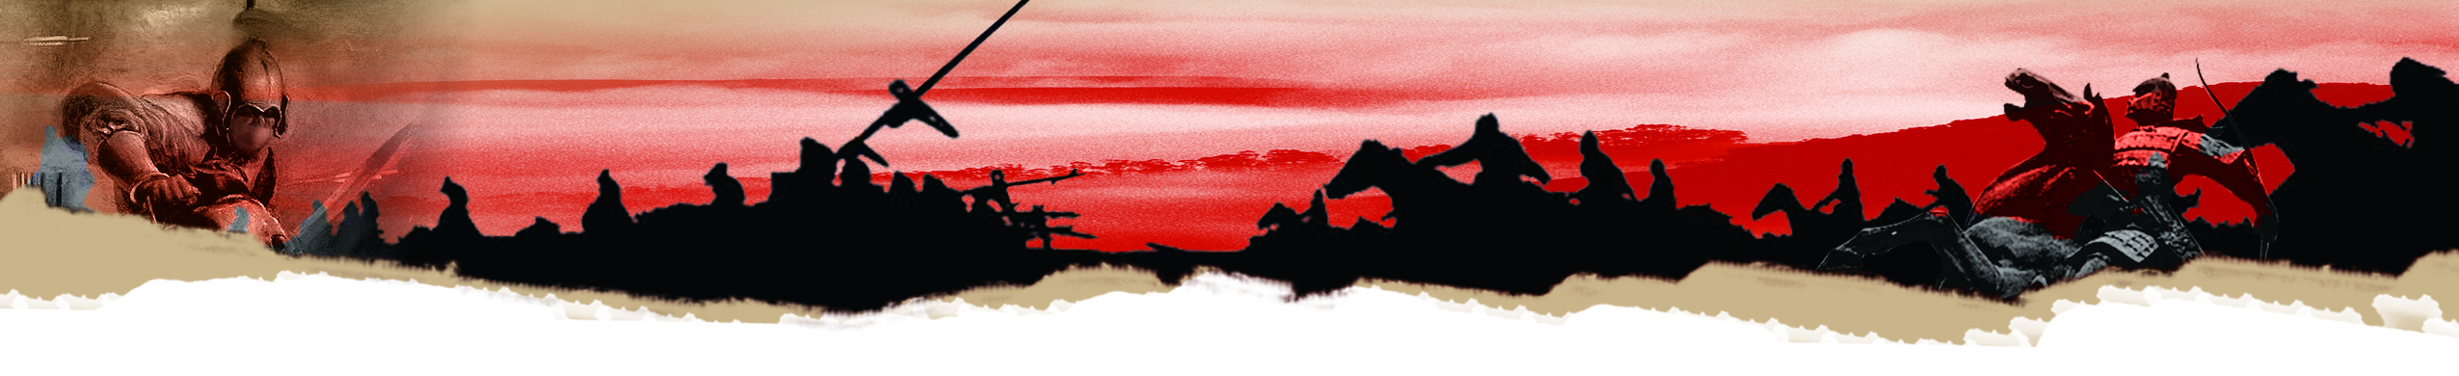
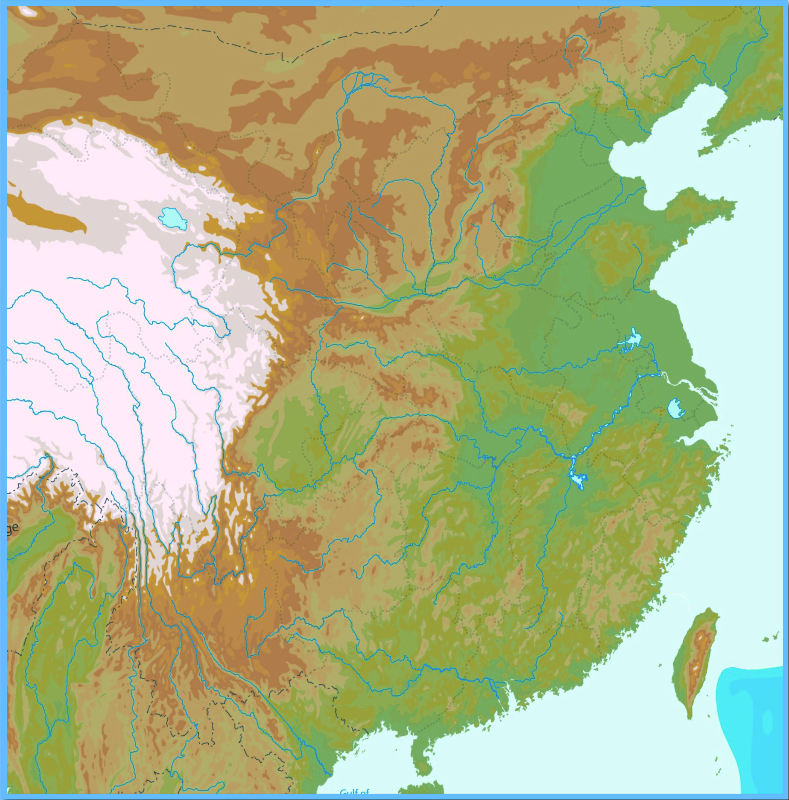
Beiting
The Battle of Xiangzhou (相州): The Evolution of Tang Dynasty Armour
Yingzhou
Youzhou
Liangzhou
Lingzhou
Shanzhou
Bingzhou
The An-Shi (An Lushan 安祿山 and Shi Shiming 史思明) Rebellion:
Background
Anxi
Chang’an
(principal
Imperial
capital)
The Ten Military Commissioners
During the reign of Emperor Xuanzong (玄宗) of the Tang Dynasty (712-756), ten military officers named “the Ten Military Commissioners” were sent to the empire’s frontier regions to protect the empire. One of these Military Commissioners (節度使) was An Lushan, who later rebelled against the Tang Dynasty. An Lushan was half Sogdian and half Göktürk.
Luoyang (secondary imperial capital)
Yizhou
Guangzhou

Slide 2
Beiting
Yingzhou
Quiz: Please fill in the titles of the Military Commissioners in the ten main frontier regions of Emperor Xuanzong of the Tang Dynasty. You may first try to work out their positions from the titles of the Military Commissioners. If you are unsure, you may check the textbook.
Youzhou
Liangzhou
Lingzhou
Shanzhou
Bingzhou
Anxi
Luoyang (secondary imperial capital)
Chang’an
(principal imperial capital)
Yizhou
Guangzhou

Slide 3
Beiting
Yingzhou
Quiz: Please fill in the titles of the Military Commissioners in the ten main frontier regions of Emperor Xuanzong of the Tang Dynasty. You may first try to work out their positions from the titles of the Military Commissioners. If you are unsure, you may check the textbook.
Liangzhou
Lingzhou
Youzhou
Shanzhou
Bingzhou
Anxi
Chang’an
(principal imperial capital)
Luoyang (secondary imperial capital)
Beiting Military Commissioner
Anxi Military Commissioner
Pinglu Military Commissioner
Shuofang Military Commissioner
Yizhou
Jiannan Military Commissioner
Hedong Military Commissioner
Hexi Military Commissioner
Lingnan Wufu Military Commissioner
Longyou Military Commissioner
Guangzhou
Fanyang Military Commissioner

Slide 4
A Legend of An Lushan
According to a folktale, An Lushan was a fat man with a prominent belly, comical appearance, and humorous speech which hid his craftiness. Once, the Tang emperor, Xuanzong, to please his favourite concubine, Consort Yang Guifei (楊貴妃), decided to invite An Lushan to the palace. When An Lushan saw Emperor Xuanzong and Consort Yang together, he first bowed to the Consort before bowing to the emperor. Emperor Xuanzong asked him whether this was appropriate etiquette. An Lushan pretended to be confused and replied that he, not being Han, did not know Tang Dynasty etiquette, and was accustomed to pay respect to his mother before his father. Afterwards, Emperor Xuanzong pointed at An Lushan’s stomach and asked what kinds of things laid inside the large barbarian stomach. Lushan replied that there was nothing inside but a loyal heart. Emperor Xuanzong praised his loyalty and honesty.（From Zhongguo Lishi Zhanzheng Shi (Chinese War History), v.9, p.2884）

Slide 5

Beiting
Beiting Military Commissioner
Hexi Military Commissioner
Yingzhou
Youzhou
Pinglu Military Commissioner
Though from a nomadic tribe, An Lushan gained the trust of Emperor Xuanzong of the Tang Dynasty, and was appointed the Military Commissioner of Pinglu (平盧), Fanyang (范陽), and Hedong (河東). He led a total of 184,000 troops and horses. He controlled the entire north-east frontier regions of the Tang empire. If he was disloyal, the empire would be put at risk. This happened in AD755. The next year, he took Luoyang (洛陽) and advanced towards Chang’an (長安). The Tang emperor was shocked. Emperor Xuanzong fled to Sichuan. The prince, Li Heng (李亨), before having obtained the approval from his father, then declared himself as the new emperor of Lingwu (靈武). As Li Heng was supported by soldiers, Emperor Xuanzong finally agreed to that.
Liangzhou
Lingzhou
Fanyang Military Commissioner
Shanzhou
Shuofang Military Commissioner
Bingzhou
Hedong Military Commissioner
Longyou Military Commissioner
Anxi
Chang’an
(principal imperial capital)
Anxi Military Commissioner
Luoyang (secondary imperial capital)
Jiannan Military Commissioner
Yizhou
Lingnan Wufu Military Commissioner
Guangzhou
By AD757, the Tang Dynasty began to gain the upper hand. On the one hand, it was because An Lushan had been murdered by his son An Qingxu (安慶緒). On the other hand, it was because the Shuofang (朔方) Military Commissioner, Guo Ziyi (郭子儀), a powerful Tang general, led frontier tribe soldiers to recover Chang’an and Luoyang and planned to attack An Qingxu at Xiangzhou, north of Luoyang.
The Battlefield of Xiangzhou

Slide 6
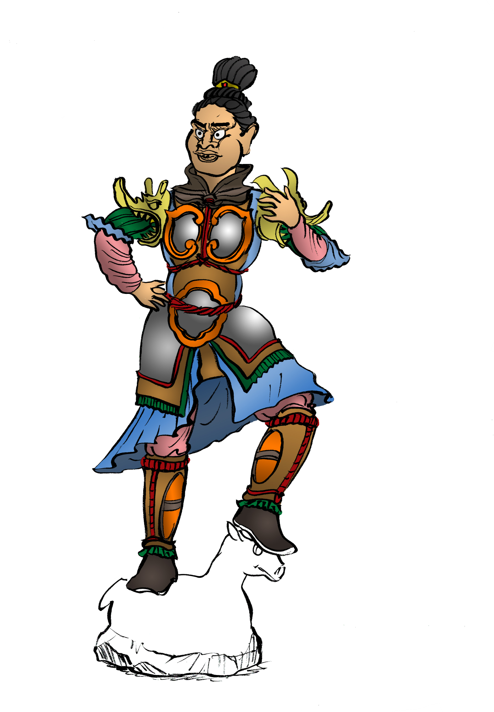
II. Tang Dynasty Infantry Armour
Reflective iron breastplate
Dragon-shaped iron armour
Leather inner layer
Iron circular plate to protect the abdomen
Leather shirt tail
Iron thigh guard
This is a pottery figure of the Heavenly Guardian, reflecting the typical image of an early Tang warrior. The key characteristic of a Tang Dynasty’s soldier was the large, wide, and reflective metal armour.
Source: Peers 1996, p. 17.

Slide 7
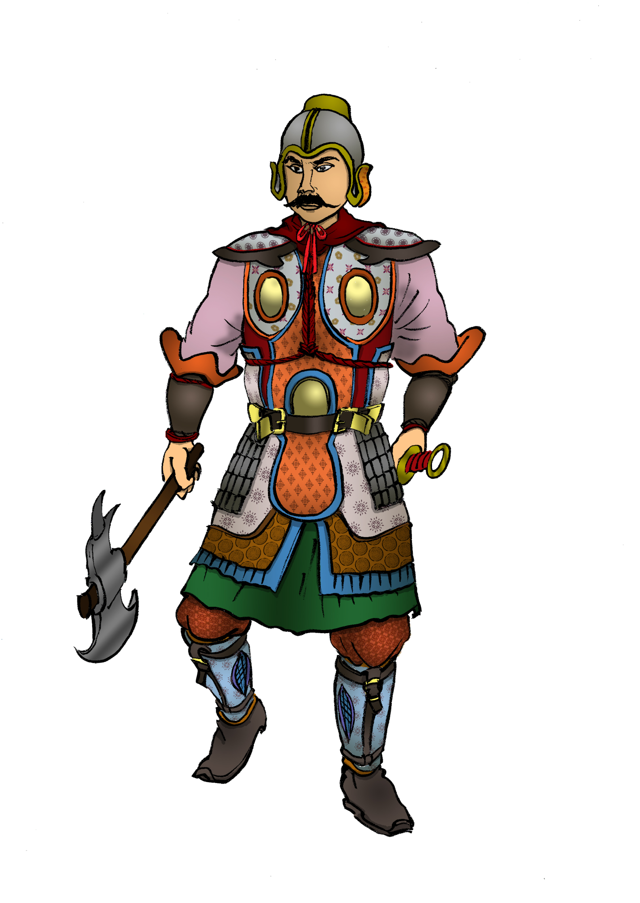
Heavy Armoured Infantry
Quiz: The infantry of the Tang Dynasty wore heavy armour. What were its advantages and weaknesses?
Due to the introduction of iron armour, soldiers obtained excellent protection and became heavily armoured infantry. However, its weakness was that it was heavy and cumbersome.
Source: Zhanlue, zhanshu, bingqi shidian: zhongguo zhonggu pian (Strategy, Tactics, and Weapons: Encyclopedia of Medieval China) , p.23

Slide 8
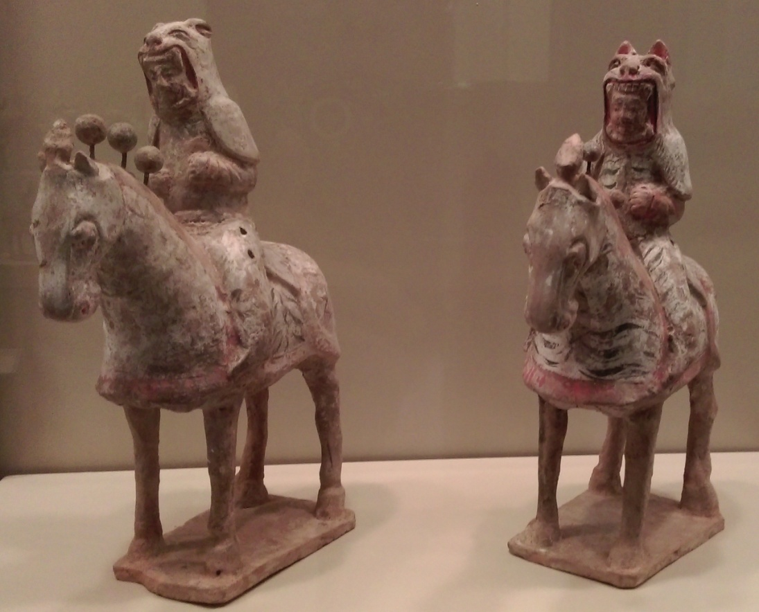
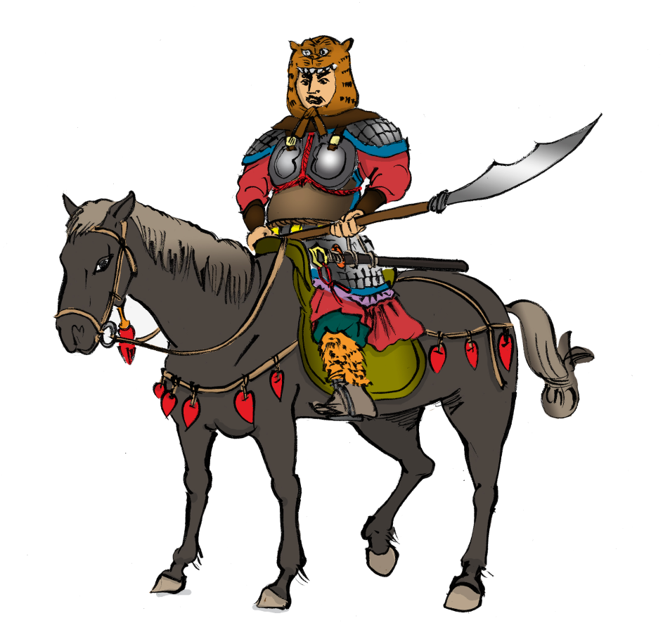
Warhorse armour was very popular from the Northern and Southern Dynasties period (AD420-589) until the Sui Dynasty (AD581-617). However, heavy calvalry was inconvenient to move as shown and this led to the final collapse of the Sui Dynasty. As such, it was discarded in the Tang Dynasty.
Quiz: What were the benefits if the horse was not armoured?
Cavalry
If the horse did not wear armour, it carried less weight and could move more easily. Highly mobile cavalry was the distinguishing characteristic of the Tang Dynasty cavalry. However, horsemen still wore the reflective armours.
Source: Photographed in the Hong Kong Heritage Museum, 2015, Dunhuang exhibition.

Slide 9
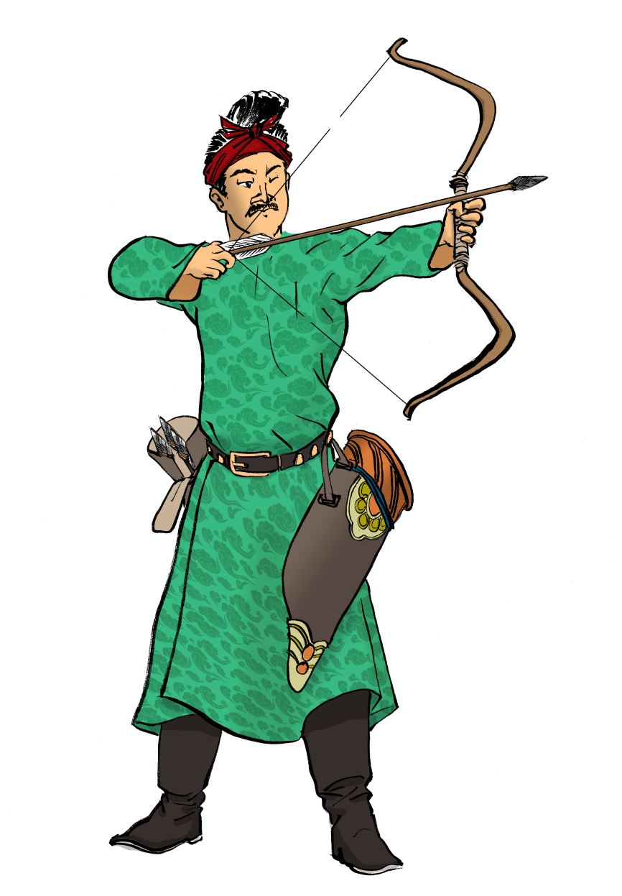
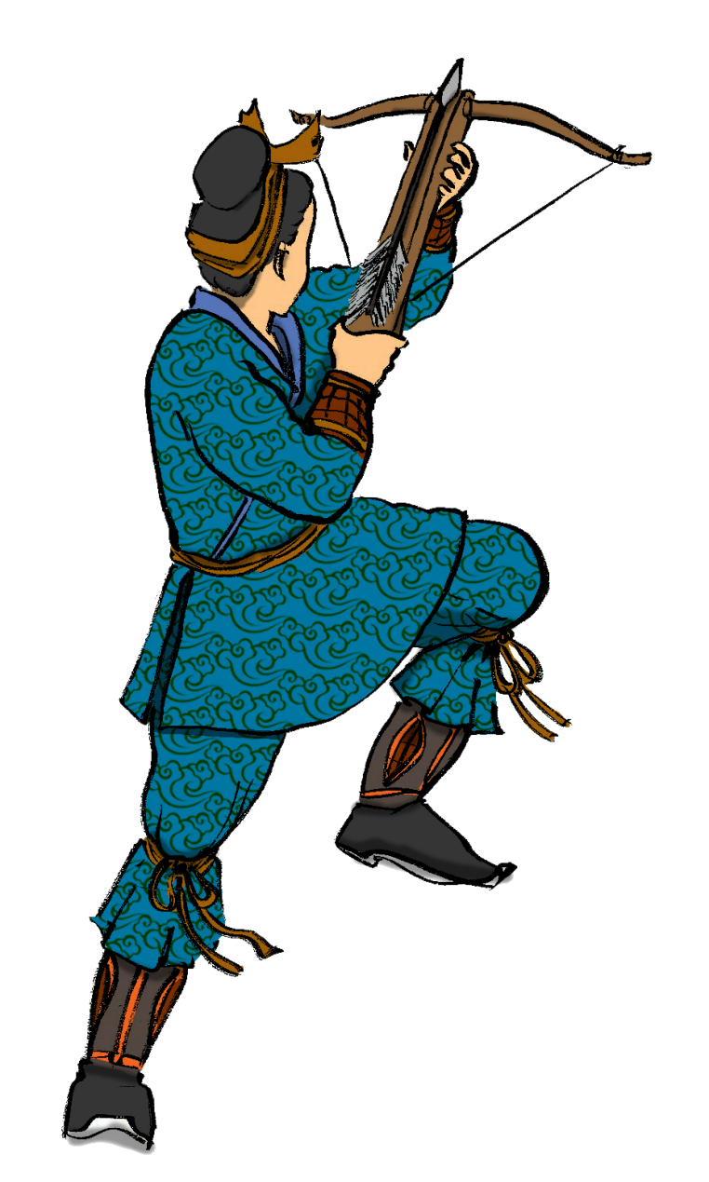
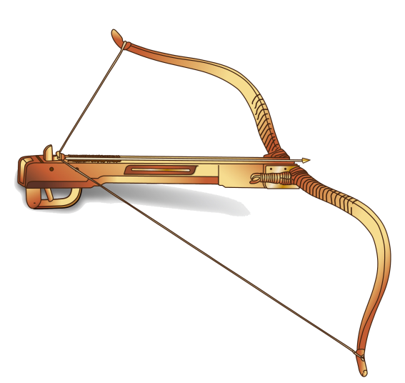
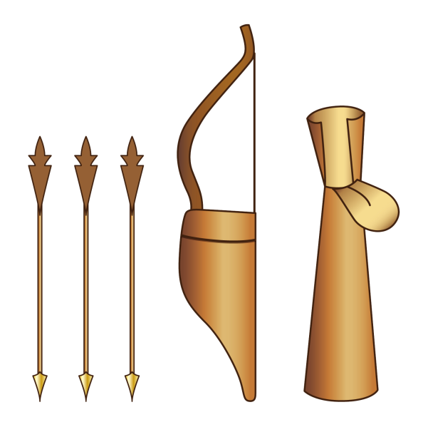
Archers and Crossbowmen
Archer
From Zhanlue, zhanshu, bingqi shidian: zhongguo zhonggu pian, p.23
Crossbowman
The Tang Dynasty did not make any great progress in developing weapons. Bows and crossbows remained the main weapons for long distance attacks.

Slide 10
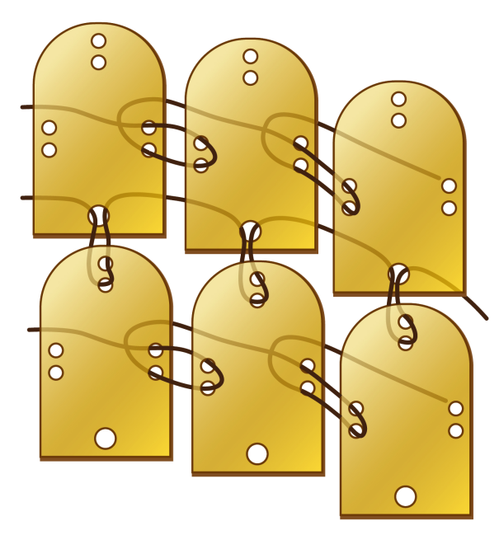
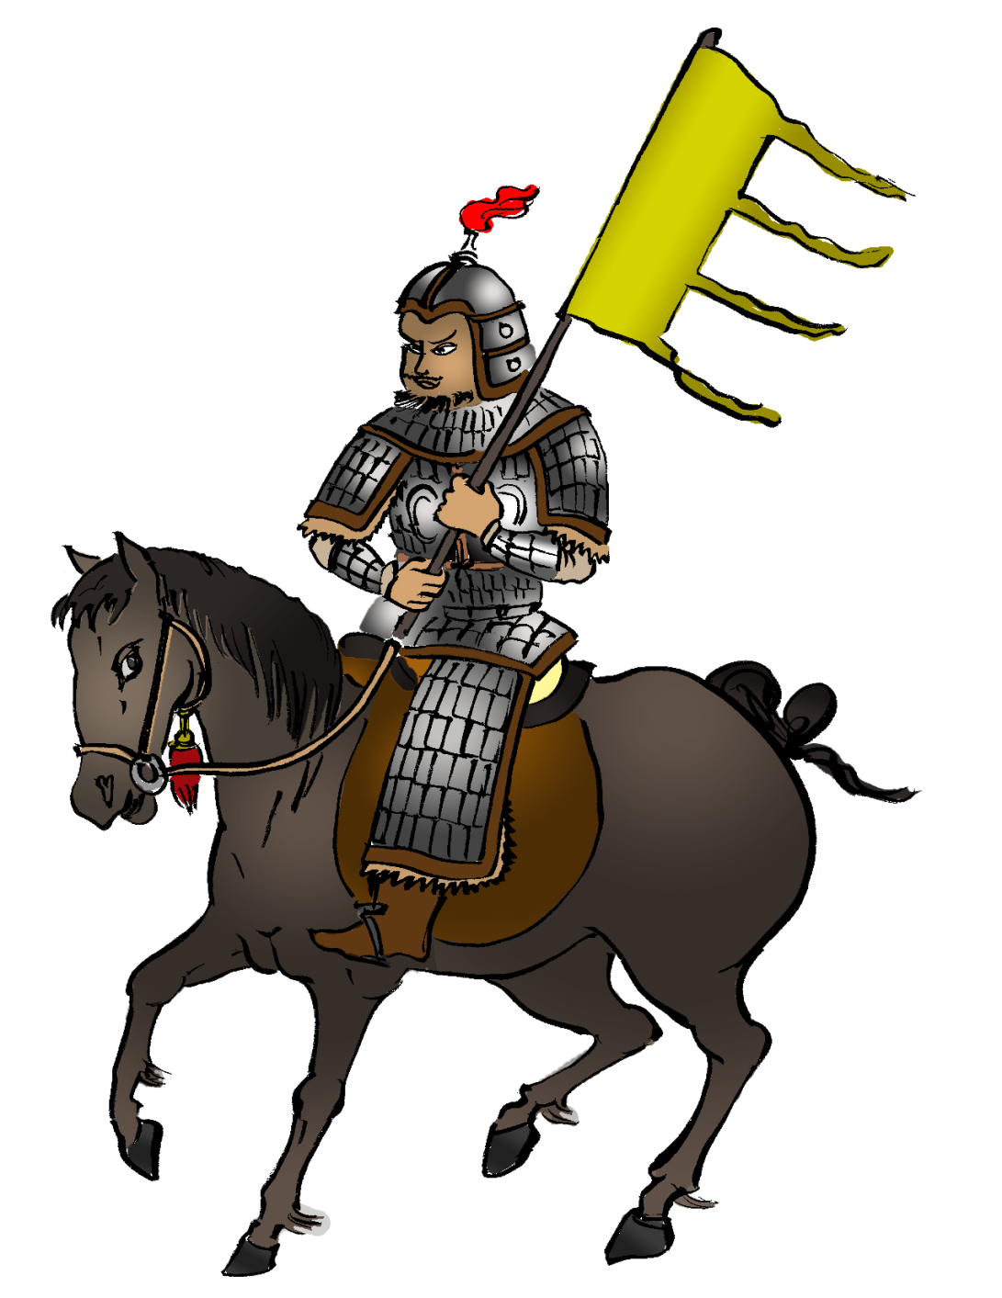
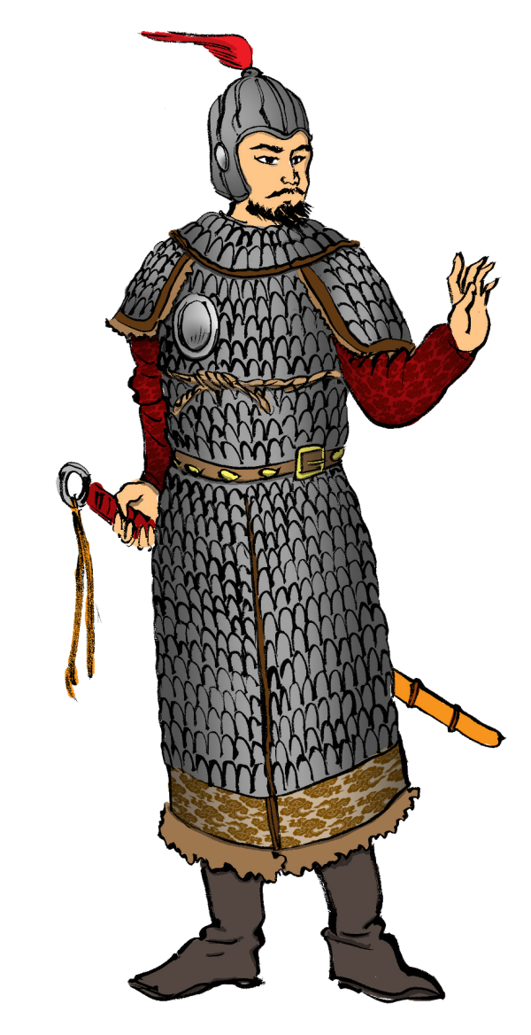
Late Tang: The Emergence of Chainmails
Copied from Wikipedia: Lamellar armour
Quiz: During the late Tang, (after the An-Shi Rebellion), the army gradually abandoned heavy reflective armours and instead used metal plates to make chainmails. What advantages did this type of armour have?
Chainmails consisted of leather cords connecting metal pieces or leather. The advantages of this design was that soldiers could still move easily as well as exhibit greater fighting strength when wearing armours. This kind of armour design was used until late Ming and early Qing.
Source: Ranitzsch 1995, p. 34-35.

Slide 11

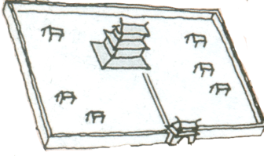
III. The Course of the Battle of Xiangzhou (AD758-759)
Zhang River
Shi Siming’s army (50,000)
An Qingxu’s Xiangzhou army (60,000)
Guo Ziyi’s army (200,000)
Tang | Rebels
Guo Ziyi | An Qingxu (son of An Lushan)
 | Shi Siming
Yellow River
Luoyang

Slide 12
The situation of the battle
Year | Battle event
Ninth month of AD758 | Guo Ziyi, the Tang general and military commissioner, led soldiers and cavalry, numbering a total of 200,000, and surrounded Xiangzhou. An Qingxu’s army came out of the city to battle but were ambushed by Guo Ziyi’s archers. They retreated and focused on defending the city. An Qingxu sent a messenger to another rebel army leader, Shi Siming, (defending Weizhou) and asked for help.
Tenth month of AD758 | Surrounded by Guo Ziyi’s army, Xiangzhou began to run out of food. An Qingxu continued to fight against Guo and did not surrender .
Second month of AD759 | Guo Ziyi’s army lacked food and therefore decided to strike at the city garrison’s fighting spirit. They destroyed the northern city walls and flooded the city with water from the Zhang River (漳水). However, Xiangzhou was still not captured. Morale on both sides was equally low.
Third month of AD759 | In the third lunar month, Shi Siming led 50,000 soldiers to rescue Xiangzhou and defeated Gao Ziyi. The Tang soldiers retreated. Xiangzhou was no longer in danger.

Slide 13
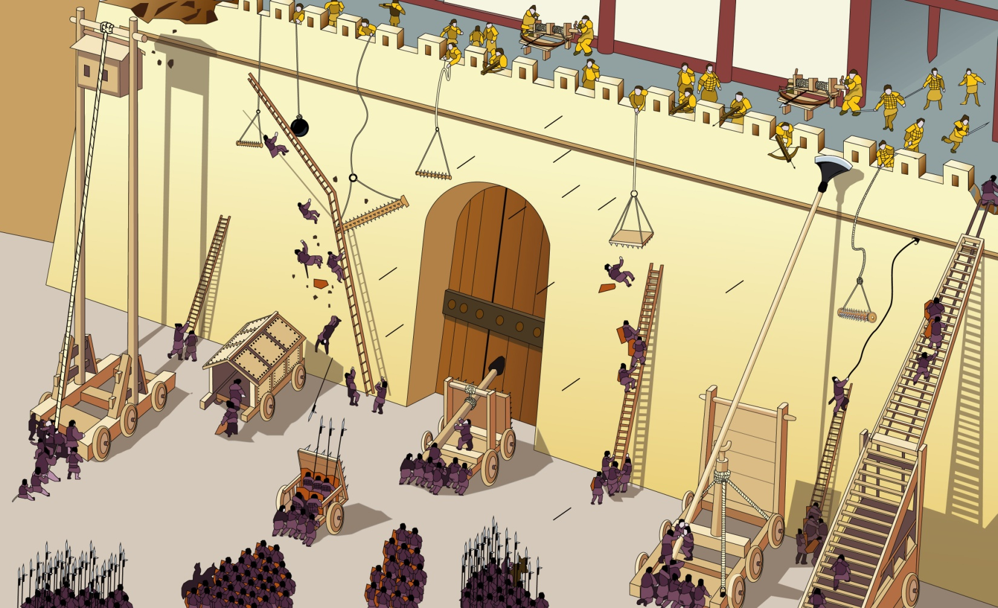
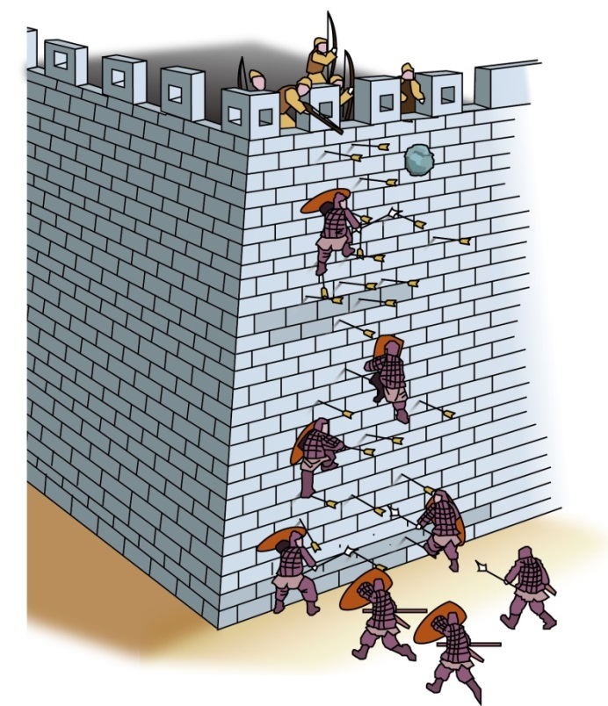
IV. Utilization of weapons
An imagined image of the Battle of Xiangzhou
Source: Tushuo Zhongguo Wuqi Jicheng (A Collection of Illustrated Chinese Weapons), pp.18-19
Siege use □
Defensive use □
Operating principle:
Quiz: The above image depicts many siege and defensive weapons. Can you guess the purposes of these weapons?
Please in□ add a √, and try to use simple words, verbally or in the written form, to describe how these weapons worked. You may look at the example below first.
First, crossbowmen shot crossbow arrows at the city wall. Then, soldiers were ordered to use the arrows to climb the wall and fought the battle above it.

Slide 14
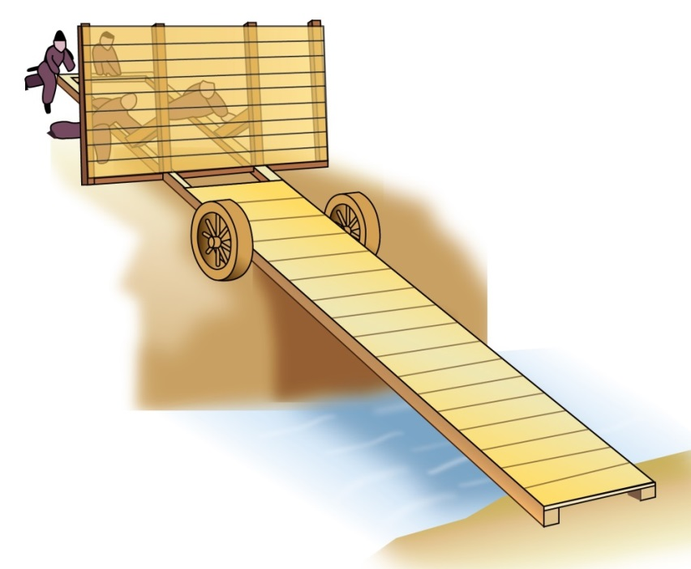
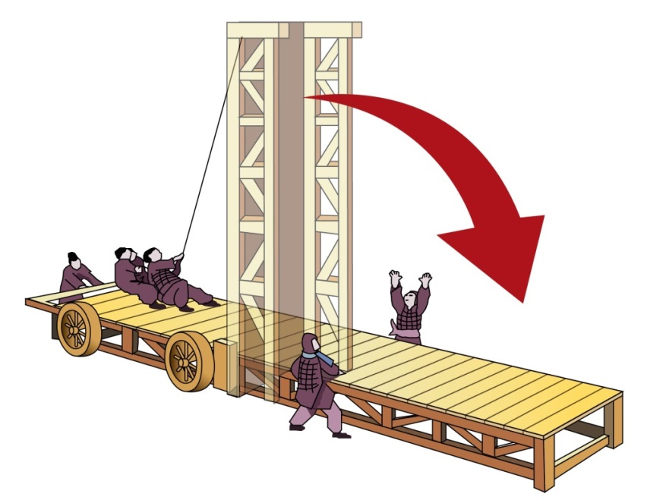
Moat Bridge
Folding Bridge
Siege use □
Defensive use □
Operating principle:
Siege use □
Defensive use □
Operating principle:
A portable bridge used by soldiers to cross trenches or moats in order to attack.
A portable bridge used by soldiers to cross uneven terrain in order to attack.

Slide 15
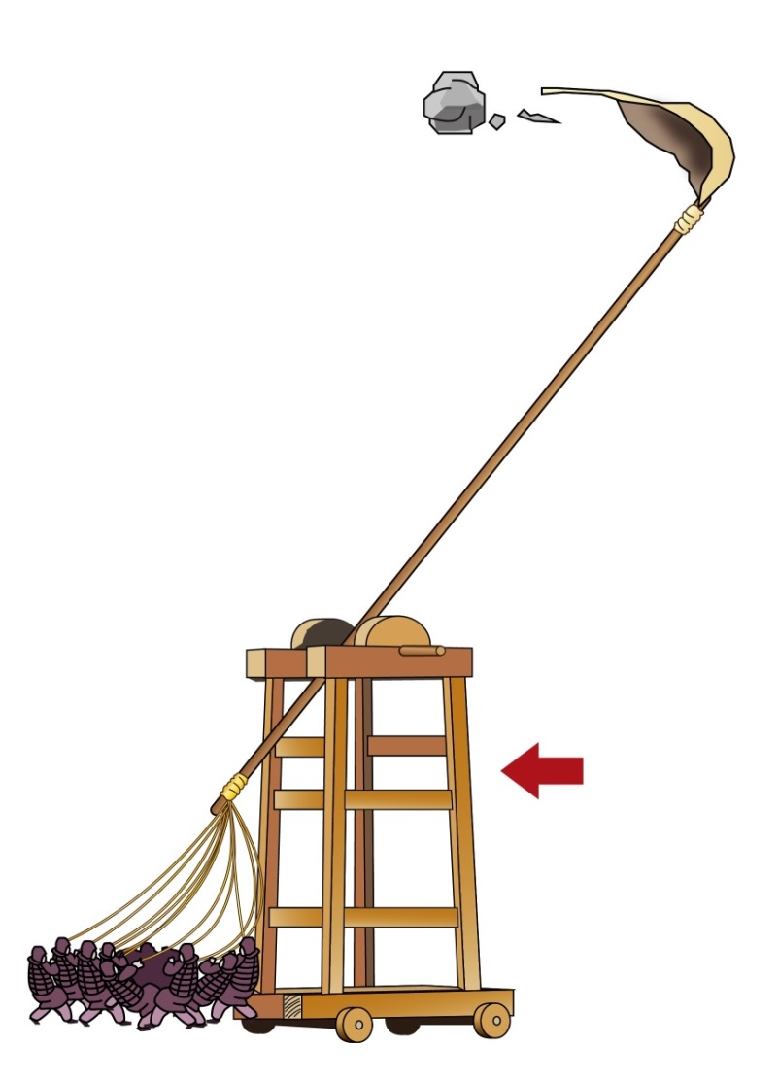
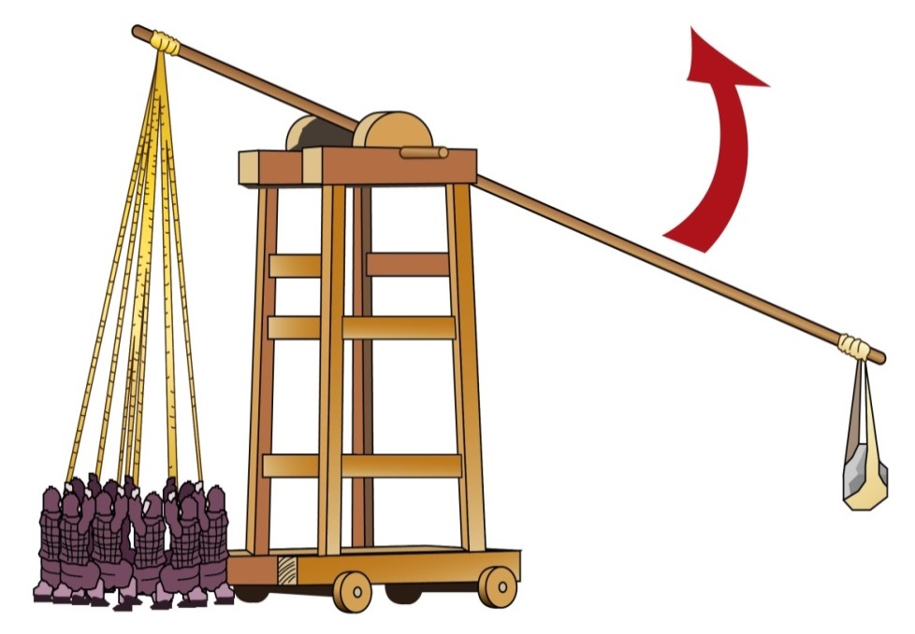
Catapult
Siege use □
Defensive use □
Operating principle:
It used lever principles to throw rocks into the city.

Slide 16
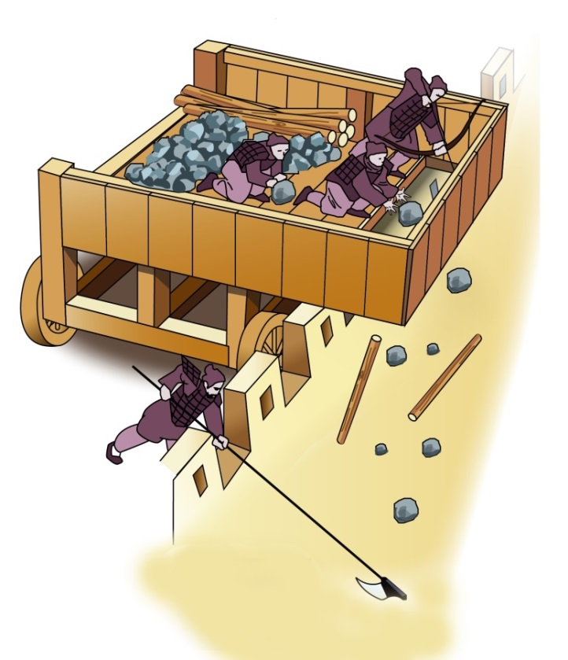
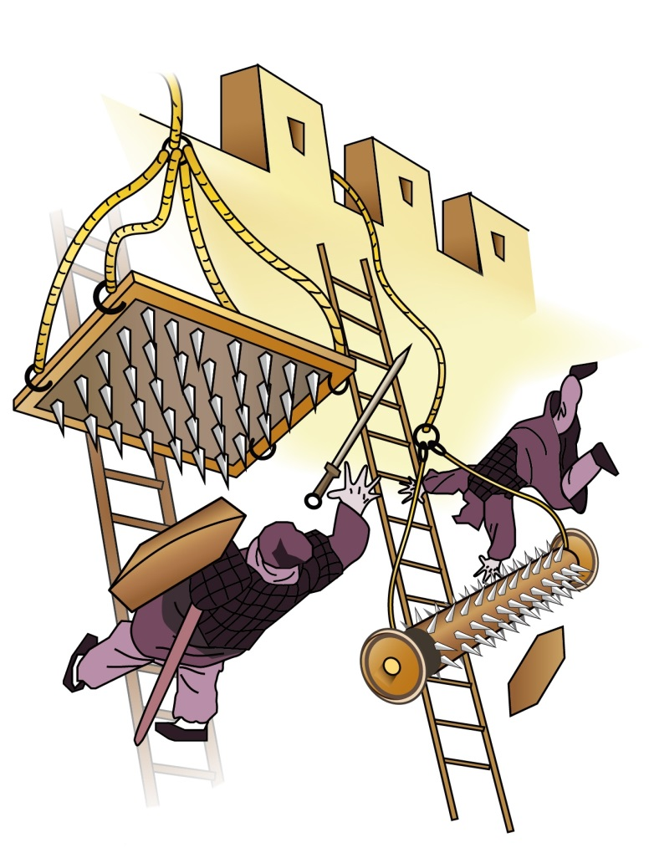
Cart for throwing rocks
Nail board (left) and nail log (right)
Siege use □
Defensive use □
Operating principle:
Siege use □
Defensive use □
Operating principle:
It was used to defend the city wall from enemy soldiers attacking on wooden ladders
It transported soldiers and rocks to and from the battle on the city wall.

Slide 17
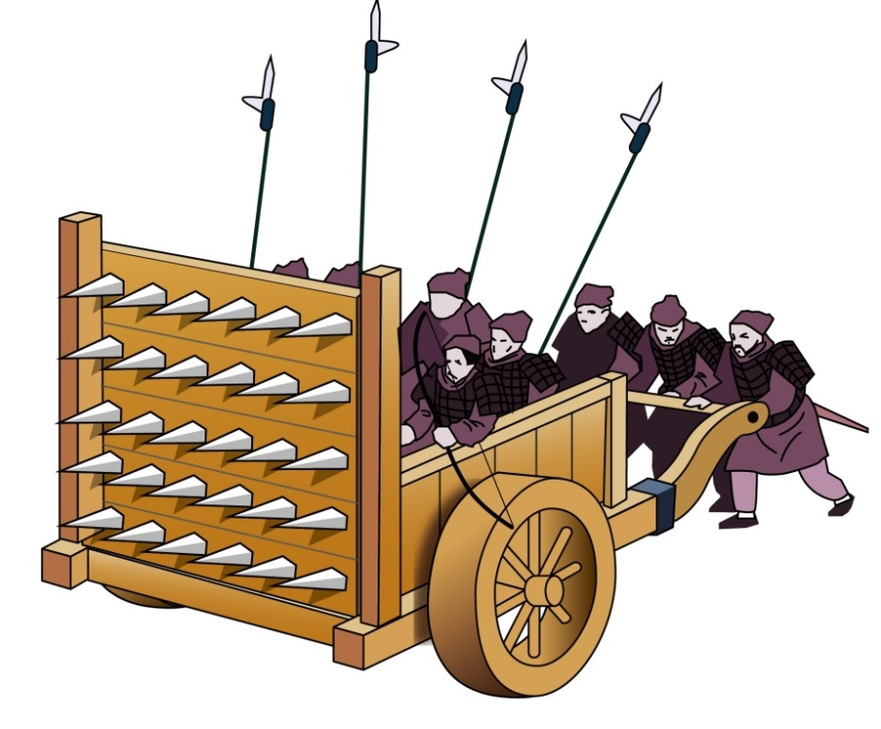
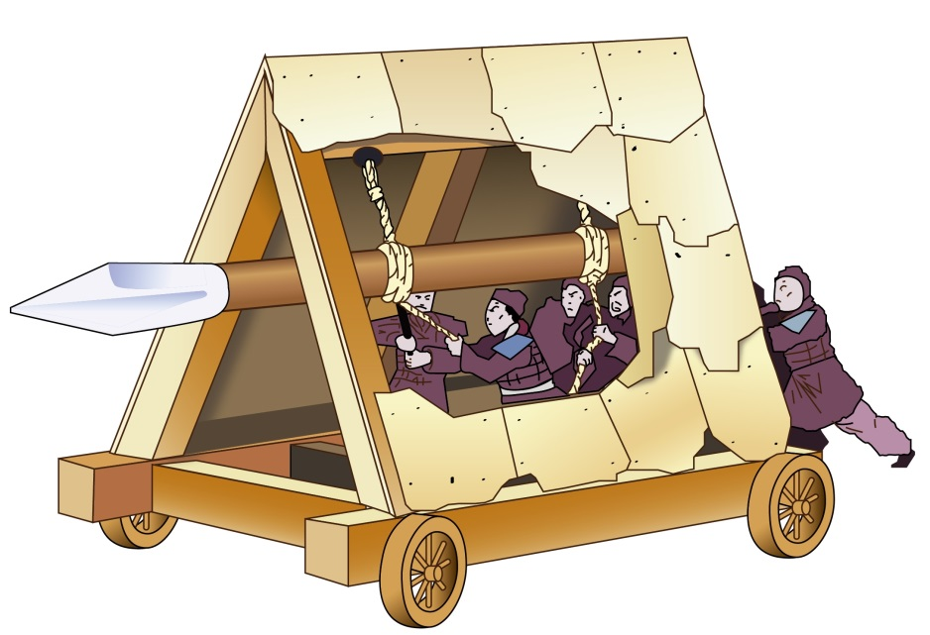
Battering Ram
Door Blocking Knife Cart
Siege use □
Defensive use □
Operating principle:
Siege use □
Defensive use □
Operating principle:
The metal point of the battering ram could be used to attack the city gate.
When the city gate was breached, this defensive weapon could be used to block the entrance. The cart could be pushed to the city gate entrance. It could kill or wound the enemies. Besides, it could obstruct enemy arrows and rocks. This was a portable city gate.

Slide 18
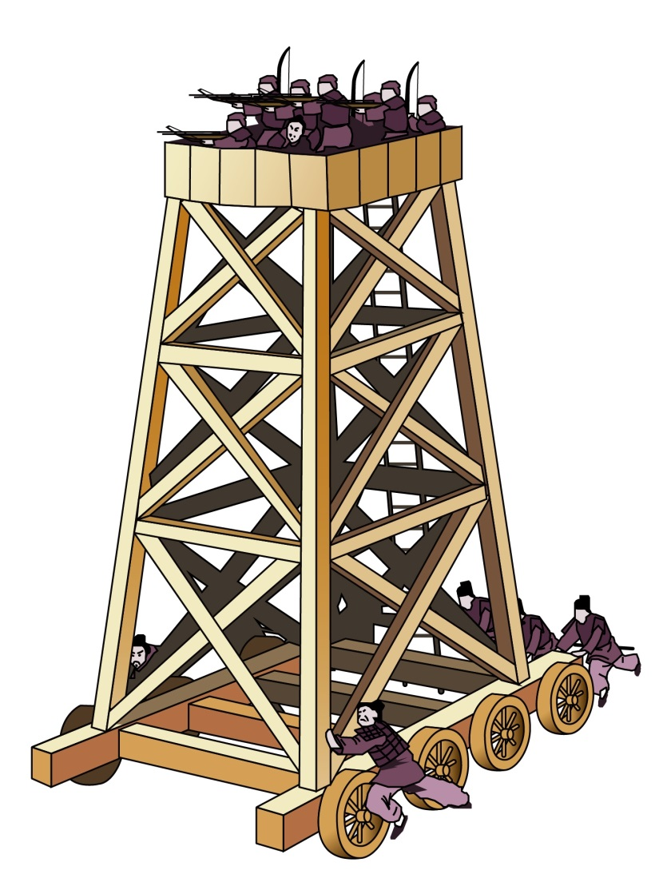
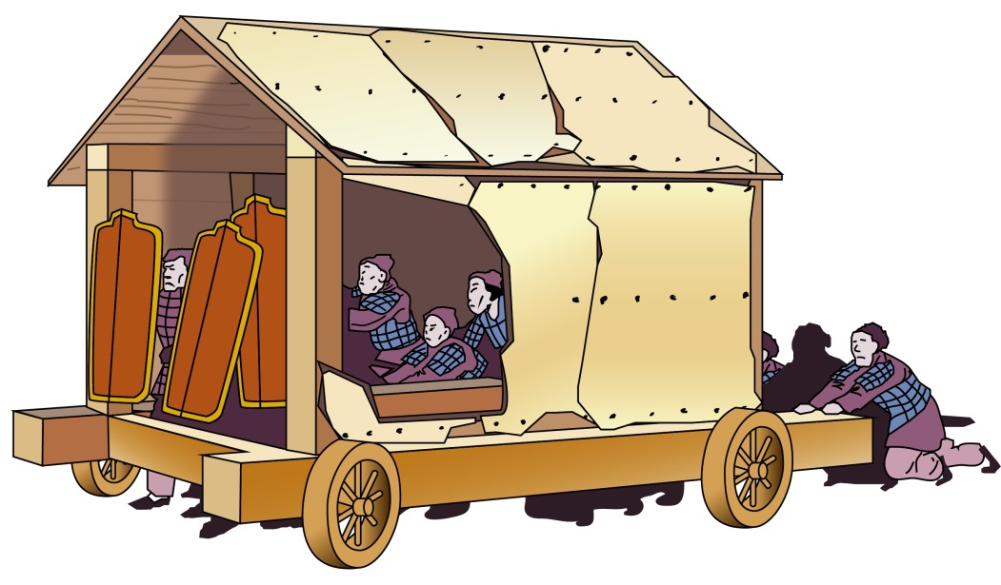
Siege tower
Sheltered cart for transporting soldiers
Siege use □
Defensive use □
Operating principle:
This was a house-like shelter installed on a car with a pointed top to lessen the damage of canon-fire and rocks. It transported soldiers safely in front of the city to dig tunnels or conduct other siege operations.
Siege use □
Defensive use □
Operating principle:
This was a mobile tall trolley used to transport armed soldiers to attack enemies on the city walls.

Slide 19
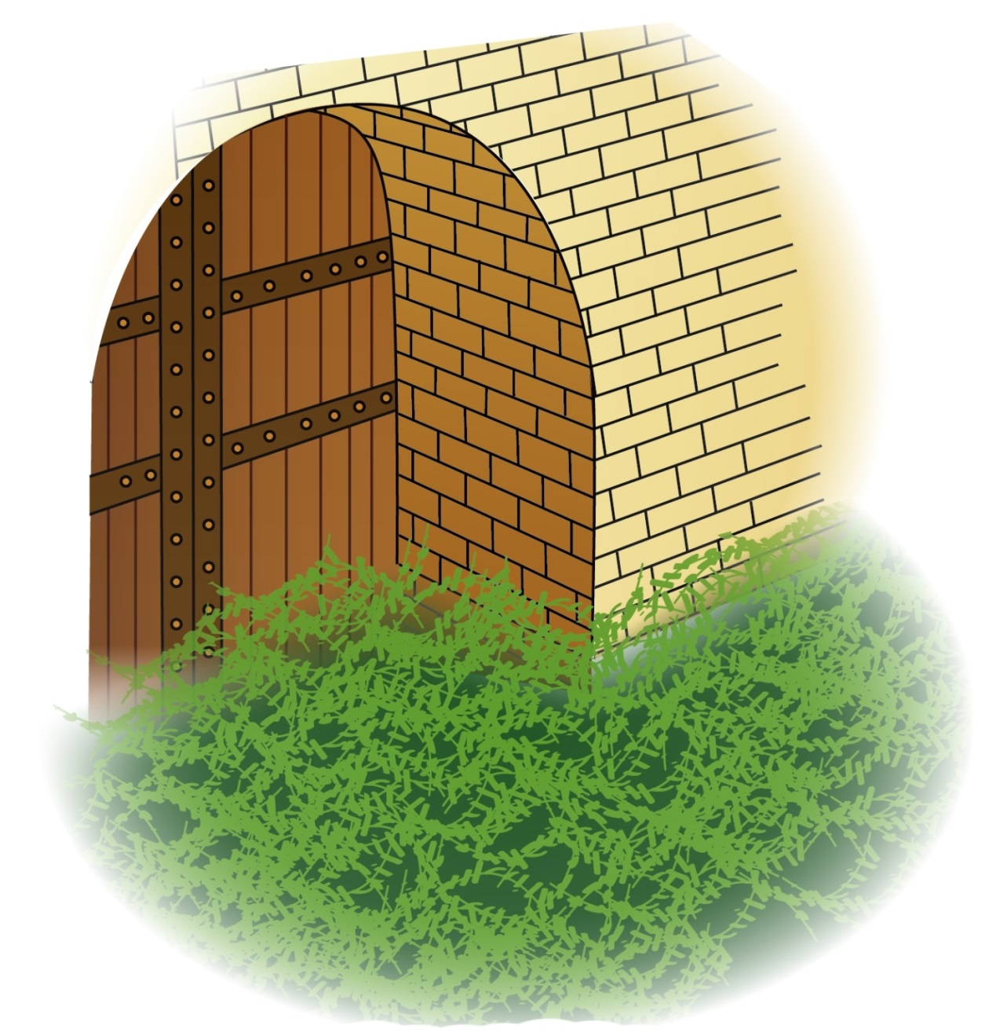
Siege use □
Defensive use □
Operating principle:
It was placed in front of the city gate and arranged to obstruct enemy attacks.
Thorny plant at the city gate

Slide 20
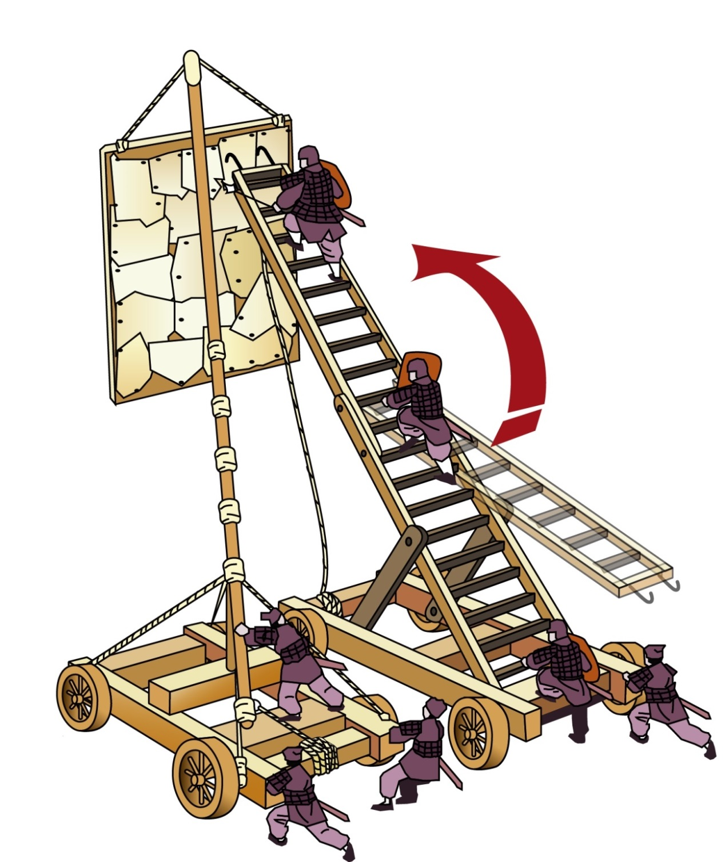
Left: Wooden curtain Right: Tall ladder
Siege use □
Defensive use □
Operating principle:
These were used for transporting soldiers and assisting them in climbing the city walls to attack.

Slide 21
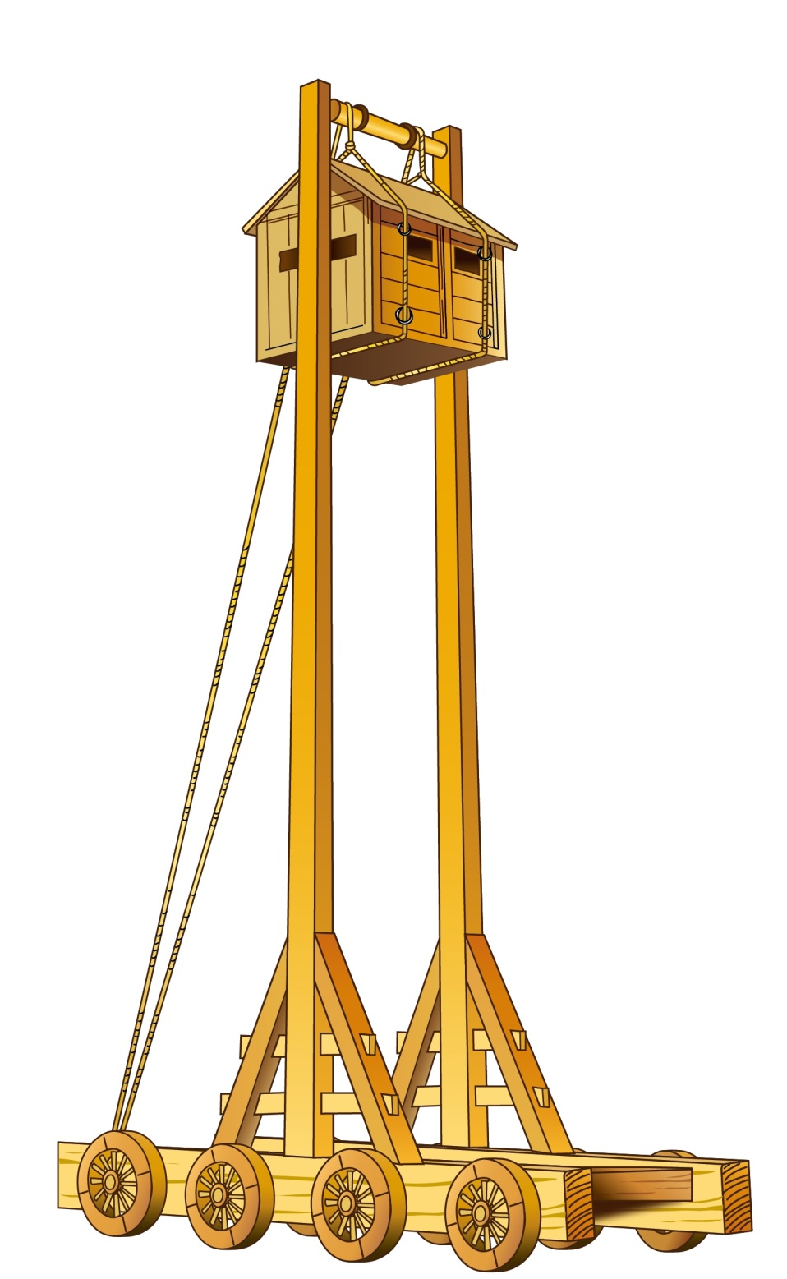
Lookout Tower Cart
(Hint: Soldiers on the ground pushed these into appropriate positions and then used the rope to lift the small house containing other soldiers.)
Siege use □
Defensive use □
Operating principle:
Soldiers on the ground pushed these into the appropriate positions and used the rope to lift the soldiers in the small house. From there, soldiers watched the enemies on the city walls or attacked the enemies in high places.

Slide 22
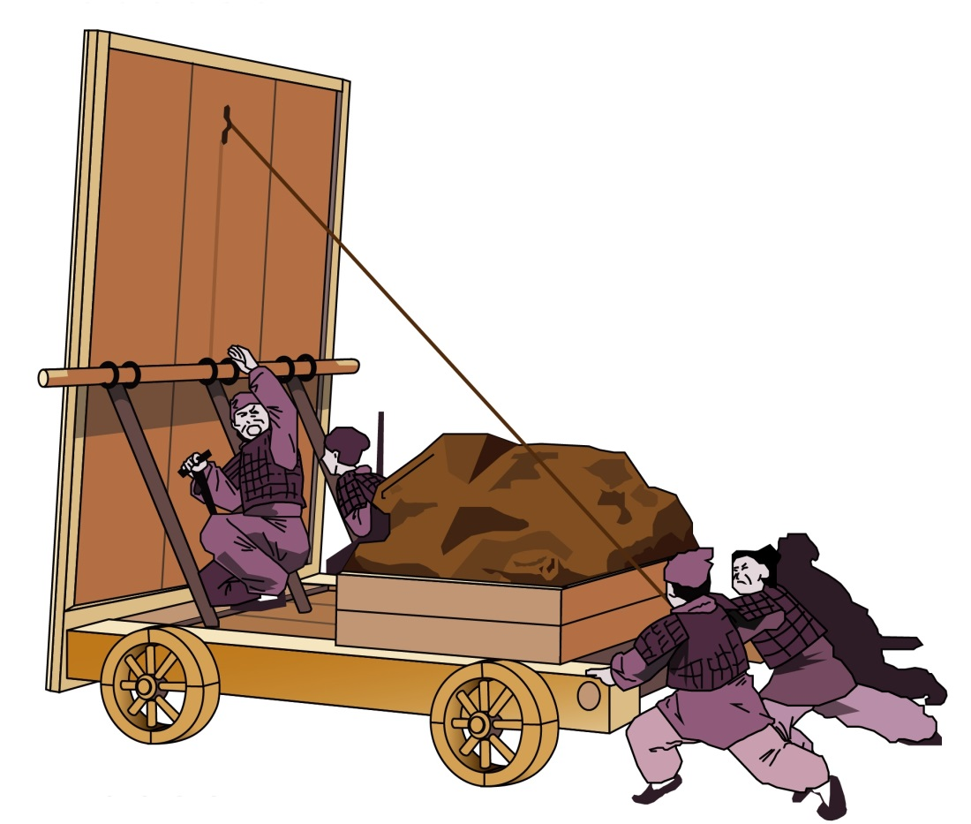
Moat filling cart
Siege use □
Defensive use □
Operating principle:
It carried earth to fill trenches and moats at the moat cities.
In AD759, even though Guo Ziyi’s army did not do anything and just returned, An Qingxu’s soldiers were exhausted. Once the siege at Xiangzhou was lifted, Shi Siming simply took soldiers into Xiangzhou and killed An Qingxu. In AD761, Shi Siming was killed by his son, Shi Chaoyi (史朝義). In AD762, Shi Chaoyi’s soldiers were defeated by Huihe (回紇) soldiers and he was ordered to commit suicide. The An-Shi Rebellion was over.

Slide 23
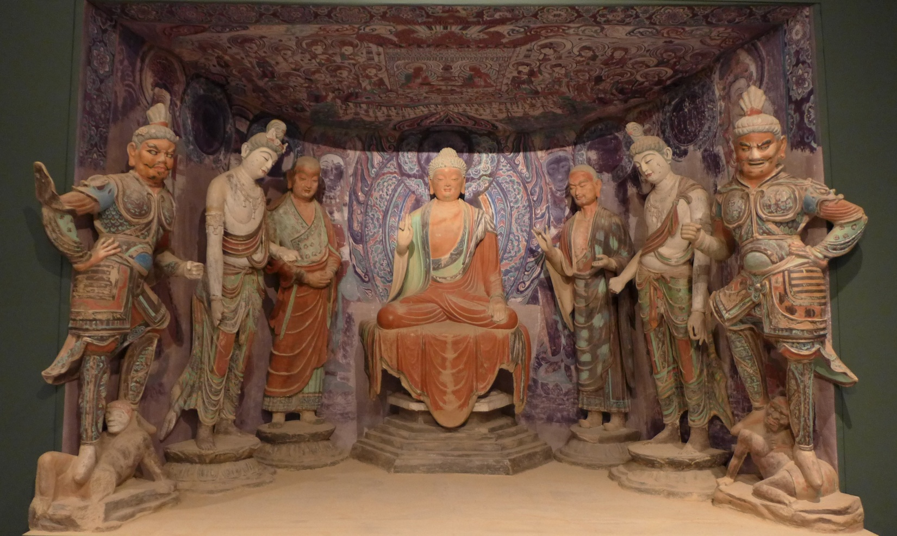
V. Explore Other Problems
Quiz: Please use what you have just learnt about the armour of the Tang Dynasty soldiers to guess when the following displays in the Dunhuang Caves were produced.
Heavenly Guardian of the South
Heavenly Guardian of the North
When do you think these cave statues were produced?
A. Northern and Southern Dynasties (AD420-589)
B. Early to middle Tang period
C. Late Tang
How do you know?
Source：photographed in the Hong Kong Heritage Museum, 2015 Dunhuang Exhibition
This is part of a series of statues in Dunhuang’s 194th cave. In the middle is Siddhartha Gautama. In the front row, the ones on the left and right are the Heavenly Guardian of the South and the Heavenly Guardian of the North respectively.

Slide 24
V. Explore Other Problems
Quiz: Please use what you have just learnt about the armour of the Tang Dynasty soldiers to guess when the following displays in the Dunhuang Caves were produced.
Heavenly Guardian of the South
Heavenly Guardian of the North
When do you think these cave statues were produced?
A. Northern and Southern Dynasties (AD420-589)
B. Early to middle Tang period
C. Late Tang
How do you know?
Source：photographed in the Hong Kong Heritage Museum, 2015 Dunhuang Exhibition
This is part of a series of statues in Dunhuang’s 194th cave. In the middle is Siddhartha Gautama. In the front row, the ones on the left and right are the Heavenly Guardian of the South and the Heavenly Guardian of the North respectively.

Slide 25
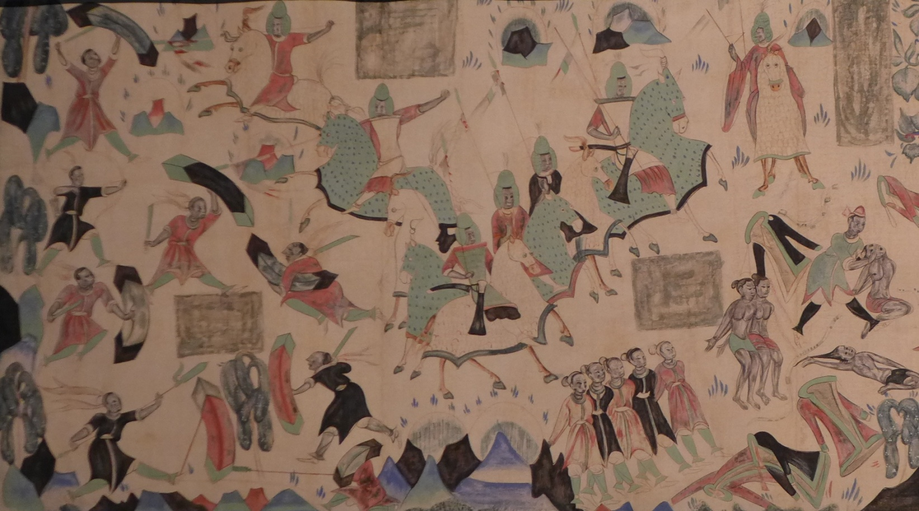
When do you think these cave statues were produced?
A. Northern and Southern Dynasties (AD420-589)
B. Early to middle Tang period
C. Late Tang
How do you know?
Source：photographed in the Hong Kong Heritage Museum, 2015 Dunhuang Exhibition
This is part of a painting in Dunhuang’s 285th cave. The content is about the story of 500 bandits becoming Buddhas.

Slide 26
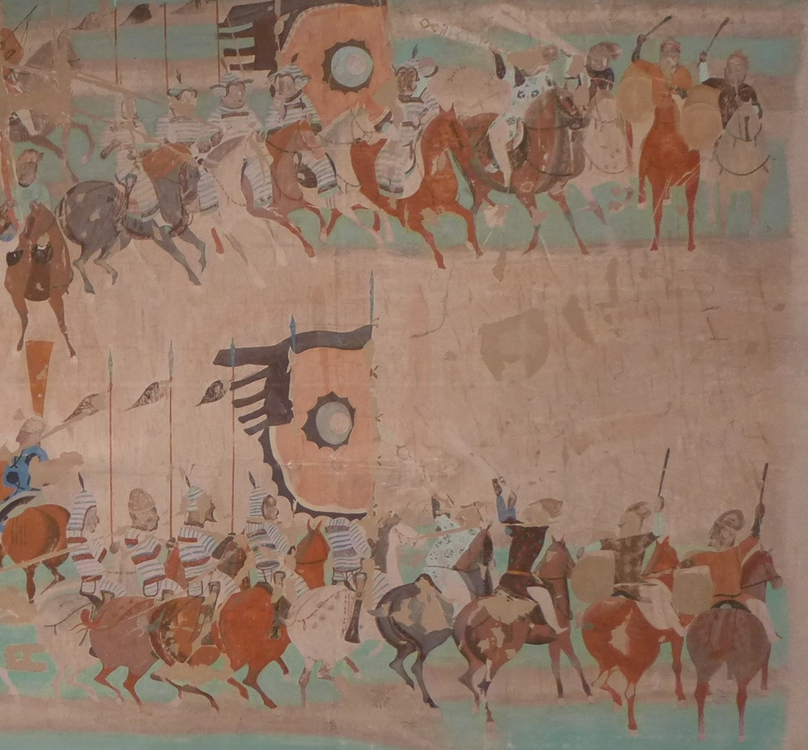
This is part of a mural from the 156th pit in Dunhuang. It shows the Hexi (河西) military commissioner, Zhang Yichao (張議潮), led his soldiers out to patrol.
When do you think these cave statues were produced?
A. Northern and Southern Dynasties (AD420-589)
B. Early to middle Tang period
C. Late Tang
How do you know?
Source: photographed in the Hong Kong Heritage Museum, 2015 Dunhuang Exhibition

