Slide 1
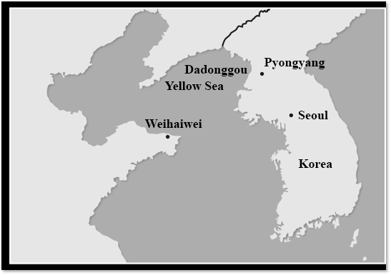
The Battle of the Yalu River (黃海海戰):
The Beiyang (北洋) Navy and the Line Abreast Battle Formation
Battle Situation
Qing army’s line of advance
Japanese army’s line of advance

Slide 2
The Circumstances behind the Battle of the Yalu River
On 25 July AD1894, the Chinese cruiser, Jiyuan (濟遠), and the torpedo gunboat, Guangyi (廣乙), of the Qing Dynasty’s Beiyang Fleet were near Fengdao Island (豐島) on the Yellow Sea and were ambushed by Japanese warships. The Guangyi suffered heavy casualties and was burnt. The Jiyuan then fled in defeat. While chasing the Jiyuan, Japanese warships met Gaosheng (高陞), a British vessel temporarily chartered by the Qing government to transport soldiers and weapons which had accidentally appeared there. Although Gaosheng had no intention of being involved in this conflict, the Japanese navy ordered the transport vessel to surrender. When the Qing soldiers refused, the Japanese warships attacked and sank it, causing the deaths of over 700 Chinese crew members. This became known as the Battle of Fengdao. On September 17, both the Chinese and Japanese navies fought a decisive battle at Dadonggou (大東溝) in the Yellow Sea, which came to be known as the Battle of Dadonggou or the Battle of the Yalu River. This was also one of the most important battles of the Sino-Japanese War.

Slide 3
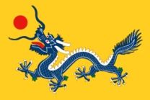
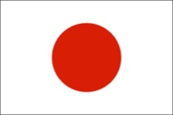
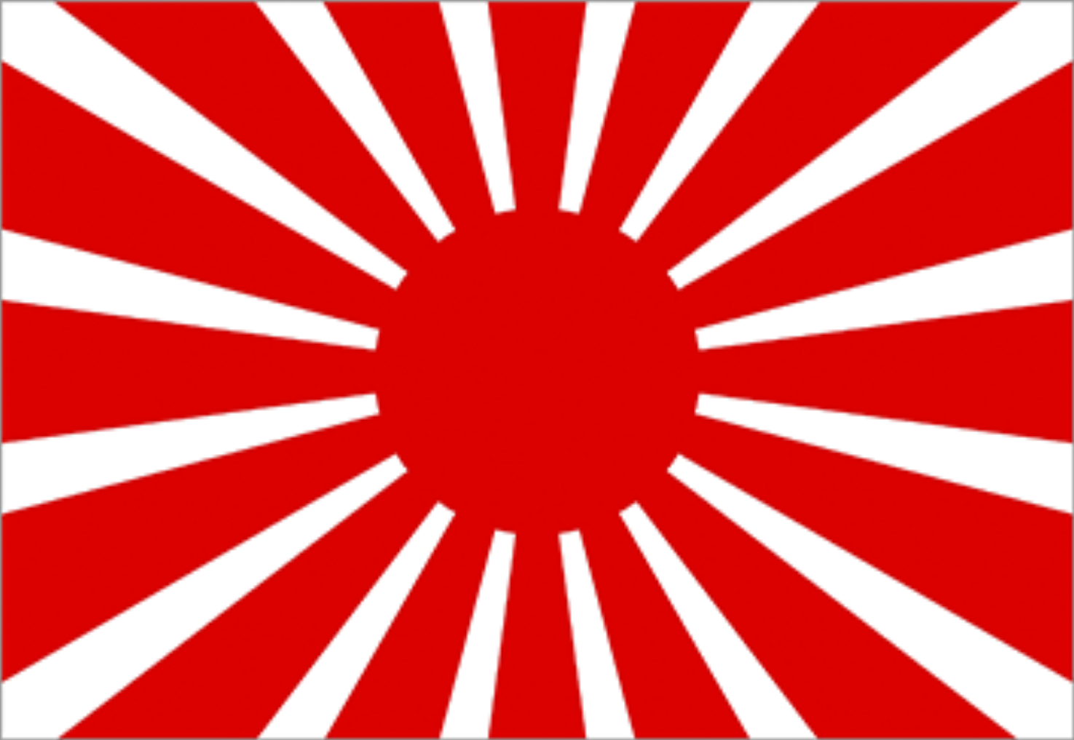
II. General Overview of the Battle of the Yalu River
Participating Countries
Qing Dynasty | Japan
Commanders in the Battle
Liu Buchan 劉步蟾 Ding Ruchang 丁汝昌 | Tsuboi Kozo 坪井航三 Ito Sukeyuki 伊東祐亨
Military Power (Warships)
2 battleships 10 cruisers 2 torpedo gunboats | Total of 12 (Early Meiji Japanese navy warships were not divided by the ship types)
Casualties
5 sunk ships (Zhiyuan 致遠, Jingyuan 經遠, Chaoyong 超勇, Guangjia 廣甲, Yangwei 揚威), those that were not sunk suffered various degrees of damages 850 dead 500 injured | 5 heavily damaged ships (Matsushima 松島, Saikyo Maru 西京丸, Yoshino 吉野, Hiei 比叡, Akagi 赤城), but none were sunk. 298 dead 200 injured.
The Battle of the Yalu River
Date: 17 September, 1894
Location: Off the mouth of the Yalu River, Yellow Sea
Losses (ships):
Japanese: none
Chinese: 5 ships
Source: Wikipedia’s “The Battle of the Yalu River”.

Slide 4
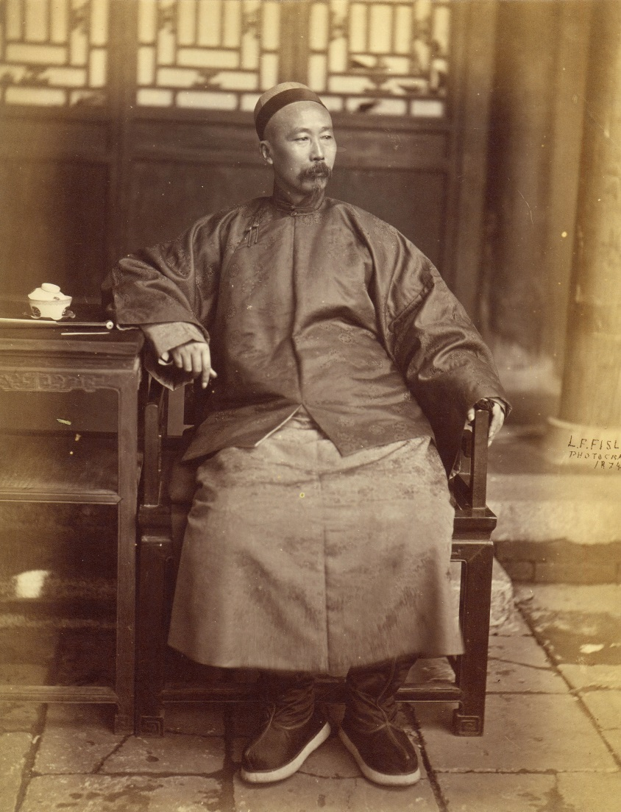
III. Chinese and Japanese Commanders-in-Chief and Military Officers
A. The Chinese Side
Qing
– The administration of Qing navies was separated. The Qing navy which fought in the Sino-Japanese War was the Beiyang Fleet headed by Li Hongzhang (李鴻章) (Governor-General of Zhili Province; Minister of the Beiyang Fleet). However, he was unable to control the military forces of the whole country. He could only control the Huai Army (淮軍) and the Beiyang Fleet as the main forces in conducting the war.
Li Hongzhang

Slide 5
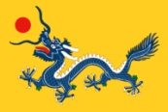
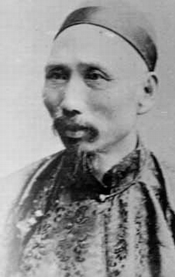
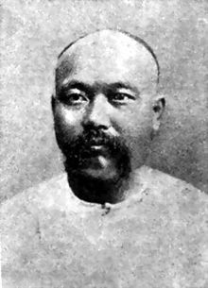
Beiyang Fleet Commanders
Ding Ruchang (Admiral)
• AD1836: He was born in Anhui (安徽).
• In his early years, he was a cavalry officer in the Huai Army.
• AD1882: When the Imo Mutiny erupted in Korea, Ding Ruchang led the Beiyang fleet to
suppress the rebellion and got an award from the Qing court.
•AD1888: The Beiyang fleet was officially founded. He became the admiral of the fleet.
•AD1894: At the Battle of the Yalu River, he issued commands from the flagship Dingyuan. Not
long after the war began, he was injured by the Japanese cannons.
•1 February AD1895: He presented a surrender letter to the Japanese fleet before killing himself by swallowing opium.
Liu Buchan (Captain)
•AD1852: He was born in Fujian (福建).
•AD1872: He graduated first place from the School of Naval Administration in Fuzhou.
•AD1876: He worked at the Britain Royal Navy’s Mediterranean fleet flagship as an intern
and learnt much while on the job.
•AD1878: He returned to China and immediately became the ship captain of the Beiyang Fleet’s Zhenbei 鎮北.
•AD1885: The Beiyang Fleet acquired Dingyuan and he served as its captain.
•AD1894: In the Battle of the Yalu River, Ding Ruchang was heavily injured. Liu, in effect,
became the entire fleet’s commander.
•4 February AD1895: The Japanese army attacked Weihaiwei (威海衛) surprisingly. To prevent the Dingyuan from falling into the Japanese hands, Liu Buchan sank the Dingyuan and swallowed opium to kill himself.
It was rumoured that Liu Buchan had some negative opinions regarding his boss, Ding Ruchang, who did not have any formal naval trainings. However, such resentment did not affect their battle performances.

Slide 6
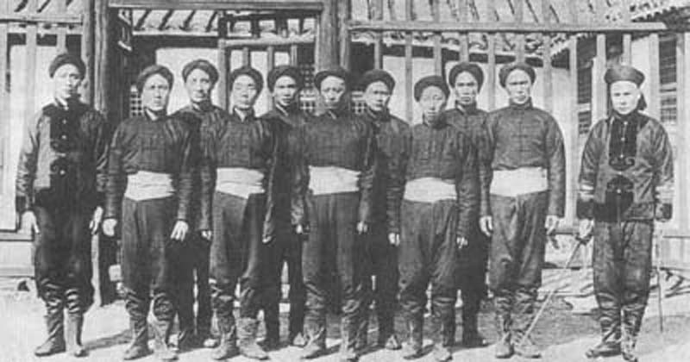
Beiyang Navy Uniform
Think:
Why did the navy soldiers of this period not wear the traditional armour or protective equipment?
(Prompt: Was traditional equipment in a modern maritime battle still useful? Why?)
Navy Uniform
-Turban (black)
-Long sleeved jacket (blue)
-Dhoti (white)
-Trousers (blue)
-Shoes (black)
Navy Officer Uniform
-Official cap (black)
-Long sleeved jacket (blue), cuffs with gold lining to indicate the official
rank
-Trousers (blue)
-Shoes (black)

Slide 7
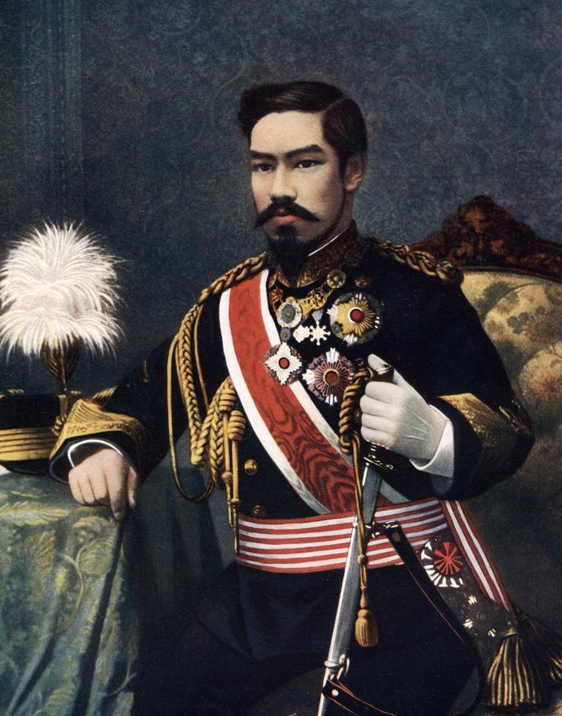
B. Japanese Side
Emperor Meiji
• Japan
– The entire war was commanded from a headquarters in the Japanese government with full support from Emperor Meiji. Therefore, its navy was coordinated better than that of the Qing Dynasty.

Slide 8
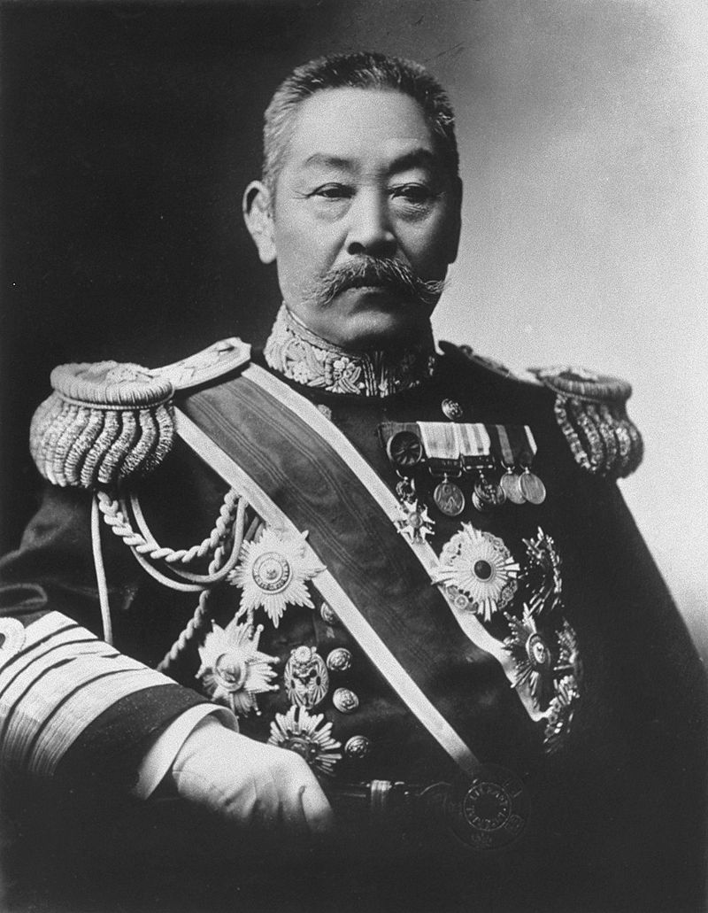
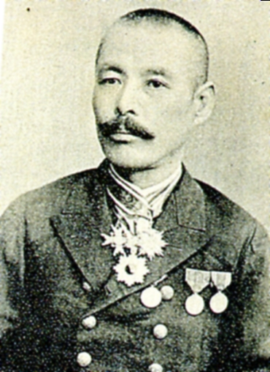
Japanese Naval Commanders officers
Ito Sukeyuki
• AD1843: He was born as a noble (his ancestors were feudal lords of Obi) and was a
Satsuma Domain official.
• AD1892: He became a naval lieutenant.
• AD1894: In the Sino-Japanese War, he was assigned to the Combined Fleet as a
commanding officer and oversaw the flagship Matsushima.
• AD1895: He sent the remains of Ding Ruchang from the captured enemy warship
Kangji back to China and was heavily praised by Japanese domestic public opinion.
• AD1898: He became a naval general.
• AD1907: He became a Count.
• AD1914: He died.
Tsuboi Kozo
• AD1843: He was born in Yamaguchi prefecture.
• AD1868: He became a Choshu Domain samurai.
• AD1871: He became a naval captain and then
went to America to learn about their navy.
• AD1890: He was promoted to naval major general.
• AD1894: In the Sino-Japanese War, he was the
commander of the vanguard.
• In the Battle of the Yalu River, he was promoted
to lieutenant general and awarded with Baron
status.
• AD1898: He died.
The navy of the Meiji Japan was constantly controlled by old powers in Satsuma. Therefore, even though Tsuboi Kozo had provided significant military service during the Battle of the Yalu River, his official career was inferior to Ito Sukeyuki who was born in the same year since Tsuboi Kozo was born in the Choshu domain.

Slide 9
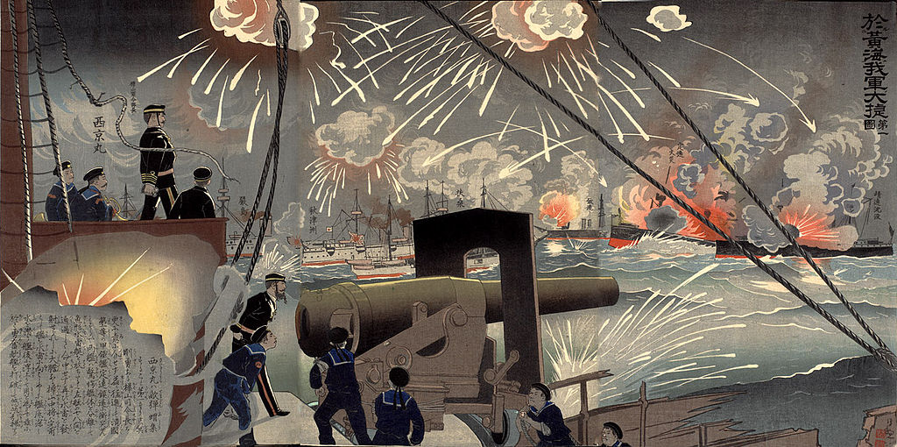
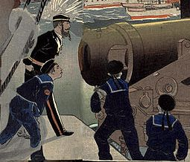
The Battle of the Yalu River (Ukiyo-e)
Japanese naval uniform
The Battle of the Yalu River was very important to Japan. Therefore, they appointed the highest minister in the Japanese navy, the Chief of the Naval Staff, Kabayama Sukenori (樺山資紀), to watch the battle on the Saikyo Maru.
The senior officers who assisted Kabayama Sukenori to command the Saikyo Maru had more or less the same uniform as Kabayama. However, if you examine it closely, the senior officers had less golden thread.
After the Sino-Japanese war, Kabayama Sukenori was promoted and became Taiwan’s first colonial governor.
Average uniform for warship infantry

Slide 10
Think: Examine and compare the Chinese and Japanese commanders, officers and navy infantry uniforms. What differences do you think the two countries have in their military modernization?
Hint: Was military modernization more thorough in China or Japan? How can you tell?

Slide 11
IV. Comparison of the Naval Power of China and Japan
Overview of the Beiyang Veseels
Ship Name | Type of Ship | Speed (knots) | Displacement (tons) | Main Installations | Main Firepower (purple circles)
Dingyuan 定遠 | Ironclad battleship | 14.5 | 7335 | four 30.5cm guns two 15cm guns
Zhenyuan 鎮遠 | Ironclad battleship | 14.5 | 7335 | four 30.5cm guns two 15cm guns
Laiyuan 來遠 | Armored cruiser | 15.5 | 2900 | two 21cm guns two 15cm guns
Jīngyuan 經遠 | Armored cruiser | 15.5 | 2900 | two 21cm guns two 15cm guns
Pingyuan 平遠 | Armored cruiser | 11 | 2100 | one 26cm gun two 15cm guns
Jiyuan 濟遠 | Protected cruiser | 15 | 2300 | three 21cm guns one 15cm gun

Slide 12
Ship Name | Type of Ship | Speed (knots) | Displacement (tons) | Main Installations | Main Firepower (purple circles)
Zhiyuan 致遠 | Protected cruiser | 18 | 2300 | three 21cm guns two 15cm guns
Jìngyuan 靖遠 | Protected cruiser | 18 | 2300 | three 21cm guns two 15cm guns
Chaoyong 超勇 | Old style cruiser | 15 | 1350 | two 10cm guns four 12cm guns
Yangwei 揚威 | Old style cruiser | 15 | 1350 | two 10cm guns four 12cm guns
Guangjia 廣甲 | Old style cruiser | 10 | 1350 | two 15cm guns four 12cm guns
Guangbing 廣丙 | Torpedo boat | 17 | 1300 | three 12cm guns
Quiz: Among the Beiyang warships, which warships were the strongest in the battle? How can you tell?

Slide 13
Explanations of Terms
Type of Ship | Special Features
Battleship | The battleship had relatively large displacement of water, thick armour and strong firepower. It was good for fighting wars because it had thick armour though it was slower.
Cruiser | As the name implies, “cruiser” refers to ships used for patrolling oceans. Due to this purpose, this type of ship was relatively fast and could search for enemies. Since its main goal was not for fighting in the battle, its armour and firepower were both weaker than that of the battleship.

Slide 14
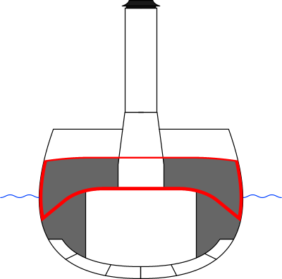
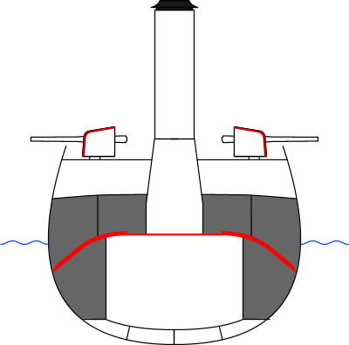
Equipment | Explanation | Diagram
Ironclad | Iron or steel navy vessels.
Armored | Wooden ships with an iron shell (marked in red on the diagram).
Protected | Wooden ships with an iron shell (marked in red on the diagram). However, the iron shell was comparatively smaller than the armoured ships.
Old type | Generally, these were constructed in an earlier period and included retired warships.
Torpedo boat | In the 1880s and 1890s, a new type of warship emerged. It had high speed and could bear the weight of torpedoes.
(Image source: Wikipedia: Cruiser)

Slide 15
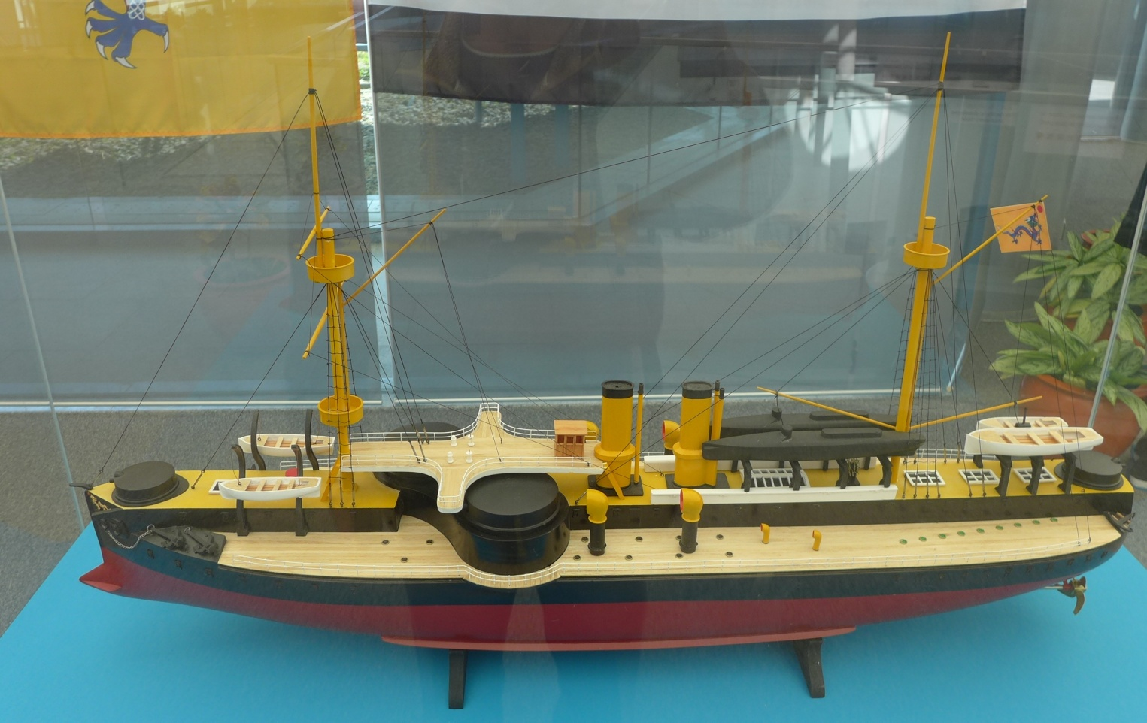
The design of Dingyuan included a “flying bridge” for someone to command from. However, it prevented the two cannons from turning right or left, weakening the attacking power of both sides. Additionally, it was outdoors without protection. At the beginning of the Battle of the Yalu River, the flying bridge was hit by a bullet and destroyed. Admiral Ding Ruchang was thrown down and fainted.
The Specifications of the Beiyang Flagship Dingyuan
The flagship was the warship where the commander was located. In an era where wireless communications had not yet developed, commanders hung different flags to issue orders to allied ships.
Two-Gun Turrets
Flying Bridge
Dingyuan
Type of ship: Ironclad
Place of production: Germany
Active Service: AD1885
Water Displacement: 7,335 tons
Total Length: 94.5m
Horsepower: 6,200 horsepower
Speed: 14.5 knots
Soldiers: 363
four 30.5cm guns
two 15cm guns
The Hong Kong Museum of Coastal Defence’s exhibition on the Sino-Japanese War, Model 1:100
Naval Ram
Battle Capabilities
The length of Dingyuan was 94.5m. It was the giant of the Battle of the Yalu River and had been nicknamed as “unsinkable”. This warship’s front and back ends were respectively fitted with a 15cm gun. However, the strongest guns were the two 30.5cm two-gun turrets protecting the warship’s right and left sides. If the enemy was in the front or behind, the two gun turrets could turn front or back to assist the attack. The naval ram at the head of the boat could also ram and break smaller enemy ships.

Slide 16
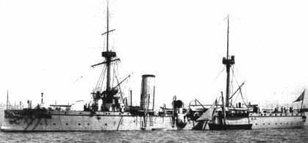
It was a British manufactured protective cruiser. It was known for its high speed (18 knots), 3 main guns, including 2 in the front and 1 behind, all 21cm, and 2 secondary guns on both sides, each 15cm. The entire warship could contain 204-260 people.
Zhiyuan

Slide 17
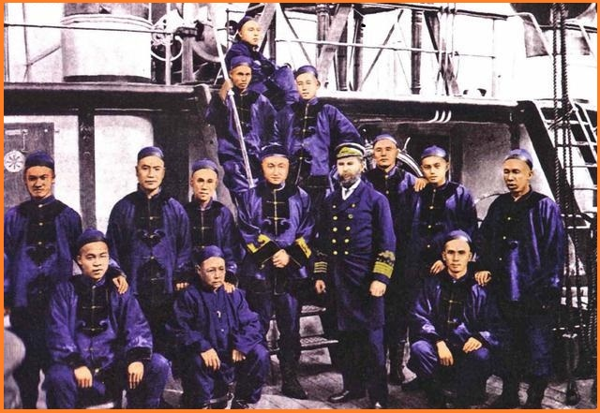
William Metcalfe Lang (AD1843-1906) was a British man who became the Vice Admiral of the Beiyang Fleet, but left this post in AD1890.
Every warship had many officers in charge of different posts. The highest grade was captain.
This was the captain of Zhiyuan. Do you know his name?
Hint: He was born in Panyu, Guangdong. He graduated from the School of Naval Administration in Fuzhou. In the Battle of Yalu River, he commanded Zhiyuan and attempted to bump and sink the Japanese ship Yoshino but failed. A Japanese torpedo sunk his ship instead. There were only 7 survivors on the entire ship and he also bravely sacrificed his own life.

Slide 18
Densely packed quick-firing guns had fearsome attacking capabilities. Apart from torpedo boats, they were one of the few types that could attack large enemy vessels effectively. This was precisely one of the tactics used in the Battle of the Yalu River.
Overview of the Japanese Navy Ships
In the early Meiji period, Japanese navy warships were not differentiated
Ship Name | Speed (knots) | Displacement (tons) | Main Installations | Main Firepower (red circles)
Matsushima 松島 | 16 | 4278 | one 32cm gun twelve 12cm guns
Itsukushima 嚴島 | 16 | 4278 | one 32cm gun eleven 12cm guns
Hashidate 橋立 | 16 | 4278 | one 32cm gun eleven 12cm guns
Yoshino 吉野 | 23 | 4216 | four 15cm guns eight 12cm guns
Saikyo Maru 西京丸 | 15 | 4100 | one 57mm gun two 47mm guns one 12cm gun

Slide 19
Ship Name | Speed (knots) | Displacement (tons) | Main Installations | Main Firepower (red circles)
Takachiho 高千穗 | 18 | 3709 | two 26cm guns six 15cm guns
Naniwa 浪速 | 18 | 3709 | two 26cm guns six 15cm guns
Fuso 扶桑 | 13 | 3717 | four 24cm guns four 17cm guns six 7.5cm guns
Akitsushima 秋津州 | 19 | 3150 | four 15cm guns six 12cm guns
Chiyoda 千代田 | 19 | 2439 | ten 12cm guns
Hiei 比叡 | 13.7 | 2250 | three 17cm guns six 15cm guns two 7.5cm guns
Akagi 赤城 | 10 | 622 | four 12cm guns

Slide 20
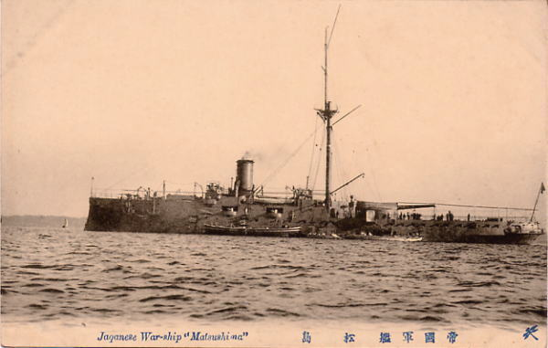
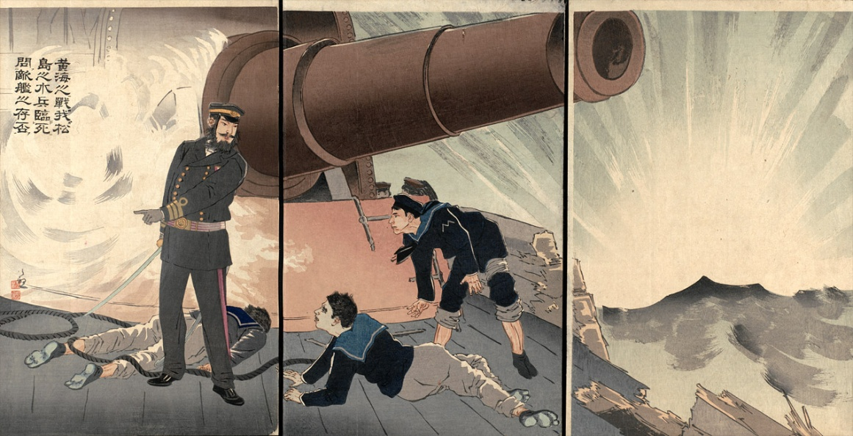
Type of Warship: coastal defense cruiser
Place of Production: France
Active Service: AD1892
Water Displacement: 4,278 tons
Full Length:89.9m
Horsepower: 5,400
Ship Speed: 16 knots
Soldiers: 360
one 32cm gun
twelve 12cm quick-firing guns
The Specifications of the Japanese Flagship Matsushima
Main gun
The Matsushima had the largest gun in the entire Battle of the Yalu River with a diameter of 32cm. It was installed at the end of the ship. Due to the large size of this gun, the entire warship would shake violently when it fired every time.
(Image: Wikipedia: Japanese cruiser Matsushima)

Slide 21
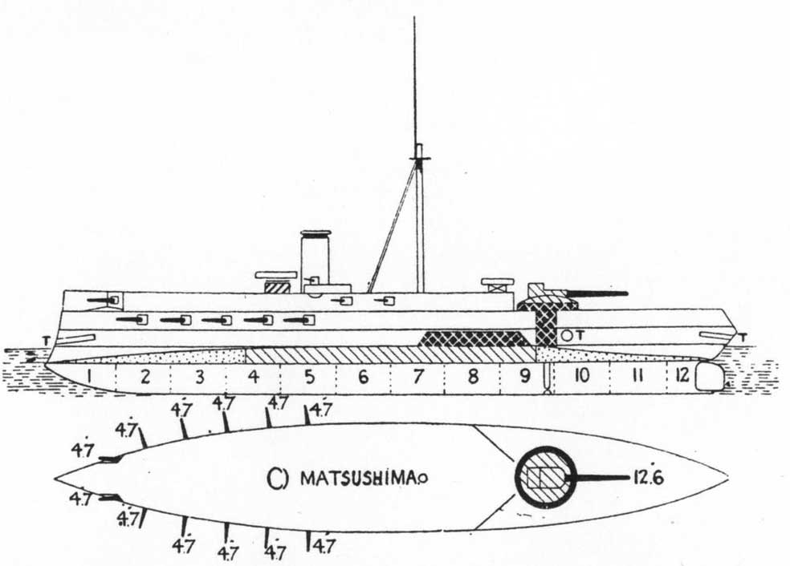
The Matsushima had installed a large number of quick-firing guns on both sides. Even though the power of quick-firing guns was unlike average cannons, it could carry out short range quick-firing. Average guns often needed several minutes before they could fire again. At the same time, quick-firing guns could have already fired 7 times.
(Image: Wikipedia: Japanese cruiser Matsushima)

Slide 22
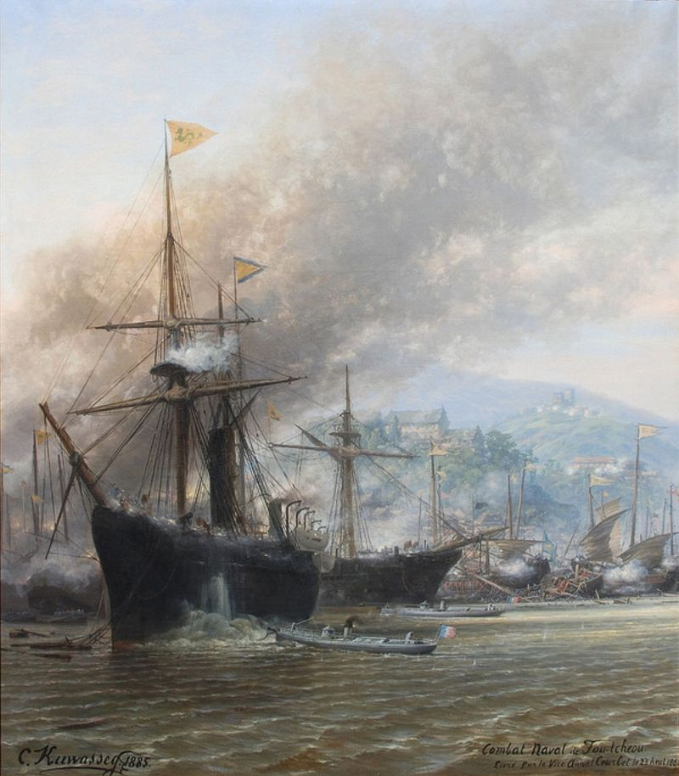
The Secret Weapon of the Japanese Navy: Quick-Firing Guns
Quick-firing guns originated from the small-scale weapons designed to counter torpedoes. In the 1880s, the small torpedo boats became the nemesis of large warships.
The image on the left depicted the 1884 Battle of Fuzhou in which a Qing warship was attacked by a French torpedo boat and then sunk (Source from Wikipedia: The Battle of Fuzhou).
Torpedo
The torpedo was the nemesis of the large scale warships. However, this era’s torpedoes had not yet developed navigation equipment. Therefore, many were placed on the small boats and sent to nearby navy vessels where a simple machine was used to lower it into the water.

Slide 23
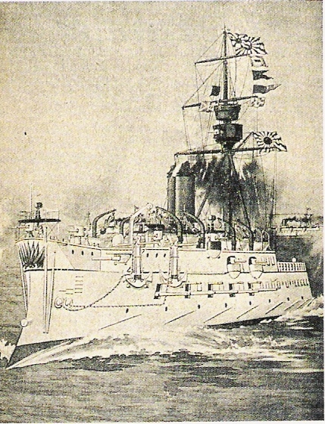
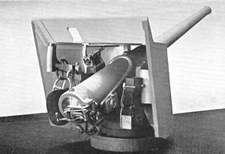
In the Battle of the Yalu River, the Japanese navy warships all installed 4.7 inch diameter quick-firing guns. This image showed Matsushima. Can you find its quick-firing cannons?
4.7 inch diameter quick-firing guns
Reference: Wikipedia: QF 4.7-inch Gun Mk I-IV
To protect warships, new types of warships put light guns on both sides which allowed them to attack nearby torpedo boats. Due to the lightness of these guns (each artillery shell only weighed a few pounds), operation was simple and easy. Therefore, bombardment speed increased. They became the “quick-firing guns” later.
(Reference: Wikipedia, Japanese cruiser Matsushima)
Think: What distinguishing characteristics did the Chinese and Japanese fleets have respectively? Under what battle circumstances could they display their power? If you were the admiral of the Beiyang Fleet, how would you arrange their formation?

Slide 24
V. The Confrontation and Outcome of Chinese and Japanese Naval Formations
Torpedo boat
Torpedo boat
Guangbing
The Beiyang Fleet’s Naval Formation
Pingyuan
Since the firepower of the Beiyang fleet warships tended to be at the front, the optimal battle formation was line abreast (or side by side) formation. This meant lining ships up in a row with the warship bow facing forward.
Yangwei
Chaoyong
Jīngyuan
Beiyang’s side by side formation also had a benefit. Despite the size differences of ships, this formation made it easier to make navy vessels of different speeds conform.
Laiyuan
Zhenyuan
Under circumstances where the side was attacked, the more powerful Jiyuan was assigned to defend the left side. Pingyuan, Guangbing, and two torpedo boats protected the right side where Yangwei and Chaoyong were easily sunk. This meant that the main force became capable of a double-pronged attack in which they could mutually protect each other.
Dingyuan
Jìngyuan
Zhiyuan
Think: If you were the admiral of the Japanese navy commander, how would you organize the battle formation?
Guangjia
Jiyuan

Slide 25
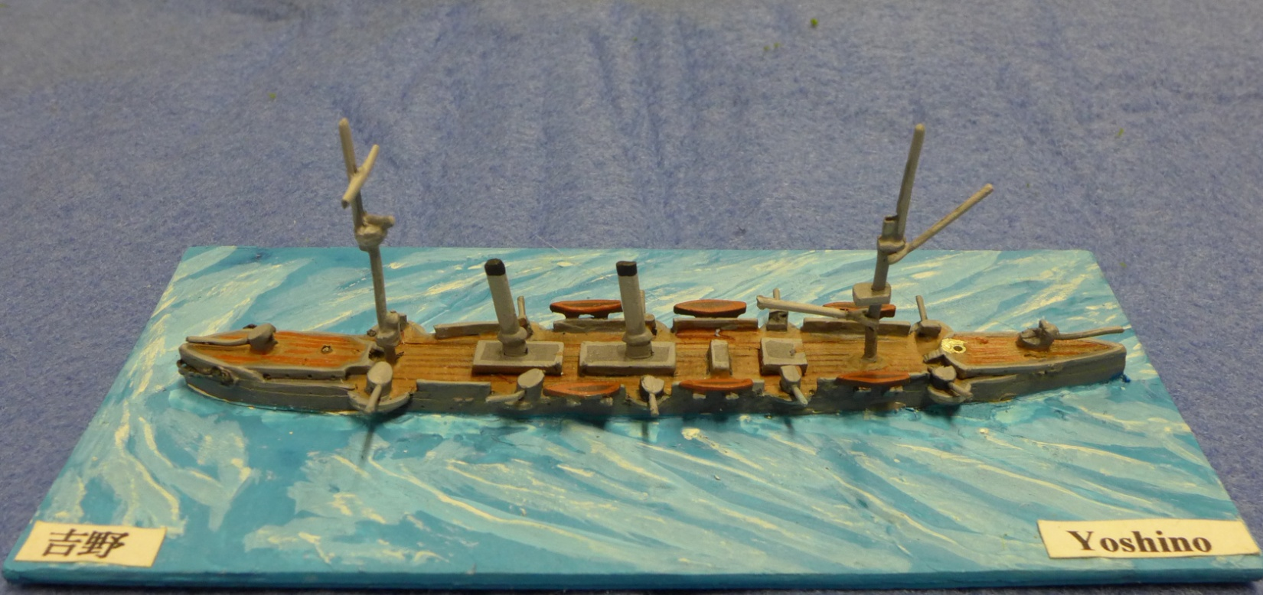
Japanese Army Battle Tactics: Vanguard
Yoshino
23 knots
Compared with the Beiyang Fleet, the Japanese fleet had outstanding guns in the front and sides of their warships. Therefore, it could consider using either the “line abreast” formation or the “line ahead”（that was, follow-the-leader) formation against the Beiyang Fleet. After discussion, they finally decided to adopt the “line ahead” line formation.
Takachiho
18 knots
Akitsushima
The line ahead formation was not easy. When warships following one another travelled, they needed to prevent collision. Besides, they would be disturbed by artillery barrage or low morale. All these factors would confuse the formation. Therefore, Japanese soldiers practiced many times before the battle.
Naniwa
The Japanese army chose the 4 fastest warships to act as the vanguard. They would advance at a high speed and attack the Beiyang warships from the right side.
19 knots
18 knots (speed)
Although these 4 battleships were not part of the main force, they were already the most powerful in the Battle of the Yalu River. The British manufactured Yoshino (in active service since AD1893) was, for example, the fastest in the world (23 knots) and the Japanese fleet’s most advanced warship. At the Battle of the Yalu River, the first attack team’s commander, Tsuboi Kozo, issued orders from on board the Yoshino.

Slide 26
Japanese Army Battle Formation: Main Force
Matsushima
In the main force, there were two weaker warships: the Saikyo Maru and the Akagi. They were basically unable to fight and therefore assigned a relatively safe position.
This was a cruiser in reserve remodeled from a merchant ship. On that day, its mission was to bring the Imperial Japanese Navy General Chief of Staff, Kabayama Sukenori, to watch the battle.
Chiyoda
The main force had two relatively weak warships: Hiei and Fuso. They could only follow behind.
This was a small gunboat of approximately 600 tons. It was unable to battle and used for investigating shallow water only.
Itsukushima
The line ahead formation relied on the quick-firing guns on both sides of the warships. In that era, every country wanted to have large scale warships equipped with gigantic guns, like Dingyuan and Zhenyuan. The Japanese army’s use of the quick-firing guns to confront the enemy was marked a new way to battle in global naval battle history. The power of quick-firing guns could not destroy the entire warships. However, it was enough to injure and kill soldiers and sailors on board and brought about panic. Gigantic guns would then be used to sink the wounded ships. This was the method that the Japanese used to win the Battle of the Yalu River.
Hashidate
Saikyo Maru
This was a corvette, a three mast old style warship
Akagi
Hiei
This was originally an old style warship. Three years were used to renovate it into an ironclad cruiser.
Fuso

Slide 27
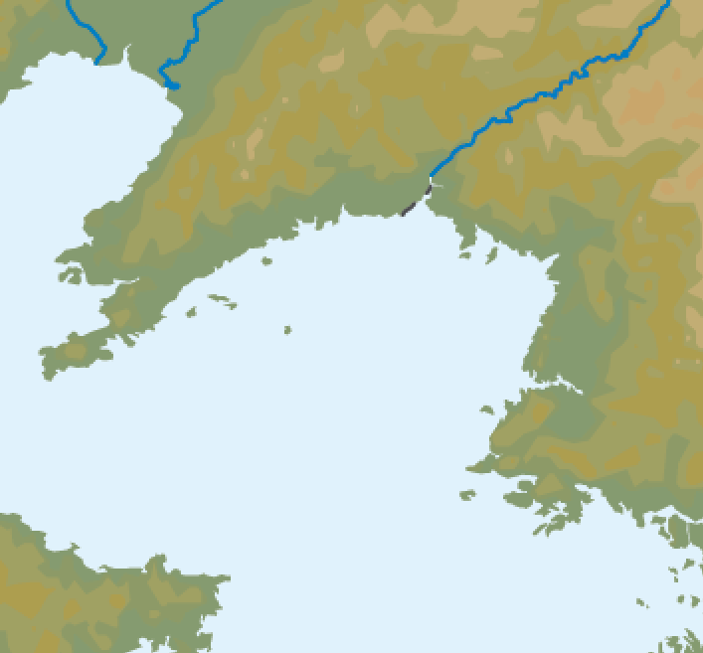
The Battle of the Yalu River Diagram
The Battle of the Yalu River in AD1894 was the key military campaign of the Sino-Japanese War. The loss of the Sino-Japanese war had a huge impact on Qing politics, especially the Hundred Days Reform.
In the Battle of the Yalu River, the Qing Dynasty’s Beiyang Fleet suffered a crushing defeat at the hands of the Japanese navy and lost sea power superiority in the Yellow Sea. Was the defeat derived from the Beiyang Fleet’s quality, battleship equipment or battle formation?
Yalu River
Dagu Hill
Beiyang fleet
Lushun
September 17 Battlefield
Pyongyang
September 16, set out
September 18 defeated survivors returned to Lushun
Changyon
Liugong Island
Source: Rekishi Hito (Historical People) v.16（2012.1), p. 25.
Japanese fleet

Slide 28
Date: 17 September AD1894
Place: Yellow Sea
The Battle of the Yalu River Diagram: Japanese Line Ahead Formation vs Beiyang Line Abreast Formation
Image 1 of 4: Original Battle Formation
Akagi
Saikyo Maru
The line ahead formation consisted of warships lining up and advancing in a single line.
Fuso
Hashidate
Naniwa
Hiei
Chiyoda
Itsukushima
Takachiho
Question: Why was the line ahead formation a battle formation that demanded great coordination?
Matsushima
Akitsushima
Main force
Yoshino
Vanguard
The speed of each ship was not the same. If they could not mutually assist one another, the formation could not be preserved.
Torpedo boat
Torpedo boat
Dingyuan
Laiyuan
Guangbing
Zhiyuan
Zhenyuan
Jīngyuan
Chaoyong
Yangwei
Jiyuan
Guangjia
Jìngyuan
Pingyuan
Question: The Pingyuan, Guanbing, and two torpedo boat were positioned at the corner of the main fleet. What was its purpose?
The line abreast formation had ships advancing side by side. There were differences in the warships’ speed in this formation. In this formation, warships were paired into teams of two to look after each other.
The small group of warships and the main fleet could protect one another.

Slide 29
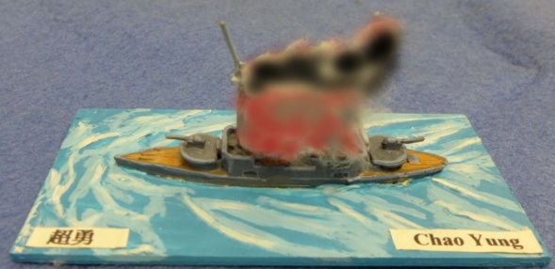
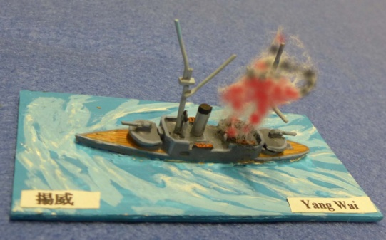
The Battle of the Yalu River Diagram: Japanese Line Ahead Formation vs Beiyang Line Abreast Formation
Akagi
Fuso
Image 2 of 4: When the two fleets began exchanging fire, the Beiyang fleet’s weaker Chaoyong and Yangwei were hit by shells and caught fire. They immediately turned around and left the scene. Chaoyong was soon sunk after serious damage.
Saikyo Maru
Hiei
Hashidate
Itsukushima
Yoshino
Hiei was heavily damaged by gun fire and later surrounded by Beiyang warships.
Chiyoda
Takachiho
Torpedo boat
Guangjia
Jìngyuan
Matsushima
Jiyuan
Akitsushima
Zhiyyuan
Dingyuan
Zhenyuan
Laiyuan
Guangbing
Naniwa
Chaoyong
Jīngyuan
Torpedo boat
Yangwei
Pingyuan

Slide 30
The Battle of the Yalu River Diagram: Japanese Line Ahead Formation vs Beiyang Line Abreast Formation
Pingyuan
Jiyuan
The Zhiyuan fell behind, suffered serious damage and was sunk very quickly.
Akitsushima
Jiyuan suddenly abandoned the battlefield. Guangjia and Laiyuan followed.
Naniwa
Guangbing
Takachiho
Guangjia
Yoshino
Zhiyuan
Laiyuan
Zhenyuan
Jīngyuan
Dingyuan
Jìngyuan
Image 3 of 4: Many Beiyang fleet warships were damaged and the fleet lost its formation. The Japanese vanguard pursued and attacked the Beiyang warships fleeing the area. The Japanese main force surrounded and cornered the desperate ironclad warships, Dingyuan and Zhenyuan, for a last fight.
Fuso
Hashidate
Chiyoda
Itsukushima
Matsushima

Slide 31
The Battle of the Yalu River Diagram: Japanese Line Ahead Formation vs Beiyang Line Abreast Formation
Laiyuan
Jìngyuan
Zhenyuan
Matsushima
Dingyuan
Chiyoda
Takachiho
Yoshino
Naniwa
Akitsushima
Itsukushima
Jīngyuan suffered heavy losses and was sunk very quickly.
Hashidate
Jīngyuan
Image 4 of 4: Jīngyuan of the Beiyang fleet was sunk in the end. The Japanese navy surrounded and attacked Dingyuan and Zhenyuan many times but there was no way to sink them. Thus, both sides retreated from the battlefield.
Fuso

Slide 32
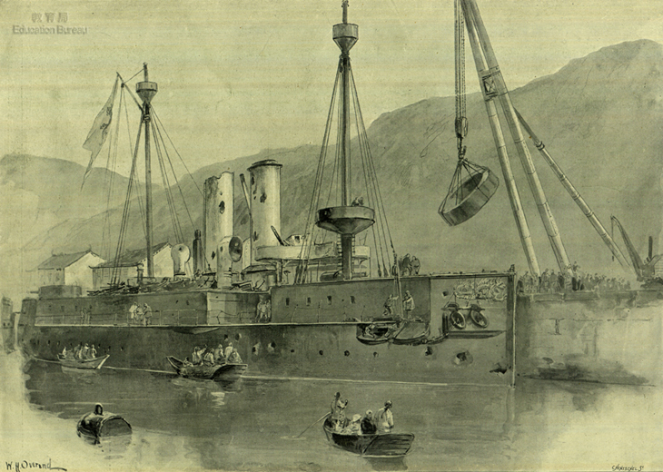
Think: Having understood the course of the Battle of the Yalu River, do you think the defeat of the Qing’s Beiyang Fleet was due to its quality, battleship equipment or battle formation?
The end of the warships that were not sunk
The battle was illustrated in the 24 November AD1894 The Illustrated London News. It showed the ironclad battleship Zhenyuan, which had just battled as part of the Beiyang Fleet’s main force, at Lushun port for maintenance. From the damaged holes one can see the fierce degree of the battle with the Japanese navy.
Dingyuan and Zhenyuan were of the same standard, and carried the nickname of “unsinkable battleships”. In the Battle of the Yalu River, they really did not sink but the bodies of these ships were covered with holes. The appearance of the Zhenyuan battleship could be said to be a portrayal of the Qing Dynasty.

Slide 33
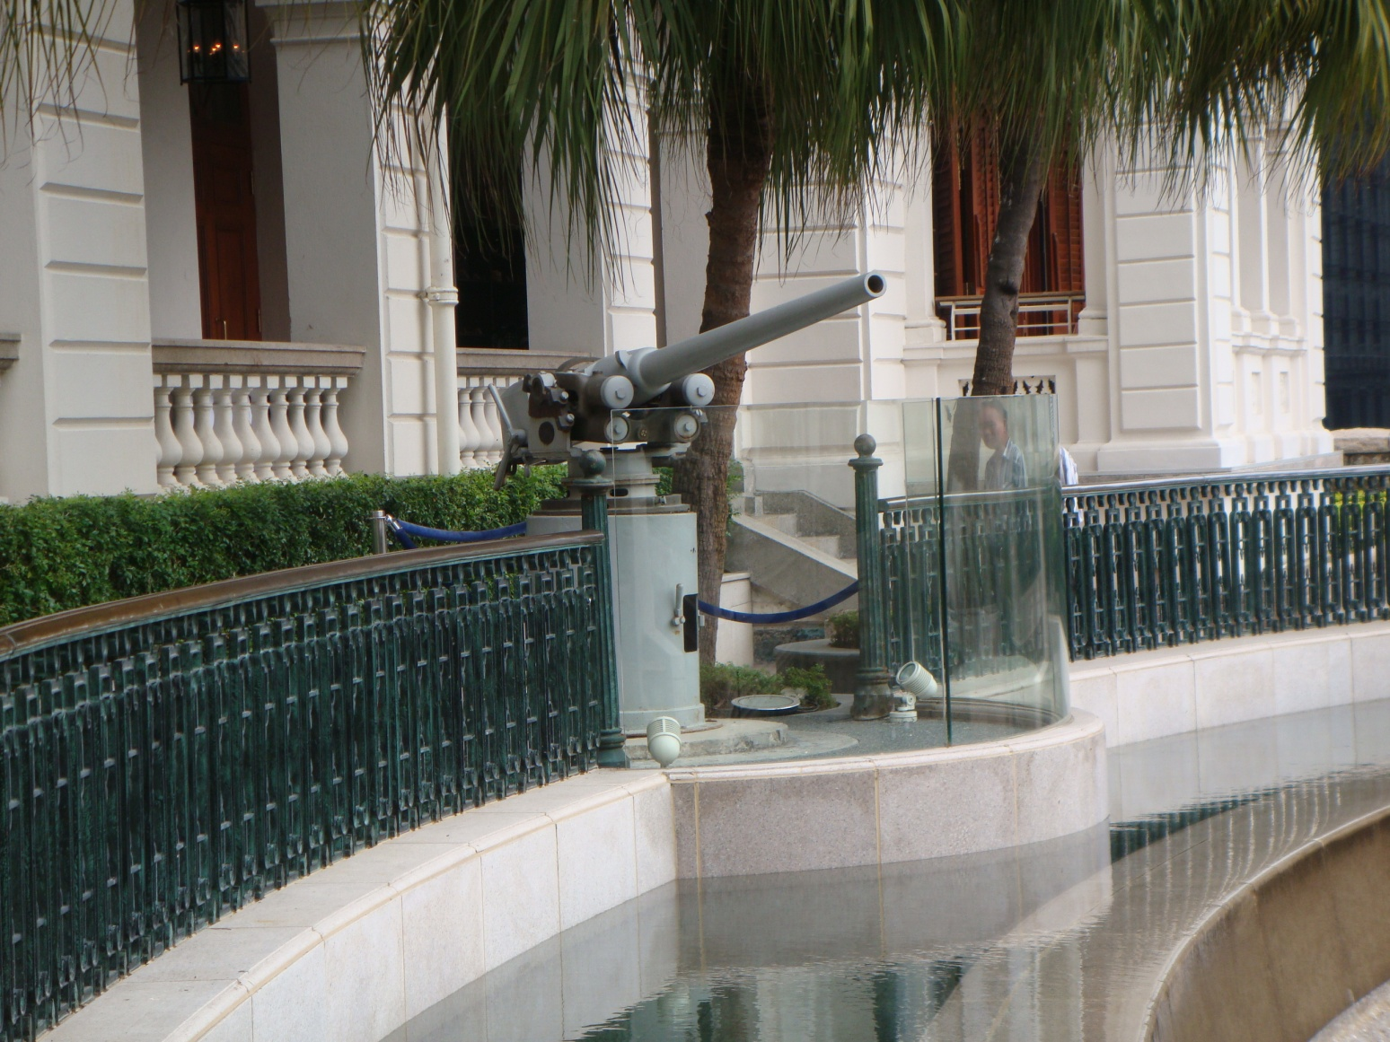
VI. Appendix
Investigation Activity:
1 This is also a quick-firing gun. Do you know where it is in Hong Kong?
2 Please use the information provided on site to find out the statistics of its artillery shell weight.
3 Please examine it on site and use simple sentences and images to introduce how quick-firing guns operate.

