Slide 1
The Battle of Yancheng:
Fighting with Cavalry
Yellow River
Kaifeng (capital)
Zhuxian (town)
Background Information
Yancheng
After the Jingkang Incident (靖康之難) in which the Song emperors were captured by the Jurchen-led Jin Dynasty, the Song Dynasty’s capital, Kaifeng (開封), fell into Jin hands and the Huai River (淮河) became the natural border of Jin and Southern Song Dynasties.
Huai River
Yue Fei’s route
Yangzi River
Jiangling prefecture
The Song general, Yue Fei (岳飛), at that time based at Jiangling (江陵) in the middle of the Yangzi river, began an expedition northwards to recover the old capital of Kaifeng. Yancheng (郾城) was in the south of Kaifeng and it became the battlefield.

Slide 2
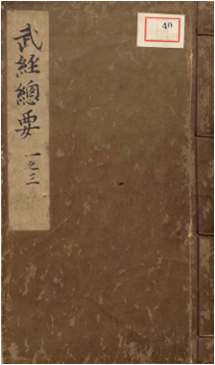
Basic information about the battle
Year: AD1140
Location: Yancheng County, mid-southern Henan
Geography: South bank of the Yellow River, flat terrain
Commander-in-chiefs:
Jin – (Wanyan Zongbi 元顏宗弼, known as Jin Wushu 金兀朮)
Vs.
Southern Song - (Commander Yue Yun 岳雲)
Total number of soldiers:
Jin: 15,000; Southern Song: unknown
Elite cavalry:
Jin: “Iron Buddha” (鐵浮屠)
Yue Yun: Beiwei army (背嵬兵)
Result of the battle: Southern Song Dynasty won in the battle. Jin soldiers retreated from Kaifeng.
Introduction: Art of war in the Song Dynasty
Faced with the never-ending war crises, the Song Dynasty had to carefully select weapons and arrangements for national defense. In AD1044, in response to an imperial court order, Grand Minister Ceng Gongliang (曾公亮) and Ding Du (丁度) compiled “Wujing Zongyao” (The Essentials of the Military Classics 武經總要). It became contemporary reference document for national defense. However, when the Jin army occupied Kaifeng in AD1126, the original manuscript was lost. In AD1231, people of Southern Song made a new one, but they claimed that it was restored from some existing copies of the lost book. This is the “Wujing Zongyao” that we see today. The book shows the weapon development in the Northern and Southern Song Dynasties.

Slide 3
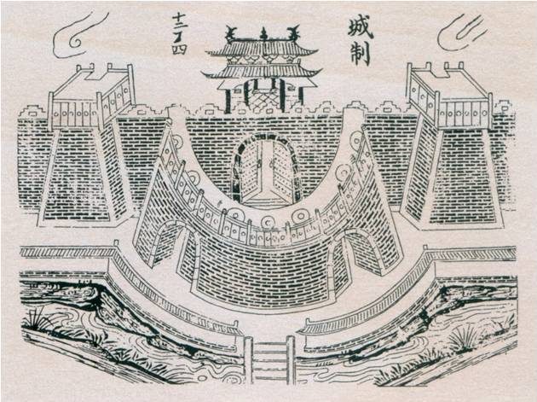
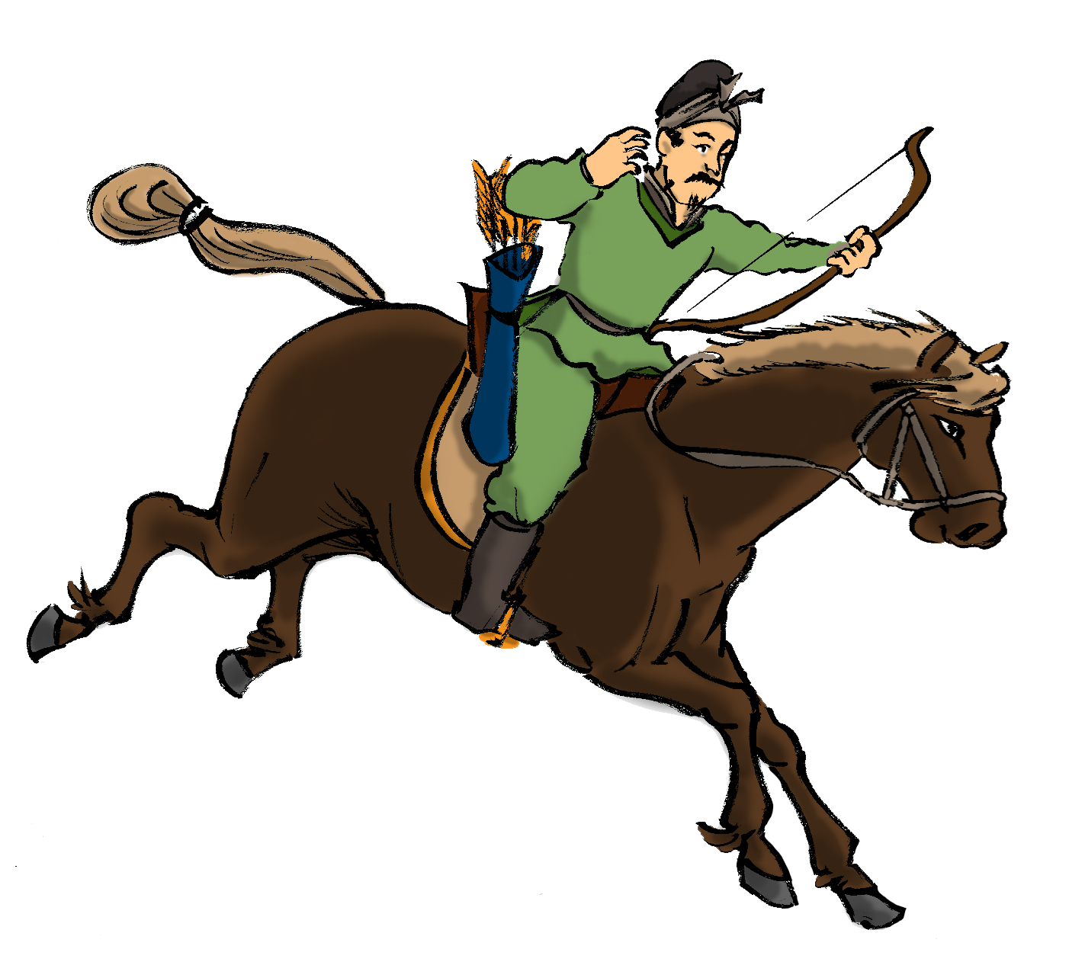
Many military plans from “Wujing Zongyao” influenced later developments. For example, it recommended that a semi-circular barbican entrance was constructed in front of the city gate so as to form a double entrance defenses.
Quiz: What defensive advantages did this design have?
When enemies forced their way into the city gate, they fell into a container and were unable to advance or retreat. Garrison soldiers from the walls above the city gate could then shoot the enemies with arrows from different directions.
II. The Southern Song Army
In the Song Dynasty, the development of cavalry was at a relatively mature stage. Stirrups allowed soldiers to control the horses, and shoot arrows above the horses’ heads.
It was not easy for the Song Dynasty to develop their cavalry because all good warhorses were produced in the north historically. Nevertheless, facing the threat of Liao and Jin on its borders, the Song Dynasty still valued the development of cavalry.
A. Southern Song Light Cavalry
Source: “Tushuo Zhongguo Wuqi Jicheng” (Illustrated Chinese Weapons), p.56

Slide 4
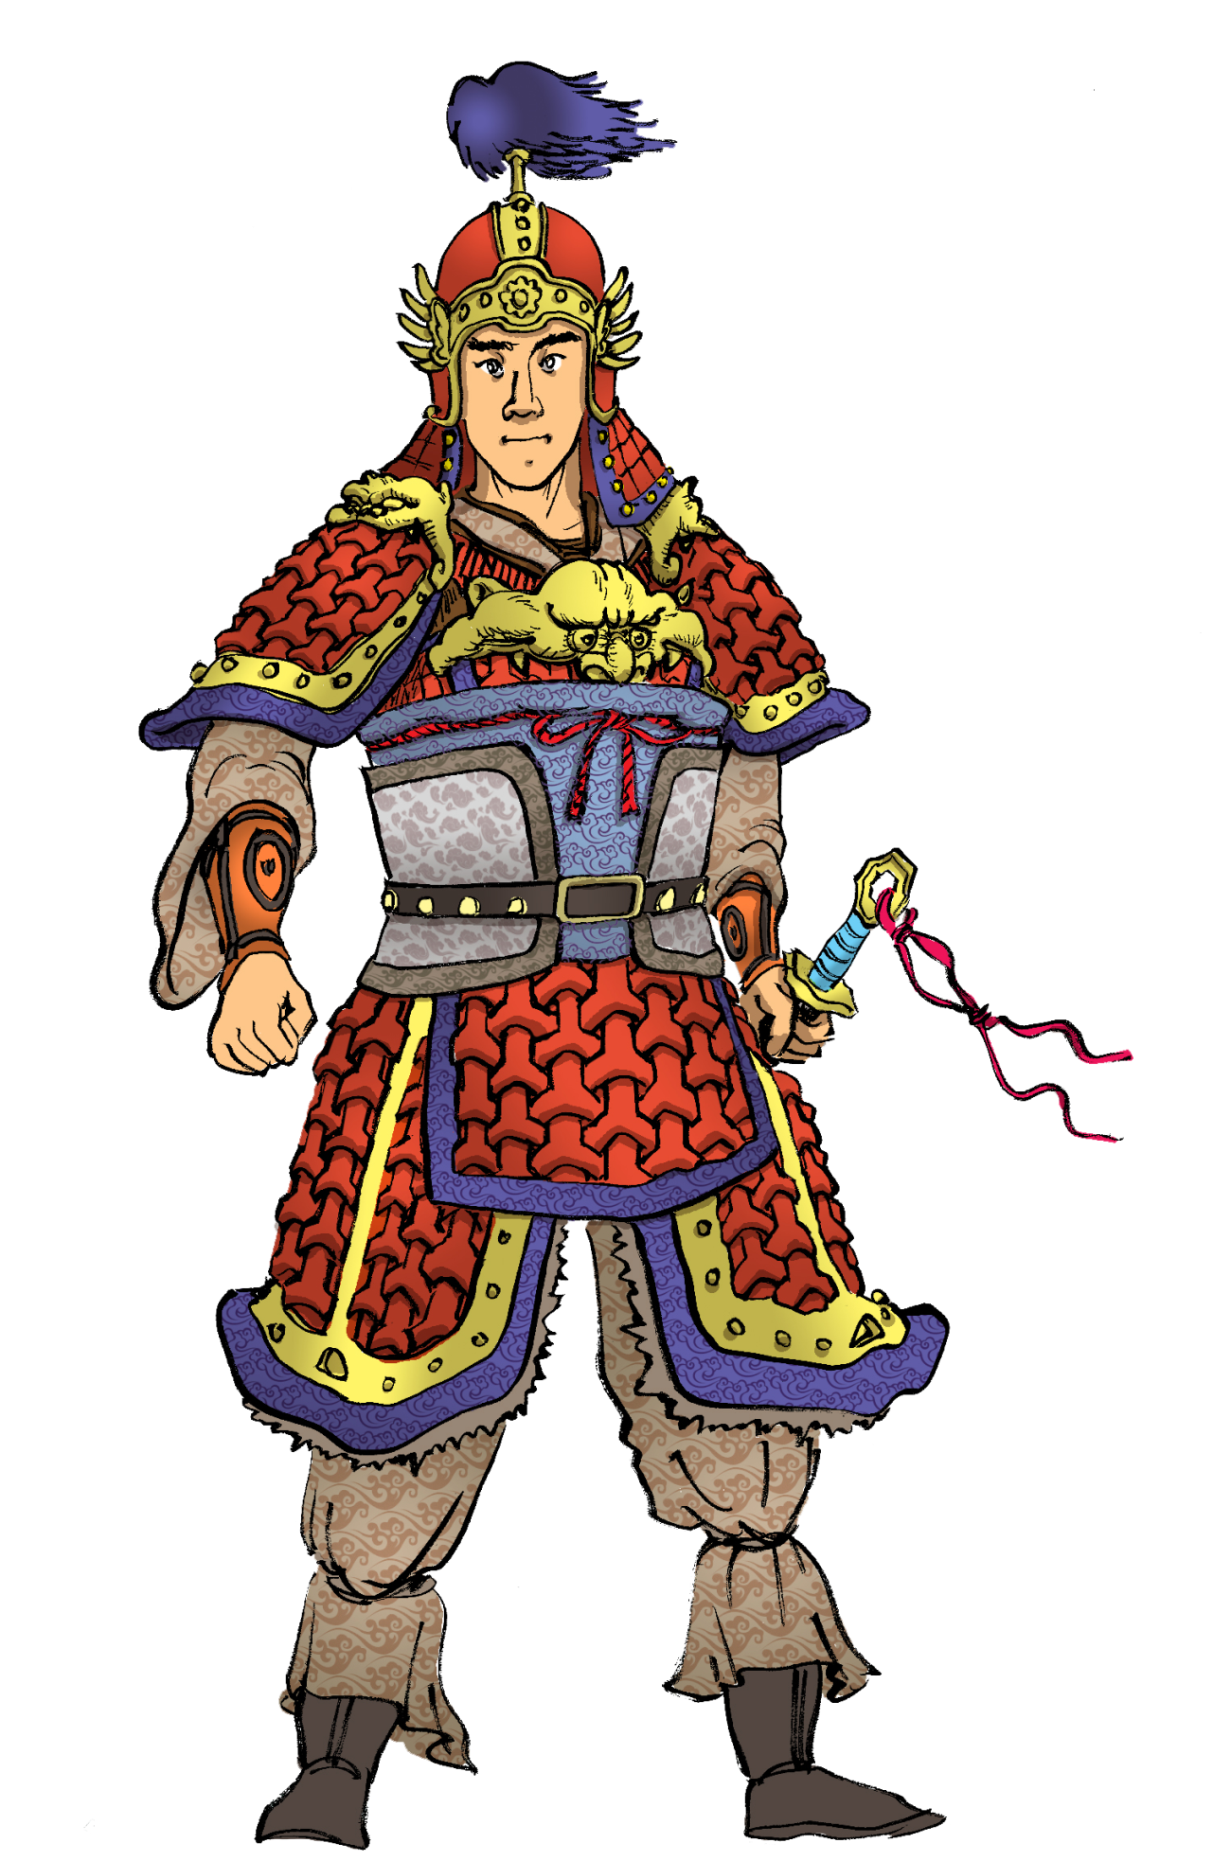
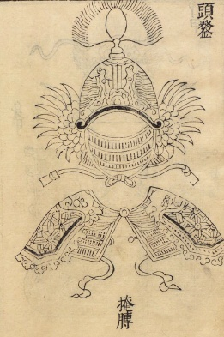
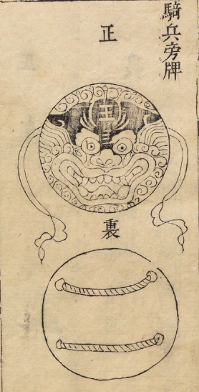
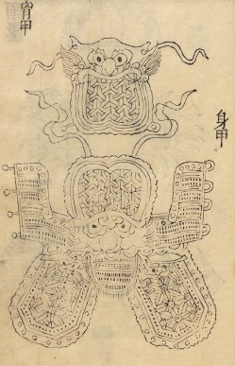
B. Heavy Cavalry
Armoured Song cavalry:
From the “Wujing Zongyao”
we know that the armours of the Song army were made of materials including iron, leather and paper. The military handbook contained no explanations for this but we can guess that the materials of the armours might vary according to the infantry’s various divisions. Though paper armours were weak, Song’s armies only needed to soak the armours in the water before going to the battle. The softness of the wet paper was able to absorb some of the impact of the arrows.
Quiz: Please match the various armour pieces onto the body of the soldier.

Slide 5
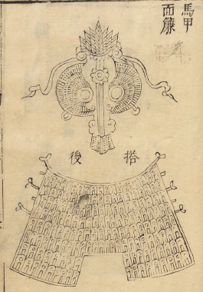
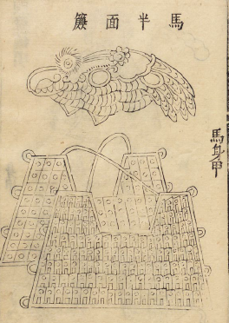
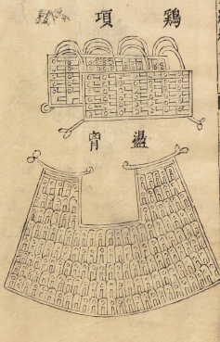
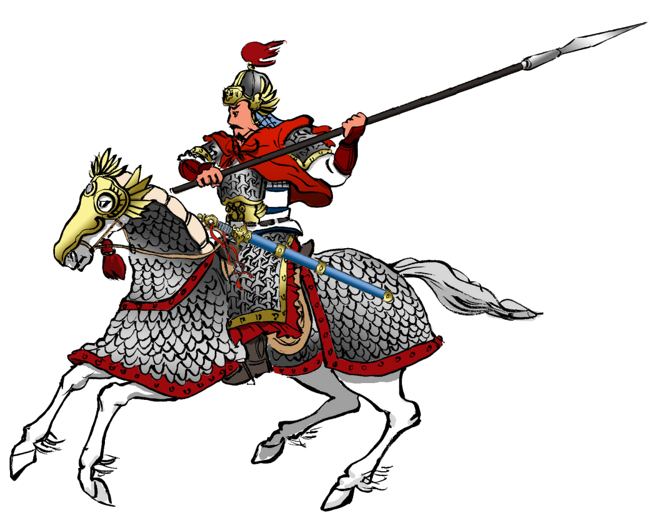
To protect warhorses and increase cavalry’s attack capabilities at the same time, both Song and Jin Dynasties developed armours on horses.
The Song Dynasty immediately used chainmails in the battles and heavy cavalry developed. From the descriptions of “Wujing Zongyao”, the chainmail armour of one warhorse consisted of six parts.
Quiz: Please match the below six pieces of armour onto the horse’s body.
An imagined illustration of the Song heavy cavalry

Slide 6
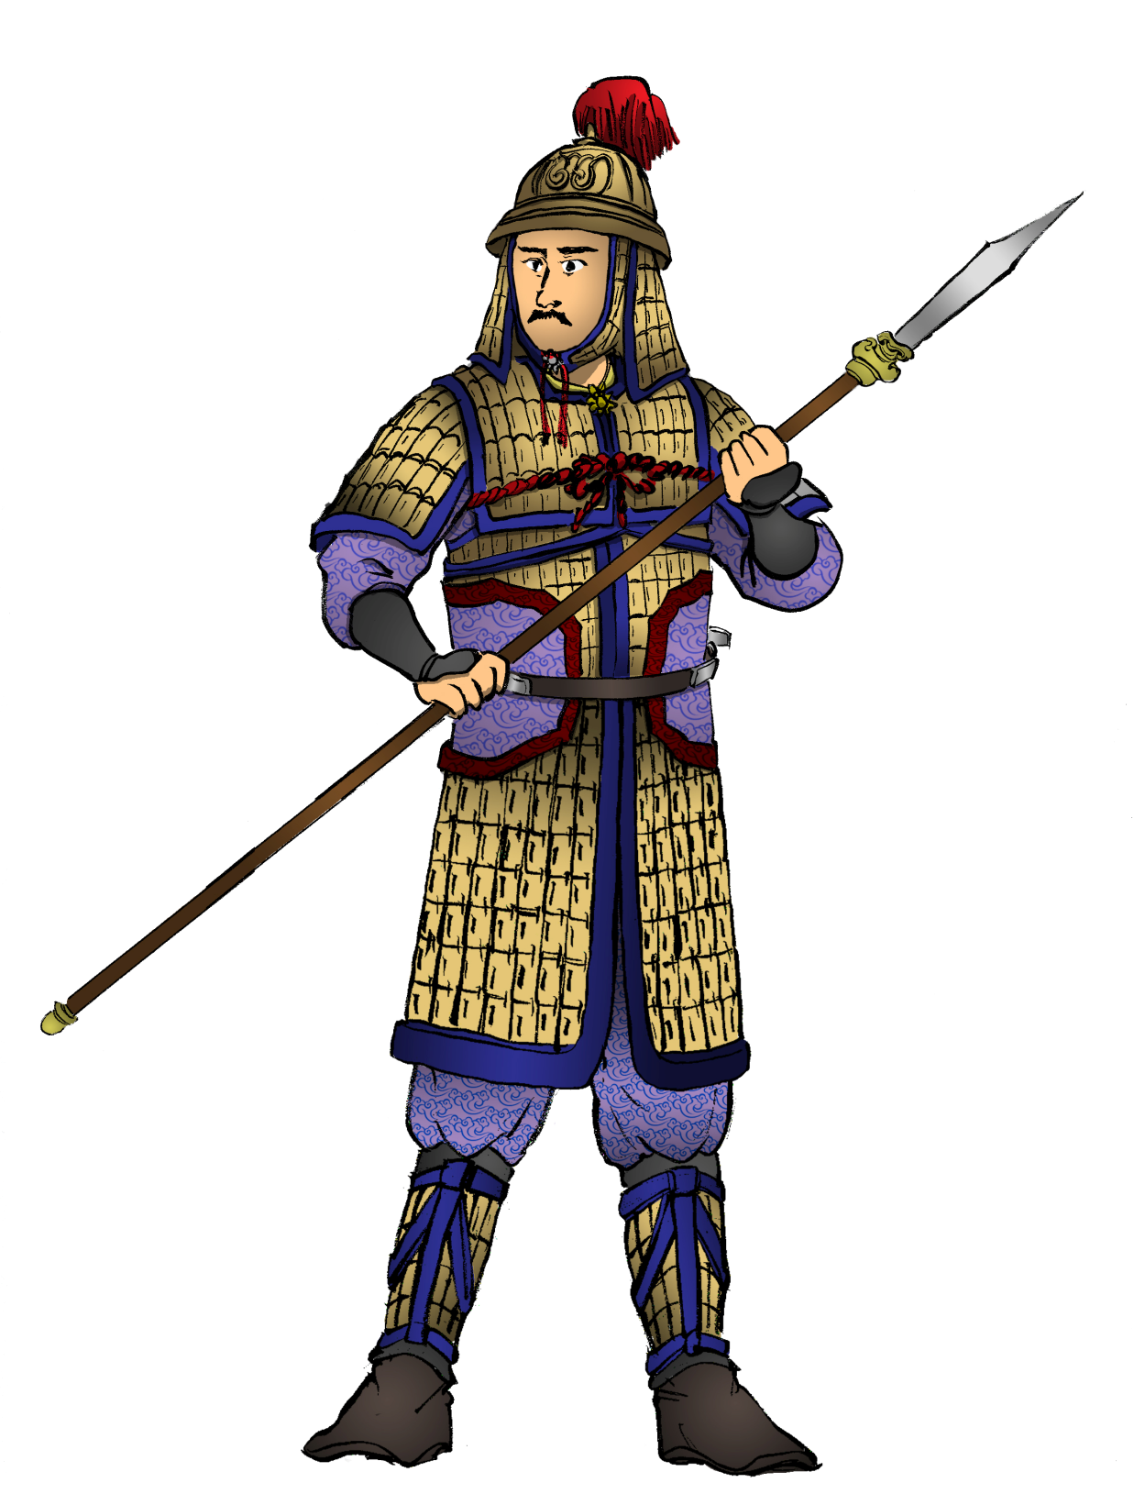
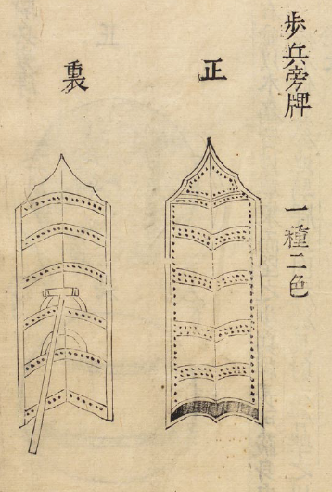
C. Heavy Infantry
The long shield was widely used in the battlefield. Frontline infantry used shields arranged in a row to form defensive surrounding walls. This could resist not only bows and arrows but also reduce the effectiveness of the enemy cavalry and infantry’s direct attacks.
Quiz: What was the difference between the armour of heavy infantry and heavy cavalry? Why?
Song Dynasty’s heavy infantry also wore armour below the knee which protected the whole body.

Slide 7
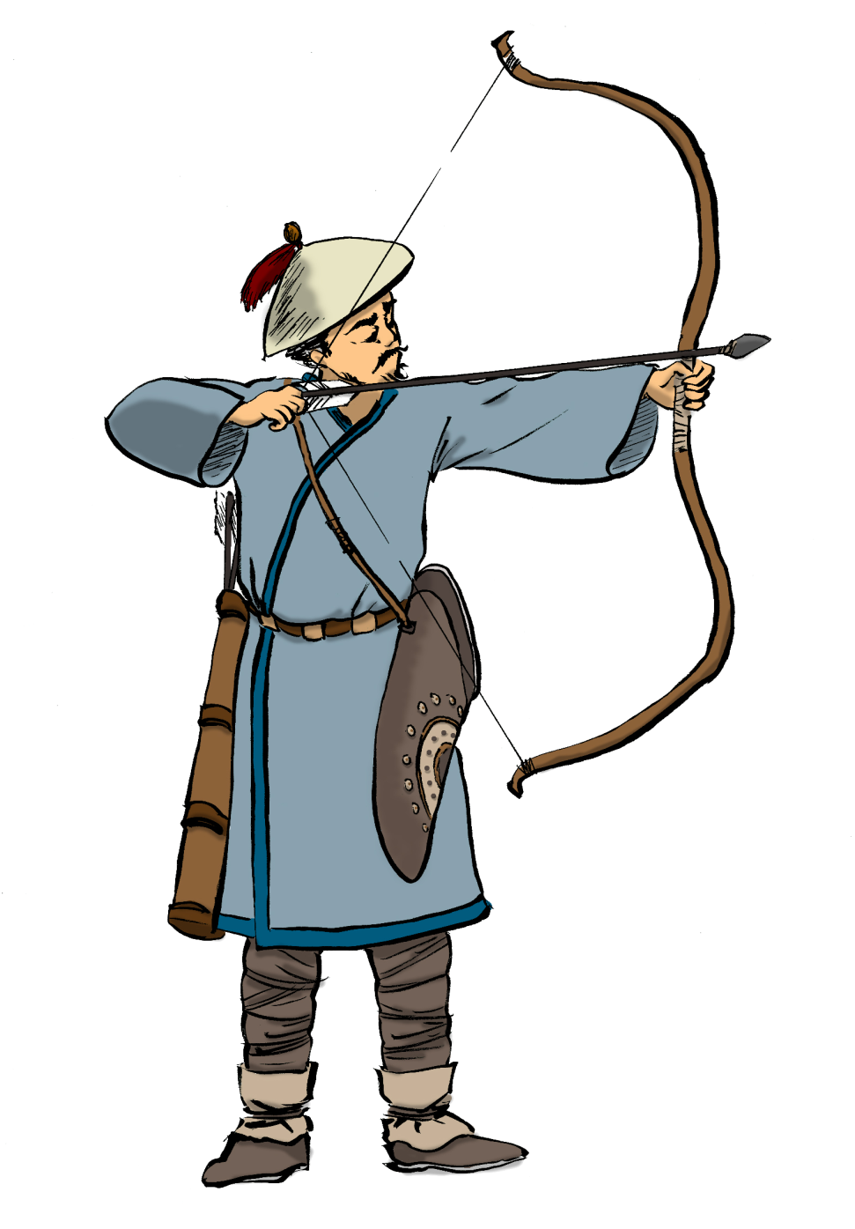
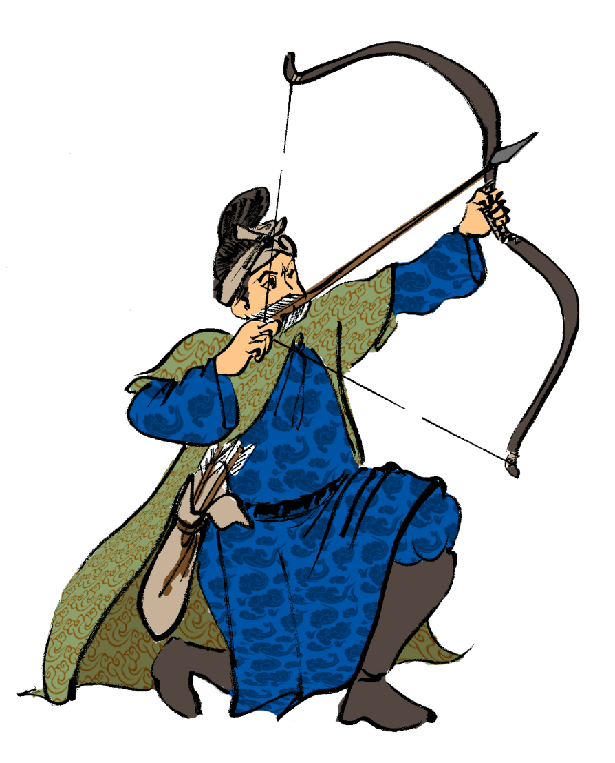
D. Light Infantry / Archers
In the battles, it was impossible for all infantry to wear expensive armours. Most of the soldiers on the frontlines were light infantry who did not wear armours and were provided with bows, arrows and swords only. When two armies fought, the enemy entered firing range and were shot at with arrows. When the enemy army came closer, bows and arrows were abandoned in favour of fighting with swords. These types of soldiers were essential in the wars. However, their casualties were also the most severe and therefore they would not be the office holders. Song and Jin armies both forcefully recruited able bodied men from nearby village farms to replenish these types of soldiers during wartime.
Source: “Tushuo Zhongguo Wuqi Jicheng,” p.57

Slide 8
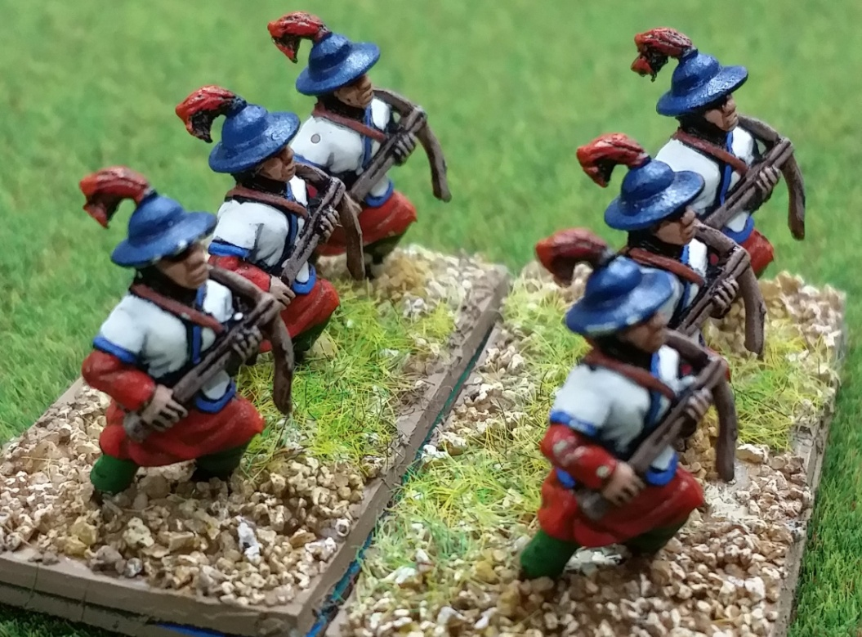
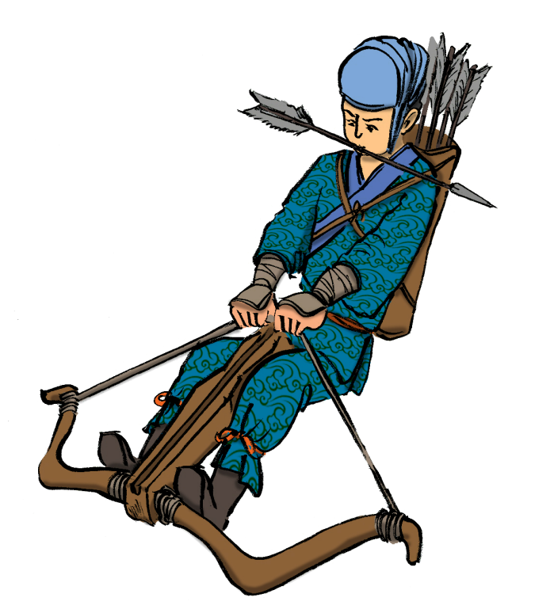
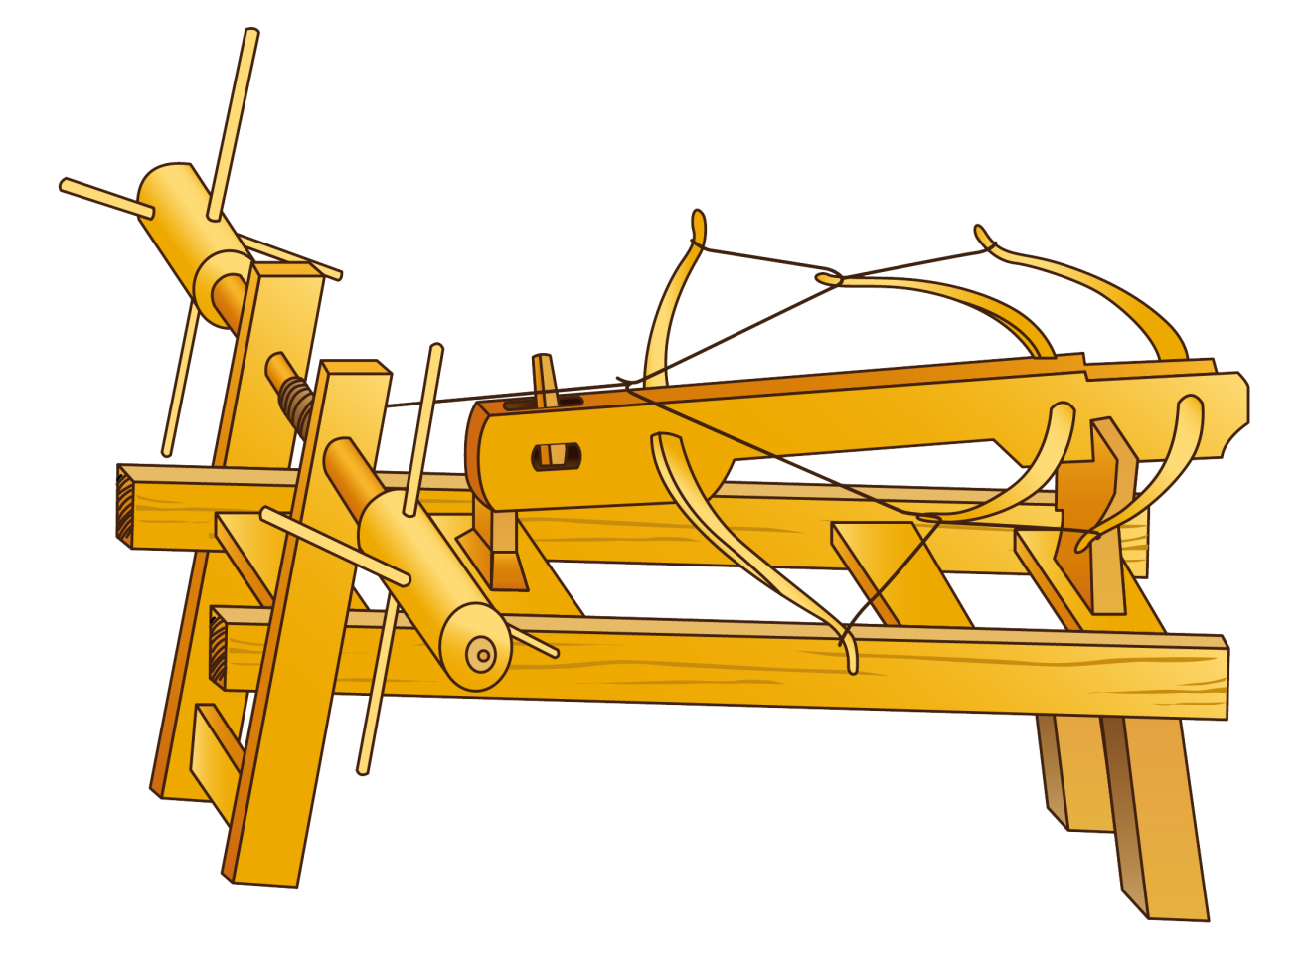
E. Crossbowmen
Crossbowmen remained, from the Qin Dynasty onwards, the battlefield’s long distance killers. The power of the crossbow depended on its size. The bigger it was, the further it could shoot and the more force its arrows had. The problem was that there were limits to one man’s strength when pulling crossbows. The Song Dynasty therefore designed large scale mechanical crossbows, the “three bow crossbow”, which used the strength of tens of people on three large crossbows placed together. It became a deadly weapon in the battlefields and could take down the heavy cavalry of Jin.
Source: “Tushuo Zhongguo Wuqi Jicheng,” p.62
Consider: Please look carefully at how this “three bow crossbow” operates. How powerful do you think it was? Which types of enemies could it be used to fight against?
A machine used to pull bowstrings
Three bow crossbow

Slide 9
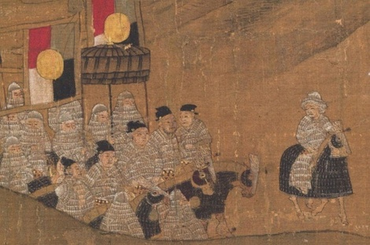
III. Jin Soldiers
These are very rare images showing the Jin soldiers from the book “Zhongxing Ruiying Tu” (Picture of an Auspicious Age 中興瑞應圖), now kept in the Tianjin Museum. They showed the aftermath of the Jingkang Incident in which the Song emperors were captured by the Jin soldiers and then how a Song prince Zhao Gou continued the Southern Song Dynasty by succeeding to the throne. It is said that a part of this image depicts the Jin cavalry. (see left)

Slide 10
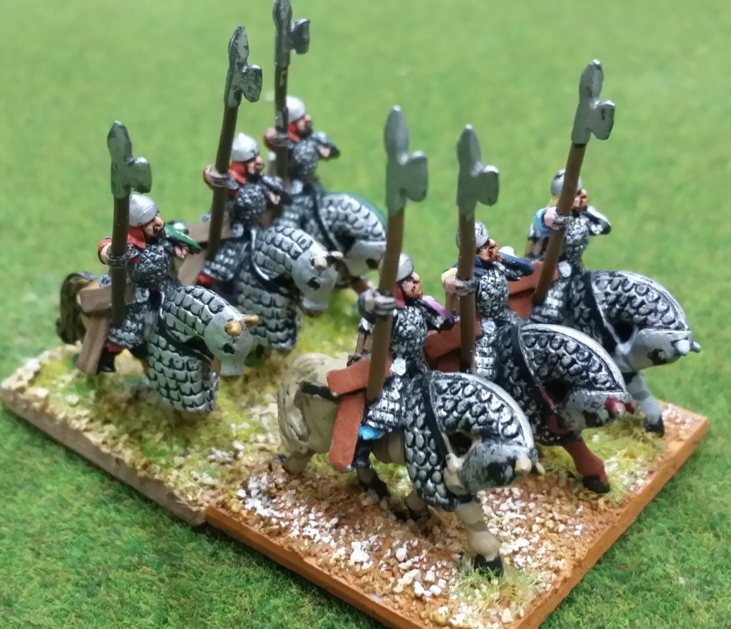
Quiz: What was the difference between the equipment of the Jin cavalry as shown in the last image and that of the Song Dynasty?
Both the Southern Song cavalry and the Jin cavalry were fully equipped with both horse riders and warhorses wearing armours. It was said that Jin Wushu’s elite cavalry numbering 3,000 wore heavy white armours. Due to the heavy armours, these elite calvary of Jin Wushu were also known as “Iron Buddhas”. These “Buddhas” resembled metal pagodas and were incomparable. This also emphasized how the armour in this period was made of metal.
Iron Buddhas

Slide 11
The historical truth about the Guaizi Ma 拐子馬 (Horse team)
Quiz: Folklore said that the Jin cavalry was strong due to the use of the Guaizi Ma tactic, which resembled the childhood game of “three legged race” (二人三足). Three heavily armoured war horses would be bound together with rope, becoming known as an “Iron Buddha”. They were indestructible and could break through enemy lines.
Inferring from common knowledge, do you believe it is possible to tie three horses together in a fight? Why?
It was also said that Yue Fei ordered soldiers to equip long knives and focus on cutting the feet of horses in the Battle of Yancheng. Even only one pair of the horses’ feet was cut, all three horses would naturally be confused. Yue Fei’s tactics therefore greatly confused and weakened the Jin soldiers.
This saying first came from Yue Fei’s grandson, Yue Ke (岳珂)’s (born in AD1183) “E’wang Xingshi Biannian” (Biography of Lord E 鄂王行實編年). When the government of the Yuan Dynasty compiled the Song history, it followed this claim. Thus, stories like this spread. However, some people questioned about that. Emperor Qianlong of the Qing Dynasty, who was a self proclaimed Juchen descendant, was the one who had doubts on the story. Emperor Qianlong (乾隆帝) was a horse riding enthusiast. Relying on personal experience in riding, he suggested that horsepower and bravery varied from horse to horse. Therefore, tying three horses together to become a cavalry unit was not practical.
Historian Deng Guangming (鄧廣銘)’s Yuefei Chuan (Biography of Yue Fei 岳飛傳) agreed with Emperor Qianlong. He further pointed out that Yue Fei had already been dead for 40 years when Yue Ke was born. He therefore made guesses when he wrote about his own grandfather’s affairs. These guesses confused the Guaizi Ma and “Iron Budda”. He pointed out that the Jin army definitely used the Guaizi Ma tactic. After research, he found that Guaizi Ma was a northern dialect phrase referring to cavalry flanking the left and right wings. In Yue Ke’s era, the Southern Song had already taken root in the south and therefore northern sets of dialects had been lost. Seeing Guaizi Ma in old texts, Yue Ke therefore did not understand and simply used his imagination. As a result, the original formation with cavalry flanking the left and right became the battle formation resembling the “three legged race”.

Slide 12
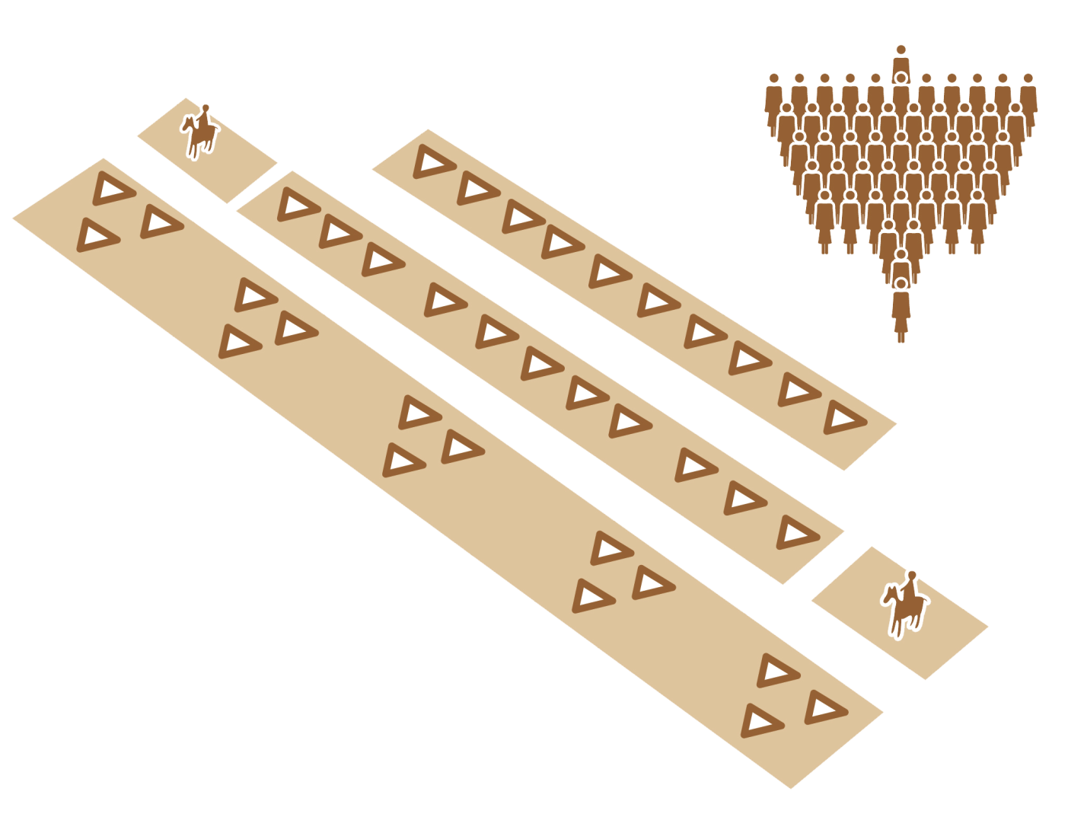
IV. The Cavalry Formations of the Battles in the Song Period
Middle army
The vanguard contained archers and crossbowmen.
When assessing the war tactics of the Song Dynasty, one needs to refer to “Tangtaizong Liweigong Wen Dui” (Duke Li of Wei Answering Emperor Taizong of Tang 唐太宗李衛公問對). It was said that the book was written by the famous general of the Tang dynasty, Li Jing (李靖). However, as no Tang Dynasty histories recorded this book, it was possible that it was written by a Song writer under the fake name of Li Jing. This book recorded the true form of the Guanzi Ma as cavalry flanking the left and right wings. This formation was the best formation for cavalry in the battles. Both Song and Jin armies used this tactic.
Reserve force
Source: “Zhanlue, Zhanshu, Bingqi Shidian,” vol.7, p.54
Cavalry
Every 3 vanguard squadrons formed a large brigade
Large Brigade
These battle tactics were distinctive in that they allowed the large brigade and the reserve force to take turns fighting the enemy. They would fight the first round of war through attrition, sacrificing their own forces and consuming enemy forces. Then, the cavalry on the left and right sides would begin to attack. The middle army, where the commander-in-chief was based surrounded by elite soldiers, would conserve their strength.

Slide 13
The Mode of the Battle
-When enemies were 150 steps away, crossbowmen released their arrows.
- When enemies were 60 steps away, archers released their arrows
- When enemies were 20 steps away, shooting stopped. Swords or axes were drawn and soldiers prepared for close combats.
-When enemy soldiers arrived, the vanguard and large brigades fought. When they grew tired, they retreated to the back row to rest. Reserve force and cavalry would charge forward into the battle. Stationed archers assisted from the back.
-When the reserve force and cavalry were exhausted, they exchanged places with the large brigades once more.
Middle army
The vanguard contained archers and crossbowmen.
Reserve force
Copied from “Zhanlue, Zhanshu, Bingqi Shidian,” vol.7,p.54
Cavalry
Every 3 vanguard squadrons formed a large brigade
Large Brigade

Slide 14
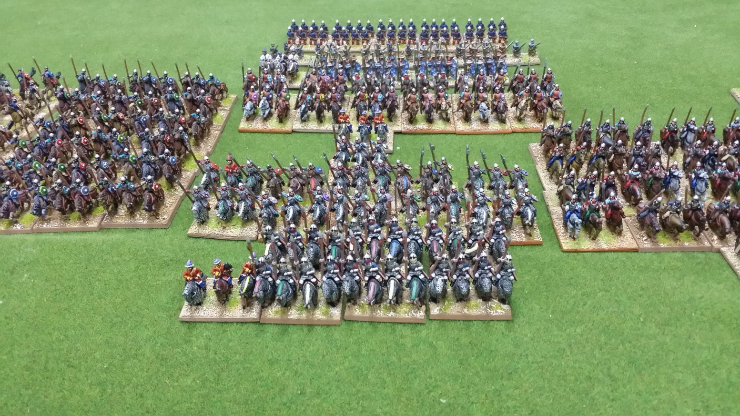
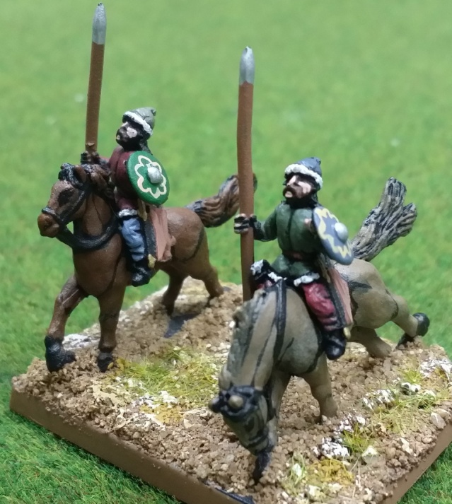
V. Jin Battle Tactics: “Iron Buddhas” and “Guaizi Ma”
The Jin army was made of infantry and cavalry. As the Song soldiers were also composed in the same way, they had to place large numbers of infantry in the front as the vanguard to rush forwards into the battle. The infantry was mainly recruited from the local population in the north China.
The heavily armoured cavalry was placed in the middle of the army to protect the general. They became known as “Iron Buddhas”.
Light cavalry was placed in the left and right of the middle army. They became known as Guaizi Ma.

Slide 15
VI. How Yue Yun Defeated the Jin Army: The Reality Behind the Battle of Yancheng
The Battle of Yancheng happened in AD1140 was not recorded in great details. The existing available information all comes from the battle reports of the Song army. Firstly, this was not a large battle. Jin soldiers totaled only 15,000 men. Secondly, Song soldiers suspected that Jin Wushu was within but there was no exact evidence to show that Jin Wushu was in such a small battle.
In the Battle of Yancheng, the Song army won. However, the victory was not achieved by the Song army using knives to cut horses’ feet, but rather by Yue Yun’s leading of the elite cavalry, the Beiwei army, to beat back Jin cavalry. Perhaps, Yue Yun’s father, Marshal Yue Fei, had known that the Song army would definitely win in this small battle, and therefore sent his son for the task so as to develop a good record in the military.
After the victory at Yancheng, the Song army went a step further and attacked Zhuxian town (朱仙鎮), which was not far away from the old capital of Kaifeng at that time. Unexpectedly, Marshal Yue Fei then received twelve military orders from the imperial court which ordered him to retreat immediately. Yue Fei returned to the capital of Southern Song, Lin’an (臨安，即杭州Hangzhou), afterwards and was stripped of military power. In AD1142, the imperial household ordered Yue Fei to commit suicide and at the same time executed Yue Yun under baseless charges.

Slide 16
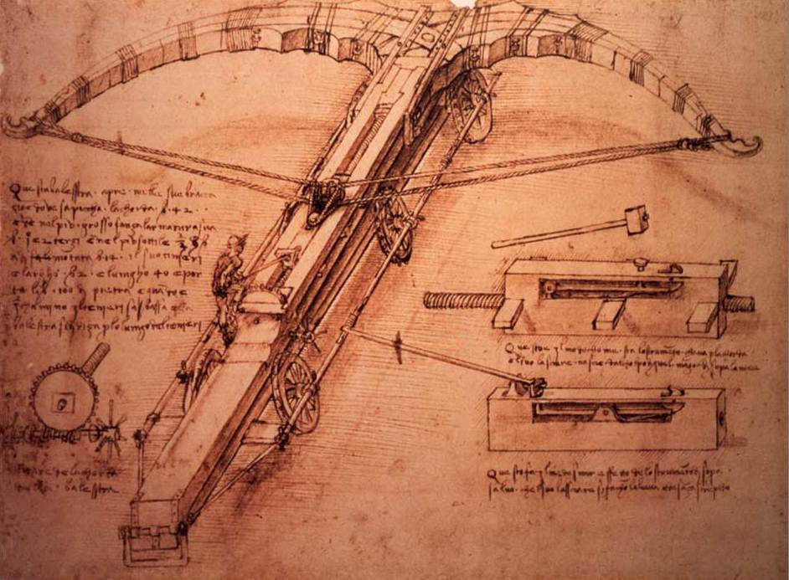
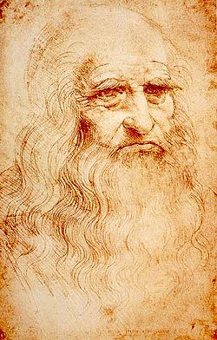
Appendix: Leonardo da Vinci’s Crossbow
Leonardo Da da Vinci (1452-1519) was a famous painter from the Italian Renaissance period. He was widely known for producing “Mona Lisa” and “The Last Supper”. However, Da Vinci was also a military engineer and he made weapon plans for new types of weapons on behalf of his monarch. Throughout his life, he designed many new, odd, and eccentric machines including airplanes, tanks, a gigantic mechanical crossbow, etc.
Da Vinci’s Crossbow blueprint

Slide 17
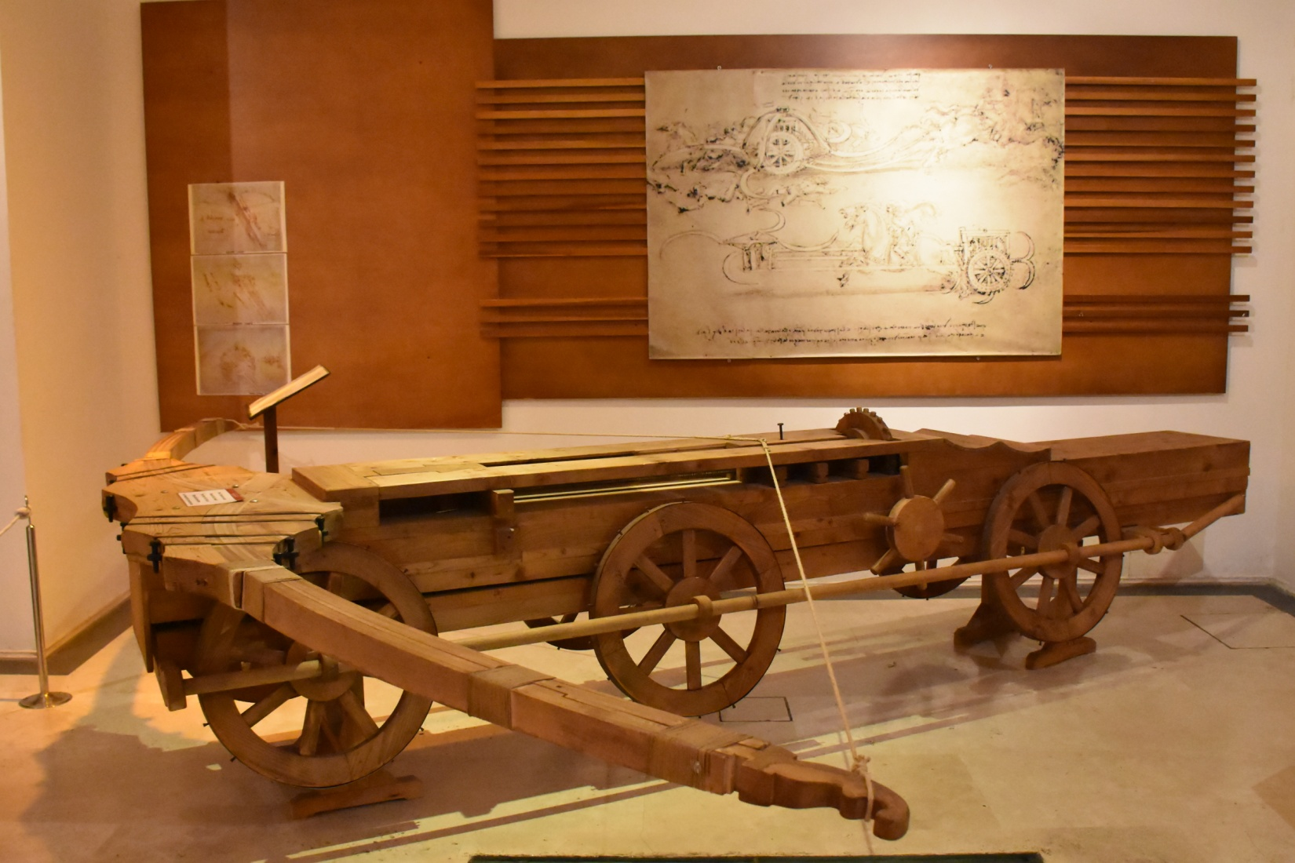
A reproduction of a giant crossbow from Da Vinci’s blueprints in the Italian Museum (Roma-Palazzo della Cancelleria).
Question 1: The most important parts of the mechanical crossbow are the two wheels on its left and right. When they turn, they pull the bowstring back. Can you explain how the mechanical crossbow works using the image on this page? (Hint: When these two wheels move, how do the large wooden gears on the upper planks and the wooden block with an iron nail in front of it move?)

Slide 18
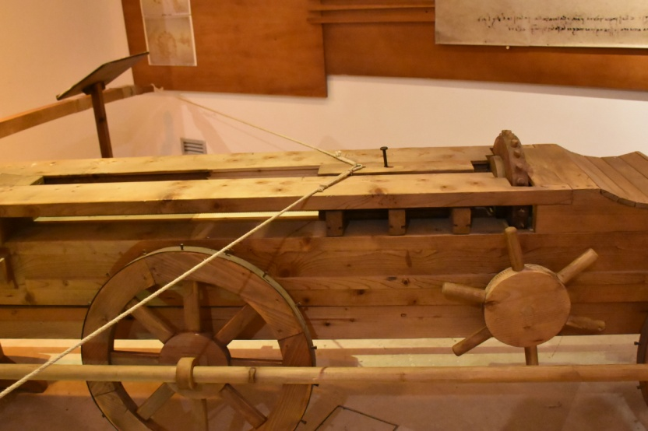
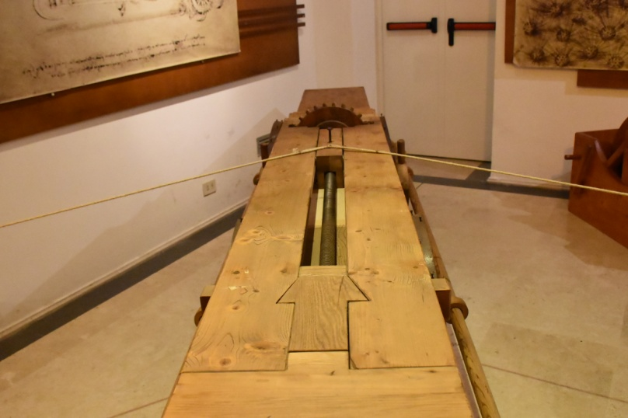
Question 2: Since the invention of mechanical crossbows, the level of the Southern Song’s science and technology no longer lagged behind Europe. How true is this claim? Express your opinion. (Hint: compare the Southern Song period to the Da Vinci period)

Slide 19
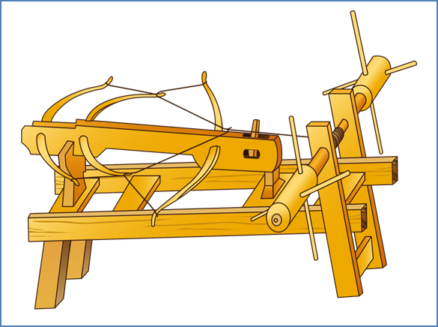
Answers to “Da Vinci’s Giant Crossbow” Question
Song Dynasty Crossbow Machine
Trigger
To make giant crossbows, hard wood had to be chosen and large bows had to be made. Most importantly, one had to think of a way to pull the bowstring back to the greatest possible extent. The Song Dynasty’s crossbow machine used manpower to turn the wooden wheels on both sides and pull the bowstring backwards. The string would be fastened onto the trigger. When it was time to shoot, the trigger could be pulled down and the arrow would naturally fly straight out.

Slide 20
C
B
A
Leonard da Vinci’s blueprint was identical in this respect to the Song Dynasty’s crossbow machine. Therefore, the technological level of Song was not far behind Europe. However, da Vinci’s giant crossbow, theoretically, was still a success. Leonard da Vinci’s giant crossbow and Song Dynasty’s crossbow machine were nearly identical, but da Vinci’s crossbow had an extra wheel (B). Therefore, when soldiers turned A, B would move and pull back the wooden block (C) linked to the bowstring easily. Therefore, in comparison to the Song Dynasty’s crossbow machine, da Vinci’s giant crossbow, due to an extra set of wheels, made pulling the bowstring more effortless.

