Slide 1
Nutrition and Health
Glycaemic Index

Slide 2
Topics
What is Glycaemic Index?
Studies of Glycaemic Index
Effects of High and Low Glycaemic Index Foods
Examples of High and Low Glycaemic Index Foods
Factors Affecting the Glycaemic Index of a Food Item
Other Considerations

Slide 3
What is Glycaemic Index?
The glycaemic index (GI), measures how a carbohydrate-containing food raises blood glucose.
Foods are ranked based on how they are compared to a reference food — either glucose or white bread.
Foods with carbohydrates which are digested and metabolised quickly tend to have a high GI. Glucose is released into the bloodstream rapidly.
Foods with carbohydrates which are digested slowly and release glucose more gradually into the bloodstream have a low GI.
A food item with a high GI raises blood glucose quicker than a food item with a medium or low GI.

Slide 4
What is Glycaemic Index?
Adapted from: Studio34 at English Wikipedia / Public domain

Slide 5
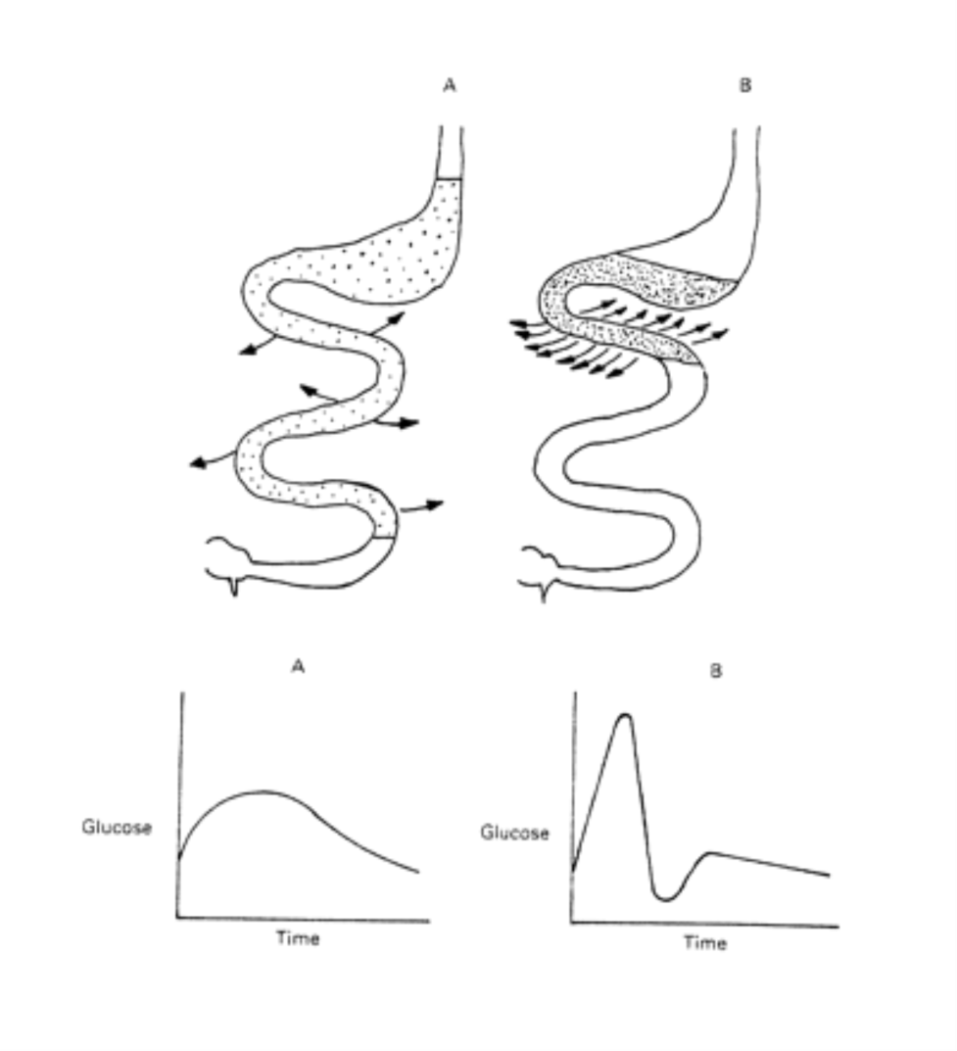
Hypothetical effect of feeding diets with a low (A) or high (B) glycemic index on gastrointestinal glucose absorption and postprandial blood glucose.
Source: Glycemic index: overview of implications in health and disease
Notes:
FIGURE 1. Hypothetical effect of feeding diets with a low (A) or high (B) glycemic index on gastrointestinal glucose absorption and postprandial blood glucose.
5

Slide 6
Studies of Glycaemic Index
The four major areas that are tracked during glycaemic clinical studies include how the ingested food:
raises blood glucose levels
affects insulin secretion
stimulates lipoprotein lipase (LPL) and fat-storage mechanisms
affects the pancreas

Slide 7
Effects of High and Low Glycaemic Index Foods
High glycaemic index foods
Elevate blood glucose and insulin levels
Provide energy to the body in a short period of time
Rapid fall of blood glucose after the effect of insulin, triggering hunger sooner
Stimulate fat-storage
Low glycaemic index foods
Do not overly elevate blood glucose and insulin levels
Slow and gradual release of sugar into blood
Maintain increased energy levels for a longer duration
Do not stimulate lipoprotein lipase (LPL) and fat-storing mechanisms

Slide 8
Effects of High and Low Glycaemic Index Foods
Carbohydrate-containing food raises blood glucose differently, using glucose (GI:100)as a reference, foods are divided into three categories:
Low GI (55 or less)
Medium GI (56-69)
High GI (70 or more)

Slide 9
Examples of High and Low Glycaemic Index Foods
 | Low GI (55 or less) | Medium GI (56-69) | High GI (70 or more)
Rice | Brown rice, black kernel rice | Red rice (boiled), brown rice (boiled) | Glutinous rice (boiled), white rice (boiled)
Noodles | Vermicelli, spaghetti, macaroni, egg noodles | Udon | Regular wheat noodles
Bread | Pumpernickel | Pita bread, croissant | White bread, steamed buns
Breakfast cereals | All bran, muesli, oat bran | Bran with raisins | Cornflakes, rice crispy, cocoa rice crispy
Roots and tubers | Corn, konjac | Sweet potato, baked potato with skin | Mashed potato, pumpkin
Sugars | Fructose, lactose, sugar alcohol | Sucrose, honey | Glucose, sugar, maltose
Milk | Skimmed/low fat milk
Fruits | Orange, apple, snow pear, grape, kiwi, pomelo, strawberry | Honeydew melon, banana, papaya, mango | Watermelon, lychee, longan
Beans | Soya beans, mung beans, black-eyed beans, red kidney beans, lentils | Baked beans
Source: Diabetes Hongkong

Slide 10
Factors affecting the Glycaemic Index of a Food Item
Fat and fibre tend to lower the GI of a food item.
In general, when a food item is cooked for a longer time or has undergone a lot of processes, it may have a higher GI; however, this is not always true.
Factors that can affect the GI of a food item, for example:
ripeness and storage time: the more ripe a fruit or vegetable is, the higher the GI
processing: fruit juice has a higher GI than whole fruit; mashed potato has a higher GI than a whole baked potato; stone ground whole wheat bread has a lower GI than whole wheat bread
cooking method: how long the food is cooked (al dente pasta has a lower GI than soft-cooked pasta)
variety: long-grain white rice has a lower GI than brown rice but short-grain white rice has a higher GI than brown rice

Slide 11
Other Considerations
The amount of carbohydrates in food can affect blood glucose levels directly.
Glycaemic Load (GL) is used to estimate the effect of actual intake of carbohydrates on blood glucose levels.
Portion sizes and total calories should be considered when managing blood glucose.

Slide 12
Other Considerations
The GI of a food item may vary, depends if it is eaten alone or combined with other foods.
When eating a high GI food item, it can be combined with other low GI foods to balance out the effect on blood glucose levels.

Slide 13
Other Considerations
Some foods that are low in GI should not be eaten in excess, for example:
fructose
fat
protein
A diet low in carbohydrates may in turn raises the percentage of intake from fat and protein, which may also affect the normal metabolism in the body.

Slide 14
Other Considerations
There is no one diet or meal plan that works for everyone.
People with diet-related issues should consult their dietitians for a meal plan that is suitable for an individual to attain healthy eating habit.

Slide 15
References
Augustin, L., Kendall, C., Jenkins, D., Willett, W., Astrup, A., Barclay, A. (2015). Glycemic index, glycemic load and glycemic response: An International Scientific Consensus Summit from the International Carbohydrate Quality Consortium (ICQC). Nutrition, Metabolism and Cardiovascular Diseases,25(9), 795-815. doi:10.1016/j.numecd.2015.05.005
Diabetes Hongkong
"Glycemic Index Defined". Glycemic Research Institute
Jenkins, David J A, Kendall, Cyril W C, Augustin, Livia S A, Franceschi, Silvia, Hamidi, Maryam, Marchie, Augustine, Axelsen, Mette. (2002). Glycemic index: Overview of implications in health and disease. The American Journal of Clinical Nutrition, 76(1), 266S-73S.
Studio34 at English Wikipedia / Public domain.

