Slide 1
Key Business Functions
Lesson 1
Form 4 Accounting Strand

Slide 2
TABLE OF CONTENTS
Introduction to New Topic:
Key Business Functions
Teaching Part 2: Financial management
Debriefing
Teaching Part 1: Human resources management
Teaching Part 3: Operations management

Slide 3
01
Introduction to New Topic
Key Business Functions

Slide 4
Introduction to New Topic: Key Business Functions
Do you want to start a business and become a proprietor? Why?
To make money, you need to manage your business well. So how would you run your business? What are the expected daily work in your business?
If I ask you to classify this daily business work into the following categories, how would you classify them?
People, money, goods, promotion, data, potential loss

Slide 5
Introduction to New Topic: Key Business Functions
Responsible areas:
● People
● Money
● Goods
● Promotion
● Data
● Potential loss
Six Key Business Functions:
Human Resources Management ●
Financial Management ●
Operations Management ●
Marketing Management ●
Information Management ●
Risk Management ●

Slide 6
Lesson Objectives
Identify the roles and importance of the key business functions: human resources, financial, operations management

Slide 7
Background of Tai Hing
What kinds of information have you found on Tai Hing’s website?
2. How many brands and restaurants does Tai Hing have?
Food Production & Distribution, Career, Vacancies, Investor relations, Financial Report, Latest News, Leadership, …
Tai Hing Group has 19 brands and over 200 restaurants,
e.g. Teawood, Men Wah Bing Teng, Phở Lê...

Slide 8
Background of Tai Hing
Tai Hing Group has a large-scale business of 19 brands and over 200 restaurants. Do you know how it manages the six business functions based on its website information?
human resources management –
financial management –
operations management –
marketing management –
information management –
risk management –
Career, Vacancies
Financial Report
Food Production & Distribution
Markets & Brands
Latest News
Investor relations

Slide 9
An Overview: Key Business Functions
Human Resources Management - acquiring, training, appraising and compensating employees, and dealing with employees’ relations and well-being
Financial Management - managing financial resources and financial obligations of a company to achieve the company’s goals
Operations Management – managing operating systems and processes that transform inputs into outputs
Marketing Management – identifying customers’ needs and executing marketing strategies
Information Management - gathering, processing, storing and distributing information to support a company’s operations and decision-making.
Risk Management - identifying and assessing a company’s exposure to various types of risk and developing measures to minimise losses

Slide 10
02
Teaching Part 1:
Human Resources Management

Slide 11
Part 1: Human Resources Management
Revision and Warm-Up
Do you remember anything about departmentalisation?
(Tips: We’ve learned that in Management Functions - Organising)
If there is a human resources department in a company, which type of departmentalisation does the company follow?
Departmentalisation by function/product/location.
Grouping jobs involving same or similar activities together into a department.
By function.

Slide 12
Part 1: Human Resources Management
3. Do you know how a business hires employees?
4. What are the concerns of the job applicants?
A business can hire employees by posting job openings on its website, newspapers, job hunting websites.
They may be concerned whether they are qualified for the job description, whether the company provides an equitable salary, benefits, training, fair promotion opportunities…

Slide 13
Part 1: Human Resources Management
HRM is the process of
acquiring, training, appraising and compensating employees,
dealing with matters concerning employee relations and employees’ well-being.
Key functions of human resources management:
- Human resources planning
- Recruitment and selection
- Training and development
Performance appraisal
Compensation and benefits management
Enhancing employee relations

Slide 14
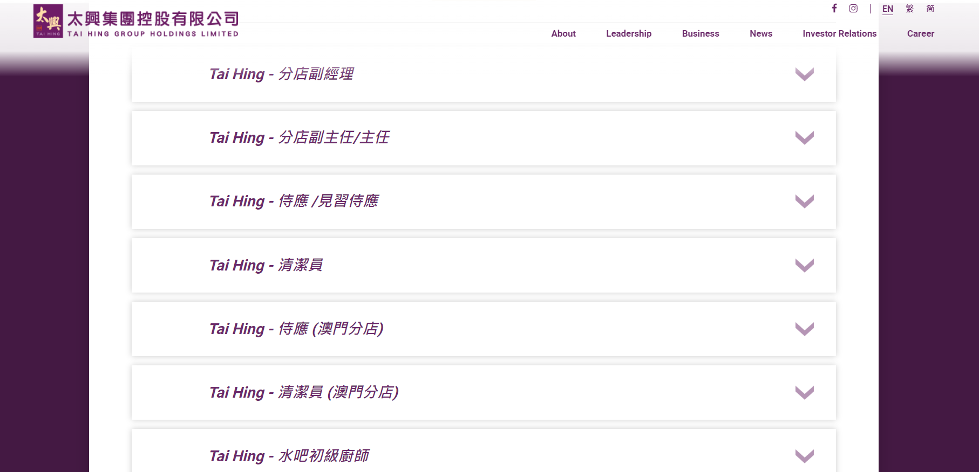
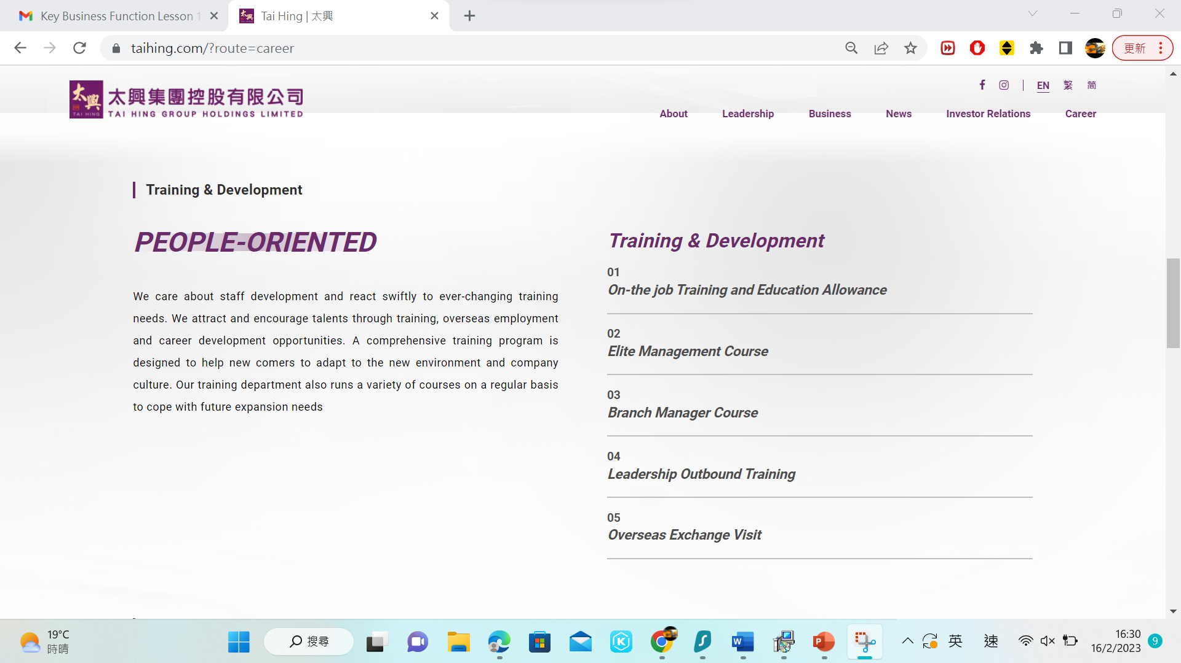
Part 1: Human Resources Management
Let’s explore the recruitment information extracted from Tai Hing’s website.
Extract A
Extract B
Tai Hing Group Holdings Limited (2022, March 16). Tai Hing Official Website. https://www.taihing.com/?route=home#home-banner

Slide 15
Group Discussion: Human Resources Management of Tai Hing Group
Instructions:
Divide into groups of 4-5 students each
Read the extract from Tai Hing’s website
Answer the questions in 8 minutes
Share the discussion results on the online post-it board

Slide 16
Group Discussion: Human Resources Management of Tai Hing Group
What kind of HRM activities can you identify from Extract A?
Why does the HRM of Tai Hing carry out the activities in Extract A?
What kind of HRM activities can you identify from Extract B?
What will happen if a company has no HRM activities mentioned in Extract B?
Training and development
To improve the skills and performance of employees, help newcomers to adapt to the new environment
Human resources planning, compensation and benefits management
No human resources planning: do not know what position should be filled
No compensation and benefits management: cannot retain talents

Slide 17
Key functions of human resources management
Human Resources Planning -
forecast the number and types of employees the company needs in order to achieve its objectives
Decide what positions the company needs to fill and how they would be filled
HRM decides what positions Tai Hing needs to fill and how many workers they would like to recruit

Slide 18
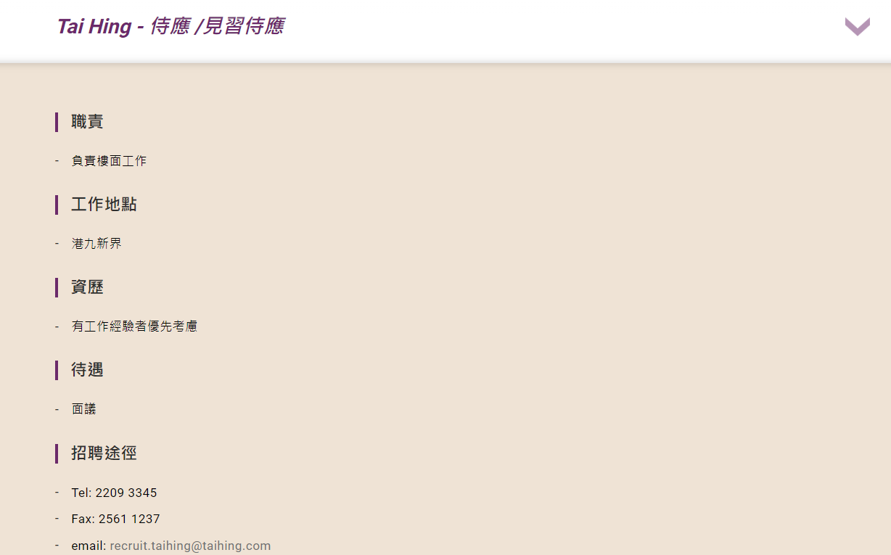
Key functions of human resources management
Recruitment & selection -
Recruit, select and employ capable applicants for the company’s vacancies.
General duties
Location
Qualifications / Experience
Tai Hing states the job requirements on their job openings to identify and attract capable applicants for each job and select the most appropriate candidates.
Compensation & Remuneration
Application

Slide 19
Key functions of human resources management
Training and Development -
Design training and development programmes for employees to improve their skills and competencies
Tai Hing HRM provides different courses and training for employees to improve their skills and performance

Slide 20
Key functions of human resources management
Performance appraisal
Evaluate employees’ performance by designing a performance appraisal system
Employee’s performance is evaluated by comparison with standards and feedback is given to employees. This can help improve employees’ work performance
Tai Hing established “Top-notch Training Program” and “Qualifications Framework” to evaluate employees’ performance through objective standards

Slide 21
Key functions of human resources management
Compensation and benefits management -
Design a fair and competitive compensation system which can motivate, attract and retain competent employees
Tai Hing provides employees a rewarding career with competitive salary, discretionary bonus, special leave package (birthday leave, marriage leave, family leave) and insurance.

Slide 22
Key functions of human resources management
Enhancing employee relations -
Establish good relationships with employees by holding different kinds of activities for staff
With good employee relations, employees will be more committed to their work and to the company
Tai Hing Group has arranged a wide range of activities and measures to promote close cooperation and effective communication among employees and increase their sense of belonging and productivity.
e.g. Employees can report their comments to their supervisors, managers or human resources department.

Slide 23
Let’s think: Compare and contrast
Are there any differences between small and large businesses in HRM function?
Both would have similar HRM functions but the scale and content may be very different, e.g. small businesses may have a very simple recruitment process and fewer benefit schemes for the employees, but large businesses may have more complex recruitment processes and benefit schemes for the employees.

Slide 24
03
Teaching Part 2:
Financial Management

Slide 25
Part 2: Financial Management
Businesses generally try to manage and keep cash flow for business running. That means a business needs sufficient money to meet current and short-term debt so as to continue its daily operation. That is known as working capital.
As the financial manager, what would you do if the company's working capital was insufficient to support daily operation?
2. What happen if the company has a poor financial management?
To find more source of financing: borrow money from banks, find new investors
Exercise financial control: cut cost, layoff staff, reduce expenses, increase sales
The company may face liquidation risk

Slide 26
Part 2: Financial Management
Financial management is
the management of the financial resources and financial obligations of a company in order to achieve the company’s goals
aiming to maximise a company’s net worth
Key Functions of financial management:
Financial analysis
Financial planning and budgeting
Making investment decisions
Making financing decisions
Making working capital decisions

Slide 27
Financial Management of Tai Hing Group
Read the extract of the 2022 Interim Report of Tai Hing Group to explore the financial management of the Tai Hing Group.
Tai Hing Group Holdings Limited (2022, March 16). 2022 Interim Report.
https://moebius.asia/Documents/company/reports/listedco/listconews/sehk/2022/0923/2022092300825.pdf.

Slide 28
Financial Management of Tai Hing Group
Questions:
What are the major sources of funds for Tai Hing Group?
What is the use of funds raised from listing for long-term use?
Internally generated cash flows, bank borrowings and funds raised from listing.
Implementing the future expansion plan.

Slide 29
Key functions of financial management
Financial analysis
Assess the company’s business performance in terms of profitability, liquidity, solvency and management efficiency using accounting ratios
Identify the company’s strengths and problems
Tai Hing Group presented financial analysis in their financial reports. They included the revenue, costs, financial resources in the reports. The Group compared the business performance with the previous year as well as with the industry.

Slide 30
Key functions of financial management
Financial planning and budgeting
Forecast the company’s financial needs and develop budgets to meet those needs
A budget is a forecast of future income and expenses
Help a company plan its financial resources
What budgets does Tai Hing Group need to forecast?
Wages expenses, sales, revenues, cost of raw materials...

Slide 31
Key functions of financial management
Making investment decisions
Identify good investment projects in order to maximise the company’s net worth
The finance department may use different appraisal methods (e.g. net present value) to assess whether an investment is worthwhile
e.g. Tai Hing Group invests by purchasing items of property, plant and equipment

Slide 32
Key functions of financial management
Making financing decisions
Determine the sources of financing and raise funds for the company to make investments, and to support its operations and expansion
Common sources of financing include issuing stocks and bonds, obtaining bank loans and using retained profits
What are the major sources of financing of Tai Hing?
Internally generated cash flows, bank borrowings and funds raised from listing.

Slide 33
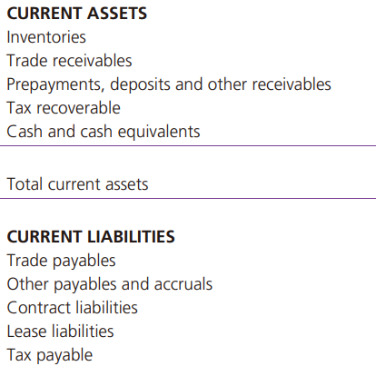
Key functions of financial management
Making working capital decisions
Management of the short-term assets and the short-term liabilities to ensure a business has sufficient capital to support its daily operations
This involves managing the company’s current assets and current liabilities, including cash, trade receivables, trade payables and inventory.
Proper working capital management can help the company maintain its liquidity.
Current assets and current liabilities of Tai Hing Group

Slide 34
Case Study
Mr. Ho is an ice cream shop owner whose business would be greatly dropped by the low season in winter and would have insufficient cash flow every winter. Hence, Mr. Ho wants to invest an additional $100,000 to boost the business.
1. Can you suggest some ways to help a business to obtain additional funds for further development?
2. Suggest ways for Mr Chan to improve his financial planning.
Borrow money from banks, find new investors, raise fund from the listing...
Better budgeting and planning, including the short-term and long-term planning.

Slide 35
04
Teaching Part 3:
Operations Management

Slide 36
Part 3: Operations Management
1. When you go to some chain restaurants, do you think that the taste of food is similar even you go to different stores? Why and how?
Yes, the taste is similar.
The restaurants would like to standardise their products and ensure the food quality. They can produce their standardised food in the factory.

Slide 37
Part 3: Operations Management
Operations management refers to the management of operating systems and processes that transform inputs into outputs.
Key Functions of operations management:
Designing efficient and effective production processes
Inventory management
Quality assurance
Logistics and distribution management

Slide 38
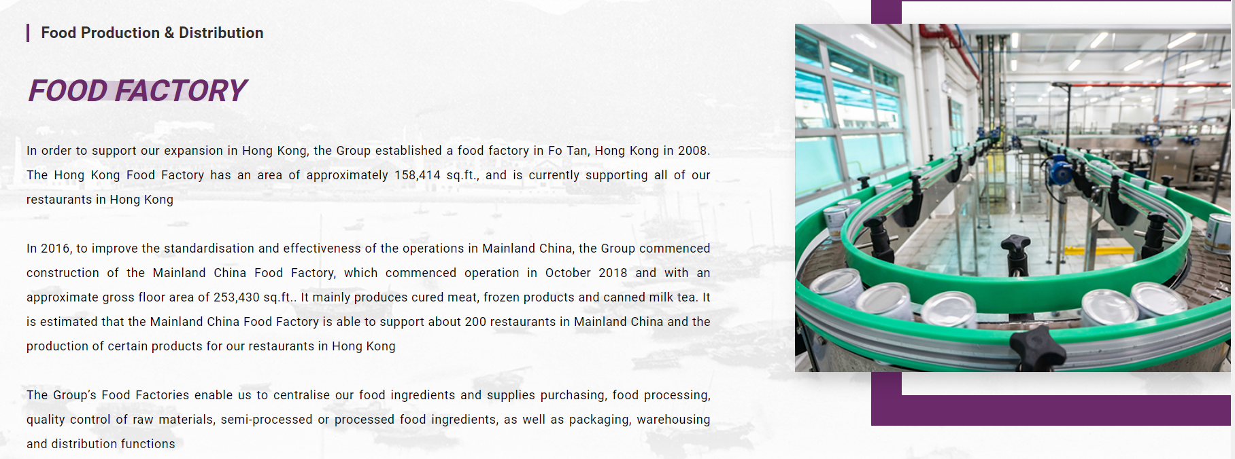
Operations Management of Tai Hing Group

Slide 39
Operations Management of Tai Hing Group
Watch the video and answer the questions.
How does Tai Hing restaurants meet the food safety standard and assure the quality of their Siu Mei?
How does the pork and seasoning be processed?
The quantity in producing Siu Mei is according to the sales of the branch to ensure the food safety.
The standard portion of the pork and seasoning are prepared and packed in the food factory.

Slide 40
Key functions of operations management
Designing efficient and effective production processes
Steps:
Plan for capacity
Choose a facility location
Design the workflow
Design jobs
Design a facility layout
e.g. Tai Hing established a food factory in Fo Tan to support their expansion in Hong Kong
Centralises the food ingredients and supplies purchasing, food processing, quality control of raw materials, semi-processed or processed food ingredients, as well as packaging, warehousing and distribution functions

Slide 41
Key functions of operations management
Inventory management
Keep track of the company’s inventory
Make sure that all inventory is in good condition and available whenever the company needs it
e.g. Operations department of Tai Hing needs to
keep track of the quantity of each product at its branches
arrange delivery of ingredients (e.g. pre-chopped pork and pre-mixed seasoning) to the branches in time to avoid running out of stock

Slide 42
Key functions of operations management
Quality assurance
Ensure that the company’s goods and services are of high quality
It may do so by...
imposing quality control regulations for employees to follow
inspecting products, tools and equipment regularly; and
acquiring quality raw materials from suppliers
e.g. Tai Hing Group applies the food safety and quality management principles with quality standards issued by the ISO in the Food Factories quality control system
Tai Hing invented machines in mixing the ingredients and roasting the Siu Mei. Every branch is using same pork, seasoning, cooking time and method to ensure the quality.

Slide 43
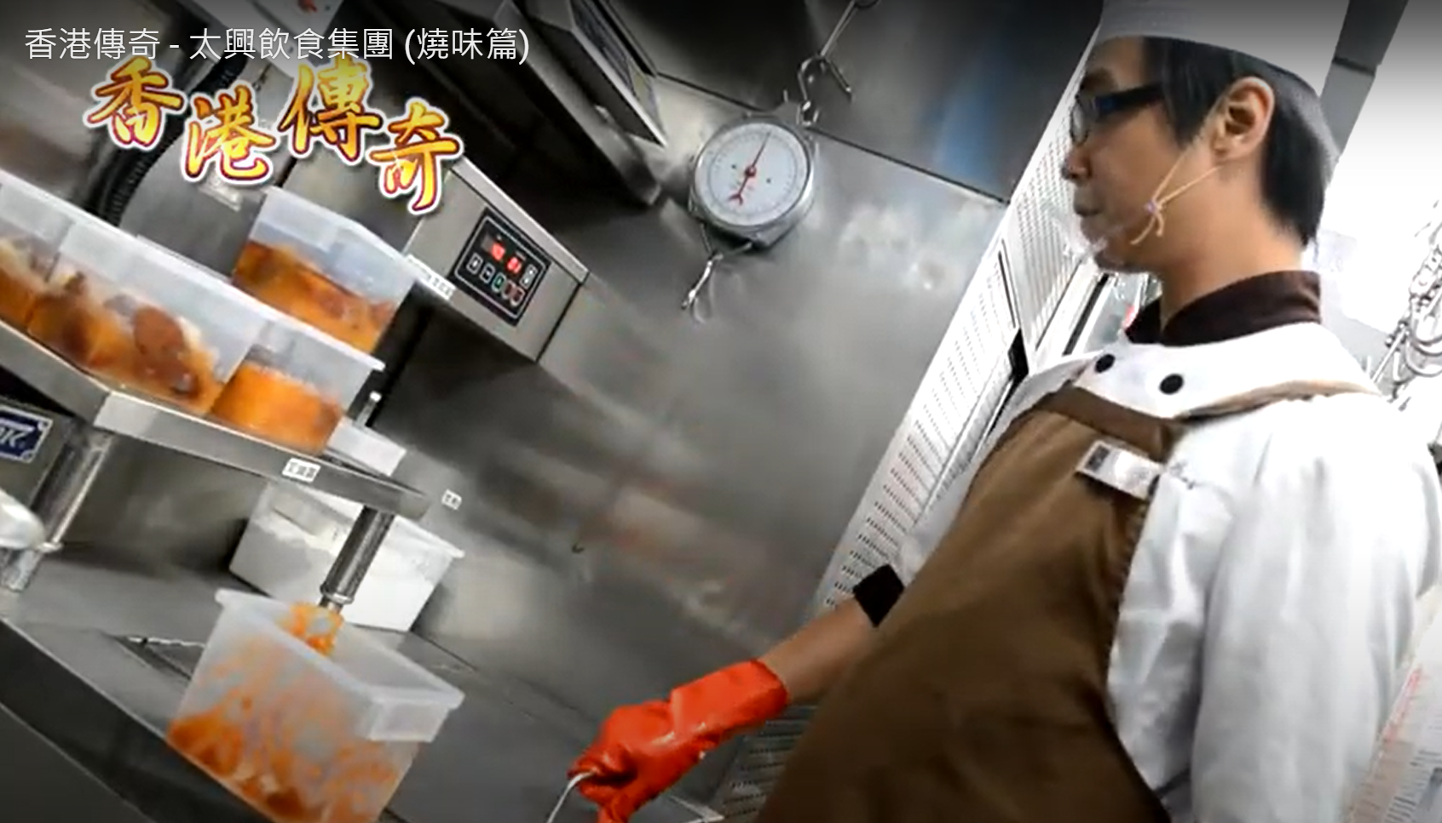
Key functions of operations management
e.g. The pre-mixed Siu Mei seasoning are well-packed in boxes and being delivered to different branches
Logistics and distribution management
Ensure that the goods are packaged securely for transportation and delivered to customers within a reasonable time

Slide 44
Let’s think
Explain the following operations management functions using one concrete example. Take one familiar brand name to conduct a case study.
Production processes
Inventory management
Quality assurance
Logistics and distribution management

Slide 45
05
Conclusion

Slide 46
Test your knowledge!
Questions:
Only large companies need financial management. (True/False)
Operations management is responsible for organising annual dinners for employees. (True/False)
Small businesses also need to plan the acquisition and use of funds to achieve its business goals and maximise its value.
Human resources management is responsible for organising annual dinners as it aims to enhance employee relations.

Slide 47
Test your knowledge!
Try to match the key business functions with their corresponding key functions.
1. Human resources management
2. Financial management
3. Operations management
A. Develop the budget of wages expenses
B. Interview job applicants
C. Design jobs in production process

Slide 48
Test your knowledge!
If you are a retail store manager who found out the following reasons for making a loss in your store in the recent few months, what follow-up actions will you take with the company?
two sale persons keep underperforming in selling products
the most popular product constantly keeps out of stock

Slide 49
Conclusion
Key points of the lesson:
The six business functions
Functions and importance of human resources, financial and operations management
Examples of how the Tai Hing Group adopt human resources, financial and operations management

Slide 50
References:
Chan, R. & Pak, C.K. (2022). NSS BAFS Business Management 2 (Elective Part) (3rd Ed.). Pearson.
Ho, K.W.P., Tsui, S.C.L. (2014). BAFS in the New World 1: Business Environment & Introduction to Management (2nd Ed.). Hong Kong: Pilot Publishing Company Ltd.
So, R., Kwok, R. & Yip, K. (2019). New Horizon Business, Accounting and Financial Studies: Business Environment and Introduction to Management. Hong Kong Educational Publishing Company.
Ho, K.W.P., Tsui, S.C.L. (2014). BAFS in the New World 1: Business Environment & Introduction to Management (2nd Ed.). Hong Kong: Pilot Publishing Company Ltd.
Tai Hing Group Holdings Limited (2023, March 16). 2022 Interim Report. https://moebius.asia/Documents/company/reports/listedco/listconews/sehk/2022/0923/2022092300825.pdf.
Tai Hing Group Holdings Limited (2023, March 16). Tai Hing Official Website. https://www.taihing.com/?route=home#home-banner

