Slide 1
Key Business Functions
Lesson 2
Form 4 Accounting Strand

Slide 2
TABLE OF CONTENTS
Recall prior knowledge in the previous lesson
Teaching Part 5: Information management
Formative assessment:
5 MCQs
Debriefing
Teaching Part 4: Marketing management
Teaching Part 6:
Risk management

Slide 3
01
Recall Prior Knowledge

Slide 4
Recall memories: Key Business Functions
What are the six business functions?
How do these functions work in managing a business?
Which three key business functions we have not yet learned the detail?
human resources, financial, operations, marketing, information and risk management

Slide 5
Key Business Functions
Six Key Business Functions:
Human Resources Management
Financial Management
Operations Management
Marketing Management
Information Management
Risk Management

Slide 6
Lesson Objectives
Identify the roles and importance of the key business functions: marketing, information and risk management

Slide 7
02
Teaching Part 4:
Marketing Management

Slide 8
Part 4: Marketing Management
As a customer, what are your concerns during consumption?
Do you think a business like Tai Hing Group will have the same concerns? Why?
How does a business like Tai Hing Group address the customers’ concerns?
Yes, Tai Hing Group will have the same concerns to keep profit making for the company.
Tai Hing may adjust price, product, location, and etc. to meet the customers’ needs.

Slide 9
Part 4: Marketing Management
Marketing management is the process of identifying customers’ needs and executing marketing strategies.
A company can meet those needs with its goods and/or service better than competitors to make profits
It helps a company provide goods or services that can satisfy customers’ needs and earn money for itself in return.
Key functions of marketing management:
Conducting marketing research
Segmenting the market, selecting target markets and determining market position
Formulating market strategies
Implementing and controlling marketing activities
Managing customer relationships

Slide 10
Key functions of marketing management
Conducting marketing research
To obtain market information
to identify customers’ needs, forecast customer demand and evaluate the company’s marketing performance
explore market opportunities and deal with threats
E.g. Tai Hing Group collects sales data to identifies customers’ preferences

Slide 11
Key functions of marketing management
Segmenting the market, selecting target markets and determining market position
- Divide the market into smaller segments with distinct needs, characteristics and consumption patterns
- Evaluate the attractiveness of the segments and select market(s)/subgroup(s) to serve
Determine the company’s market position
E.g. Tai Hing Group
Positioned as a multi-brand casual dining restaurant group
Targeted the general public

Slide 12
Key functions of marketing management
Formulating market strategies
- To satisfy customers’ needs and deal with the competition, the marketing department needs to formulate marketing strategies
- The Marketing mix, also known as the four P's of marketing, refers to the four key elements: product, price, place and promotion.
Product | Determine the goods or services the company offers to satisfy its target customers’ needs
Price | Determine the amount of money target customers need to pay to obtain the product
Place | Determine how to make the product available to target customers
Promotion | Determine the kind of activities needed to communicate the product’s features and merits to target customers and to persuade them to buy the product

Slide 13
Part 4: Marketing Management 4 Key Elements of Marketing a Product/Service
Product Tai Hing Group launched different brands which offer different catering services E.g. TeaWood-Taiwan cuisine, Tai Hing-Siu Mei, Asam Chicken Rice-Southeast Asian cuisine, Pho Le-Vietnam cuisine). Canned products are developed | Pricing Position: multi-brand casual dining restaurant group Target customers: general public Comparable to other restaurant groups (e.g. Maxim’s Group)
Place Tai Hing restaurants are located in some shopping malls and provides online ordering service | Promotion Tai Hing invites celebrities to film the TV commercials Men Wah Bing Teng launched limited edition drinks

Slide 14
Group discussion: Marketing Management of Nissin Group
Instructions:
Divide into groups with 5 students each
Find out the 4Ps of the Nissin Group.
After discussion, students from each group are invited to stick their discussion results on the blackboard.

Slide 15
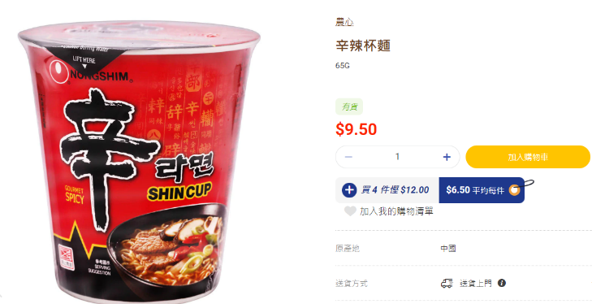
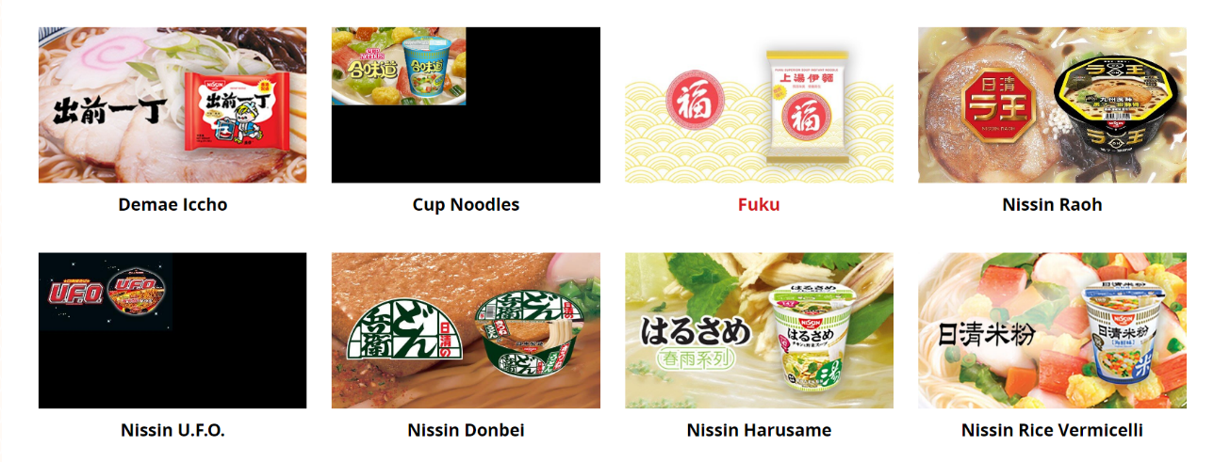
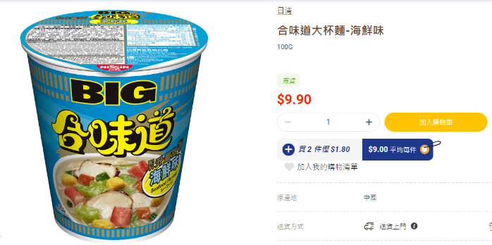
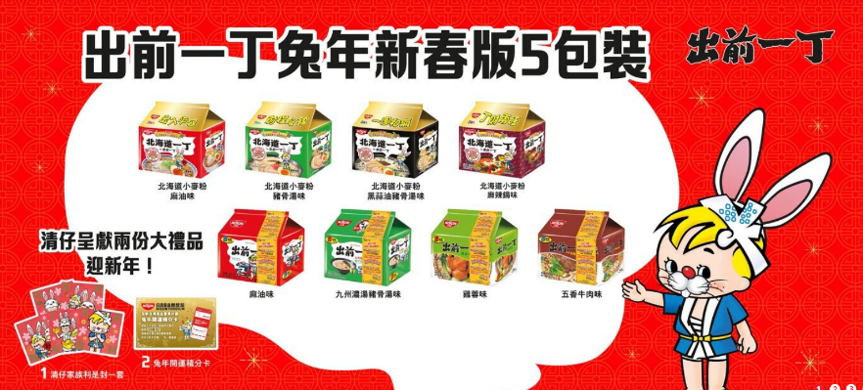
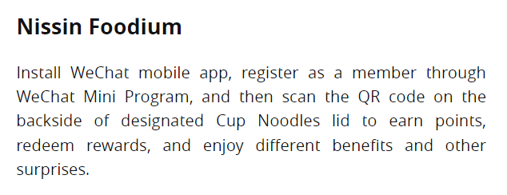
Extract B
Extract A
Extract C

Slide 16
Group discussion: Marketing Management of Nissin Foods Group
Product Nissin Foods Group produces different types of instant noodles including cup noodles, ramen, rice vermicelli, macaroni; local tastes are developed | Pricing Position: provide “safe, convenient and delicious” food product Target customers: general public Comparable to other instant noodles
Place Nissin noodles can be easily bought from supermarkets, convenience stores and retail shops | Promotion Launched new flavors with special packaging Launched a membership program via a mobile app

Slide 17
Key functions of marketing management
Implementing and controlling marketing activities
- Turn marketing plans into action by working with stakeholders inside and outside the company, e.g. working out the advertisement with the marketing department and advertising company
- Monitor and evaluate the marketing results by using different measuring tools, e.g. questionnaire surveys and interviews
- Ensure that the marketing activities are conducted as planned
Managing customer relationships
Maintain good relationships with customers
Help the company to attract new customers, retain existing customers and enhance customer loyalty
E.g. Tai Hing Group developed a mobile app to understand customers’ preferences to enhance customer relationships

Slide 18
03
Teaching Part 5:
Information Management

Slide 19
Part 5: Information Management
1. Make a guess, which restaurants do you think are the top three revenue contributors of the Tai Hing Group?
2. Can the business make decisions just by guessing the performance of different brands?
3. How can the Tai Hing Group collect sales data?
4. After collecting the data, how would you make use of them?
No, they have to collect data from the customers to understand their preferences so as to make marketing decisions.
They can record the sales of each brand through daily operations, conduct survey of customers...

Slide 20
Part 5: Information Management
Information management is the process of gathering, processing, storing and distributing information to support a company’s operations and decision-making.
Key functions of information management:
Storing, processing and managing business transaction data
Setting up and maintaining information systems to support other departments
Setting up and maintaining network systems to facilitate communication

Slide 21
Business segment analysis of Tai Hing Group
Extracted from: Tai Hing Group Holdings Limited (2023, March 16). 2022 Interim Report. https://moebius.asia/Documents/company/reports/listedco/listconews/sehk/2022/0923/2022092300825.pdf.
According to the sales data of Tai Hing, TeaWood and
Men Wah Bing Teng were the three largest revenue contributors of Tai Hing.

Slide 22
Information Management of Tai Hing Group
Tai Hing Group was developing a mobile app for customers to order online and collect sales data in order to improve the customer relationship management (e.g. attract potential customers and enhance customers’ loyalty)
Extracted from: Tai Hing Group Holdings Limited (2023, March 16). 2022 Interim Report. https://moebius.asia/Documents/company/reports/listedco/listconews/sehk/2022/0923/2022092300825.pdf.

Slide 23
Key Functions of Informantion Management
Storing, processing and managing business transaction data
- Develop/adopt a system that can store, process and manage business transaction data resulting from daily operations
- Process and analyse data to become information
E.g. Tai Hing Group collected sales data and transformed it into segment information like revenues generated from each brand, brand coverage and awareness so as to help making marketing decisions for the future development of the Group

Slide 24
Key Functions of Informantion Management
Setting up and maintaining information systems to support other departments
- Set up and maintain the company’s information systems
- Allow other departments to obtain reliable and timely information which can aid their decision-making
Setting up and maintaining network systems to facilitate communication
- Set up and maintain network systems for communication
- Intranet and email system for internal communication, an online storage space for file sharing
E.g. Marketing management of Tai Hing can make marketing decisions according to the collected sales data (attract potential customers and enhance customers’ loyalty)
E.g. Tai Hing will publish the latest news and information on their intranet

Slide 25
04
Teaching Part 6:
Risk Management

Slide 26
Part 6: Risk Management
From 2019 to 2021, what major challenge did the catering service providers face?
2. Besides the challenge mentioned above, what kinds of risk can you think of when running a business?
Because of the COVID-19, restaurants in Hong Kong had to follow the pandemic prevention policies adopted by the Health Department of Hong Kong. For example, the opening hours and the number of customers are restricted.
Fire, robbery, occupational injuries of employees...

Slide 27
Part 6: Risk Management
Risk management is the process of identifying and assessing a company’s exposure to various types of risk and developing measures to minimise losses.
Key functions of Risk Management:
Identifying and measuring risks
Controlling risks

Slide 28
Key functions of risk management
Identifying and measuring risks
- Identify the possible risks that the company faces and assess the company’s exposure to the risks
- A company may face various types of risks such as: fires, death or injuries of employees, thefts, machine breakdowns, labour strikes, lawsuits against the company and natural disasters

Slide 29
Risks faced by Tai Hing Group
COVID-19 pandemic
The pandemic prevention measures affected the normal operations of the industry severely. The business operation under the pandemic can be risky to the health and safety of employees and customers.
If employees or customers are infected, the relevant branded restaurants will have to close down to avoid mass infection, and further affect social stability.
Workplace injuries
If the employees are careless or lifting heavy items improperly, they may risk workplace injuries
The Group has to pay compensation to the employees according to the Employees’ Compensation Ordinance. The cost will be increased if there are any workplace incidents.

Slide 30
Let’s think!
After we identified the two risks for Tai Hing, what would you do?
Will ensuring good hygiene and safe workplace increase the cost of production?
How can a company strike the balance between compliance with responsibilities and the profitability of a business?
Yes, the cost will increase.
When the business fulfils its responsibilities on food hygiene and workplace safety, the corporate image can be improved which might bring profit.

Slide 31
Key functions of risk management
Controlling risks
Formulate risk management strategies and choose the most appropriate measures to control and manage the risks
Companies can use four major risk management strategies to control risks: risk assumption, risk reduction, risk avoidance and risk transfer

Slide 32
Part 6: Risk Management - Methods to control risks
1. Risk assumption
Bearing or retaining the risk of loss by setting aside an amount of money to cover potential losses
2. Risk reduction
Reducing the risk of loss by preventing the loss from happening or reducing the size of the loss
3. Risk avoidance
Eliminating the risk of loss by not engaging in activities which would cause a loss
4. Risk transfer
Transfer the risk of loss to another party (often through insurance or contractual agreements)

Slide 33
Part 6: Risk Management - Methods to control risks
How could Tai Hing Group control the risk?
Risk assumption: Established “Committee on Emergency Management” and the “Pandemic Prevention Team” to closely monitor the pandemic situation and adjust the response strategies in a timely manner. Provision of funds to cope with additional expenses caused by the epidemic
Risk reduction: provide departments and branded restaurants with hygiene and pandemic prevention guidelines and pandemic prevention equipment, comply with pandemic prevention measures required by the government

Slide 34
Part 6: Risk Management - Methods to control risks
How could Tai Hing Group control the risks?
3. Risk avoidance: do not require employees to lift heavy items, use lift machine instead
4. Risk transfer: take out employees’ compensation insurance to transfer risks of employees getting injured at workplace to the insurance company

Slide 35
Case Study
Fanny is a senior administrative officer of a company, and her daddy, Mr Wong is the owner of a design company.
Fanny’s company recently decided to re-design and renovate the entrance of the company, so Fanny was appointed to select a design company to be responsible for the renovation.
Due to the tight renovation schedule and budget, Fanny simply selected his Daddy’s company as the contractor.
What are the possible risks in Fanny’s company if the company allows Fanny to do so?
Any suggestions for Fanny’s company to avoid and/or manage such risk(s)?

Slide 36
05
Formative Assessment: MC Quiz

Slide 37
Formative Assessment: MC Quiz
You have already learnt the six key business functions. Let’s scan the QR code and enter the game room to answer five multiple choice questions!
Link: https://create.kahoot.it/share/formative-assessment-key-business-functions/34174d1f-c8fc-49b2-b527-c1adf64e966f

Slide 38
Multiple-Choice Questions
1. In order to reduce the risk of theft, the management of a commercial building decided to hire two more security guards. Which of the following business functions does this involve?
(1) Human Resources Management
(2) Marketing Management
(3) Risk Management
A. Only (1)
B. Only (3)
C. (1) and (3) only
D. (1), (2) and (3)

Slide 39
Multiple-Choice Questions
2. Happy Company intends to recruit an employee. This employee will be responsible for finding new target customers and maintaining contact with them. The employee will most likely work in the ____________ department.
A. human resources
B. marketing
C. operation
D. finance

Slide 40
Multiple-Choice Questions
3. A bank recently redesigned the layout of its branches. Seeing that there are more and more high-net-worth customers, the branch will use 70% of its space to set up special counters to receive these customers. Comparatively, this redesign project is closely related to all the following management except ____________ management.
A. risk
B. finance
C. operation
D. human resources

Slide 41
Multiple-Choice Questions
4. A mall will hold a workshop to teach employees how to use a defibrillator. When a customer suffers a heart attack, the staff can use a defibrillator to provide first aid to them. Which of the following business functions are involved in hosting this workshop?
(1) Human Resources Management
(2) Financial Management
(3) Information Management
(4) Risk Management
A. Only (4)
B. (1) and (3) only
C. (1) and (4) only
D. (1), (2), (3) and (4)

Slide 42
Multiple-Choice Questions
5. A garment factory decided to build a new factory in Vietnam to reduce costs. Which of the following business functions are involved in this decision?
(1) Human Resources Management
(2) Financial Management
(3) Operations Management
(4) Risk Management
A. (1) and (4) only
B. (2) and (3) only
C. (1), (2) and (3) only
D. (1), (2), (3) and (4)

Slide 43
06
Conclusion

Slide 44
Key points of the lesson:
Functions and importance of marketing, information and risk management
Examples of how the Tai Hing Group adopt marketing, information and risk management
In sum, the 6 Key Business Functions are
human resources, financial, operations,
marketing, information, risk management

Slide 45
References:
Chan, R. & Pak, C.K. (2022). NSS BAFS Business Management 2 (Elective Part) (3rd Ed.). Pearson.
Ho, K.W.P., Tsui, S.C.L. (2014). BAFS in the New World 1: Business Environment & Introduction to Management (2nd Ed.). Hong Kong: Pilot Publishing Company Ltd.
So, R., Kwok, R. & Yip, K. (2019). New Horizon Business, Accounting and Financial Studies: Business Environment and Introduction to Management. Hong Kong Educational Publishing Company.
Ho, K.W.P., Tsui, S.C.L. (2014). BAFS in the New World 1: Business Environment & Introduction to Management (2nd Ed.). Hong Kong: Pilot Publishing Company Ltd.
Tai Hing Group Holdings Limited (2023, March 16). 2022 Interim Report. https://moebius.asia/Documents/company/reports/listedco/listconews/sehk/2022/0923/2022092300825.pdf.
Tai Hing Group Holdings Limited (2023, March 16). Tai Hing Official Website. https://www.taihing.com/?route=home#home-banner

